Slide 1
What I learned at IVECCS
Josh Smith

Slide 2
The Glycocalyx
LUNG MECHANOTRANSDUCTION: CHALLENGING THE STARLING PRINCIPLE
  Randal Dull MD
Notes:
Based on the starling principle the effect that pressure has on the endothelial lining should be linear
Pressure activates mechanotransduction leading to increases in size of gap junctions
Flash Pulmonary edema – this is why this happens
The change in vascular permeability characteristics may account for the overall poor correlation between pulmonary
capillary pressure and the clinical signs of edema
demonstrated that small changes in airway pressure (3-5 cm H2O) in combination
with elevated vascular pressure (left atrial pressure = 15 cm H2O) resulted in significantly increased vascular
permeability compared to elevated left atrial pressure at low airway pressure 4. This form of synergy demonstrates the
cross talk between the airway compartment and the vascular compartment and highlights the sensitivity to seemingly
small changes in mechanical forces.
In fluid boluses and increases in CVP Lungs gain weight secondary to mechanotransduction

Slide 3
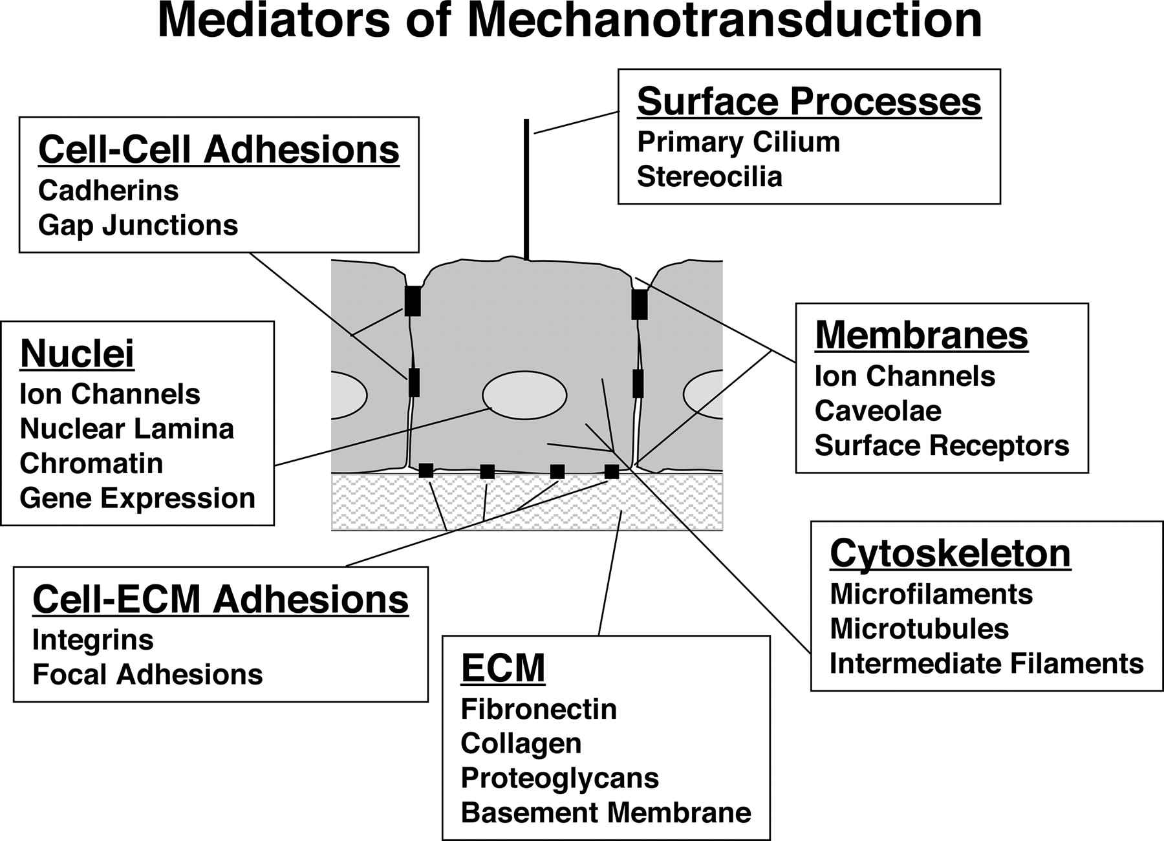
Figure 1. Mediators of cellular mechanotransduction.
Ingber D E FASEB J 2006;20:811-827
Copyright Federation of American Societies for Experimental Biology (FASEB). Please see the journal's copyright policies at www.fasebj.org to obtain permission to use this image.
Notes:
Mediators of cellular mechanotransduction.
Many molecules, cellular components, and extracellular structures have been shown to contribute to mechanochemical transduction.
These transduction elements include ECM, cell-ECM, and cell-cell adhesions, membrane components, specialized surface processes, cytoskeletal filaments, and nuclear structures.
The challenge for the future is to understand how cells orchestrate all these transduction mechanisms in the context of living tissue anatomy to produce a concerted response to mechanical signals.

Slide 4
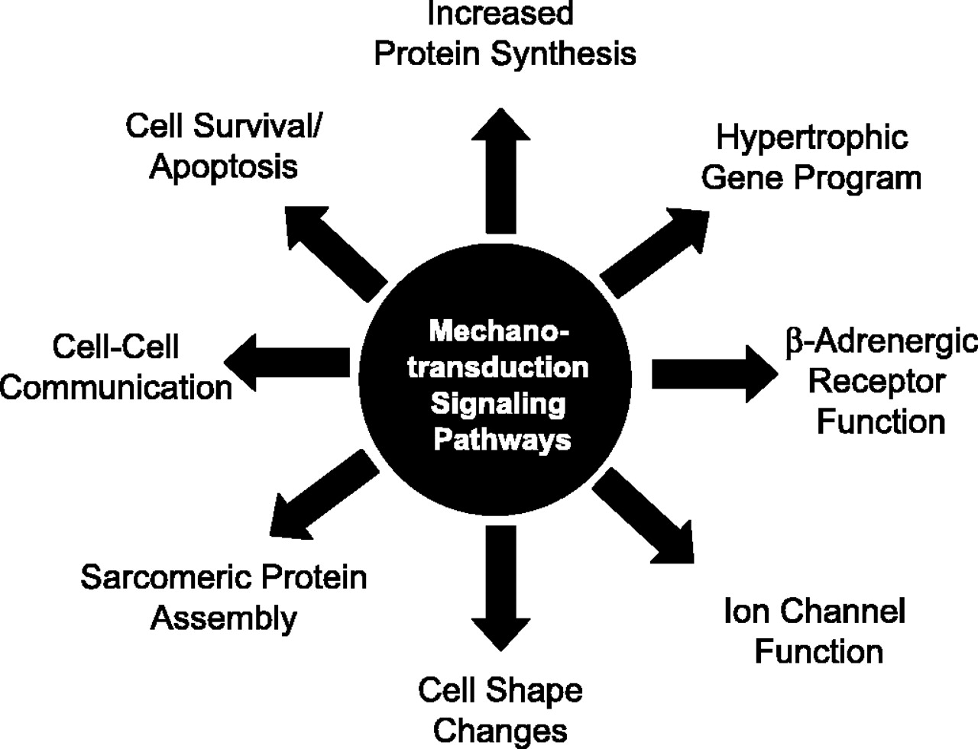

Consequences of cardiomyocyte mechanotransduction.
Samarel A M Am J Physiol Heart Circ Physiol 2005;289:H2291-H2301
©2005 by American Physiological Society
Notes:
Consequences of cardiomyocyte mechanotransduction.
Mechanochemical signaling pathways activated during outside-in signaling modulate multiple cardiomyocyte functions.

Slide 5
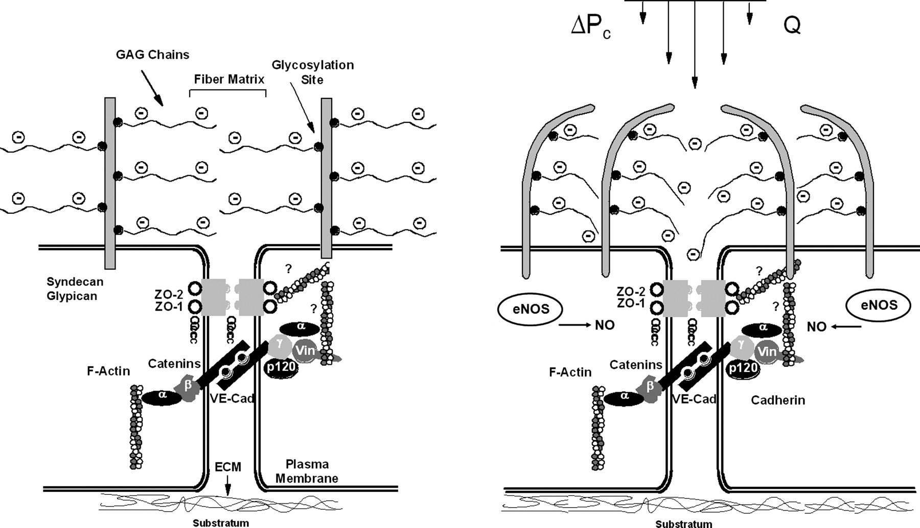

Schematic of hypothesized role of glycocalyx in lung vascular mechanotransduction.
Dull R O et al. Am J Physiol Lung Cell Mol Physiol 2012;302:L816-L828
©2012 by American Physiological Society
Notes:
The glycocalyx is composed of proteoglycans (PG) and secreted GAGs, with heparan sulfates (HS),
chondroitin sulfates (CS) and hyaluronan (HA) comprising the principle elements.
The major proteoglycans include the syndecan and glypican families that both carry HS as the primary GAG. Syndecans are transmembrane PG while glypicans are embedded in the plasma membrane via a GPI anchor. Based on in vitro work, HSPGs appear to be the primary mechano-sensor/transducer
I will present the experimental evidence suggesting that HSPGs are the primary mechanotransducing elements within the glycocalyx based on results from cell culture and intact lung experiments. This pathway involves an HSPG-nitric oxide pathway that results in loss of VE-cadherin from the adherence junction that results in increased permeability.

Slide 6
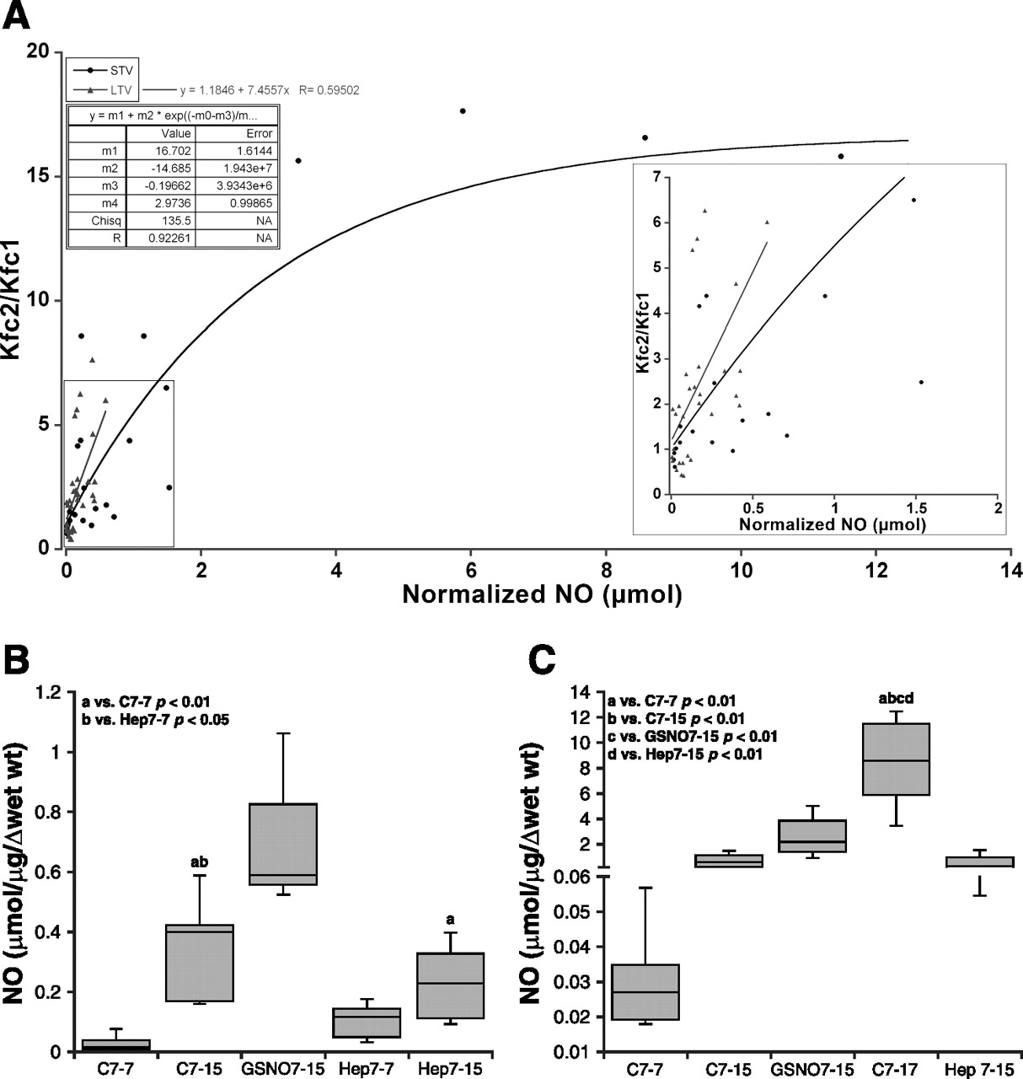
Lung nitrate/nitrite (NOx) concentrations.
Dull R O et al. Am J Physiol Lung Cell Mol Physiol 2012;302:L816-L828
©2012 by American Physiological Society
Notes:
Tarbell and colleagues 7 showed that pressure-induced increase in nitric oxide production in bovine aortic
endothelial cells (BAECs) resulted in increase permeability to water
Lung nitrate/nitrite (NOx) concentrations. NOx was measured in lung tissue following increased Pla.
A: relationship of NOx concentration vs. K_{fc2}/K_{fc1} ratio for pooled Low Vt (LTV) and ST Vt (STV) data. Inset shows close up of relationship at low NOx concentrations; note linear correlation of Low Vt group vs. NOx and left shift of Low Vt vs. ST Vt group.
B: during Low Vt ventilation, an increase in Pla from 7 to 15 cmH₂O results in a 4-fold increase in tissue NOx. GSNO further increased tissue NOx levels when Pla = 15 cmH₂O. Heparanase treatment at low Pla had no effect on NOx (Hep7–7) but significantly reduced NOx concentrations at Pla = 15 cmH₂O, (Hep7–15).
C: during ST Vt increases in Pla to 15 cmH₂O result in large increases in NOx to 0.70; GSNO at Pla = 15 cmH₂O further increased NOx to 2.60. When Pla = 17 cmH₂O, NOx increased to 8.41; heparanase significantly reduced the NOx to 0.54, when Pla = 15 cmH₂O (n = 4–6). m1–m4, fit parameters. Chisq, chi squared.

Slide 7
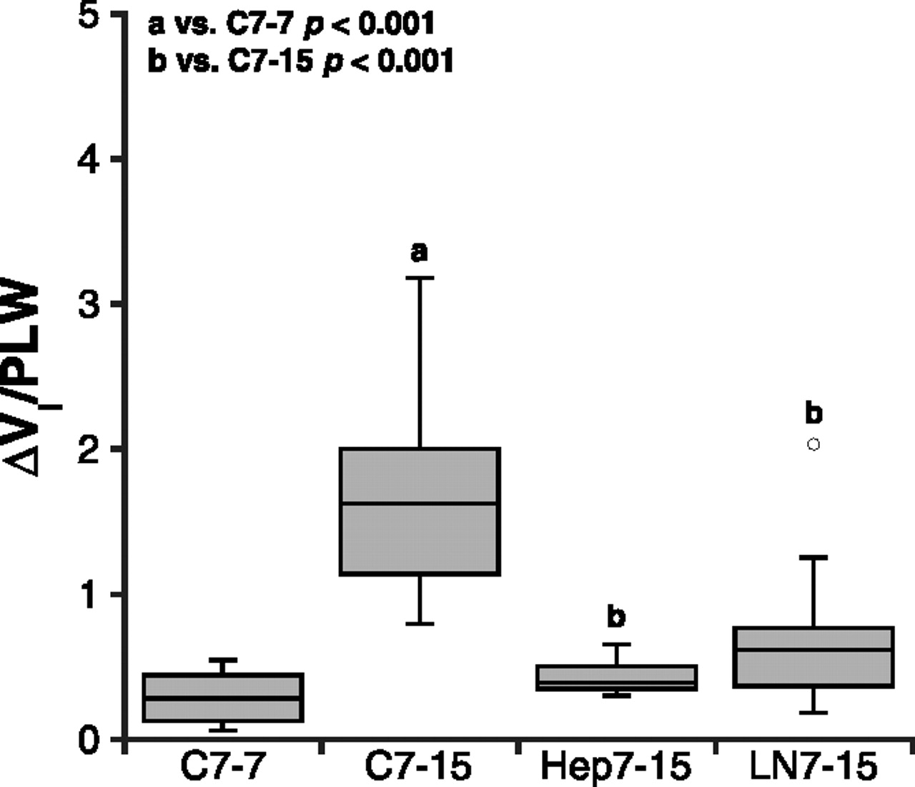
Interstitial volume after elevated Pla during Low Vt. Retained lung weight after measurement of Kfc2 was used as a marker of interstitial volume (ΔVi) and normalized to the predicted lung weight (PLW).
Dull R O et al. Am J Physiol Lung Cell Mol Physiol 2012;302:L816-L828
©2012 by American Physiological Society
Notes:
Interstitial volume after elevated Pla during Low Vt. Retained lung weight after measurement of K_{fc2} was used as a marker of interstitial volume (ΔVi) and normalized to the predicted lung weight (PLW). Heparanase III and l-NAME significantly reduced ΔVi/PLW, consistent with a reduction in vascular permeability.

Slide 8
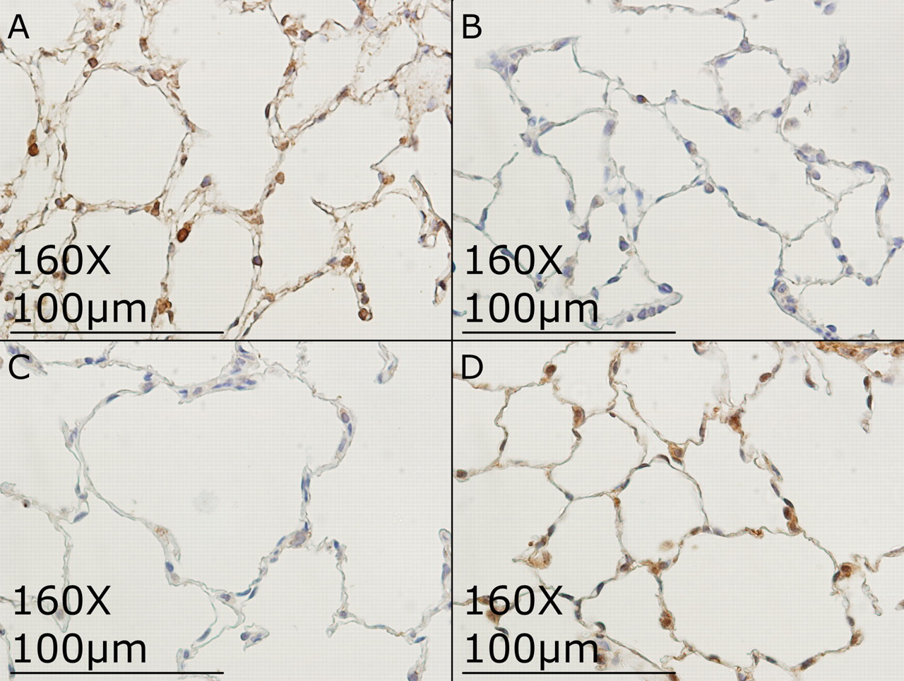
Immunohistochemistry of heparan sulfates.
Dull R O et al. Am J Physiol Lung Cell Mol Physiol 2012;302:L816-L828
©2012 by American Physiological Society
Notes:
heparan sulfates are directly involved in nitric oxide synthase activation
In parallel experiments, we measured monolayer hydraulic conductivity in cells treated with heparanase or L-NAME and observed that both compounds prevent pressure-induced increase in permeability.
Collectively, these results strongly suggest that heparan sulfates are involved in mechanotransduction and NO is an
immediate down stream mediator of barrier function. The next question to answer was if heparan sulfates participated in
whole lung mechanotransduction
When lungs
were treated with L-NAME (nitric oxide synthase inhibitor) between baseline Kf assessment and the increase in PLA to
15 cm H2O, the increase in Kf was abolished, demonstrating the role of eNOS in this mechanism. Removal of vascular
heparan sulfates resulted in a nearly identical attenuation of pressure-induced increase in Kf. Immunohistochemical
techniques using anti-HS antibodies were used to validate the removal of heparan sulfates. These results are essentially
identical to the effects of L-NAME and heparanase when tested on endothelial permeability in a cell culture model. We
also used immunohistochemistry to localize nitrosylated tyrosine residues (NO-tyr) to demonstrate the extent of protein
nitrosylation under control conditions, acute elevations in pressure and after treatment with heparanase and L-NAME.
Control lungs (normal vascular pressure) exhibited very little NO-tyr staining while high-pressure lungs showed
significant and widespread staining consistent with high nitric oxide production. Lung treated with heparanase or LNAME
and exposed to high vascular pressure had very little NO-tyr staining, consistent with our model that heparan
sulfate proteoglycans are mechanosensors that activate nitric oxide synthase.
Immunohistochemistry of heparan sulfates. Lungs were immune-stained with anti-heparan sulfate antibody (HSS-1) for heparan sulfates. A: control lungs show significant vascular staining for heparan sulfates. B: heparanase abolishes all heparan sulfate staining, demonstrating removal of cell surface heparan sulfates. C: control lungs stained with 3G10, which recognizes the neoepitope created by heparanase. Note absence of neoepitope staining. D: heparanase treatment results in robust staining for neoepitope formation demonstrating activity of the enzyme.

Slide 9
Protecting the Glx
FFP may protect it
Ropivicaine
Hypercapnea
Notes:
Elevated airway pressure is an issue during
mechanical ventilation and has lead to the concept of baro-trauma and volume-trauma 9. Lung protective strategies for
ventilating the injured lung result in hypercapnic acidosis that, by itself, has protective effects on the lung

Slide 10
GLYCO-MIMETIC POLYMERS AND FUTURE THERAPIES FOR LUNG INJURY
  Randal Dull MD
Most therapies for the treatment of acute lung injury are supportive
  Mechanical ventilation
  Antibiotics
  Fluid restriction
Few interventions look at mechanisms of cellular injury

Slide 11
An ideal therapy could be given intravascularly or via inhalation
Would selectively target the lung vascular surface or airway compartment, respectively, to attenuate inflammation or initiate repair processes
Inhaled drug delivery represents a viable option for getting small compounds into the lung but has limited utility for larger molecules

Slide 12
Prototype polymer that binds to the endothelial glycocalyx
  Enhances barrier function
  Attenuates inflammatory-induced changes in permeability
  Attenuates mechanotransduction

Slide 13
Glycocalyx has a net negative charge
  Abundance of sulfate groups found on heparan and chondroitin
  Sialic acids present on other glycoproteins also contribute to this
Albumin interacts with these negative components of the glycocalyx via its argentine residues
Interaction is crucial for albumin’s ability to lower hydraulic conductivity

Slide 14
Pretty much all over my head
Testing in mouse lung models may show benefit and attenuation of mechanotransduction and NO release

Slide 15
THE GLYCOCALYX AND BACTERIAL PNEUMONIA
  Randall Dull MD
The term glycocalyx means “sugar husk” and describes the collective layer of glycosaminoglycans (GAGs) and glycoproteins that form a polymer matrix on the cell surface.
The GAGs include heparan sulfates, chondroitin sulfates and hyaluronan with heparan sulfates and chondroitin sulfate being carried on proteoglycans that are represented by two major families: the syndecans and glypicans

Slide 16
Syndecans
Syndecan carries both heparan sulfate and chondroitin sulfates while glypican only carries heparan sulfates
Syndecans are transmembrane proteoglycans while glypicans are inserted into the plasma membrane with a glycosylphosphoinosotide (GPI) domain
Hyaluronan is a large, secreted GAG that does not have a protein component and is, therefore, not a proteoglycan

Slide 17
It remains attached to the cell surface unless degraded during inflammatory states, where fragments can be found in the plasma
In the airway compartment the glycocalyx and cilia form a scaffolding that mucins reside upon and together create a formidable barrier against inhaled particles and pathogens
The syndecan family is comprised of 4 members with isoforms 1, 2 and 4 being expressed by most cells, while syndecan-3 expression is limited to neuronally-derived cells

Slide 18
Syndecans are unique in being a transmembrane proteoglycan and their cytoplasmic domain is small but highly conserved
Syndecans may participate in inflammation by signaling via the cytoplasmic domain as well as functional attributes of the GAG chains
Mice inoculated intra-nasally with P. aeruginosa develop a severe pneumoniae with significant lung injury
Syn-1 knockout mice, however demonstrate a protective phenotype to P. pneumoniae, with reduced histological evidence of inflammation, less lung and spleen colonization of bacteria and improved survival

Slide 19
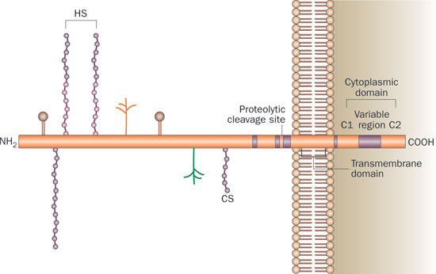

Figure 5 Structural organization of syndecan‑1
Edwards, I. J. (2012) Proteoglycans in prostate cancer
Nat. Rev. Urol. doi:10.1038/nrurol.2012.19
Notes:
The prototype syndecan-1 has a core protein comprised of three domains: highly conserved transmembrane and cytoplasmic domains and a unique extracellular domain. The cytoplasmic domain contains two constant regions, C1 and C2, separated by a variable region that is unique to each syndecan. The C regions interact with a variety of cytoskeletal and signaling molecules. The glycosaminoglycan chains attached to the extracellular domain are usually HS but a CS chain can also be present. The HS chains display complex sulfation patterns that are required for interactions with specific ligands and may be refashioned for different interactions during tissue changes such as tumor progression. The intact ectodomain can be cleaved at a site proximal to the plasma membrane to generate a soluble effector molecule with tumor suppressor activity for prostate cancer.

Slide 20
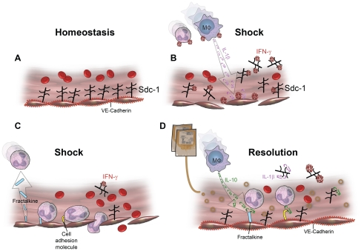
Notes:
Proposed model of syndecan-1 interaction with inflammatory cytokines after shock and resuscitation with FFP.(A) Syndecan-1 (sdc-1) is a major constituent of the protective glycocalyx found on the surface of endothelial cells (ECs).
(B) During hemorrhagic shock, syndecan-1 is shed from the EC surface, exposing the underlying endothelium to pro-inflammatory cytokines. IFN-γ binds the heparan sulfate chains located on syndecan-1 and activates ECs which attracts neutrophils and macrophages to the site of injury. Macrophages further stimulate ECs by secreting IL-1β.
(C) Activated ECs secrete fractalkine, a neutrophil chemoattractant, and express cell adhesion molecules on the endothelial cell surface, facilitating pathologic leukocyte-endothelial cell interactions.
(D) FFP acts to store vascular integrity. VE cadherins form an intact endothelium. IL-10 counteracts inflammation by decreasing expression of cell adhesion molecules. Shed syndecan-1 facilitates resolution of inflammation by removal of the pro-inflammatory cytokines, IL-1β, IFN-γ, and fractalkine.

Slide 21
The alveolar epithelial glycocalyx in coordination with secreted mucins are important barrier components to impede and/or prevent pathogens from gaining access to the epithelial cell
Heparan sulfate GAGs on syndecan-1 and syndecan-4 are important regulators of the innate immune response
Can either enhance or attenuate the inflammatory response to specific pathogens

