Slide 1
Ventilator Waveforms
Questions

Slide 2
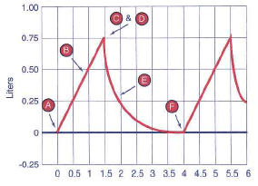
Questions
Is this scalar…
  Flow
  Volume
  Pressure
Label the following:
  Termination of inspiration
  Exhalation
  Beginning of expiration
  Beginning of inspiration
  Inspiration
  End expiration

Slide 3
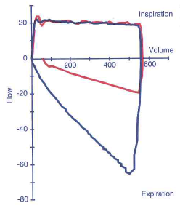
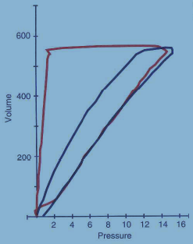
What does the red loop represent?
Notes:
Red loop - Increased expiratory airway resistance

Slide 4
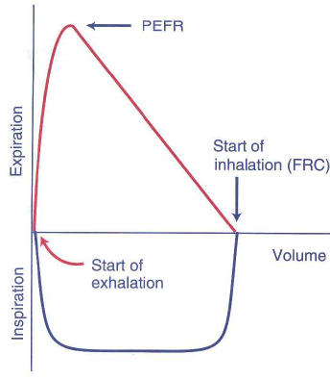
Label the Following
A
Start of inhalation
Start of exhalation
Peak expiratory flow rate
Inspiration
Expiration
Volume
E
B
C
D
F
Notes:
A: peak exp flow rate
B: start inhalation
C: Volume
D: start exhalation
E; Expiration
F: Inspiration

Slide 5
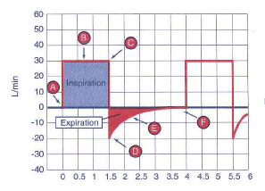
Questions:
Is this scalar…
  Flow
  Volume
  Pressure
Label the following:
  Termination of inspiration
  Exhalation
  Beginning of expiration
  Beginning of inspiration
  Inspiration
  End expiration

Slide 6
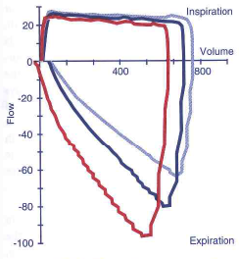
Compliance
What is compliance?
Which loop has the lowest compliance?
Which loop has the highest compliance?
Notes:
Lowest compliance – red
Highest compliance – light blue

Slide 7
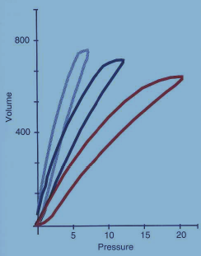
Compliance
Pressure-Volume
Which loop represents increased compliance?
Which loop represents decreased compliance?
Notes:
Increased compliance – light blue
Decreased compliance – red
Decreased compliance – “right shift” in PV loop

Slide 8
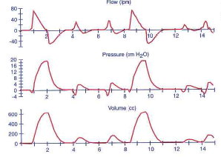
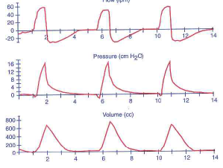
Ventilator modes
Volume or pressure?
Ventilator mode?
Notes:
Top: Pressure
SIMV
Bottom: Volume
Assist control

Slide 9
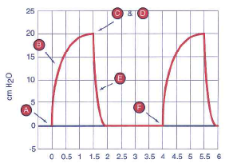
Questions
Is this scalar…
  Flow
  Volume
  Pressure
Label the following:
  Termination of inspiration
  Exhalation
  Beginning of expiration
  Beginning of inspiration
  Inspiration
  End expiration

Slide 10
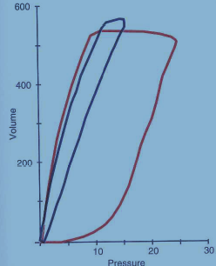
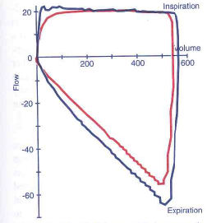
What does the red loop represent?
Notes:
Increased inspiratory resistance

Slide 11
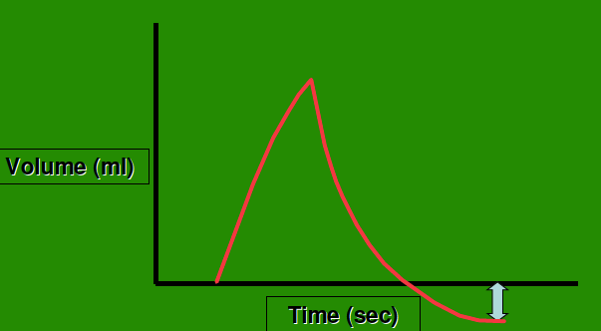
What does the arrow indicate?
Notes:
Active exhalation

Slide 12
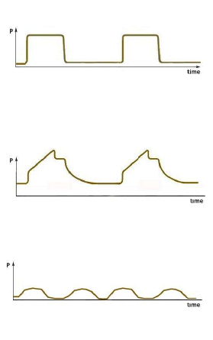
Matching
Sine wave
Square wave
Ramp wave
Spontaneous breathing
Represents constant parameter
Represents variable parameter
Notes:
Square wave:
▫Represents a constant or set parameter.
▫For example, pressure setting in PC mode or flowrate setting in VC mode.
•Ramp wave:
▫Represents a variable parameter
▫Will vary with changes in lung characteristics
▫Can be accelerating or decelerating
•Sine wave:
▫Seen with spontaneous, unsupported breathing

Slide 13
Matching
Sine wave
Square wave
Ramp wave
Spontaneous breathing
Represents constant parameter
Represents variable parameter

Slide 14
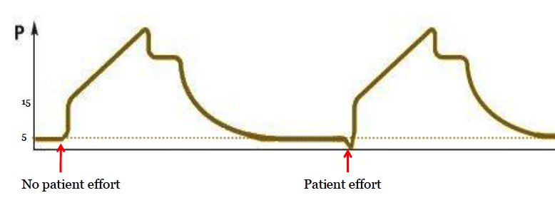
What is the difference between these two breaths?

Slide 15
Pressure-volume loop
What does the

Slide 16
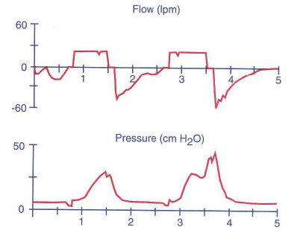
What does this represent?
Notes:
Vent-patient asynchrony

Slide 17
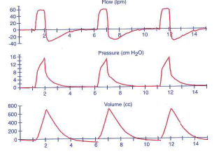
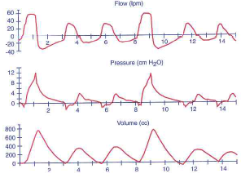
Ventilator modes
Volume or pressure?
Mode?
Notes:
Top: Volume
Controlled ventilation
Bottom: Volume
SIMV

Slide 18
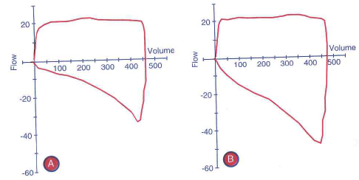
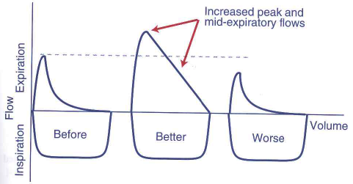
Ventilator modes
What intervention has happened in these loops?
Notes:
bronchodilator

Slide 19
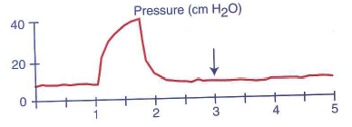
What does this represent?
Notes:
Auto-peep

Slide 20
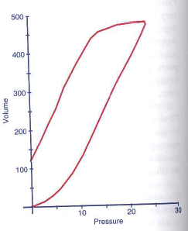
What is depicted here?
Notes:
leak

Slide 21
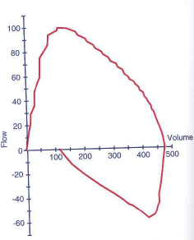
What is depicted here?

Slide 22
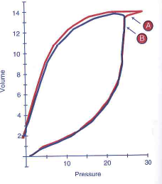
What is depicted here (A)
Notes:
Beaking – increase in pressure with no increase in volume

Slide 23
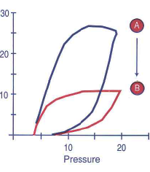
What is depicted here (B)
Notes:
Reduced compliance

Slide 24
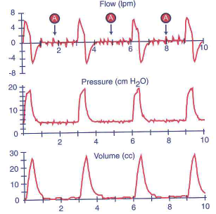
What are potential causes for these scalars?
What intervention should be attempted?
Notes:
1. Partial obstruction or water in circuit
2. Check for condensation in tubes. Suction airway.

Slide 25
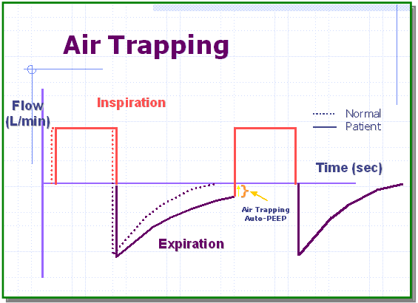
What is occurring in the area indicated by the circle?
Notes:
Air trapping

Slide 26
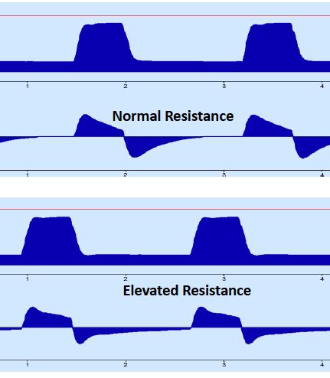
What do the bottom scalars represent ?(top=normal)
Notes:
Elevated expiratory resistance

Slide 27
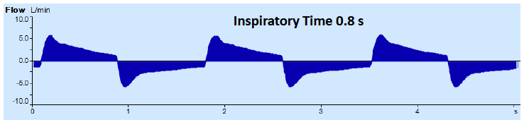
What is indicated here?
Notes:
Air trapping

Slide 28
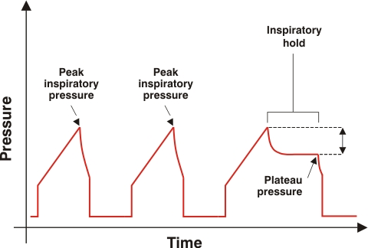
What is depicted?
???
Notes:
Inspiratory hold

Slide 29
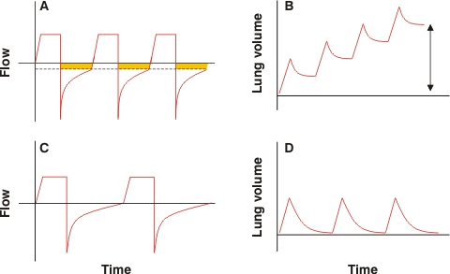
Notes:
Mechanics of dynamic pulmonary hyperinflation in the setting of severe airflow obstruction.
A flow-time curve - inspiration begins before complete exhalation of the previous breath, leading to gas trapping (shaded area).
B) Gas trapping over the course of several breaths leads to an increased end-expiratory lung volume. The trapped volume (Vtrap) over functional residual capacity is indicated by the double-headed arrow.
C) Increase in expiratory time and decrease in respiratory rate allow for complete exhalation prior to the initiation of the next breath.
D) Increase in expiratory time and decrease in respiratory rate result in no air trapping and absence of dynamic hyperinflation

Slide 30
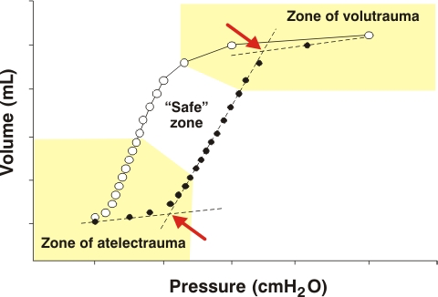
? ? ? ?
? ? ? ?
Notes:
Upper right – volutrauma
Lower left - atelectrauma

Slide 31
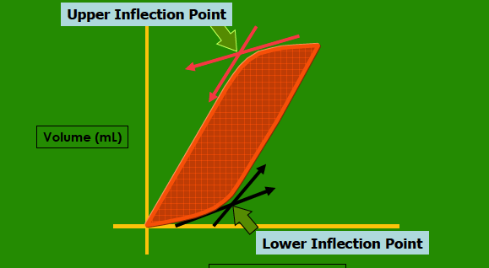
Notes:
Upper inflection point
Lower inflection point

Slide 32
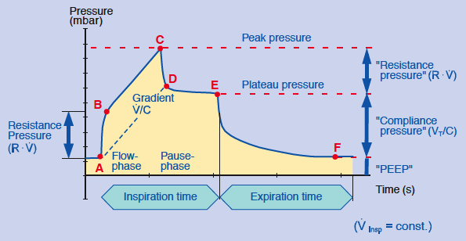
Notes:
Peak pressure
Plateau pressure
Inspiration time
Expiration time

