Slide 1
Smoke inhalation
&
CO toxicity
Josh Smith

Slide 2
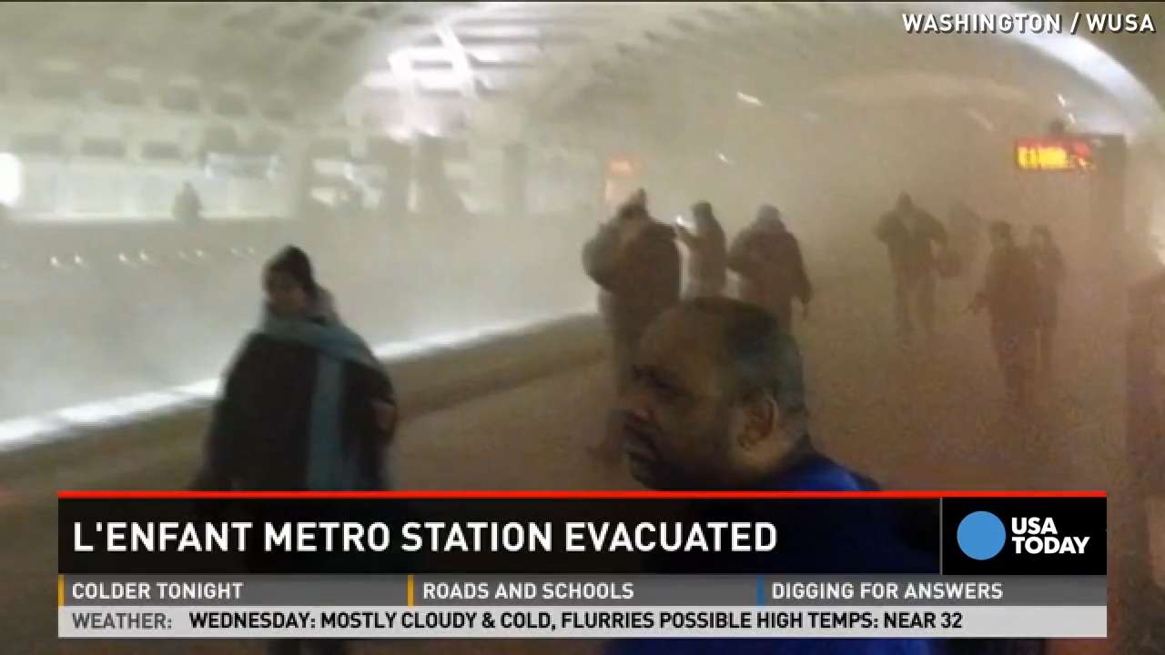

Slide 3
Smoke inhalation
Smoke inhalation present in 22% of burn patients
30% of burn patients with smoke inhalation die vs 2% of burn patients without
Smoke inhalation is a greater contributor to morbidity and mortality than either %BSA or age
Inhalation injury often progresses:
  73% progress to respiratory failure
  20% progress to ARDS
Notes:
Resp failure = hypoxemia, multiple pulmonary infections or prolonged ventilatory support

Slide 4
Smoke inhalation
Death due to hypoxia from carbon monoxide toxicity
Other complications seen
  Direct thermal or irritant gas injury- URT, LRT
  Skin burn injury
  ARDS
  Bacterial pneumonia
  Neurologic signs
Notes:
Hypoxia from CO tox is presumed to the be themost common cause of acute death. Other complications include direct thermal injury to the URT, LRT injury from irritant gases, ARDS, bacterial pneumonia, dermal burn injury
Thermal injury, irritant gases/superheated particulate matter, reduced lung complaince (from atelectasis and edema), airway obstruction, bacterial pneumonia, dermal burn injury. Rem that O2 saturation via pulse ox may be nromal b/c cannot differtiate b/w Cohgb and Oxyhgb. Co-ox allows direct measurement.
From one study- the PaO2-FiO2 ratio had a nadir at 32hrs postadmision
Prognosis- MR in ppl < 10% w/o dermal injury and 25-65% w/ dermal injury. Of 27dogs in one retrospective study, 4 died and 4 were euthanized. In uncomplicated cases, dogs recovery from the initial CO tox had a favorable prognosis, w/ iprovemnts in resp signs over 24hrs. However, dogs that were clinically worse the following day were more likely to die, euthanized or req prolonged hosp.

Slide 5
Epidemiology
35% of hospitalized burn patients have smoke inhalation injury
Can triple the length of stay
Compared to burns alone, there is a 60% increase in mortality if inhalation injury is present
When ARDS develops from burn inhalation injury, mortality rate up to 66%.
60% TBSA burns with inhalation injury & ARDS, almost 100% fatal.

Slide 6

Clinical signs
Hoarseness
Dyspnea
Stridor on inspiration
Singed facial and nasal hair
Black-tinged (carbonaceous) sputum
Facial burns
Notes:
20 – 35%of patients admitted to burn centers and some 60 -70% of burn patients who die have an associated inhalation injury.

Slide 7
Clinical signs
Systemic toxicity signs are maximal at time of exposure
  Altered mentation, ataxia, collapse, and syncope suggest CO or HCN toxicity
Respiratory signs may worsen with time
Dogs –
  Coma/stupor, coughing/gagging/hacking, increased respiratory effort
Cats –
  Difficulty/open-mouth breathing, vocalizing, coughing

Slide 8
Assessment for Smoke Inhalation
Monitoring pulse oximetry
Frequently reassessing vital signs
  Watch for changes in the respiratory system
  Frequently reassess breath sounds listening for any changes
Listen for changes in tone of speech in people
  Hoarseness will develop
If CO-oximeter available, evaluate for the presence of CO

Slide 9
Pathophysiology of Injury
Thermal Injury: Heat Burns
Hypoxemia: Fire steals your oxygen
Toxic Exposure & Asphyxiants
  Fire releases poison

Slide 10
Thermal Injury
Direct heat injury, typically supraglottic
  Facial-oral burns create anatomic obstruction
  Laryngospasm (rare) & bronchoconstriction
  Local erythema, edema, ulceration
  cellular necrosis of ciliated epithelium and capillary leakage
Edema, maximal within 24-48 hours
Causes airflow obstruction, therefore stridor
Resolves after 3-5 days

Slide 11
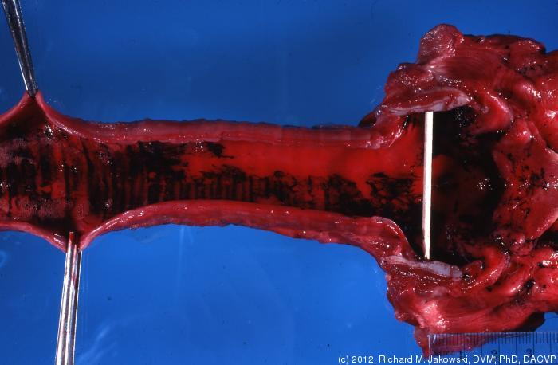
Thermal Injury: Direct Heat
Heat dissipates on inhalation and damage occurs above the carina
Steam or prolonged exposure or particles 5-10 microns in diameter of less can damage airway below the cords

Slide 12
Hypoxemia
Fire consumes the ambient oxygen → lower the environmental FIO2 below 0.21
Fuel dependent
  Gasoline: 0.15
  Oxygen containing compounds: 0.10
Exacerbates CO and HCN toxicity

Slide 13
Oxygen depletion
Displacement of oxygen with other gases
  Carbon dioxide, methane
  Consumption by combustion
Acute FiO₂ changes and clinical signs:
  15% - dyspnea
  10% - dyspnea and altered mentation
  8-10% - loss of consciousness followed by death within 8 minutes
Notes:
Acute changes in oxygen

Slide 14
Particulates & irritants
Primary contributor to pathophysiology of smoke inhalation = particulates
Soot impregnated with toxins can reach the alveolar level
Water-soluble compounds
  Dissolve in airway mucus of URT = inflammation
Lipid-soluble compounds
  Penetrate the mucosa deeply
  May cause severe delayed (up to 48 hr) damage via interaction with lower airway tissues
Notes:
Water soluble – upper airway injury – acrolein, ammonia, sulfur dioxide
Hydrogen chloride
Intermediate – high and low – chlorine, isocyanates
Lipid soluble – lower airway injury – phosgene, oxides of nitrogen

Slide 15
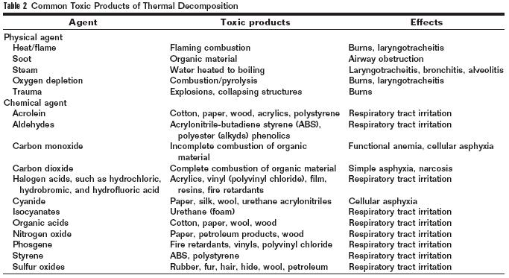
Fitzgerald TK, Flood AA. Smoke inhalation. Clin Tech Small Anim Pract 2006; 21: 205.

Slide 16
Pathophysiology
Inflammatory cascade is of paramount importance
  Activation of classic complement cascade
  Intrapulmonary leukocyte aggregation
  Increasing amounts of chemokines/cytokines
  Production of oxygen free radicals
Pulmonary edema
Notes:
Act

Slide 17
Pathophysiology
NO synthase is induced by respiratory epithelial cells & alveolar macrophages
  Increases bronchial blood flow
  Decreases hypoxic pulmonary vasoconstriction
  NO also combines with superoxide O₂⁻ =
    ONOO- leads to DNA damage
    Activation of poly (ADP-ribose) polymerase for repair
    Requires a lot of ATP and NAD
    Leads to energy depletion and cell death
Notes:
NO is a powerful vasodilator
NO combines w/ O2- by activated neutrophils

Slide 18
Systemic toxins
CO
HCN
  Combines with trivalent iron in mitochondrial cytochrome a3 complex
  Inhibits cellular respiration
  Tachypnea, severe depression, convulsions, respiratory arrest, death
Notes:
HCN initially causes tachypnea but quickly leads to severe depression, convulsions, resp arrest and death

Slide 19
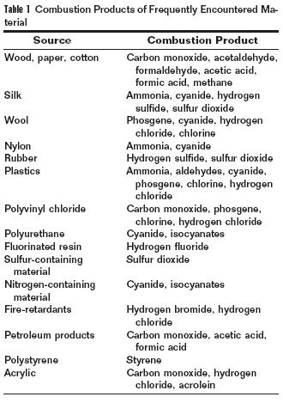
Fitzgerald TK, Flood AA. Smoke inhalation. Clin Tech Small Anim Pract 2006; 21: 205.

Slide 20
Toxic Exposure: Physiologic Changes
Destruction of ciliated epithelium in trachea and bronchial tree
Increased vascular permeability causing pulmonary edema
Alveolar hemorrhage & hyaline membrane formation
Airway obstruction facilitates surfactant consumption, distal airway collapse and atelectasis

Slide 21
Pathophysiology
Combined effects produce:
  Tissue injury
  Increased pulmonary vascular permeability
  Decreased diffusion
  Pulmonary edema
  V/Q mismatch
Neutrophil infiltration & fibrinogen activation cause airway cast formation / plugging
  Increased likelihood of ventilator-induced barotrauma
  Vicious cycle

Slide 22
Diagnostics
Blood gas analysis
Carboxyhemoglobin concentration
  Pulseoximetry may be unreliable
Chest radiographs
  May be normal initially
  Within 24-36 hr – patchy atelectasis to diffuse interstitial and alveolar patterns
Ophthalmic exam
  Check for particulates under lids
  Fluorescein stain

Slide 23
CXR is a Poor Indicator of Inhalation Injury
29 of 56% of patients had normal chest xrays
Most frequent abnormal findings is diffuse alveolar infiltrates (35%)
Focal abnormalities, consolidation or atelectasis, 12.5% on admission and 25.6% on day 2
First CXR not predictive of duration of MV or ICU length of stay, or positive sputum cultures
Hantson, et al. Early complications and value of initial clinical and paraclinical observations in
victims of smoke inhalation without burns. Chest, 111 (3), 2007.

Slide 24
Treatment
Monitor airway patency
  Intubate early if signs of upper airway obstruction
  Can deteriorate
Oxygen therapy
Fluid resuscitation
  Aggressive fluid therapy worsens upper airway edema – may need to intubate
Care for eyes & skin

Slide 25
Treatment
Inhaled B2-agonists may help
Corticosteroids are bad
Inhaled epinephrine may be beneficial
Antibiotics…..maybe
If intubated…
  Low tidal volume/pressure ventilation
  Frequent suctioning of airways
  Consider bronchoscopy to help clear airways
Even if apparently well – wait 6-8 hr to discharge
Notes:
Corticosteroids cause increased mortality and infection rates in animals with smoke inhalation
Abx – prophylactic use in smoke inhalation is no benefit and may help develop abx resistant organisms
Start abx if fever and persistent leukocytosis after more than 2 days

Slide 26
Complications of Smoke Inhalation
Swelling of the highly vascular tissues
  Airway restrictions
  Severe dyspnea
  Respiratory arrest
In any environment where carbon monoxide is present, cyanide should be suspected
Notes:
The airway is comprised of a narrow tube that is lines with highly vascular tissue. If damaged, this tissue swells rapidly reducing the size of the lumen.
Cyanide poisoning should be suspected with severe symptoms of dyspnea, chest pain, altered mental status, seizures, and unconsciousness.

Slide 27
Carbon monoxide

Slide 28
Carbon monoxide
Nonirritant gas, colorless, odorless
CO binding to hgb is > 200x the affinity than of O2 to hemoglobin
  Also shifts O2-hemoglobin curve to the left
Produced by incomplete combustion of hydrocarbons in fire, car exhaust, charcoal grills, generators

Slide 29
HIstory
Ancient time - used to execute criminals
Mid 19th century - found that CO causes hypoxia by interacting with hemoglobin
End of 19th century – high partial pressure of oxygen can counteract CO-Hgb interaction

Slide 30
Incidence of CO poisoning
Leading cause of poisoning mortality
Most common cause of death in combustion related inhalation injury
1000 to 2000 deaths / year ( USA )
Difficult diagnosis
  incidence of unrecognized cases higher
  estimated > 42 000 visits / year
  ED visit rate 16.5 / 100 000 population

Slide 31
Sources of CO
Motor vehicle exhaust
  running engine in closed space
  faulty exhaust systems
Propane-powered equipment
  lift, water heater, concrete saw, polishers
Combustion for heating or cooking
  camping equipment, heating systems
Smoke inhalation in fires

Slide 32
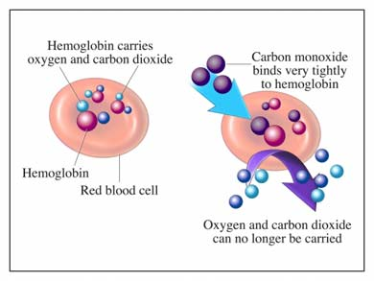
chemistry
CO is diffusion-limited
  Rapidly forms carboxyhemoglobin (COHb)
  “Cherry-red” color
  Hb has ~210 times higher affinity for CO compared to O₂
Shifts the oxygen dissociation curve to the left
Amount of CO taken up affected by:
  CO concentration
  Minute volume
Notes:
The amount of CO in the blood remains very low b/c it is VERY rapidly taken up by the Hgb, therefore, the blood concentration of CO
Cherry red color of mm and skin often not seen until death – need 50-60%COHb to see this
For any oxygen bound hgb, the dissociation curve is shifted to the left making it more difficult to liberate the oxygen present.
MV also affects excretion

Slide 33
chemistry
CO is also taken up by myoglobin
  Cardiac myoglobin takes up three times as much CO as skeletal muscle myoglobin
  Hypoxia exacerbates this process
  Carboxymyglobin dissociation is slower than COHb dissociation – rebound effect
  Cardiac myoglobin : circulating COHb is 3:1

Slide 34
Xenobiotics metabolism
Methylene chloride
  peak of 50 % in humans
Dibromomethane
  peak of 27 % in rodents
Diiodomethane
  peak of 14.2 % in humans
Bromochloromethane
  peak of 11 % in rodents

Slide 35
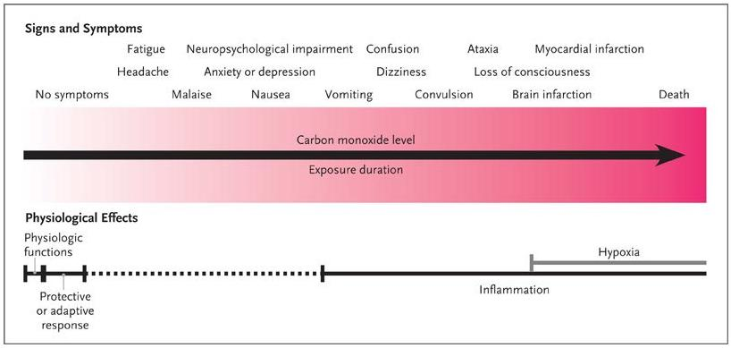
Pathophysiology
Physiologic changes/damage are greater than with hypoxia alone
COHb levels and clinical signs or outcome do not correlate well
Tissues with highest oxygen demands most affected
  Brain – neurologic signs predominate acutely
  Heart – 37% have acute myocardial injury
Notes:
Hypoxia itself directly causes cell injury

Slide 36
Pathophysiology
Increased cytosolic heme levels
  Oxidative stress
Binds to cytochrome c oxidase
  Interruption of cellular respiration
  Production of ROS
  Induces stress response
    Activation of hypoxia-inducible factor 1α
    Initially a protective response but then injurious
Notes:
Hypoxia inducible factor – neurologic and cardiac protection or injury dependent on the dose of CO by means of gene regulation

Slide 37
Pathophysiology - Tissue hypoxia
Binding to Hb to form COHb
Hb affinity for CO 250 times affinity for O2
Effect on oxyHb dissociation curve
  left shift, distortion of shape
Impaired release of oxygen at tissue level
Increased minute ventilation with subsequent increased CO uptake

Slide 38
Pathophysiology - Cellular level
15 % of CO bound to extravascular heme-containing proteins
Cytochrome oxidase ( aa3 )
  alteration in ATP production
  intracellular acidosis
  persists after exposure
Cardiac and skeletal myoglobin
  occuring at COHb 2 %
  alteration in tissue O2 uptake

Slide 39
Pathophysiology - Cardiovascular
Myocardial depression consequence of
  hypoxic stress
  cytochrome a3 dysfunction
  CO binding to cardiac myoglobin
Arterial hypotension
  myocardial depression
  NO-related peripheral vasodilatation
LOC with reduction of cerebral perfusion
Ischemic reperfusion injury

Slide 40
Pathophysiology - Neurovascular
CO in circulation associated with massive increase in NO in perivascular tissues
NO released from vascular endothelial cells and platelets
Production of oxygen radicals from impaired mitochondrial function
Reaction NO with oxygen radicals to form peroxynitrite ( ONOO- )

Slide 41
Pathophysiology - Neurovascular
Peroxynitrite binds to perivascular tissue proteins causing injury
Increased capillary permeability in CNS and pulmonary vascular beds
Endothelial injury causing expression of adherence molecules - beta 2 integrins
Leucocytes bind to injured endothelium reducing cerebral perfusion
Initiation of CNS lipid peroxidation

Slide 42
Severity of CO intoxication
Inhaled CO concentration
Duration of exposure
Individual susceptibility
  minute ventilation
  pregnancy
Presence of systemic illnesses
  cardiac and pulmonary diseases
Initial COHb not predictive

Slide 43
COHb elimination half-life - human
O2 20.9 % 1 atm
  320 min ( 128-409 )
O2 100 % 1 atm
  131 min ( 27-462 )
  72 min ( 26-146 )
O2 100 % HBO
  3 atm : 23 min
  1.58 atm : 27 min
  2.5 atm : 22 min

Slide 44
Clinical manifestations
General
  headache, nausea, vomiting, weakness
Cardiovascular
  chest pain, tachypnea, tachycardia, hypotension
  pulmonary edema, arrythmias, cardiac arrest
Neurologic
  dizziness, ataxia, seizures, coma
Others
  retinal hemorrhages, metabolic acidosis

Slide 45
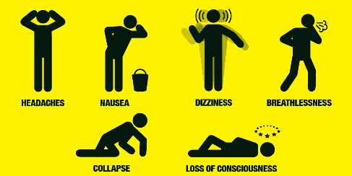

Slide 46
Acute poisoning
Headache
Dizziness, disorientation
Weakness, myalgia
Nausea/vomiting
Trouble thinking, confusion, memory loss
Shortness of breath, chest pain
Visual problems
Loss of consciousness
Seizures, coma, death

Slide 47
Chronic exposure
“Protean symptoms”
Headache, nausea
Chronic fatigue, difficulty working
Affective conditions, emotions distress
Sleep disturbances, memory deficits
Vertigo, neuropathy, paresthesias
Aggravation of existing cardiopulmonary diseases
Polycythemia, recurrent infections
Notes:
Highly variable signs
Often mistake for flu-like symptoms esp when multiple people are affected.
Affective disorder – consistent pervasive alteration in mood – affects thoughts and emotions

Slide 48
Sequelae
Common occurrence days to months after intoxication
Thought to occur from the inflammation that is induced
Cardiac
  Up to 1/3 of people develop chest pain
  Increased risk of CV disease and death
Notes:
Study by Henry – pts with moderate/severe toxicity that otherwise had low risk for CV disease – within 7.6 years, 37% suffered heart attack, and 38% were dead – mortality rate three times higher than expected
Some studies show as high as 45% of people develop late neurologic sequela

Slide 49
Sequelae
Neurological
  Up to 45% of victims have cognitive and/or affective sequelae
  Mental deterioration
  Urinary or fecal incontinance
  Gait disturbances
  Epilepsy, “Parkinson like syndrome,” mutism, hearing or visual disturbances
Notes:
Low pressure chronic HBOT has been found to be beneficial with many “static” neurologic conditions – fetal alcohol syndrome in an adult, decompression sickness (over 100 tx in some patients to reach neurologica plateau)

Slide 50
Diagnosis
Index of suspiction
Blood testing – COHb levels
  Often underestimate true toxicity
  >3% for non smokers
  >10% for smokers
CO-oximeters
  May be used “in the field”
  Can continuously monitor levels
Notes:
The administration of treatment and elapse of time from intoxication to reaching a therapeutic center can dramatically lower COHb levels
Massimo CO-oximeters use 7 wavelengths of light (rather than 2) to distinguish between MetHb, COHb, and oxyHb
Traditional pulse oximetry overestimates oygenation in patients with COHb

Slide 51
Treatment
T_{1/2} of COHb:
  Room air ~4-5 hours
  100% oxygen - 40 min
  Hyperbaric oxygen @ 2.5 atm ~20 min
Monitor ECG
Oxygen until COHb <5%
Patients initial signs, [COHb], response to therapy does not predict long term prognosis
Notes:
Studies show differing results – with one exception they do not show any harm
Cochrane review

Slide 52
HBOT
100% oxygen at >1.4 atm of pressure
Arterial pO2 often exceeds 2000 mm Hg
  Tissue oxygen levels of 200-400 mm Hg
  Shortened half-life of COHb
  Enough oxygen is dissolved to support tissues
  Increases ATP production
  Reduces oxidative stress and inflammation
One RCT showed a 46% decrease in cognitive sequela
Notes:
Definition – undersea and hyperbaric medical society
Normal tissue oxygen level in brain is 20-35 mm Hg
Studies show differing results – with one exception they do not show any harm
Cochrane review shows no significant benefit.
Only one study showed worse outcome with HBOT but used 100% oxygen between tx and treatments were extended beyond 24 hours after intoxication.

Slide 53
HBOT
Many recommend for “severe” toxicity
  No consensus on technique
  1-3 treatment within 24 hours (30-120 min each), no oxygen supplementation after 1st treatment
May be helpful for pregnant women
  Takes longer for fetal blood to eliminate COHb
  Fetal mortality exceeds 50% in severe toxicity
Low pressure, chronic HBOT may help patients with long-term effects
Notes:
Do not recommend oxygen in between to give an “oxygen break” – prevents/delays oxygen toxicity

Slide 54
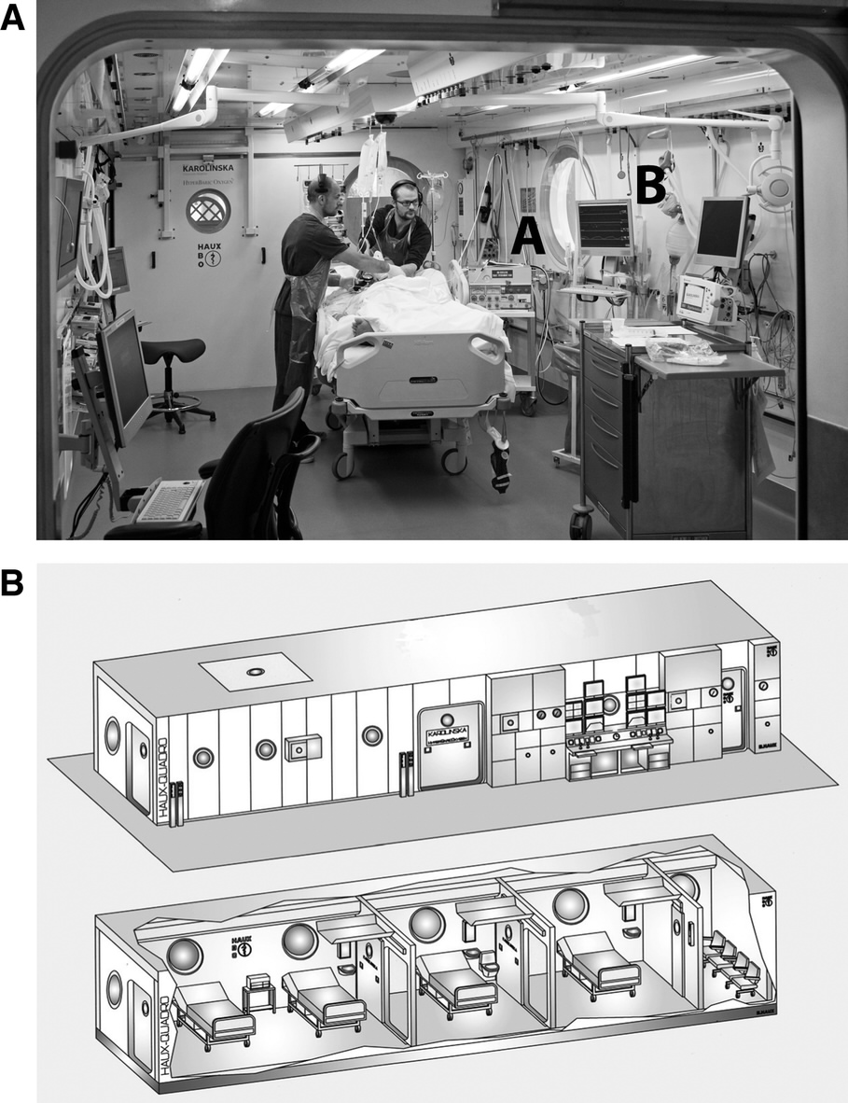
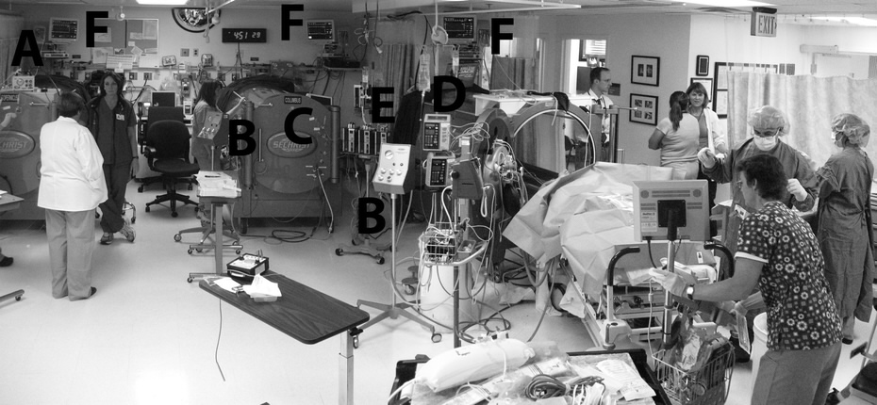
Weaver LK. Hyperbaric oxygen in the critically ill. Crit Care Med 2011; 39: 1784.
Notes:
MONOPLACE chambers - 3 intubated critically ill pts w/ acute CO poisoning from operating a propane-powered heater in a tent while hunting.
MULTIPLACE chamber – chamber is air filled (23% or less for safety) and patient is given 100% oxygen and exhaled air is vented outside the chamber.

Slide 55
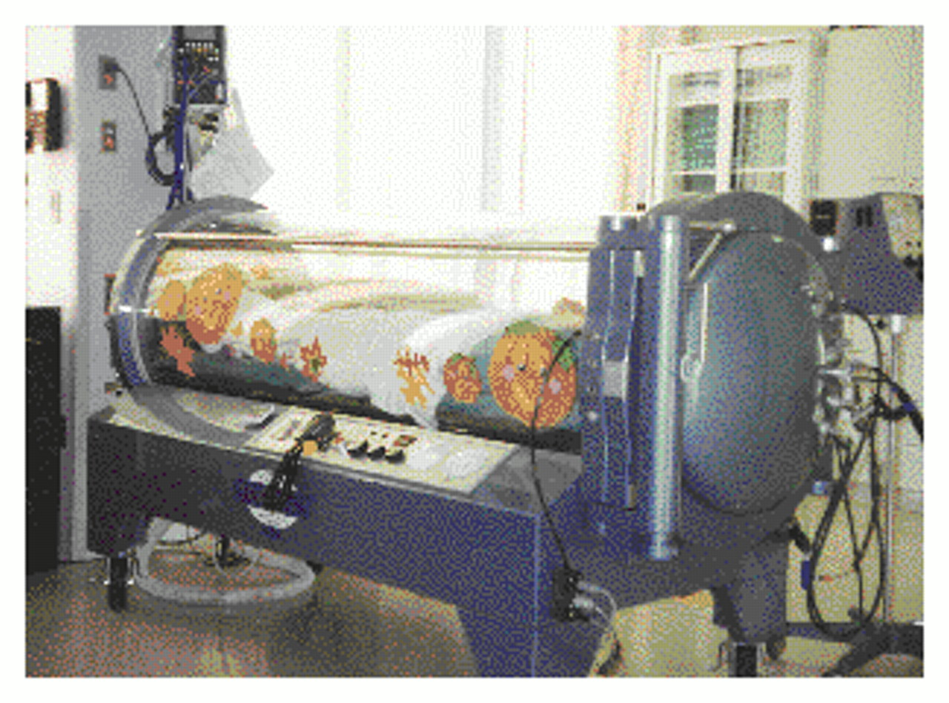

Monoplace Hyperbaric Chamber
Tibbles P and Edelsberg J. N Engl J Med 1996;334:1642-1648
Notes:
Figure 1. Monoplace Hyperbaric Chamber. Photograph courtesy of Massachusetts Eye and Ear Infirmary, Boston.

Slide 56
Prognosis
Overall survival without burns is 90%
Mortality increases greatly with thermal burns
  Increased vascular permeability, fluid shifts to interstitium, worse lung edema
Dogs with severe signs that die usually do so within 3 days
If presenting signs do not worsen by day 2, patient generally has a favorable prognosis
CO toxicity can change this…delayed sequela
Long-term
  Chronic hyper-reactive airways
    Cough, wheezing, asthma
  Bronchiectasis, pulmonary fibrosis
Notes:
90% for dogs/cats without burns
Most die w/I 3 days
If not getting worse by day2 – usually survive

Slide 57
Cyanide toxicity
Incidence and significance remains undefined
  May contribute in smoke inhalation
  Found in very low concentrations in foods in the form of amygladalin
  Iatrogenic sources (nitroglycerin, nitroprusside)
Several intrinsic biochemical pathway for CN detox exists
  Formation of thiocynate
Hallmark- histotoxic hypoxia
Cyanohemoglobin further contributes to hypoxia

Slide 58
HCN toxicity therapy
Aggressive restoration of cardopulmonary function
  Allows liver to clear cyanide via rhodanase
Hydroxocobalamin
  Actively binds cyanide to form cyanocobalmin
  Excreted via the kidney
Amyl nitrate & sodium thiosulfate
  Convert Hb to metHb which chelates cyanide
  MetHb converted to thiocyanate in liver and excreted in urine
Notes:
First two preferred as the third creates metHb which further decreases oxygen carrying capacity

Slide 59
Lit Review

Slide 60
Retrospectives about smoke inhalation
Dogs (27)
  16 uncomplicated, 11 complicated cases.
  Many dogs unconscious at the scene – improved rapidly with oxygen
  79% had radiographis abnormalities – focal alveolar pattern
Cats (22)
  15 uncomplicated, 5 complicated, 2 unknown
  91% survived
  1 euth due to respiratory, 1 due to neuro
  69% had radiographic abnormalities – variable – diffuse interstitial and focal alveolar most common
Notes:
Drobatz and colleagues – 1988-1997 at u penn
Complicated – intestive monitoring in ICU or death, or euth due to severity

Slide 61
Carbon monoxide toxicity: a case series – Berent 2005 JVECC
  4 dogs and 2 cats from the same household
  5/6 survived (one euthanized for abdominal mass)
  4/5 were thought to be temp deaf during recovery
  Treated with supportive care, o2, oxyglobin
Notes:
Berent JVECC 2005- case series of 4dogs and 2 cats. 6 animals from the same fm were brought to UMN- with the complain of recumbency, stiffness and dyspnea of unknown duration (6-8hrs). Dogs were left free in a large warehouse overnight, in which an RV was parked w/ a generator running. The 2 cats were in an office w/in the warefhouse. 5/6 survived (one was euthanized d/t abdominal mass). 4/5 animals were temp deaf (although was never rechecked) and made a full recovery. Treated w/ O2 and oxyglobin.
Full recovery following delayed neurologic signs after smoke inhalation in a dog- Mariani JVECC 2003. 1yo Aussie presented for dementaia and tetraparesis. Been in a house fire 5d prior and was found unconsicous on an upper floor. Was given o2 for 15min. Was ataxic at the rDVM- treated w/ supporive care and sent home w/ ab’s and pred. Neuro signs were worsening (mentally inappro, decrease in CN) progressive ataxia- eventually made full recovery w/ supporitve care for pneumonia. HBO- controversy- appears to accelerate the resolution of acute symptoms, there are conflicting reports of its efficacy in preventin glate sequale. Antioxidants were given but efficacy unk. Previous repots of DNS 3/5 dogs died or euthized, the other 2 made full recovries.
Clinical and neuro findings of acute CO toxicity in chiahuahuas following smoke inhalation- 3 adult chiahuahuas were present UGA for smoke inhalation after 12hrs during a house fire. Removed after 30m in a smoke-fillled room. All 3 were depressed w/ cyanosis, 2/3 were lat recumbent. Alll 3 received supporitve care and O2. After initial improvement the dogs dev sz- which were non responsive.
Ashbaugh et al- goal was to char the Cohb concentration in a group of dogs that were exposed to a structural fire and to relate the conc of Cohgb w/ clinical parameters, to describe the use of O2 and document the duration of hosp in these dogs. Also had a control group. Clinical parameters, 2 samples (24hrs apart) were taken. Suspected exposure for 30-60min, 3 were dead at the scence. Included 21 dogs. Only 1/21 dogs died during hosp, duration of hosp ranged from 2-28d. There is debatel about whether there is a true relationship b/w temp and Cohb levels in human patients, a a rapid return to euthermia improves survivaling following acute signs- dogs w/ a temp < 100 had sig higher Cohgb concn. RR not correlated, but increased RE and abnormal auscultation had a greater Cohb. Dogs w/ altered mental status had a sign increased presenting COhgb as did length of hosp stay. O2 therapy resuled in a more rapid decline in Cohb but 5 dogs still had a mildly increased level.
Guillaumin- 1st descriptino of extensive management of a patient suffering both neuro and resp complication d/t smoke inhalation with a successful outcome.

Slide 62
The association of physical exam abnormalities and carboxyhemoglobin concentrations in 21 dogs trapped in a kennel fire - Ashbaugh JVECC 2012
  Recorded clinical parameters, samples were taken on admission and 24hrs later
  Clinical parameters associated with high levels of carboxyhemoglobin
    RE/abnormal auscultation, lower temp
    Altered mental status and longer hospital stay
  O2 therapy resulted in faster decline in carboxyhemoglobin
Successful outcome in a dog with neurologic and respiratory signs following smoke inhalation- Guillaumin JVECC 2013

Slide 63
Neurologic dysfunction associated with smoke exposure in dogs
Of dogs with neuro signs at presentation:
  46% mortality rate
  46% developed delayed neurologic signs after a period of improvement
    60% mortality
    Some hospitalized 4 weeks
  Some dogs had persistent neuro signs
Jackson CB, Drobatz K. Neurologic dysfunction associated with smoke exposure. JVECC 2002; 12: 193.
(Abstracts for 8th IVECC Symposium

Slide 64
Full recovery following delayed neurologic signs after smoke inhalation in a dog
Dog in house fire found unconscious, improved with supportive care, mentation deteriorated 4 days later
Also developed pneumonia
  Supportive care, antibiotics
Tx w/ acetylcysteine and vitamin E for the neurologic deterioration
5 days later neuro signs almost completely resolved
Long term follow up – dog was normal
Mariani CL. Full recovery following delayed neurologic signs after smoke inhalation in a dog. JVECC 2003; 13: 235.
Notes:
Corticosteroids cause increased mortality and infection rates in animals with smoke inhalation
Abx – prophylactic use in smoke inhalation is no benefit and may help develop abx resistant organisms
Start abx if fever and persistent leukocytosis after more than 2 days

Slide 65
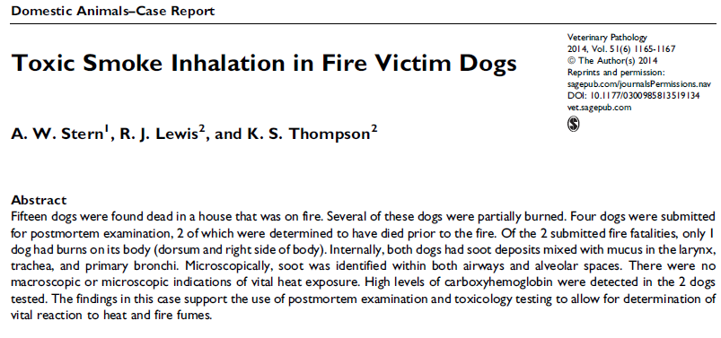

Slide 66
Preclinical evaluation of epinephrine nebulization to reduce airway hyperemia and improve oxygenation after smoke inhalation injury
Sheep exposed to smoke inhalation without thermal injury then ventilated for 48 hours
  Used 12-15 ml/kg tidal volume
Treatment was nebulizing with 4 mg epinephrine q4 hours post-injury
Results:
  Tx group had lower peak and pause airway pressures 30-48 hours post-injury
  Tx group had higher P:F ratio and lower shunt fraction from 36-48 hours
  Tx group had lower malondialdehyde formation
Lange M, Hamahata A, Traber DL, et al. Preclinical evaluation of epinephrine nebulization to reduce airway hyperemia and improve oxygenation after smoke inhalation injury. Crit Care Med 2011; 39: 718.
Notes:
Epinephrine – alpha effects cause vasoconstriction and less edmea formation, beta effects cause bronchodilation
Malondialdehyde formation is used to measure lipid peroxidation in lung tissue.

