Slide 1
Severe Pancreatitis
M&M Rounds
December 18 2014

Slide 2
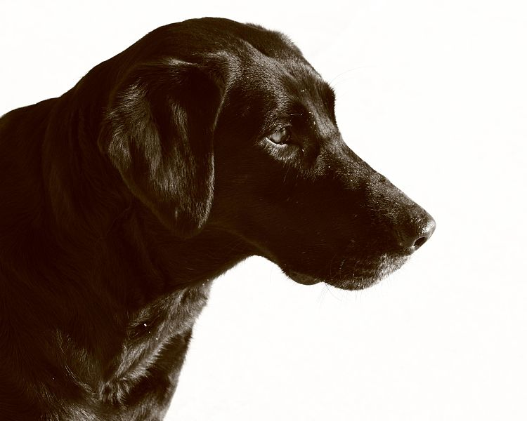
6 year old FS Labrador
Presented to CUHA 10/29/2014
Chief complaint: vomiting, diarrhea, hematochezia, lethargy

Slide 3
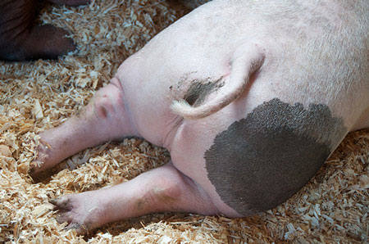
6 year old FS Labrador
History
Access to compost 4 days ago
  Pig fat, vegetables, pumpkin carvings, chicken wings with bones
3 days history of lethargy, PD
2 day history of anorexia and
vomiting
Straining to defecate, diarrhea?
Spends a lot of time outside
Similar episodes in past after
consuming human foods
Notes:
Vomited yellow foam and mucus
Spends a lot of time outside, don’t

Slide 4
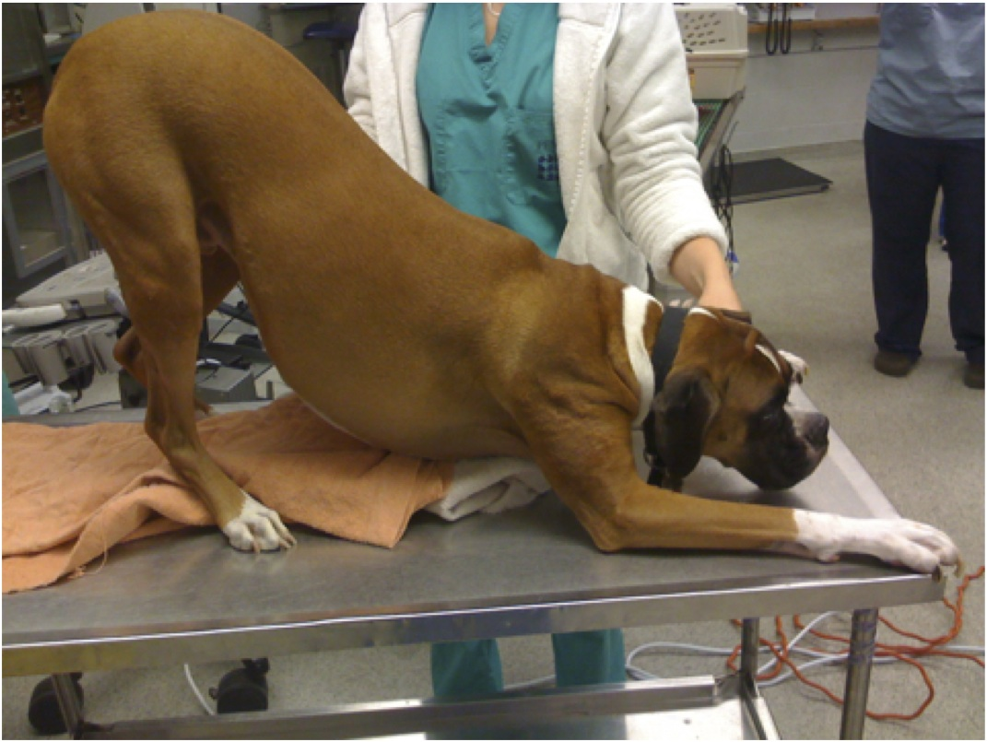
6 year old FS Labrador
Presented to rDVM 10/29/2014 am
  Painful abdomen
  Abdominal radiographs
    Decreased serosal detail
    No evidence of obstruction
  Treatment
    Cerenia and/or sulcrate
    Subcutaneous fluids

Slide 5
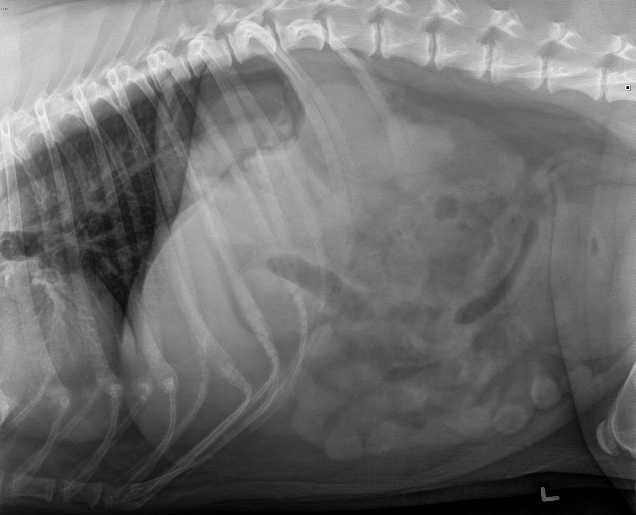
10/29/2014
Notes:
Decreased serosal details
Difficult to interpret due to exposure
No evidence of obstruction

Slide 6
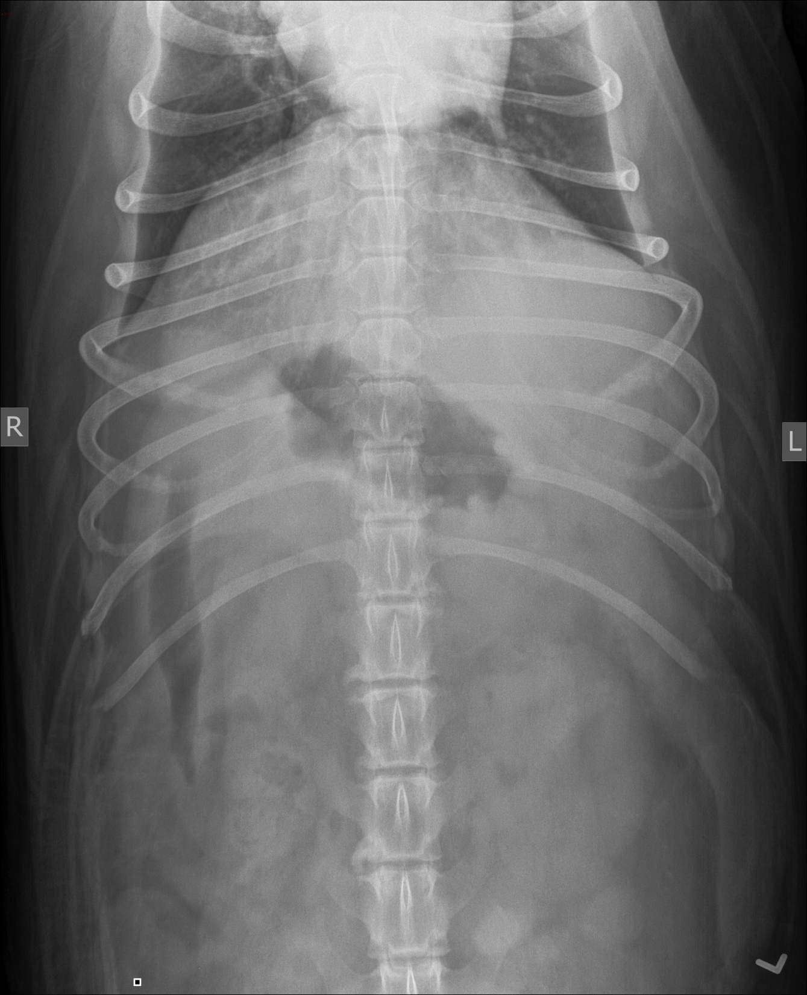
10/29/2014

Slide 7
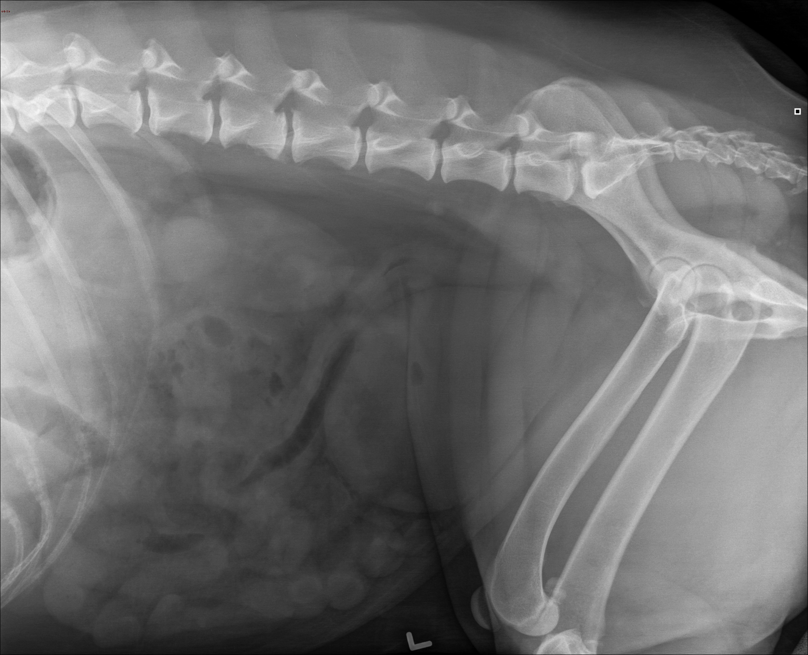
10/29/2014

Slide 8
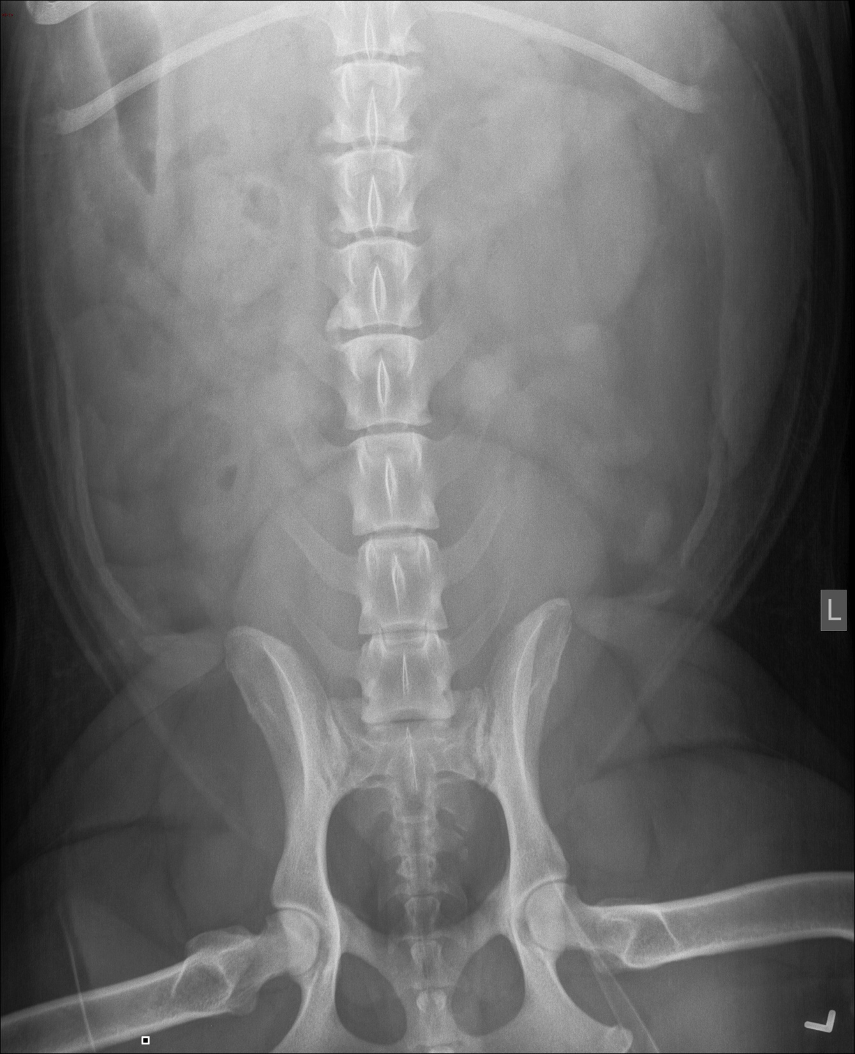
10/29/2014

Slide 9
Physical Exam Findings
T: 104.1 HR: 180bpm RR: 60brpm Wt: 45.2kg
QAR, mm pink, tacky, CRT<1sec
EENT: moderate dental tartar
MSK: No lameness observed, but reluctant to move
CV: Tachycardia, pulse quality poor and synchronous
Resp: panting heavily, no crackles or wheezes
ABD: Moderately painful and tense on palpation

Slide 10
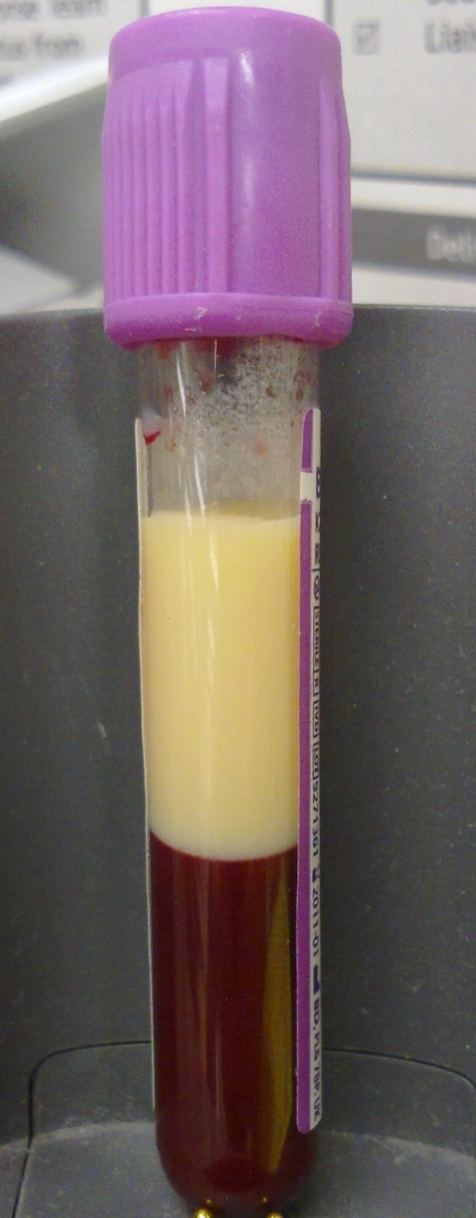
Initial Diagnostic Tests
QATS: PCV 48%; TS 8g/dL; AZO 5-15; BG 120mmol/L
Gaslyte: metabolic acidosis with compensation
  pH: 7365 pCO2: 32.2 HCO3: 18 BE: -7.4
  Na: 152.6 K: 4.2 Cl: 115 Ca: 1.27
Lactate 1.3
Lipemic serum
Blood smear: Neutrophils with bands present
PT 14; PTT 98
Notes:
Corrected chloride 111

Slide 11
Initial Diagnostic Tests
BP (Cardell): 160/44 (142)
SpO2: 96%
ECG: sinus tachycardia
AFAST/TFAST: no evidence of peritoneal, pleural or pericardial effusion
Small amount of peritoneal effusion aspirated while attempting cystocentesis
  Cytology: moderate neutrophils

Slide 12
Bloodwork 10/29 pm
CBC
  Moderate leukocytosis 20.6 (5.7-14.2thou/uL)
  Moderate mature neutrophilia 17.9 (2.7-9.4thou/uL)
Chemistry
  Elevated AG 31 (14-24 mEq/L)
  Decreased urea 6 (10-32 mg/dL)
  Moderate lipemia
Urinalysis
  USG 1.018
  pH 8
  Protein > 300 mg/dL (3+)
Urine culture
  No growth

Slide 13
Abdominal Ultrasound 10/30
Pancreas
  Left and right limbs moderately enlarged
  Heteroechoic
  Surrounded by large region of hyperechoic mesentery
Severe pancreatitis with focal and diffuse peritonitis
Small intestinal hypomotility and liquid feces
Anechoic free fluid in peritoneal cavity

Slide 14
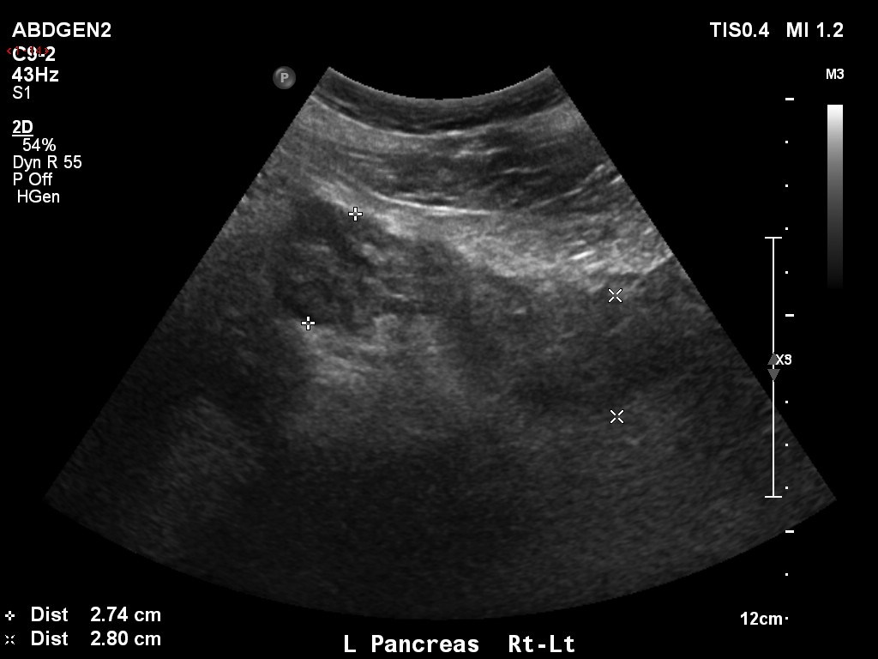
Abdominal Ultrasound 10/30

Slide 15
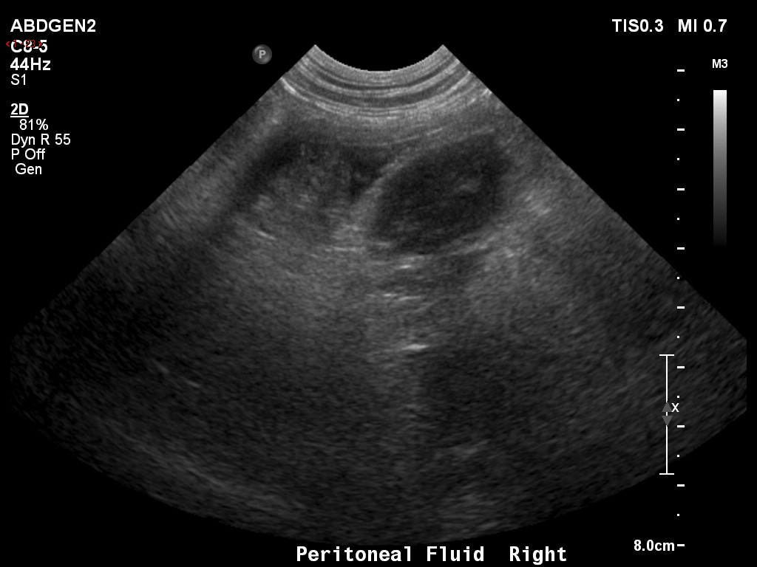
Abdominal Ultrasound 10/30

Slide 16
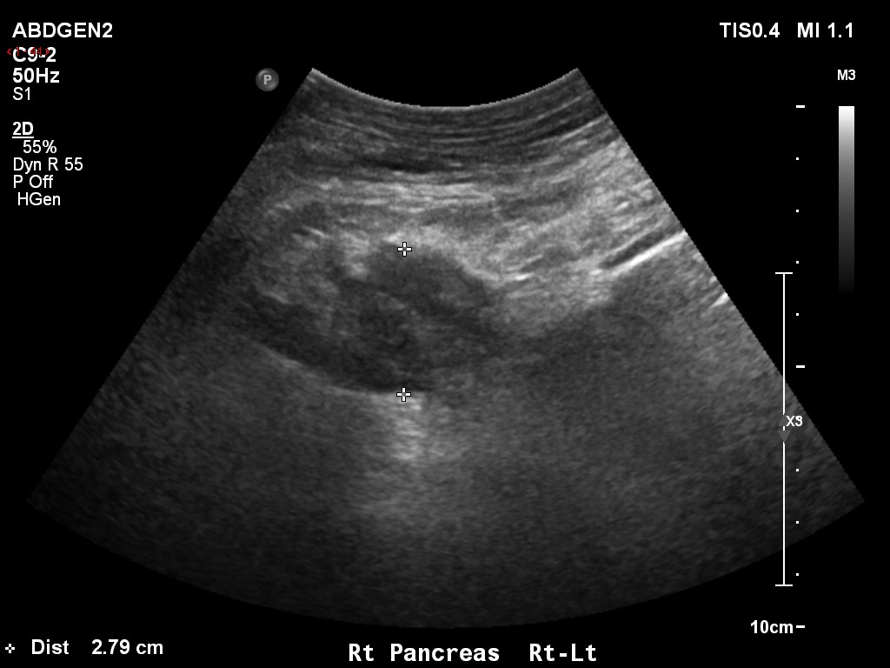
Abdominal Ultrasound 10/30

Slide 17
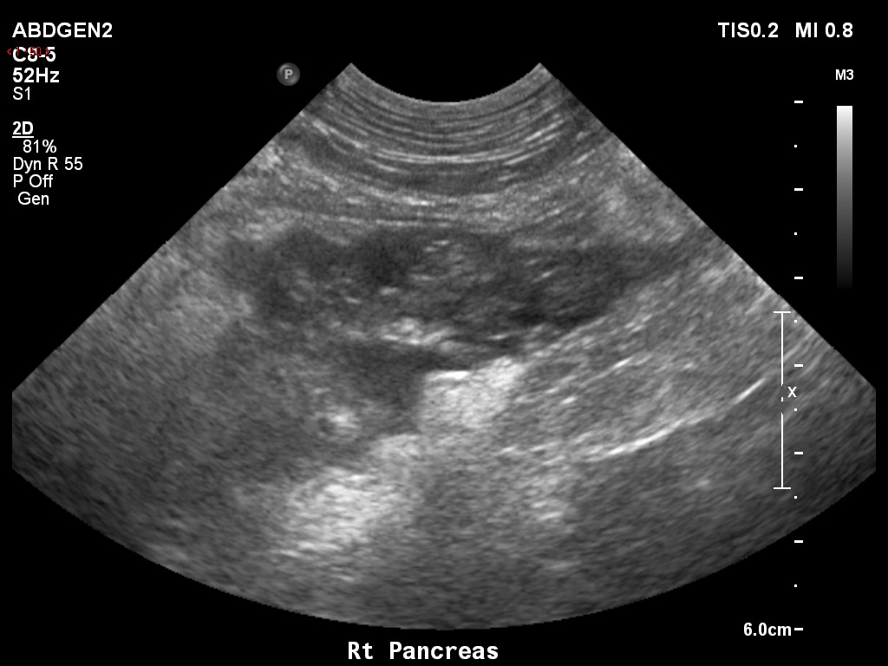
Abdominal Ultrasound 10/30

Slide 18
Initial Therapy
P-Lyte: 1L over 30 minutes (20ml/kg)
Methadone 0.2mg/kg IV
P-Lyte + 15mEq/L KCl 170mls/hr (90mls/kg/hr)
Fentanyl bolus 3ug/kg followed by CRI 3ug/kg/hr
Ondansetron 0.2mg/kg IV q8
Unasyn 30mg/kg IV q8
Metronidazole 10mg/kg IV q12
Notes:
Metronidazole for diarrhea
Unasyn because left shift

Slide 19
6yo FS Labrador
10/29-10/30
Appeared nauseated, regurgitated 3x over 7 hours
Metoclopramide 1mg/kg/day → increased to 2mg/kg/day
HR decreased with fluid therapy
Worsening pyrexia (105.4 at 5am)
Blood pressure increased at 2am 224/135 (193)
Uncomfortable, painful abdomen
Dexmedetomidine 1-1.5mcg/kg/hr
Added Ketamine 5mcg/kg/min
Increased P-Lyte fluid rate (105ml/kg/day) + KCL
Added pantoprazole 1mg/kg IV q24, cerenia 1mg/kg IV q24
Notes:
Added ketamine 8 hours after starting dexemdetomidine CRI

Slide 20
6yo FS Labrador
10/30 am
HR 180; T 106.1C; panting heavily
Abdominal discomfort, mm tacky
Weight gain 46.6kg (1.4kg)
Continued to regurgitate until afternoon
AFAST/TFAST: scant amount of pleural/peritoneal effusion
Could not obtain SpO2
Assumed panting and tachycardia were secondary to pain, +/- hypovolemia
Notes:
Can come back to this

Slide 21
6yo FS Labrador
10/30 am
Central catheter placed into left jugular vein
Aminosyn + 10% dextrose
NG tube placed - custom nutrition slurry into NG tube
  After initially attempting to use clinicare
IV fluids increased*
Fentanyl increased to 3mcg/kg/hr (from 2)
Lidocaine 30mcg/kg/min initiated
Heart rate decreased (120-160bpm)
Notes:
INDICATIONS AND USAGE
Aminosyn II with Electrolytes in Dextrose Injection with Calcium is indicated for central vein infusion in the prevention of nitrogen loss and negative nitrogen balance in cases where (a) the gastrointestinal tract by the oral, gastrostomy or jejunostomy route cannot or should not be used, (b) gastrointestinal absorption of nutrients is impaired or (c) metabolic requirements for protein and calories are substantially increased as with extensive burns and (d) morbidity and mortality may be reduced by replacing amino acids lost from tissue breakdown, thereby preserving tissue reserves, as in acute renal failure. In such patients intravenous feeding for more than a few days would be expected.
The addition of supplemental trace metal additives and multivitamin additives will be in accordance with the prescription of the attending physician.
*Should I have not increased fluids? Art gas or chest rads at this point. Supplement oxygen

Slide 22
Custom Nutrition Slurry
Per Loftus
1 scoop (6.25g protein) Whey protein powder
3 tbs carbogain (maltodextrin)
¼ tsp 1-glutamine
Blenderize with 100mls water + 100mls clinicare
1kcal/ml
7.2g protein/100kcal
2.5g fat/100kcal

Slide 23
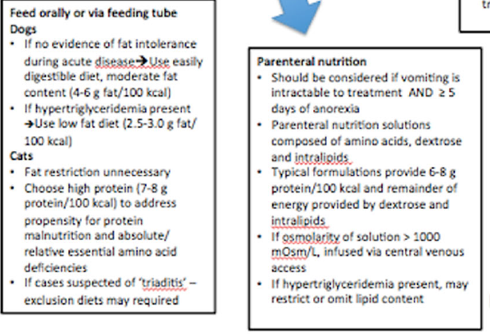
Jensen et al JVECC 2014

Slide 24
Enteral Nutrition
Current standard of care is to initiate EN early, within 24-48 hours of hospitalization, or immediately if the patient has been anorexic for 5 days or longer
Admitted at 6pm and Clinicare CRI @ 1/3 RER attempted 20 hrs later
d/c after she continued to regurgitate
    Metoclopramide 2mg/kg/day initially?
Custom slurry started 8 hrs later (28hrs hospitalization)
  No longer regurgitating
Notes:
NOT recommended to withhold food and water
The argument against early enteral nutrition is based on the notion that feeding stimulates exocrine pancreatic secretion, which could exacerbate AP.

Slide 25
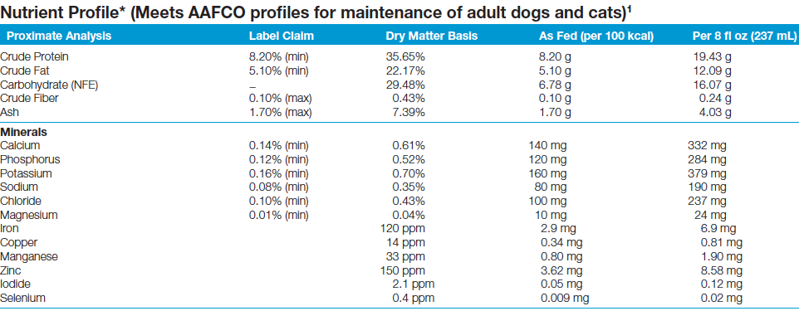
Clinicare composition
Notes:
Too much fat for the hyperlipidemic patients????

Slide 26
Treatment: Enteral vs Parenteral Nutrition
Early enteral feeding is associated with fewer complications compared to parenteral nutrition
  Fewer infections
  Reduced risk of MODS
  Decreased mortality rates
  Reduced duration of hospitalization
  Less expense.
Enteral nutrition attempted first
Notes:
References:
Mansfield, C. Acute Pancreatitis in Dogs: Advances in Understanding, Diagnostics, and Treatment. Topics in Compan An Med 2012;
Mansfield et al. A pilot study to assess tolerability of early enteral nutrition via esophagostomy tube feeding in dogs with severe acute pancreatitis. J Vet Intern Med 2011; 25:419–425;
Silverstein 2013 chp 113; Jensen et al. Nutritional management of acute pancreatitis in dogs and cats. JVECC 2014: 24(3) 2014, pp 240–250

Slide 27
Parenteral Nutrition: Indications
When EN is not well tolerated
Intractable vomiting who has been anorexic for ≥5 days
Patients receiving supplemental EN in addition to PN survived more often than animals who received PN alone
High lipid formulations well tolerated in animals with nonhyperlipidemic pancreatitis.
For hyperlipidemic patients lipid portion should be omitted
Ideal PN solution for dogs with pancreatitis and hypertriglyceridemia is not known
Notes:
Formulating PN diets requires specialized expertise and is limited to referral centers. They are composed of animo acids, dextrose and intralipids. Typical formulations provide 6-8g protein per 100kcal and the remainder of energy is provided through dextrose and intralipid. Commercially available PN solutions for humans are not properly formulated for animals. Temporary or interim solutions such as amino acid and glucose solutions can be used until the animal can tolerate either placement of feeding tube or will eat voluntarily. There is currently no evidence to suggest that high lipid content in PN solutions is detrimental to animals with AP.
Complications of PN include hyperglycemia, hyperlipidemia, azotemia, hypophosphatemia, and mechanical issues associated with administration.

Slide 28
Parenteral Nutrition: Complications and Monitoring
Complications of PN: hyperglycemia, hyperlipidemia, azotemia, hypophosphatemia
Complications of Aminosyn administration: metabolic acidosis and alkalosis, hypophosphatemia, hypocalcemia, osteoporosis, hyperglycemia, hyperosmolar nonketotic states and dehydration, glycosuria, rebound hypoglycemia, osmotic diuresis and dehydration, elevated liver enzymes, hypo- and hypervitaminosis, electrolyte imbalances and hyperammonemia in children
Should we have monitored phosphorous more often?
Notes:
DID NOT MONITOR PHOSPHOROUS
Mansfield, C. Acute Pancreatitis in Dogs: Advances in Understanding, Diagnostics, and Treatment. Topics in Compan An Med 2012
Silverstein 2013 chp 113; Jensen et al. Nutritional management of acute pancreatitis in dogs and cats. JVECC 2014: 24(3) 2014, pp 240–250
Mansfield et al. A pilot study to assess tolerability of early enteral nutrition via esophagostomy tube feeding in dogs with severe acute pancreatitis. J Vet Intern Med 2011; 25:419–425

Slide 29
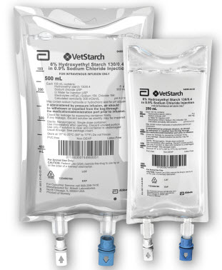
6yo FS Labrador
10/30 pm
Developed hemorrhagic diarrhea, generalized edema, icterus
Urinary catheter placed
Arterial catheter placed
Vetstarch 10ml/kg bolus followed by 2ml/hr CRI
Could not obtain SpO2 reading
Arterial BG showed hypoxemia (pO2 85)
Nasal cannula placed at 10pm, oxygen @ 4L/min
Notes:
Blood pressure at 8pm 108/86 (95)
Nasal cannula placed at 10pm, oxygen @ 4L/min
Heart rate decreased from 160 to 90, then 140 bpm

Slide 30
October | Systolic | Diastolic | MAP | Method
29 18:00 | 160 | 44 | 142 | Cardell
29 20:00 | 197 | 143 | 125 | Cardell
29 22:00 | 197 | 115 | 137 | Cardell
30 2:00 | 224 | 135 | 193 | Cardell
30 8:00 | 174 | 115 | 129 | Cardell
30 12:00 | 173 | 115 | 131 | Cardell
30 14:00 | 164 |  |  | Doppler
30 18:00 | 110 |  |  | Doppler
30 22:00 | 108 | 86 | 95 | Direct BP
31 0:00 | 111 | 58 |  | Direct BP
31 1:00 | 96 | 51 | 61 | Cardell
31 2:00 | 97 | 58 | 71
31 3:00 | 221 | 190 | 205?? | Direct BP
31 4:00 | 106 | 99 | 103 | Direct BP
31 6:00 | 99 | 57 | 77 | Cardell
31 8:00 |  |  |  | Did not record
Notes:
Verify with doppler when noted to be hypertensive????
Should I have interfered when the dog was hypertensive?

Slide 31
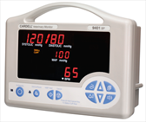
Blood Pressure
Hypertension – should we have interfered earlier?
Pressor type
  Norepinephrine
  Dopamine: in experimental feline model low dose dopamine (5mcg/kg/min) reduced degree of pancreatic inflammation by decreasing microvascular permeability
  No controlled studies in cats or dogs with spontaneous disease
Karanjia et al. Low dose dopamine protects against hemorrhagic pancreatitis in cats. JSR. 1990.
Notes:
Patients that are hypotensive despite adequate volume replacement will need pressor therapy.
STUDY - We hypothesized that low dose dopamine might have beneficial effects on both blood flow and microvascular permeability, thus ameliorating the severity of the disease. We studied its actions in an animal model of HP. In anesthetized cats, intragastric ethanol (20 ml/40% solution) rendered the main pancreatic duct permeable to pancreatic enzymes.
Why ne??
ACCOMPLISHES THREE GOALS
1. Critical Perfusion Pressures (Heart will get better, but may look worse)
2. Increase Venous Return
3. Avoid Gut Ischemia and Flow Reduction
*****Norepi Increases Venous Return as well as Constricting Afterload

Slide 32
Resuscitation fluid
Resuscitation fluid types and rates of administration have not been evaluated in veterinary patients with AP
Preliminary study in human AP suggested that resuscitation with LRS reduced systemic inflammation at 24 hours when compared with normal saline
Wu et al. Lactated Ringer’s Solution Reduces Systemic Inflammation Compared With Saline in Patients With Acute Pancreatitis. CLINICAL GASTROENTEROLOGY AND HEPATOLOGY 2011;9:710–717
Notes:
randomized controlled trial of 40 patients with acute pancreatitis–
Patients received goal-directed fluid resuscitation with lactated Ringer’s solution, goal-directed fluid resuscitation with normal saline, standard fluid resuscitation with LRS, or standard fluid resuscitation with normal saline.
****Systemic inflammation was measured on the basis of levels of systemic inflammatory response syndrome (SIRS) and C-reactive protein (CRP) level after 24 hours
The primary study outcome was systemic inflammation measured clinically as the change in prevalence of SIRS at 24 hours post-randomization. SIRS was defined as the presence of
2 of the following criteria within 4 hours of assessment: pulse 90 beats/min; respirations 20/min or PaCO2 32 mm Hg; temperature 36°C or 38°C; white blood cell count 4000 cells/mm3 or 12,000 cells/mm3 or 10% bands.
The secondary outcome was CRP level at 24 hours. Systemic inflammation is a major intermediate pathway in the development of complications such as organ failure in acute pancreatitis.
Both SIRS and CRP have been established as important early prognostic markers related to mortality in acute pancreatitis.

Slide 33
Colloids and pancreatitis
Should we have started colloids?
Combination of normal saline, HES and glutamine are more efficient in resuscitation of SAP by relieving inflammation and sustaining the intestinal barrier
Pulmonary edema and lung injury score are not affected by type of fluid used (crystalloid or colloid) for treating hypovolemia in septic and nonseptic patients
  Van der Heijden et al. Prospective randomized trial (24 septic and 24 non septic MV patients with hypovolemia
Zhao. Effects of different resuscitation fluid on severe acute pancreatitis. World J Gastroenterol 2013 April 7; 19(13): 2044-2052
Van der Heijden et al. Crystalliod or colloid fluid loading and pulmonary permeability, edema and injury in septic and nonspetic critically ill patients with hypovolemia. Crit Care Med 2009 37(4).
Notes:
120 patients with SAP. The patients were randomly treated with normal saline (NS group), combination of normal saline and hydroxyethyl starch (HES) (SH group), combination of normal saline, hydroxyethyl starch and glutamine (SHG group) in resuscitationUrine lactulose/mannitol (L/M) ratio during 7 d was analyzed to evaluate intestinal permeability as described before
Urine L/M ratio in all three groups increased after administration of SAP. Compared to the NS group, urine L/M ratio in the SH and SHG groups was significantly lower after day 4. serum endotoxin in the NS group was also significantly higher than that in the SH and SHG groups. Nevertheless, serum endotoxin in the SHG group was markedly lower than that in the SH group after day 6
Some research has shown that HES reduces intestinal permeability by modulating inflammatory response and has a promising effect on survival, together with antibiotics
under septic conditions[18]. Although glutamine has been proved to protect the intestinal barrier as a nutrient supplement in nutritional support of SAP, the effects of
glutamine delivered as a supplement in resuscitation fluid in the early stage of SAP have not been defined

Slide 34
6yo FS Labrador
10/31 am
Obtunded, recumbent
Dyspneic, increased work of breathing
Continuous ECG showed sinus tachycardia
AFAST – moderate peritoneal effusion (4/4)
  PCV 2%, T.S 2g/dL
TFAST – B lines, some pleural effusion
Notes:
Respiratory abnormalities – ALI/ARDS, aspiration pneumonia, pleural effusion, PTE, overhydration

Slide 35
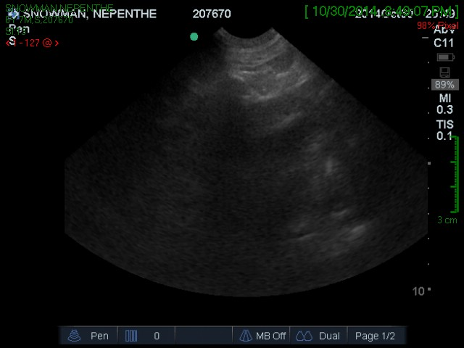
TFAST

Slide 36
6yo FS Labrador
10/31 am
Arterial blood gas (obtained while on oxygen)
  P/F ratio of 257 - acute lung injury
  SpO2 could not be obtained
We discussed prognosis and that mechanical ventilation was required

Slide 37
 | 10/29 17:12 | 10/29 21:39 | 10/30 7:52 | 10/30 8:35 | 10/30 14:56 | 10/30 19:41 | 10/30 20:07 | 10/30 21:25 | 10/30 23:46 | 10/31 3:42 | 10/31 6:10 | 10/31 7:31
pH | 7.365 | 7.354 | 7.404 | 7.433 | 7.345 | 7.361 | 7.365 | 7.333 | 7.365 | 7.181 | 7.084 | 7.073
pCO2 | 32.2 | 36.4 | 25.3 | 18.9 | 30.9 | 16.9 | 18.5 | 26.1 | 22.5 | 39.9 | 58 | 54.2
HCO3 | 18 | 19.8 | 15.5 | 12.3 | 16.5 | 9.4 | 10.3 | 13.5 | 12.6 | 14.6 | 17 | 15.5
BE | -7.4 | -5.7 | -9.3 | -11.9 | -9.2 | -16.1 | -15 | -12.3 | -12.8 | -13.8 | -13 | -14.6
AG | 23.8 | 17.1 | 21.2 | 23.4 | 17.8 | 23.4 | 21.6 | 18 | 16.3 | 18 | 14.2 | 16
Na | 152.6 | 152.2 | 154.5 | 156 | 153.1 | 153.1 | 153.2 | 151.9 | 150.9 | 153.5 | 151.5 | 150
K | 4.2 | 3.76 | 4.15 | 3.7 | 4.19 | 3.65 | 3.69 | 3.67 | 4.01 | 4.11 | 4.69 | 5.43
Ca | 1.27 | 1.26 | 1.28 | 1.33 | 1.21 | 1.23 | 1.28 | 1.1 | 1.3 | 1.32 | 1.32 | 1.3
Cl | 115 | 119 | 122 | 124 | 123 | 124 | 125 | 124 | 126 | 125 | 125 | 124
Glu | 120 | 110 | 92 | 82 | 76 | 76 | 71 | 81 | 93 | 61 | 76 | 76
Hct | 53 | 49 | 58 | 57 | 51 | 48 | 48 | 40 | 46 | 43 | 43 | 43
pO2 |  |  |  |  |  | 88.8 | 79.3 | 108.8 | 131.1 |  |  | 99.4
O₂Sat |  |  |  |  |  | 97.1 | 95.7 | 97.7 | 99.5 |  |  | 94.5
P:F |  |  |  |  |  | 240 | 214 | 294 | 354 |  |  | 269
Lact | 1.3 |  |  | 2.2 |  |  | 4.9 | 2.8 | 1.9 | 3.8 | 2.1
PCV | 48 | 44 | 50 | 45 |  |  | 41 |  |  |  | 40
TS | 8 | 7 | 6.4 | 4.8 |  |  | 5 |  |  |  | 4.2
Notes:
pO2 95-109
O2sat 94-100
Azp always 5-15
Corrected chloride >120 in purple
Considering nasal O2 at 40%

Slide 38
10/31 am
At this point owner elected humane euthanasia.
30 minutes later
Respiratory arrest → intubation
Euthanized

Slide 39
Post Mortem
Acute necrotizing pancreatitis with extensive necrosis of the surrounding adipose
Changes in liver and lung (including acute interstitial pneumonia), and heart are consistent with a systemic inflammatory state and shock
Additional findings include chronic infarction in the kidney and nodule hyperplasia in the spleen

Slide 40
Post Mortem
Histologic Diagnosis
Lung: mild multifocal acute suppurative interstitial pneumonia and edema
Heart: mild, focal, acute myocardial hemorrhage
Spleen: nodular hyperplasia, moderate congestion with fibrin and edema
Kidney: moderate, multifocal, subacute centrilobular congestion with hepatocellular degeneration and necrosis
Pancreas: severe, diffuse, acute, necrotizing pancreatitis with peripancreatic and mesenteric steatitis

Slide 41
Post Mortem
Histologic Description
Lung
  Multifocally, alveoli are filled with pale eosinophilic fluid and foamy macrophages or dense sheets of degenerate neutrophils
  Large airways are unaffected
Heart
  Connective tissues of endocardium and 1/3 of the width of the ventricular myocardium are expanded by free erythrocytes and pale eosinophilic fluid
Notes:
ARDS/ALI is clinical rather that histologic diagnosis

Slide 42
Post Mortem
Histologic Description
Spleen
  Diffusely congested with areas of fibrin accumulation and edema
Pancreas
  Diffusely replaced by hypereosinophilic cells with pyknotic to karyolytic nuclei that retain tissue architecture (coagulative necrosis), edema, and hemorrhage

Slide 43
Treatment
FFP
Against
Weatherton and Streetor reported no benefit
  Mortality rates dogs treated with plasma were higher
  Evidence of SIRS and presence of coagulopathy were not significantly different between groups
Cost
Transfusion reactions
Risk of volume overload
In Support
No prospective controlled studies
To provide a source of α2-macroglobulins, protease inhibitors that may help decrease activated circulating proteases.
Provide coagulation factors
Provide source of albumin (a poor choice)
Weatherton and Streeter. Evaluation of fresh frozen plasma administration in dogs with pancreatitis: 77 cases (1995-2005). JVECC 2009;19(6):617-622;
Mansfield, C. Acute Pancreatitis in Dogs: Advances in Understanding, Diagnostics, and Treatment. Topics in Compan An Med 2012; 27:123-132; Silverstein 2013 chp 113;
Notes:
Between groups that did and did not receive FFP
In support: Further investigation is required to make appropriate decision regarding the use of FFP in the treatment of AP.
References:
Silverstein 2013 chp 113;
Weatherton and Streeter. Evaluation of fresh frozen plasma administration in dogs with pancreatitis: 77 cases (1995-2005). JVECC 2009;19(6):617-622;
Mansfield, C. Acute Pancreatitis in Dogs: Advances in Understanding, Diagnostics, and Treatment. Topics in Compan An Med 2012; 27:123-132

Slide 44
Treatment: Broad Spectrum Antibiotics
Against
Risk of inducing resistant bacterial strains and fungal infections
Pancreatic infection has only been rarely documented in dogs with naturally occurring AP
  Contrast to what has been demonstrated in humans
In Support
Reasonable for patients that do not respond to other therapy
Indicated for those that initially respond, however, later deteriorate
Patients with other or distant potentially related infections
  e.g. pneumonia.
Patients with suspected GI bacterial translocation
Notes:
In Nepenthe’s case she had evidence of GI bacterial translocation – hemorrhagic diarrhea
References:
Silverstein 2013 chp 113;
Holm et al. Acute Pancreatitis in Dogs. JVECC 2003; 13(4):201-213;
Weese et al. Antimicrobial Use Guidelines for Treatment of Urinary Tract Disease in Dogs and Cats: Antimicrobial Guidelines Working Group of the International Society for Companion Animal Infectious Diseases Veterinary Medicine International. Volume 2011, Article ID 263768, 9 pages doi:10.4061/2011/263768

Slide 45
Treatment: Surgery
Surgery is not indicated for most cases involving sterile pancreatic necrosis.
Indications
  Infected pancreatic necrosis
  Local complications such as abcessation or extrahepatic biliary obstruction
  Diagnostic confirmation of neoplastic disease
  Continued deterioration despite aggressive medical therapy
Silverstein 2013 chp 113; Mansfield, C. Acute Pancreatitis in Dogs: Advances in Understanding, Diagnostics, and Treatment. Topics in Compan An Med 2012; 27:123-132; Holm et al. Acute Pancreatitis in Dogs. JVECC 2003; 13(4):201-213;
Thompson et al. Characteristics and outcomes in surgical management of severe acute pancreatitis: 37 dogs (2001-2007). JVECC 2009; 19(2):165–173; Son et al. Surgical intervention in the management of severe acute pancreatitis in cats: 8 cases (2003-2007). JVECC 2010;20(4):426–435
Notes:
References:
Silverstein 2013 chp 113; Mansfield, C. Acute Pancreatitis in Dogs: Advances in Understanding, Diagnostics, and Treatment. Topics in Compan An Med 2012; 27:123-132;
Holm et al. Acute Pancreatitis in Dogs. JVECC 2003; 13(4):201-213;
Thompson et al. Characteristics and outcomes in surgical management of severe acute pancreatitis: 37 dogs (2001-2007). JVECC 2009; 19(2):165–173;
Son et al. Surgical intervention in the management of severe acute pancreatitis in cats: 8 cases (2003-2007). JVECC 2010;20(4):426–435

Slide 46
Treatment: Surgery
High mortality rate (> 50%) reported regardless of the technique used
  Spontaneous resolutions of acute fluid collections in the veterinary literature have been reported
  Good responses to percutaneous drainage (Mansfield)
Most studies show no benefit to surgery in cases of sterile necrosis (Holm)
Mansfield, C. Acute Pancreatitis in Dogs: Advances in Understanding, Diagnostics, and Treatment. Topics in Compan An Med 2012; 27:123-132
Holm et al. Acute Pancreatitis in Dogs. JVECC 2003; 13(4):201-213
Notes:
Noninvasive methods are preferable for managing fluid accumulation secondary to pancreatitis
References:
Silverstein 2013 chp 113; Mansfield, C. Acute Pancreatitis in Dogs: Advances in Understanding, Diagnostics, and Treatment. Topics in Compan An Med 2012; 27:123-132;
Holm et al. Acute Pancreatitis in Dogs. JVECC 2003; 13(4):201-213;
Thompson et al. Characteristics and outcomes in surgical management of severe acute pancreatitis: 37 dogs (2001-2007). JVECC 2009; 19(2):165–173;
Son et al. Surgical intervention in the management of severe acute pancreatitis in cats: 8 cases (2003-2007). JVECC 2010;20(4):426–435

Slide 47
Treatment: Surgery
Retrospective study reported surgery with aggressive postop care may be pursued in select dogs with AP
  Depends on the extent of pancreatic pathology found (including infection of tissue, biliary obstruction pancreatic abscess) or the need for histologic confirmation
May be associated with a good prognosis in dogs with extrahepatic biliary obstruction, pancreatic necrosis/abscess secondary to AP
  A more guarded prognosis was reported in dogs that underwent surgery with pancreatic abscess formation.
Thompson et al. Characteristics and outcomes in surgical management of severe acute pancreatitis: 37 dogs (2001-2007). JVECC 2009; 19(2):165–173;
Notes:
References:
Silverstein 2013 chp 113; Mansfield, C. Acute Pancreatitis in Dogs: Advances in Understanding, Diagnostics, and Treatment. Topics in Compan An Med 2012; 27:123-132;
Holm et al. Acute Pancreatitis in Dogs. JVECC 2003; 13(4):201-213;
Thompson et al. Characteristics and outcomes in surgical management of severe acute pancreatitis: 37 dogs (2001-2007). JVECC 2009; 19(2):165–173;
Son et al. Surgical intervention in the management of severe acute pancreatitis in cats: 8 cases (2003-2007). JVECC 2010;20(4):426–435

Slide 48
Treatment: Surgery
Cats with extrahepatic biliary obstruction secondary to severe AP may have a good prognosis (Son)
Holm et al. Acute Pancreatitis in Dogs. JVECC 2003; 13(4):201-213;
Thompson et al. Characteristics and outcomes in surgical management of severe acute pancreatitis: 37 dogs (2001-2007). JVECC 2009; 19(2):165–173;
Son et al. Surgical intervention in the management of severe acute pancreatitis in cats: 8 cases (2003-2007). JVECC 2010;20(4):426–435
Notes:
References:
Silverstein 2013 chp 113; Mansfield, C. Acute Pancreatitis in Dogs: Advances in Understanding, Diagnostics, and Treatment. Topics in Compan An Med 2012; 27:123-132;
Holm et al. Acute Pancreatitis in Dogs. JVECC 2003; 13(4):201-213;
Thompson et al. Characteristics and outcomes in surgical management of severe acute pancreatitis: 37 dogs (2001-2007). JVECC 2009; 19(2):165–173;
Son et al. Surgical intervention in the management of severe acute pancreatitis in cats: 8 cases (2003-2007). JVECC 2010;20(4):426–435

Slide 49
Treatment:
Immunomodulation of Pancreas
Glutamine – amino acid
The pancreas has the highest turnover of glutamine in the body.
  Prevents atrophy of pancreatic acinar cells
  Improved pancreatic exocrine function
  Improved outcomes following critical illness.
In human trials, patients treated with glutamine-enriched PN solutions demonstrated significant decreases in CRP, decreased dependence of PN, reduced infectious complications, and reduced hospitalization time.
Not currently supplemented in veterinary formulations.
Mansfield, C. Acute Pancreatitis in Dogs: Advances in Understanding, Diagnostics, and Treatment. Topics in Compan An Med 2012; Jensen et al. Nutritional management of acute pancreatitis in dogs and cats. JVECC 2014: 24(3) 2014, pp 240–250

Slide 50
Treatment:
Immunomodulation of Pancreas
Inhibition of NF-κB activity attenuated AP-associated injuries in the pancreas and lungs
  Amobarbital
  Pyrrolidine dithiocarbamate (NF-κB activity inhibitor)
NF-κB regulates the transcription of many genes involved in inflammatory responses, such as TNF-α, IL-1β and IL-6
TNF-α blockade with anti-TNF-α antibodies or soluble TNF-α receptors was able to decrease the severity of AP and reduce the associated mortality rate by prohibiting the effect of TNF-α
Notes:
Theoretically, the modulation of immunocytes and inflammatory mediators may be able to prevent overactive immune reactions and to alleviate inflammatory injuries;
Blocking these inflammatory pathways (Figure1), moderately and at the appropriate time, may be an effective treatment for AP.

Slide 51
Treatment:
Immunomodulation of Pancreas
IL
Endothelin
Platelet activating factor
Mostly in experimental animal models
Li et al. Immunomodulatory therapies for acute pancreatitis. World J Gastroenterol 2014 December 7; 20(45)

Slide 52
Complication: Short Term
Acute Lung Injury – incidence unknown
  Pathogenesis linked to platelet activating factor
  PLA-2, tumor necrosis factor alpha and interleukin-1
Acute kidney injury
Acute fluid accumulation within pancreatic parenchyma
DIC, cardiac arrhythmias
  Mediated by the many systemic inflammatory cascades initiated by acute pancreatitis
Notes:
Acute kidney injury
hypovolemia, ischemia, intravascular coagulopathy and direct inflammation resulting from peritonitis. Nuclear factor kappa B activation may cause aggregation of activated neutrophils in the glomeruli. Endotoxin released during intestinal ischemia may also promote renal vasoconstriction.
Acute fluid collections within the pancreatic parenchyma. In humans acute fluid accumulations develop in the first 6 weeks after a bout of acute pancreatitis.

Slide 53
Questions
Start metoclopramide at 2mg/kg/day initially?
  Instead of 1mg/kg/day
Hypertension – should we have interfered earlier?
Should we use a different type of liquid diet?
  Ensure?
Should phosphorous have been monitored more closely?
Changing antibiotic choice?
Indication for colloids? Use of colloids in pancreatitis?
FFP in pancreatitis and other treatment options?

Slide 54
Ensure Original
Amount Per Serving % DV* % RDI
Characteristics
Fat, % Cal: 25
Carbohydrate, % Cal: 58
Nutrient Data
Calories: 220; Calories from Fat: 50
Fat, g: 6
Sodium, mg: 200
Potassium, mg: 370
Carbohydrate, g: 32 Dietary Fiber, g: <1
Sugars, g: 15
Protein, g: 9

Slide 55
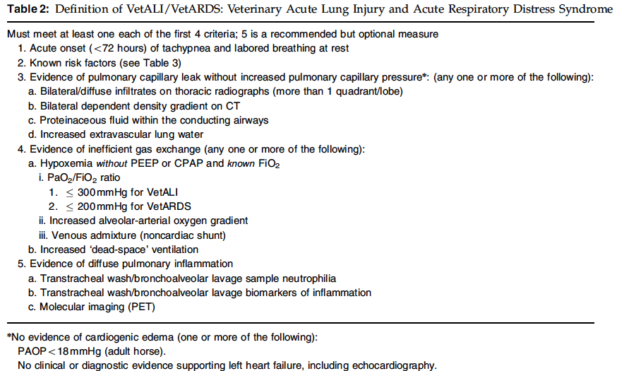

Slide 56
