Slide 1
Seizures and Anticonvulsants
Josh Smith DVM

Slide 2
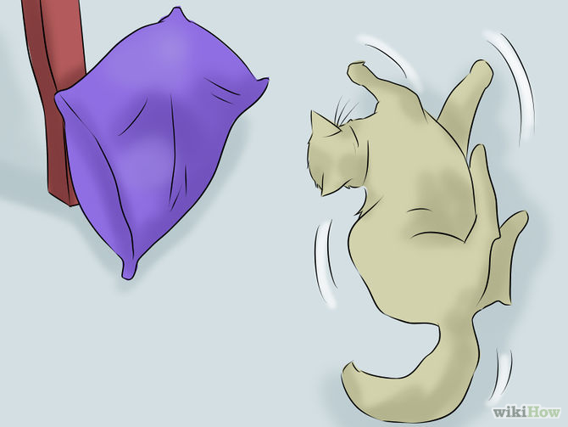
Seizures
Extremely complicated
Much to understand
Many mechanisms
Resources

Slide 3



Resources

Slide 4
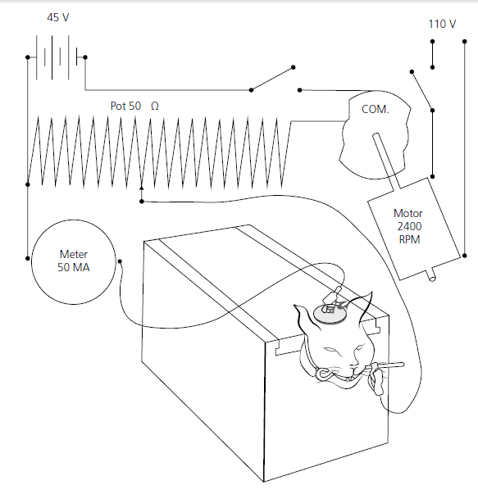
The cat electrocution apparatus

Slide 5
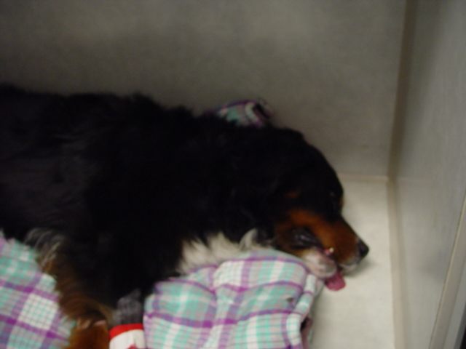
Definitions
Seizure (convulsion, ictus, fit)
  Clinical manifestation of excessive or hypersynchronous neuronal discharges in the brain
    Impairment or loss of consciousness
    Abnormal motor activity
    Sensory disturbances
    Autonomic signs

Slide 6
Definitions
Status epilepticus
  Continuous seizure activity for greater than 5- 10 minutes or repeated seizure activity without recovery of consciousness (or baseline neurologic function)
  20-30 minutes reported for permanent injury
Cluster seizures
  2 or more seizures within a 24 hour period

Slide 7
Types of seizures - generalized
Tonic
  Sustained, increased muscle contraction, the animal usually becomes recumbent in this phase
Myoclonic
  Sudden, brief, involuntary, single or multiple contractions of muscles or muscle groups
Clonic
  Regularly repetitive myoclonus, which involves the same muscle groups, and is prolonged
Atonic
  Sudden loss of muscle tone, usually lasting 1–2 seconds or more

Slide 8
The seizure
The ictal event usually lasts for 60–90 second
Should this event last for longer than 5 minutes, then it is termed status epilepticus
The event should be peracute in its onset and stereotypical
  (i.e. its characteristics are identical each time it occurs)
Most ictal events also have no identifiable precipitating event, occurring most commonly from sleep or at rest
This distinguishes seizure activity from narcolepsy/cataplexy, which is precipitated by excitement, and from syncope and neuromuscular collapse, which are precipitated by activity

Slide 9
Stages of seizure activity
The prodrome
  A behavioural phenomenon that precedes the onset of a seizure by hours to days and is manifested by hiding, restless activity or fearful behaviour
An aura
  A subjective sensation that marks the onset of a seizure
  Obviously difficult to recognize in dogs and cats unless it is presumed that vomiting, salivation or inappropriate urination seen prior to an obvious seizure event is classed as the aura

Slide 10
Stages of seizure activity
The ictus
  The seizure event itself
The post-ictal period
  Characterized by atypical behaviour that immediately follows the seizure
  The behaviour seen may include restlessness, aggression, delirium, lethargy, confusion, visual loss, thirst, hunger and inappropriate urination
  This may last for hours in some animals regardless of the underlying cause of the seizure

Slide 11
Seizures by etiology
Idiopathic seizures
  The term idiopathic implies a suspected genetic basis for the seizure activity for which the underlying disorder is frequently suspected to be a transient functional or neurochemical abnormality
  There are no identifiable structural abnormalities of the forebrain

Slide 12
Seizures by etiology
Symptomatic seizures
  This term is often used to describe seizures resulting from a structural intracranial cause (e.g. brain tumours, inflammation or hydrocephalus) which causes structural damage to the forebrain
  A seizure focus that is not compatible with an idiopathic origin, but is not readily identifiable as a structural defect on MRI and CSF analysis, is referred to as cryptogenic

Slide 13
Seizures by etiology
Reactive seizures
  This term is often used to describe seizures resulting from an extracranial cause and includes metabolic and toxic disorders
  These ultimately cause seizure activity due to secondary interference with cerebral metabolism or, more directly, as primary neurotoxic insults
  There are no identifiable structural abnormalities of the brain, but the functional impairment is global and exists as long as the etiology exists

Slide 14
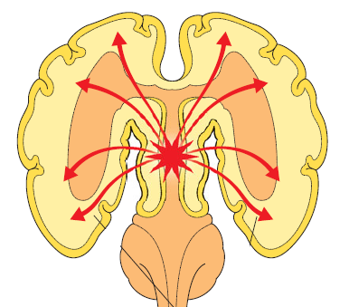
Types of seizures - generalized
Generalized seizures indicate involvement of both cerebral hemispheres simultaneously
Consciousness is often impaired and motor manifestations are bilateral
Generalized seizures may have one or several phases, with a combination of tonic–clonic being most common

Slide 15
Types of seizures - generalized
Tonic:
  Sustained, increased muscle contraction
Myoclonic
  Sudden, brief, involuntary, single or multiple contractions of muscles or muscle groups
Clonic
  Regularly repetitive myoclonus, which involves the same muscle groups, and is prolonged
Atonic
  Sudden loss of muscle tone, usually lasting 1–2 seconds or more

Slide 16
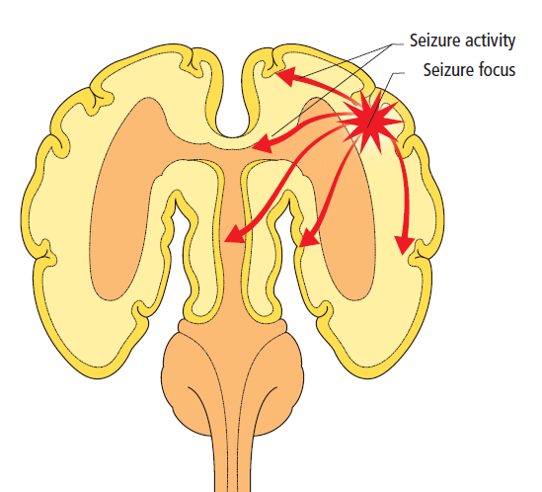
Types of seizures - focal
A focal seizure is due to initial activation of only one part of one cerebral hemisphere or specific region in the forebrain, such as the hippocampus
Compared with dogs, cats more commonly exhibit focal seizures
If there is an alteration in the animal’s awareness during the event, it is called a complex focal seizure (previously termed psychomotor seizures).

Slide 17
Types of seizures - focal
Focal motor seizures
  1) Elementary motor events, which consist of a single type of stereotyped contraction of a muscle or group of muscles
  2) Automatisms - movements that resemble voluntary motor movements and include chewing activity and rhythmic contractions of a single limb
  Consciousness is often unaffected during focal motor seizure activity, but it is difficult to assess whether this is the case in many patients

Slide 18

Types of seizures - focal
Focal sensory seizures
  These are behavioural seizures involving the limbic system
  They may present as rage, aggression without provocation, flycatching, running in circles, floor licking, vocalization and tail chasing
  An aura that does not evolve into loss of consciousness is a focal sensory seizure

Slide 19
Types of seizures - focal
Focal autonomic seizures
  These seizures are apparently rare and cause predominantly autonomic signs such as vomiting, diarrhea and abdominal pain
  A syndrome characterized by drooling, dysphagia and painful enlargement of the mandibular salivary glands is probably a form of focal autonomic seizure
Types of seizures - focal

Slide 20

Types of seizures - focal
A seizure may start focally and ultimately spread throughout both cerebral hemispheres, resulting in secondary generalization
  The owner may not notice until the animal has exhibited several such events

Slide 21
Focal vs Generalized Seizures
Sometimes not clear-cut
Focal seizures often very difficult to control, not as severe as generalized
Both occur as part of idiopathic epilepsy

Slide 22
may be Confused with Seizures
Syncope
Episodic neck pain (cervical disks)
Head tremors
Generalized tremors
Movement disorders/dyskinesia
Vestibular episodes
Behavioural disorders

Slide 23
Neuroanatomical basis
An epileptic seizure definitively implies a disorder of the forebrain (Prosencephalon)
Underlying causes and subsequent investigations are vastly different from those considered for cardiovascular and neuromuscular ‘events’
Extracranial or intracranial

Slide 24
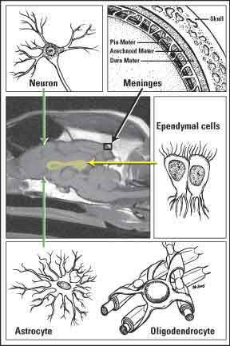
Neuroanatomical basis
Intracranial causes may be further subdivided
  Functional disorders - where no gross structural changes are evident in the brain and the cause is probably a neurochemical dysfunction
  Structural disorders - where there is a gross structural cause within the brain [e.g. a brain tumour or hydrocephalus

Slide 25
Extracranial
Liver failure
Hypoglycemia
Hypocalcemia
Rapid sodium changes
Thiamine deficiency
Toxicities – lead, organophosphates, ethylene glycol, bromethalin, methylxanthines,
Hypertension

Slide 26
Pathophysiology of seizures
Irrespective of cause the epileptic seizure always reflects abnormal hypersynchronous electrical activity of neurons in the forebrain
Seizures are linked to membrane potentials, ionic fluxes and action potential generation
Seizure activity is ultimately due to an imbalance between excitation and inhibition, with increased excitation or decreased inhibition leading to epileptiform activity in the brain

Slide 27
Pathophysiology of seizures
Maintenance of membrane potential and transient changes in ion flux culminate in the generation of an action potential
  Dependent on the tight regulation of Na+, K+ Cl- and Ca2+
Changes or abnormalities in the regulation or activity of these ions could have a dramatic impact on the excitability and ‘epileptogenicity’ of individual neurons
Seizure propagation may be especially likely in neurons with intrinsic firing (bursting) abilities (such as those in the cortex and hippocampus) if the balance between excitatory or inhibitory inputs is altered

Slide 28
Pathophysiology of seizures
In the absence of appropriate inhibitory regulation, these populations of neurons may begin to fire synchronously, leading to a seizure
It is hypothesized that a population of neurons within an epileptic focus in the cortex undergoes paroxysmal synchronous depolarization, termed a paroxysmal depolarizing shift (PDS)
Results in an abnormal burst of action potentials that continue in synchronous volleys without appropriate inhibition

Slide 29
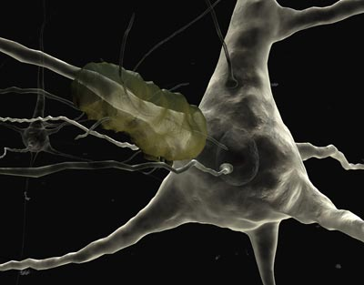
Pathophysiology of seizures
A neuronal action potentials result from the action of neurotransmitters
  Glutamate and GABA
Abnormalities of these neurotransmitters and their receptors have been implicated in the generation of seizures
Glutamate is the main excitatory neurotransmitter and GABA is the main inhibitory neurotransmitter in the brain

Slide 30
Pathophysiology of seizures
Normally, the excitatory post-synaptic potentials in neurons are followed immediately by inhibitory transmission due to GABA
If excitatory mechanisms dominate neurons become hypersynchronized, capturing more and more neurons and generating an epileptic seizure
Perpetuation of the seizure activity is possibly due to a vicious cycle whereby glutamate initiates widespread neuronal excitement, which can lead to neuronal damage and death, which contributes to further glutamate release

Slide 31
Pathophysiology of seizures
The neurotoxic effects of glutamate stem in part from alterations in Ca++ permeability
Results in an increase in intracellular Ca++ levels
Induce a cascade of Ca++-dependent intracellular events
  Activation of proteases and lipases, influx of other cations, such as sodium, and osmotic swelling of neurons that culminates in cell death
Responsible for the seizure-induced excitotoxicity present in prolonged seizures and ultimately enlarge the seizure focus, potentiating more frequent and severe seizures, such as status epilpeticus and clustering

Slide 32
Pathophysiology of seizures
Studies in idiopathic epileptic dogs have confirmed there to be significantly less GABA and more glutamate in the CSF compared with normal controls
The mechanisms responsible for the ‘arrest’ of seizure activity are poorly described, but supposedly relate to the accumulation of lactic acid during the seizure
A breakdown in the mechanisms of seizure arrest, in addition to the evolution of seizure-induced excitotoxicity, forms the basis of the pathophysiology of status epilepticus

Slide 33
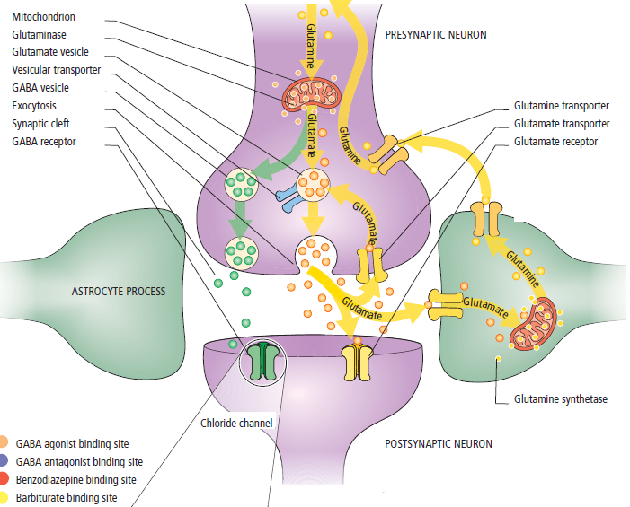
Pathophysiology of seizures

Slide 34
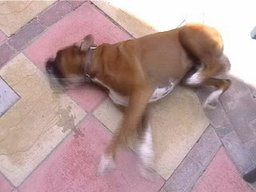
Diagnosis of Idiopathic Epilepsy (IE) in Dogs and Cats
Diagnosis of Exclusion
Characteristic Signalment
Characteristic History
Advanced Imaging Results
CSF Findings

Slide 35
sIGNALMENT
Certain breeds predisposed, but any dog can get IE
Age of first seizure typically 1-5 years, but this is not absolute (juvenile and late-onset)
Males and females affected

Slide 36
History
Seizures are always “acute onset”
Should describe as recent onset vs chronic
Most IE dogs seizure while at rest-early mornings and evenings

Slide 37
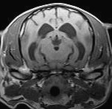
Advanced Imaging Results
MRI preferred imaging modality
CT a poor second choice for ruling out other brain disorders
MRI provides superior soft tissue detail
CT mainly used for bone detail, acute hemorrhage, post-op implant assessment
Main decision for owners is whether or not to pursue MR imaging

Slide 38
Diagnosis of IE: CSF Findings
Typically unremarkable
Variable based on time from last seizure
Often not pursued during workup

Slide 39
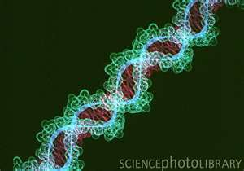
Genes and Epilepsy
Known genetic epilepsies
  Lagotto Romagnolo – LGI2
  Min Wire Haired Dachshund – EPM2B
  English Setter – CLN8
  Border Collie - CLN5
  American Bulldog – CTSD
  Dachshund – TPP1
  Am Staff Terrier – ARSG
  Australian Shepherd – CLN6
  Tibetan Terrier ATP13A2
  Belgian Shepherd – ADAM23

Slide 40
Epidemiology
Dogs prevalence is between 0.5 – 5 %
Highest prevalence of domesticated species
Much higher in specific breeds
  Specific Belgian Shepherd family – 33%
  Belgian Tervurens – 9.3%
Cats prevalence is 2-4%

Slide 41
When to start treatment
Absolute
  Any seizure secondary to trauma
  After any episode of status epilepticus
  Multiple seizures in a short period of time (i.e., clusters)
  Any seizure secondary to a known or highly suspected cause (tumour, encephalitis, etc.)
  A trend toward increased frequency or severity of seizures
  Excessive or prolonged postictal deficits

Slide 42
When to start treatment
Recommended
  Seizures occurring more than once every 4–6 weeks
  Significant emotional stress on family members
  Tendency toward trauma or multiple ER visits
  “Threats” of euthanasia
  Attacks by other dogs in family or “stress” to other pets

Slide 43
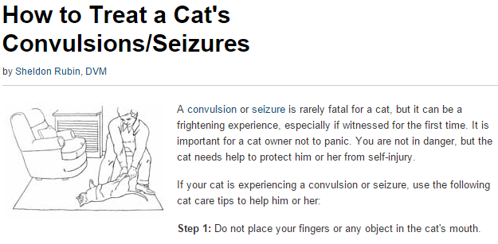
Treating seizures

Slide 44
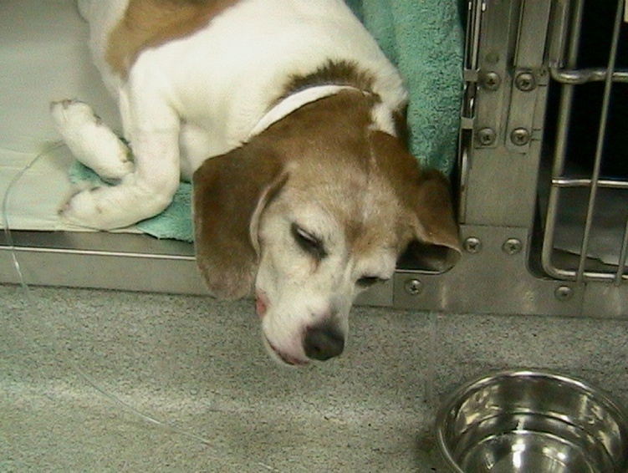
Review of Anticonvulsant Drugs
Phenobarbital
Potassium bromide
Gabapentin
Felbamate
Zonisamide
Levetiracetam
Pregabalin

Slide 45
Phenobarbital
Initial drug of choice in cats
One of two first-choice drugs in dogs
Longest history of use in vet med
MOA:
  Enhanced GABA activated Cl conductance
  Reduced current through Ca channels
  Reduced glutamate-mediated excitation

Slide 46
Phenobarbital
Metabolism
  1/3 unchanged in urine
  Liver via p-450 enzymes
  Induces upregulation of P-450 enzymes
Side effects
  Sedation, ataxia – usually improve in 1-2 weeks
  PU/PD/PP
  Blood dyscrasia and liver toxicity are rare
  Superficial necrolytic dermatitis, facial pruritus
  Elevated ALP
  Decreased T4/fTF and increases TSH – consider thyroid testing before starting treatment

Slide 47
Phenobarbital
Starting dose: 3-5 mg/kg BID dogs
  2.5 mg/kg BID cats
Steady state in 10-14 days
Check levels in 2 weeks
  Goal is 20-35 mcg/ml
  More side effects if above this
Monitor CBC/Chem and levels serially
Can be loaded by giving 16-20 mg/kg over 24 hours

Slide 48
Bromide (Potassium or Sodium)
Second initial drug of choice for dogs
Do NOT use in cats – asthma like signs
Capsules may cause mucosal irritation
MOA:
  Hyperpolarizes neuronal membranes after crossing Cl channels

Slide 49
Bromide (Potassium or Sodium)
Metabolism:
  Renally excreted
Side-effects
  Ataxia, weakness, lethargy, stiffness, PU/PD/PP, hyperactivity, pruritic skin rash
  Rarely cough, pancreatitis, and GI intolerance
  Will increase Cl level on chemistry
  High Cl diets (or changing diet) can alter excretion and result in seizures

Slide 50
Bromide (Potassium or Sodium)
Starting dose is 15-40 mg/kg SID
  If using NaBr decrease dose by 15%
Steady state in 80-120 days
Levels 1 week after loading or 3 months
  Target 1-3 mg/mL as sole agent, 1-2 mg/mL with phenobarb
Loading:
  24 hours – 400-600 mg/kg divided, requires hospitalization
  5 days – give 90 mg/kg/d in addition to maintenance dose of 35 mg/kg – divide BID to aoid GI upset

Slide 51
Benzodiazepines
Midazolam, Diazepam, Lorazepam have been used in dogs/cats
MOA:
  Interact with specific benzodiazepine receptor in CNS to activate the GABAa Cl channel which hyperpolarizes neurons

Slide 52
Benzodiazepines
Cannot be used long-term
  Antiseizures activity is very short lived
  Can increase hepatic enzyme inhibition
  Physical dependence
  Tolerance will prevent effective use IV to stop seizures in an emergency
  Severe rebound seizures if drug is withdrawn after chronic use

Slide 53
Benzodiazepines
Metabolism
  Liver
Side-effects
  Sedation, ataxia
  Oral diazepam in cats may cause hepatic necrosis

Slide 54
Benzodiazepines
Diazepam
  0.25-1 mg/kg IV, up to 3 doses
  Can give rectally or intranasaly (dogs)
Midazolam
  0.1 – 0.3 mg/kg
  IV, IM, intranasal (dogs). NOT rectally

Slide 55
Benzodiazepines
Clorazepate
  Long acting oral benzo that is a diazepam prodrug
  May be used in dogs/cats
  Tolerance can develop
  Can increase phenobarb concentrations
  May cause hepatotoxicity
  Useful in refractory epileptics

Slide 56
Felbamate
Dicarbamate
May be used as an add-on drug
MOA:
  Interfers with voltage-gated sodium channels
  Antagonizes NMDA-preferring glutamate receptors
  Interfers with glycine binding

Slide 57
Felbamate
Metabolism:
  30% metabolized in the liver
  Excreted in urine
Side-effects
  Uncommon, non-sedating
  Increased risk of liver dysfunction especially if on other hepatotoxic meds
  Blood dyscrasia, KCS, termors in small dogs

Slide 58
Felbamate
Starting dose is 15mg/kg every 8-12 hours
  Increase in 15 mg/kg increments every 2 weeks until seizures controlled
  Toxic dose is 300 mg/kg/d
Broad therapeutic levels - $$$
  Routine monitoring of levels not needed
Monitor CBC and chemistry

Slide 59
Gabapentin/Pregabalin
Structural analogues of GABA
Possible add-on drug
MOA:
  Does not involve GABA or its receptors
  Inhibition of voltage gated Calcium channels – α2∂ subunit
    Reduces excitatory neurotransmitter release
    Pregabalin has higher affinity
Pregabalin is more effective AED in people than gabpentin

Slide 60
Gabapentin/Pregabalin
Metabolism
  30-40% liver metabolized
  Does not induce p$%)
  Renally excreted
Side effects
  Sedation, rear limb ataxia, PP, weight gain
  **Human Oral Neurotin suspension has 300 mg/ml xylatol**

Slide 61
Gabapentin/Pregabalin
Gabapentin
  25-60 mg/kg/d – divide to TID
  Start with 10 mg/kg TID
  Therapeutic level is 4-16 mg/L but levels are rarely checked
  Anectdotal use in cats 5-10 mg/kg q8-12h
Pregabalin
  2-4 mg/kg q8-12 hours
  Start at low end and increase as needed

Slide 62
Zonisamide
Sulfonamide derivative
Primary or add-on drug
MOA:
  Blockage of T-type Ca channels
  Blockage of voltage-gated sodium channels
  Binding to the Cl channel associated with GABA

Slide 63
Zonisamide
Metabolism:
  Hepatic microsomal enzymes
  Shorter half-life in patients already on meds that induce CYP-450
  Cats – half-life is longer, ~35 hours
Side effects
  High margin of safety
  Transient sedation, ataxia, vomiting
  Reports of hepatic toxicity and renal tubular acidosis in dogs are rare

Slide 64
Zonisamide
Dogs:
  5-10 mg/kg PO q12
  Can load by doubling dose for first three days.
  Therapeutic level 25-40 mcg/ml
Cats:
  5-10 mg/kg PO q24

Slide 65
Levetiracetam
Pyrrolidine-based AED
Usually an add-on drug in pets
MOA:
  Specifically binds synaptic vesical protein 2A
  Inhibits voltage-gated Ca channels
  Ameliorates allosteric inhibition of GABA and glycine

Slide 66
Levetiracetam
Metabolism:
  70-90% excreted in urine
  Hydrolyzed in serum and other organs
  No hepatic metabolism
Side effects
  Very safe in dogs
  Salivation, restlessness, vomiting, ataxia if exceed 400 mg/kg/d

Slide 67
Levetiracetam
Starting dose 20 mg/kg IV/IM or PO q8
IV bolus of 20-60 mg/kg does not cause apparent side effects and rapidly achieves plasma concentrations at or above therapeutic range
Nearly 100% bioavailable PO
Extended release can be given q12

Slide 68
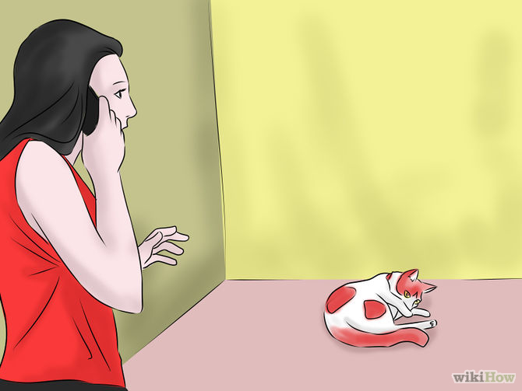
Status epilepticus
A seizure lasting longer than 5 minutes, or two or more seizures between which the patient does not completely recover consciousness
The basic pathophysiology of SE involves a failure of mechanisms that usually stop an isolated seizure
This failure can arise from abnormal excessive excitation or ineffective recruitment of inhibition

Slide 69
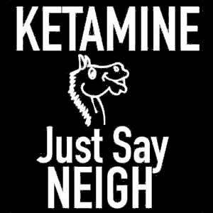
Status Epilepticus
Many molecular signals are triggered by SE, activating receptors in neuronal membranes
Activation of the NMDA receptor has been shown to play a key role in neuronal signalling and delayed neuronal death
NMDA receptors become activated during continuous neuronal stimulation
NMDA receptor antagonists have been shown to block or delay seizure activity

Slide 70
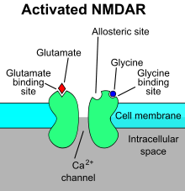
Status Epilepticus
Excessive concentrations of the excitatory amino acid glutamate cause NMDA receptors to open cation channels to calcium
Other possible neurotoxic substances released during SE include
  Aspartate
  Free fatty acids
  Arachidonic acid
  Free radicals

Slide 71
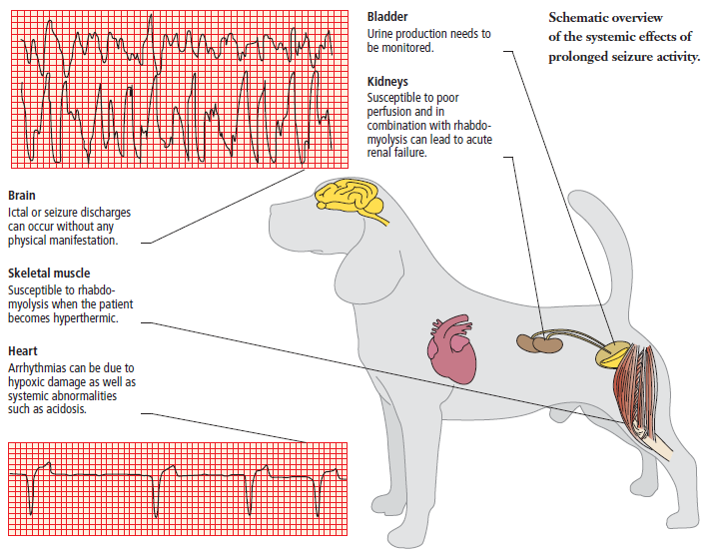
Systemic effects

Slide 72
Treatment
First Line
  Diazepam 0.5 – 2.0 mg/kg IV, IN or PR
  Midazolam 0.06 – 0.3 mg/kg IV, IM or IN
Second Line
  Levetiracetam 20-60 mg/kg IV
  Phenobarbital 2 mg/kg IV x 3

Slide 73
Treatment
Third line
  Ketamine 5 mg/kg IV followed by 5mg/kg/h CRI
  Propofol 2 mg/kg followed by CRI 1-6 mg/kg/h
Fourth line
  Inhalant anesthetic

