Slide 1
Respiratory Physiology
WEST
Valerie Madden
Emergency and Critical Care Resident
Cornell University
2013

Slide 2
Overview
Structure and function
Ventilation
Diffusion
Blood flow and metabolism
Ventilation – perfusion relationships
Gas transport by the blood
Mechanics of breathing
Control of ventilation
Tests of pulmonary function

Slide 3
Structure and Function
Pulmonary Anatomy

Slide 4
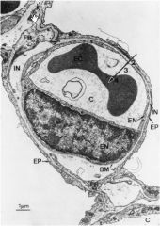
Structure and Function
Blood gas interface
Where exchange of respiratory gasses occur
Oxygen and CO2 move between air and blood by simple diffusion
High pressure → low pressure
Partial Pressure of gasses

Slide 5
Structure and Function
Fick’s Law of diffusion:
The amount of gas that moves across a sheet of tissue is proportional to the area of the sheet but inversely proportional to its thickness
Blood gas barrier is exceedingly thin and is well suited for gas exchange
Large surface area accomplished by the presence of numerous capillaries wrapped around many alveoli

Slide 6
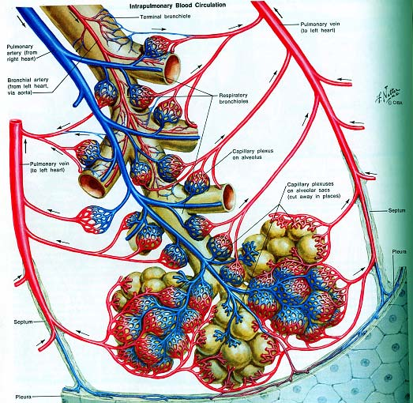
Structure and Function
Human lung → 500 million alveoli, each 0.3 mm diameter

Slide 7
Structure and Function
Airways and air flow:
Airways consist of a series of branching tubes
Trachea → right and left main stem bronchi → lobar bronchi → segmental bronchi → terminal bronchioles (smallest airways without alveoli)
All of these bronchi make up the conducting airways

Slide 8
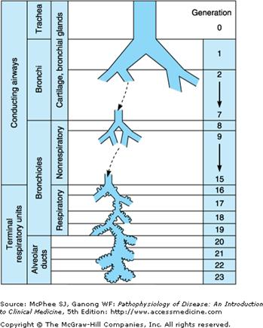
Structure and Function
Function of conducting airways:
To lead inspired air to the gas exchange regions of the lung
Do not take part in gas exchange
Constitute anatomic dead space

Slide 9
Structure and Function
Terminal bronchioles divide into respiratory bronchioles
Respiratory bronchioles have occasional alveoli
Alveolar ducts → completely lined with alveoli

Slide 10
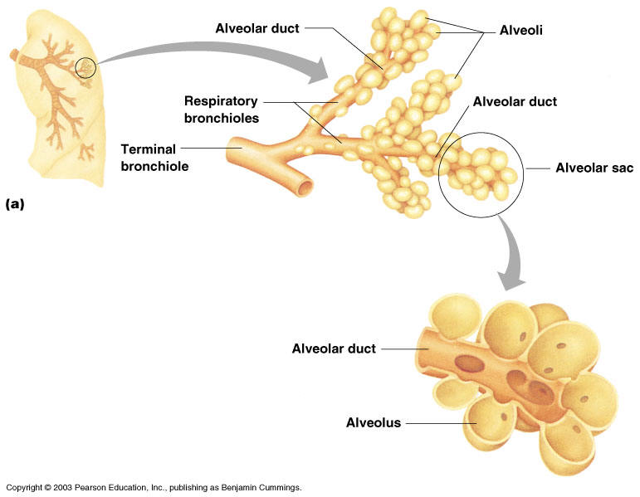
Structure and Function
Respiratory zone → the alveolated portion of the lung where gas exchange occurs
The respiratory zone makes up the majority of the lung

Slide 11
Structure and Function
Respiratory zone
Acinus:
Considered an anatomic unit
The portion of the lung distal to a terminal bronchiole
Contains respiratory bronchioles and alveolar ducts

Slide 12
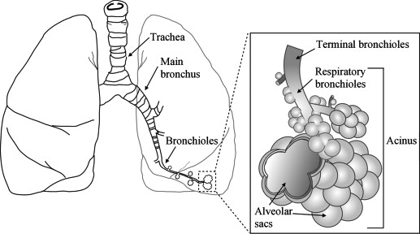
Structure and Function

Slide 13
Structure and Function
Air flow:
Inspiration → volume of thoracic cavity increases due to contraction of the diaphragm and intercostal muscles → negative pressure within the thorax → air is drawn into the lung
Air flows to bronchioles by convective flow (higher velocity)
Large cross sectional area beyond bronchioles results in low velocity flow of air
Diffusion of gas within the airways takes over as the dominant mechanism of ventilation in the respiratory zone

Slide 14
Structure and Function
Circulation of the Lung
2 circulatory systems
Pulmonary and Bronchiolar circulation

Slide 15
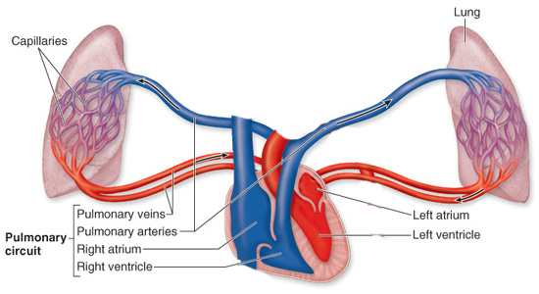
Structure and Function
Pulmonary circulation
Pulmonary artery → capillaries → pulmonary vein

Slide 16
Structure and Function
Pulmonary artery:
Receives whole output from right side of heart
Mean pulmonary artery pressure ~ 15mm Hg (20cm H20)
Contains poorly oxygenated blood
PaO2 ~40mmHg

Slide 17
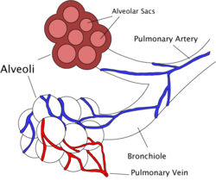
Structure and Function
Pulmonary capillaries:
Line alveoli
Form a dense network in the walls of the alveoli
Participate in gas exhange
Early capillary PaO2 ~ 40mmgHg
End capillary PaO2 ~ 100mmHg

Slide 18
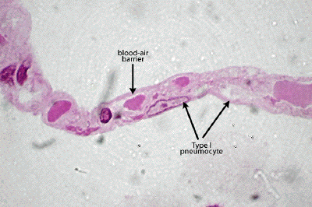
Structure and Function
Diameter of a capillary segment is ~ 7-10um
Capillary wall thickness ~ 0.3um
Diameter just large enough for a single red blood cell
Each RBC spends ~ 0.75sec in the capillary network (crosses ~2-3 alveoli)

Slide 19
Structure and Function
Pulmonary Vein:
Carries oxygen rich blood to the left side of the heart
PaO2 ~100mmHg
Venous admixture from bronchial circulation reduces PaO2 ~ 95mmHg

Slide 20
Structure and function
Key point: blood gas barrier is very thin!
0.2-0.3um over much of its area
Enormous surface area ~ 50-100m²
Short time and distance required for complete equilibration of O2 and CO2 between alveolar gas and capillary blood

Slide 21
Structure and Function
Bronchial circulation:
Supplies the the conducting airways down to the level of the terminal bronchioles
Venous blood in this system is poorly oxygenated
Some is carries away by pulmonary veins
Some enters the systemic circulation
Provides a component of venous admixture to pulmonary venous blood

Slide 22
Structure and Function
Stability of alveoli:
Thin walled small diameter structure
Liquid lining the alveoli creates surface tension that provide forces that tend to cause collapse
Surfactant produced by certain cells lining the alveoli reduces surface tension

Slide 23
Ventilation
Lung volumes
Total ventilation and alveolar ventilation
Distribution of ventilation

Slide 24
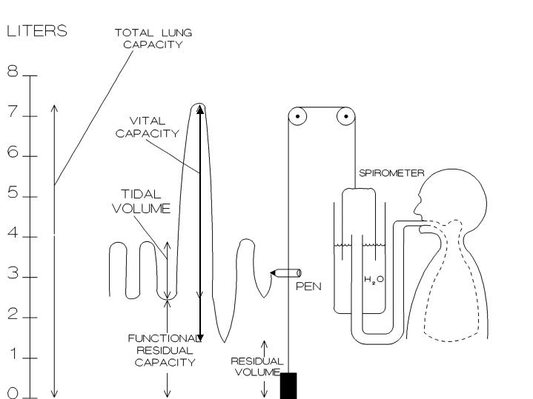
Ventilation
Lung Volumes
And Capacities
Measured by spirometry

Slide 25
Ventilation
Abbreviations:
V_{T} = tidal volume
IRV = inspiratory reserve volume
ERV = expiratory reserve volume
RV = Residual volume
FRC = Functional residual capacity
VC = Vital capacity
TLC = Total lung capacity
IC = Inspiratory capacity

Slide 26
Ventilation
Tidal volume :
the volume of gas inhaled and exhaled during one respiratory cycle
Normal quiet breathing.
The volume of air that fills the alveoli plus the volume of air that fills the airways
~ 10mls/kg

Slide 27
Ventilation
Inspiratory reserve volume:
The additional volume that can be inspired above the V_{T}
Expiratory reserve volume:
The volume that can be expired below the V_{T}
Residual volume:
Gas remaining in the lung following maximal expiration
Always present
Notes:
Check definitions

Slide 28
Ventilation
IRV
VT
VT
ERV
ERV
RV
RV

Slide 29
Ventilation
Lung capacities:
Each lung capacity contains 2 or more lung volumes

Slide 30
Ventilation
Inspiratory capacity (IC):
Tidal volume+ Inspiratory reserve volume
Functional residual capacity (FRC):
The volume of gas in the lung after a normal expiration
Expiratory reserve volume + residual volume

Slide 31
Ventilation
Vital capacity:
Maximal inspiration followed by maximal expiration → exhaled volume is known as the vital capacity
Inspiratory capacity + expiratory reserve volume + Tidal volume
Total lung capacity:
All of the lung volumes combined
Vital capacity + residual volume
V_{T}+ Inspiratory reserve vol + expiratory reserve vol + residual vol

Slide 32
Ventilation
IRV
VT
VT
ERV
ERV
RV
RV
FRC = ERV + RV
VC = ERV + V_{T} + IRV
IC = V_{T} + IRV
TLC = ERV + V_{T} + IRV + RV

Slide 33
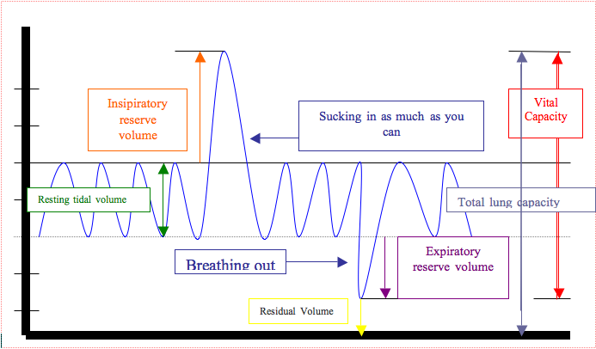
Ventilation

Slide 34
Ventilation
TLC, FRC and RV cannot be measured with a spirometer
This is due to inability to measure RV with a spirometer
Gas dilution techniques are required (ie. Helium dilution technique) or body plethysomgraphy (Boyle’s law)
Notes:
Helium is insoluble in blood

Slide 35
Ventilation
Total ventilation/Minute ventilation:
Total volume of air leaving the lung each minute (ml/min)
Minute ventilation = V_{T}x Breaths/min
Note: Ventilation = volume x respiratory frequency

Slide 36
Ventilation
Not all gas that enters the upper airway reaches the alveolar gas compartment to participate in gas exchange
Some remains in the anatomic dead space

Slide 37
Ventilation
Dead space:
The volume of the airways and lungs that does not participate in gas exchange
Anatomic ( volume of conducting airways)
Physiologic ( total volume of the lungs that does not participate in gas exchange); this includes anatomic dead space + functional dead space in the alveoli
Functional dead space → ventilated alveoli that do not participate in gas exchange (V/Q mismatch where ventilated alveoli are not perfused)

Slide 38
Ventilation
Normal individuals → physiologic dead space nearly equals anatomic
Physiologic dead space increases with V/Q mismatch
Can measure physiologic dead space by using the Bohr equation
Notes:
Bohr → VD/VT = PaCO2- PECO2/PaCO2
In normal subjects the ratio of VD to VT is in the range of 0.2 to 0.35

Slide 39
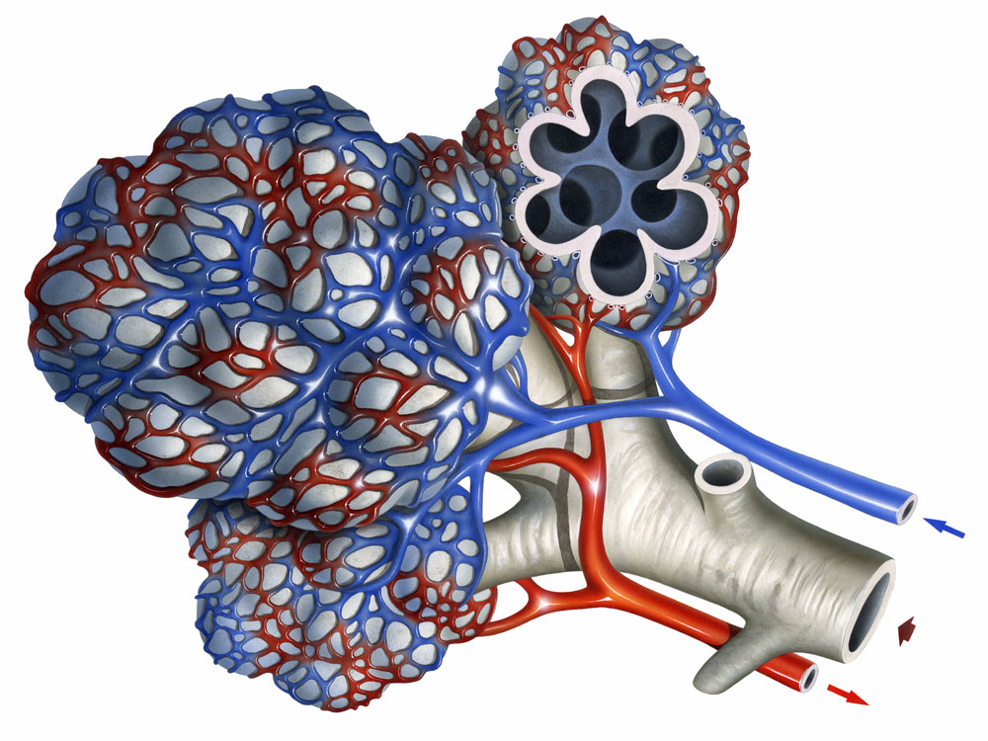
Ventilation
Alveolar ventilation:
= the volume of fresh gas entering the the respiratory zone each minute
Represents the amount of fresh air inspired available for gas exchange (ml/min)

Slide 40
Ventilation
V_{A} (gas from alveolar ventilation)
V_{D} (gas from anatomic dead space)
V_{T} (tidal volume)
Then… V_{T} ₌ V_{D} + V_{A}

Slide 41
Ventilation
Alveolar ventilation is minute ventilation corrected for physiologic dead space
V_{A} (ml/min) = (V_{T} – V_{D}) x breaths/min
V_{D} = V_{T} x PaCO2 – PECO2
PaCO2
Note: if physiologic dead space is zero, P_{E}CO2 = P_{A}CO2
If physiologic dead space is present, then P_{E}CO2 will be diluted by dead space air and P_{E}CO2 < P_{A}CO2
Notes:
Problem with this equation is VD (anatomic dead space is hard to measure)

Slide 42
Ventilation
Determination of V_{A}: (alveolar ventilation equation)
V_{A} = VCO2 x K OR P_{A}CO2 = VCO2 x K
P_{A}CO2 V_{A}
V_{A} = Alveolar ventilation (ml/min)
VCO2 = Rate of CO2 production (ml/min)
K is a constant (863mmHg)
P_{A}CO2 = Alveolar PCO2 (mmHg)
Notes:
BPTS = body temperature (310K), ambient pressure (760mmHg) and gas saturated with water vapor
CO2 is produced by aerobic metabolism of the tissues and excretes this CO2 in expired air

Slide 43
Ventilation
Alveolar ventilation equation cont’d…
Describes the inverse relationship between alveolar ventilation and P_{A}CO2
Assuming expired CO2 comes from alveolar gas
If CO2 production is constant, P_{A}CO2 comes from alveolar ventilation
PaCO2 can be used for P_{A}CO2 in this equation as they are close in normal subjects

Slide 44
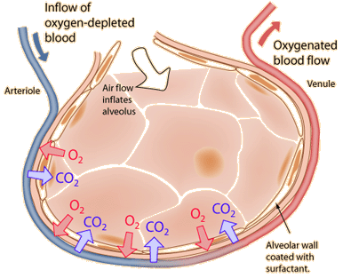
Diffusion
How gas gets across the blood-gas barrier

Slide 45
Diffusion
Diffusion: the passive movement of molecules or particles along a concentration gradient from regions of higher to regions of lower concentration
The rate of transfer of a gas through a sheet of tissue is proportional to the tissue area and the difference in gas partial pressure between the 2 sides, and inversely proportional to the thickness of the tissue

Slide 46
Diffusion
Rate of diffusion depends on a diffusion constant, which depends on the properties of the tissue and particular gas
The constant is proportional to the solubility of the gas and inversely proportional to the square root of the molecular weight
Example: CO2 diffuses ~ 20x more rapidly than O2; as CO2 is highly soluble with a similar molecular weight
Notes:
Example → CO2

Slide 47
Diffusion
Diffusion and perfusion limitations:
Diffusion limited: the amount of gas that gets into the blood is limited by the diffusion properties of the blood-gas barrier (not by the amount of blood available).
Example: carbon monoxide
Perfusion limited: the amount of gas taken up by the blood depends entirely on the amount of available blood flow (not on the diffusion properties of the blood gas barrier)
Example: nitrous oxide

Slide 48
Diffusion
Oxygen uptake along the pulmonary capillary:
PO2 in a RBC entering a pulmonary capillary = 40mmHg
Across the blood-gas barrier P_{A}O2 = 100mmHg
O2 diffuses down the gradient and PO2 in red cell almost reaches P_{A}O2 by the time its 1/3 the way across the capillary

Slide 49

Diffusion
With exercise the time a RBC spends in the capillary is reduced (up to .25sec) as pulmonary blood flow is increased
Time for oxygenation is less, however end capillary PO2 remains unchanged in a normal lung

Slide 50
Diffusion
If the blood-gas barrier is thickened by disease, diffusion is impaired and the rate of rise of O2 in the capillary blood is slowed
Thus PaO2 may not reach that of alveolar gas
In this case, a measurable difference in P_{A}O2 and PaO2 of capillary blood may occur

Slide 51
Diffusion
Breathing a low oxygen mixture reduces the effective gradient
In this case patients with normal blood-gas barrier may show a reduced rate of rise of O2 in the capillary blood
Failure to reach P_{A}O2 is more likely
Example: high altitudes

Slide 52
Diffusion
Key points:
the diffusion process is challenged by exercise, alveolar hypoxia and thickening of the blood-gas barrier
Oxygen transfer into the pulmonary capillary is normally limited by the amount of blood flow available, although under some circumstances diffusion limitation also occurs

Slide 53
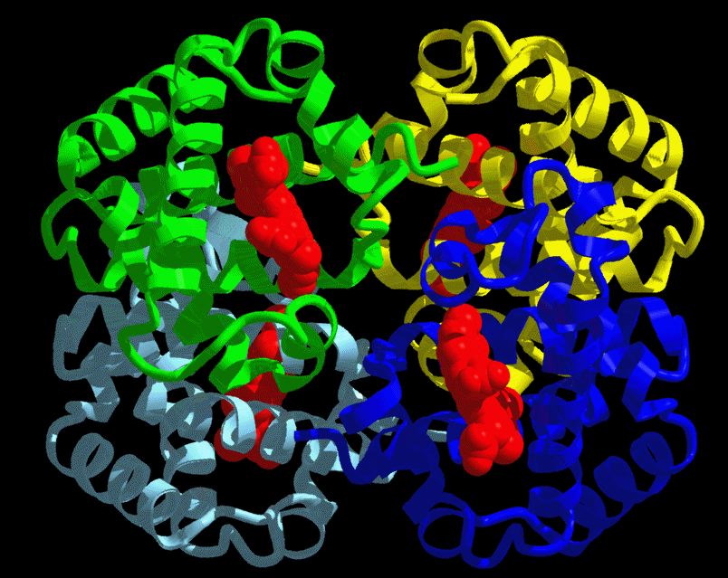
Diffusion
Reaction rate with hemoglobin:
Provides some resistance to gas transfer
Reaction of O2 combination with Hb ~ 0.2sec
This delays the loading of O2 by the red cell

Slide 54
Diffusion
Thus uptake of oxygen can be regarded as occurring in 2 stages:
1. Diffusion through blood-gas barrier (including
plasma and red cell interior)
2. Reaction of O2 with hemoglobin

Slide 55
Blood flow and Metabolism
How the pulmonary circulation removes gas from the lung
Metabolic functions of the lung

Slide 56
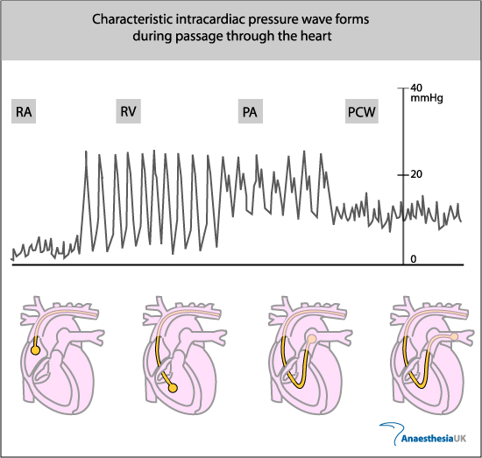
Blood flow and Metabolism
Pressures within the pulmonary circulation:
Pulmonary artery:
Mean 15mmHg
Systolic 25mmHg
Diastolic 8mmHg

Slide 57
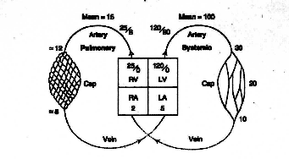
Blood flow and Metabolism
Right atrial pressure:
2mmHg
Left atrial pressure:
5mmHg
Aortic pressure
100mmHg

Slide 58
Blood flow and Metabolism
Pulmonary vascular resistance:
Resistance = Δ Pressure
Flow
Pulmonary vascular resistance is low
  As pulmonary artery pressures rise → resistance decreases due to:
  Recruitment of vessels (that normally have no flow)
  Distension of individual capillaries
Lung volumes also affect pulmonary vascular resistance →
resistance increases at very low or very high lung volumes

Slide 59
Blood flow and Metabolism
Measurement of pulmonary blood flow:
Volume of blood passing through the lung each minute (Q) can be calculated using the Fick principle:
Q = V_{O2} / Ca_{O2} – Cv_{O2}
Where:
V_{O2} = oxygen consumption per minute
Ca_{O2} = arterial oxygen content
Cv_{O2} = venous oxygen content
Notes:
VO2 is measured by collecting the expired gas in a large spirometer and measuring its O2 concentration
Pulmonary blood flow can also be measured by the indicator dilution technique

Slide 60
Blood flow and Metabolism
Distribution of blood flow:
Uneven distribution of blood flow in the lungs
Can be explained by the hydrostatic pressure differences within the blood vessels
Lung is divided int0 zones

Slide 61
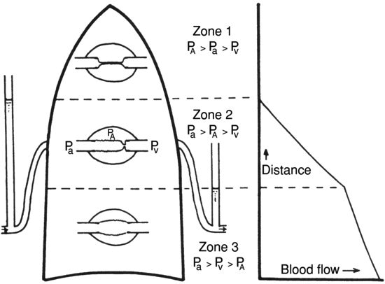
Blood flow and Metabolism
Zone 1
Zone 2
Zone 3
Notes:
Zone 2 → blood flow is determined by differences between arterial and alveolar pressures

Slide 62
Blood flow and Metabolism
Zone 1 : P_{a} pressure is < P_{A} pressure; does not normally occur (only if arterial pressure is reduced or if alveolar pressure is increased)
Normally arterial pressure is just high enough to prevent closure of
pulmonary capillaries and zone 1 is perfused
Zone 2 → blood flow is determined by differences between arterial and alveolar pressures
Zone 3 → flow is determined by differenced in arterial and venous pressures

Slide 63
Blood flow and metabolism
Active control over the circulation:
Occurs when P02 of alveolar gas is reduced
Hypoxic pulmonary vasoconstriction
Consists of contraction of smooth muscle cells in the arterioles in the hypoxic region
Likely secondary to local action of hypoxia on artery (not via a central mechanism)
Directs blood flow away from poorly ventilated areas
Notes:
Contraction via increased intracellular calcium
May be mediated by NO
Inhaled NO reduces hypoxic mediated vasoconstriction in humans (toxic at high doses)
NO vasodilates
Pulmonary vascular endothelial cells release potent vasoconstrictors (endothelin 1, TXA2) normally
This response is important in fetal lungs as it allows high resistance in fetal pulmonary circulation and shunts blood away from the lungs

Slide 64
Ventilation Perfusion Relationships
Oxygen transport from air to tissues:
At sea level (760mmHg) the PO2 of inspired air is 15ommHg
PO2 at alveoli is 100mmHg
- due to balance of removal of O2 by capillary blood
and continuous replacement by alveolar ventilation
Alveolar PCO2 is 40mmHg
O2 reaches tissues where it diffuses into mitochondria → tissue PO2 varies depending on tissue location/type

Slide 65
Ventilation Perfusion Relationships
4 causes of Hypoxemia:
Hypoventilation
Diffusion limitation
Shunt
Ventilation-perfusion mismatch

Slide 66
Ventilation Perfusion Relationships
Hypoventilation:
Again → alveolar PO2 is determined by a balance between rate of removal of O2 by the blood (set by tissue demands) and alveolar ventilation
Low alveolar ventilation → Low P_{A}O2
PCO2 rises

Slide 67
Ventilation Perfusion Relationships
Remember…. Alveolar ventilation equation
P_{A}CO2 = VCO2 x K
V_{A}

Slide 68
Ventilation Perfusion Relationships
Hypoventilation:
Secondary to many causes
PCO2 always rises
Hypoxemia responds to supplemental O2

Slide 69
Ventilation Perfusion Relationships
Diffusion:
In a perfect lung P_{A}O2 = PaO2
Normal conditions → the difference between P_{A}O2 and end capillary blood results from incomplete diffusion
Difference becomes larger with exercise, when blood gas barrier is thickened or if a low O2 mixture is inhaled

Slide 70
Ventilation Perfusion Relationships
Shunt:
Refers to blood that enters the arterial system without going through ventilated areas of the lung

Slide 71
Ventilation Perfusion Relationships
Physiologic shunting:
~ 2% of cardiac output
Some bronchial artery blood gets collected by the pulmonary veins after it has perfused the bronchi and its O2 has been partially depleted
Small amount of coronary venous blood that drains directly into the left ventricle via thesbian veins
A small amount of physiologic shunting is always present and thus PaO2 is always less than P_{A}O2
Notes:
This shunting decreases PaO2 to a normal level

Slide 72
Ventilation Perfusion Relationships
Pathologic shunting:
Abnormal connections between a small pulmonary artery and vein (arteriovenous fistula)
Heart disease → direct addition of venous blood to arterial blood across a defect between the right and left sides of the heart

Slide 73
Ventilation Perfusion Relationships
If the shunt is caused by mixed venous blood, shunt size can be calculated from the shunt equation:
Q_{s} = Cć_{O2} – Ca_{O2}
Q_{T} Cć_{O2} – Cv_{O2}
Where:
Q_{T} = total blood flow
Q_{s} = shunt flow
Cć_{O2} = End capillary oxygen content
Cv_{O2} = Venous blood oxygen content
Ca_{O2} = arterial blood oxygen content

Slide 74
Ventilation Perfusion Relationships
Shunt:
Does NOT respond to oxygen
Shunted blood bypasses ventilated alveoli
PaCO2 is NOT usually elevated
(as chemoreceptors detect elevated CO2 levels
and therefore respond by increasing ventilation and
thus reducing the PCO2 of un-shunted blood)

Slide 75
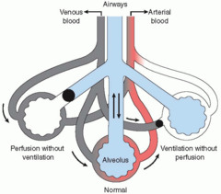
Ventilation Perfusion Relationships
Ventilation – Perfusion Mismatch:

Slide 76
Ventilation Perfusion Relationships
Ventilation- Perfusion ratio:
PO2 in a lung unit is determined by the ratio of ventilation to blood flow
Normal V/Q ratio is ~ 0.8
- Alveolar ventilation is ~80% of the value for blood flow
- if V/Q is normal, PaO2 ~100mmHg, PaCO2 ~ 40mmHg
Impairment of both O2 and CO2 transfer occurs with mismatch

Slide 77
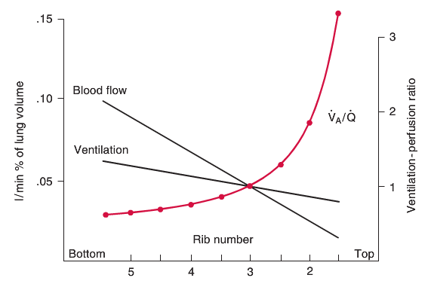
Ventilation Perfusion Relationships
Regional gas exchange in the lung:
V/Q of 0.8 is an average for the entire lung
In the 3 zones of the lung, V/Q is uneven
Variations in V/Q have consequences for PaO2 and PaCO2 in blood leaving these zones

Slide 78
Ventilation Perfusion Relationships
Regional gas exchange in the lung:
Blood flow:
Zone 1 has the lowest blood flow
Zone 3 has the highest blood flow
Ventilation:
Zone 1 has lower ventilation
Zone 3 has higher ventilation
Notes:
Zone 1 has lower ventilation because gas hangs out there and there is more potential space in the lower portions of the lung that is utilized with the breath (think vertical accordion)

Slide 79
Ventilation Perfusion Relationships
Note: regional variations with ventilation are not as great as regional variations in blood flow
V/Q ratio is the highest in zone 1
V/Q ratio is the lowest in zone 3

Slide 80
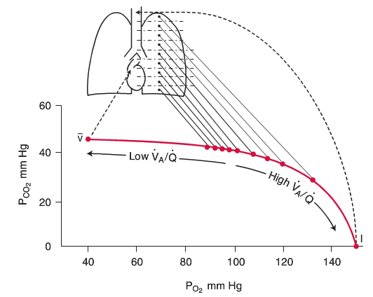
Ventilation Perfusion Relationships
High V/Q ratio at apex results in a high PaO2 and low PCO2
Low V/Q ratio at base results in a low PaO2 and high PCO2
Regional differences in PaO2 are much greater than regional differences in PaCO2
Notes:
Ventilation/perfusion ratio decreases down the lung
Note PO2 changes by 40mmHg and the PCO2 changes are much less

Slide 81
Ventilation Perfusion Relationships
Ventilation perfusion ratio:
Ventilation/perfusion ratio decreases down the lung
Note PO2 changes by ~ 40mmHg and the PCO2 changes are much less
pH changes down the lung which reflects variation in CO2 output by the base and apex
Minimal contribution to O2 uptake at the apex attributed to low blood flow in this region
Differences in CO2 output by base and apex is much less as it is related to ventilation
Notes:
With exercise blood flow becomes more even and the apex assumes a larger share of the oxygen uptake

Slide 82
Ventilation Perfusion Relationships
Effect of V/Q inequality on overall gas exchange:
Reduced ability to transfer O2 and CO2
If same amounts of gas are being transferred (as set by body’s metabolic demands), lungs with V/Q mismatch cannot maintain as high a PaO2 or as low PCO2 as a normal lung
Net result is a depressed PaO2 below that of P_{A}O2 → alveolar-arterial O2 difference

Slide 83
Ventilation Perfusion Relationships
Effect of V/Q inequality on overall gas exchange:
V/Q mismatch causes both hypoxemia and hypercapnea
Elevated CO2 can be corrected by increasing ventilation
Low PaO2 cannot be corrected by changes in ventilaiton
Some patients with V/Q mismatch may have a normal PaCO2 due to chemoreceptor response
Notes:
O2 and CO2 behave differently due to different shapes of their dissociation curves

Slide 84
Ventilation Perfusion Relationships
Measurement of V/Q inequality:
Radioactive gasses
Alveolar – arterial PO2 difference

Slide 85
Ventilation and Perfusion Relationships
Alveolar – arterial PO2 difference and alveolar gas equation:
Alveolar gas equation:
P_{A}O2 = P_{I}O2 – P_{ACO2} + F
R
PaCO2 is used for P_{A}CO2
R is the respiratory exchange ratio = 0.8
F is ignored
P_{A}O2 = P_{IO2} – P_{aCO2}
0.8

Slide 86
Ventilation Perfusion Relationships
Alveolar – arterial gradient:
A – a gradient = (P_{IO2} – P_{aCO2} ) – PaO2
0.8
OR
A – a gradient =( FiO2 (Patm – PH2O) – P_{aCO2} ) – PaO2
0.8

Slide 87
Ventilation Perfusion Relationships
A – a gradient =( FiO2 (Patm – PH2O) – P_{aCO2} ) – PaO2
0.8
Where Patm = 760mmHg at sea level
PH20 = 47
Thus on room air…..
A – a gradient =( 150– P_{aCO2} ) – PaO2
0.8

Slide 88
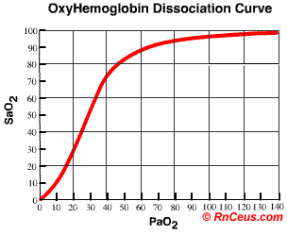
Gas Transport by the Blood

Slide 89
Gas Transport by the Blood
Oxygen is carried in the blood in 2 forms:
Dissolved in plasma
Combined to hemoglobin

Slide 90
Gas Transport by the Blood
Dissolved O2:
Amount dissolved is proportional to the partial pressure
For each mmHg of PO2 → there is 0.003ml O2/100 ml of blood
Thus arterial blood with PaO2 of 100mmHg → contains 0.3ml per 100ml blood
Thus only a very small amount of O2 is transported dissolved in plasma

Slide 91
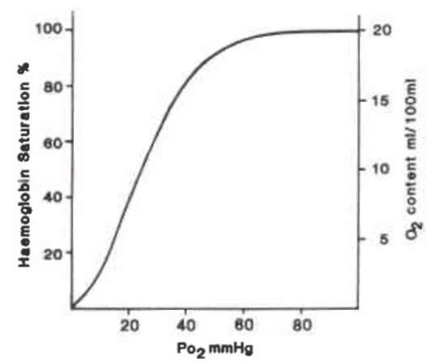
Gas Transport by the Blood
O2 bound to hemoglobin:
Accounts for majority of O2 transport

Slide 92
Gas Transport by the Blood
Amount of O2 carried by Hb increases rapidly up to a PaO2 of ~ 50mmHg
Curve flattens out above PaO2 50mmHg
Initial binding (first portion of the curve) results in a slow increase in saturation
The curve then becomes very steep → where increases in PaO2 result in rapid O2 binding and large increases in saturation of Hb → this is due to “cooperativity” of Hb

Slide 93
Gas Transport by the Blood
O2 dissociation curve physiologic advantages:
Flat upper portion means even if PO2 in alveolar gas decreases, O2 loading is minimally affected
Large partial pressure difference exists between alveolar gas and blood when most of O2 has been transferred → diffusion process is hastened
Steep lower part means peripheral tissues can withdraw large amounts of O2 for only a small drop in capillary PO2

Slide 94
Gas Transport by the Blood
O2 capacity = the maximum amount of O2 that can be combined with Hb
ie. all binding sites occupied by O2
One gram of Hb can combine with 1.39 ml O2
Blood has ~ 15 g Hb / 100ml
O2 capacity is ~ 20.8ml O2 / 100ml blood

Slide 95
Gas Transport by the Blood
O2 saturation of Hb = % of available binding sites that have O2 attached:
O2 Sat = O2 combined with Hb x 100
O2 capacity
O2 Sat of arterial blood with a PaO2 100mmHg is ~ 97.5%
O2 Sat of mixed venous blood with a PaO2 40mmHg is ~ 75%

Slide 96
Gas Transport by the Blood
*Calculation of O2 content of blood*:
O2 concentration = (1.39 x Hb x %satHb) + 0.003PaO2
Units : (ml O2 / 100ml blood)

Slide 97
Gas Transport by the Blood
O2 dissociation curve shifts:
Right → O2 affinity for Hb is reduced by:
An increase in H+ concentration
An increase in PCO2
An increase in temperature
An increase in 2,3 DPG in RBCs (chronic hypoxia)
→ Offloading is increased
Notes:
2,3 DPG is an end product of red cell metabolism → shift curve to right
2,3 DPG can be increased with chronic hypoxia (high altitude, chronic lung disease)

Slide 98
Gas Transport by the Blood
O2 dissociation curve shifts:
Left → O2 affinity for Hb is increased by:
A decrease in H+ concentration
A decrease in PCO2
A decrease in temperature
A decrease in 2,3 DPG in RBCs (stored RBCs)
Offloading is reduced
Note: small addition of carbon monoxide causes a left shift
Notes:
COHb
CO has ~ 240 times the affinity for HB than O2

Slide 99
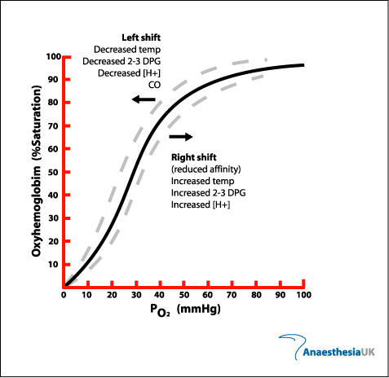
Gas Transport by the Blood

Slide 100
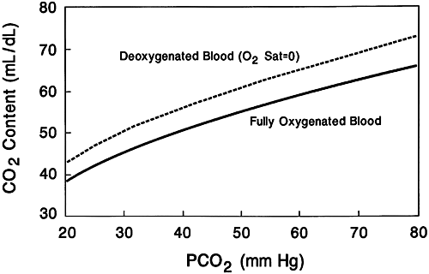
Gas Transport by the Blood
Haldane effect:
describes how oxygen concentrations determine Hb's affinity for carbon dioxide
High oxygen concentrations reduce Hb’s affinity for CO2
Low oxygen concentrations increase Hb’s affinity for CO2

Slide 101
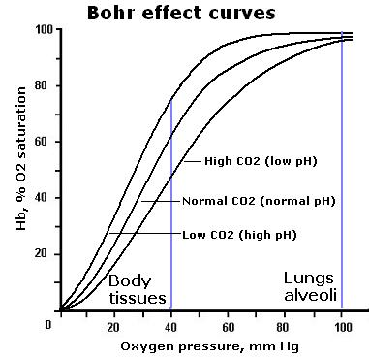
Gas Transport by the Blood
Bohr effect:
describes how carbon dioxide concentrations determine Hb's affinity for oxygen
Increase in CO2 in the blood and a decrease in pH results in a reduction of the affinity of Hb for O2
Reduction in CO2 and increase in pH increase affinity of Hb for O2

Slide 102
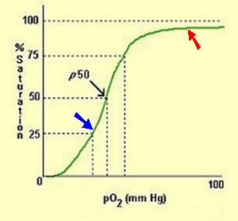
Gas transport by the Blood
P50….
Useful measure of position of the dissociation curve
PO2 for 50% saturation
Normal value for human blood is 27mmHg

Slide 103
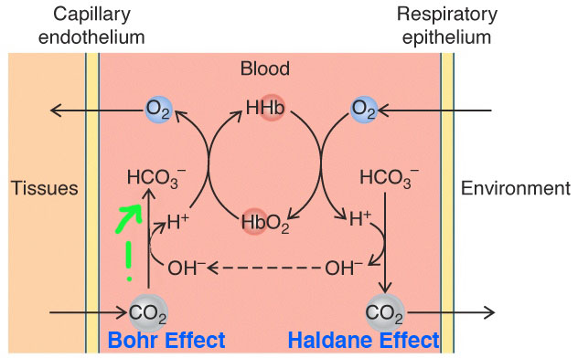
Gas transport by the blood

Slide 104
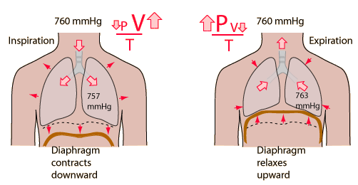
Mechanics of Breathing

Slide 105
Mechanics of Breathing
Compliance:
Describes the distensibility of the system
Describes the change in lung volume for a given change in pressure
Compliance is inversely correlated with the elastic properties of the lung (Elastance)
The greater the elastance, the greater the recoil force, but lower compliance

Slide 106
Mechanics of Breathing
To measure compliance requires simultaneous measurement of pressure and volume
Zero pressure is atmospheric pressure
Notes:
Transpulmonary pressure → difference between intra-alveolar pressure and intraplerual pressure

Slide 107
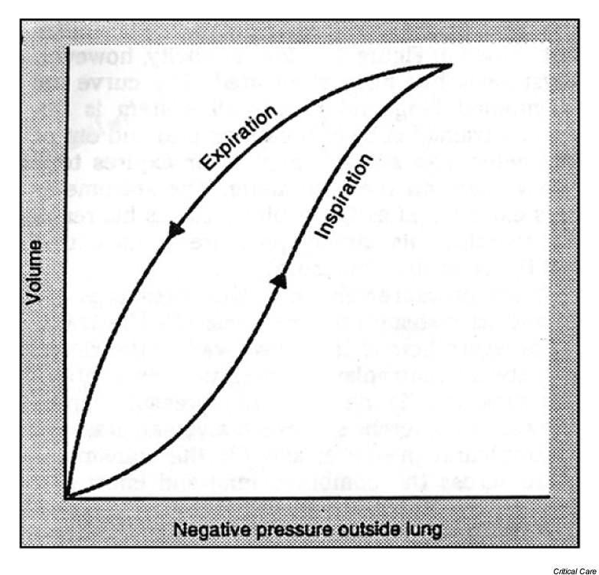
Mechanics of Breathing
Pressure – Volume Relationship:

Slide 108
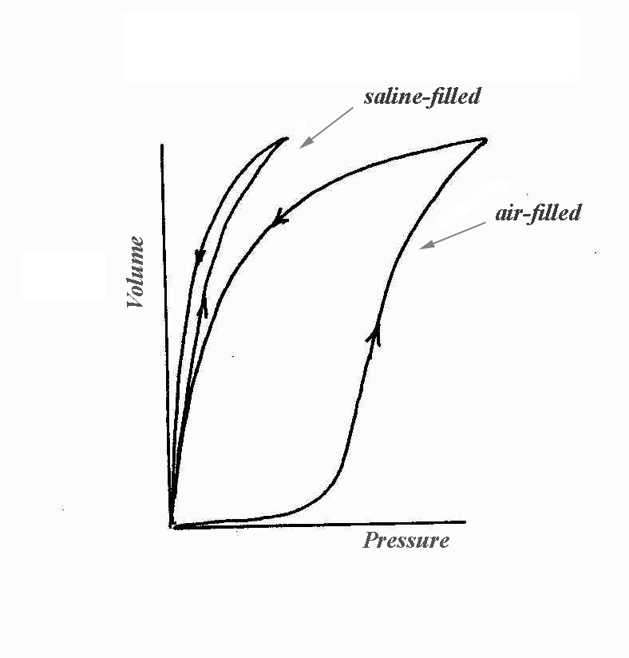
Mechanics of Breathing
The slope of each limb of the pressure – volume loop is the compliance ( ΔV/ ΔP )
Negative pressure outside the lungs = expanding pressure
Expanding pressure → lungs fill with air along the inspiration limb
At highest expanding pressure → alveoli are filled to the limit and become stiffer and less compliant and the curve flattens

Slide 109
Mechanics of breathing
Once the lungs are expanded maximally, pressure outside the lungs is made gradually less negative, causing lung volume to decrease along the expiration limb
Note: slopes of the relationships for inspiration and expiration are different → Hysteresis
Compliance differs for inspiration and expiration
For a given outside pressure → volume of the lung is greater during expiration than inspiration
Compliance is higher during expiration
Notes:
Lung displays decreased compliance at maximal expanding pressures

Slide 110
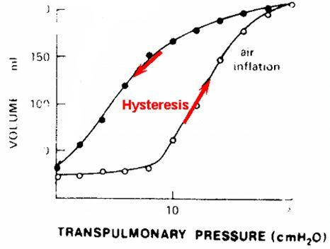
Mechanics of Breathing
Hysteresis is due to the surface tension of the liquid- air interface
Intermolecular attractive forces between liquid molecules lining the lung are stronger than the forces between liquid and air molecules
Notes:
When lung is deflated, the attractive forces between the liquid is high as liquid moldecules are close together → high surface tension, low compliance. Higher pressures are required to overcome attractive forces and inflate the iung. Also at this point surfactant density is low
On expiration, lung volume decreases rapidly (faster than surfactant can be removes) and thus surfactant density is high, thus increasing compliance. Liquid molecules are further apart and there is less attractive forces

Slide 111
Mechanics of Breathing
Factors that reduce compliance:
Pulmonary fibrosis
Alveolar edema
Atelectasis
Increased surface tension
Increased pulmonary venous pressures
Factors that increase compliance:
Emphysema
Asthma

Slide 112
Mechanics of Breathing
Elastance:
Elastic properties of the chest wall makes it want to spring outward
Elastic properties of the lung make it want to pull inward
These forces balance each other out at equilibrium (FRC is the equilibrium volume)
These forces are important during pressure changes during the respiratory cycle

Slide 113
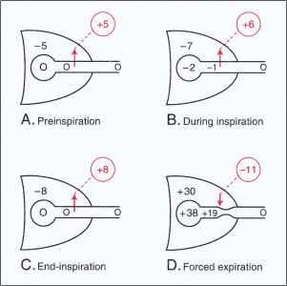
Mechanics of Breathing

Slide 114
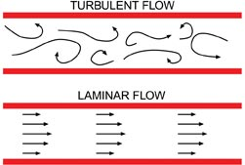
Mechanics of Breathing
Airway resistance:
2 types of air flow through conducting airways
Laminar → at low flow rates
Turbulent → at high flow rates
Note: a Δ P across the system is required for flow

Slide 115
Mechanics of Breathing
Poiseuille’s law:
V = Pπr⁴
8nl
For laminar flow, gives volume flow rates
Where
P is driving pressure ( ΔP)
r is radius of the tube
n is viscosity
l is length

Slide 116
Mechanics of Breathing
Resistance:
R = 8nl
πr⁴
Radius significantly affects resistance
If the radius is halved, R increases 16 fold
Note: for laminar flow, gas in the center of the tube moves twice as fast as the average velocity (high axial flow velocity), creating a velocity profile

Slide 117
Mechanics of Breathing
Reynold’s number:
Whether flow will be laminar or turbulent depends largely on Reynold’s number
Re = 2rvd
n
Turbulence is probable when Reynold’s number > 2000
Turbulence is most likely to occur with high velocity flow, large tube diameter
Low density gasses produce less turbulence

Slide 118
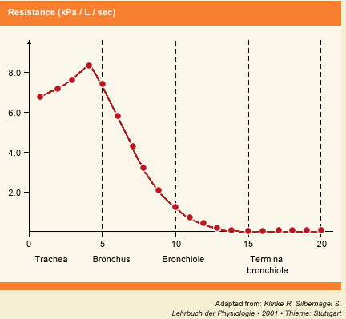
Mechanics of Breathing
Airway resistance is the pressure difference between the alveoli and mouth divided by flow rate
R = Δ P/V
Key point: Major sites of airway resistance are medium sized bronchi

Slide 119
Mechanics of Breathing
Small airways contribute very little to resistance
likely due to their large number
May act as a “silent zone” in disease states as significant disease may be present, however the usual measurements of resistance do not detect any changes

Slide 120
Mechanics of Breathing
Factors determining airway resistance:
Lung volume
→ as lung volume is reduced, resistance
rises rapidly
→ at very low lung volumes, small airways
may close completely
Contraction of bronchial smooth muscle
→ narrowing of the airway
→ parasympathetic stimulation, histamine, fall of P_{A}CO2
→ resistance reduced by use of β adrenergic agonists
Density and Viscosity of inhaled gas
Notes:
Patients who have an increased airway resistance often breathe at higher lung volumes (to reduce their resistance)
Resistance is less at higher lung volumes as the airways are pulled open

Slide 121
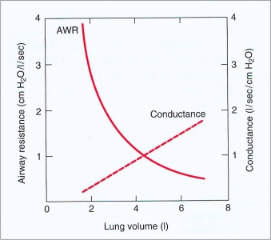
Mechanics of Breathing

Slide 122
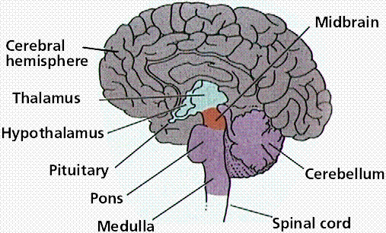
Control of Breathing
Central controller
Sensors
Effectors
Abnormal patterns of breathing

Slide 123
Control of Breathing
3 basic elements of the respiratory control system:
Sensors: gather information and send it to...
Central controller: coordinates information and sends it to…
Effectors: resp muscles which cause ventilation

Slide 124
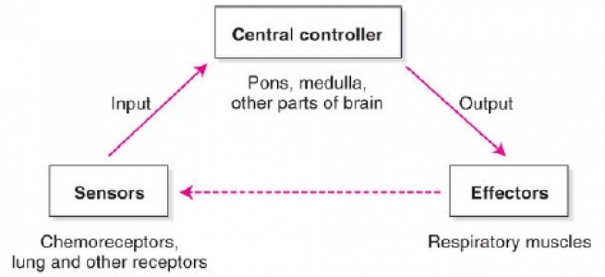
Control of Breathing

Slide 125
Control of Breathing
Central controller:
Located in the brainstem
Receive input from chemorecptors, lung, and other receptors in the cortex
Major output is to the phrenic nerves
Impulses also go to respiratory muscles

Slide 126
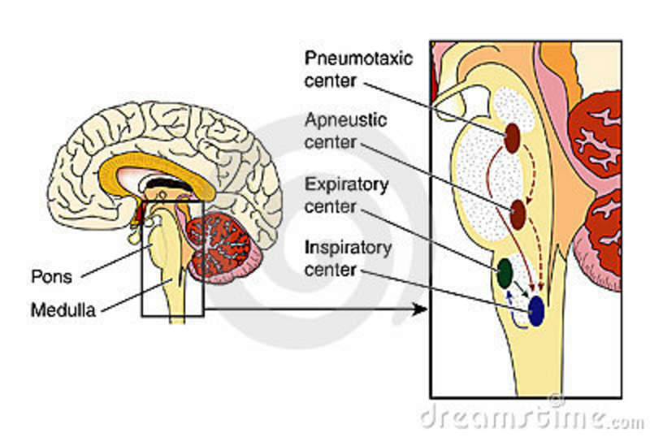
Control of Breathing
Central controller:
Generates Impulses that come from the brainstem
Cortex can override these centers if voluntary control is desired
Central pattern generator → comprises a group of neurons in the pons and medulla

Slide 127
Control of Breathing
Central controller (brainstem):
3 main groups of neurons recognized:
Medullary respiratory center
Apneustic center (lower pons)
Pneumotaxic center (upper pons)

Slide 128
Control of Breathing
Medullary respiratory center:
Located in the reticular foramen of the medulla beneath the floor of the 4th ventricle
Pre-Botzinger complex → group of cells essential for generation of the respiratory rhythm
Dorsal respiratory group → group of cells located dorsally that is chiefly associated with inspiration
Ventral respiratory group →group of cells located ventrally that is chiefly associated with expiration
These cells have the property of intrinsic periodic firing

Slide 129
Control of Breathing
Inspiration impulses may be modulated by inhibiting impulses from the pneumotaxic center, vagus and glossopharyngeal nerves
During quiet breathing the expiratory area is quiescent, as expiration is a passive process in that situation
Expiratory area becomes activated during forceful breathing

Slide 130
Control of Breathing
Apneustic center:
Located in the lower pons
Impulses from this area have an excitatory effect on the inspiratory center of the medulla

Slide 131
Control of Breathing
Pneumotaxic center:
Located in upper pons
“switches off” or inhibits inspiration
Regulates inspiratory volume and rate
A normal rhythm can exist in the absence of this center

Slide 132

Control of Breathing
Cortex:
Voluntary control of breathing
Can override brainstem to a certain extent
Hyperventilation
Breath holding
Other:
Limbic system
Hypothalamus
Breathing patterns associated with emotional states

Slide 133
Control of Breathing
Sensors:
Central chemoreceptors:
Most important receptors involved in control of minute by minute ventilation are those situated on the ventral surface of the medulla
Surrounded by brain ECF and respond to changes in H⁺ concentration
Composition of ECF in this region is governed by CSF, local blood flow and metabolism (CSF being the most important)
Increase in H⁺ stimulates ventilation; decrease does the opposite
Notes:
BBB is relatively impermeable to H+ and HCO3+, although molecular CO2 diffuses across readily

Slide 134
Control of Breathing
BBB is relatively impermeable to H+ and HCO3+, although molecular CO2 diffuses across readily
As CO2 rises in the blood CO2 diffuses into the CSF, liberating H⁺ ions that stimulate chemoreceptors
Key point: CO2 levels in the blood regulate ventilation chiefly by its effect on pH of the CSF
Notes:
CSF has less protein than blood → thus has a lower buffering capacity. Therefore pH of CSF is more sensitive to change from CO2 than is arterial blood

Slide 135
Control of Breathing
Peripheral chemoreceptors:
Carotid bodies
Aortic bodies
Respond to decreases in PaO2, pH and increases in PCO2
Major response is to PaO2
Responsible for all the increase in ventilation that occurs in humans in response to arterial hypoxemia → hypoxic ventilatory drive
Response to PCO2 is less important than that of the central chemoreceptors
Response is more rapid than central chemoreceptors

Slide 136
Control of Breathing
Lung receptors:
Stretch receptors → located within airway smooth muscle. Reflex is to slow resp frequency due to an increased expiratory time.
Irritant receptors → located between airway epithelial cells. Reflex includes bronchoconstriction and hyperpnea.
J receptors → located in alveolar walls and respond to chemicals in capillary blood. Reflex is rapid shallow breathing. May be associated with the feeling of dyspnea.
Bronchial C fibers → supplied by the bronchial circulation. Respond to chemicals in bronchial circulation. Reflex is rapid shallow breathing.
Note → impulses of these receptors mainly travel via the vagus

Slide 137
Control of Breathing
Other receptors:
Nose and upper airway
Joint and muscle
Gamma system
Arterial baroreceptors
Temperature and pain
Notes:
Arterial barocecptors → an increase in ABP may lead to a reflex hypoventilation or apnea through stimulation of the aortic and carotid sinus baroreceptors

Slide 138
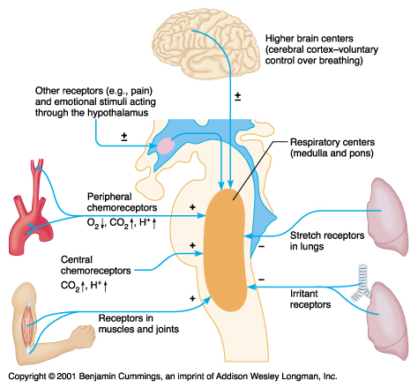
Control of Breathing

Slide 139
Control of Breathing
Integrated responses:
Overall response of the system to changes in O2, pH and CO2

Slide 140
Control of Breathing
Response to CO2:
PaCO2 is the most important stimulus to ventilation under most normal conditions and is tightly controlled
Majority of the stimulus comes from the central chemoreceptors
Peripheral chemoreceptors also contribute to the response and their response is much faster

Slide 141
Control of Breathing
Response to O2:
Ventilatory response to hypoxia
Only peripheral chemoreceptors are involved
Negligible control under normoxic conditions, as PO2 can be reduced significantly without evoking a ventilatory response
Response to PaO2 > 50mmHg is minimal
Control becomes important at high altitude and in long term hypoxemia caused by chronic lung disease
Chronic lung disease → CO2 retention; ECF of brain has compensated and returned to near normal, thus they have lost their normal stimulus to ventilation from CO2. Under these conditions, arterial hypoxemia becomes the chief stimulus for ventilation.
Notes:
Response to PO2 > 50mmHg is minimal

Slide 142
Control of Breathing
Resp0nse to pH:
A reduction in arterial pH stimulates ventilation
Can occur independently of CO2 concentration (in response to a metabolic acidosis)
Chief site of action is peripheral chemoreceptors
Central receptors can be involved if change in blood pH is large enough (BBB becomes partially permeable to H⁺)

Slide 143
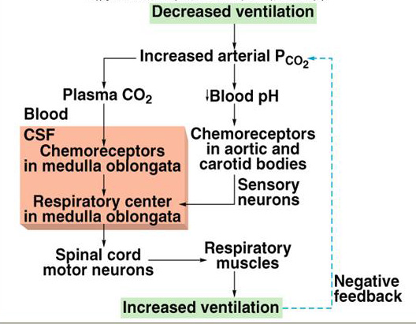
Control of Breathing

Slide 144
Control of Breathing
Abnormal breathing patterns:
Cheyne – Stokes respiration
Occurs with severe hypoxemia
Characterized by periods of apnea of 10-20 seconds, separated by equal periods of hyperventilation
May be seen with high altitudes, severe heart disease or brain damage

Slide 145
Tests of Pulmonary Function
Tests of ventilation:
Forced expiration
Determination of FEC and FVC
Development of flow volume curves

Slide 146
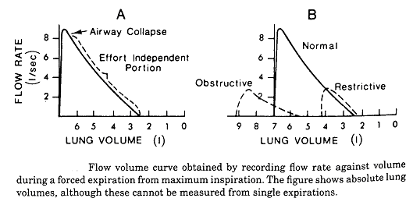
Tests of Pulmonary Function
Restrictive disease → max flow rate is reduced as is total volume exhaled
Obstructive disease → low flow rate in relation to volume; scooped out
appearance following the point of maximum flow

Slide 147
Tests of Pulmonary Function
Restrictive diseases
→ inspiration is limited by reduced compliance of the lung or chest
wall, or weakness of the inspiratory muscles
Obstructive diseases
→ total lung capacity is abnormally large, but
expiration ends prematurely
→ early airway closure due to increased smooth muscle tone of
bronchi, loss of radial traction from surrounding parenchyma
FEV
→ reduced with increase airway resistance or a reduction in elastic recoil
of the lung
Notes:
Reason for reduced FEV is due to dynamic compression of the airways

Slide 148
Tests of Pulmonary Function
Lung volumes:
Lung volumes measures by spirometry
FRC measured by helium dilution and body plethysomgraphy
FRC can also be measured by having the patient breathe 100% O2 for several minutes and washing all the N2 out of the lung

Slide 149
Tests of Pulmonary Function
Ventilation – Perfusion relationships:
Topographical distribution of V/Q
→ radioactive xenon
Single breath and multiple breath methods
→ measuring N2 % concentration changes in expired breath as an index of uneven ventilation
With V/Q mismatch → different units of the lung have N2 diluted at different rates
Fast ventilated alveoli cause a rapid fall in N2, where as slow (poorly) ventilates areas have a slow fall in N2

Slide 150
Tests of Pulmonary Function
Ventilation – Perfusion relationships:
A- a gradient
Determination of shunt fraction
Determination of physiologic dead space (normal is ~ 30% f tidal volume)

Slide 151
Tests of Pulmonary Function
Blood gas analysis and pH
Mechanics of breathing
Lung compliance
→ esophageal pressure measurements as a surrogate for
intrapleural pressure
→ ΔV / ΔP at “no flow points” (end inspiration or end expiration).
At these points, intraplueral pressure reflects only the elastic
recoil forces and not those associated with airflow
Airway resistance
→ resistance is the pressure difference between the alveoli and the
mouth per unit airflow
→ measured by body plethysmograph

Slide 152
The End

