Slide 1
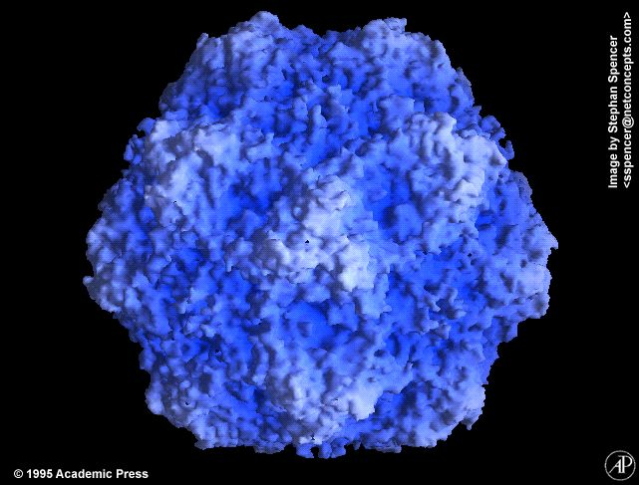
Canine Parvovirus
Clare Hyatt, DVM, MS
Emergency/Critical Care Resident
Cornell University

Slide 2
Parvovirus
Etiology
Epidemiology
Pathogenesis
Clinical illness
Diagnosis
Treatment
Prevention
Prognostication

Slide 3
Etiology
Parviviridae
Small nonenveloped single stranded DNA virus
  Survives in environment 5-7 months
Possibly derived from feline panleukopenia virus or wildlife parvoviral strains
CPV-2 - 1978
  CPV-2a – 1980’s
  CPV-2b – 1984
  CPV-2c – 2000

Slide 4
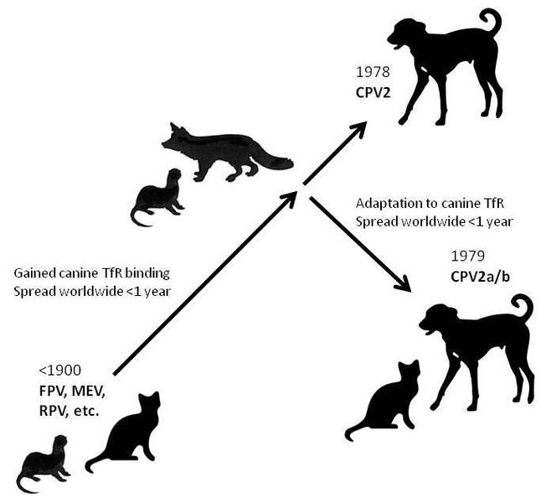
Etiology
CPV-2c
  2000 – Italy
    Also reported in Spain and Vietnam
    Glu substitution in lieu of Asn or Asp at residue 426 of capsid protein VP2
      Involves majr antigenic site (epitope A)
      Results in change in antigenicity that was detectable by monoclonal antibodies
    US
      Confirmed cases in 27 states – coast to coast (Hong et al J Vet Diag Invest 2007)
      “Probably widespread”
  Produce similar clinical syndromes
Notes:
Genetic sequencing of virus type probably not needed

Slide 5
Etiology
CPV-1
  Canine minute virus
  Subclinical to severe illness in specific-pathogen-free puppies
  Gastrointestinal and respiratory disease
  Most asymptomatic
  Experimental disease generally mild but fatalities reported
  Bocavirus genus of Parvoviridae

Slide 6
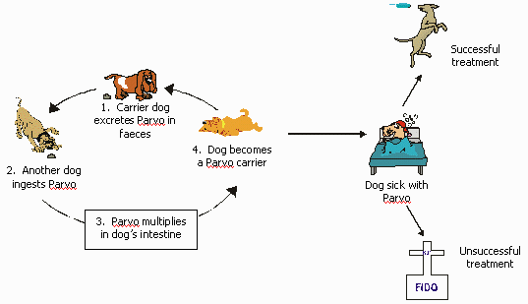
Epidemiology

Slide 7

Epidemiology
Highly contagious
6 week – 6 month old puppies
Most canidae susceptible
  Domestic dogs, bush dogs, coyotes, crab-eating foxes, maned wolves
  Experimentally in ferret, mink, cats
Infection conveys long term immunity
July-September

Slide 8
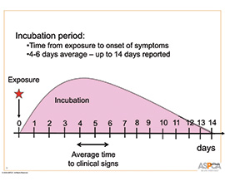
Epidemiology – incubation period

Slide 9
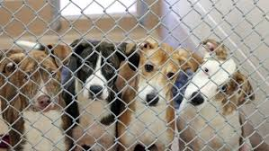
Epidemiology
Risk factors
  Lack of protective immunity
  Unsanitary conditions/overcrowding
  Endoparasites
Breeds at higher risk
  Rottweiler*
  Doberman Pinscher*
  Pit bull
  Labrador retriever
  German Shepherd
Notes:
Possible genetic predisposition
Rott: inherited immunodeficiency
Dobie: vWD / common ancestry

Slide 10
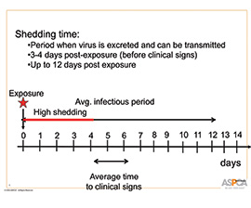
Pathogenesis
Fecal-oral route of infection
Rapidly dividing cells
Once infected:
  0-2 days – from oropharynx to lymphoid tissues
  3-5 days – viremia maximum
Fecal shedding
Notes:
In utero-2 weeks age – myocarditis can occur only at time of rapid myocardial cell proliferation

Slide 11
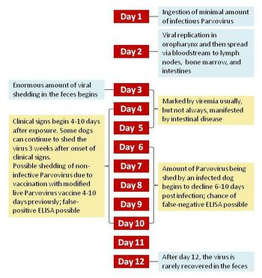

Slide 12

Pathogenesis
In puppies <2 weeks:
  Lymphoid tissue
  Intestinal epithelium
  Bone marrow
  Myocardium
Puppies >2 weeks age
  Lymphoid tissue
  Intestinal epithelium
  Bone marrow

Slide 13
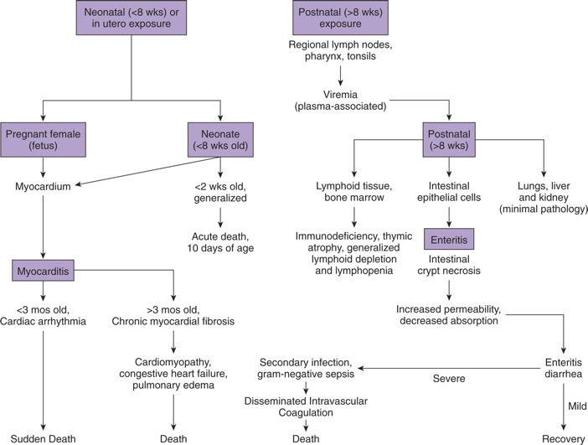

Slide 14
Pathogenesis - Myocarditis
Occurs during time of rapid cell proliferation
  In utero → 2 weeks
  Unvaccinated dams
    Rare now due to maternal vaccination
  Usually all puppies affected
  Generally found dead or dead within 24 hours
  Clinical signs – dyspnea, crying, retching
  Histopathology
    Focal necrosis or lysis of myofibers with out without inflammation.
    Intranuclear inclusion bodies can be seen

Slide 15
Pathogenesis – lymphoid tissue
Lymphoid tissue
Decreased lymphocytes
Lymphoid necrosis
Notes:
Oropharyngeal lymphoid tissue, mesenteric lymph nodes, thymus affected initially but will affect all lymph tissue
Thymus – germinal centers and thymic cortex – extensive lymphocytolysis
Moves to intestinal crypts within 3-4 days
Higher rates of turnover is associated with more severe disease – ie co-morbidities such as parasitic infection, weaning

Slide 16
Pathogenesis - gastrointestinal
Blood (viremia)
Germinal epithelial crypts
Collapse of intestinal epithelium
Loss of absorptive capacity
Hemorrhagic diarrhea

Slide 17
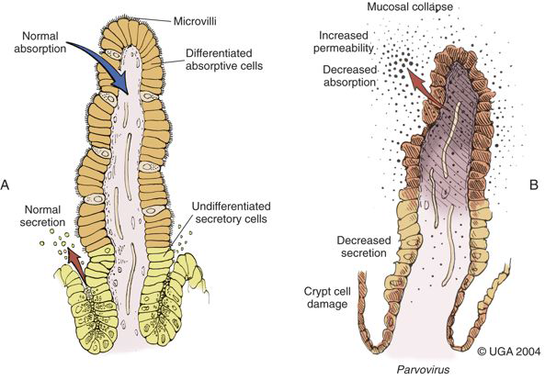
Notes:
Epithelial necrosis
Villous atrophy
Collapse +/- disruption of lamina propria
Worse in recently weaned pups → increased mitosis due to diet change leading to change in flora

Slide 18
Pathogenesis - brain
Diffuse leukoencephalomalacia
Liquefactive necrosis of cerebral white matter
  Secondary to severe cardiac lesions
    Cerebral hypoxia/ischemia

Slide 19
Clinical illness
Initially vague
  Lethargy, inappetance, fever
Vomiting, diarrhea –
  May be hemorrhagic
  24-48 hours if initial clinical signs
  May result in dehydration and/or hypovolemic shock
Abdominal pain
  Gastroenteritis
  Intussusception
Notes:
Shock clinical signs – impairment in tissue perfusion, changes in mentation, prolonged CRT, tachycardia, poor pulse, hypotension, cool extremities, low temp

Slide 20
Clinical illness
Anemia
  Not uncommon in later phases
  Decreased erythropoiesis
  Intestinal hemorrhage/rehydration
Thrombocytopenia
  Decreased production
  Hemorrhagic manifestations rare

Slide 21

Clinical illness
Neutropenia
Lymphopenia
Monocytopenia
  May rebound before neutrophil counts
Panleukopemia
  Severe cases
Notes:
Neutropenia – attributed to destruction of mitotically active myeloblasts in bone marrow as a direct effect of the virus. May also be related to endotoxemia and possible sepsis leading to neutrophil margination, and loss of neuts thru the intestinal wall.
Lymphopenia – endogenous release of cortisol leading to redistribution of lymphs and trapping of lymphs in nodes, direct action of virus – destruction/atrophy of lymphoid tissue, loss, sequestration, blockage of flow of lymph
Monocytes – number and potentially phagocytic ability affected

Slide 22

Clinical illness
Nonspecific serum chemistry findings
  Azotemia
  Hepatocellular enzyme elevations
  Hypoalbuminemia
  Hypokalemia
  Hypoglycemia
  Hypocholesterolemia
Notes:
Azotemia – prerenal
Liver enzymes – dehydration, tissue hypoperfusion, age related
Alb – GI losses, inad intake
K+ - GI losses
BG – sepsis, malnutrition

Slide 23

Clinical illness
Systemic manifestations
  SIRS / sepsis
  ARDS
  Hypercoagulable state without DIC

Slide 24
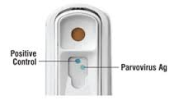
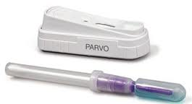
Diagnosis
Detection in feces
  ELISA
  Shedding d3-12 post infection
  False positive – 3-10d post vax with MLV
  False negative – neutralizing antibodies in feces

Slide 25
Diagnosis
Serology
  Antibodies detectable with clinical signs
  Titers increase rapidly, remain elevated for years
  25-90 unvaccinated dogs are seropositive secondary to clinical or subclinical infection
  Must detect IgM combined with clinical signs for confirmation of infection

Slide 26
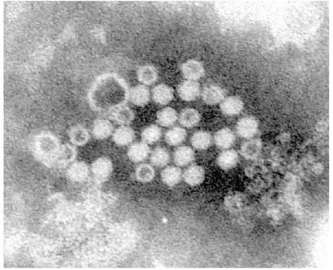
Diagnosis
Necropsy and histopathology
Polymerase chain reaction
  Higher sensitivities/specificities
Electron micropsopy
Stool hemagglutination
Latex agglutination
Counterimmunoelectrophoresis

Slide 27
Diagnosis
Radiographs – nonspecific findings
  Gas/fluid filled intestines
Ultrasound – not pathognomonic
  Fluid filled atonic mucosal small or large intestines
  Duodenal/jejunal mucosal thinning
    +/- Indistinct wall layers and irregular luminal/mucosal surfaces
  Extensive duodenal +/- jejunal hyperechoic mucosal speckling
  Duodenal or jejunal corrugations

Slide 28
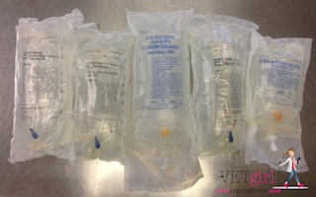
Treatment
Supportive care
Inpatient
  Intravenous fluids
  Intravenous antibiotics
  Antiemetics
Outpatient
  Subcutaneous fluids
  Oral or intramuscular/subcutaneous antibiotics
  Antiemetics
Notes:
Some data to sugget outpatient therapy can be very nearly as successful as inpatient therapy

Slide 29
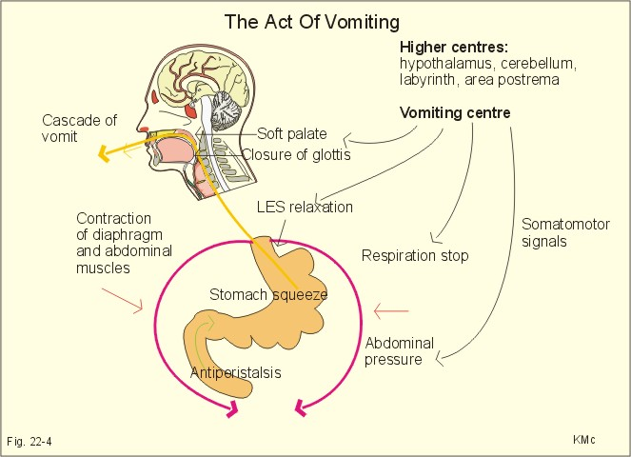
Notes:
Vomiting center in medulla coordinates.
Afferent to vomiting center from: vestibular system, back of the throat, GI tract, and CRTZ in fourth ventricle.
Reverse peristalsis begins in SI; relaxation of stomach/pylorus; forced inspiration to increase abdominal pressure; movement of larynx upward and forward and relaxation of the lower esophageal sphincter; closure of the glottis; and forceful expulsion of gastric, and sometimes duodenal, contents.
In retching, the upper esophageal sphincter remains closed, and because the lower esophageal sphincter is open, the gastric contents return to the stomach when the retch is over

Slide 30
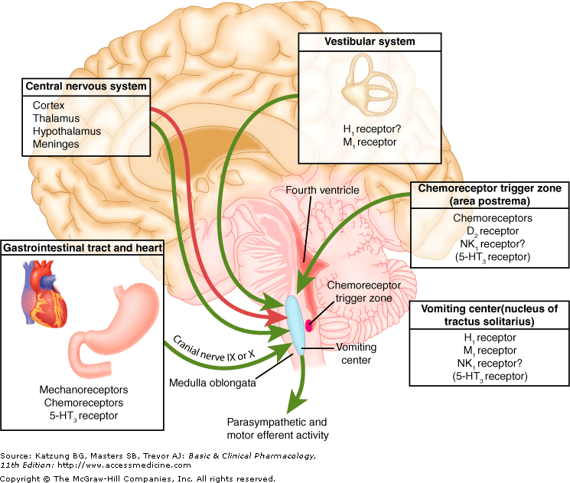

Slide 31
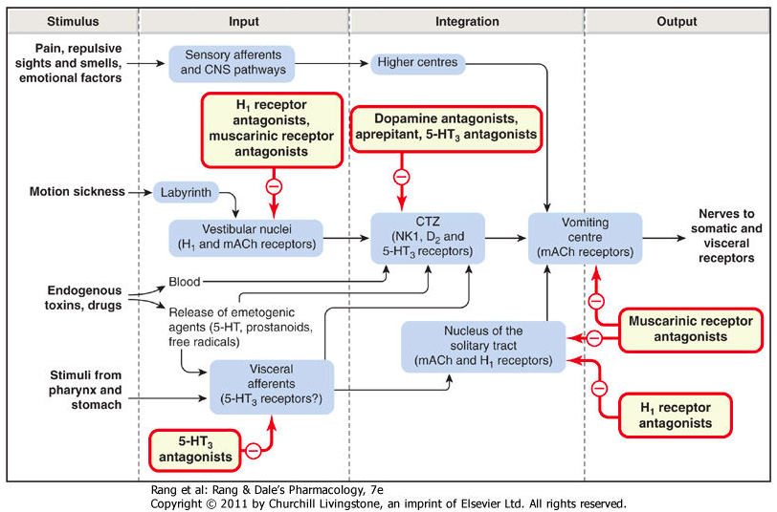

Slide 32
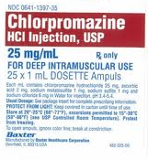
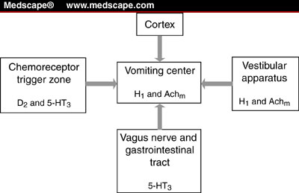
Treatment - Chlorpromazine
Phenothiazine
Notes:
Blocks CRTZ and emetic center
Sedative

Slide 33
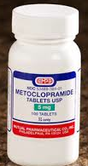
Treatment - Metoclopramide
Dopaminergic antagonist
Notes:
CRTZ
Increases GI motility

Slide 34
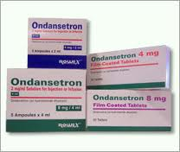
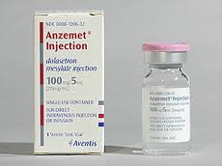
Treatment – 5-HT₃ antag
Ondansetron / dolasetron
5-HT₃ antagonist
Notes:
5-HT3 (hydroxytryptamine) receptors found in the CRTZ and vagal nerve terminals
Unsure if peripheral/central
Low oral bioavailability

Slide 35

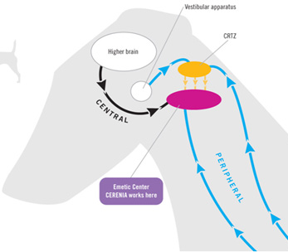
Treatment - Maropitant
NK-1 antagonist
Notes:
Neurokinin-1 (NK-1) antagonist – inhibiting binding of substance P (neuropeotide of the tachykinin family. Substance P is found in the nuclei of the emetic center. Suppresses both centrally and peripherally transmitted emetic signals.
Tablets: Approved for use in dogs 8 weeks and older Injectable: dogs 8 weeks and older, cats 16 weeks and older
Puppies <11weks – has seen BM hypocellularity compared to control dogs
Have seen dose dependent inappetance and weight loss

Slide 36

Treatment - Antibiotics
Broad spectrum
  Potentiated penicillin and third generation cephalosporin
  Potentiated penicillin and aminoglycoside
  +/- Metronidazole
Notes:
Disruption of the intestinal barrier and severe leukopenia.

Slide 37

Treatment – Enteral nutrition
Early enteral nutrition via NE tube has shown to be associated with earlier clinical improvement
  Weight gain
  Improved gut barrier function
Compared to puppies held NPO until vomiting ceased

Slide 38
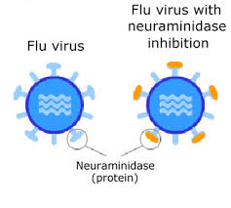
Treatment - Oseltamivir
Neuraminidase inhibitor (influenza virus)
Prevents cleavage of sialic acid residues
  Necessary for liberation of newly formed virus particles and decreased aggregation to facilitate viremia
CPV does not rely on NA

Slide 39
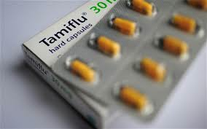
Oseltamivir – human studies
  Decreased development of bacterial infection
    Decreased permeation through mucin layer of respiratory epithelial cells
      NA required
    Gut epithelial – could have inhibitory effects on bacterial permeation through the mucin layer
      Decreased bacterial translocation and decreased endotoxemia

Slide 40

Oseltamivir
Studied in a group of parvoviral infected dogs
Control group – lost 4.5% body weight
Treatment group – lost 2.6% body weight
No clear advantage to the use of oseltamivir

Slide 41
Treatment-Serum immune plasma
Plasma from dogs recovered from parvoviral infection
High titers of antibodies to CPV-2
Thought to neutralize free virus in plasma
Single dose had no effect on viremia, duration of hospitalization, or cost of treatment
Recombinant bactericidal permeability-increasing protein (rBPI₂₁)

Slide 42
Treatment - rBPI₂₁
Recombinant bactericidal permeability-increasing protein
Produced and stored in azurophilic granules of PMN cells
Cytotoxic to gram-neg bacteria
High affinity binding for lipid-A component of LPS to amino-terminal domain of BPI
  Outer membrane permeability → bacterial death
Binding to free LPS prevents interactions with host cells and inhibits endotoxin-induced inflammatory responses
No proven benefit in parvoviral infections

Slide 43


Prevention
Vaccination recommendations
First dose between 6-9 weeks
  Repeat q3-4 weeks until 16 weeks of age
Booster 1 year later, then q3yr
Nonresponders identified

Slide 44

Prevention
MLV vaccine – attenuated vaccine of canine origin
High titer / low passage
Retains some ability to infect – does not cause disease
Cross protection between CPV-2, CPV-2a, CPV-2b, CPV-2c
Notes:
High titer – amt of virus in dose
Low passage - # times virus is grown in tissue culture

Slide 45
Prognostication
C-reactive protein
  Liver
  Released following pro-inflammatory cytokine release
  Short half life
  Increased in sepsis, pancreatitis, neoplasia, erhlichiosis, leptospirosis, leishmaniasis
Higher CRP values at 12 and 24 hours corresponded with shorter survival
Higher CRP values at 12, 24, 36 hours corresponded with longer hospitalization
Should not use CRP alone as prognosticator for survival

Slide 46

Prognostication
High serum baseline cortisol – associated with death
Decreased total T4 – associated with death

Slide 47
Prognostication
JVIM 2008
  NSD in segmented neutrophils between survivors and nonsurvivors
  Survivors developed a degenerative left shift compared to nonsurvivors
  Survivors had significant increase in lymphocytes between admission and 24 hours postadmission
    Count remained significantly higher throughout hospitalization

Slide 48

Prognostication
Lack of cytopenia had PPV of 100% for survival 24 hours post admission

Slide 49
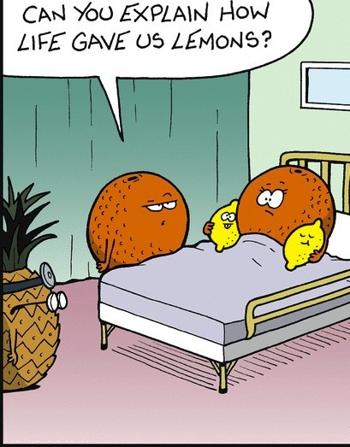
Questions??

Slide 50
