Slide 1
M&M ROUND
By Jo-Annie Letendre, DVM
Residents Board Review

Slide 2
Signalment
4 year old
Female spayed
Maltese mixed
Notes:
This round is a bout a 4 year old female spayed maltese mixed

Slide 3
Presenting complaint
O1/09/2015
Referred by rDVM for possible multiple organ failure
Notes:
Who presented to CUHA as a referral for possible MOF

Slide 4
History of the present illness
01/06/15 pm (Tuesday)
  Not acting as usual; “does not seem comfortable”
  Tremors/shivering
  Vomiting – “big chunks of bone”
  Diarrhea with blood and mucus
  Not eating; still drinking but will vomit it back up
  AM: Ham bone ingestion
Notes:
The CS started on Tuesday January 6th. She ate a ham bone in the morning and later during the day she started tremoring and shivering and not acting herself. She also vomited once and and a diarrhea with blood and mucus. She did not eat for the rest of the day. She was still drinking but not able to keep the water down.

Slide 5
Past medical issues
UTD on vaccination
No current medications
No significant health history except occasional UTI
No travel history
Only pet in the household

Slide 6
History of the present illness
01/07/15 am (Wednesday)
  Presented to her rDVM
  Physical examination Heart rate: 176 bpm; respiratory rate: 36 breath/min
    Dehydrated 3-5%
    Mild abdominal tenderness
    Scant bloody mucus on rectal examination
  Imaging
    2 view abdominal radiographs
      Mineralized opacities throughout intestinal tract – no mechanical obstruction
Notes:
The following day, she presented to her vet
PE showed a HR of 176 and a RR of 36
She was slighlty dehydrated.
Her abdomen was painful with palpation and there was a small amount of bloody mucus on rectal examiantion
2 view abdominal xrays were performed – which showed mineralized opacities throughout the intestinal tract but no evidence of mechanical obstruciton

Slide 7
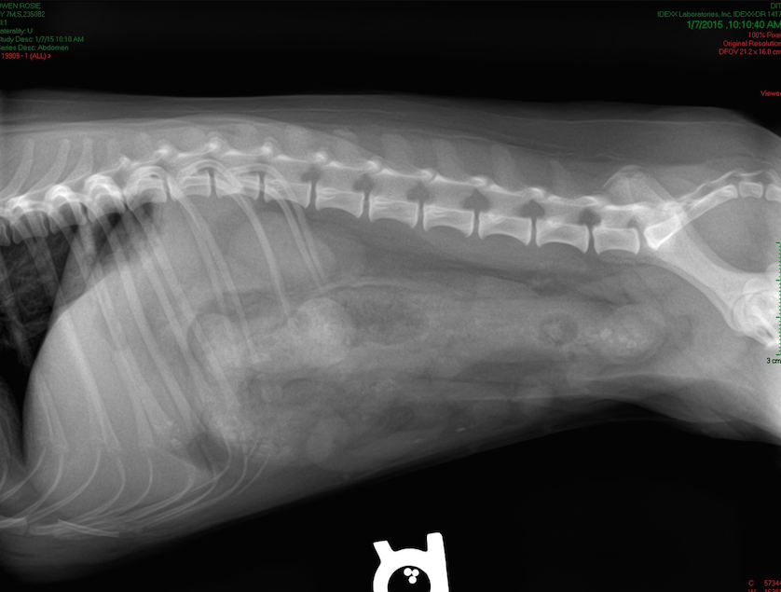

Slide 8
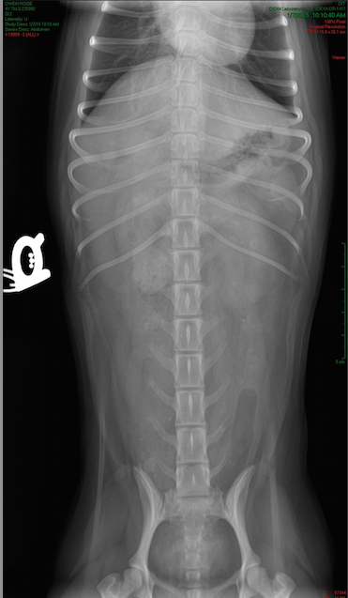

Slide 9
History of the present illness
01/07/15 am (Wednesday)
  Blood work
    Hematology
      Leucopenia: 2.48 (5.05-16.76 K/uL)
      Neutropenia: 1.28 (2.95-11.64 K/uL)
      Eosinopenia: 0.02 (0.06-1.23 K/uL)
      Lymphopenia: 1.02 (1.05-5.10 K/uL)
      Reticulocytes: 127.0 (10.0-110.0 K/uL)
      Suspected NRBCs
      Suspected bands
    Blood smear:
      Mild anisocytosis, mild poikilocytosis
      No bands
      Platelets: 4-10/hpf
Notes:
Blood was submitted to the lab for CBC and Chem
Leucopenia with neutropenia was reported, as well as eosinopenia and lymphopenia. There was no bands
Thrombocytopenia based on blood smear evaluation
IDEXX VetLab In-clinic

Slide 10
History of the present illness
01/07/15 am (Wednesday)
  Blood work
    Biochemistry
      Calcium: 7.8 (7.9-12.0 mg/dL)
      Chloride: 106 (109-122 mmol/L)
      Cholesterol: 99 (110-320 mg/dL)
      GGT: 9 (0-7 U/L)
      Phosphate: 7.9 (2.5-6.8 mg/dL)
      Potassium: 3.1 (3.5 – 5.8 mmol/L)
      Albumin: 2.1 (2.3-4.0 g/dL)
      ALP: 330 (23-212 U/L)
      ALT: too high
      Creatinine: too high
      Total protein: 4.6 (5.2-8.2 g/dL)
Notes:
On the biochemistryL

Slide 11
History of the present illness
01/07/15 am (Wednesday
  Fecal
    Gram stain
      60% gram negative
      40% gram positive
      Rare clostridium
Treatments
  IVFT with LRS supplemented with B vitamins
  Cerenia
  Famotidine
  Metronidazole
  Buprenorphine
Notes:
Fecal stain was also performed
She was admitted to the hospital on IVFT with LRS supplemented with B vitamins, famo, metro and buprenorphine

Slide 12
History of the present illness
01/07/15 pm (Wednesday)
  Trembling
  Body temperature: 94.5
    → heat support; continue to decrease (to 92.7); 99.9 by the following am
  Dull mentation
  Blood glucose: 22 mg/dL
    →3 cc 50% dextrose orally; supplementation of IVF with 5% dextrose
    Blood glucose q 2h: resolution of hypoglycemia with dextrose supplementation
  Anorexia
  No vomiting
  Large amount of frank blood in diarrhea
    → Ampicillin/sulbactam, enrofloxacin, sucralfate
Notes:
During the day, she developped hypothermia, which was addressed with heat support
Her mentation became progressively dull
A BG was checked at that time and identified hypoglycemia
A bolus of dextrose was given po and IVFT was supplemented with dextrose.
BG was monitored and hypoglycemia resolved with dextrose supplementation
She remained anorexic but did not vomit
She continued to have diarrhea with frank blood – Unasyn and baytril were started at that time, as well as sucralfate

Slide 13
History of the present illness
01/08/15 am (Thursday)
  Bright, alert, responsive
  Body temperature: 99.9
  Blood glucose: 404 mg/dL
    →D/C dextrose supplementation
  Abdomen still tense
  Anorexia
  No vomiting
  Persistent bloody diarrhea
Notes:
The following day – she was brighter, alert and responsive
Her T was
BG was elevated so the dextrose supplementation was d/c
Her adbomen was still tense
There was no vomiting, but she was not eating
Diarrhea was still present

Slide 14
History of the present illness
01/08/15 am (Thursday)
  New diagnostics
    Biochemistry
      ALT: > 10000 (10-100 U/L)
      Creatinine: 3.2 (0.5-1.8 mg/dL)
      BUN: 45 (7-27 mg/dL)
      Phosphate: 8.5 (2.5-6.8 mg/dL)
      Albumin: 1.6 (2.3-4.0 g/dL)
      Total protein: 3.5 (5.2-8.2 g/dL)
      Globulins: 1.9 (2.5-4.5 g/dL)
      ALP: 403 (23-212 U/L)
      GGT: 13 (0-7 U/L)
      Calcium: 6.9 (7.9-12.0 mg/dL)
      Cholesterol: 92 (110-320 mg/dL)
Notes:
Biochemistry was repeated
ALT and creatinine were readable following dilution
BUN was elevated as well as phosphate (was 7.9)
ALP and GGT were more elevated
TP and albumin were lower as well as calcium and cholesterol

Slide 15
History of the present illness
01/08/15 am (Thursday)
  New diagnostics
    Urinalysis
      USG: 1.020
      NSF
    PCV/TP
      38%/3.8 g/dL
Notes:
A UA was performed – USG was 1.020
PCV/TP was 38 and 3.8

Slide 16
History of the present illness
01/08/15 (Thursday)
  Regurgitated several times
    → Metoclopramide CRI and ondansetron
  Elevated liver enzymes
    → Lactulose, Denamarin, and Ursodiol
  Repeat abdominal radiographs - reviewed by DACVR
    Liver: normal in volume and contour
    Intra-abdominal adipose tissue is altered in its opacity
  Abdominal US vs aFAST?
    Fluid/sludge in stomach
    Altered liver but normal in size
    Distended gallbladder containing sludge
Notes:
Throughout the day, she started regurgitating
Metoclopramide CRI and ondansetron were added to her Tx plan
Because the liver enzymes were more elevated: lactulose, denamarin and ursodiol were started
Abdominal xrays were repeated and reviewed by a DACVR
There is mention of ultrasonographic findings in the rDVM medical records but it is not known if it is a full abdominal US or aFAST and who performed the exam –
There was……
Recommended abdominal US

Slide 17
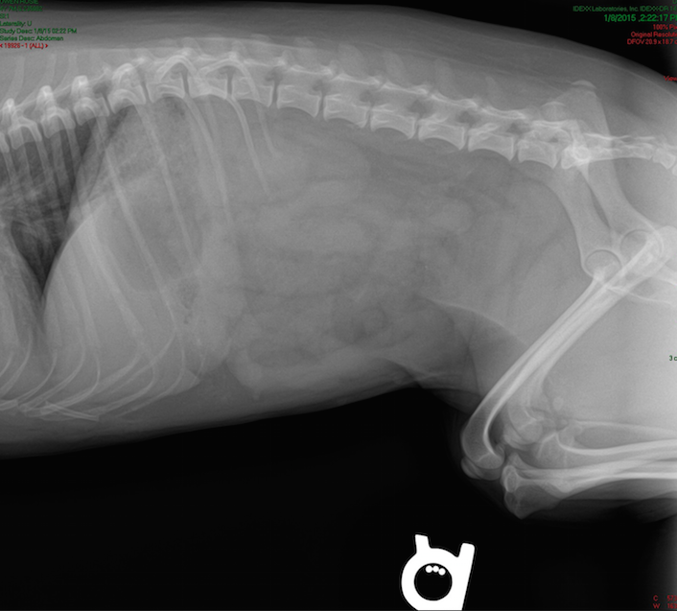

Slide 18
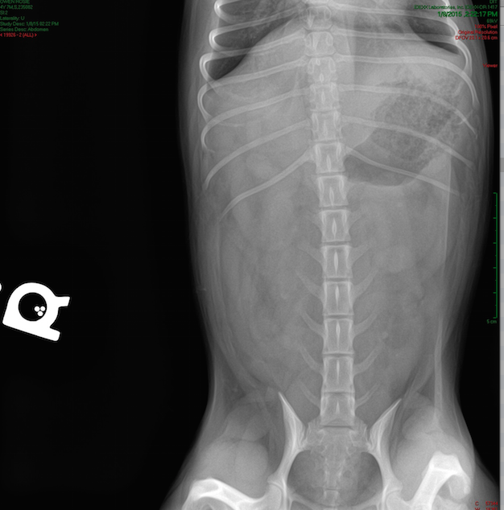

Slide 19
History of the present illness
01/09/15 am (Friday)
  Dull, mentally appropriate, semi-alert =?
  Body temperature: 99.1
  Abdomen still tense, worse
  Anorexia
  No vomiting but regurgitation (mucous with blood)
  Diarrhea (no blood)
Notes:
The following day – the rDVM medical record reported a dull mentally appropriate, semi-alert mentation
Body temperature was 99.1
Her abdomen was more tense
She was still not eating
There was no vomiting but continued to regurgitate mucous with blood
There was still diarrhea, but no blood.

Slide 20
History of the present illness
01/09/15 am (Friday)
    New diagnostics
      Biochemistry
        ALT: 8043 (10-100 U/L)
        GGT: 12 (0-7 U/L)
        ALP: 238 (23-212 U/L)
        Total bilirubin: 1.9 (0.0-0.9 mg/dL)
        Creatinine: 3.8 (0.5-1.8 mg/dL)
        Phosphate: 8.7 (2.5-6.8 mg/dL)
        BUN: 66 (7-27 mg/dL)
        Total protein: 3.6 (5.2-8.2 g/dL)
        Globulins: 2.0 (2.5-4.5 g/dL)
        Albumin: 1.6 (2.3-4.0 g/dL)
        Calcium: 5.2 (7.9-12.0 mg/dL)
        Cholesterol: 116 (110-320 mg/dL)
Notes:
Biochemistry was repeated again
Panhypoproteinemia was the same
Calcium and cholesterol normalized
BUN increased from 45 to 66
Phosphate was the same
Creat increased from 3.2 to 3.8
Bilirubin was now elevated at 1.9
Liver enzymes were still elevated

Slide 21
History of the present illness
01/09/15 pm (Friday)
  Respiratory distress: tachypnic, significant effort, SpO2 = 88-89%
    →Thoracic radiographs
      Alveolar pattern in cranial left lung lobe
      Scant pleural effusion
    Oxygen supplementation – oxygen chamber
      Improved breathing
Referral to Cornell
  Deemed stable
Notes:
Throughout the day, she developped respiratory distress – with tachypnea, significant effort and a SpO2 of 88-89 on room air
Thoracic xrays were performed which showed an alveolar pattern in the cranial LLL and scant pleural effusion
Respiratory effort improved with oxygen supplementation
A transfer to Cornell was recommended.

Slide 22
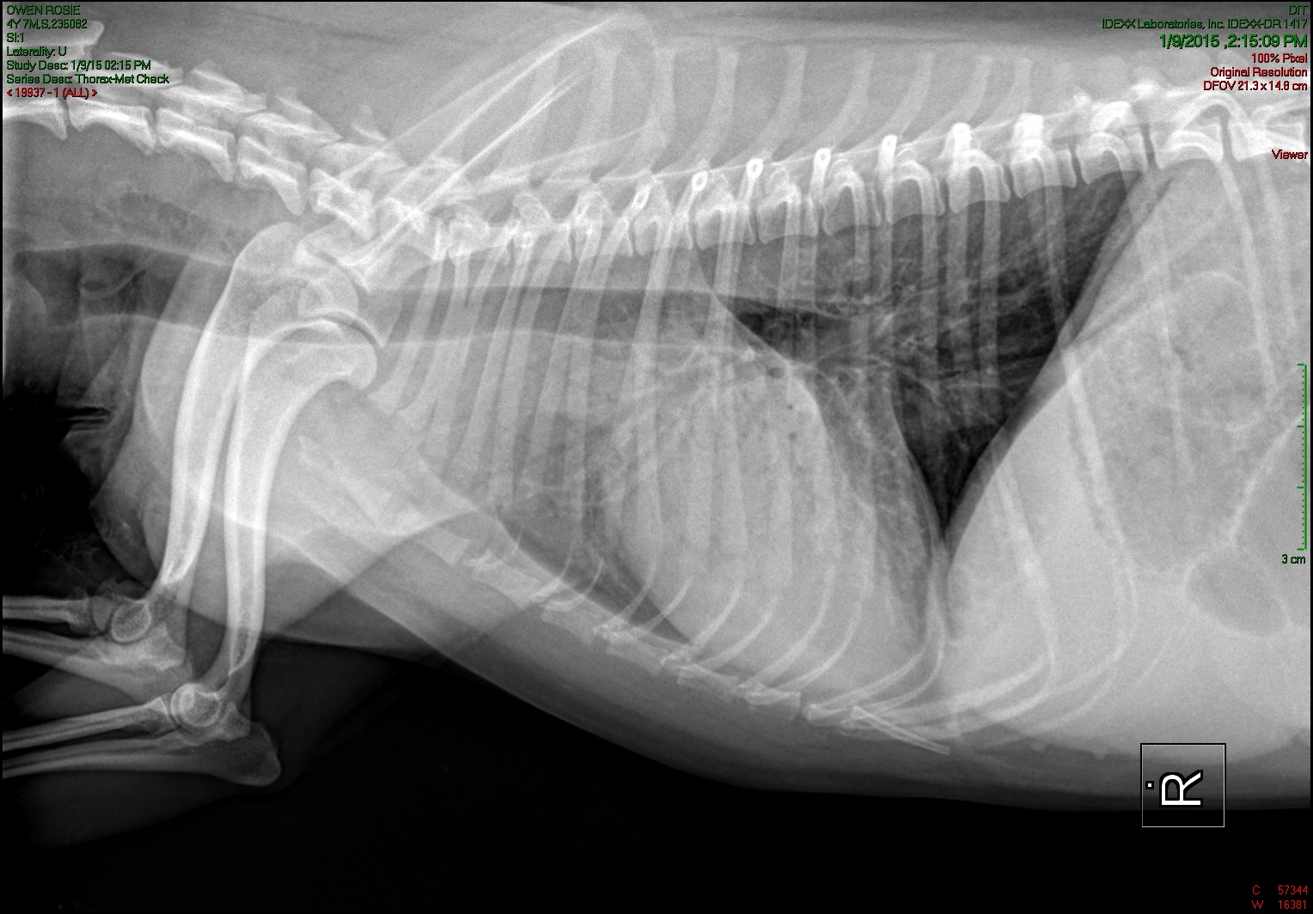

Slide 23
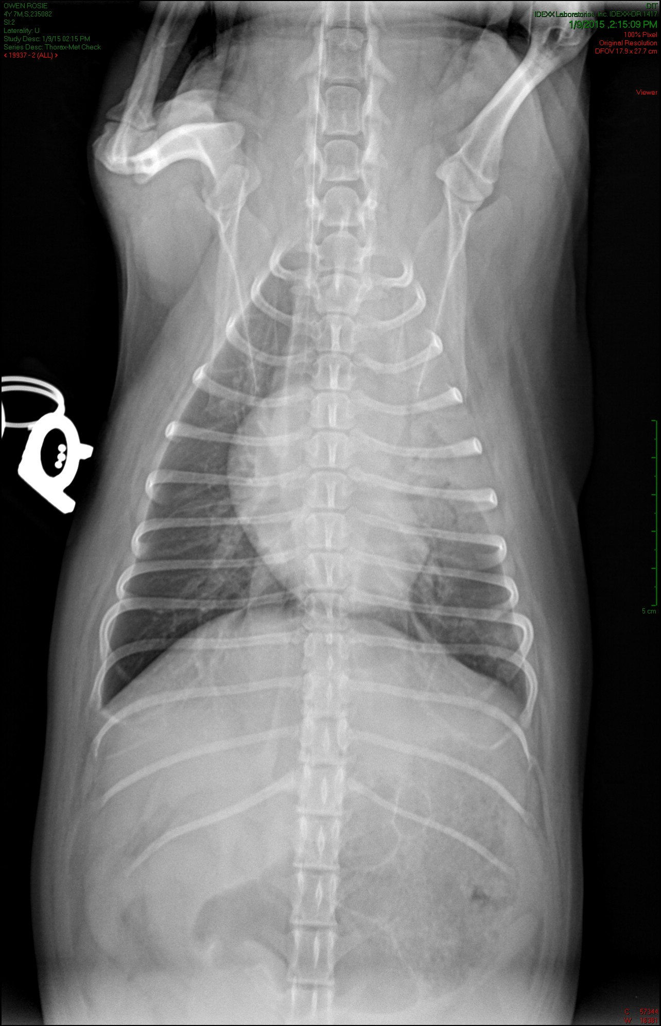

Slide 24
Initial assessment at the
Emergency Department
Temperature: 100.5
HR: 120 bpm
  Pulse quality: fair to poor
RR: 60 breaths/min
  Increased respiratory effort, harsh lung sounds (*left lung fields)
MM: pink, slightly icteric, and tacky, CRT < 2 secs
ECG: normal sinus rhythm
Blood pressure: 94/65 (74) mmHg; Doppler: 80 mmHg
SpO2: 92-93%
  →Responsive to oxygen flow-by
Notes:
When she arrived at Cornell, she had a temp of 100.5, HR of 120 with fair to poor PQ, RR of 60 with increased RE, harsh lung sounds worse in the left LF
Her MM were pink and tacky with a CRT < 2
ECG was WNL
BP with Cardell was and with doppler..
SpO2 was 92-93 on room air – she responded to oxygen flow-by

Slide 25
Physical examination
Body weight: 3.57 kg BCS: 5/9
General appearance: dull mentation, weak, mildly icteric mucous membranes
Integumentary: initially normal; ecchymosis/petechiations on ventral abdomen
Digestive: abdomen tense and painful
Notes:
She had a dull mentation and was weak.
Her skin was initially normal, but later during examination she developped eccchymosis and petechiations on the ventral abdomen
Her abdomen was tense and painful

Slide 26
Initial assessment at the
Emergency Department
QATS
  PCV/TP: 30%/4.4 g/dL
  Azo: 30-40
Lactate: 0.9
PT/aPTT: 19/142 (12-17/71-102 seconds)
Gaslyte
  pH: 7.315
  pCO2: 38.3
  HCO3: 19.1
  BE: -7.1
  An Gap: 14.9
  Na+: 140.5
  K+: 5.42
  Ca++: 1
  Cl-: 112
  Glu: 113
  HCT: 33
Blood smear: 5 plt/hpf; leukopenia, no bands, mild toxic changes, no evidence of polychromasia
Blood type: DEA 1.1 positive
VERY difficult to collect blood
Notes:
An IV was placed and blood collected for QATS and gaslyte
Blood sampling was difficult and we did not get enough blood for a CBC/chem – was possible to blood type – DEA 1.1 +
We were able to collect blood for a PT/aPTT in a syringe filled with citrate
PCV/tp was 30/4.4
Azo 30-40
PT and aPTT were slighlty prolonged 58% - 39%
Lactate was 0.9
Gaslyte showed:
On the blood smear, there were approximately 5 plt/hpf, evidence of leukopenia, no bands, mild toxic changes

Slide 27
Stabilization
IVFT : Plasmalyte-R
  Total of 165 ml (46 ml/kg) as boluses
  Minimal improvement in BP: up to 86 mmHg
Methadone 0.2 mg/kg IV
Oxygen supplementation flow-by
Notes:
IVFT boluses were given with P-lyte a total of 46 ml/kg was given as boluses
Minimal improvement in BP (up to 86)
Methadone 0.2 mg/kg was given to address abdominal pain
Oxygen supplementation flow-by while in the ER

Slide 28
Additional diagnostic tests
aFAST: negative for free fluid
tFAST: negative for free fluid, gliding sign; appropriate cardiac contractility
USG: 1.009
Notes:
Afast and t fast were negative for free fluid
USG was 1.009

Slide 29
Problem list
History
  Hemorrhagic diarrhea
  Vomiting; then regurgitation
Physical examination
  Hypotension
  Increased respiratory effort/hypoxemia – oxygen responsive
  Dull mentation, weakness
  Icteric
  Painful abdomen
  Ecchymosis/petechiations
  Dehydration
Blood work
  Elevated liver enzymes (ALT, GGT, ALP)
  Hyperbilirubinemia
  Prerenal azotemia
  Hyperphosphastemia
  Panhypoproteinemia
  Anemia (non-regenerative)
  Thrombocytopenia
  Leucopenia
  Prolonged PT/aPTT
  Metabolic acidosis
  Hyperkalemia
  Hyponatremia
  Ionized hypocalcemia
SHOCK
LUNG
LIVER
KIDNEY
COAGULATION
Notes:
List of abnormalities include
Problem list included shock, respiratory distress/hypoxemia, elevated liver parameters, elevated renal parameters
Anemia, leukopenia, thrombocytopenia
Coagulopathy
Hypoglycemic event at rDVM

Slide 30
Differential diagnosis
Digestive vs extra-digestive: Dietary indiscretion/intolerance, infection, inflammation, neoplasia, Addison’s, pancreatitis; esophagus
GI signs
Hypotension
Resp. signs
Elevated liver enzymes/bilirubin:
Prerenal azotemia /Hyperphosphastemia
Panhypoproteinemia
Anemia (non-regenerative)
Thrombocytopenia
Leucopenia
Prolonged PT/aPTT
Shock: hypovolemic, distributive
Aspiration pneumonia, infectious pneumonia, pulmonary edema, ARDS, neoplasia
Primary vs secondary hepatopathy (inflammation, infection, neoplasia), cholestasis
AKI, infection, toxic, neoplasia
Decreased production, loss (GI/renal)
Decreased production (chronic disease, bone marrow),
loss (GI), destruction, sequestration; infection, neoplasia
Hepatopathy, DIC
Notes:
I wont go over the possible differential diagnoses for every abnormalities

Slide 31

Working diagnosis
  Severe sepsis/SIRS
    Secondary to pancreatitis/dietary indiscretion;
    Leading to AKI, liver dysfunction, coagulopathy;
    Regurgitation with secondary aspiration pneumonia
Notes:
Our working diagnosis at this point was severe sepsis/SIRS secondary to possibly secondary to pancreatitis or dietary indiscretion caused by ham and bone ingestion – this leads to AKI, liver dysfunction and coagulopathy, and regurgitation with secondary aspiration pneumonia

Slide 32
Plan
  Therapeutic
    Continue antibiotic therapy
      Metronidazole 10 mg/kg IV q12h
      Enrofloxacin 10 mg/kg IV q24h
      Ampicillin/sulbactam 22 mg/kg IV q8h
    Continue antiemetics
      Ondansetron 0.2 mg/kg IV q12h
      Maropitant 1 mg/kg IV q24h
    Pain management
      Fentanyl CRI 2 mcg/kg/h
    Liver support
      N-acetylcysteine 140 mg/kg IV once; then 70 mg/kg IV q6h x 4 doses
      Vitamin K 0.5 mg/kg SQ q12h x 3 doses
    Fresh frozen plasma transfusion
      10 ml/kg = 40 ml – given over 2 hours
    Oxygen chamber
    Heat support: 98.6
Notes:
Our plan was to admit the dog to the ICU to continue ATB with metronidazole, enro and unasyn, continue antiemetics ondansetron and cerenia. Pain management with fentanyl CRI
Liver support with NAC and vitamin K
Oxygen support in the oxygen chamber
Heart support
And FFP 10 ml/kg over 2 hours

Slide 33
Plan
  Diagnostic
    3 view abdomen radiographs
      Stomach: gas and fluid; moderately and diffusely enlarged
      Small intestines: normal in size, course, content
      Abdominal serosal detail: diffusely, mildy poor; worse in the mid-abdomen
      Visible thorax:
        Left cranial lung lobe: severe increase in soft tissue opacity, air bronchogram, lobar sign
      SUMMARY
        Moderate gastropathy – similar to previous xrays by rDVM
        Mild loss of serosal detail
        Severe aspiration pneumonia, left cranial lung lobe
Notes:
Because of the history of ham bone ingestion and worsening abdominal pain – it was decided to repeat 3 views abdominal xrays – which were reviewed by the radiology resident:
They showed:
They were also compared to the xrays done by the rdvm.
Conclusion of the xrays evaluation:
Placement of feeding tube – continue to regurge; with the intent to empty stomach and to provide nutrition in the next couple days…
Xrays: because of the history of FB ingestion / maybe would have been better to not repeat xrays and go straight forward to abdominal US….
Gastric changes likely represent a functional ileus, and differential diagnoses include both ptimary GI pathology *inflammation, infectious*, pancreatitis, systemic illness. Loss of detail: peritoneal fluid/peritonitis.
Negative for GI obstruction
FROM DISCUSSION WITH RADIOLOGY RESIDENT (before full report); unsure about presence or not of mehanical obstruction; because of the history of liver abnormalities, patient very sick, recommend abdominal US the same night.

Slide 34
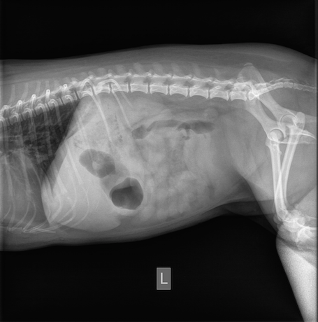

Slide 35
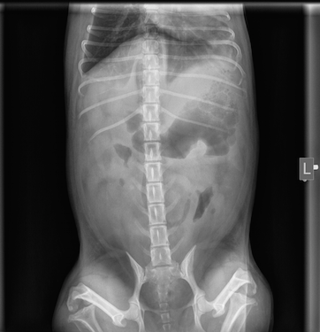

Slide 36
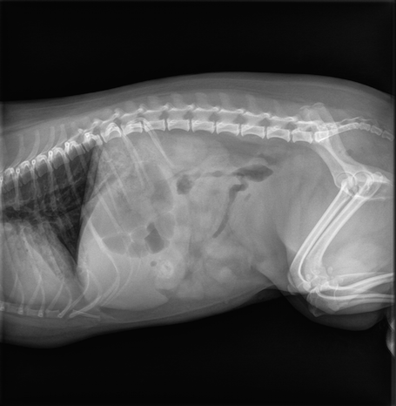

Slide 37
Progression
  FFP transfusion
    Blood pressure improved; from 80 to 120-130 mmHg (Doppler)
    HR: 120 bpm
    RR: 20-36 breaths/min – persistent increase in respiratory effort
    No adverse reactions to transfusion
  Temperature remained low normal
  SpO2: 96-97% with oxygen supplementation (40%)
  Regurgitation:
    Once during physical examination in ER
    Again in oxygen chamber in ICU
    Before US: placement of NG tube
Notes:
She did well during the FFP transfusion with no adverse reactions. BP improved from 80 to 120-130 mmHg on Doppler. RR was between 20-36 with persistent increase in effort. Temperatue remained low normal. SpO2 on oxygen was 96-97%
She regurgitated once during PE in ER, again when placed in the oxygen chamber, Before US was decided to place NG With the intent to aspirate gastric content after US or during if allows better US images (at the discretion of the radiology resident)
(Plasma was run at 20 ml/hr = 2 hours transfusion)
No IVFT during transfusion.
After transfusion – brought to the US room – IVFT + O2 flow by (IVFT = P-lyte at 20 ml/hr)

Slide 38
Plan
  Abdominal ultrasound
    Gallbladder: wall is thick (0.4 cm in regions) with a thin, outer hypoechoic layer. Small amount of dependent echoic sediment.
    Stomach: moderately, diffusely enlarged, contains fluid, gas, echoic material. Wall layering and thickness is normal. Hypomotile.
    Small intestines: diffusely hypomotile. Normal size and layering. A few loops of SI have a mildly undulating contour.
    Pancreas: right limb is mildy, diffusely heteroechoic with normal size and shape. Left limb is not seen.
    Mesentery: diffusely, moderately hyperechoic. Pleural and peritoneal cavities contains a mild volume of anechoic fluid.
    Pancreaticoduodenal lymph node: enlarged (0.45 cm thick)
    Liver, spleen, kidneys, adrenals, other LN: normal
    SQ edema
    SUMMARY
      Mild-to moderate diffuse gastroenteropathy with functional ileus
      Mild pleural and peritoneal fluid with diffuse, hyperechoic mesentery
      Mild gallbladder wall edema
      Questionable pancreatopathy and pancreaticoduodenal lymphadenopathy
    Aspiration of the peritoneal fluid: serosanguineous fluid; PCV/TP: 2%/2.1; poor cellularity: occasional RBCs, no WBCs, no microorganism.
Notes:
After the FFP, AUS was performed and showed…..
Definitive underlying cause for sepsis/sirs is not determined. Indeterminate for pancreatitis (changes are mild and may be normal variation).
Most likely ddx for the diffuse gastroenteropathy includes GE secondary to systemic illness and dietary indiscretion.
GB wall edema is likely 2nd to peritoneal fluid

Slide 39
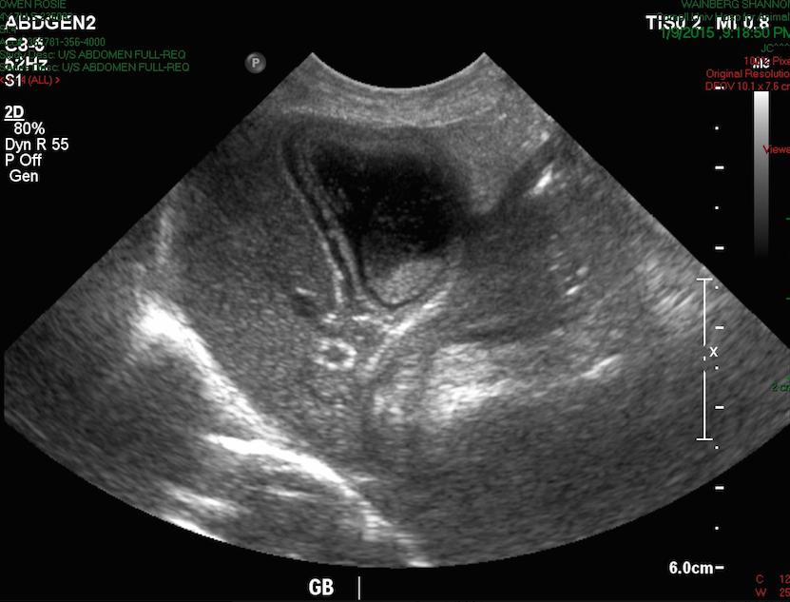

Slide 40
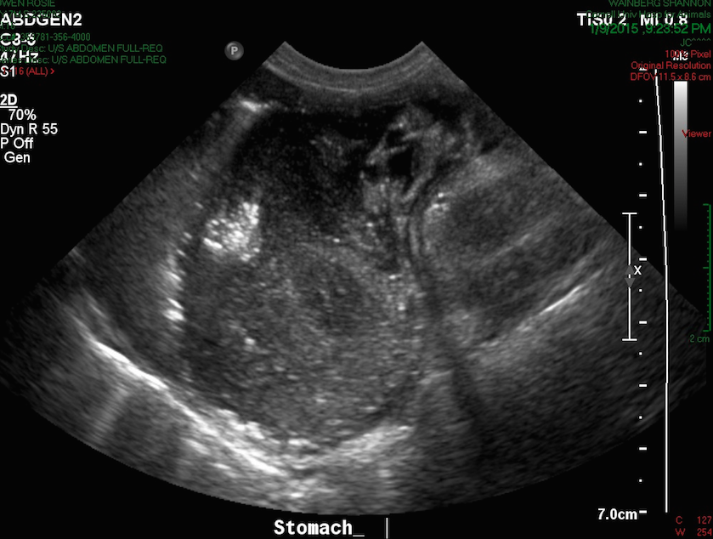

Slide 41
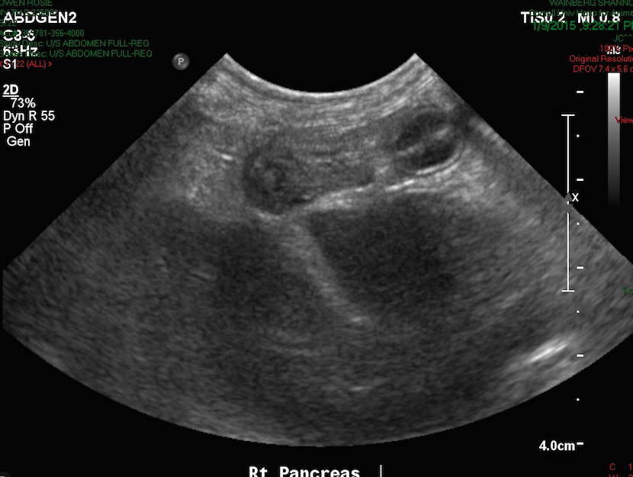

Slide 42
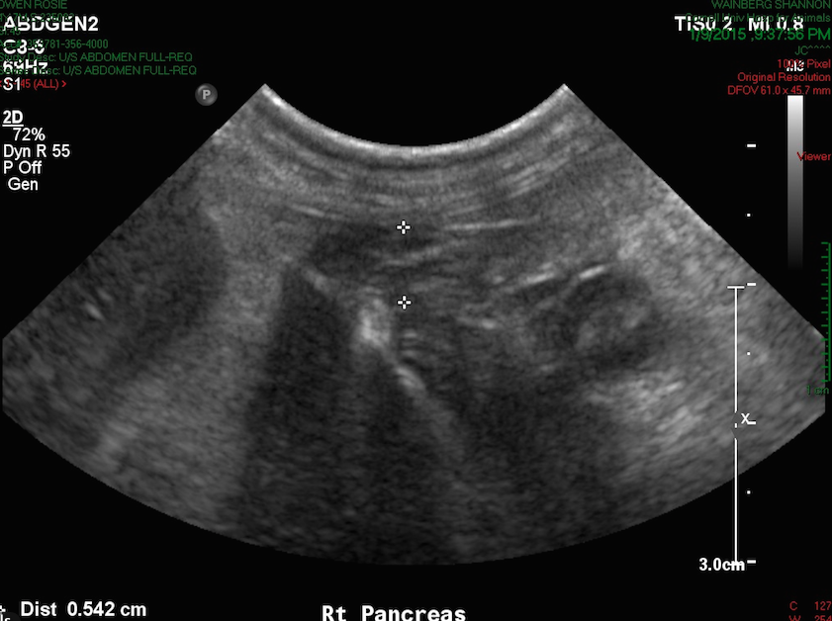
Notes:
Pancreas

Slide 43
Progression
  After the US
    NG tube aspiration
      35 ml of brownish gastric fluid and mucus
    HR: 120 RR: 52 (36-48) BP: 100 mmHg
    Asleep
    Attempt to place a Cavafix®
      To collect blood sample to check PCV/TP/gaslyte/PT/aPTT post transfusion
      To collect blood for blood cultures
      To collect blood for CBC/chem
      → unsuccessful: bruising +++
Notes:
After the AUS, we aspirated the feeding tube – we collected 35 ml of brownish gastric fluid with mucus.
HR was 120, RR was around 52 right after the US but decreased to 36-48 – BP 100
She was quieter
We attempted to palce a cavafix –
To collect blood to checp PCV/TP gaslyte, pt/appt, to collect blood for culture, tfor CBC/chem
Unsuccessful brusing +++
The only blood we were able to collect (all the other vessels were not available!): draw blood from the IV cephalic catheter placed by the rDVM… Certainly not ideal.
Able to collect a sample of blood for PT/aPTT in a syringe….

Slide 44
 | 11:30p | Presentation (5p)
PCV/TP | 29/4.0 | 30/4.4
Lactate | 1.8 | 0.9
PT/aPTT | 18/399 | 19/142
Azo | 50-80 | 30-40
pH | 7.204 | 7.315
pCO2 | 50.2 | 38.3
HCO3- | 19.4 | 19.1
BE | -8.6 | -7.1
Na+ | 143.7 | 140.5
K+ | 4.51 | 5.42
Ca++ | 0.81 | 1
Cl- | 110 | 112
Glucose | 66 | 113
Notes:
PCV/TP was 29/4é0
Lactate 1.8 (was 0.9 on presentation)
PT was similar to that on presentation – aPTT too long to read
Azo was 50-80
PCO2 50.2
BE was more negative
BG was lower
Concerns about the volume status – perfusion (increased lactate compared to presentation) ; but sample not ideal (not good stick). No urination since presentation.

Slide 45


Slide 46
Plan – review problem list
No diarrhea since presentation. Regurgitated 2x. NG tube in place; metoclopramide CRI.
GI signs
Hypotension
Resp. signs
Elevated liver enzymes/bilirubin:
Prerenal azotemia /Hyperphosphastemia
Panhypoproteinemia
Anemia (non-regenerative)
Thrombocytopenia
Leucopenia
Prolonged PT/aPTT
Improved, from 80 to 100-130 mmHg
Slightly increased lactate compared to presentation (still WNL). Worsening acidemia
(not ideal sampling)
O2 responsive; decreased RR, same effort. pCO2: 50.2 (was 38.3; sampling)
No evidence of surgical hepatopathy. On liver support medications.
Increased Azo. No urination
since presentation.
TP was 4.4 on presentation; now 4.0.
SQ edema noted on US.
PCV was 30% on presentation, now 29%
May need a pRBC transfusion.
More bruising (sampling sites; not abdominocentesis site); very prolonged aPTT but not ideal sampling. Received 10 ml/kg FFP.
Notes:
If we review the problem list:
She did not have any diarrhea since presentation, regurgitated twice. NG tube was now in place and was given metoclopramide
Hypotension improved
Lactate increased compated to presentation (still WNL) not ideal sampling
O2 responsive, same increase in effort. PCO2 was 50.2 but sampling issues
Based on AUS no evidence of surgical hepatopathy like biliary mucocele
No urintation was observed since presentation
Panhypoproteinemia worsens
SQ edema was noted on US
PCV sliglyt decreased from presentation to after AUS – consider pRBCS transfusion
We were not able to trsut PT/aPTT results due to sampling –she did have more bruising at the sampling sites, not from abdominocentesis.

Slide 47
Plan – review problem list
SQ edema
Low normal blood glucose – reliable?
High normal lactate – reliable?
Prolonged aPTT- reliable?
Worsening Azo – reliable?
Hypercapnia – reliable?
Worsening ionized hypocalcemia – reliable?
  FFP additional 20 ml (5 ml/kg) over 2 hours
  Dextrose 2.5 %
  Continue same other treatments as before
Artificial colloids?
Notes:
A lot of the values on the gaslyte were questionably reliable
Because of the possible lower BG – we decided to supplement fluid with dextrose
Because of the quesitonable prolongation in PT/aptt, the SQ edema – decide to give additional 5 ml/kg FFP transfusion
Not able to get more bloods – no idea about the coagulation, no more bruising (from abdominocentesis),
Cardiovascularly stable – based on HR and BP (120 bpm; BP: 130-160 mmHg) – to high BP.

Slide 48
Progression
While preparing 2nd transfusion
  Slightly worse respiratory effort
  SpO2 on oxygen: 90-93%
  aFAST: scant peritoneal effusion, large bladder
  tFAST: scant pleural effusion, occasional B-lines, normal LA:Ao, appropriate contractility
    → Furosemide 2 mg/kg IV once
    → increase O2 to 50%
    → close monitoring during transfusion
Notes:
While preparing 2nd transfusion- it was observed that her RE was sliglty worse
SPO2 on o2 was 90-93 but not able to get a reading that match for a long time HR
aFAST: scant peritoneal fluid, large bladder
tFAST; scan pleural effusion, occasional blines. Normal LaAo, appropriate contractility
Ideally would have liked to do ABG – impossible in this patient
Decide to increase O2 to 50%
TO give a dose of furosemide in case of fluid overload/permeability issues due to SIRS to move fluid in the good direction
Arterial blood gas: forget that

Slide 49
Progression
Remains the same during transfusion
  HR:150-160 RR:28-48 BP:145-160 mmHg
  SpO2 on oxygen 94-95%
Shortly after transfusion
  Significant increase in respiratory effort – dyspnic
  Cough 1-2 x
  Communication with the owners
    Worsening respiratory signs
    Challenge to get accurate/reliable assessment of her condition because we can’t get blood
    Possible need for mechanical ventilation
    → Decided to come for a visit and to discuss the options
Notes:
She remained quite the same during transfusion- HR, RR, BP, SpO2 on oxygen
Shortly after transfusion, significant increase in RE – dyspnic
Cough 1-2 x
Called the owners to give them an update- They were informed that her respiratory signs were getting worse – that it was challenging to get a reliable/accurate assessment of her condition because we cant get blood. If she continues to worsen in terms of respiratory signs, may need mechanical ventilation – We had the long disucssion regarding mechanical ventilation. They declined but wanted to come for a visit to see her and discuss the options
Discussion that she may not need the ventilator at the moment right now – difficult to say but the way she was breathing when I called, she would not be able to breath like this all night; likely that she will end up needing it.
If they decline ventilation she may get worse….
They were told that she may get worse in the mean time and that I was very concerned about her sudden deterioration.

Slide 50
And …
After communication with the owners
  Started coughing and gasping
  Propofol IV
  Endotracheal intubation
    → large amount of hemorrhagic fluid; suctioned
  Cardiopulmonary arrest
  CPR: 5 runs
    → stop
  No post-mortem
Notes:
2 minutes after hanging up with the owners – she started coughing and gasping and cyanotic
Decided to intubate
Propofol to allow intubation
Large amount of hemorrhagic fluid came out of the trachea while intubating –– we suctioned the airway – and then it was noted that she was in cardiac arrest – CPR was started – after 5 runs I called the owners and we decided to stop
They arrived 1 hour later – they were in shock and PM was not offered.

Slide 51
Discussion
What went wrong?
  Challenges
    No sampling line
    No blood sampling possible
  Before 2nd transfusion
    Slight worsening of her clinical signs
      Discussion with the owners at that time?
      Thoracic radiographs?
        Pulmonary edema? Change in treatment? Too unstable…
  Volume status
    Body weight – not repeated
  FFP transfusion
    Necessary?
  ATB
    Was already on ATB for couple days before development of respiratory CS
Notes:
This case was kind of challenging - I’m part because it was not possible to get blood
When I looked back to this case, I think that probably just before the 2nd transfusion – I should have call the owners to let them know she had slight worsening of her clinical signs. Introduce the idea of mechanical ventilation earlier so may have consent and would have been able to proceed when needed
I don’t think I could have done more diagnostic tests at that time (I did tFAST to see if it could be pleural fluid that causes the respiratory distress…) chest xrays would not have changed anything and she was too unstable for that anyway.
I questioned the neccesity of FFP administration, especially the 2nd home, if it causes harm and may be the cause of her worsening condition
Did not repeat the body weight – possible overhydration?
To introduce the idea of mechanical ventilation and be able to proceed if needed?
Should we choose I chosen a different ATB? Since was already on ATB…

Slide 52
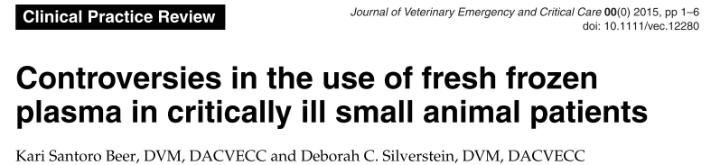
Discussion
FFP: to prevent bleeding or to stop active bleeding
FFP for coagulopathic patients WITHOUT bleeding?
  Effective?
Reactions to FFP transfusion
  Veterinary medicine?
  1% of patients: fever, pruritus, anxiety
Immunologic or non-immunologic reactions; acute or delayed
  Transfusion-related acute lung injury (TRALI)
Notes:
To review the literature supporting or discouraging the use of fresh frozen plasma (FFP) transfusion in critically ill patients.
In general, human and veterinary patients are administered fresh frozen plasma (FFP) transfusions for 2 main reasons: to prevent clinical bleeding, and to stop active bleeding. The use of FFP in patients with coagulopathy and no evidence of clinical bleeding is of particular interest in both human and veterinary medicine, since there is little evidence to support this practice.
While reactions have been reported tooccur in 8–13% of veterinary patients receiving packedred blood cell (pRBC) transfusions, the incidence ofreactionstoplasmatransfusionsislesswellcharac-terized in veterinary medicine.
One retrospective veterinary study reported that the incidence of plasma transfusion-associated reactions was low (affecting 1% of patients) and reactions were characterized by fever, pruritis, and anxiety.11 Adverse reactions to FFP are more known and reported in human medicine – and FFP can be associated with development of ALI

Slide 53

FFP and TRALI/TACO
Retrospective human study
115 patients with coagulopathy – no active bleeding
Higher incidence of ALI in patients that received FFP transfusion (18%) vs patients that did not (4%)
Conclusions: Patients receiving plasma transfusions may be more susceptible to TRALI or TACO
Notes:
Fresh frozen plasma transfusion in critically ill medical patients with coagulopathy.
In one retrospective human study of 115 patients with coagulopathy (in- ternational normalized ratio [INR] > 1.5) but no active bleeding, the administration of FFP was significantly associated with a higher incidence of acute lung injury (ALI) within 48 hours of transfusion (18% versus 4%;P = 0.021), leading the authors to conclude that patients receiving plasma transfusions may be more susceptible to TRALI.
There was no difference in new bleeding episodes (6.8% in transfused vs. 2.8% in nontransfused group, p = .369), new onset acute lung injury was more frequent in the transfused group (18% vs. 4%, p = .021). Adjusted for severity of illness, hospital mortality and intensive care unit length of stay among survivors were not different between the two groups.

Slide 54


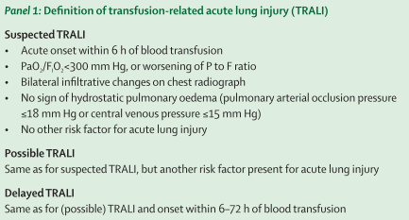
TRALI
Notes:
Transfusion-associated acute lung injury (TRALI) is a significant concern in humans, and the HLA antibody in donor plasma (especially female donors) appears to be causative agent in most cases.^{5 and 6} The clinical signs are caused by WBC aggregates in the pulmonary circulation leading to hypoxemia, respiratory distress, and often death – SACCM
what is transfusion related ALI : it is ALI that develops within 6 hours of blood transfusion –
In human medicine, they have definiton for suspected TRALI, possible TRALI and delayed TRALI. Possible TRALI takes into account that patients at risk of TRALI (example: patients with sepsis) can also develop ALI secondary to the underlying disease process (sepsis) not necessary from the transfusion.
They also recognized the occurrence of delayed TRALI – TRALI that develops within 6-72 hours of blood transfusion – it is unknown if the pathophysiology for the development of delayed TRALI is the same
HLA = human leukocyte antigents

Slide 55
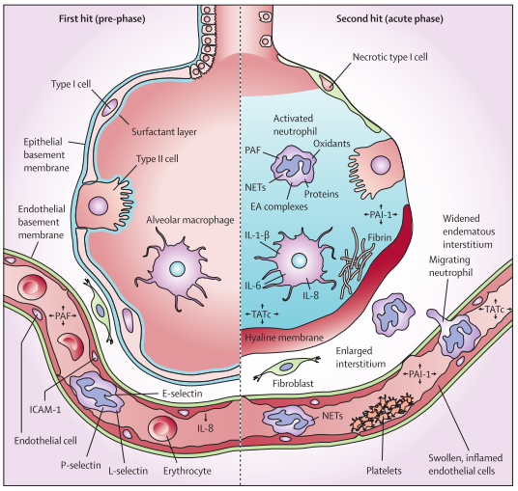
Notes:
To describe the pathophysiology of TRALI they sometimes use the 2 hit theory.
First-hit involves specific inflammatory host factors tha tprime neutrophils and/or pulmonary endothelium. Numer-ous “first hits” have been documented such as infection, recent surgery (in particular cardiac surgery), hematologicmalignancies, and massive transfusion.
This first hit is the underlying disorder of the patient (eg, sepsis or pneumonia) causing neutrophil attraction to the capillary of the lung. Neutrophils are attracted to the lung by release of cytokines and chemokines from upregulated lung endothelium. (((( Loose binding by L-selectin takes place. Firm adhesion is mediated by E-selectin and platelet-derived P-selectin and intracellular adhesion molecules (ICAM-1))))))
a second hit caused by mediators in the blood transfusion takes place. This hit results in activation of infl ammation and coagulation in the pulmonary compartment. Neutrophils adhere to the injured capillary endothelium and marginate through the interstitium into the air space, which is fi lled with protein-rich oedema fl uid. In the air space, cytokines --- interleukin-1, -6, and -8, (IL-1, IL-6, and IL-8, respectively) are secreted, which act locally to stimulate chemotaxis and activate neutrophils----- resulting in formation of the elastase-α1-antitrypsin (EA) complex. Neutrophils can release oxidants, proteases, and other proinfl ammatory molecules----------, such as platelet-activating factor (PAF), and form neutrophil extracellular traps (NETs).-------
------Furthermore, activation of the coagulation system happens, shown by an increase in thrombin-antithrombin complexes (TATc), as does a decrease in activity of the fi brinolysis system, shown by a reduction in plasminogen activator activity.------- The infl ux of protein-rich oedema fl uid into the alveolus leads to the inactivation of surfactant, which contributes to the clinical picture of acute respiratory distress in the onset of TRALI. PAI-1=plasminogen activator inhibitor-1.www.thelancet.com
So long story short:
First hit is the underlying disease that causes neutrophil attraction to the pulmonary capillary.
The secondhit occurs when transfused mediators cause neutrophil activation and additional damage topulmonary endothelium.20,24,31

Slide 56
TRALI
Antibody-mediated TRALI
  HLA or HNA and corresponding antibodies from the donor.
Non-antibody mediated TRALI
  Accumulation of pro-inflammatory mediators during storage and possibly by ageing of the RBCs and platelets.
Notes:
They also define 2 types of TRALI –
Antibody mediated and non antibody mediated
Antibody mediated is caused passive trans-fusion of HLA or human neutrophil antigen (HNA) and corresponding antibodies from the donor directed against antigens of the recipient.33,34
(((((((Transfusion of donor antibodie sis believed to activate neutrophils either directly or indirectly via interaction with HLA antigen-antibody complexes on pulmonary endothelial cells.15,17-20. Consequently, activated neutrophils are sequestered in lung capillaries where theyrelease toxic mediators that damage the endothelium andcause loss of vascular integrity. Leakage of fluid and inflam-matory cells results in pulmonary edema, a hallmark of ALI. ))))))
(((((((HLA antibodies may be directed against either HLA classI antigens that are present in all leuko-cytes or HLA class II antigens that arefound on B lymphocytes and monocytes.
multiparous female donors who aremore likely to possess anti-HLA antibod-ies and anti–neutrophil-specific antibod-ies)))))
liNon-antibody-mediated TRALI is caused by accumulation of proinfl ammatory mediators during storage of blood products, and possibly by ageing of the erythrocytes andplatelets themselves.1Non Ab mediated trali is most likely mediated by biologic response modifiers (BRMs),soluble factors that accumulate during storage of bloodactivateproducts. Proposed BRMs that may potentiallyneutrophils include bioreactive lipids, CD40L, and variouscytokines.24,26
CD40L, is a protein that is primarily expressed on activated T cells and is a member of the TNF superfamily of molecules.

Slide 57
TRALI
Incidence (human medicine)
  0.08-15% of patients receiving transfusion
  50-100 times higher in the critically ill population
Clinical presentation
  Dyspnea
  Tachypnea
  Hypoxemia
  Thoracic radiographs: bilateral interstitial abnormalities
  Laboratory testing: non specific
DDX
  Septic transfusion reaction
  Anaphylactic transfusion reaction
  Transfusion-associated circulatory overload
Notes:
Incidence of TRALI in human medicine is reported to be between 0.08-15% of patients receiving transfusion.
It seems to be 50-100 times higher in the critically ill population. Which is not surprising since
Clinical presentation associated with TRALI include:
DDX include:
(Compare the level of albumin from the sputum to serum albumin; cardiac biomarkers)

Slide 58
TRALI
Treatment
  Supportive
    Oxygen supplementation
    Mechanical ventilation – 70-90% (human medicine)
      Lung protective strategy
    Diuretic?
      Fluid restrictive strategy for patients with ARDS/ALI due to other causes
Risk factors
  Mechanical ventilation
  Specific surgical procedures: cardiac surgery, cardiopulmonary bypass
  Sepsis
  Hematological malignancy, bleeding from liver failure, massive transfusion
    Underlying condition or number of transfusions?
  Positive fluid balance
Prognosis
  Good; 5-10 % mortality (human medicine)
Notes:
Treatment is mostly supportive and include oxygen supplementation, mechanical ventilation in 70-90% of the case (with a lung protective strategy)
Diuretic admx has been suggested since fluid restrictive strategy for patients with ARDS/ALI due to other causes is recommended
Risk factors associated with development of TRALI are:
Improvement within 48 hours
Severe cases: pulmonary infiltrated for up to 7 days
Prognosis is usually good – with a 5-10% mortality in human
(Treatment for TRALI is supportive care.Supplemental oxygen and fluid resuscitation with colloidmay improve hypotension and tissue perfusion.10,11; human patients with TRALI – usually hypotensive. )

Slide 59

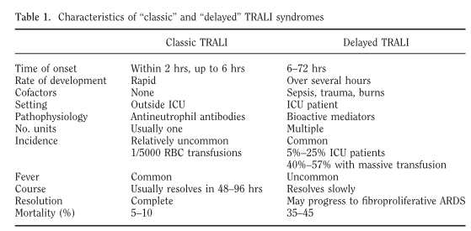
DELAYED TRALI
Distinct from the classic TRALI syndrome
Notes:
Delayed TRALI is a phenomenon of immunomodulation caused by transfusions that renders the“primed” lung more vulnerable to ARDS(i.e., the two hit theory)
The delayed TRALI syndrome occurs in up to 25% of critically ill pa-tients receiving a blood transfusion, it de-velops 6–72 hrs after the transfusion, and is associated with a mortality of up to40%. The risk of delayed TRALI increases with increasing numbers of transfused blood products. The management of botht he classic and delayed TRALI syndromes is essentially supportive
The delayed form of TRALIcan be seen in patients with other preexisting risk factorsfor ALI, such as sepsis, trauma, and burns, and seems to be more prevalent (5% to 25% of intensive care unit patients) than the classic form of TRALI
The prognosis is worse (35% to 45% mortalityrate) compared to the prognosis for the classic form of TRALI (5% to 10% mortality)
The classic form of TRALI typically resolves in 48 to 96 hours, whereas the delayed form of TRALI resolves much more slowly.

Slide 60

TRALI in veterinary medicine
Prospective study
n = 54 dogs receiving blood or plasma transfusion
ABG: 0-12 hours before, 24-48 hours after transfusion
  PaO2:FiO2
Thoracic radiographs
Echocardiography to exclude left-sided heart failure
Incidence of VetALI in dogs receiving transfusion vs ARDS/ALI in ill dogs not receiving transfusion vs incidence of TRALI in people
Notes:
TRALI is not commonly reported in veterinary medicine
This prospective study evaluated the incidence of TRALI in 54 dogs that receive blood or plasma transfusion
Dogs with posttransfusion radiographic signs of pulmonary infiltrates, a PaO2:FIO2ratio < 300, or clinical signs of respiratory compromise were suspected of having VetALI and underwent echocardiography to exclude left-sided heart failure.

Slide 61
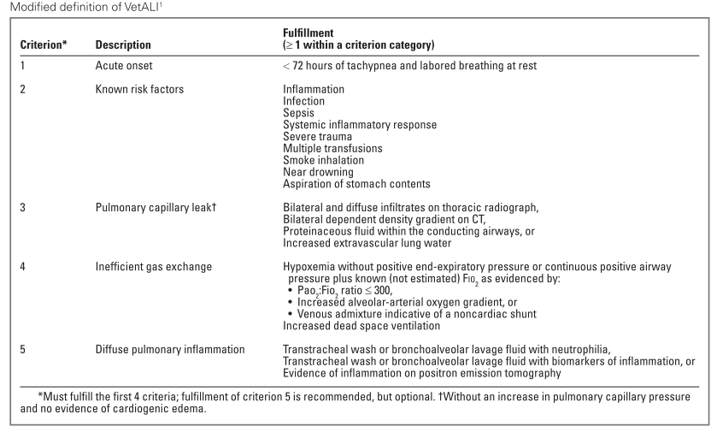

Slide 62
TRALI in veterinary medicine
 | VetALI transfusion | VetALI no transfusion
Incidence | 3.7% (2/54) | 10%
 | Dog 1: Pancreatitis 13 ml/kg FFP Euthanasia PM: ALI
 | Dog 2: Post lung lobectomy 22 ml/kg FFP
Notes:
2/54 dogs: VetALI within 48 hours of transfusion
Secondary to transfusion or secondary to disease process
Dog 1: pancreatitis; 13 ml/kg FFP; Dog 2: post-op lung lobectomy; 22 ml/kg FFP
PaO2:FiO2 < 300 and worsening hypoxemia (but no dyspnea)
Radiograph changes
No echocardiogram
It is unclear whether TRALI occurs in those 2 patients.
The reported incidence of ALI in dogs that did no receive transfusion is 10%
It is possible that TRALI is underappreciated in veterinary medicine because an acute onset of tachypnea in some animals receiving transfusions could be attributed to other disease processes.
SO: these 2 patients had underlying diseases that already predisposed them for the development of ALI, the role that transfusion played in the development of ALI is unclear.

Slide 63

Coagulopathy and risk of bleeding
Administration of FFP to prevent bleeding complication in non-bleeding patients with a coagulopathy (before performing an invasive procedure)
  PT has limited value in predicting bleeding risk and poorly represents in vivo hemostatic potential.
  Central venous KT placement, tracheostomy, thoracocentesis: low bleeding risk.
  Limited evidence to support the use of FFP to reduce risk of bleeding before invasive procedure.
  TRALI in up to 30% of transfused critically ill patients
  Transfusion associated with prolonged mechanical ventilation and ICU length of stay and increased infection risk.
Notes:
FFP is also sometimes transfused prophylactically to nonbleeding patients with a coagulopathy, in particular before an invasive procedure.
Cur-rently used diagnostic tests for coagulopathy such as INR and PT poorly represent risk of bleeding. Also, retrospective studies suggest thatcommonly performedinvasive procedures in the critically ill, such as central venous catheter placement, percutane- ous tracheostomy, and thoracocentesis, carry a lowbleed- ing risk
There is limited evidence to support the use of FFP to prevent risk of bleeding before invasive procedure. And as we said, TRALI is a possible complication of transfusion and it has been shown that transfusion is associated with prolonged mechanical ventilation and ICU length of stay and increased risk of infeciton.

Slide 64
Coagulopathy and risk of bleeding
Multicenter randomized trial
Coagulopathy: prolonged INR: 1.5-3.0
Invasive procedures: central venous KT, tracheostomy, chest tube, abscess drainage.
FFP: 12 ml/kg or no transfusion
Outcomes:
  Occurrence of bleeding complication (w/in 24 hours)
  INR correction
  Ocurrence of lung injury
Notes:
In this study, they evaluated the risk of bleeding in coagulopathic patients undergoing invasive procedures. A group of patients received 12 ml/kg FFP transfusion prior to the procedure, and a second group did not receive FFP. They evaluate the occurrence of bleeding, correction of INR and occurrence of lung injury in both groups.
(A multicenter ran- domized open-label trial with blinded endpoint evalua- tion was performed in critically ill patients with a prolonged international normalized ratio (INR; 1.5-3.0). Patients undergoing placement of a central venous catheter, percutaneous tracheostomy, chest tube, or abscess drainage were eligible. Patients with clinically overt bleeding, thrombocytopenia, or therapeutic use of anticoagulants were excluded. Patients were randomly assigned to omitting or administering a prophylactic transfusion of FFP (12 mL/kg). Outcomes were occur- rence of postprocedural bleeding complications, INR correction, and occurrence of lung injury)
Score for major vs minor bleeding
INR correction
Lung injury score

Slide 65
Coagulopathy and risk of bleeding
n=81
  40 FFP 41 no FFP
None experienced fatal bleeding
Overall: 1 major bleeding and 13 minor bleedings
8 bleedings in the FFP group; 6 in the no FFP group
Preprocedural omission of FFP was not associated with increased occurrence of bleeding
  Relative risk: 1.17; 95% CI: 0.62-2.19; p = 0.78
INR: Median reduction of INR from 1.8 to 1.4
  Only 54% had correct INR < 1.5 after FFP
  Higher pretransfusion INR → higher reduction after FFP
No difference in lung injury scores
  FFP group: P/F ratio tended to be worse, mechanical ventilation prolonged and incidence of VAP higher.
Notes:
They enrolled 81 patients, 40 received FFP and 41 did not.
No patient expereience fatal bleeding.
Overall , 1 major bleeding and 13 minor bleeding events occur.
8 in the FFP and 6 in the non transfused group.
They concluded that preprocedural omission of FFP was NOT associated with increased occurrence of bleeding.
Following FFP, ony 54% of the patients had an INR < 1.5.
There was no diffrence in lung injury scores between the 2 groups.
In the FFP group, the PF ratio tended to be worse, mechanical ventilation tended to be prolonged and incidence of VAP tended to be higher.
(A Major bleeding event in the non transfused group only – only one event; no stat possible
Since just one major bleeding event; they combined the major and minor bleedings together.
FFP transfusion resulted in a median reduction of INR from 1.8 (IQR, 1.5-2.5) to 1.4 (IQR, 1.3-1.63; p < 0.001). However, only 54% of patients had a corrected INR to less than 1.5 after FFP transfusion (Fig. 3). The effect of FFP on INR reduction varied widely. Patients with higher pretransfusion INR values experienced the greatest reduc- tion after FFP transfusion (r = 0.68, p < 0.01; Figs. 3 and 4).
The result (in seconds) for a prothrombin time performed on a normal individual will vary according to the type of analytical system employed. This is due to the variations between different batches of manufacturer's tissue factor used in the reagent to perform the test. The INR was devised to standardize the results. Each manufacturer assigns an ISI value (International Sensitivity Index) for any tissue factor they manufacture. The ISI value indicates how a particular batch of tissue factor compares to an international reference tissue factor. The ISI is usually between 1.0 and 2.0. The INR is the ratio of a patient's prothrombin time to a normal (control) sample, raised to the power of the ISI value for the analytical system being used.)

Slide 66

FFP transfusion in intensive care medicine – coagulopathy & bleeding
No evidence for FFP transfusion to a non-bleeding patient in whom no procedure is planned
For most procedures: the risk of major bleeding is extremely low
The risk to benefit balance does not support FFP administration
Pre-procedural FFP transfusion
  Significant coagulopathy
  Undergoing high-risk procedures
Notes:
There is no evidence for FFP transfusion to a non-bleeding patient in whom no procedure is planned.
For most procedures, the risk of major bleeding is extremely low.
The risk to benefit balance does not support FFP administration
It is suggested that FFP transfusion before an invasive procedure should be reserved to patients with a SIGNIFICANT coagulopathy or patients udnergoing high-risk procedures.
And for those patients, a larger dose of FFP (20-30 ml/kg) is suggested.
There is no evidence and little clinical rationale, for transfusing FFP to a non-
bleeding patient in whom no procedure is planned. For most procedures, the risk of
clinically important bleeding in patients with prolonged INR or APTT is extremely
low, and in the absence of high-quality evidence, the risk to benefi
t balance does not
support administration of FFP. Pre-procedural FFP should be reserved for patients
with signifi
cantly prolonged INR (>2.5–3.0) undergoing higher-risk procedures,
including those where the risk from bleeding is high
For patients with more signifi
cant abnormalities (e.g. INR >3) or where physio-
logical correction is intended because of high-risk procedures (e.g. CNS proce-
dures), a larger dose of FFP (20–30 mL/kg) is required. The signifi
cant volume
associated with larger doses requires careful consideration of the rate of admin-
istration, the patient’s intravascular status and the potential risk of transfusion-
associated circulatory overload.

Slide 67
FFP transfusion in intensive care medicine – volume expansion
No evidence to support the use of FFP as a colloid solution.
Risk/benefit balance
Cost
Lack of a adequately powered randomised controlled trials
Notes:
And finally, there is no evidence to support the use of FFP as a colloid solution.
Before considering the use of FFP for this reason, we need to consider the associated risk benefit balance and the cost.

Slide 68

Discussion
What went wrong?
  Challenges
    No sampling line
    No blood sampling possible
  Before 2nd transfusion
    Slight worsening of her clinical signs
      Discussion with the owners at that time?
      Thoracic radiographs?
  Volume status
    Body weight – not repeated
  FFP transfusion
    Necessary?
Notes:
Should this patient have received FFP or not at all?
Would the outcome have been different without the transfusion? Did FFP cause harm?
More diagnostic tests performed?
Discussion about mechanical ventilation earlier?
Volume status? – More monitoring?

