Slide 1
Morbidity and mortality rounds
Valerie Madden

Slide 2
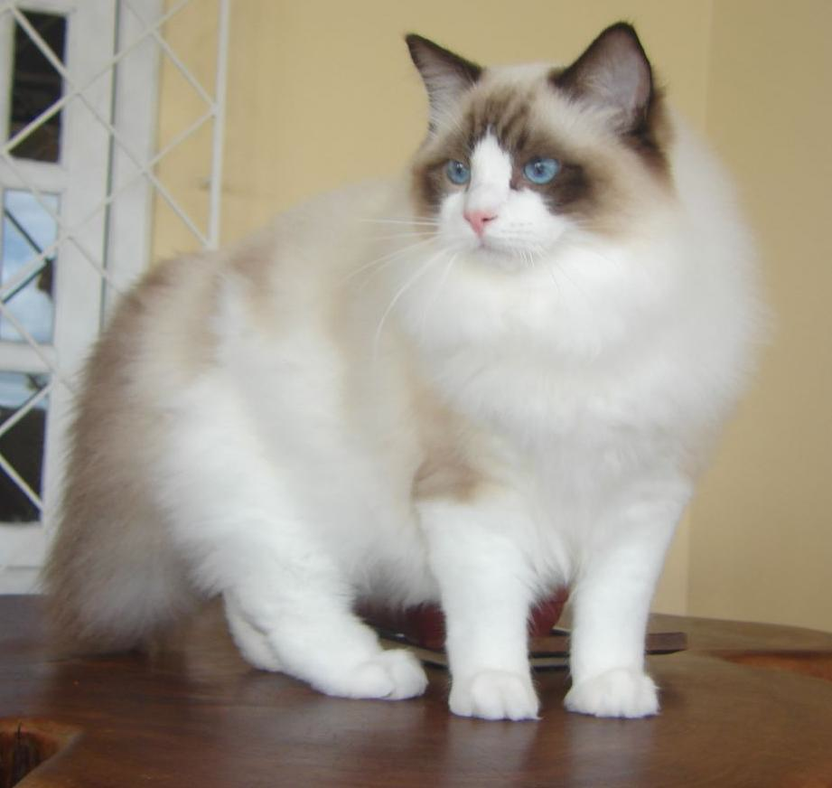
Signalment/History
14 year old spayed female Ragdoll
7 day history of decreased appetite
2 day history of increased respiratory effort
Progressive respiratory distress within 24hrs prior to presentation

Slide 3
Past History
New kitten from the SPCA 2 months ago
Cats kept separate for initial 3 weeks
Both cats are up to date with vaccines
Both cats FeLV/FIV negative
Boots is an indoor/outdoor cat, but only spends time on the back deck when outside
Right hock luxation in 2006
Current TX glucosamine and probiotics daily
Since 2001 she has moved from Nebraska to Kentucky to Hawaii to Alaska to Arizona to Rhode Island to Germany (moved to NY in June)
Recently she was seen drinking out of a water bowl that a coyote was witnessed drinking out of

Slide 4
Physical Exam Presentation 09/28/14 (Sunday)
Temp: 103.3 F
Pulse: 180 bpm
Resp: 72 breaths/min
Pale pink mm, CRT < 2 sec, strong synch pulses
Weight: 4.8 kg
~7% dehydrated
Increased respiratory effort
Increased bronchovesicular sounds bilaterally, wheezes
Intermittent gallop; no murmur

Slide 5
Diagnostics
PCV 34%, TS 8.2g/L, Azo 15-26, BG 153 mg/dL
pH 7.307, PCO2 41.4, HCO3 20.2, BE -6.1
Na+ 155.3, K+ 4.41, Cl 113, Ca++ 1.25
BP 136/85 (112)
SPO2 room air 93% poor signal
Lactate 4.0mmol/L
PT/PTT 15sec, 160sec
TFAST: Negative, La:Ao 1:1
Blood smear: RBC: anisocytosis, normal morphology otherwise. Subjective neutrophilia, mild toxic change and 1 inclusion body seen. 10-13 platelets/hpf

Slide 6
Initial Therapy and Response
0.2 mg/kg butorphanol IM
    Decreased resp effort and adequate sedation for radiographs
2. 2 mg/kg lasix SC after rads
    Respiratory effort had increased
Radiographs obtained prior to IVC placement

Slide 7
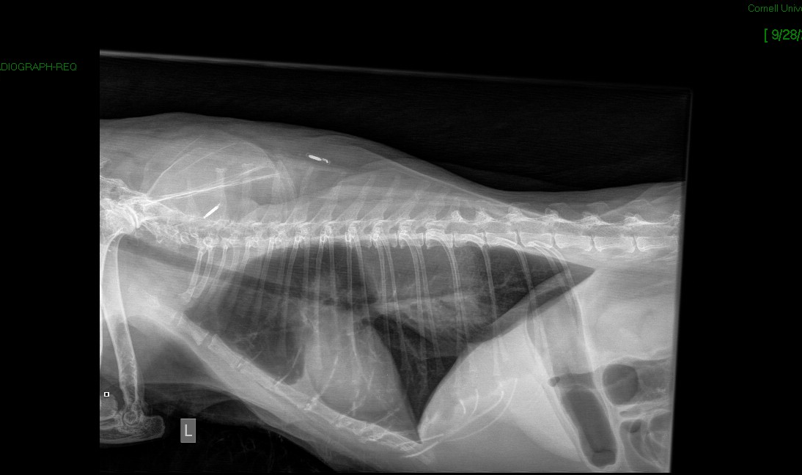
Thoracic Radiographs

Slide 8
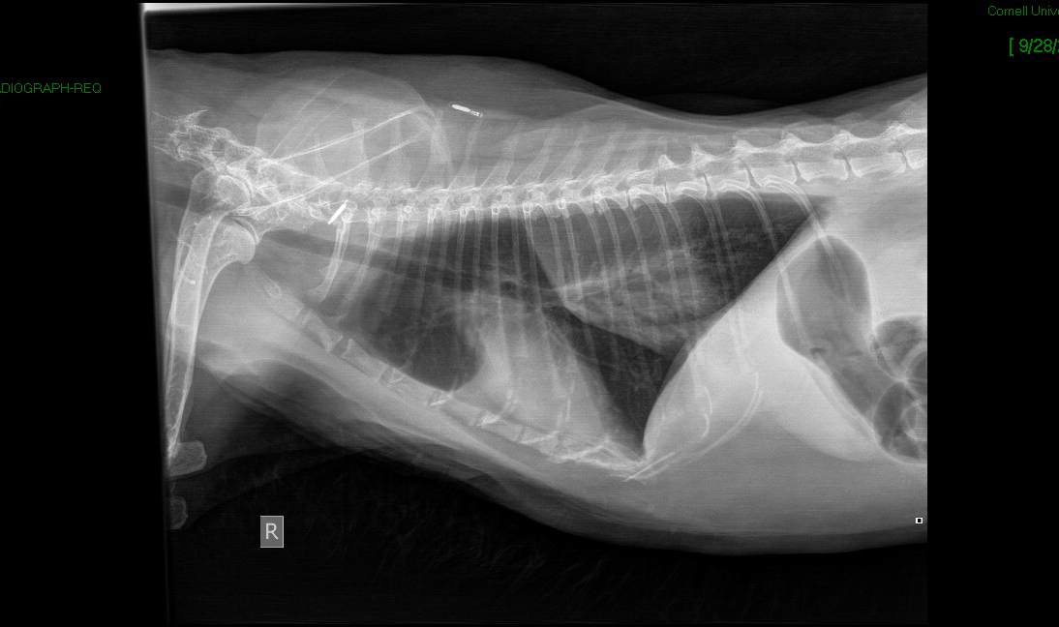
Thoracic Radiographs

Slide 9
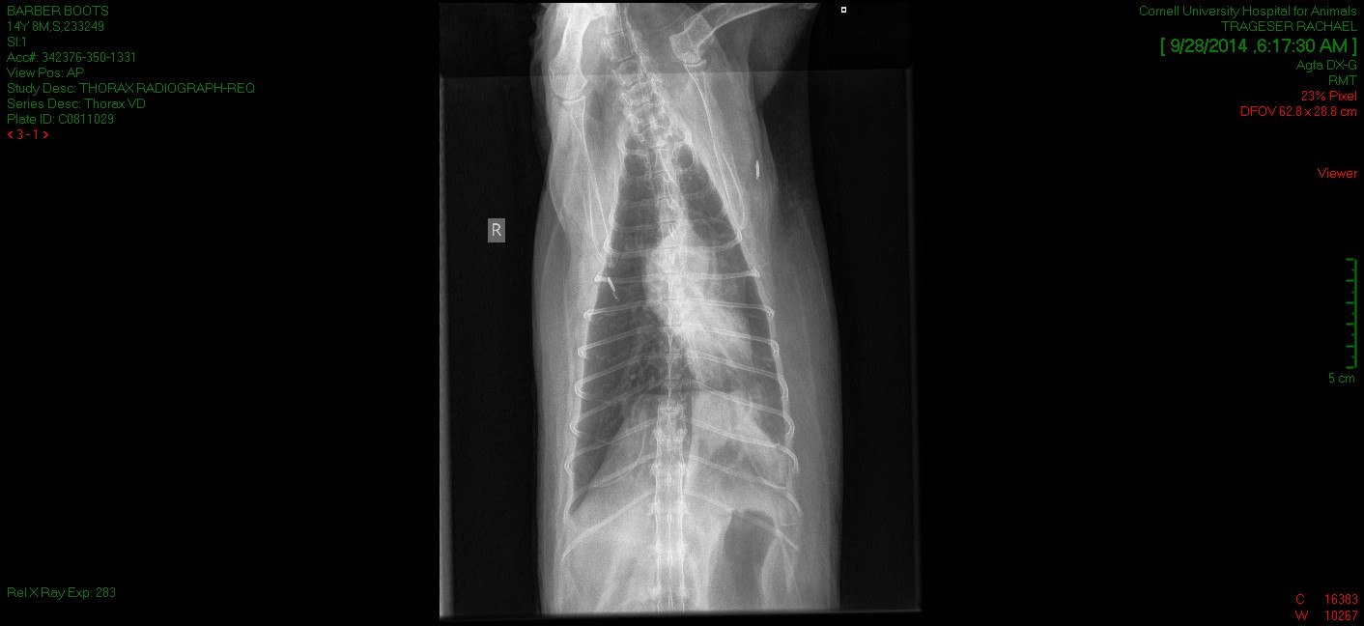
Thoracic Radiographs

Slide 10
Information on transfer
Consulted imaging service
3 view thorax: alveolar pattern in cranial aspect of caudodorsal lung field, diffuse mild interstitial pattern in cranial lung fields bilaterally
Reviewed by radiology resident and chief
    PTE is primary differential
    Does not appear consistent with heart disease due to lack of cardiomegaly or pulmonary venous distension

Slide 11
Treatment
O2 therapy
Respiratory watch
PLyte + 15 mEq/L KCl at 60 ml/kg/day
Butorphanol 0.2 mg/kg IV PRN per DVM

Slide 12
Communication
Discussed that after the rads, we are still unsure the underlying problem causing the increased respiratory rate and effort. Potential problems include heart failure, PTE, pneumonia. Need to perform more diagnostics before we know what the underlying problem is. Will decide what specialty service is most appropriate based on what the underlying problem is found to be. We will move in a step-wise fashion, and keep the owner updated as we have more information. Will receive another update this evening unless we have more information prior to that time. Estimate has the potential to increase depending on the underlying cause and what we would need to do to treat. Will keep the owner updated if we need to go higher than estimate
Initial estimate $2000-4000

Slide 13
09/28/14 Day Evaluation
Patient presented 530am, transferred to critical care shortly after 7am
Reassed around 11am due to ER case load.
TFAST: Normal LA:Ao, no pleural effusion and no more than 1-2 B lines per lung field on ultrasound other than left caudal where there were possibly more
Nothing in the heart that looked obviously like a thrombus
When reevaluated at 11am, noted tachypnea and increased effort, worse with door open and stimulation, but when left alone was able to rest/sleep
Evaluated blood smear from admission: few bands, some toxic change, normal WBC morphology, adequate platelets plus clumping
Was able to collect the free catch blanket urine sample (performed protein only dipstick - trace)

Slide 14
Treatment
Based on the left shift elected to begin antibiotics (Unasyn 22mg/kg IV TID)
ICU treatments
  --Plyte + KCL at 13ml/hr (60ml/kg/day)
  --Clopidrogrel 18.75mg PO SID
  --Unasyn 22mg/kg IV TID
Discussed (with GLS) heparin, elected not to tonight due to prolonged PTT at 160 seconds, potential for sampling/FNA/angio that may require sampling or jugular sticks
Consider heartworm antibody test - unsure of turnaround time, but given extensive travel history…
Notes:
Submitted in UVIS and placed in fridge/freezer pick up area: CBC, Chemsitry, DIC (from admission) - so these should be picked up first thing

Slide 15
Communication
Discussed what we currently know and that we do not at this time know the underlying cause and needed additional information to try to figure this out (with the chance that we might not determine the underlying cause)
Discussed recommended plan: monitor overnight, and probably CT (+/-angio) whole body (quoted abt 1200 for this part alone), possibly cardio, possibly FNA, etc as indicated based on results
Reasons to not do today include: weekend staffing, emergency procedure for both CT and anesthesia, and the chance that she might be more stable/better tolerant of procedures, but that it was possible she may continue to experience PTE or other TE events tonight

Slide 16
Progression
Evaluation in the am revealed the patient to be in severe respiratory distress
Patient was in an orthopneic position, marked ptyalism, vocalizing (groan) on expiration and signs of impending fatigue
Offered MV at this time
Owners elected euthanasia and necropsy

Slide 17
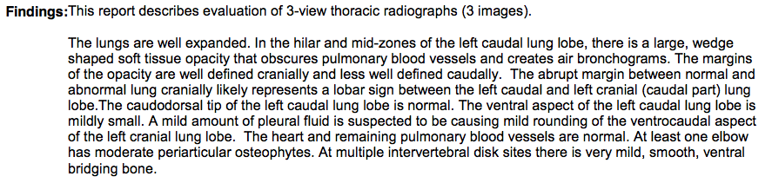
Final Radiograph Report

Slide 18
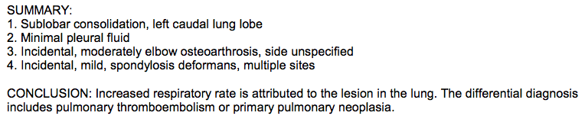
Final Radiograph Report

Slide 19
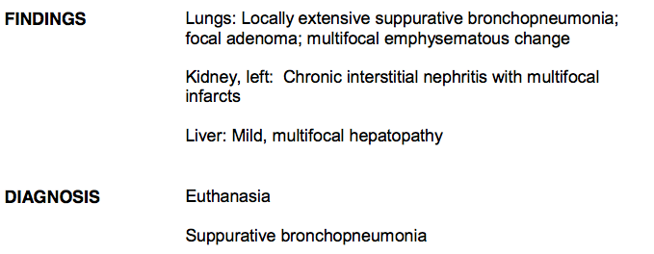
Necropsy Report

Slide 20
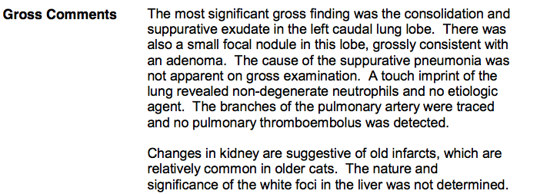
Necropsy Report

Slide 21
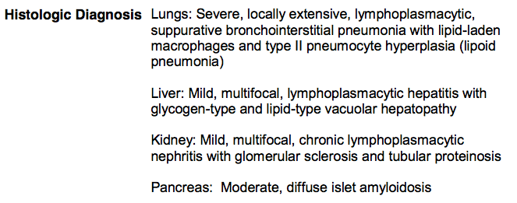
Necropsy Report

Slide 22
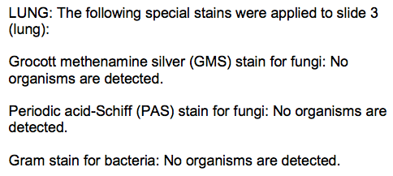
Necropsy Report

Slide 23
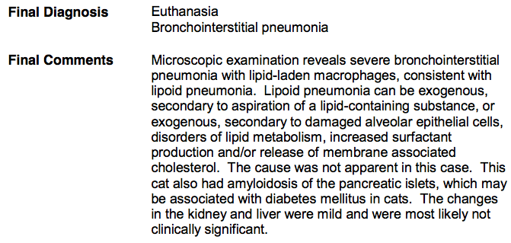
Necropsy report

Slide 24
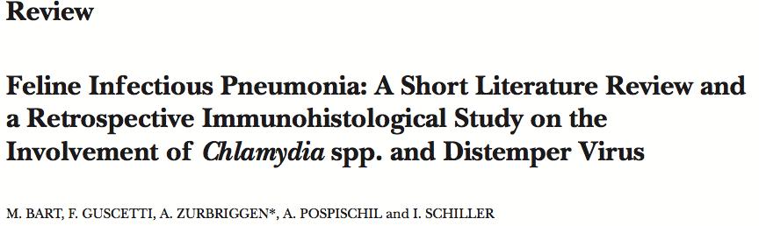
Literature Review
The results confirm previous reports indicating that feline chlamydia is not a primarily pulmonary pathogen and that CDV is not a causative agent of pneumonia in cats as it is in large felids
Review of many infectious causes of pneumonia

Slide 25
Literature Review
Microlithiasis associated with chronic bronchopneumonia in a cat. J Am Vet Med Assoc. 1989 Apr 15;194(8):1061-4.
Abstract
Chronic bronchopneumonia associated with microlithiasis was diagnosed in a 9-year-old domestic shorthair cat with a 3-month history of coughing and dyspnea. Thoracic radiography revealed multifocal patchy alveolar infiltrates in all lung fields. Numerous acellular, concentrically laminated, periodic acid-Schiff-positive microliths were seen in mucus from tracheal washing. Microliths were composed primarily of calcium carbonate. A definite cause could not be identified. There was no response to treatment and the cat was euthanatized. Marked type-II alveolar cell proliferation, peribronchiolar smooth muscle proliferation, and alveolar microlithiasis were seen histologically. Microliths are rarely encountered in tracheal washings from companion animals. Their pathophysiologic properties and meaning remain to be established.

Slide 26

Literature Review

Slide 27
Questions
Cause of pneumonia?
Antibiotic choice?
Viscoelastic testing?
Treatment of thromboembolic disease?
Obtainment of thoracic rads in a resp distress patient prior to placement of IVC?

