Slide 1
IVECCS 2014 review

Slide 2
ACOTS/ATC/TIC/blabla

Slide 3
Terms
RAC – resuscitation assoc-coagulopathy (aka TIC, I think)
TIC – trauma induced coagulopathy
ACOTS – acute coagulopathy of trauma/shock (also called ATC – acute traumatic coagulopathy)

Slide 4
Options…
Trauma
  ACOTS → Survival
  → Death
  RAC → Survival
  → Death
  None → recovery

Slide 5
Coagulopathy of trauma
Iatrogenic coagulopathy of trauma (aka trauma inducedcoagulopathy (TIC), aka Resuscitation associated coagulopathy (RAC)
  Hypothermia
    Rm temp fluids
    Reduces enzymatic activity (10% reduction for each1C reduction in body temp)
  Dilution
    IV fluid administration → dec fibrinogen and clotting factor depletion
  Acidosis
    Caused by fluids (NaCl), hypoperfusion, blood in CPDA
    Impairs clotting factor activity
    Increases fibrinogen breakdown

Slide 6
ATC / ACOTS
Occurs shortly after injury, manifested even before admission to ED
Increased mortality
Independent of iatrogenic causes
Tissue hypoperfusion and injury activates protein C pathway
Sympathoadrenic stimulation drives ACOTS
  Mild-mod trauma with minimal catecholamine stimulation →balance achieved between tPA release and APC generation →no coagulopathy

Slide 7
ACOTS – massive trauma
Endothelial damage
Promotes systemic coagulation activation, consumption of clotting factors and plts
Sympathoadrenal stimulation and hypoxia/inflammation enhance TM expression
  Thrombin-TM: Activates protein C
Dec fibrinogen concentrations
  Independently linked to mortality
  ~7-11% of human cases have hyperfibrinolysis
  CRASH-2 – tranexamic acid
Thrombocytopenia – levels unlikely to add to coagulopathy
  Dec plt responsiveness by plt aggregometry

Slide 8
DIC
Non-overt/thrombotic/antifibrinolytic
  PAI-1 mediated fibrinolysis inhibition
Overt/hemorrhagic/fibrinolytic
  Activation of primary and secondary fibrinolysis
  Similar to ACOTS? In early phase?

Slide 9
Why not DIC?
DIC
De novo TF expression →thrombin generation → consumption →coagulopathy
ACOTS
Protein C activation →inhibit FV FVIII →dec thrombin generation → bleeding tendency

Slide 10
In vet med
Ummm…
Coagulopathy can happed secondary to trauma, but unsure if it follows the human ACOTS pathway
Dogs are normally hyperfibrinolytic relative to people
Dogs have need of higher dosing for TXA, EACA than people
Need more studies

Slide 11
HES and AKI

Slide 12
HES
Polymer of glucose derived from amylopectin, modified by substituting hydroxyethyl for hydroxyl groups ar C2, C3, C6 positions of glucose
Range of molecular weights in each concoction
Classified by
  Concentration
    Concentration of HS in solution, ie 6% = 6g HES/100mL
  MW
    First gen – High MW
    Second gen – medium MW
    Third gen – lower MW
  Molar substitution
    Avg number of hydroxyethyl resudies per glucose unit
    0.4 = tetrastarch, 0.5 = pentastarch, 0.6 = hexastarch, 0.7 = hetastarch
  Carrier fluid
    LRS, NaCl
  Type of starch molecule
    Potato starch or waxy maize
  Generally listed by MW/molar substitution
    670/0.75
    130/0.4, 130/0.42

Slide 13
HES - metabolism
Alpha-amylase in plasma, cleared by renal excretion or tissue uptake
<45-60kD – not metabolized – filtered by glomerulus then excreted renally
High molar weight substitution – slower breakdown
Higher ratio of C2:C6 ratio – slower breakdown

Slide 14
HES 130/0.4
CRYSTMAS – underpowered
6S – more HES req RRT
CHEST – AKI higher in NaCl group, but RRT req more in HES group

Slide 15
Meta-analysis
Cochrane – 2011
  RR of AKI of 1.5
  RR for requiring RRT of 1.38
Cochrane 2013 –
  RR for RRT of 1.31
  RR for AKI of 1.59

Slide 16
HES
Osmotic nephrosis – vaculoization and swelling of prox tubular cells
  Has been shown in people
  Inconsistent reporting

Slide 17
HES conclusions
Human recommendations to avoid HES in hospitalized patients (SSC)
Europe has all but banned them
US FDA – black box warning
In vet patients? No clear evidence that AKI occurs in assoc with HES usage.

Slide 18
Mechanisms of edema

Slide 19
Damn that glycocalyx
New Starlings equation
Fluid flow = net hydrostatic - net colloid
gradient pressure gradient pressure gradient
(betn intravascular space (between ESL and subglyceal
and the perimicrovascular interstitium) space)
Jv = (P_{c} – P_{i}) – π_{ESL} – Π_{SG})

Slide 20
VetBlue

Slide 21
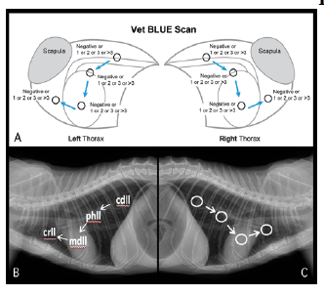

Slide 22
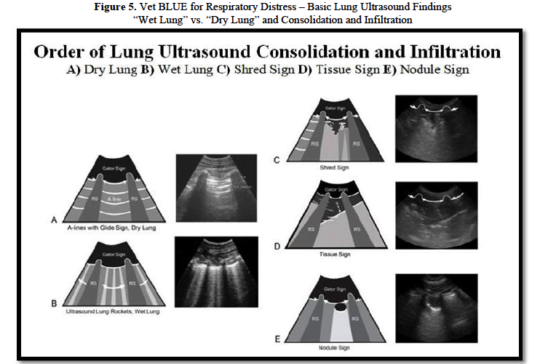

Slide 23
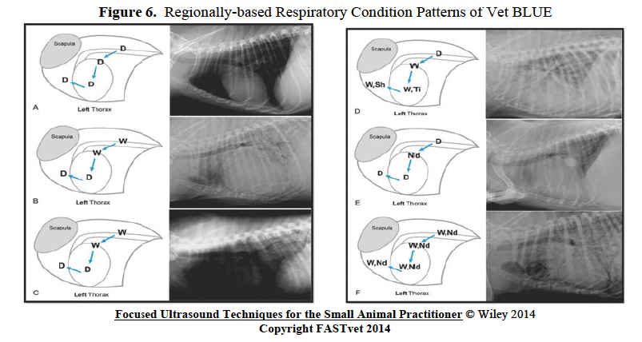
VetBlue

