Slide 1

Intervertebral Disk Disease
June 2 2015
Francesca Di Mauro
Cornell University Hospital for Animals

Slide 2
Intervertebral Disc Anatomy
Nucleus Pulposus (NP)
  Mucoid, translucent, mainly composed of water
Annulus Fibrosus (AF)
  Dense network of organized, concentric fibrous lamellae
  The ventral part 2-3x thicker than the dorsal part
End Plate (EP)
  Form cranial and caudal borders of the IVD
Transitional Zone (TZ) - inner most AF
  Transition from a fibrous to cartilaginous/mucoid structure
Notes:
The healthy IVD is composed of four distinct components, namely, the NP, AF, EP and TZ.
The NP is a mucoid, translucent, bean-shaped structure, mainly composed of water, located slightly eccentrically in the IVD.
NP is surrounded by the AF, a dense network of multiple, organized, concentric fibrous lamellae.
The ventral part of the AF is two to three times thicker than the dorsal part
Near the centre of the IVD, the AF becomes more cartilaginous and less fibrous
This transition from a fibrous to a more cartilaginous/mucoid structure, the TZ or the innermost AF, forms the interconnection between the NP and AF
The cranial and caudal borders of the IVD are formed by the cartilaginous Eps
The fibres of the inner AF are strongly connected with the EPs, whereas the fibres of the outer AF form connections with the bony vertebral body epiphyses (Sharpey’s fibres)

Slide 3
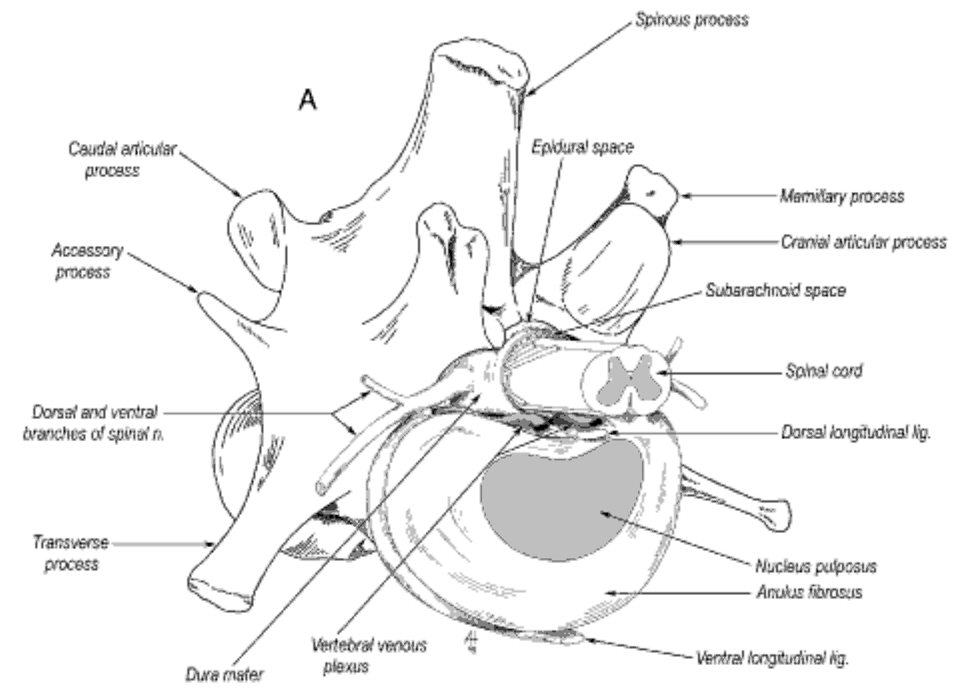
Notes:
Disc in relation to spinal cord and vertebral column
The annulus fibrosus is a multilaminated ligament that encompasses the periphery of the disc and attaches to the hyaline cartilage of the vertebral end plates
The nucleus pulposus, an embryologic remnant of the notochord, is the central portion of the disc and is highly hydrated.

Slide 4
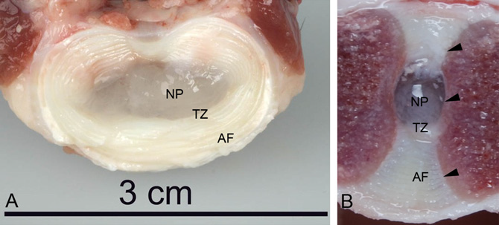
Intervertebral Disc Anatomy
Transverse (A) and sagittal (B) sections through a L5–L6 intervertebral disc
of a mature non-chondrodystrophic dog, showing the nucleus pulposus (NP),
transition zone (TZ), annulus fibrosus (AF), and endplates (arrowheads).
N. Bergknut et al. / The Veterinary Journal 195 (2013) 282–291

Slide 5
Biochemical structure of IVD
Composed of: collagenous and non-collagenous proteins, proteoglycan aggregates, glycoproteins
Glycosaminoglycans (GAGs) are proteoglycans composed of repeating units of hexosamines:
  Chondroitin sulphate (CS), dermatan sulphate, keratan sulphate (KS), hyaluronic acid
GAGs are –vely charged, large → osmotic gradient
  Function to imbibe water
[GAGs] are highest in the nucleus pulposus
  NP is >80% water; AF is 60% water; EP is 50-80% water
Notes:
The major molecular components of the discs are collagenous and non-collagenous proteins, proteoglycan aggregates and glycoproteins.
Glycosaminoglycans (GAGs) are proteoglycans composed of repeating units of hexosamines: chondroitin sulphate (CS), dermatan sulphate, keratan sulphate (KS) and hyaluronic acid.
One of the functions of GAGs is to imbibe water. Concentrations of these GAGs are highest in the nucleus pulposus.
The healthy NP is composed of a complex network of negatively charged proteoglycans interwoven in a mesh of collagen fibres (mainly collagen type II)
The proteoglycan molecules consist of a protein backbone with negatively charged glycosaminoglycan (GAG) side chains. The most common side chains are chondroitin sulfate and keratin sulfate, which are covalently bound to the central core protein
The most common proteoglycan in the healthy IVD is aggrecan. The proteoglycans are in turn aggregated with hyaluronic acid, and these negatively charged large complexes create a strong osmotic gradient, attracting water into the NP.
As a result, over 80% of the healthy NP is composed of water creating a high intradiscal pressure
The outer part of the AF contains mostly collagen type I, whereas the inner part (TZ) contains predominantly collagen type II. The AF consists of 60% water

Slide 6
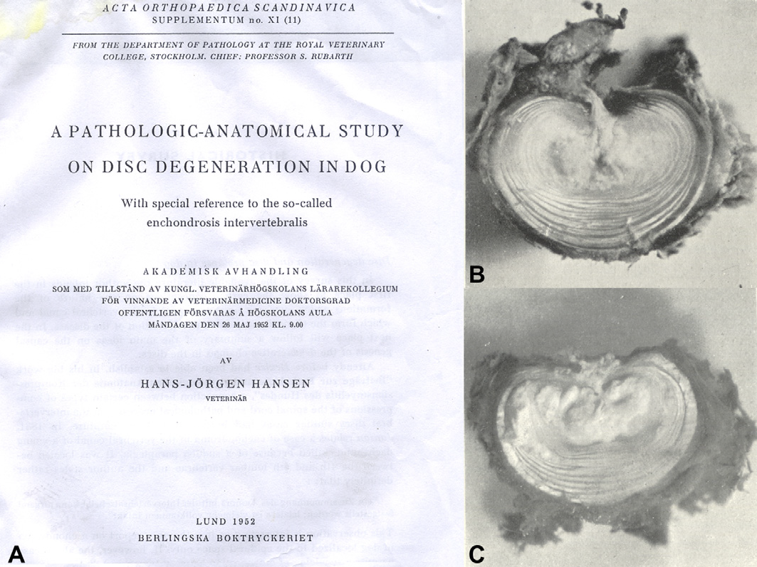
IVD Degeneration
Characterized by changes in composition of cells and extracellular matrix of the NP, TZ, AF, Eps
Notes:
There are complex, multifactorial processes involved in IVD degeneration
Degeneration is characterized by changes in composition of cells and extracellular matrix of the NP, TZ, AF, Eps
HISTORY - Title page of the thesis written by Hans-Jörgen Hansen in 1952, providing the first clear description of intervertebral disc degeneration and herniation in dogs, and
the distinction between chondrodystrophic and non-chondrodystrophic breeds with regard to this process (discussed in Smolders et al. (2013)). (B) Reproduction from
Hansen’s thesis (1952). The original figure legend reads as follows: ‘Dachshund, 6 years old. Disc 21 (L2–L3). Protrusion of type I. the picture shows the large dimensions of the
protrusion and demonstrates clearly its origin from nucleus. The annulus fibrosus rupture is situated close to the right side of the dorsal longitudinal ligament. Nucleus is the
site of a calcified necrosis and has lost its normal shape’. (C) Reproduction from Hansen’s thesis (1952). The original figure legend reads as follows: ‘Dachshund, 4 years old.
Disc 22 (L3–L4) with a calcified centre and a dorsomedian rupture of the a.f. the protrusion is of type I with loose consistency and rough, uneven surface. An interlamellar
dissection of calcified material is seen to the left o nucleus, emanating from a ventral rupture of the inner layer of the a.f. this rupture, however, is not seen in this picture’ (a.f.,
annulus fibrosus)

Slide 7

Degeneration of the Disc
Associated with
Genetic predisposition
Chronic physiomechanical overload and trauma
Inadequate metabolite and nutrient transport
Cell senescence and death
Altered levels of enzyme activity
Changes in matrix macromolecules
Changes in water content

Slide 8
Process of IVD Degeneration
GAG content decreases with concurrent increase in collagen content
Matrix of the IVD becomes more rigid
Disc loses its hydrostatic properties to function as a hydraulic cushion
Impaired diffusion of nutrients in to disc
Impaired ability of IVD cells to repair the matrix
  Avascular and low cellular nature of IVD
  Inferior biomechanical environment
Notes:
In the process of IVD degeneration, the GAG content decreases with a concurrent increase in collagen content.
As a result, the matrix of the IVD becomes more rigid and loses its hydrostatic properties to function as a hydraulic cushion, rendering the IVD matrix suboptimal to fulfil its biomechanical function.
Structural failure of the matrix results in a changed biomechanical environment of the IVD cells within the matrix. In addition, because of the changes of the IVD matrix, diffusion of
nutrients and the bulk fluid flow in and out of the disc become impaired, further deteriorating the health of the IVD cells and synthesis of healthy matrix

Slide 9
Process of IVD Degeneration
Disc height may decrease due to dehydration
Abnormal loading of NP, AF, Eps
Result in annular tears and EP fractures
Structural failure of the IVD as a whole may also result in bulging or herniation of the IVD
Notes:
IVD degeneration’ describes deterioration of the quality of the IVD matrix as a result of pathological and age-related changes and the associated structural changes of the disc

Slide 10
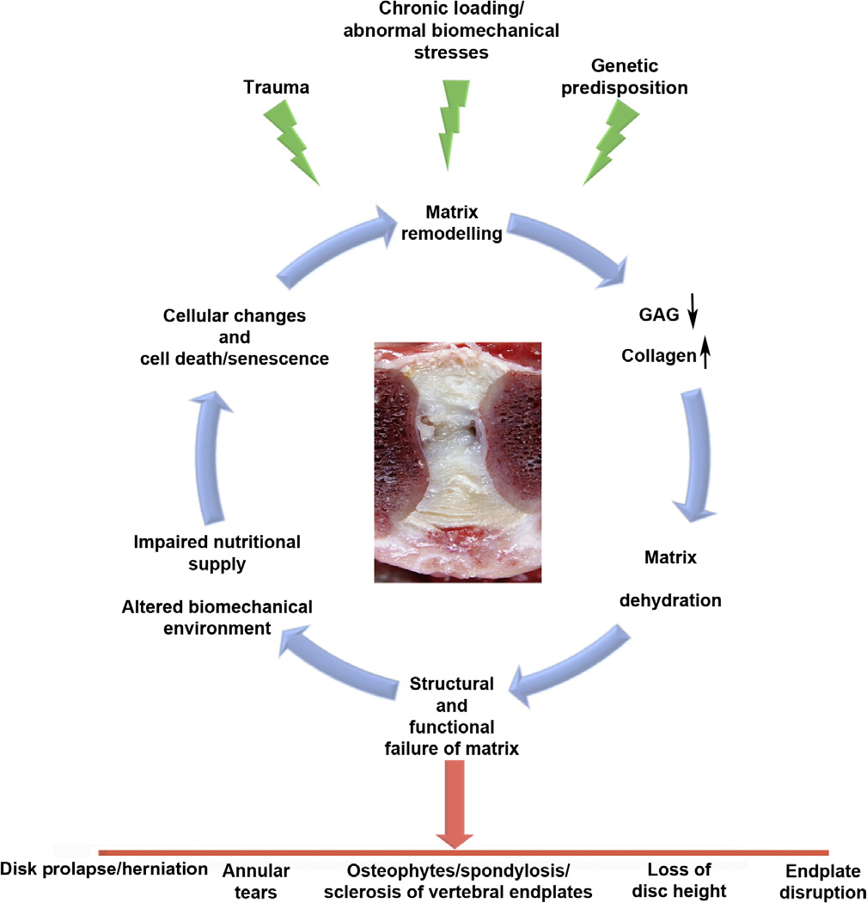
Process of IVD Degeneration
N. Bergknut et al. /
The Veterinary Journal
195 (2013) 282–291

Slide 11
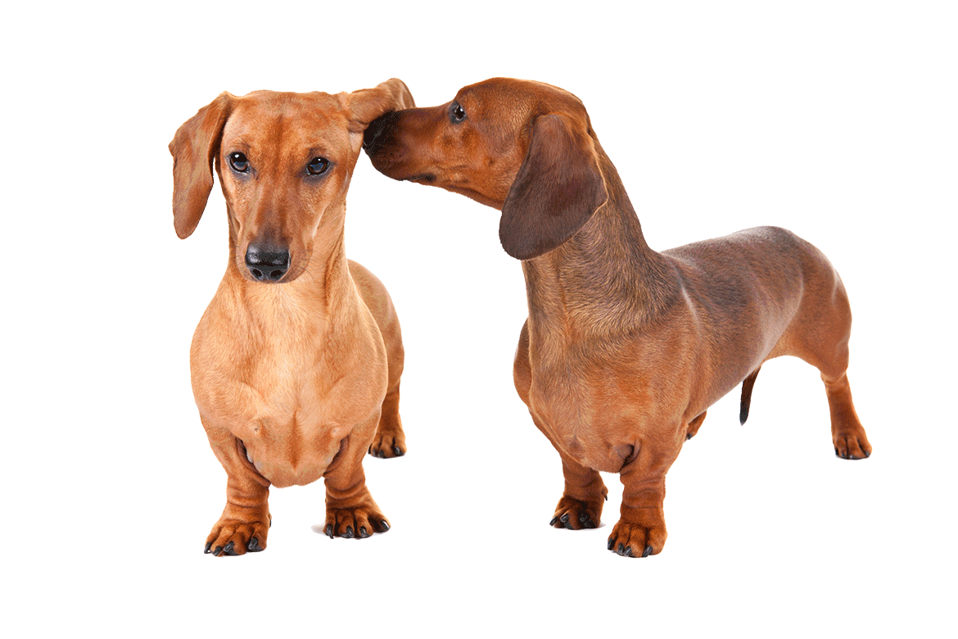
Chondrodystrophic (CD) vs Non-Chondrodystrophic (NCD) Breeds and IVD
IVD degeneration more common in CD
CD characterized by a disturbed endochondral ossification of the long bones
  Disproportionally short limbs
Hansen (1952) provides the basis for the distinction between CD and NCD dogs
  Dachshund
  Dachsbrache
  Pekingese
  Spaniel (unspecified)
  French Bulldog
Notes:
IVD degeneration is more common in CD breeds
CD – characterized by a disturbed endochondral ossification, primarily of the long bones, such that CD dogs have disproportionally short limbs
Popular CD breeds include, among others, the (miniature) Dachshund, Basset Hound, French and English Bulldog, Shi Tzu, miniature Schnauzer, Pekingese, Beagle, Lhasa Apso, Bichon Frisé, Tibetan Spaniel, Cavalier King Charles Spaniel, Welsh Corgi, and the American Cocker Spaniel

Slide 12
Pathological Findings
In Chondrodystrophic Breeds
Newborn CD: TZ wide, cells lack orientation
  Newborn NCD: transition from AF to NP is more distinct and abrupt
Disc degeneration earlier and faster
Change from gelatinous, semi-fluid NP to a drier NP at 3–4 months
Transformation complete by 1 year of age in:
  75% of cervical
  100%, of thoracic
  93.8% of lumbar
Notes:
Compared with the TZ of new-born NCD dogs, the TZ of newborn CD dogs is relatively wide, occupying most of the annulus fibrosus (AF), and its cells lack orientation
In new-born NCD dogs, the transition from AF to nucleus pulposus (NP) is more distinct and abrupt (Hansen, 1952).
IVD degeneration in CD breeds occurs earlier and faster than in NCD breeds
In CD breeds, the change from a gelatinous, semi-fluid NP to a drier NP (Fig. 1) can already be observed at 3–4 months of age and this transformation is complete in 75% of the cervical, 100%, of the thoracic, and 93.8% of the lumbar IVDs by 1 year of age.
Ultimately, all IVDs are affected.

Slide 13
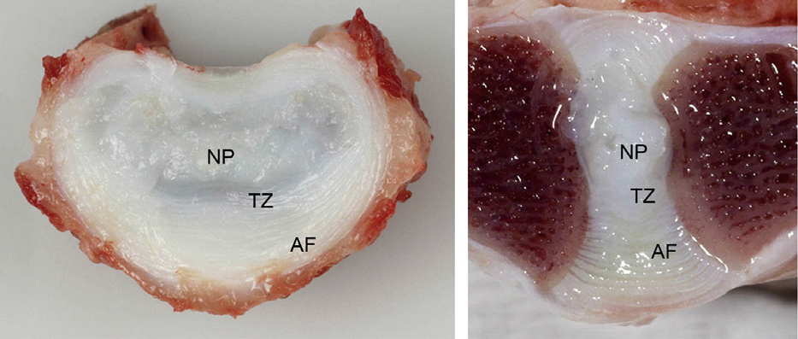
Pathological Findings
In Chondrodystrophic Breeds
Transverse (left) and sagittal (right) sections through the L5–L6 intervertebral disc of a 2-year-old chondrodystrophic dog, showing a dorsally located, drier nucleus pulposus (NP), a widened transition zone (TZ), and a normal annulus fibrosus (AF).
N. Bergknut et al. / The Veterinary Journal 195 (2013) 282–291

Slide 14
Pathological Findings
In Chondrodystrophic Breeds
NP occupies small portion of IVD surface and is located eccentrically to the dorsal side of the IVD
Differences in NP, TZ, and AF morphology decrease functional size of NP
At 3 months of age NP gradually replaced by chondrocyte-like cells
  Chondroid metaplasia or chondrification of the NP
  Starts in the periphery and spreads throughout the NP
  Completed in most IVDs by 1 year of age
Notes:
In addition, the NP of CD dogs occupies a relatively small portion of the total transverse IVD surface and is located eccentrically to the dorsal side of the IVD
In contrast, the ventral TZ and AF are relatively wide compared to those of NCD dogs
These macroscopic differences in NP, TZ, and AF morphology decrease the functional size of the NP in IVDs from CD breeds
In CD dogs, at 3 months of age the NP is gradually replaced by chondrocyte-like cells embedded in a large amount of dense extracellular matrix
This chondroid metaplasia or chondrification of the NP tends to start in the periphery and spreads throughout the NP, and is completed in most IVDs by 1 year of age

Slide 15
Pathological Findings
In Chondrodystrophic Breeds
Degeneration of AF (in CD dogs) occurs after NP degeneration, not independently
AF degeneration tends to occur at one specific location, where it is more severe and acute
Degenerative changes in the AF
  Chondroid metaplasia
  Partial or complete rupture
  Separation of the annular lamellae
Changes observed in the dorsal AF, rarely in ventral AF
Notes:
IVD degeneration progresses rapidly in CD breeds and can result in dorsal herniation of the NP as early as 2 years of age

Slide 16
Biochemical Differences:
Chondrification of the NP
Decrease in proteoglycan and hyaluronic acid content
Increase in collagen content
Occurs in all IVDs in CD dogs, in selected IVDs in NCD dogs
Rapid deterioration of hydroelastic properties and hydraulic function
Notes:
Chondrophication of NP involves:

Slide 17
Biochemical Differences
At 9 months: proteoglycan content of NP is significantly higher in NCD dogs than in CD dogs
At 30 months of age: NP proteoglycan content decreases in CD dogs; remains constant throughout life in NCD
Before 1 year of age: NP contains ~25% collagen in CD, <5% in NCD

Slide 18
Pathological Findings
NON- Chondrodystrophic Breeds
Changes of the NP typically occur later (>5 years)
  Changes similar to those in CD dogs
Transition from a gelatinous to fibrillar NP occurs in single IVDs
  Usually in the caudal cervical and lumbosacral spine
By 6–7 years of age 50% - 68.7% of all NPs have undergone such changes
  NOT ALL IVDs undergo degenerative change
Notes:
In NCD breeds, the macroscopic changes of the NP are largely similar to those in CD dogs, but typically occur later in life (>5 years)
The transition from a gelatinous to fibrillar NP typically occurs in single IVDs and usually in the caudal cervical and lumbosacral spine
By 6–7 years of age, between 50% and 68.7% of all NPs have undergone such changes (in a subset of dogs consisting of various Terrier breeds, Toy breeds, Afganian, Alsatian, Boxer, Chow-Chow, Collie, Dalmatian, Dobermann pincher, Elkhound, Great Dane, Labrador, Maltese, Mongrel, New Foundland, Old English Sheepdog, Pointer, Poodle, Rottweiler,
Russian Greyhound, Schnauzer, Setter, Spitz, St. Bernhard, Swedish Hound, and Whippet), but not all IVDs undergo degenerative change

Slide 19
Pathological Findings
NON- Chondrodystrophic Breeds
Degenerative changes of AF often occur concurrently with those of the NP
  May occur earlier
Degeneration gradual
Mainly consists of partial rupture of the AF fibres
Partial NP herniation through a defect in the AF
  Hansen Type II disc disease

Slide 20
IVDD: CD vs NCD
Chondrodystrophic
Non-Chondrodystrophic
3-7 years old
  As early as 2 years of age
Cervical or thoracolumbar spine
Hansen type I
  Hansen type II also reported
6-8 years old
Caudal cervical or lumbosacral spine
(Thoracolumbar spine)
Hansen type II
  Hansen type I also reported
German Shepherd, Dobermann, Rottweiler, Labrador Retriever, Dalmatian, mixed breeds
Notes:
In CD breeds, IVD degenerative disease typically develops around 3–7 years of age, with the degenerative disease mainly occurring in the cervical or thoracolumbar spine
Herniation typically has a sudden and explosive character, with complete rupture of the dorsomedian or dorsolateral AF, and dorsal longitudinal ligament, leading to extrusion of the degenerated NP into the vertebral canal (Fig. 2).
This type of herniation, or Hansen type I herniation usually occurs in the cervical and thoracolumbar spine although Hansen type II herniation (discussed below) is also reported in CD breeds
In contrast, in NCD breeds IVD degenerative disease develops later, around 6–8 years of age, and mainly affects the caudal cervical or lumbosacral spine, although the thoracolumbar spine can also be affected
NCD breeds frequently affected by IVD degenerative disease include the German Shepherd, Dobermann, Rottweiler, Labrador Retriever, Dalmatian, as well as mixed breed
Hansen type I herniation can also occur in NCD dogs, mainly in the cervical and thoracolumbar spine

Slide 21
Disc Herniation
Hansen type I
Hansen type II
Sudden, explosive herniation
Complete rupture of AF
Extrusion of the degenerated NP into the vertebral canal
Cervical or TL
Partial NP herniation through a defect in AF
Leads to intradisc protrusions, bulging of IVD and dorsal longitudinal ligament
Caudal cervical or LS
Notes:
intradisc protrusions (refers to migration of NP into the AF)
The L7–S1 junction of NCD dogs permits considerable mobility in flexion/extension and axial rotation (Hansen, 1952; Benninger et al., 2006; Smolders et al., 2012).
In addition, the L7–S1 IVD in NCD dogs exhibits a low ventrodorsal shear stiffness, making it more susceptible for ventrodorsal subluxation/instability

Slide 22
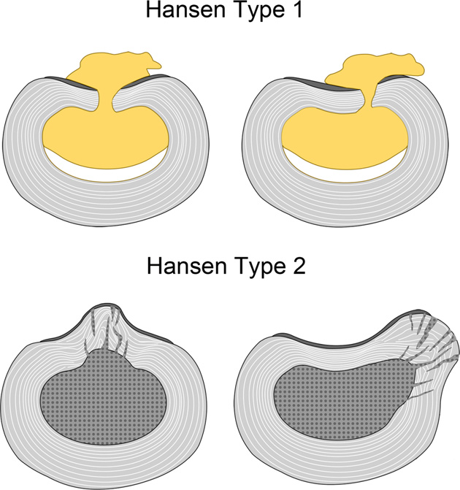
N. Bergknut et al. / The Veterinary Journal 195 (2013) 282–291
Notes:
Schematic pictures of a type I and type II herniation of an intervertebral disc (IVD).
Type I IVD herniation involves complete rupture of the dorsomedian (left) or dorsolateral (right) annulus fibrosus (AF, grey) and dorsal longitudinal ligament (DLL, dark grey) with extrusion of degenerated nucleus pulposus (NP) material (yellow). Type I IVD herniation is commonly observed in chondrodystrophic dog breeds.
Type II IVD herniation involves partial ruptures and disorganization of the AF (grey), and bulging of NP, AF, and DLL towards the dorsomedian (left) or dorsolateral (right) side. Type II IVD herniation is commonly observed in nonchondrodystrophic dog breeds.

Slide 23
Calcification
Frequently observed in CD, but rarely in NCD dogs
Most commonly in thoracic spine
As early as 5 months of age
By 1 year of age 31.2% of cervical, 62.5% of thoracic, and 43.8% of lumbar IVDs in CD dogs show macroscopic calcification
Prevalence increases with age
  Steady state or maximum at 24–27 months of age

Slide 24
Calcification (Platt 2013)
IVD calcification may be associated with herniation
Odds of IVD herniation occurring at any spinal location increases by 1.42 per calcified disc
  Jensen et al., 2008
Disc extrusion can occur in IVDs without any radiographic evidence of calcification
  Rohdin et al., 2010
Partial or complete resolution of disc calcification has been reported and is common among CD dogs >3 years
Notes:
IVD calcification might be associated with IVD herniation (Stigen and Christensen, 1993; Stigen, 1996; Jensen and Christensen, 2000; Jensen and Arnbjerg, 2001; Jensen et al., 2008), with the total number of calcified discs in the spinal column being associated with the risk of developing IVD herniation at random spinal levels (not necessarily the calcified disc): the odds of IVD herniation occurring at any spinal location increases by 1.42 per calcified disc (Jensen et al., 2008).
Although calcification can affect IVD integrity and calcified discs can herniate, calcification occurs more often than IVD herniation. Moreover, disc extrusion can occur in IVDs without any radiographic evidence

Slide 25
Clinical Presentation
Neurological signs may be
  Peracute (<1 hour)
  Acute (<24 hours)
  Subacute (>24 hours)
Hansen type I most common cause for peracute and acute presentations
Clinical signs are variable
  Determined by the rapidity and severity of spinal cord injury and neuroanatomical localization

Slide 26
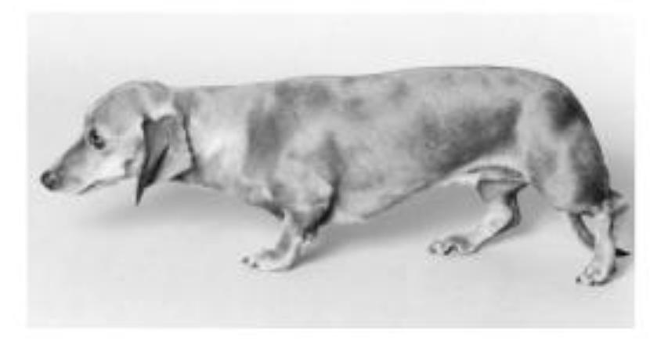
Cervical IVDD: Clinical Signs
Cervical spinal pain is most common sign
Low head and neck carriage
Neck guarding
Cervical spinal muscle spasms
Stilted gait
Radicular pain
Notes:
Cervical spinal pain is the most common clinical sign of acute-onset cervical IVDD.
Low head and neck carriage, neck guarding, stilted gait, radicular pain and spasms of the cervical spinal muscles are common clinical manifestations of cervical spinal pain.
Due to the greater ratio of the vertebral canal diameter to spinal cord diameter in the cervical spine, Hansen type I cervical disc disease commonly presents with pain only even if a large amount of nucleus is extruded.
Pressure from disc material on the nerve root can cause nerve root ischaemia and severe pain.
Pain is often intermittent and manifests as forelimb lameness (root signature or radicular pain).

Slide 27
Cervical IVDD: Clinical Signs
Hansen type I cervical disc disease commonly presents with pain only, even with large amount of extruded nucleus
  Greater ratio of the vertebral canal diameter to spinal cord diameter in cervical spine
Pressure from disc material on the nerve root can cause nerve root ischaemia and severe pain
This pain is often intermittent and manifests as forelimb lameness
  Root signature or radicular pain
Notes:
Gait evaluation is assessed as normal, GP ataxia (more severe in the hindlimbs) and hemi- or tetraparesis/ plegia.
Neurological dysfunction can be asymmetric based on lateralization of the extruded disc.
In general, forelimb spinal reflexes are normal to hyperreflexic with a C1–C5 spinal cord lesion and normal to hyporeflexic with a C6–T2 lesion.
However, spinal reflex evaluations may not be reliable for neuroanatomical localization within the cervical spinal cord region following acute disc disease.
A decreased withdrawal reflex does not always indicate a lesion from C6–T2 and it can also occur with lesions at the C1–C5 spinal cord level.
Nonambulatory tetraplegia is an infrequent clinical manifestation of cervical IVDD.

Slide 28
Cervical IVDD: Neuro exam
Gait: normal, GP ataxia (more severe in the hindlimbs) and hemi- or tetraparesis/ plegia
  Nonambulatory tetraplegia – infrequent manifestation
TL Reflexes:
  Normal
  C1-C5: normal to hyperreflexic (can also have decreased)
  C6-T2: normal to hyporeflexic
  May not be reliable for localization w/in C spine
Horner’s syndrome
  Disruption of tectotegmental spinal tract
Loss of nociception is rare
Notes:
Gait evaluation is assessed as normal, GP ataxia (more severe in the hindlimbs) and hemi- or tetraparesis/ plegia.
Neurological dysfunction can be asymmetric based on lateralization of the extruded disc.
A study of 32 dogs summarized that fewer than one-third of dogs that are non-ambulatory secondary to cervical disc herniation experience complete loss of voluntary motor function; sensory deficits are encountered even less frequently.
In general, forelimb spinal reflexes are normal to hyperreflexic with a C1–C5 spinal cord lesion and normal to hyporeflexic with a C6–T2 lesion.
However, spinal reflex evaluations may not be reliable for neuroanatomical localization within the cervical spinal cord region following acute disc disease.
A decreased withdrawal reflex does not always indicate a lesion from C6–T2 and it can also occur with lesions at the C1–C5 spinal cord level.
Nonambulatory tetraplegia is an infrequent clinical manifestation of cervical IVDD.
Horner’s syndrome can be a clinical manifestation caused by disruption of the tectotegmental spinal tract with severe cervical spinal cord injury. Loss of nociception is rare in dogs with acute cervical IVDD, but is associated with severe spinal cord damage, myelomalacia, cardiac arrhythmia and respiratory dysfunction.

Slide 29
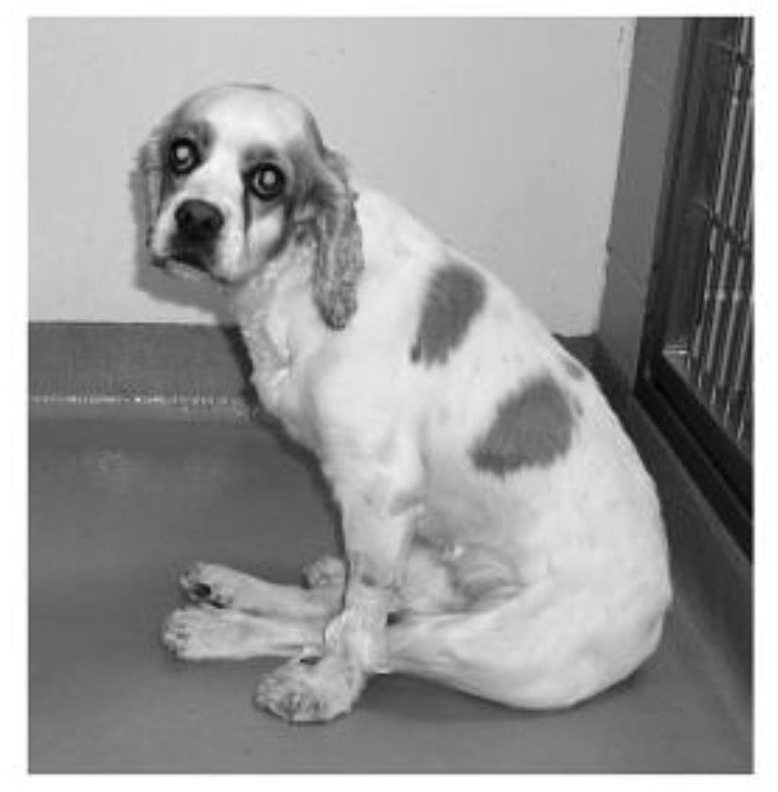
Thoracolumbar IVDD: Clinical Signs
Gait: paraplegia, back pain with kyphosis, normal
+/- nociception
Reflexes:
  Normal
  T3-L3: hyperreflexic
  L4-S3: hyporeflexic
Neurolocalization determined
  by reflexes and
  by site of paraspinal hyperaesthesia
Notes:
Clinical signs of thoracolumbar IVDD vary from spinal hyperaesthesia only to paraplegia with or without nociception.
Dogs with back pain only are reluctant to walk and may show kyphosis. Dogs with back pain alone or minimal neurological deficits can have imaging evidence
of substantial spinal cord compression. Lateralization of the extruded disc and spinal cord compression will often cause asymmetry of neurological deficits.
Neuroanatomical localization of thoracolumbar spinal lesions is determined by normal to hyperreflexic (T3–L3) or hyporeflexic (L4–S3) spinal reflexes and by site of paraspinal hyperaesthesia.

Slide 30
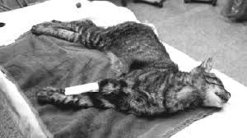
TL IVDD:
Spinal shock and Schiff– Sherrington postures
Peracute or acute thoracolumbar disc extrusions
Characterized by flaccidity distal to the lesion
Spinal reflexes are depressed to absent
Bladder may be flaccid - with urine retention and sphincter hypotonia
Notes:
Dogs presented with peracute or acute thoracolumbar disc extrusions often manifest initial clinical signs of ‘spinal shock’ and/or Schiff– Sherrington postures. Spinal shock is usually manifested as flaccidity distal to the lesion.
Likewise, the spinal reflexes are depressed to absent and the bladder may be flaccid, with urine retention and sphincter hypotonia.
The cause of spinal shock is unclear. A transient decrease in limb tone may be due to loss of descending supraspinal input on the alpha-motor neurons and interneurons,
along with an increase in segmental inhibition. Spinal shock is important to recognize in order to prevent erroneous lesion localization.
These transient phenomena indicate acute and severe spinal cord injury, but do not determine the prognosis.

Slide 31
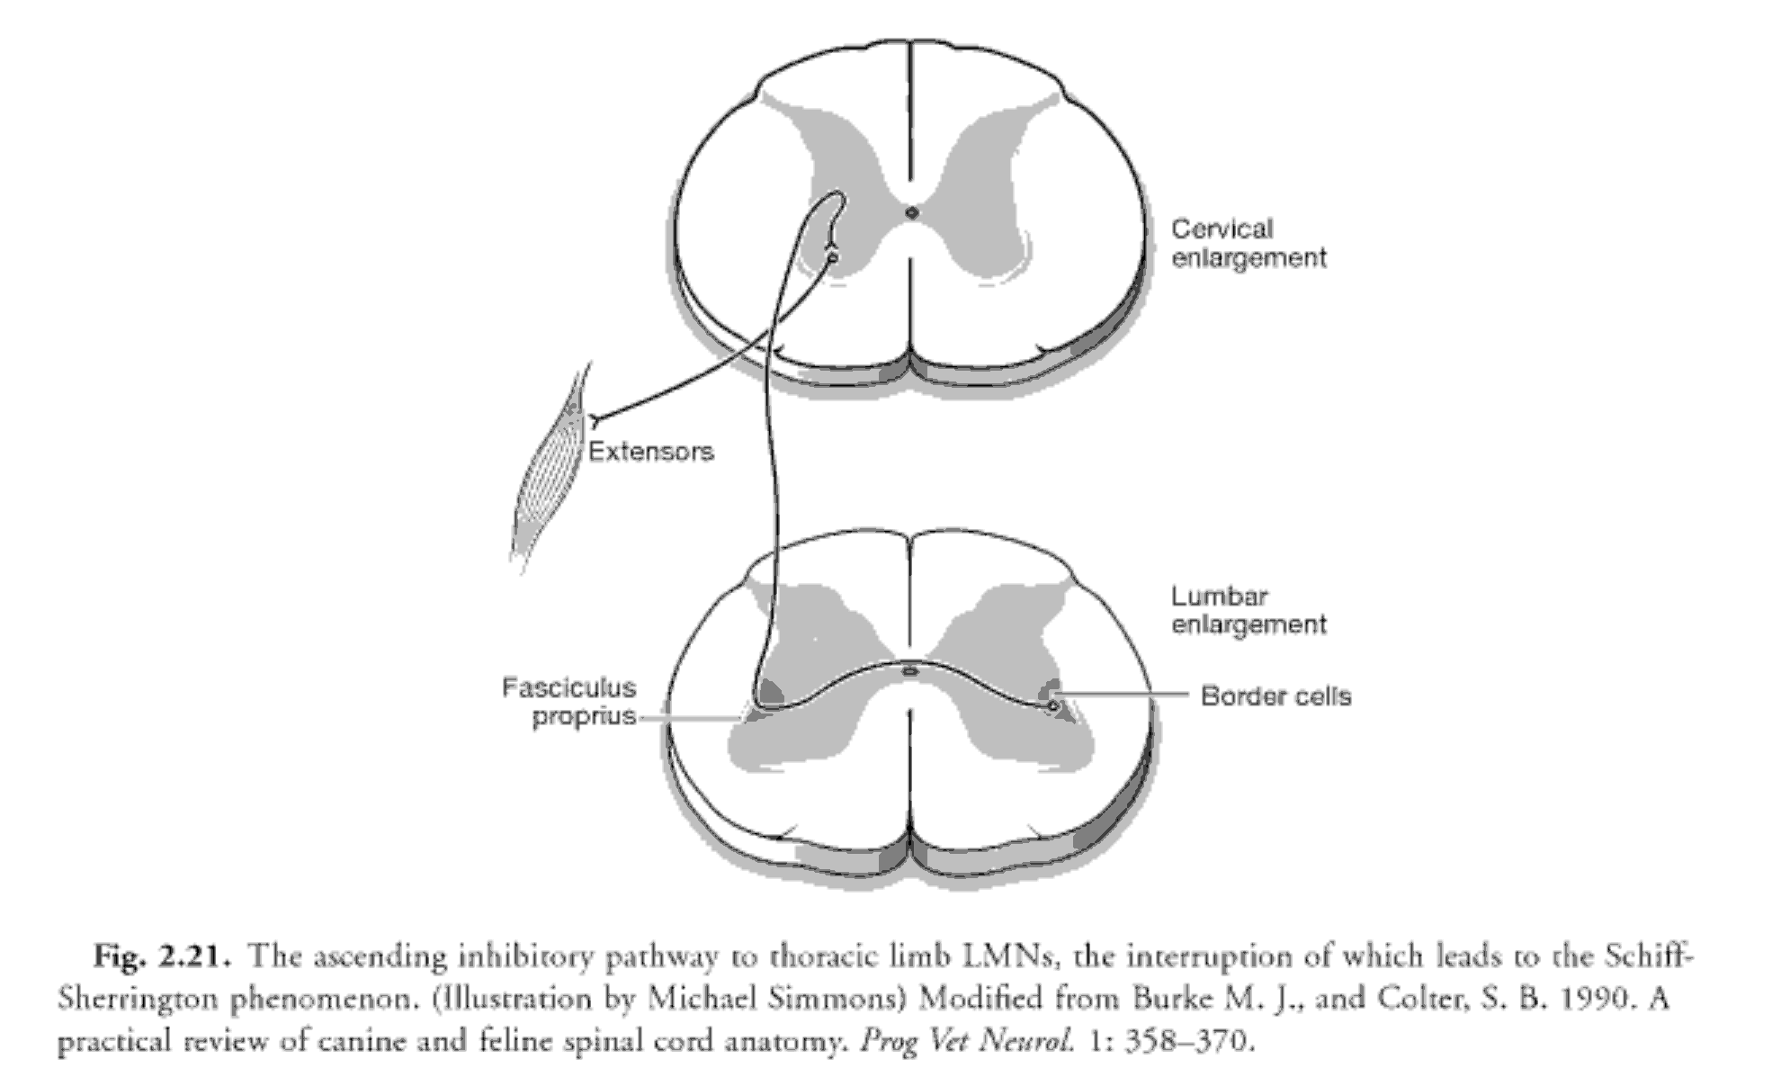
TL IVDD:
Spinal shock and Schiff– Sherrington postures
Disruption of neurons that provide tonic inhibitory activity to muscles of TL
  Result in disinhibition, manifested as TL extensor rigidity
Transient phenomenon that indicates acute and severe spinal cord injury
Does not determine prognosis
Notes:
Border cells in the dorsolateral border of ventral grey column on L1-L7 (mainly L2-L4) are neurons that projct to the cervial intumescnce providing tonic inhibitory activity to muscles of thoracic limbs. DISRUPTION of these neurons or their ascending processes can result in disinhibitiom usually manifested as thoracic limb extensor rigidity.
Patient with S-S has normal functioning thoracic limbs, that have increased extensor tone(most readily appreciated when in lateral recumbency)
Most common clinical errors made when this is encountered
Incorrectly assume C1-C5 lesion based on increased thoracic limb extensor tone
To assume poor prognosis bases on this posture

Slide 32
TL IVDD: Griffiths Classification Scheme
Describes hyperaesthesia, sensory and motor dysfunction and loss of micturition
0 = Normal.
1 = Paraspinal hyperaesthesia only.
2 = General proprioceptive ataxia and/or ambulatory
paraparesis.
3 = Non-ambulatory paraparesis.
4 = Paraplegia (intact nociception).
5 = Paraplegia with loss of nociception.
Notes:
Has been used as a functional grading system to provide treatment guidelines for thoracolumbar IVDD

Slide 33
TL IVDD: Signs of Myelomalacia
Ascending loss of the cutaneous trunci reflex
Loss of nociception caudal to the lesion
Ascending and descending flaccidity and areflexia
Tetraplegia
Hyperthermia and respiratory distress
  Death from intercostal and diaphragmatic muscle paralysis
Signs manifest in hours to days from onset of paraplegia
Notes:
Ascending and descending haemorrhagic myelomalacia should be suspected in dogs with thoracolumbar IVDD that have an ascending loss of the cutaneous trunci reflex. Other neurological signs of myelomalacia include loss of nociception caudal to the lesion, ascending and descending flaccidity and areflexia, tetraplegia, hyperthermia and respiratory distress. Death results from asphyxia associated with intercostal and diaphragmatic muscle paralysis. Clinical signs of ascending and descending myelomalacia may manifest in hours to several days from the onset of paraplegia.

Slide 34
Diagnosing IVDD: Survey Radiographs
Rules out ddx causing bony lesions and assists with confirmation of anatomical landmarks
Lacks accuracy
Accuracy for determining the site of TL IVD extrusion reported as 51–61%
Radiographic findings of suspected disc extrusion
  Narrowing of the disc space
  Altered shape of the intervertebral foramen
  Wedging of the disc space
  Presence of mineralized material in the vertebral canal or superimposed over the intervertebral foramen
Notes:
acks accuracy in identifying exact location of extruded disc

Slide 35
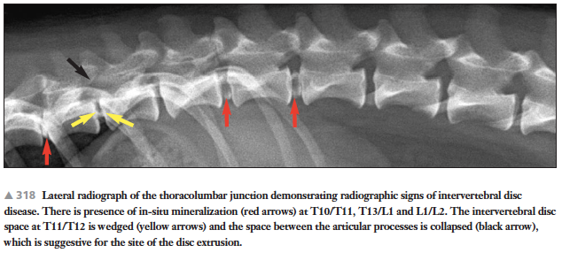
Diagnosing IVDD: Survey Radiographs
Platt. Small Animal Neurological Emergencies

Slide 36
Diagnosing IVDD: Myelography
Nonionic, radiographic contrast medium
Injected into the subarachnoid space at the cerebellomedullary cistern or caudal lumbar (L4/L5, L5/L6) region
Attenuation of contrast flow at sites of compression
Lesion localization with myelography in TL IVDD, ~90% accuracy
Subarachnoid space attenuation of contrast flow seen with haemorrhage and/or spinal cord swelling

Slide 37
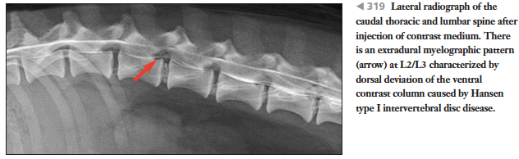
Diagnosing IVDD: Myelography
Extent of spinal cord swelling seen with myelography may help establish prognosis
Dogs with absent nociception have a significantly worse outcome if the extent of spinal cord swelling is greater than five times the length of L2
Disadvantages: systemic complications
Platt. Small Animal Neurological Emergencies
Notes:
Common technical problems associated with myelography include difficulties during injection and poor distribution of contrast medium.
Anatomical problems include atypical displacement of disc material and the presence of spinal cord swelling.
Systemic complications of myelography include seizures, worsening of neurological status, apnea, cardiac arrhythmias, meningitis, subarachnoid haemorrhage and death.

Slide 38
Diagnosing IVDD: CT
Delineate lateralization of the extruded disc material
  Sometimes used as adjunct to myelography
Non-invasive, quick
Fewer complications than myelography
Myelogram may also be necessary if more than one site has extruded disc material
Acutely extruded disc material
  Heterogeneous hyperattenuating extradural mass
Chronically extruded disc material
  Homogeneous hyperattenuating
Notes:
Acutely extruded disc material typically is recognized as a heterogeneous hyperattenuating extradural mass
Chronically extruded disc material has a more homogeneous hyperattenuating appearance
If more than one site has extruded disc material, a myelogram may be necessary to identify the site of the lesion based on a corresponding area of cord swelling

Slide 39
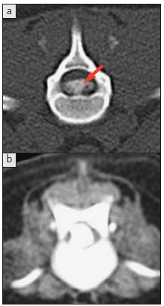

Diagnosing IVDD: CT

Slide 40
Diagnosing IVDD: MRI
Gold Standard
T1- and T2-weighted sagittal and transverse (axial) images
Best method for early recognition of in-situ disc degeneration
May provide better clarity for detecting haemorrhage associated with IVDD
Notes:
Standardized MRI protocols for intervertebral disc disease often use T1- and T2-weighted sagittal and transverse (axial) images over the areas of interest. MRI also is considered
the best method for early recognition of in-situ disc degeneration based on a decrease in signal intensity within the nucleus pulposus on T2-weighted images
The hypointensity seen with degenerative disc disease is linked with changes in proteoglycan concentrations.
Focal signal void within the intervertebral disc

Slide 41
MRI to Predict Prognosis
Dogs with an area of hyperintensity at least as long as the L2 vertebral body seen on pre-operative T2- weighted sagittal MR images have a poorer prognosis for functional recovery
Success rate following surgery in dogs without hyperintensity of the spinal cord was 100%
  Compared to 55% in those with areas of hyperintensity
Notes:
Dogs with an area of hyperintensity at least as long as the L2 vertebral body seen on pre-operative T2- weighted sagittal MR images of the spinal cord have a
poorer prognosis for functional recovery (326 ).
The success rate following surgery in dogs without hyperintensity of the spinal cord was 100% compared to 55% in those with areas of hyperintensity. Moreover, the success
rate reported for dogs with areas of hyperintensity and loss of nociception was 31%, and the success rate in dogs with no nociception and hyperintensity >3 times the length of the L2 vertebral body was 10% (1/10 dogs).
As expected, the degree of cord compression noted on MRI of thoracolumbar disc disease has not been associated with prognosis

Slide 42
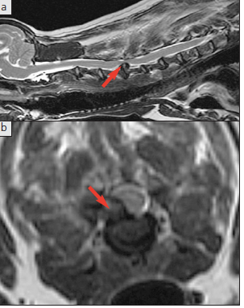
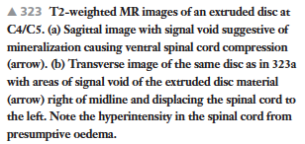
Diagnosing IVDD: MRI

Slide 43
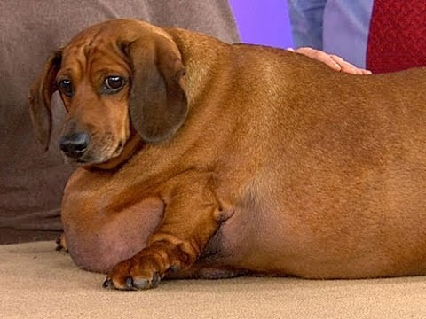
Treatment: Medical Management
Indications: first time incidence of spinal pain only, mild to moderate paresis, financial constraints
Pain control
  NSAIDS, opioids and muscle relaxants
Strict cage confinement for minimum of 4–6 weeks
  Annular and ligamentous healing
  Prevention of further disc herniation
Acupuncture
Muscle relaxants
Physical therapy, weight control
Avoidance of jumping activities
Notes:
The importance of cage rest is that it allows for annular and ligamentous healing and prevention of further disc herniation
Acupuncture and muscle relaxants have also been advocated as treatments for pain management Cases with recurrent episodes of neck or back pain uncontrolled by medication and/or worsening of neurological status should have decompressive surgery. Physical therapy, weight control and avoidance of jumping activities may reduce recurrence rates.
Dexamethasone (0.5–1.0 mg/kg IV once) or prednisone (0.5–1.0 mg/kg PO q12–24h for 5 days, then taper) has also been advocated to reduce spinal cord oedema. However, administration of corticosteroids is controversial from the standpoint of countering pathophysiological mechanisms and efficacy still remains to be proven. Corticosteroid
use in dogs with acute IVDD can increase rates of postoperative complications (which include gastrointestinal disease) and financial cost to the client

Slide 44
Medical Management for Cervical IVDD
Cervical IVDD: conservative therapy often ineffective
  Total immobility of the cervical spine is difficult to maintain
Surgical management recommended
  When pain is refractory for > 1–2 weeks with medical therapy
  Progression of neurological deficits
Recurrence rate reported as 33% (as high as 36%)
Success rate of nearly 50% reported
18% have therapeutic failure
Duration of cage rest not significantly associated with success

Slide 45
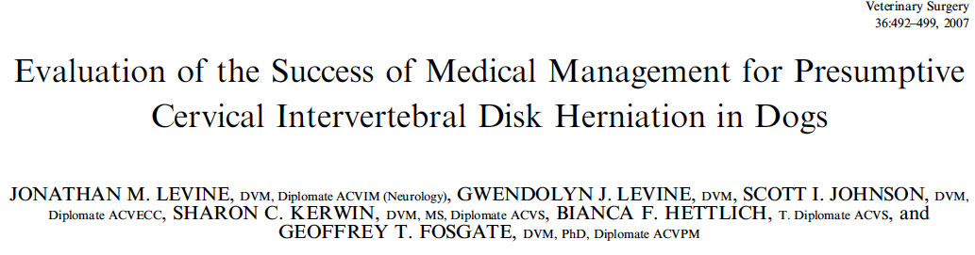
Retrospective study
88 dogs
49% recovered
33% recurrence
18% failed to recover
NSAIDs associated with success
Duration of cage rest and steriods were not associated with success or quality of life

Slide 46
Medical Management for TL IVDD
Success rates of ambulatory dogs with TL pain only and/or mild paresis range from 82–100%
Recovery rates in nonambulatory dogs are lower and recurrence rates are higher
Recurrence rates in dogs with minimally affected ambulatory status 30–50%
Recurrence of signs usually occurs within 6 months to 1 year from onset of the initial clinical signs

Slide 47
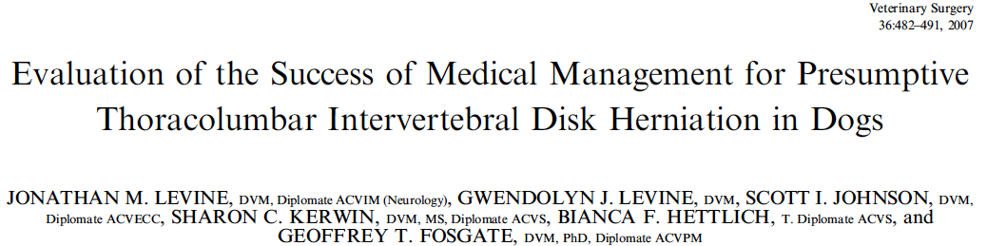
223 dogs
Retrospective study
83% ambulatory at presentation
  54.7% had successful outcome
  30.9% recurrence
  14.4% failure
Cage rest duration did not affect outcome
Glucocorticoids may negatively impact success and QOL

Slide 48
Surgical Management
Goals: decompression, removal of extruded disc and haemorrhage, visual observation of the spinal cord
Decompressive procedures: ventral slot, dorsal laminectomy, hemilaminectomy, partial corpectomy and pediculectomy

Slide 49
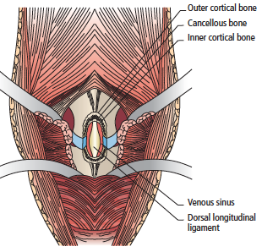
Surgical Management of Cervical IVDD:
Ventral Slot
Indications for surgery: pain refractory to medical management and/or severe and progressive deficits
Advantages
  Minimal muscle dissection
  Exposure for prophylactic
  fenestration
Disadvantages
  Excessive venous sinus haemorrhage
  Lack of spinal cord decompression
  Inadequate exposure for lateral
  or intraforaminal disc extrusion
Notes:
Using the identifiable landmarks of the ventral prominence of C1 and the transverse processes of C6 to identify the disc interspace of interest, a slot is cut into the ventral aspect of the cervical vertebrae using a high-speed surgical drill.
Advantages of the ventral decompressive technique include minimal muscle dissection and exposure for prophylactic fenestration of adjacent cervical discs.
Disadvantages may include excessive venous sinus haemorrhage, lack of spinal cord decompression and inadequate exposure for lateral or intraforaminal disc extrusion.
If the width of the slot is >30% of the size of the vertebral body, dogs may suffer from instability or subluxation at the surgery site

Slide 50
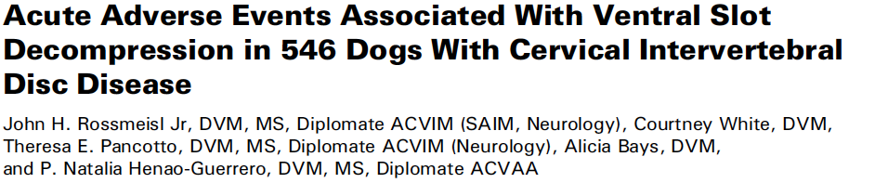
Adverse events occurred in 9.9% of dogs
Associated with perioperative hypotension, C7–T1 disc extrusions, surgeon experience, and NSAID usage.
Identification of a major postoperative AE is an indication for immediate diagnostic imaging studies, as 50% of dogs experiencing major AE required reoperation

Slide 51
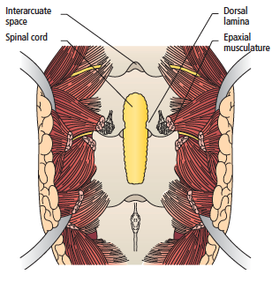
Surgical Management of Cervical IVDD:
Dorsal Laminectomy
Risk excessive haemorrhage from muscle dissection and damage to the internal vertebral venous plexus or vertebral artery
Complications
  Incomplete removal of
  disc material
  Risk for spinal instability
  dorsal slot > ventral slot
  technique

Slide 52
Surgical Management: TL IVDD
Indications: spinal pain or paresis refractory to medical therapy, recurrence or progression of neurological deficits, paraplegia with intact nociception and paraplegia with loss of nociception for less than 24–48 hours
Type of decompressive sx may not affect outcome
Ability to retrieve the disc material depends on the type of decompressive procedure
  Hemilaminectomy > dorsal laminectomy

Slide 53
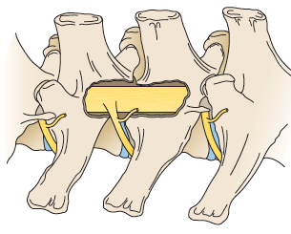

Surgical Management: TL IVDD
Surgical complications: excessive haemorrhage, incomplete removal of extruded disc, constrictive fibrosis, instability (rarely)

Slide 54
Surgical Management: Fenestration
The effectiveness of fenestration is related to the amount of nucleus pulposus removed
Performed from T11/T12 to L3/L4
Not recommended in large NCD dogs due to the potential for underlying spinal instability as a predisposing factor for annular protrusion
Recurrence rates
  0–24% with prophylactic fenestration
  2.7–42% without prophylactic fenestration

Slide 55
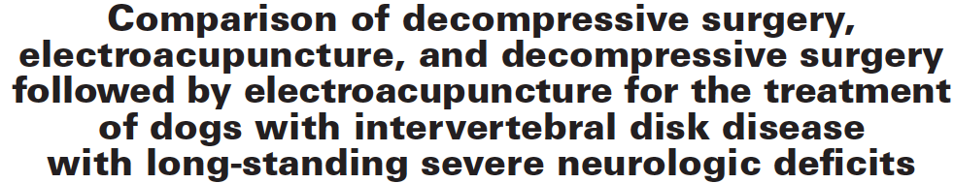
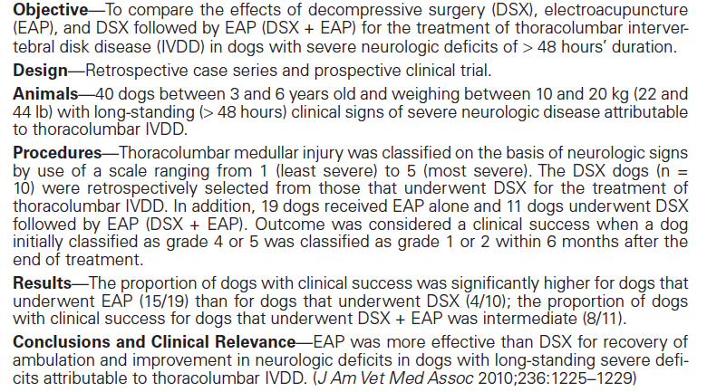

Slide 56
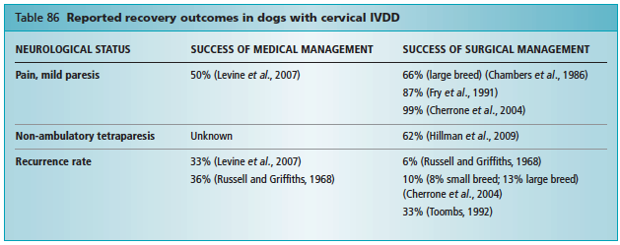
Cervical IVDD: Prognosis
In a study of 190 dogs with cervical IVDD treated surgically, outcomes were no different for the ambulatory versus nonambulatory dogs with intact nociception (Cherrone)
Notes:
In a study of 190 dogs with cervical IVDD treated surgically, outcomes were no different for the ambulatory versus nonambulatory dogs with intact nociception. After surgery,
99% of those dogs had resolution of cervical spinal hyperaesthesia and were able to ambulate unassisted.
Recurrence is very high after medical management

Slide 57
TL IVDD: Prognosis
Overall success rates after decompressive surgery range from 58.8–95%
  Depends on definition of success
Reported that ~40% of dogs that recovered from loss of nociception continued to have faecal incontinence
Dogs with more severe motor dysfunction have longer recovery times for regaining ambulatory function
  Reported mean time varies from 10 days -52 days
Notes:
Disc extrusions caudal to L3–L4 are likely to achieve ambulatory status sooner than dogs with disc extrusions between T10 and L3

Slide 58
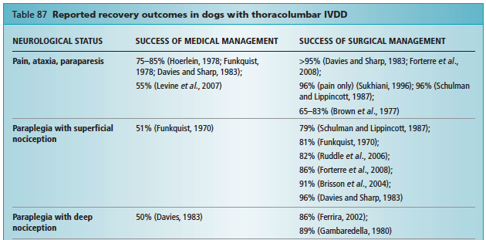
TL IVDD: Prognosis

Slide 59
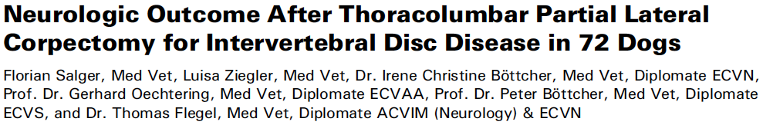
Retrospective Study
72 dogs with IVDD (T9 - L5) treated by at least 1 PLC
Based on owner questionnaire
91.4% of dogs were ambulatory 6 months postop
  74.5% having a normal gait
Improved neurologic function within 6 months after surgery
Conclusions: PLC is an option for decompression in ventrally compressing thoracolumbar IVDD
Prognosis is associated with presurgical neurologic condition

Slide 60
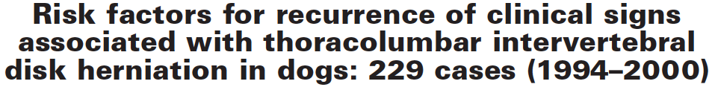
Retrospective study
229 dogs
Clinical signs associated with recurrence of IVDD developed in 44 (19.2%) dogs.
96% of recurrences in 3 years after surgery
Recurrence developed in 25% of Dachshunds and 15% of dogs of other breeds combined.
Number of opacified disks was significant risk factor for recurrence
Dogs with 5-6 opacified disks at time of first surgery had a recurrence rate of 50%
Dogs with multiple opacified disks at the time of first surgery should be considered a high-risk subpopulation.

Slide 61
Prognosis: Nociception
Most important prognostic indicator is presence of nociception
Without surgery, or with delayed surgery, dogs with absent nociception have extremely guarded prognosis
Duration of absence of nociception prior to surgery as a prognostic indicator is controversial
Platt: In general, loss of nociception for longer than 24–48 hours prior to surgery have a poorer prognosis for return of function

Slide 62
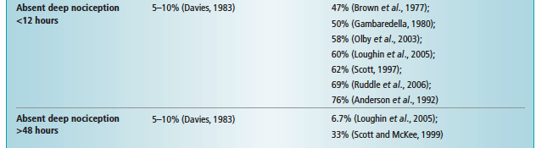
Prognosis: Nociception
Recovery rates for thoracolumbar IVDD and absent nociception range from 0–76%
Prognosis is considered poor if nociception does not return within 2–4 weeks after surgery

Slide 63
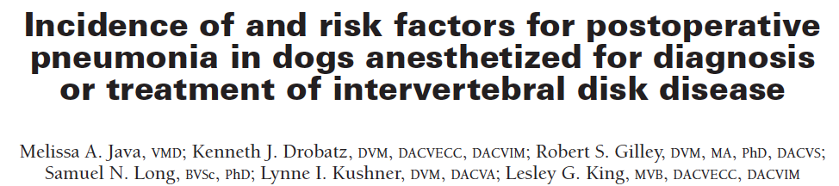
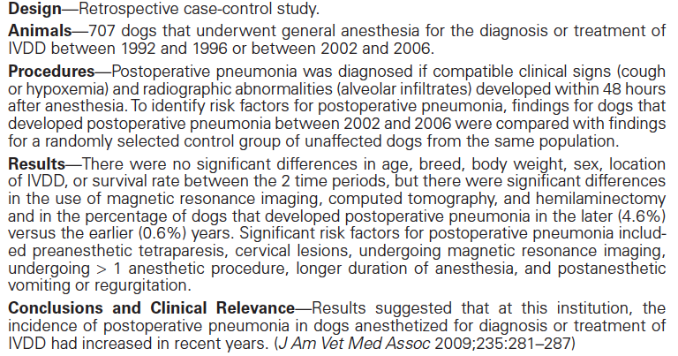

Slide 64

Feline IVDD

Slide 65
Feline IVDD
Less frequent - reported incidence of 0.02–0.12%
Hansen type I IVDD
  Acute or peracute
  Mean age of 9 years old (1.5-17 years) - Middle-aged cats
  TL
Hansen type II IVDD
  Chronic
  Common incidental age related change in older cats
  CS and caudal lumbar

Slide 66
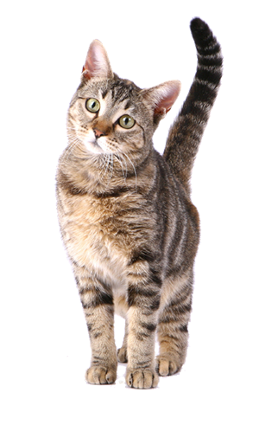
Feline IVDD: Prognosis
Do not respond well to conservative
Decompressive surgical techniques
Long-term prognosis
is good to excellent in the
majority of cases

Slide 67
References
In Presentation
Platt.
Dewey.

Slide 68
Differential Diagnoses
Vascular: FCEM thrombosis, infarction.
Inflammatory/Infectious: meningitis/myelitis (viral, fungal, bacterial, rickettsial, protozoal, algal), spinal epidural empyema, discospondylitis (bacterial, fungal), vertebral physitis. Noninfectious: MEM of unknown aetiology (granulomatous MEM, necrotizing encephalomyelitis), steroid-responsive meningitis, vasculitis.
Trauma: Vertebral fractures/luxations, AA subluxation.
Neoplasia: Primary: extradural (vertebral, lymphoreticular), intradural extramedullary (lymphoreticular, meningioma, nerve sheath tumour), intramedullary (oligodendroglioma, astrocytoma, ependymoma). Secondary: metastatic (lymphoreticular, haemangiosarcoma, meningeal carcinomatosis, undifferentiated sarcomas).
Degenerative: Degenerative lumbosacral stenosis.
Notes:
Disorders that typically do not manifest paraspinal pain include intramedullary neoplasia an fibrocartilaginous embolic myelopathy (FCEM).

Slide 69
Healthy Intervertebral Disc
Vascularity
Outer layers of the AF have limited blood supply
No direct blood supply to inner layers of AF or NP
Innervation
Sparse
Nerve endings in outer lamellae of the AF, and not in the inner AF, TZ, and NP
Nutrients
EP supply disc with nutrients
Small molecules (oxygen, glucose) reach NP, TZ, AF through diffusion and osmosis
Larger molecules (albumin, enzymes) transported by bulk fluid flow (‘pumping mechanism’)
Notes:
No direct blood supply to inner layers of annulus fibrosis or nucleus pulposa
Innervation of the IVD tissue itself is sparse: nerve endings have only been found in the outer lamellae of the AF, and not in the inner AF, TZ, and NP
This is in contrast with the dorsal longitudinal ligament, which is densely innervated
The EPs play an essential role in supplying the IVD with nutrients.
Small molecules (such as oxygen and glucose) reach the cells of the NP, TZ, and AF through diffusion and osmosis from the capillary buds through the semipermeable Eps
Larger molecules, such as albumin and enzymes, are transported by bulk fluid flow (‘pumping mechanism’) created by the physiological loading of the IVD and changes in posture

Slide 70
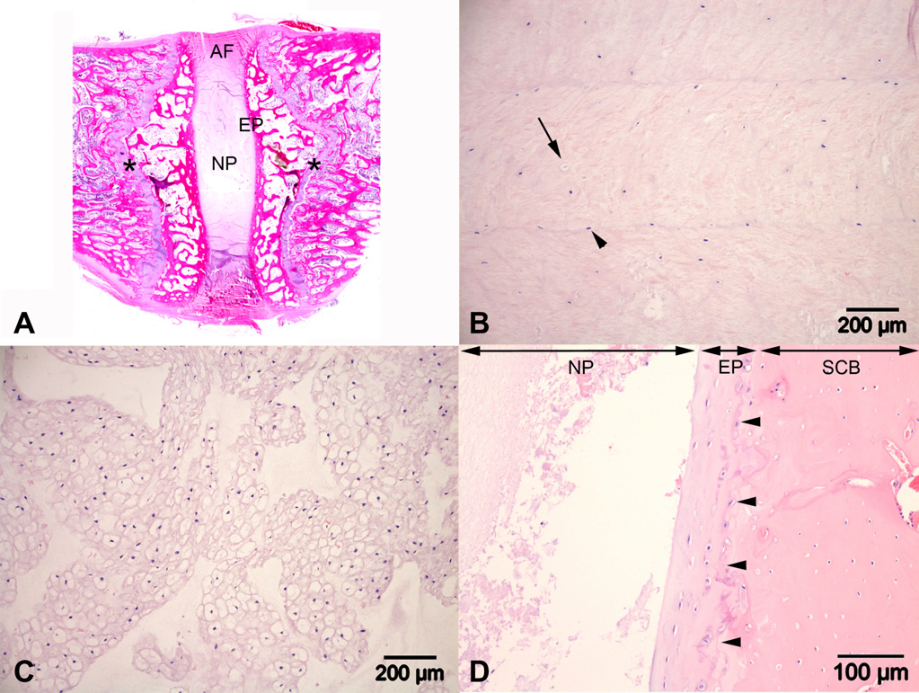
Histology of IVD
(B) Annulus fibrosus (AF), showing the lamellar layers with fibrocyte-like cells (arrowhead) and chondrocyte-like cells (arrow). (D) Cartilaginous endplate (EP), showing chondrocyte-like cells in a hyaline-type matrix. The border between endplate (left) and subchondral bone (SCB) (right) is indicated with arrowheads
Notes:
The cell population changes from fibrocyte-like cells in the outer layers of the AF to a mixed population of fibrocytes and chondrocyte-like cells in the inner layers
Mid-sagittal histological section (H&E) of a healthy, immature canine intervertebral disc, still with active growth plates in the vertebral bodies
(C) Nucleus pulposus (NP), showing clustered notochordal cells.

Slide 71
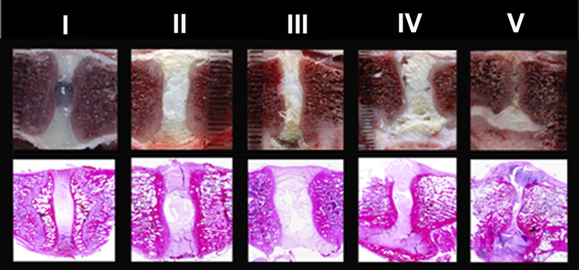
Grading Schemes: Macroscopic changes associated with IVD
Thompson scheme validated for use in dogs
Does not include herniation and prolapse of the IVD (consequences of the degenerative process)
Notes:
This grading scheme for macroscopic changes associated with IVD, has been validated for use in dogs
According to this scheme (Fig. 7; Table 1), the gradual process of IVD degeneration can be divided into five stages, ranging from a completely healthy IVD (grade I) to a severely degenerated IVD (grade V). This grading scheme does not include herniation and prolapse of the IVD, which are considered consequences of the degenerative process (Hansen, 1952).

Slide 72
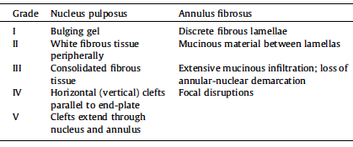

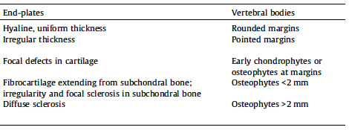
Grading Schemes: Macroscopic changes associated with IVD
N. Bergknut et al.
/ The Veterinary
Journal
195 (2013) 282–291

Slide 73
Grading Schemes: Macroscopic changes associated with IVD
A new scheme for grading histopathological changes in the canine IVD recently proposed
  Bergknut et al., 2013
Evaluates the cellular and structural changes in the AF, NP, and Eps
  Using hematoxylin and eosin staining
Uses specific stains to assess changes in the extracellular matrix components
  Alcian blue to stain proteoglycans
  Picrosirius red to stain collagens
Notes:
The grading system also considers changes in tissues or structures adjacent to the IVD, such as new bone formation and sclerotic changes in subchondral bone.

Slide 74
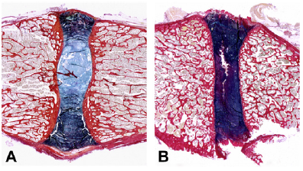
Grading Schemes: Macroscopic changes associated with IVD
Mid-sagittal histological sections of a healthy and a moderately degenerated canine intervertebral disc (IVD) stained with picrosirius red and Alcian blue.
Healthy IVD (B) Degenerated IVD.
N. Bergknut et al. / The Veterinary Journal 195 (2013) 282–291
Notes:
Fig. 8. Mid-sagittal histological sections of a healthy and a moderately degenerated canine intervertebral disc (IVD) stained with picrosirius red and Alcian blue. Alcian
blue stains proteoglycans light blue and picrosirius red stains principally collagen type I red. In the healthy IVD (A), a clear distinction can be made between the nucleus pulposus (NP) containing chiefly proteoglycans, and the annulus fibrosus (AF) staining dark blue/purple, which indicates a mixture of proteoglycans and collagen type I.
In the degenerated IVD (B), no clear distinction between the NP and AF can be made, with increasing collagen staining seen throughout the IVD. A cleft transecting the NP can also be seen.

