Slide 1
COMPuted tomography
RADIOLOGY
Resident Board Review
January 23rd, 2014
Jo-Annie Letendre, DVM

Slide 2
Outline
Basic principles of CT
Use of CT in ECC
Review of the paper:
  Radiology of thoracic trauma in the dog and cat
Review of the paper:
  Comparison of whole-body computed tomography vs selective radiological imaging on outcomes in major trauma patients: a meta-analysis
Review of the paper:
  Multidetector Computer Tomography: Evaluation of Blunt Chest Trauma in Adults
Discussion

Slide 3

Basic principles of CT

Slide 4
Basic principles of CT
Definition:
  Creation of a transverse tomographic section (or slice) of the body using a rotating fan beam, detector array, and computed reconstruction
  tomos = slice
  → digital image
Notes:
CT is an imaging technique whereby cross-sectional images are obtained with the use of xrays; CT is a radiograph obtained with a moving source image receptor assembly
Tomography is from the greek tomos”tomos”, meaning section or slice.
Information from the detectors is analysed by a computer and displayed as a digital image.

Slide 5
Basic principles of CT
Components
  Operating console
  Computer
  Gantry
    X-ray tube
    Radiation detection system
Notes:
The gantry is the framework that holds the xray tube and the radiation detection system

Slide 6
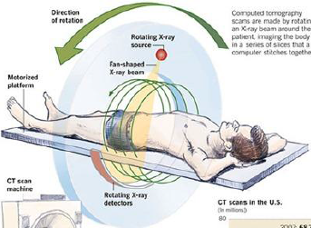
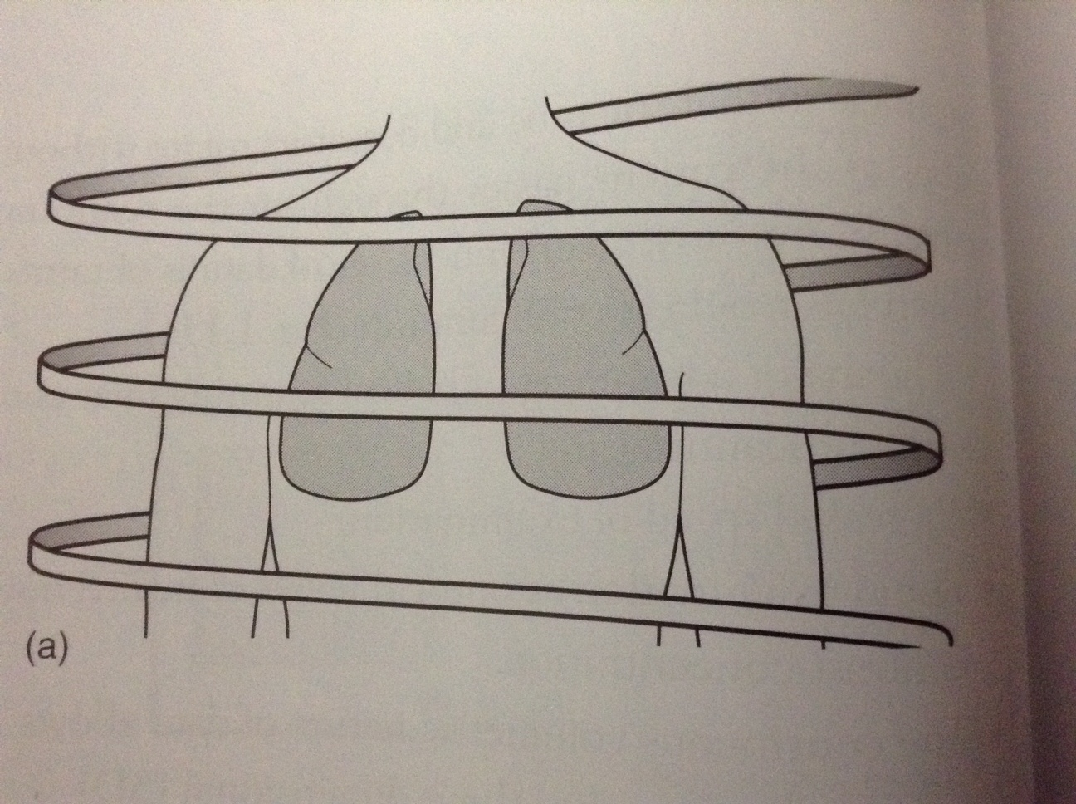
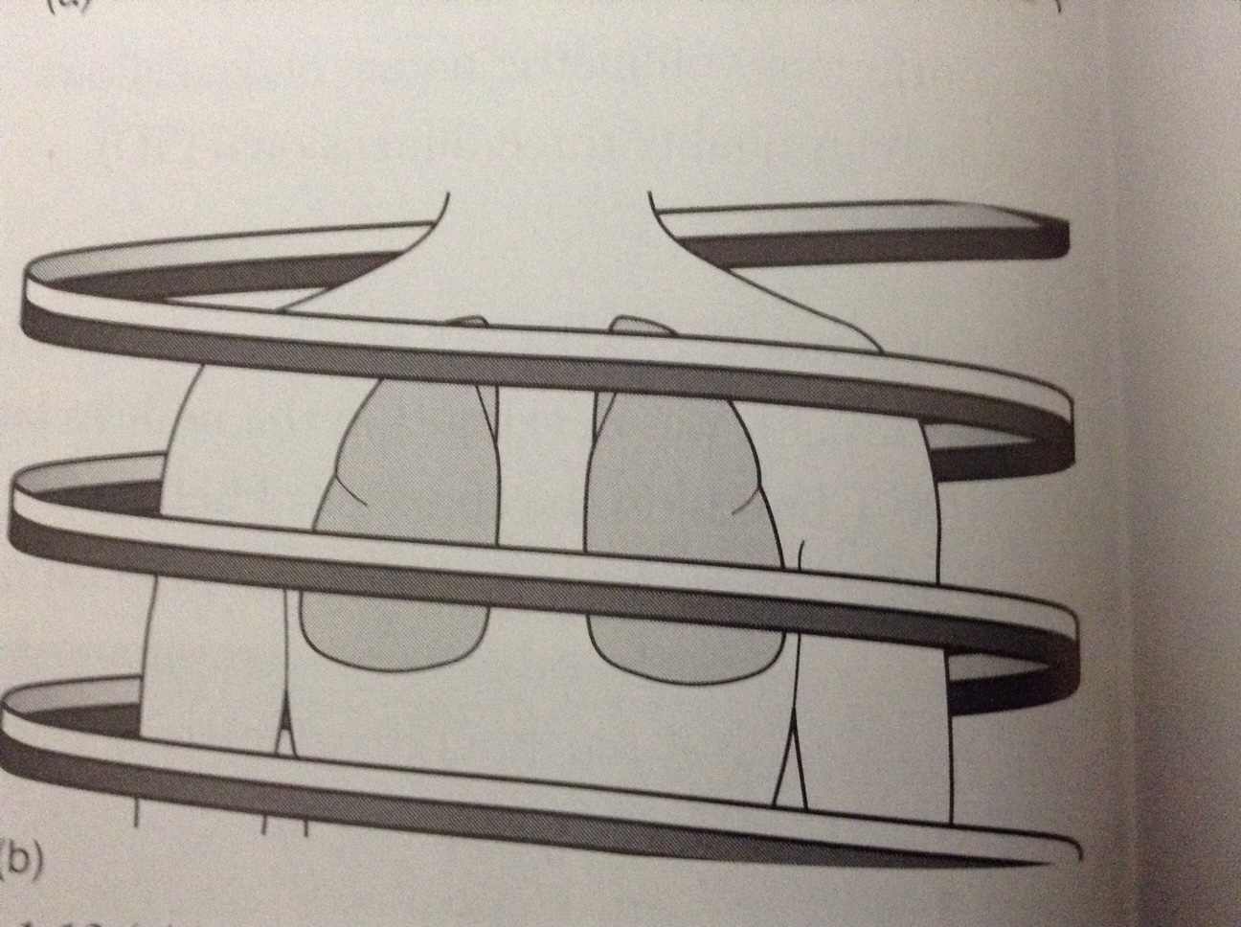
Basic principles of CT
Principles of operation
  First to fourth generations
  EBCT
    Fast imaging; < 100 ms
    Microwave accelerated electron beam
    Cardiac imaging
  Spiral CT -1989
    3rd or 4th generation CT imager
    Patient couch is moved
  Multislice CT/multidetector – 1990s
    Rapid
    High resolution of a large tissue volume
    High-quality 3D reconstruction
  CUHA: Toshiba Aquilion Large-Bore, 16-slice
    16-slice = 16 detectors;
      able to take 16 slices of anatomy/rotation
Notes:
First commercial CT was available in 1971 – since then four generations CT were developed with different type of xray beam, number of detectors, number of image projection per translation, time of operation
EBCT: developed for fast imaging, images obtained in less than 100 ms, about the time of a radiograph
Spiral CT: 1989 – the tube and detectors rotate without stops as the patient passes through on the scanning table – in this way, a continuous set of data is obtained
Multidetector: difference is that instead of using a single row of detectors, multiple detector rows are used. – allows acquisition of overlapping fine sections of data
3rd: both the xray tube and the detector rotate (opposite direction)
4th: only the xray tube rotates, the detector array is fixed
Multslice CT: in the early 1990s
rapid, high- resolution imaging of a larger tissue volume without motion artifacts.
The advent of mul- tislice CT scanners permits the imaging of more anatomy in less time, likely alleviating the need for breath-hold techniques to eliminate motion artifact.
Sedation or conscious

Slide 7
Basic principles of CT
Advantages of CT over radiographs
  Better contrast resolution
    By blurring tissues above and below the focal plane
    No superimposition of tissue
    Less scatter radiation
  3D imaging
Notes:
Areas outside of focus, therefore not shown
Scatter Radiation is a type of secondary radiation that occurs when the useful beam intercepts any object, causing some x-rays to be scattered

Slide 8
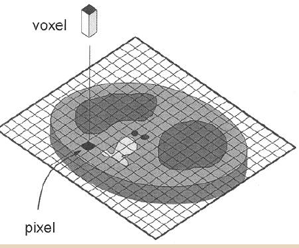
Basic principles of CT
Radiology = 2D: pixel (mm²)
  Pixel = picture element
  Each cell of a matrix
CT = 3D: voxel (mm³)
  Voxel = volume element
  Voxel = pixel size x slice thickness
  Normal slice thickness: 1-10 mm
  Matrix: 512x512 or 1024x1024
Notes:
FIELD OF VIEW = diameter??? Of the reconstructed image
MATRIX SIZE: Current CT imagers: 512X512 or 1024X1024

Slide 9
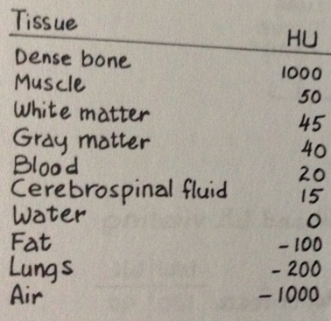
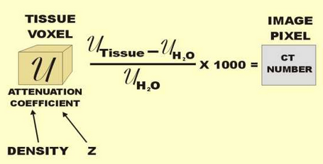
Basic principles of CT
Hounsfield scale
  Tissue density in different shades of grey in relation to its x-rays absorption
    High HU (bone): bright
    low HU (air):dark
CT numbers
  Numbers used to define relative attenuation coefficient for each voxel as compared with attenuation coefficient of water.
Notes:
As with plain xrays, high-density objects cause more attenuation of the xray beam and are therefore displayed as lighter grey to white than objects of lower density which are displayed drak grey to black.

Slide 10
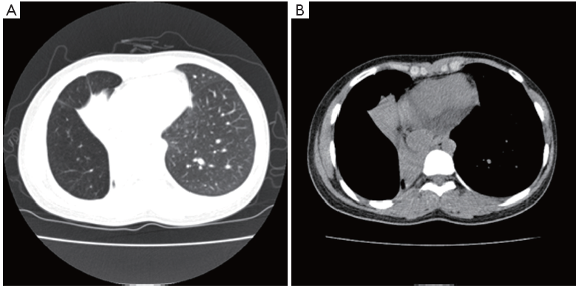
Basic principles of CT
256 shades of grey; eye: 20
Window width (WW)
  Range of CT numbers displayed
Window level (WL)
  Central value of the WW
BONE | SOFT TISSUE
Wide WW | Narrow WW
Gray image Low contrast | Black&white image High contrast
Notes:
The image information can be manipulated by the computer to display the various tissues of the body, which is called altering the window settings.
In chest CT where a wide range of tissue densities is present, a good image of the mediastinal structures shows no lung details –by setting a lung window the lung parenchyma is seen with good detail, though the mediastinal structures are poorly differentiated.
Wide WW for bone imaging
Narrow for soft tissue
Wide WW: gray image with low contrast
Narrow WW: black white image, high contrast
WL is the center of WW
CT image is optimized for that tissue with the same CT number as the WL

Slide 11
Basic principles of CT
CONTRAST AGENTS
  To improve the visibility of internal structures
  Iodinated contrast
    Ionic: hyperosmolar
    Nonionic: low-osmolar or iso-osmolar
      Fewer side effects
        Contrast-induced nephrotoxicity
        Caution with dehydrated patients; patients with renal disease
Notes:
Iodinated contrast agents may be ionic or nonionic. Ionic contrast agents, which are salts, are hyperosmolar to blood. These agents should not be used for myelography or in injections that may enter the spinal canal (because neurotoxicity is a risk) or the bronchial tree (because pulmonary edema is a risk). Nonionic contrast agents may be low-osmolar (which is still hyperosmolar relative to blood) or iso-osmolar (with the same osmolarity as blood). Newer nonionic contrast agents are now routinely used at many institutions because they have fewer adverse effects.
The most serious contrast reactions are allergic-type reactions and contrast nephropathy (renal damage after intravascular injection of a contrast agent).
Other side effects: anaphylactic reaction
The effects of repeated intravenous iohexol administration on renal function in healthy beagles – a preliminary report

Slide 12
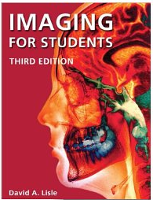
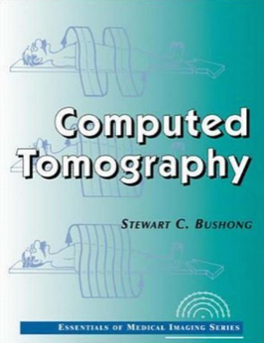

Slide 13
Use of CT in ECC
Respiratory system

Slide 14
CT pulmonary angiography (CTPA)
Use of CT in ECC
CTPA = gold standard for PTE diagnosis in human medicine
Rapid, spiral thoracic CT, peripherally infused contrast media with a pressure injector (peak enhancement of the pulmonary arteries)
Diagnostic criteria for PTE:
  Complete pulmonary arterial occlusion
  Central intraluminal arterial filling defect(s)
  Peripheral intraluminal arterial filling defect(s)
Notes:
Rapid, multislice helical CTPA is key to diagnosis of PTE in
human medicine, Very high Sn (100) and Sp (96)
These studies are obtained
by performing rapid, spiral thoracic CT concurrent with bolus injection of contrast media. The contrast agent is infused
through a peripheral catheter using a pressure injector, linked electronically to the scanner to ensure peak enhancement
of the pulmonary arteries.80
A normal CTPA study essentially rules out PTE as the cause of the patient’s respiratory distress, unless the index of suspicion is very high.82, 83
Multidetector row CT is also increasingly available in veterinary medicine. These multislice CT scanners permit the
imaging of the whole thorax in sedated patients without the need for breath-hold techniques to eliminate motion artifact.

Slide 15


CT pulmonary angiography (CTPA)
Use of CT in ECC
Spiral CTPA using 16-slice CT-scanner
Butorphanol 0.3 mg/kg IV
CTPA can be used to confirm and rule out PTE in dogs under sedation, even in at-risk patients with respiratory distress.
Spiral CTPA using 16-slice CT-scanner
No sedation; obtunded mentation
Hypoattenuating luminal-filling defects consistent with multiple PTE
Notes:
This study reports the successful use of a 16-slice scanner for identification of PTE in dogs with IMHA. study dogs with naturally occurring PTE were definitively identified using a sedation-only protocol

Slide 16
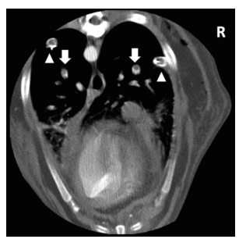
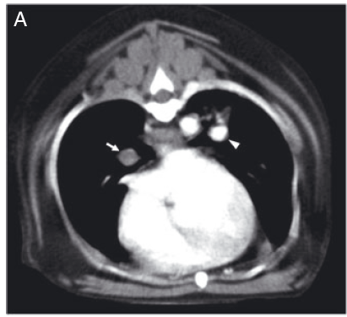
CT pulmonary angiography (CTPA)
Use of CT in ECC

Slide 17
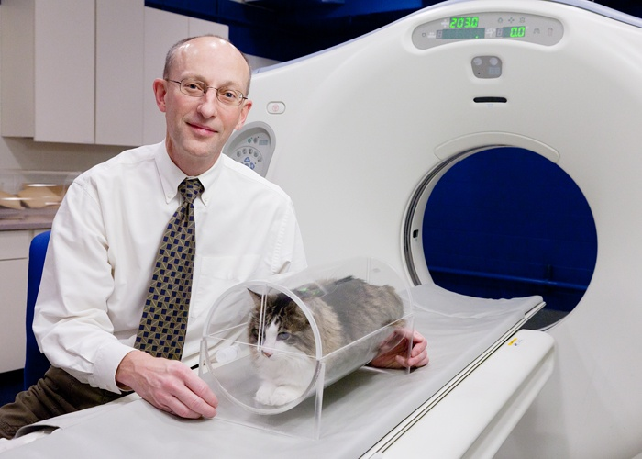

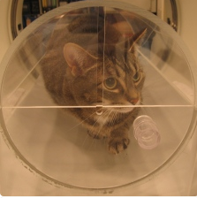
Upper airway obstruction
Use of CT in ECC
10 cats with clinical signs of upper airway obstruction
VetMouseTrap™
No sedation, no anesthesia
7 cats: intramural upper airway masses
2 cats: laryngotracheitis
1 cat: laryngeal paralysis
Notes:
Cats were imaged in sternal recumbency using a transparent positioning device (VetMouseTrap, University of Illinois, Urbana, IL), and no sedation or anesthesia.
Seven cats were diagnosed with intramural upper airway masses, two with laryngotracheitis, and one with laryngeal paralysis.
llowed constant oxygen to dyspneic cats and fluid administration throughout the procedure. – no restraint; Cats in the positioning device tended to remain in sternal recumbency with minimal movement.
Computed tomographic findings for the third cat included symmetric narrowing of the rima glottis with medially displaced cuneiform processes. This finding was considered suggestive of laryngeal paralysis, however the upper airway was not mentioned in the necropsy report. This cat also had a peritoneal pericardial diaphragmatic hernia and right cranial lung lobe atelectasis with a pulmonary bulla present on CT and necropsy. This cat presented with respiratory stridor and dyspnea

Slide 18

Cats with thoracic disease
Use of CT in ECC
54 cats with recent history or current clinical signs of respiratory disease
VetMouseTrap™ – no sedation/no anesthesia
41/54 were dyspnic
44 cats also had thoracic radiographs
Correct final diagnosis: 77.8% with CT; 58% with xrays
Additional information provided with CT in 74% of cats
Diagnosis:
  Lung neoplasia
  Cardiomyopathy
  Lower airway disease
  Mediastinal mass
  Infection
  Trauma
  Hernia
Notes:
cats presenting to the emergency department with a recent history of, or current clinical signs of, respiratory disease were stabilized and underwent CT thoracic imaging in the positioning device* without sedation or general anesthesia. Clinical signs included increased respiratory rate or effort, cyanosis, open-mouth breathing, extension of head and neck, anxious behavior, decreased tolerance to handling, cough, auscultation of abnormal breathing sounds, abdominal breathing, or nasal discharge
41/54 were dyspnic
Overall accuracy of the correct final diagnosis was higher for survey CT (42/54; 77.8%) than radiography (29/50; 58%)
n conclusion, CT was highly accurate (77.8%) for the evaluation of cats with respiratory distress. CT provided additional information in 74% of the cats allowing a correct diagnosis not achieved with radiographs in 28% of cats. CT imaging of cats using the positioning device without general anesthesia or sedation, is safe and provides more accurate diagnostic information than radiography.

Slide 19
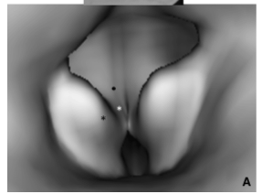

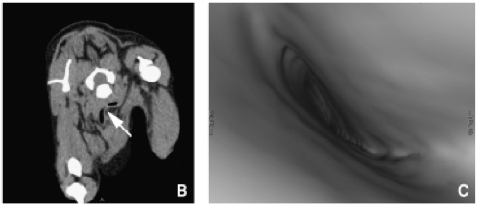
Dogs with upper airway obstruction
Use of CT in ECC
17 dogs with CS attributed to upper airway obstruction
Non sedated or sedated CT, without endotracheal intubation
Diagnosis:
  Laryngeal paralysis
  Laryngeal collapse
  Tracheal hypoplasia
  Tracheal collapse
  Tracheal stenosis
Notes:
To (1) describe the CT and three-dimensional (3D) internal rendering endoscopy findings in awake or sedated dogs with suspected upper airway obstruction and (2) evaluate the correlation between the CT imaging findings and the definitive diagnosis
CORRELATION?????????? CT imaging of unanesthetized dogs with upper airway obstruction compares
favorably with traditional definitive diagnostic methods
Larger vetmousetrap or sedation
3D internal rendering was performed using appropriate CT software,¶ to create virtual endoscopic images of suspected lesions. : mode of 3d reconstruction
Picture: laryngeal collapse with everted saccules, collapse of the cuneiforme and corniculate processes
Tracheal collapse

Slide 20
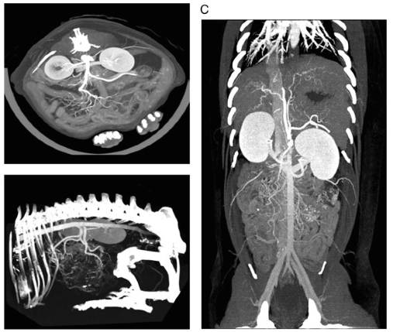

Dogs with acute abdominal signs
Use of CT in ECC
18 dogs with acute abdominal signs
Without sedation or with sedation if poor quality study
  8 without sedation; 10 with light sedation
Scan time < 10 minutes
16/18 CEMD CT: fair to excellent diagnostic quality
2: poor quality
  Motion artifacts
  Beam hardening from previously administered barium contrast agent
Notes:
Targeted helical computed tomography (CT) of the abdomen has been described as the modality of choice in people with acute abdominal pain.
Sixteen of 18 contrast-enhanced multi-detector CT scans were scored fair to excellent in diagnostic quality, with no statistical difference in diagnostic quality for awake vs. sedated patients. Causes for two poor quality diagnostic scans included severe beam hardening from previously administered barium contrast agent and severe motion artifacts.
We conclude that dual-phase contrast-enhanced multi-detector CT is a feasible and safe technique for evaluating awake and minimally sedated dogs presenting with acute abdominal signs
DIAGNOSIS??????? Do not mention diagnosis – was just to assess quality and diagnostic

Slide 21
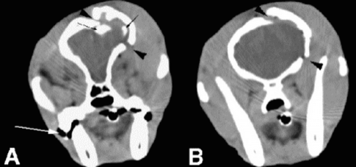

Traumatic brain injury –CT vs MRI
Use of CT in ECC
MRI is generally superior in identifying lesions, except
  Skull fracture
  Subarachnoid hemorrhage
MRI is also more sensitive for intraparenchymal injury: edema, axonal injury, contusions, hematomas
CT is most commonly used
  Faster
  Easier
  Imaging of the spines/pelvis/chest abdomen
  Abnormalities less well seen on CT do not appear to be clinically significant
Notes:
CT = mainstay of diagnostic work-up in human patient with TBI. However CT scan is not performed in all patients and there are several different algorithm or set of criteria to decide if a CT should be performed immediately or if the wait and see approach can be applied.
the MRI scan has proven superior for every pathology other than skull fracture and subarachnoid
Hemorrhage
In addition
MRI is much more sensitive to the presence of intrapa-renchymal injury; edema, diffuse axonal injury, contusions and hematomas

Slide 22

Traumatic brain injury –CT vs MRI
Use of CT in ECC
10 dogs with TBI; MGCS of 15 (mild), CT performed
9/10 had abnormalities on CT
  Fractures (8)
    Frontal, parietal, temporal, multiple bones, osseous bulla
    Depressed, elevated, linear or compound
  Hydrocephalus (4)
  Parenchymal damages (3)
  Hemorrhage (1)
    Epidural; associated with multiple calvarial fracture
  Mass effect (1)
Notes:
The decision as to when CT scan imaging should be recommended in veterinary patients as not been evaluated.
Cases were not evaluated to determine whether the results of CT changed the therapeutic approach or wheter this would potentially alter the outcome of each case
Interesting findings: almost all dogs evaluated in this study with mild TBI (MCGS = 15) had abnormalities on CT
n the few papers that have compared CT and MRI scans
after trauma, the MRI scan has proven superior for every
pathology other than skull fracture and subarachnoid
hemorrhage [1, 2, 3, 13, 20]. The ability to identify even
epidural and subdural hematomas appears to be approxi-
mately 30% better for MRI. These studies do not demon-
strate a clinical care deficit related to the lower sensitivi-
ty of CT scanning, but the sensitivity and specificity for
extracerebral lesions appears better for MRI. In addition
MRI is much more sensitive to the presence of intrapa-
renchymal injury; edema, diffuse axonal injury, contu-
sions and hematomas (Figs. 1, 2). Based on the small
amount of comparative information available from chil-
dren, the most sensitive neuro-imaging study following a
head injury appears to be the MRI scan

Slide 23
Radiology of thoracic trauma in the dog and cat
Paper review

Slide 24
INTRODUCTION
Radiology of thoracic trauma in the dog and cat
Blunt thoracic trauma
  Inertial forces
  Spalling effect (or implosion)
Dorsoventral and lateral views
Thorax
  Air and bones: high inherent contrast
  High kV/low mAs technique
Static evaluation
  Serial xrays may be valuable
Notes:
High Kv/low mAs: WHY???
Spalling effect: shock wavefront passing through the interface between air/alveolar tissue and blood vessels which lead to burst BV and torn alveolar septa

Slide 25
Classification thoracic trauma
Radiology of thoracic trauma in the dog and cat
Thoracic wall
Pleural space
Pulmonary parenchyma
Mediastinum
Notes:
High Kv/low mAs: WHY???
Spalling effect: shock wavefront passing through the interface between air/alveolar tissue and blood vessels → burst BV and torn alveolar septa

Slide 26
Radiographic signs
Radiology of thoracic trauma in the dog and cat
Thoracic wall
  Rib fracture/laceration, SQ emphysema, vertebral/sternebral fracture/luxation, visceral herniation
Pleural space
  Pneumothorax: best view In lateral; between heart and sternum (dogs) ; lucency, lobe collapse
  Tension pneumothorax: large volume of air, pulmonary collapse and diaphragm flattening, mediastinal shift
  Hemothorax: increased opacity, decreased visualization of cardiac silhouette/diaphragm, widened interlobar fissures
  Diaphragmatic hernia: displacement of thoracic viscera, cranial displacement of abdominal viscera (abdominal xrays, positive contrast gastrography or peritoneography)
Notes:
High Kv/low mAs: WHY???
Spalling effect: shock wavefront passing through the interface between air/alveolar tissue and blood vessels → burst BV and torn alveolar septa
Pneumothorax: best view in lateral than DV unless LARGE amount
Right middle lung lobe frequently collapse: lack of collateral ventilation, large surface volume area compared to volume

Slide 27
Radiographic signs
Radiology of thoracic trauma in the dog and cat
Pulmonary parenchyma
  Contusions = rapid compression and decompression of the lungs → Hemorrhage and edema: focal, multifocal, lobar or generalized increase in opacity; can be more marked (clinically and xrays) in the 4-6 hours following trauma
  Lacerations: focal or multifocal cavitary lesions (air or blood); periphery of the lung; resolve w/in a few days
Notes:
High Kv/low mAs: WHY??? : High kVp techniques are most useful for studies of body regions with many different tissue densities (like the chest)
Spalling effect: shock wavefront passing through the interface between air/alveolar tissue and blood vessels → burst BV and torn alveolar septa
Pneumothorax: best view in lateral than DV unless LARGE amount
Right middle lung lobe frequently collapse: lack of collateral ventilation, large surface volume area compared to volume
Increased pulmonary opacity: fluid, collapse

Slide 28
Radiographic signs
Radiology of thoracic trauma in the dog and cat
Mediastinum
  Pneumomediastinum: visualization of the borders or the oesophagus, trachea or mediastinal vessels, pneumopericardium, pneumoretroperitoneum/cervical emphysema (direct extension)
  Mediastinal hemorrhage: widening of the cranial mediastinum, displacement of the trachea.
  Tracheal avulsion: Focal deviation, narrowing of the trachea, focal air-filled cavity superimposed on the trachea, pneumomediastinum
Notes:
Mediastinal hemorrhage: likely when there is a suddent deceleration: soft tissue slides relative to the bones → tear and laceration (vertebral arteries supplying mid-thoracic vertebrae)
Air filled cavity: trapped by intact tracheal adventitia or mediastinal tissue. More in cats. 2-3 weeks after trauma . Mi-thorax (jct fixed and mobile portion)

Slide 29
Radiographic signs
Radiology of thoracic trauma in the dog and cat
Trauma patients
  Radiographs?
  CT?
  Ultrasounds?

Slide 30
Comparison of whole-body computed tomography vs selective radiological imaging on outcomes in major trauma patients: a meta-analysis
Paper review

Slide 31
Introduction
Comparison of whole-body computed tomography vs selective radiological imaging on outcomes in major trauma patients: a meta-analysis
Published in the Scandinavian Journal of Trauma, Resuscitation and Emergency Medicine
2014
Aim of the study: to explore the value of whole-body CT(WBCT) in major trauma patients (MTPs)
From 1980-2013
11 trials – 26 371 patients

Slide 32
Background
Comparison of whole-body computed tomography vs selective radiological imaging on outcomes in major trauma patients: a meta-analysis
Leading cause of mortality
Reduction of the diagnostic interval = better prognosis
Conventional evaluation methods:
  Thoracic and pelvic xrays
  FAST
  Organ-specific CT
  → misdiagnosis and time-consuming

Slide 33
Background
Comparison of whole-body computed tomography vs selective radiological imaging on outcomes in major trauma patients: a meta-analysis
Increased use of WBCT in trauma patients
  From 5% in 2002 to 46% in 2010
Radiations exposure
Should WBCT be used as an initial assessment tool in MTPs?
Contradictory results regarding effect of WBCT on mortality in MTPs

Slide 34
Methods
Comparison of whole-body computed tomography vs selective radiological imaging on outcomes in major trauma patients: a meta-analysis
Meta-analysis
Primary endpoint: all-cause mortality rate
Secondary endpoints: time spent in the ED, duration of mechanical ventilation, ICU/hospital length of stay, incidence of MODS/MOF

Slide 35
Results
Comparison of whole-body computed tomography vs selective radiological imaging on outcomes in major trauma patients: a meta-analysis
WBCT was associated with a lower mortality rate and a shorter stay in the ED.
No effect of WBCT on ICU/hospital length of stay.
WBCT was associated with longer duration of mechanical ventilation and higher incidence of MODS/MOF.
  Due to decreased mortality?
  Higher level of injury severity score

Slide 36
Discussion
Comparison of whole-body computed tomography vs selective radiological imaging on outcomes in major trauma patients: a meta-analysis
Advantages of WBCT
  Higher accuracy
  Reduces interval time between patient’s arrival and the end of life saving procedures/end of diagnostic procedures/beginning of emergency surgery.
  Possible to detect all injuries with one test
  Faster
Notes:
Our results indicated that the integration of WBCT into the early diagnostic protocol significantly increased the probability of survival in MTPs. We also found that pa- tients in the WBCT group had a significantly shorter ED stay.
Diagnostic work-up reduces by 50%
Improved trauma management – cannot attribute improved survival to the application of WBCT

Slide 37
Limits of the study
Comparison of whole-body computed tomography vs selective radiological imaging on outcomes in major trauma patients: a meta-analysis
Observational, non-randomized studies
Differences between 2 groups, especially ISS values
Improved survival because of use WBCT?
Confounding factors: type of scanners, scanning methods, indications for WBCT, different inclusion criteria, location of the scanners, publications bias.

Slide 38
Multidetector Computer Tomography: Evaluation of Blunt Chest Trauma in Adults
Paper review

Slide 39
Introduction
Multidetector Computer Tomography: Evaluation of Blunt Chest Trauma in Adults
Trauma: 4th most common cause of mortality in USA and western Europe
Xrays:
  Suboptimal for vascular and nonvascular thoracic injuries
  Underestimation of the severity/extent of injury/misdiagnosis

Slide 40
Introduction
Multidetector Computer Tomography: Evaluation of Blunt Chest Trauma in Adults
MDCT
  More sensitive in the detection/characterization of injuries
  Other body regions at the same time
  Faster
  Better outcome
  Radiation exposure
  Risks associated with contrast media administration
Aim of the paper: To review and illustrate MDCT findings of traumatic chest injuries

Slide 41
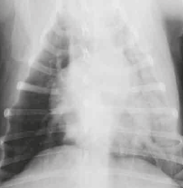
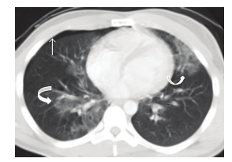
Thoracic trauma injuries seen on CT
Multidetector Computer Tomography: Evaluation of Blunt Chest Trauma in Adults
Pulmonary contusions

Slide 42
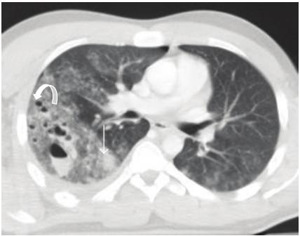
Thoracic trauma injuries seen on CT
Multidetector Computer Tomography: Evaluation of Blunt Chest Trauma in Adults
Pulmonary laceration
Notes:
Multiple focus of pulmonary
lacerations can be depicted, some of them are filled with air
(pneumatocele, curved arrow), others filledwith blood (hematocelestraight
arrow), and some filled with both, making an air-liquid
level (pneumo-hematocele, arrowhead). Surrounding pulmonary
contusions are appreciated. Associated left pulmonary contusions
and a small right pneumothorax are also depicted.

Slide 43
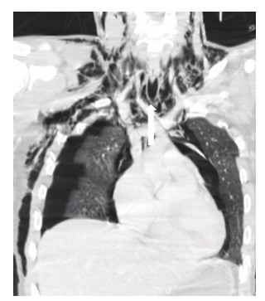
Thoracic trauma injuries seen on CT
Multidetector Computer Tomography: Evaluation of Blunt Chest Trauma in Adults
Tracheobronchial laceration
Notes:
Tracheal rupture. Coronal reconstruction of axialMDCT
in lung window. An extensive subcutaneous emphysema, bilateral
pneumothorax, and pneumomediastinum are observed

Slide 44
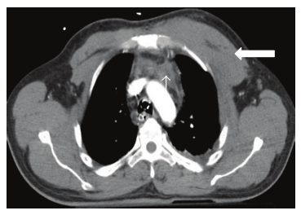
Thoracic trauma injuries seen on CT
Multidetector Computer Tomography: Evaluation of Blunt Chest Trauma in Adults
Large chest vessels lesions
Notes:
aortic arch, demonstratesmediastinal hemorrhage (thin arrow) and
left anterior chest muscle wall hematoma

Slide 45
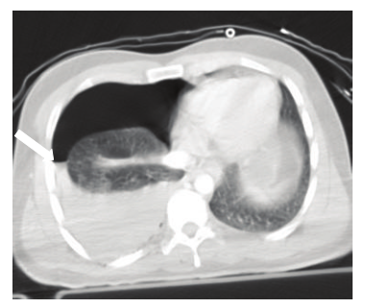
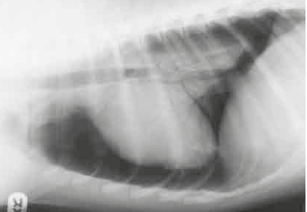
Thoracic trauma injuries seen on CT
Multidetector Computer Tomography: Evaluation of Blunt Chest Trauma in Adults
Hemothorax/pneumothorax

Slide 46
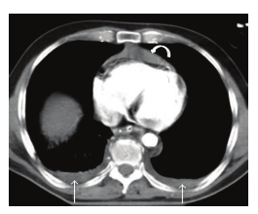
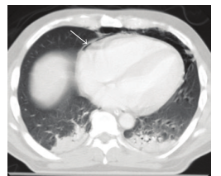
Thoracic trauma injuries seen on CT
Multidetector Computer Tomography: Evaluation of Blunt Chest Trauma in Adults
Hemopericardium/pneumopericardium
Notes:
Left:: Hemopericardium and bilateral hemothorax
Right: Pneumopericardium + lung contusions

Slide 47
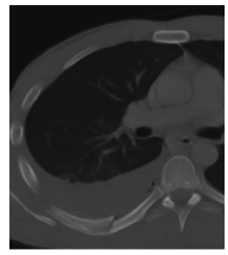
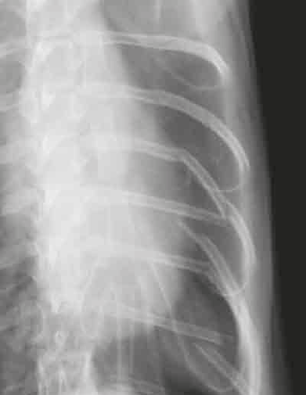
Thoracic trauma injuries seen on CT
Multidetector Computer Tomography: Evaluation of Blunt Chest Trauma in Adults
Chest wall/diaphragm trauma

Slide 48
DISCUSSION
Should we use WBCT in our trauma patients (as an initial diagnostic tool)?
Should we use WBCT in all trauma patients or only in patients more severely affected?
Overnight WBCT?
Localization of CT room/radiology room - ER

Slide 49

Questions?

