Slide 1
Mechanical ventilation in patients with CHF
Jo-Annie Letendre, DMV
Resident Vent Lab
Notes:
I will talk about MV in patients with CHF – focusing on the pathophysiology of congestive heart failure and the effects of MV on the cardiopulmonary systems.
I will also talk briefly about the use of NI ventilation in cardiac patients and I do a quick lit review of the paper regarding MV in veterinary patients with cardiogenic pulmonary edema.

Slide 2
PATHOPHYSIOLOGY OF DISTURBED GAS EXCHANGE IN CHF
Clin Pulm Med 2009;16: 323–327
Notes:
First, I will talk about the pathophysiology of disturbed gas exchange in CHF

Slide 3
Interstitial edema
  Increases the diffusion distance between the alveolar epithelium and the pulmonary capillary endothelium
    → decreased oxygenation and inadequate washout of CO₂
Alveolar edema
  Begins in discrete dependent areas of the lung → coalesce to involve whole segments, lobes, entire lung
  Limits ventilation and causes V/Q mismatch
  Alveolar groups completely filled with fluid develop atelectasis (→ shunt)
  Atelectatic alveoli require higher airway pressures to reopen from the collapsed state
    Great risk for repetitive opening and collapse → barotrauma and VILI
Notes:
CHF is associated with increased extravascular fluid volume, first in the interstitial space.
Edema increases the diffusion distance between the alveolar epithelium and the pulmonary capillary endothelium, which contributes to decreased oxygenation and inadequate washout of CO2
Further increase in extravascular lung water results in the edema fluid flooding the alveolar spaces.
Alveolar edema limits ventilation and cause a v/q mismatch.
Alveolar groups that are completely filled with fluid develop atelectasis and retain limited ventilation, thus causing a right to left shunt of deoxygenated blood to the systemic circulation.
Atelectatic alveolar units also require higher airway pressures to reopen from the collapsed state.
Alveolar atelectasis and cyclic reopening predisposes the involved alveolar units to barotrauma or ventilator-induced lung injury.

Slide 4
Respiratory muscles
  Have to work harder
    → larger swings in intrathoracic pressures → increase preload and reduce afterload → can worsen CHF
    → increased oxygen demand
Increased peripheral extraction of oxygen
  → lower mixed venous oxygen saturation
Lower SaO2
  Atelectasis, alveolar and interstitial edema
  → Decreased CaO₂
Notes:
5Because of the altered lung mechanics in CHF, the respiratory muscles have to work harder to ventilate the lungs. The increased work of breathing causes larger swings in intrathoracic pressures during breathing. The changes in intrathoracic pressure increase preload. These hemodynamic changes can potentially worsen CHF, leading to decompensation.
The increasedwork of breathing also leads to increased oxygen demand by the respiratory muscles.
CHF is also associated with increased peripheral extraction of oxygen resulting in lower mixed venous oxygen saturation (SvO2).
The atelectasis and alveolar and interstitial edema related to CHF results in increased ventilation perfusion mismatch, shunt, or diffusion defects, all of which may lower SaO2

Slide 5
PATHOPHYSIOLOGY SEQUELAE OF DISRUPTED OXYGEN TRANSPORT IN CHF
Clin Pulm Med 2009;16: 323–327
Notes:
The oxygen transport is also disrupted in patients with CHF

Slide 6

CHF = reduced CO
  → poor peripheral perfusion and high tissue extraction of oxygen
    → tissue anoxia and metabolic acidosis → organ dysfunction
    Tissue anoxia of the respiratory muscles (harder WOB) causes respiratory muscle dysfunction and pe
    Tissue anoxia of the cardiac muscles triggers myocardial ischemia and worsens CHF.
    Anxiety can also triggers a highly adrenergic state that can trigger cardiac arrhythmias and worsen myocardial dysfunction
DO₂ = CO x CaO2
Notes:
A reduced CO is the main attribute of CHF.
A reduced DO2 leads to poor peripheral perfusion and high tissue extraction of oxygen. Tissue anoxia of the respiratory muscles causes respiratory muscle dysfunction. Similarly, tissue anoxia of the cardiac muscles triggers myocardial ischemia and worsens CHF. In addition, concomitant anxiety also triggers a highly adrenergic state that can trigger cardiac
arrhythmias and worsen myocardial dysfunction.

Slide 7
Cardiopulmonary interactions
Cardiovascular effects of mechanical ventilation
Arch Dis Child 1999;80:475-480
Notes:
Now we will talk about the effects of spontaneous and mechanical ventilation on the circulation/ cardiac function

Slide 8
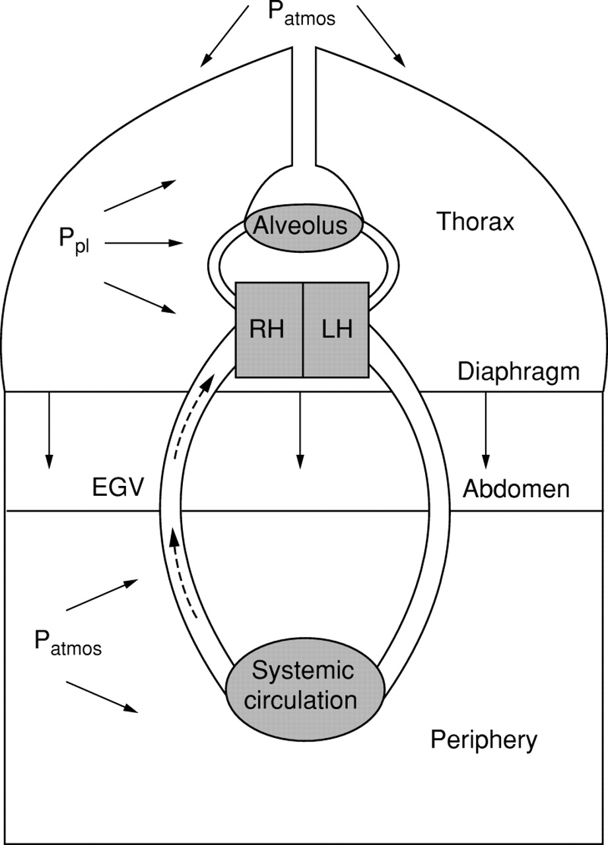
Model of the circulation, showing factors that influence systemic venous drainage.
Spontaneous respiration Inspiration -P_{RA} falls -P_{IA} increases -Increased gradient between EGV and RA = accelerates venous return -Increased RV preload and SV
Positive pressure ventilation Positive intrathoracic pressure -P_{RA} increases -Decreased venous return and RV preload -PEEP also prevents intrathoracic pressure from returning to P_{atm} during expiration
Lara Shekerdemian, and Desmond Bohn Arch Dis Child 1999;80:475-480
Notes:
The right heart (RH) and intrathoracic great veins are subjected to pleural pressure (Ppl), which varies throughout the respiratory cycle. Intra-abdominal pressure increases with inspiratory diaphragmatic descent, and normalises to atmospheric (Patmos) with expiration
P_{RA} falls during inspiration and intra-abdominal pressure increases with inspiratory diaphragmatic descent, whereas the peripheral venous pressure remains constant throughout the respiratory cycle. Systemic venous return, depends on a pressure gradient between the extrathoracic veins and the P_{RA}). Spontaneous inspiration increases this gradient, and so accelerates venous return. Thus, RV preload and stroke volume all increase during spontaneous inspiration.
On the contrary, during PPV, pleural pressure increases and pressure in the RA increases as well which decrease venous return and preload. PEEP also prevents the IT pressure from returning to atmospheric pressure during expiration, also affecting the venous return.

Slide 9
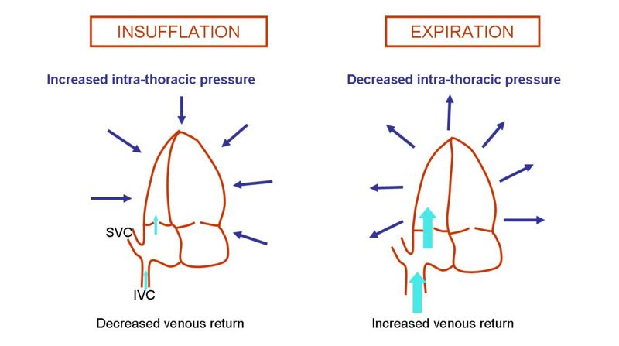
PPV AND INTRATHORACIC PRESSURE

Slide 10
EFFECT OF CHANGES IN INTRATHORACIC
PRESSURE ON VENOUS RETURN
* PEEP can limit this effect

Slide 11
EFFECT OF CHANGES IN INTRATHORACIC
PRESSURE ON THE LEFT VENTRICLE
Transmural pressure (P_{tm})
  = the difference between the pressure within a chamber or vessel and the pressure around it.
  P_{tm} of the aorta= difference between the pressure within the aorta and the P_{pl}
During spontaneous breathing
  P_{pl} and intravascular aortic pressure fall but the fall in P_{pl} is > fall in aortic pressure → P_{tm} increases → increased LV afterload and reduction in LV stroke volume
    Not important in healthy patients with normal myocardial function
During PPV
  P_{pl} increases → P_{tm} decreases → decreased LV afterload
Notes:
transmural pressures (the difference between the pressure within a chamber or vessel and the pressure around it).the thoracic aorta, is subjected to changes in pleural pressure rather than atmospheric pressure. The transmural pressure (P_{tm}) of the aorta is therefore the difference between the pressure within the vessel and the pleural pressure (P_{pl}).
P_{tm} = intravascular systolic pressure − P_{pl}
during spontaneous or negative pressure inspiration, both P_{pl} and intravascular aortic pressure fall, but the fall in pleural pressure is relatively greater than the fall in aortic pressure. Therefore, P_{tm} actually increases, resulting in an increased LV afterload and a reduction in LV stroke volume. The influence of spontaneous and negative pressure respiration on LV afterload is unimportant in health and in patients with normal myocardial function
During PPV, Ppl is increased to the PTm decreases which decreased the afterload, which may be favorable in the cardiac patient.

Slide 12
THE EFFECT OF MV ON CO AND
CARDIAC CONTRACTILITY
Clin Pulm Med 2009;16: 323–327

Slide 13
Increased intrathoracic pressure
  → decreased venous return to the heart (reduced preload)
Airway pressure generated and transmitted by the ventilator reduces the afterloads
REDUCED VENOUS RETURN + REDUCED AFTERLOAD = OPTIMIZATION OF THE PUMP FUNCTION OF THE HEART
Notes:
Mechanical ventilation increases intrathoracic pressure and thus decreases venous return to the heart
The airway pressure generated and transmitted by the ventilator to the right and left ventricular surface reduces the right and left ventricular afterloads, respectively. Both the reduction in venous return as well as the reduced afterloads tend to optimize the pump function of the heart.1,2,6,7,9–12

Slide 14
THE EFFECT OF MV
ON GAS EXCHANGE in CHF
Clin Pulm Med 2009;16: 323–327
Notes:
Mechanical ventilation can improve gas exchange in patients with CHF

Slide 15
Pulmonary edema and cardiomegaly → reduced FRC
Mechanical ventilation with PEEP
  Keeps the alveoli open and prevents collapse at end expiration
    → promote alveolar fluid clearance
      Edema fluid confined to the periphery of the alveoli after which is is pumped out of the alveolar space to the interstitial lymphatics and the circulation
      Alveolar spaces have a reduced tendency to fill with edema fluid
    → Better alveolar ventilation and reduction in alveolar edema → improvement of FRC and oxygenation
      → V/Q decreases and shunt fraction decreases
      → Improved CO and CaO₂ → better oxygenation to the respiratory muscles and to the cardiac muscle (better respiratory function and myocardial function)
FRC = ERV + RV
Notes:
Depending on the severity of CHF, the functional residual capacity of the lung is reduced
Mechanical ventilation with PEEP, keeps the alveoli open and prevents alveolar collapse at end expiration.
These effects tend to promote alveolar fluid clearance. Edema fluid tends to be confined to the periphery of the alveoli after which the fluid is pumped out of the alveolar space to the interstitial lymphatics and the circulation. The open alveolar spaces thus have a reduced tendency to fill with edema fluid. Better aeration of the alveolar space due to PEEP, and reduction in alveolar edema both contribute to improvement of functional residual capacity.11
The ventilation perfusion imbalance thus decreases and shunt fraction decreases
Improved CO and CaO2 derive from these effects and provide better oxygenation to the respiratory muscles and promote their more efficient function.2 At the same time, improved oxygenation of the cardiac muscle promotes improvement in myocardial function.

Slide 16
MECHANICAL VENTILATION OF
PATIENTS IN CHF
PILBEAM’S MECHANICAL VENTILATION –
PHYSIOLOGICAL AND CLINICAL APPLICATIONS
Notes:
In this textbook, we can find guidelines for MV in patients with CHF

Slide 17
GUIDELINES FOR PATIENTS WITH CHF
Select a mode of ventilation that reduces WOB- CPAP or PPV.
Careful evaluation of the effects of PPV on hemodynamics
  Pulmonary artery catheter in severe cases, particularly if PEEP is greater than 10 to 15 Cm H₂O is used.
VC- or PC-CMV : to avoid spontaneous breathing
  Spontaneous breathing may divert blood flow and oxygen consumption to the respiratory muscles.
VT: 5-8 ml/kg.
Set rate from 10 or more breaths/min and peak flows at 60 L/min or greater using either descending or constant waveforms.
Set inspiratory time at 1-1.5 second.
Set a PEEP of 5-10 cm H₂O to support the cardiac function.
Start FIO₂ at 1.0 and titrate quickly with SpO₂ to maintain SpO₂ greater than 90-92%.
Monitor SpO₂, ABGs, urine output, electrolytes and hemodynamics.
Notes:
Select a mode of ventilation that reduces WOB- CPAP or PPV.
Careful evaluation of the effects of PPV on hemodynamics is essential. This may include the use of a pulmonary artery catheter in severe cases, particularly if PEEP is greater than 10 to 15 Cm H2O is used.
The use of VC- or PC-CMV is recommended to avoid spontaneous breathing, which may divert increased blood flow and oxygen consumption to the respiratory muscles.
VT range is moderate from 5-8 ml/kg. Set rate from 10 or more breaths/min and peak flows at 60 L/min or greater using either descending or constant waveforms. Set inspiratory time at 1-1.5 second.
Set a PEEP of 5-10 cm H2O to support the cardiac function.
Start FIO2 at 1.0 and titrate quickly with SpO2 to maintain SpO2 greater than 90-92%.
Monitor SpO2, ABGs, urine output, electrolytes and hemodynamics

Slide 18
VETERINARY PATIENTS WITH CHF THAT REQUIRE MV
Outcome of positive-pressure ventilation in dogs and cats with congestive heart failure: 16 cases (1992-2012).
JVECC 24(5) 2014
Notes:
There is little information in the veterinary literature regarding MV in cardiac patients.
We talked about this paper in a previous BR – I will just do a quick summary.

Slide 19
n= 16; 10 dogs; 6 cats
Underlying cardiac diseases
  CVD with +/-acute chordae tendinae rupture, +/-3rd AV block, +/- hypertensive cardiomyopathy, aortic valve endocarditis (dogs)
  HCM, DCM (cats)
Reasons to initiate MV
  Respiratory distress with
    Impaired oxygenation (PaO₂ < 60 mmHg with O₂ supplementation or need for FIO₂ > 60% to maintain PaO₂ > 60 mmHg)
    Impaired ventilation (PaCO₂ > 60 mmHg)
Anesthetic protocols
  All patients received benzodiazepines
  Other drugs used: ketamine, etomidate, propofol, NM blocking agents, opioids
  Pentobarbital = negatively correlated with survival to discharge
Notes:
ketamine (P = 0.12), etomidate (P=1.0),propofol (P=0.12),neuromus- cular blocking agents (P = 0.50), opioids (P = 0.38), or a combination of opioid/benzodiazepine/propofol (P= 0.12) and survival to discharge. Only the use of barbitu-rates (as the solemaintenance agent in 1 case and as part of amultidrug anesthesia regimen in 2 cases) was signif- icantly negatively correlated with survival to discharge(P = 0.036)

Slide 20
Ventilator settings
  SIMV used for all patients
  Specific settings available for 5/16 patients
    Initial PEEP: 6-12 cm H₂O; titrated to 2-3 cm H₂O prior to extubation
    Initial FIO₂ of 100%
Outcome
  11/16 survived to extubation
    1/11 collapsed and died while defecating postextubation
  10/16 survived to discharge
    6/10 dogs
    4/6 cats
    6/10 died during follow-up period (post-discharge): heart failure (3), renal failure (2), unknown cause (1)
  Euthanasia prior to extubation in 4/16 (oliguria or anuria; neurological deficits)
  1/16 died during MV: cardiac arrest secondary to refractory tachyarrhythmias
This study suggests that there is a relatively good overall prognosis for discharge from the hospital in dogs and cats with CHF that require mechanical ventilation.
Notes:
Spe-cific ventilator settings, including the degree of positive end-expiratory pressure (PEEP), were only available for 5 of the 16 patients in the study. Initial PEEP for these 5 patients ranged from 6 to 12 cm H2O and PEEP was gradually titrated to 2–3 cm H2O prior to extubation. All patients were continuously monitored with a tem- perature probe, electrocardiogram, and pulse oximeter. Patients were started on PPV with an initial FiO2 of 1.0, and subsequent arterial or venous blood gaseswereused to guide therapy at the attending clinician’s discretion
11 patients survived to extubation
6 dogs and 4 cats survived to discharge
6 died during follow-up period
4 were euthanized prior to extubation
And 1 dided during MV
30.8 +/- 21.3 hours
This study suggests that there is a relatively goodover-all prognosis for discharge fromthe hospital in dogs andcats with CHF that require mechanical ventilation.

Slide 21
mechanisms involved in weaning-induced cardiac failure
Weaning the cardiac patient from mechanical ventilation
Curr Opin Crit Care 2014, 20:493–498
Notes:
As we said earlier : Mechanical ventilation exerts beneficial hemodynamic effects in patients with cardiac failure (mostly reduced venous return and reduced afterload)
Disconnection from the ventilator challenges all the components of cardiac function. In some patients, this may lead to weaning-induced cardiac failure

Slide 22
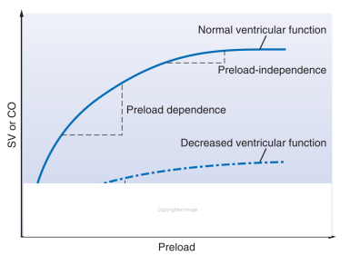
WEANING FROM MV
Decrease in intrathoracic pressure → increase in venous return
  → transmitted to the right atrium → increases the pressure gradient of venous return and increases the right cardiac preload
  → right CO increases and LV preload consequently increases
Decrease in intrathoracic pressure → increased afterload
    → increased P_{tm} → increased LV afterload
As the patient is being weaned from mechanical ventilation, the positive effects of PPV on both gas exchange and the myocardial pump function are lost.
Notes:
the decrease in intrathoracic pressure is transmitted to the right atrium, which increases the pressure gradient of venous return and increases the right cardiac preload. If the right ventricle (RV) is preload- dependent, the right cardiac output increases and the left ventricular (LV) preload consequently increases. Decrease in IT will also lead to an increased afterload.
Prior to weaning from mechanical ventilation, myocardial as well as gas exchange functions need to be optimized.
Mechanical ventilation buys time to address the underlying etiology of CHF. Correction of reversible factors that perpetuate
CHF includes treatment of arrhythmias, electrolyte imbalance, valvular dysfunction, pericardial effusions,
and use of medications that decrease the preload and afterload

Slide 23
Role of NIV in the Management of Acutely Decompensated Heart Failure
Rev Cardiovasc Med. 2002;3 Suppl 4:S35-40.
Notes:
In human medicine, there is also possibility of providing NIV for the management of patients in CHF

Slide 24
Non invasive ventilation
CPAP
Background positive pressure (I & E)
Increases FRC and lung compliance
Reduction of muscle fatigue
Fitted nasal or facial mask
BLPAP
2 different levels of pressure
Higher during inspiration
Lower during expiration
Notes:
= provision of MV without the need for an invasive artificial airway
CPAP provides a constant “background” of positive pressure, beyond which the pressure in the patient’s upper airway
is not allowed to drop. It applies the same pressure during inspiration and expiration. Theoretically, CPAP improves oxygenation by increasing
the functional residual capacity and lung compliance. CPAP supplies some of the inflating pressure needed during inspiration, potentially “offloading” the inspiratory muscles and reducing fatigue
CPAP can be applied noninvasively via specially fitted nasal or facial masks
It provides two different levels of noninvasive positive airway pressure. Higher airway pressures are applied during inspiration and lower during
expiration, but BLPAP always applies some positive pressure. In addition, the higher positive inspiratory support is generally applied for a longer
duration than was true with IPPB

Slide 25
CPAP VS STANDARD THERAPY
Faster improvement in oxygenation
Improved A-a gradient
Increased SV
More rapid and profound decrease in PaCO₂
Greater improvement in the RR, HR, BP
Lower rate of endotracheal intubation
Notes:
Faster improvement in oxygenation,
more rapid and profound decrease in the PaCO2, and greaterimprovements in the respiratory rate, heart rate, and blood pressure. Also, the rate of endotracheal intubation was 50% lower in the CPAP group.17 A second study demonstrated that patients receiving CPAP (compared to controls) had improved alveolar–arterial oxygen gradients and increased stroke volume, as wellas an improvement in PaO2. Theintubation rate was also decreasedby more than 50%.18 The sample size was not sufficient to demonstrate adecrease in mortality. A more recent randomized clinical trial was particularly
impressive

Slide 26
NIV in Veterinary medicine
JVECC 19 (5)2009
JVECC 24(5) 2014
Notes:
IN veterinary patient, the use of NIV is limited due to the difficulty nasal/facial mask/prongs that are well tolerated or effectively fitted the patients, without having to use excessive sedation.

Slide 27
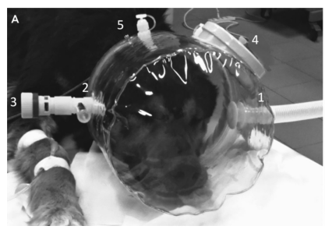
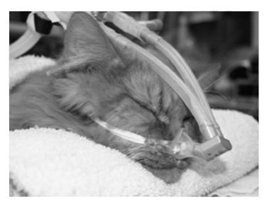
J Vet Emerg Crit Care 2014; 24(5): 578–585
J Vet Emerg Crit Care 2009; 19(5): 416–425
Notes:
Noninvasive CPAP applied through a helmet is a feasible and effective supportive technique in dogs recovering from general anesthesia
Pressure in the helmet: 5 cmH2O
FiO2 = 21%
For 20 minutes
Decreased PaCO2, RR, Aa gradient
Increased PaO2
Well tolerated
15 dogs
8 cats – wanted to assess the feasability of NI in cats and to compare cardiovascular parameters and anesthetic drug requirements associated with noninvasive ventilation to those associated with invasive ventilation.
NIV via nasal mask, or invasive ventilation using an endotracheal tube. Mechanical ventilation was performed for 6 hours. Anesthesia was provided using continuous infusions of propofol and butorphanol. After a minimum 9-day washout period, the procedure was repeated using the alternate ventilation interface.
There were no significant differences in cardiovascular parameters, drug requirements, or sedation scores between groups. PaO₂ values were significantly higher in the invasively ventilated group. Inspiratory tidal volumes were similar between groups, whereas expiratory tidal volumes were significantly lower in the NIV group (most likely secondary to leak at the level of the interface)
NIV of cats is possible. However, currently it does not confer any cardiovascular benefit over
invasive ventilation and drug requirements are similar. Use of a correctly fitted mask is essential for successful
NIV as air leaks account for the observed discrepancy between inspiratory and expiratory volumes

Slide 28


Slide 29
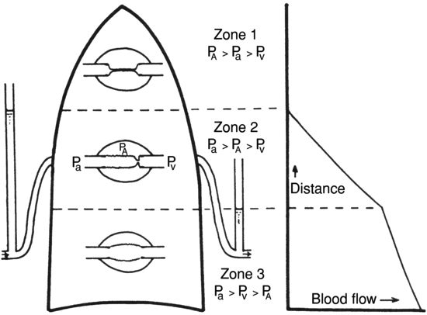
Alteration of distribution of blood flow
Normal apex-to-base gradient is inverted
  Apical flow exceeds basal flow
Notes:
Topographical distribution of blood flow is sometimes altered by interstitial edema
Normal apex-to-base gradient is inverted: apical flow exceeds basal flow.

Slide 30
Effects of pulmonary edema on pulmonary function
WEST Pulmonary pathophysiology
Notes:
First: the effects of pulmonary edema on pulmonary function

Slide 31
Reduction of lung compliance
Alveolar flooding causes a reduction in volume of the affected alveoli
Interstitial edema stiffens the lung
Abnormally large expanding pressures are needed
Tendency to collapse to abnormally small volumes when not actively expanded
COMPLIANCE = ΔV/ΔP
Notes:
Alveolar flooding causes a reduction in volume of the affected lung units as a result of surface tension forces and reduces their participation in the pressure-volume curve.
Interstitial edema stiffens the lung (interference with its elastic properties).
Abnormally large expanding pressures are needed; tendency to collapse at to very small volumes when not actively expanded.

Slide 32
Airway resistance is typically increased
When larger airways contain edema fluid
Interstitial edema increases small airway resistance (peribronchial cuff)
Notes:
Possible increase in airway resistance.
Interstitial edema increases small airway resistance (as a result of their peribronchial cuff – compressing the small airways or isolating them from the normal traction of the surrounding parenchyma)

Slide 33
Gas exchange
Interstitial edema has little effect on gas exchange
Alveolar edema causes hypoxemia
  Blood flow to unventilated alveoli
Notes:
Gas exchange
Interstitial edema has little effect on gas exchange.
Alveolar edema causes hypoxemia (edema-filled alveoli or complete airways obstruction by fluid)
→ Shunt (perfusion of unventilated units)

Slide 34
Oxygen delivery
DO₂ is decreased due to decreased CO
DO₂ = CO x CaO2
Notes:
Oxygen delivery
Decreased due to decreased cardiac output (cardiogenic pulmonary edema)

Slide 35
Control of ventilation
Rapid, shallow breathing
  Caused by stimulation of J receptors in the alveolar walls (+/- other vagal afferents)
  Rapid breathing minimizes the abnormally high elastic work of breathing
  Hypoxemia also stimulates rapid breathing pattern
Notes:
Control of ventilation
Rapid, shallow breathing
Stimulation of J receptors in the alveolar walls, +/- other vagal afferents.
Rapid breathing minimizes the abnormally high elastic work of breathing.
Hypoxemia also stimulates rapid breathing pattern.

Slide 36
Pulmonary circulation
Pulmonary vascular resistance is increased
  Hypoxic vasoconstriction of poorly/unventilated areas
  Perivascular cuffing increases resistance of extra-alveolar vessels
  Partial collapse of edematous alveoli
  Compression/distorsion of alveoli by edematous alveolar walls
Notes:
Pulmonary circulation
Increase in pulmonary vascular resistance
Hypoxic vasoconstriction of poorly/unventilated areas
Perivascular cuffing probably increases resistance of extra-alveolar vessels
Partial collapse of edematous alveoli
Compression/distortion of alveoli by edematous alveolar walls

