Slide 1
Acute Respiratory Distress Syndrome
Acute Lung Injury
Francesca Di Mauro

Slide 2
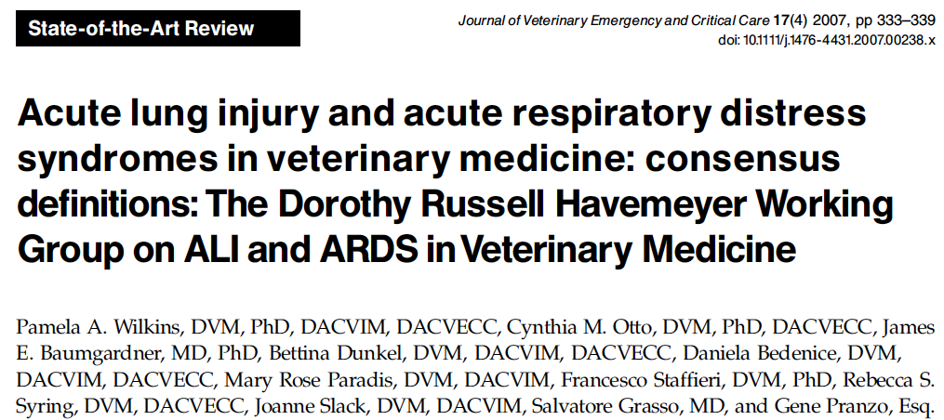
Definition of Veterinary ALI and ARDS
Clinical rather than histopathologic diagnosis
Recognized less frequently in ill dogs than humans
Consensus statement published in 2007

Slide 3
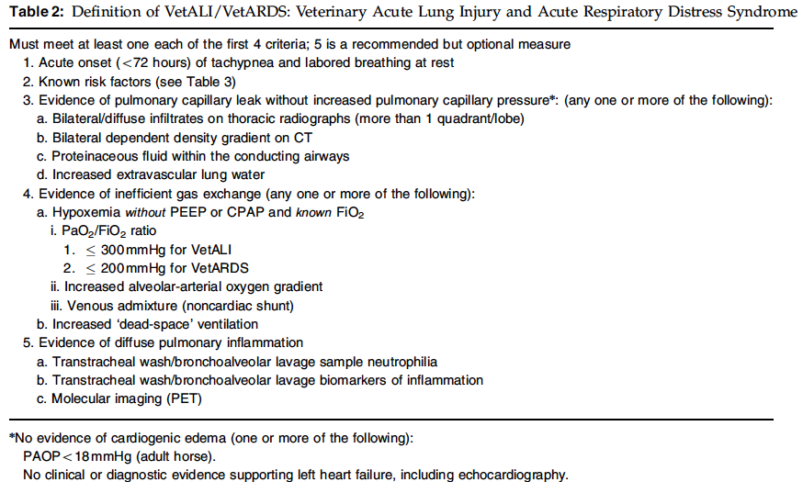
Notes:
Arterial blood gas should be evaluated for presence of hypoxemia and for calculation of alveolar arterial (A-a) gradient or PaO2/FiO2 ratio
EVIDENCE OF PULMONARY CAPILLARY LEAK WITHOUT EVIDENCE OF LEFT HEART FAILURE
A-a _{O2} Gradient = PAo2-PaO2
A-a _{O2} Gradient = [ (Fi_{O2}) * (Atmospheric Pressure - H₂O Pressure) - (Pa_{CO2}/0.8) ]
PaO2- partial pressure of oxygen in the blood.
PEEP – positive end expiratory pressure
CPAP – continuous positive airway pressure

Slide 4

Criteria for diagnosing ARDS/ALI in Veterinary Patients Summary
  Presence of risk factors (DeClue 2007, Brady 2000)
  Specific risk factors have not been identified in cats
  Severe sepsis has been associated with PM findings consistent with ALI/ARDS in cats
Measure of abnormal gas exchange
  Arterial blood gas evaluated for presence of hypoxemia
Evidence if respiratory capillary leak not associated with increased capillary pressure
Evidence of inflammation

Slide 5

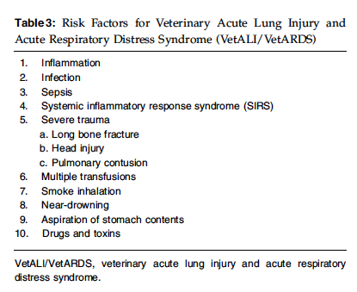
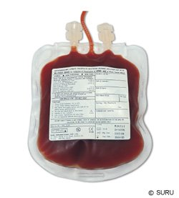

Slide 6
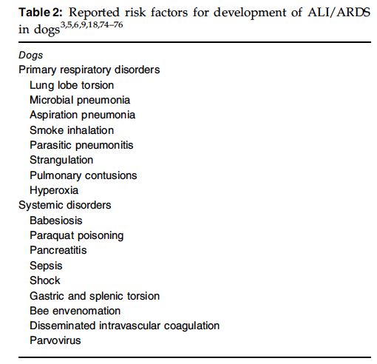
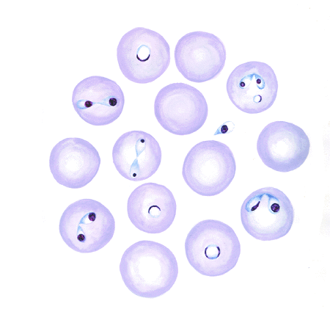
Notes:
DeClue 2007

Slide 7
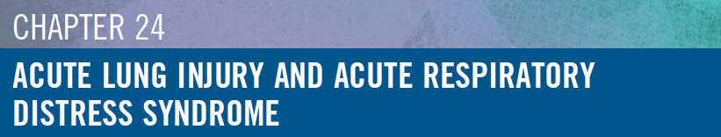
Proposed Criteria for Identification of Acute Lung Injury in Dogs
Preexisting severe acute critical illness or injury
  Pulmonary or extrapulmonary in nature
Increased respiratory rate and effort
Bilateral pulmonary infiltrates on thoracic radiographs or preferably, CT
Hypoxemia on room air with PaO₂ < 45 mmHg, SpO₂ < 85% on room air, or A-a gradient > 50
  Alternatively, in the presence of supplemental oxygen of a known concentration, PaO₂/FiO₂ < 300
No evidence of CHF/volume overload as assessed by echo or pulmonary arterial catheterization

Slide 8
ARDS/ALI Definition in Humans
American European Consensus Conference (1994)
  Severe respiratory failure after catastrophic event
  Event can be pulmonary or extrapulmonary (TRALI)
Berlin definition (2012) (Ferguson 2012)
  Better predictive validity for mortality
  Stages of mild, moderate, and severe ARDS were associated with increased mortality and increased median duration of mechanical ventilation in survivors
Notes:
Clinical rather than histopathologic diagnosis - lung biopsy or PM not required to reach diagnosis – SH reference 5
AECC – American European Consensus Conference In 1994. Catastrophic event can be pulmonary or extrapulmonary
TRALI – transfusion related acute lung injury
Berlin definition is updated definition
S&H – references 3,4,5

Slide 9

Berlin Definition of ARDS
Timing
  Within 1 week of insult or new or worsening respiratory symptoms
Thoracic Imaging
  Bilateral opacities
Origin of Edema
  Non hydrostatic edema – not secondary to CHF or fluid overload
Oxygenation
  Mild: 200mmHg < PaO₂/FiO₂ ≤ 300mmHg with PEEP or CPAP ≥ 5 cmH₂O
  Moderate: 100mmHg < PaO₂/FiO₂ ≤ 200mmHg with PEEP or CPAP ≥ 5 cmH₂O
  Severe: PaO₂/FiO₂ ≤ 100mmHg with PEEP or CPAP ≥ 5 cmH₂O
Notes:
Bilateral opacities – NOT FULLY EXPLAINED BY EFFUSIONS, LOBAR/LUNG COLLAPSE, or nodules
CPAP – continuous positive airway pressure
PEEP – positive end expiratory pressure
S&H – reference 5

Slide 10
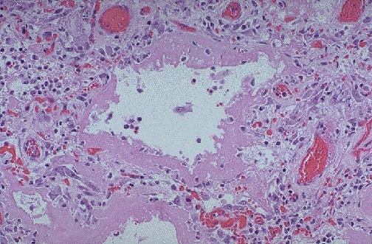
Histology
Diffuse alveolar damage
(Thille 2013; Weinacker 2001; Tomashefski 2000; Bouros 2000;
Erasmus 2002)
Histopathological findings
were correlated to
severity and duration of
ARDS.
Non specific pattern
  Acute interstitial pneumonia
  Inhalation of toxic substances
  Prior treatment with amiodarone
Notes:
Most consistent histological pattern is diffuse alveolar damage
******Non specific pattern, associated with a variety of clinical syndromes
http://library.med.utah.edu/WebPath/LUNGHTML/LUNG133.html

Slide 11
Histology
Clearly defined PM tissue sampling protocols that consider the relationship of clinically defined syndrome with gross and histopathology findings not yet established in veterinary species
  Most studies are retrospective
  Heterogenous distribution of pathologic processes within the lung
  Variability that depends on the stage of development or repair
Notes:
*** In veterinary species clearly defined PM tissue sampling protocols that consider the relationship of clinically defined syndrome with gross and histopathology findings not yet established

Slide 12
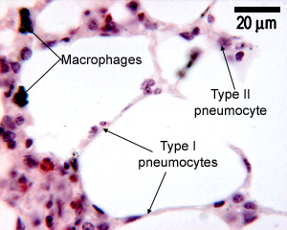
Pathophysiology: Stages of Lung Injury (DeClue 2007)
Exudative phase (days 0 to 6)
  Begins with pulmonary vascular leaking and inflammatory cell infiltration
  Loss of capillary integrity, alveolar epithelial damage, accumulation of protein-rich fluid, and development of pulmonary edema
  The lung architecture becomes altered. Type I alveolar pneumocytes, are irreversibly damaged.
  Type II pneumocytes abandon their normal function of surfactant production to repair the damaged areas
  Leads to formation of hyaline membranes, deficiency of surfactant and collapse of alveoli
Notes:
Histologically, diffuse alveolar damage, eosinophilic hyaline membranes, marked congestion, edema, neutrophil infiltration, hemorrhage, and atelectasis are noted in dogs.5,6,14,26,33–35 Protein leakage, pulmonary edema, suppurative alveolitis, thickened alveolar septae, alveolar hemorrhagic necrosis, and thrombosis have been documented in models of feline ALI/ARDS
DeClue 2007, SH
http://www.histology.leeds.ac.uk/respiratory/respiratory.php

Slide 13
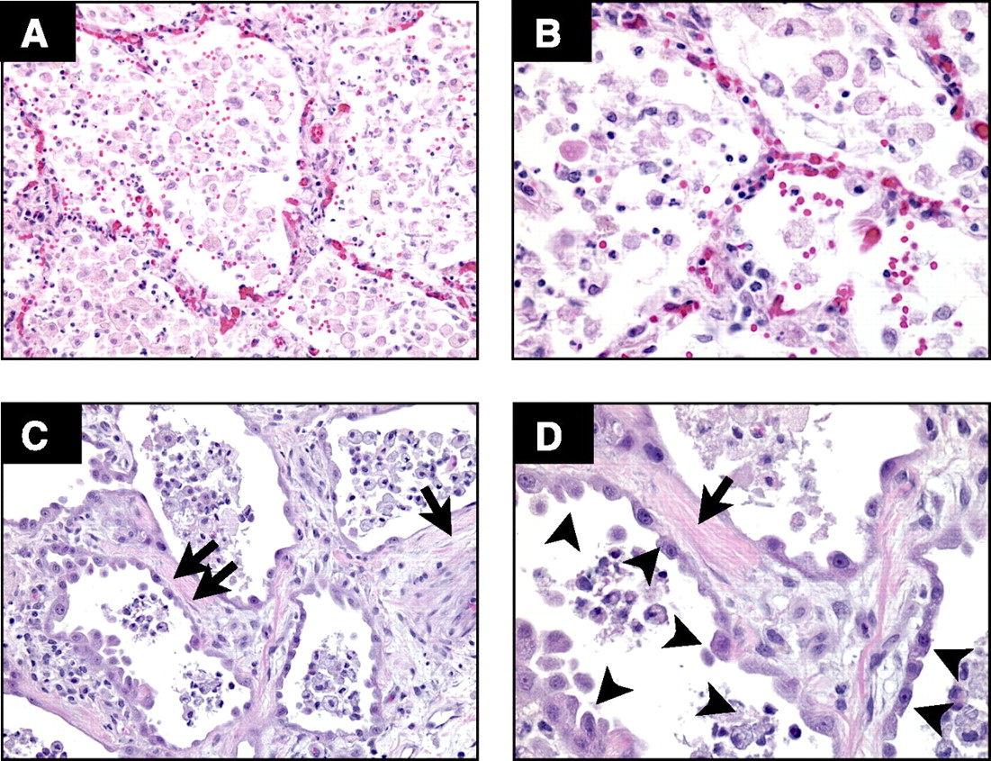
Pathophysiology: Stages of Lung Injury
Proliferative phase (days 4 to 10)
  Organization of exudates and development of fibrosis
  Fibroblastic proliferation leads to narrowing and collapse of the airspaces and pulmonary hypertension
  The interstitial space becomes dilated and edematous
  Hyaline membranes progress and the alveolar lumen fills with fibrin and cell debris
Notes:
Alveolar walls thickened and septae edematous

Slide 14
Pathophysiology: Stages of Lung Injury
Fibrotic phase (day 8 onward)
  Collagen deposition in the alveolar, vascular, and interstitial beds
  In humans with ALI/ARDS, fibrosis is a key predictor of survival
  Little is known about this phase in clinical veterinary patients
Notes:
DeClue 2007
http://ajplung.physiology.org/content/295/3/L379
Fibroproliferative response with collagen deposition

Slide 15
Pathophysiology
Inflammatory processes and pathologic changes associated with ARDS are similar in dogs, cats, and humans (DeClue 2007)
ALI/ARDS develops secondary to an inappropriate, overzealous inflammatory response that may last long after the inciting cause is removed.
Systemic inflammation can result in MODS
ALI/ARDS can occur independently or as a part of MODS
Notes:
Inciting cause: pneumonia, sepsis, trauma, smoke inhalation, emergency transfusions, near-drowning, pancreatitis, aspiration of gastric contents

Slide 16
Pathophysiology: Cellular mediators
Inflammatory mediators responsible for development and propagation
  Humoral mediators: IL-1, TNF-α
  Cellular mediators: neutrophils, macrophages
Alveolar macrophages are the earliest effector cells of the pulmonary inflammatory response
  Cytokines and chemokines, (TNF)-a and interleukin (IL)-1b produced
  ROS released
Notes:
IL-1 and TNF-alpha are proinflammatory mediators
S&H: reference 5

Slide 17
Pathophysiology: Cellular mediators
Activated neutrophils release inflammatory mediators, and ROS.
  Dysfunction/death of alveolar epithelial cells and decreased surfactant production
Persistence of the initial neutrophilic inflammatory response is associated with a increased severity of lung injury and a higher mortality rate in humans (Baugman 1996)
Notes:
IL-1 and TNF-alpha are proinflammatory mediators
S&H: reference 5

Slide 18
Arterial Hypoxemia in ARDS/ALI
Low alveolar partial pressure of oxygen (PAO₂)
  Hypoventilation associated with low pulmonary compliance
  Oxygen therapy or mechanical ventilation useful to overcome
Ventilation-Perfusion (V/Q) mismatch
  Poorly ventilated alveoli
    Fluid accumulation, perfusion abnormalities
Shunting of venous blood into arterial circulation
Notes:
Arterial hypoxemia develops from a variety of factors including (LIST)
PAO2 occurs as a result of hypoventilation….
VQ mismatch as a result of poorly ventilated alveoli subsequent to fluid accumulation and perfusion abnormalities of ventilated lung regions
Physiologic shunt occurs when deoxygenated venous blood flows past collapsed or flooded alveoli never participating in gas exchange.
Efforts to improve venous oxygenation by improving perfusion and decreasing oxygen consumption can improve arterial oxygenation in the presence of significant physiologic shunt

Slide 19
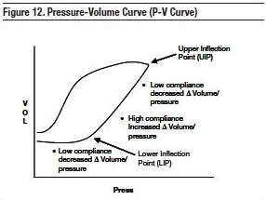
Pulmonary Functional Abnormalities
Decreased functional residual capacity (FRC)
Mild-moderate reduction in forced expiratory volume and forced vital capacity
Decreased diffusing capacity (DLco)
Decreased compliance**
Increased resistance
Decreased compliance is hallmark finding in ARDS
  Increased work of breathing
  Respiratory fatigue
Notes:
Other pulmonary functional abnormalities in addition to arterial hypoxemia
Decreased compliance is hallmark finding in ards and determined by sloe of PV curve. THIS MEANS THAT HIGHER PRESSURES ARE REQUIRED TO GENERATE ADEQUATE TIDAL VOLUMES, DECREASED PULMONARY COMPLIANCE results in increased work of breathing and respiratory fatigue may develop
COMPLIANCE IS MEASURE OF LUNG’S ABILITY TO STRETCH
Pulmonary compliance is calculated using the following equation, where ΔV is the change in volume, and ΔP is the change in pleural pressure:
=ΔV/ΔP
PV curve – Gattinoni et all - Regional effects and mechanism of positive end-expiratory pressure in early adult respiratory distress syndrome.

Slide 20
Clinical Presentation (DeClue 2007)
Signs may be be delayed for 1–4 days
  After inciting event triggers the pulmonary inflammatory response.
Progressive hypoxemia, tachypnea, respiratory distress, cyanosis.
Rarely, a productive cough may be present
Physical examination findings
  Harsh lung sounds progressing to crackles
  Increased respiratory effort
  Orthopnea
  Foamy pink expectorate in severe cases
Any animal with non-cardiogenic pulmonary edema and appropriate risk factors
Notes:
Any animal with non-cardiogenic pulmonary edema and appropriate risk factors should be suspected of having
ALI or ARDS.

Slide 21
Diagnostics
Based on Criteria
Complete blood count and serum chemistry panel typically reflect nonspecific changes related to the underlying disease process
  Hypoalbuminemia occurred in 8 of 12 dogs in a retrospective study of canine ALI/ARDS
  Correlated with an increased risk of developing ARDS in human patients with sepsis. (Parent 1996; Mangialardi 2000)
  Leukopenia is a common finding in dogs with ALI/ARDS (Parent 1996)
There are no published reports of ALI/ARDS in cats, and therefore specific clinical findings are speculative

Slide 22
Imaging in veterinary patients
No prospective imaging studies of these syndromes in clinically affected dogs
Abstract presented at ACVR 2012: Diagnostic imaging enhances management of acute respiratory distress syndrome
HRCT used in addition to traditional thoracic radiographs and oxygenation indices to monitor dogs with ARDS undergoing mechanical ventilation
Also to quantify alveolar overdistension and recruitment/derecuitment during mechanical ventilation
Notes:
INSERT FIGURE 24-2
Abstract presented at ACVR 2012: Diagnostic imaging enhances management of acute respiratory distress syndrome
Advantages of CT – evaliate for comorbidities like PTE

Slide 23
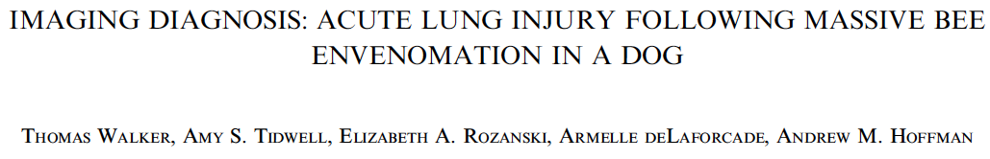
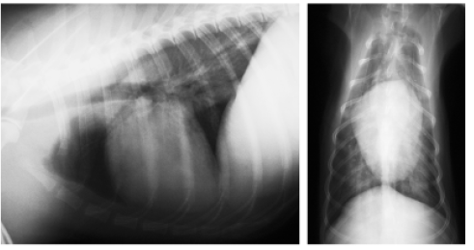
5 year old MC mixed breed dog presented for increased respiratory effort after being stung by over 100 bees
  Anaphylactic shock. ALI/ARDS suspected.
This case demonstrates the usefulness of computed tomography in the diagnosis of ALI/ARDS
Thoracic radiographs
  Mild bilateral interstitial
  pattern
Notes:
Pulmonary function testing indicated decreased pulmonary compliance, decreased diffusion capacity and decreased functional residual capacity.

Slide 24
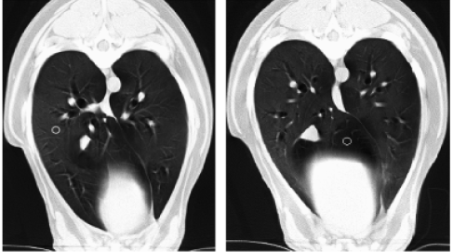
CT: diffuse bilateral opacification of the lungs, with preservation of bronchial and vascular margins.
In people, CT is widely used to characterize diffuse pulmonary parenchymal diseases.
CT features of diffuse alveolar injury
  Patchy or diffuse ground
  glass opacification
  Consolidation
  Diffuse reticular pattern
Notes:
Although not specific, ground glass opacification in ALI/ ARDS is thought to reflect an active inflammatory process involving both the lung interstitium or alveolar wall and incomplete filling of the air space with inflammatory cells, cellular debris and edema
IMAGE: There is diffuse, bilateral mild opacification of the lungs that appears to spare most of the accessory lobe and other small patches of lung. Hounsfield unit measurements ranged from 550 in the relatively higher attenuating areas (regions of interest (ROI) cursor in A) and 850 in the relatively lower attenuating areas (such as the accessory lobe, ROI cursor in B). Findings are consistent with acute lung injury/acute respiratory distress syndrome.

Slide 25

Lung Ultrasound in ARDS
Earlier detection
Estimate severity of edema
Cageside
Notes:
Thoracic X-rays are typically used
Required American-European Consensus Conference definition
CT is gold standard

Slide 26
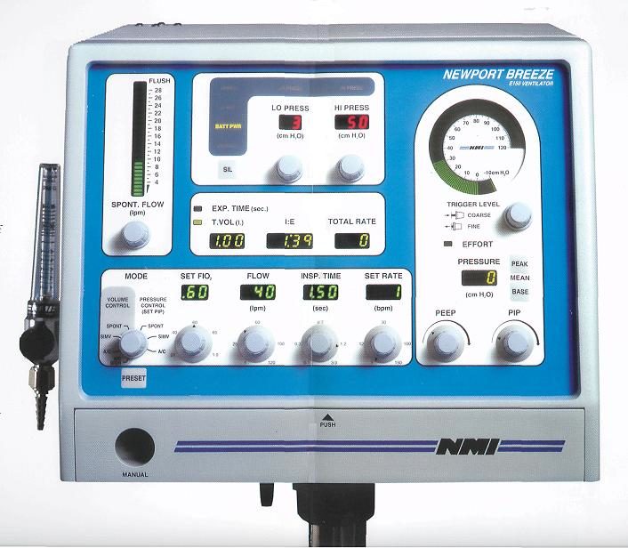
Treatment – Veterinary patients
Supportive
No specific therapy available
Therapy focuses on elimination of other treatable causes
  Bacterial pneumonia
  PTE
Ventilated dogs benefit from
limiting tidal volume
  Optimal tidal volumes for dogs
  with ARDS have not been established
  Lower tidal volumes well tolerated
  by healthy dogs
Notes:
Bacterial pneumonia – abx
PTE – anticoagulated if clinically advisable and evaluated via echo or CT

Slide 27

Prospective study with 5 healthy beagles
Dogs MV with V_{T} of 6, 8, 10, 12 and 15mL/kg
Low V_{T} tolerated in healthy dogs.
Predictable decrease in pH, decrease in airway pressure, decrease in compliance, increase in PaCO₂ associated with lower V_{T}
Low V_{T} ventilation in dogs with ALI/ARDS as well as influence of PEEP requires further evaluation

Slide 28
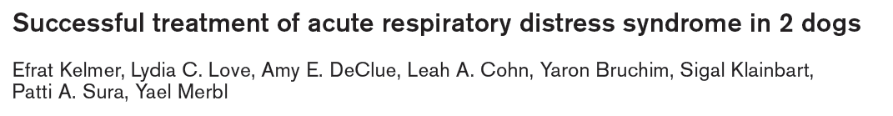
2 dogs with ARDS were successfully managed and survived to discharge
General anesthesia likely contributed to the development of ARDS/ALI in both cases.
  By causing atelectasis, increasing V/Q mismatching and shunt fraction
Notes:
Adverse effects of alveolar over-distension and end-expiratory collapse are more detrimental to patient outcome than the adverse effects of unintentional respiratory acidosis

Slide 29

Case 1: 5 year old FI Dachshund
Presented for acute dyspnea of 5 h duration.
History of recurrent pneumonia and a unilateral serous nasal discharge of 4 month duration that partially responded to antibiotic therapy.
BAL performed. Acellular cytology and negative cultures. Biopsies revealed chronic rhinitis. Thoracic radiographs unremarkable.
Notes:
Insert picture of dauschund

Slide 30
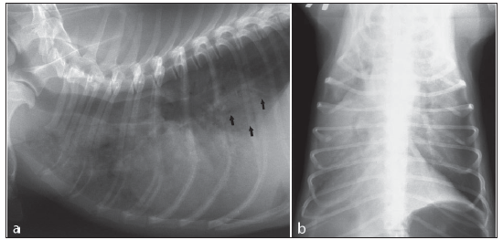
Case 1: 5 year old FI Dachshund
Presented the following day in respiratory distress
ABG: calculated FiO2/PaO2 ratio of 142.5
Thoracic radiographs
  Generalized, diffuse alveolar pattern with poor visualization of the pulmonary vessels and multiple air bronchograms
  Aspiration pneumonia unlikely based on distribution of infiltrates

Slide 31
Case 1: 5 year old FI Dachshund
Anesthetized and mechanically ventilated
The initial ventilator mode was set for SIMV with a volume controlled cycle, respiratory rate of 20 bpm, tidal volume of 15 mL/kg body weight, FiO2 of 100% and PEEP of 5 mmHg.
Weaned off ventilation after 42 hours
Remained in ICU receiving IV fluids, antibiotic therapy, oxygen, nebulization, and coupage
Discharged 5 days after being weaned off ventilator

Slide 32
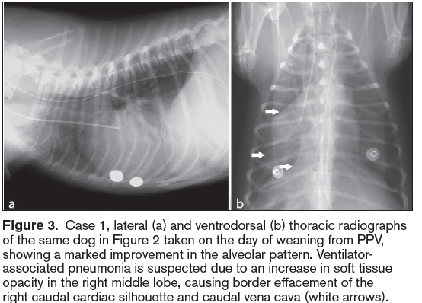
Case 1: 5 year old FI Dachshund

Slide 33
Case 2: 5 year old MC Mixed breed
Presented for penetrating bite wounds to the head, neck, and chest of a few hours’ duration.
Tachypneic – no abnormalities on auscultation
Thoracic radiographs: mild increase in pulmonary interstitial markings medial to fractured ribs
14 h after presentation anesthetized to clip, clean and repair wounds.
During recovery, increasing stridor and dyspnea were noted. Crackles were ausculted over all lung fields and the patient was reintubated
  ABG during intubation with 100% oxygen revealed calculated PaO2/FiO2 of 170

Slide 34
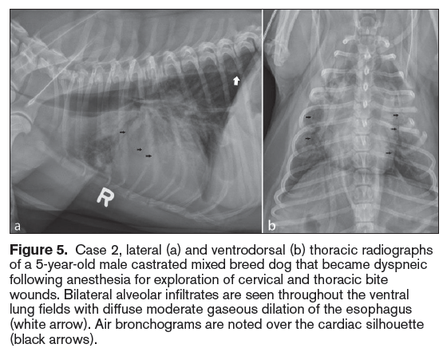
Case 2: 5 year old MC Mixed breed

Slide 35
Case 2: 5 year old MC Mixed breed
Initial ventilator settings: tidal volume of 12 mL/kg, 14 bpm, inspiratory to expiratory ratio of 1:2, and a peak inspiratory pressure (PIP) of 20 cm H2O; PEEP was set at 5 cm H2O.
After approximately 17 h of ventilation weaning attempts were begun. Extubation was unsuccessful
Tracheostomy tube was placed. Removed 2 days later.
Discharged on day 6.
Eight days after original presentation, re-admitted for cyanosis and syncope.
  A laryngeal examination revealed persistent arytenoid paralysis.
  Left-sided arytenoid lateralization performed and patient discharged
Notes:
Differential diagnoses included aspiration pneumonia or progression of pulmonary contusions. Cardiogenic edema was considered unlikely due to the distribution of pulmonary infiltrates and lack of venous congestion, murmur, or cardiomegaly.

Slide 36
Strategies for protective ventilation:
  Lowering tidal volume
  Limiting driving pressures < 20 cmH2O above selected PEEP values
  Lung recruitment maneuvers
  Permissive hypercapnia
  Preferential use of pressure-limited ventilatory cycles
In the study cases lung-protective strategies were not fully implemented; however, care was taken to avoid exceeding a PIP of 20 mmHg over the selected PEEP of 5 mmHg and no patient developed barotrauma despite the choice of volume-regulated cycles
Notes:
Protective techniques are based on the fact that massive alveolar collapse, cyclic lung reopening, and over-distention of the lungs occur during mechanical ventilation.

Slide 37

Dyspneic and cyanotic.
Arterial partial pressure of oxygen of 38mm Hg; SpO₂ of 62%
Thoracic radiographs: severe, bilateral pulmonary infiltrates.
Ventilated for 70 hours and was discharged 4 days later.
Complications: pneumonia and phlebitis
Thoracic radiographs 10 days after discharge were normal
Owners report a full recovery at 1 year
Notes:
Upon arrival the patient was cyanotic with an arterial partial pressure of oxygen of 38mm Hg (reference interval 85–100mm Hg) and oxygenation saturation of 62% (reference interval
>95%).

Slide 38
Goals of lung protective ventilation are to prevent or limit volutrauma and barotrauma to the lungs secondary to high pressures or volumes used during MV.
Normalization of ABG values is not a primary goal and a certain degree of hypercapnea is often permitted.
Lung protective ventilatory strategies used in this case
  Pressure-limited, low-volume ventilation, PEEP and recruitment maneuvers (inspiratory pauses of 10–20 s with constant airway pressure and intermittent increases of airway pressure for 1–2 min, followed by PEEP).
  The dog did not tolerate the initial low tidal volumes (the severe respiratory acidosis and hypoventilation)
  A mild increase in PIP and decreased PEEP resulted in improvement

Slide 39
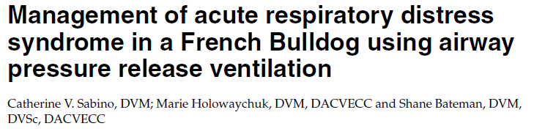
An 18-month-old female French Bulldog was presented for routine ovariohysterectomy and correction of brachycephalic airway obstruction syndrome.
Following the surgical procedures, the dog developed aspiration pneumonia and ARDS
APRV is used to successfully manage the patient
The ventilator cycles from high CPAP to low CPAP (high lung volume to lower lung volume), and the patient can breath spontaneously at either level.
Notes:
There are different techniques that can be used to increase alveolar recruitment during mechanical ventilation.. Commonly employed recruitment maneuvers include sustained inflation (inspiration with sustained inflation pressures of approximately 35–50 cmH2O for 20–40 seconds), intermittent "sighs" (multiple consecutive inspirations at elevated airway pressures of
45 cmH2O) and intermittent, incremental increases in PEEP or peak inspiratory pressure (to greater than 60 cmH2O) for brief periods of time.

Slide 40

APRV uses the concept of open lung ventilation combined with spontaneous ventilation in order to improve arterial oxygenation and minimize ventilator-induced lung injury
The dog remained hemodynamically stable and showed clinical (increased P/F) and radiographic evidence of improved alveolar recruitment following initiation of APRV
Notes:
Another benefit of spontaneous breathing during APRV is that in comparison to pressure-support ventilation, APRV leads to decreased intrapulmonary shunting, decreased dead space, increased PaO2, increased oxygen delivery, and increasedCO2 elimination due to increased alveolar ventilation
APRV also leads to similar or improved measures of hemodynamic performance, such as stroke volume, cardiac index, and renal blood flow
Another benefit of APRV is the elevated baseline airway pressure that may produce gradual, near-complete alveolar recruitment while avoiding excessively high airway pressures.
APRV was selected in order to maximize alveolar recruitment while minimizing the potentially deleterious cardiovascular and pulmonary effects of other more commonly used recruitment maneuvers.

Slide 41
APRV has not been shown to improve survival in human patients with ARDS
  Positive effects on hemodynamic parameters, oxygen exchange, and dead space ventilation have been more clearly demonstrated.
APRV can be used in canine patients and may represent a feasible alternative mechanical ventilation mode for the management of canine patients with refractory hypoxemia and ARDS
Notes:
Another benefit of spontaneous breathing during APRV is that in comparison to pressure-support ventilation, APRV leads to decreased intrapulmonary shunting, decreased dead space, increased PaO2, increased oxygen delivery, and increasedCO2 elimination due to increased alveolar ventilation
APRV also leads to similar or improved measures of hemodynamic performance, such as stroke volume, cardiac index, and renal blood flow
Another benefit of APRV is the elevated baseline airway pressure that may produce gradual, near-complete alveolar recruitment while avoiding excessively high airway pressures.
APRV was selected in order to maximize alveolar recruitment while minimizing the potentially deleterious cardiovascular and pulmonary effects of other more commonly used recruitment maneuvers.

Slide 42
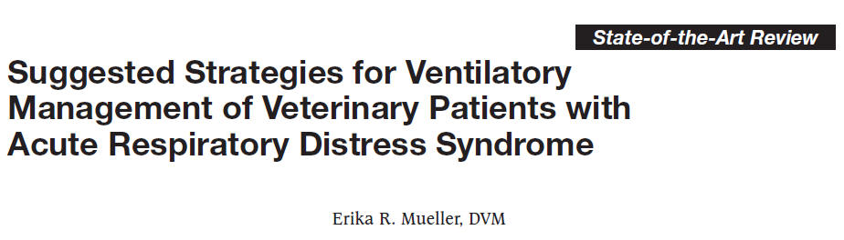
Two veterinary reports have characterized ARDS in dogs using human criteria.
There are no prospective veterinary studies using recruitment maneuvers or PEEP in conjunction with a small tidal volume.
There is ample experimental evidence demonstrating that ventilator-induced lung injury (VILI) occurs in dogs, sheep and rats.
Recruitment maneuvers in conjunction with low tidal volumes and PEEP keep the alveoli open for gas exchange and decrease VILI.
Notes:
Recriutment maneuvers - inspiratory pauses of 10–20 s with constant airway pressure and intermittent increases of airway pressure for 1–2 min, followed by PEEP

Slide 43
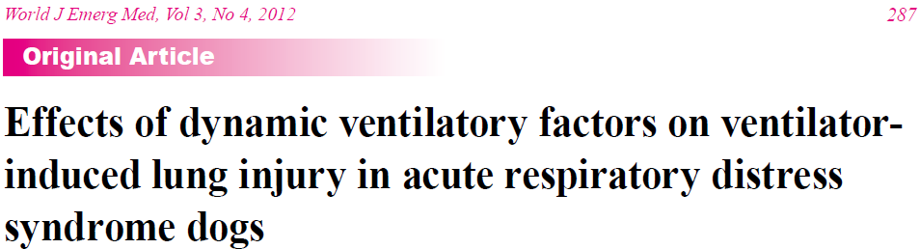
Thirty-six healthy dogs were randomly divided into a control group and an experimental group
Mechanical ventilation with a large tidal volume, a high inspiratory flow and a high ventilation frequency can cause significant damage to lung tissue structure.
  It can significantly increase the expression of TNF-α and IL-8 as well as their mRNA expression.
Results of study showed that small tidal ventilation significantly reduces the release of pro-inflammatory mediators

Slide 44
Treatment - Humans
Supportive
No specific therapy associated with improved outcome (Weinacker 2001)
Inhaled nitric oxide and surfactant therapy shown to improve oxygenation
  Survival benefits not observed (Griffiths 2005; Willson 2005)
Surfactant therapy lifesaving in infants with ARDS
  No clear benefits of their use (Willson 2005; Marraro 2004)
Cytokine blocking agents have not been shown to be effective

Slide 45
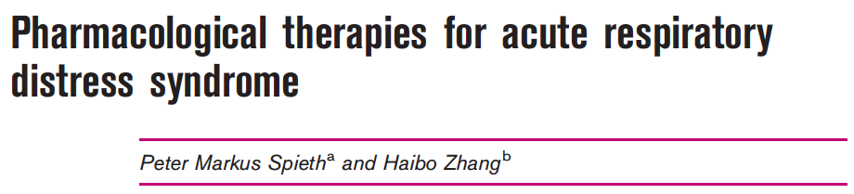
Fluid therapy
A positive fluid balance is associated with increased mortality rate in patients with ARDS
The conservative fluid approach keeps the lung dry and improved slightly oxygenation that was associated with a shortening of ventilator days
Use of hypertonic saline did not show a decreased occurrence of ARDS as compared to the use of fluid therapy by using normal saline.
  More research necessary to determine if hypertonic fluids are protective in patients with concurrent ARDS
Notes:
Hallmark of ARDS is the increased pulmonary capillary permeability leading to the development of pulmonary edema.

Slide 46

β2-agonists
β2-agonists could promote the reabsorption of fluid by stimulating cAMP-dependent protein kinase and promoting pulmonary protection mechanisms independent of its vasodilatory properties
A recent large randomized, controlled clinical trial using IV salbutamol showed that treatment with β2-agonists was poorly tolerated and was eventually associated with an increased 28-day mortality rate in patients with ARDS
Notes:
Cyclic AMP

Slide 47
Statins
  Demonstrated to have a protective effect in sepsis, ARDS or aneurysmal subarachnoidal hemorrhage
  The anti-inflammatory effects of statins are yet to be examined in prospective randomized controlled clinical trials
Corticosteroids
  Large study suggests that the early use of high-dose corticosteroids may increase mortality and cause adverse effects – not recommended
Notes:
(SH reference 26)

Slide 48
Treatment with activated protein C
  In pulmonary inflammation, tissue factor-derived activation of the coagulation cascades alters anticoagulation signal pathways such as antithrombin III and protein C leading to an inhibition of fibrinolysis and DIC
  Anticoagulation therapies using AT III or activated protein C failed to show beneficial effects on clinical outcome in large randomized controlled clinical trials
ACE inhibitors
  Investigators have demonstrated that the loss of ACE2 expression can result in increased vascular permeability in a mouse model of ARDS, and the permeability was attenuated in the AT1 receptor
  Prospective randomized clinical trials are warranted to determine the role of ACE2 and ACE inhibitors in ARDS

Slide 49
Treatment - Humans
Inhaled agents
  Inhaled nitric oxide was associated with improvement of oxygenation in ARDS patients.
  Cochrane review and two recent meta-analyses suggested that despite a transient improvement in oxygenation, it was unable to reduce mortality.
  In some cases, nitric oxide may be harmful by causing impaired renal function.
2012 Surviving Sepsis Campaign guidelines do not recommend the routine use of inhalation of nitric oxide as a supportive therapy in patients with sepsis-related ARDS
Notes:
Inhaled agents - To enhance regional perfusion by their vasodilation property, improving ventilation/perfusion match
This approach would be able to reverse hypoxemia and reduce pulmonary arterial blood pressure, which is frequently implicated during the course of ARDS.

Slide 50
Stem cells to modulate inflammation in ARDS/ALI
  Anti-inflammatory effects and lung regeneration mechanisms in the treatment of patients with ARDS
  Preclinical results are very promising in the treatment of ARDS
Surfactant
  Differences in the causes of ARDS between adults and children that may also influence the effects of surfactant treatment
  More studies required

Slide 51
Prognosis
Mortality rates for ARDS in small animals are close to 100%. Most die within the first two weeks of diagnosis (DeClue 2007)
Survival to discharge is less than 10% in veterinary medicine (Sabino 2012)
Mortality rates have not been established in veterinary medicine (Kelmer 2012)
Mortality rates as high as 40–60% have been reported in humans with ALI/ARDS (DeClue 2007, Kelmer 2012)

Slide 52
References
Wilkins PA, Otto CM, Baumgardner JE, et al: Acute lung injury and acute respiratory distress syndromes in veterinary medicine: consensus definitions: The Dorothy Russell Havemeyer Working Group on ALI and ARDS in Veterinary Medicine, J Vet Emerg Crit Care 17:333, 2007.
DeClue et al (2007). Acute respiratory distress syndrome in dogs and cats: a review of clinical findings and pathophysiology. JVECC. 2007;17(4): 340–347
Brady C, Otto C, Winkle T, et al. Severe sepsis in cats: 29 cases (1986–1998). J Am Vet Med Assoc 2000; 217:531–535
Parent C, King L, Walker L, et al. Clinical and clinicopathologic finding in dogs with acute respiratory distress syndrome: 19 cases (1985–1993). J Am Med Vet Assoc 1996; 208:1419–1427.
Mangialardi R, Martin G, Bernard G, et al. Hypoproteinemia predicts acute respiratory distress syndrome development, weight gain, and death in patients with sepsis. Crit Care Med 2000; 28:3137–3145.
Castillo RD, Guerrero S, Escalante C, et al. Serum and pulmonary angiotensin converting enzyme as a marker of acute lung injury in an experimental model of adult respiratory distress syndrome. Ann Med Intern 1999; 16:229–235.
Baughman RP, Gunther KL, Rashkin MC, et al. Changes in the inflammatory response of the lung during acute respiratory distress syndrome: prognostic indicators. Am J Respir Crit Care Med 1996; 154:76–81
ARDS Definition Task Force, Ranieri VM, Rubenfeld GD, Thompson BT, Ferguson ND, Caldwell E, Fan E, Camporota L, Slutsky AS. JAMA. 2012 Jun 20;307(23):2526-33. doi: 10.1001/jama.2012.5669. Acute respiratory distress syndrome: the Berlin Definition. Griffiths MJD, Evans TW: Inhaled nitric oxide therapy in adults, N Engl J Med 353:2683, 2005.
Willson DF, Thomas NJ, Markovitz BB, et al: Effect of exogenous surfactant (calfactant) in pediatric acute lung injury: a randomized controlled trial, JAMA 293:470, 2005.
Marraro GA: Perspectives for use of surfactant in children and adults, J Matern Fetal Neonatal Med 16(Suppl):29, 2004.

Slide 53
References
Haas SA, Davidow E. Successful management of saltwater submersion injury in a dog using mechanical ventilation. J Vet Emerg Crit Care 2008;18:646–653.
Walker T, Tidwell AS, Rozanski EA, DeLaforcade A, Hoffman AM. Imaging diagnosis: Acute lung injury following massive bee envenomation in a dog. Vet Radiol Ultrasound 2005;46:300–303.
Mueller E,R. Suggested Strategies for Ventilatory Management of Veterinary Patients with Acute Respiratory Distress Syndrome. 2001;11(3):191-198
Sabino et al. Management of acute respiratory distress syndrome in a French Bulldog using airway pressure release ventilation. 2013; 23(4): 447–454
Thille 2013. Comparison of the Berlin Definition for Acute Respiratory Distress Syndrome with Autopsy. 2013; 187(7):761–767
Weinacker AB, Vaszar LT: Acute respiratory distress syndrome: physiology and new management strategies, Ann Rev Med 52:221, 2001.
Tomashefski JF: Pulmonary pathology of acute respiratory distress syndrome, Clin Chest Med 21:435, 2000.
Bouros D, Nicholson AC, Polychronopoulos V, et al: Acute interstitial pneumonia, Eur Respir J 15:412, 2000.
Erasmus JJ, McAdams HP, Rossi SE: Drug-induced lung injury, Semin Roentgenol 37:72, 2002.
Jirik FR, Henning H, Huckell VF, et al: Diffuse alveolar damage syndrome associated with amiodarone therapy, Can Med Assoc J 128:1192, 1983.
Copetti R, Soldati G, Copetti P. Chest sonography: a useful tool to differentiate acute cardiogenic pulmonary edema from acute respiratory distress syndrome. Cardiovascular ultrasound. 2008;6:16-16.

Slide 54
Resolution of ARDS in humans
Majority of recovery occur over 3 months after extubation
Additional recovery over first year
Excessive fluid and proteins removed from airways and alveoli
Type II alveolar epithelial cell repopulate epithelial lining
Abnormal interstitium restores normal matrix
Damaged endothelium repaired to restore blood flow to remove necessary or residual cellular components
Notes:
Occurs in orderly fashion, similar to repair in any other tissue
SH reference 7,13
SH reference 14

Slide 55
Treatment - Humans
Human patients almost always require MV
  Improve VQ mismatch and decrease physiologic shunt by recruiting collapsed alveoli
  Relieves work of breathing preventing fatigue and reducing oxygen consumption
Positive fluid balance and high tidal volumes associated with worse outcomes
Lower tidal volumes associated with decreased ventilator associated lung injury and improved patient outcomes
Notes:
(SH reference 20 21)

Slide 56
Questions
What criteria must be fulfilled to diagnose ALI and ARDS?
  A1. See Table 2.
What are the 3 morphologic phases of ARDS?
  A2. Exudative, proliferative, and fibrotic.
What two inflammatory cell types are most important in the pathogenesis of ALI/ARDS?
  A3. Macrophages and neutrophils.

