Slide 1
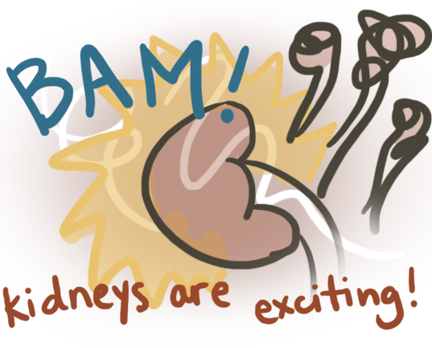
It’s not a renal, it’s a kidney…
Acute Kidney Injury
Clare Hyatt, DVM, MS
Resident, Emergency and Critical Care
Cornell University

Slide 2
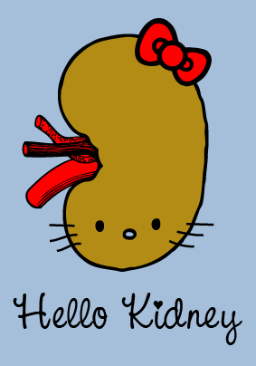
Outline
Definition
Etiology
Pathophysiology
Diagnosis
  Scoring systems
Treatment
Prevention
Prognosis

Slide 3
Definition – Acute Kidney Injury
Clinical syndrome
  Rapid decrease in renal excretory function
  Accumulation of products of nitrogen metabolism such as creatinine and urea and other clinically unmeasured waste products
  Other clinical manifestations:
    +/- decreased urine output
    Accumulation of metabolic acids
    Increased potassium and phosphate concentrations
Bellomo et al. Acute kidney injury. Lancet 2012
Tolwani. CRRT for AKI. NEJM 2012

Slide 4
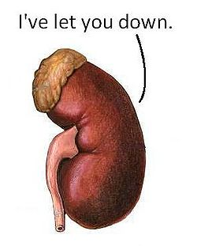
Definition - AKI
KDIGO consensus:
  Increase in serum creatinine of 0.3 mg/dL (26.5 umol/L for you damn foreigners) or more within 24 hours
  Serum creatinine level that has increased by at least 1.5 times baseline within the previous 7 days
  Urine volume of <0.5 ml/kg/h for 6 hours
Replaced the term “acute renal failure”
  Continuum
  Not true failure
Tolwani. CRRT for AKI. NEJM 2012

Slide 5
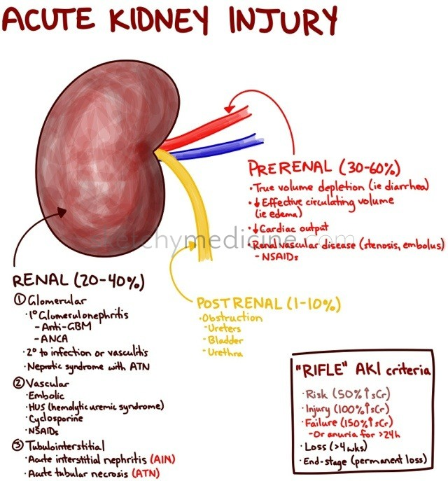
Etiology
Prerenal (Hemodynamic)
Renal parenchymal (intrinsic)
Postrenal
www.sketchymedicine.com

Slide 6
Etiology
Prerenal (Hemodynamic)
  Decrease in GFR due to a decrease in renal perfusion pressure without damage to renal parenchyma
    Excessive vasoconstriction
    Reduced renal perfusion
  Response: urine concentration, sodium reabsorption
  Rapidly reversible if inciting cause is eliminated
  Prolonged ischemia can contribute to…
Renal parenchymal (intrinsic)
Postrenal
Notes:
Causes include: hypovolemia (hemorrhage, vomiting diarrhea), third spacing, poor oral intake, burns, sweating, renal losses, impaired CO (CHF, PE/tamponade, severe pulm hypertension)…

Slide 7
Etiology
Prerenal (Hemodynamic)
Renal parenchymal (intrinsic)
  Tubular damage
  Glomerular damage
  Interstitial damage
  Vascular damage
Postrenal
Notes:
Challenging to diagnosis…wide variety of insults.

Slide 8
Etiology
Prerenal (Hemodynamic)
Renal parenchymal (intrinsic)
  Tubular damage
    Acute tubular necrosis (ATN)
      Ischemic – severe / prolonged decrease in renal perfusion
      Nephrotoxic – exogenous compounds
  Glomerular damage
  Interstitial damage
  Vascular damage
Postrenal

Slide 9
Etiology
Prerenal (Hemodynamic)
Renal parenchymal (intrinsic)
  Tubular damage
  Glomerular damage
    Acute glomerulonephritis (GN) – severe cases
      Primary renal disease
      Part of a systemic disease
  Interstitial damage
  Vascular damage
Postrenal

Slide 10
Etiology
Prerenal (Hemodynamic)
Renal parenchymal (intrinsic)
  Tubular damage
  Glomerular damage
  Interstitial damage
    Acute interstitial nephritis
      Allergic reaction
      Infection – leptospirosis, pyelonephritis
  Vascular damage
Postrenal

Slide 11
Etiology
Prerenal (Hemodynamic)
Renal parenchymal (intrinsic)
  Tubular damage
  Glomerular damage
  Interstitial damage
  Vascular damage
    Injury to intrarenal vessels
      Decreases renal perfusion
      Siminishes GFR.
      Embolic disease
Postrenal

Slide 12
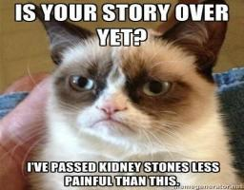
Etiology
Prerenal (Hemodynamic)
Renal parenchymal (intrinsic)
Postrenal
  Obstruction or diversion of urine flow
    Increased intratubular pressure and decreased GFR
    May lead to impaired blood flow and initiation of inflammatory processes that also contribute to GFR
    May lead to parenchymal injury
  Urethral obstruction
  Ureteral obstruction
  Rupture of the urinary tract

Slide 13
Etiology
In human medicine - most common triggers
  Sepsis
  Major surgery – ie open heart
  Acute decompensated heart failure

Slide 14
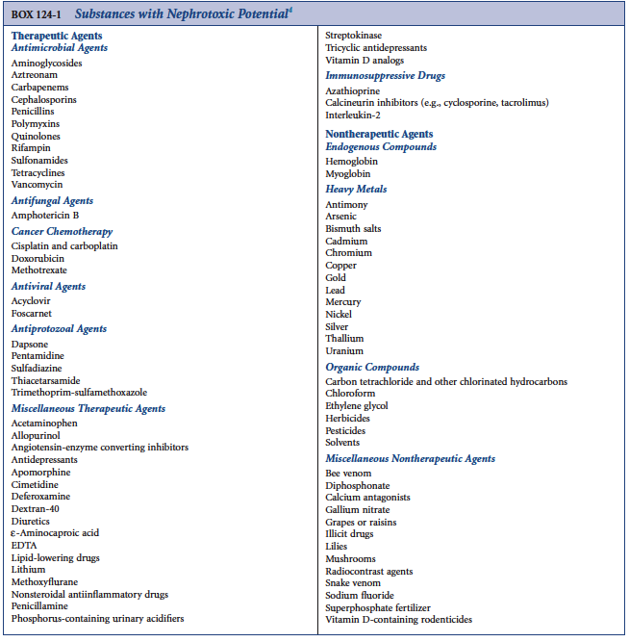

Slide 15
Pathophysiology – ATN
Acute tubular necrosis
Requires histological diagnosis
  Tubular damage
  Collapse of glomerular tuft (hypoperfusion)
  Interstitial edema
  Vascular congestion / accumulation of leukocytes
Notes:
Requires HISTO
Rarely acquired
Rarely contain sufficient medullary tissue
Damage not contained to the tubules

Slide 16
Pathophysiology – ATN
Acute tubular necrosis
Requires histological diagnosis
  Tubular damage
    Primary site of damage
    Tubular epithelial cell necrosis – rare
    Detachment of tubular epithelial cells from the basement membrane
    Sloughing of cells into tubular lumen
    Effacement and loss of brush border in proximal tubular segments
    Formation of tubular casts derived from sloughed cells/debris/protein
    Signs of regeneration generally seen
  Collapse of glomerular tuft (hypoperfusion)
  Interstitial edema

Slide 17
Pathophysiology – ATN
Acute tubular necrosis
Requires histological diagnosis
  Tubular damage
  Collapse of glomerular tuft (hypoperfusion)
  Interstitial edema
  Vascular congestion / accumulation of leukocytes

Slide 18
Pathophysiology – ATN
Acute tubular necrosis
Requires histological diagnosis
  Tubular damage
  Collapse of glomerular tuft (hypoperfusion)
  Interstitial edema
    Leakage of fluid from increased microvascular permeability
    Backleak of tubular filtrate into interstitium

Slide 19
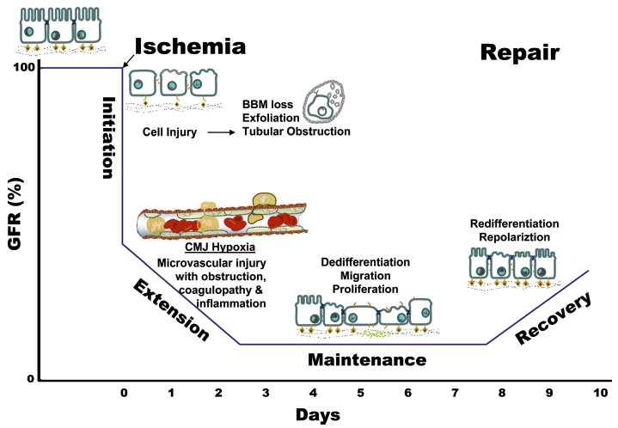
Pathophysiology of AKI

Slide 20
Pathophysiology
4 phases of AKI
Initiation
  Prolonged renal ischemia or prolonged pre-renal state → direct injury to both tubular epithelial cells and endothelial cells
  GFR decreases (intra-renal vasoconstriction)
  Tubular obstruction from epithelial cell casts and necrotic debris
  Back-leak of GFR thru damaged epithelium
  May not be biochemically evident
  Intervention may prevent progression
Extension
Maintenance
Recovery

Slide 21
Pathophysiology
4 phases of AKI
Initiation
Extension
  Continued hypoxia
  Ongoing endothelial and tubular injuries lead to activation of inflammatory mediators that amplify cellular injury
  Cellular injury progresses to cell death (apoptosis and necrosis)
    Outer medulla
  Cellular repair and improvement
    Proximal tubular cells of outer medulla
  Biochemical derangements / clinical manifestations are evident
Maintenance
Recovery

Slide 22
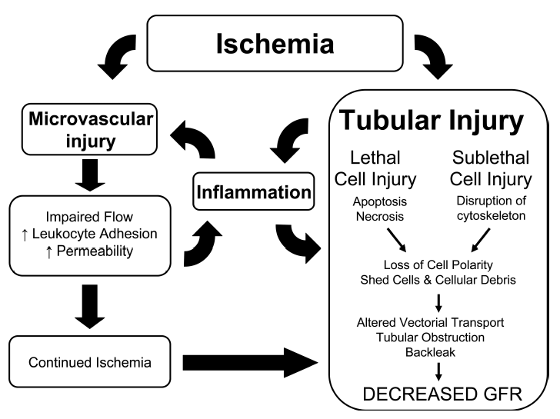
Pathophysiology - Extension

Slide 23
Pathophysiology
4 phases of AKI
Initiation
Extension
Maintenance
  Cell death and regeneration occur simultaneously
  GFR stabilizes at low level
  Uremic complications arise
  Removal of the inciting cause may allow shift to regeneration but does not alter existing damage
  Lasts 1-2 weeks
Recovery

Slide 24

Pathophysiology
4 phases of AKI
Initiation
Extension
Maintenance
Recovery
  Tubular epithelial cell repair and regeneration
  Improvement in GFR and tubular function
  Weeks to months

Slide 25

Pathophysiology
Hemodynamic changes
SNS activation
RAAS
Endothelin
Tubuloglomerular feedback
Prostaglandins
Platelet activated factor
Alterations in vascular function

Slide 26
Pathophysiology
Hemodynamic changes
SNS activation
  Enhance renal vascular resistance during AKI → reduce RBF
  Stimulus for renin secretion
RAAS
Endothelin
Tubuloglomerular feedback
Prostaglandins
Platelet activated factor
Alterations in vascular function

Slide 27
Pathophysiology
Hemodynamic changes
SNS activation
RAAS
  Angiotensin II may contribute to decreased blood flow
  Little evidence to determine role of Ang II in AKI
  Blockade of Ang II increases risk of AKI in patients undergoing cardiac sx
Endothelin
Tubuloglomerular feedback
Prostaglandins
Platelet activated factor
Alterations in vascular function

Slide 28
Pathophysiology
Hemodynamic changes
SNS activation
RAAS
Endothelin
  Renal vasoconstrictor
  Decreases GFR
  May be elevated in AKI
Tubuloglomerular feedback
Prostaglandins
Platelet activated factor
Alterations in vascular function

Slide 29
Pathophysiology
Hemodynamic changes
SNS activation
RAAS
Endothelin
Tubuloglomerular feedback
  Sublethal tubular damage → impaired Na transport →activate proximal TGF feedback → inc afferent vascular resistance and a concomitant decrease in GFR
  Extent to which TGF contributes to AKI is unknown
Prostaglandins
Platelet activated factor
Alterations in vascular function

Slide 30
Pathophysiology
Hemodynamic changes
SNS activation
RAAS
Endothelin
Tubuloglomerular feedback
Prostaglandins
  During renal hypoperfusion generation of vasodilatory prostaglandins incl PGE2 promote maintenance of renal perfusion
  COX-2 inhibitors – exacerbate reductions in GFE and medullary blood flow in endotoxemia induced by LPS
Platelet activated factor
Alterations in vascular function

Slide 31
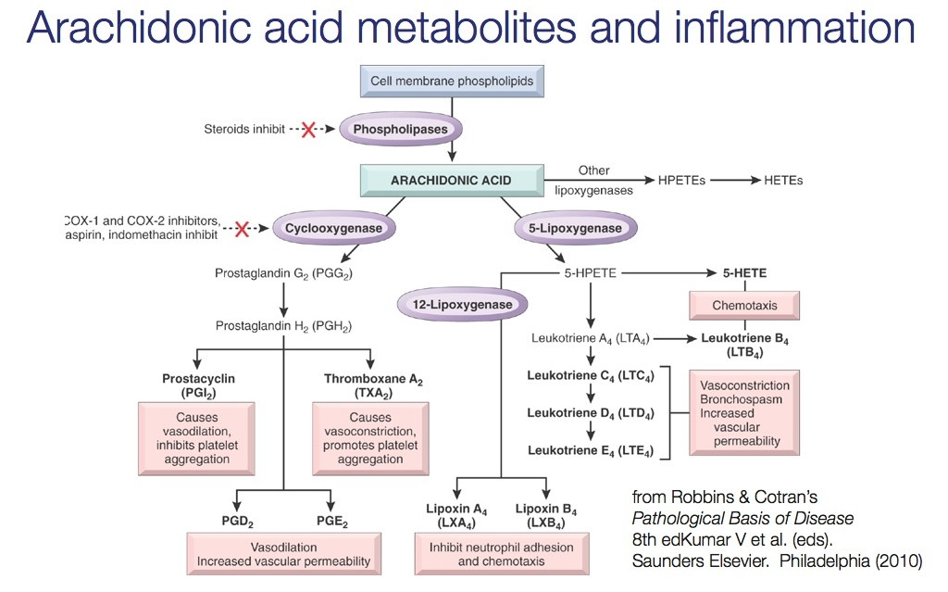

Slide 32
Pathophysiology
Hemodynamic changes
SNS activation
RAAS
Endothelin
Tubuloglomerular feedback
Prostaglandins
Platelet activated factor
  Reductions in GFR and RBF
  Directly stimulate afferent arteriole constriction
Alterations in vascular function

Slide 33
Pathophysiology
Hemodynamic changes
SNS activation
RAAS
Endothelin
Tubuloglomerular feedback
Prostaglandins
Platelet activated factor
Alterations in vascular function
  Direct damage to the renal vasculature may alter its activity
  Impaired eNOS function
  Release of ROS may influence effects of vaso- constrictors/dilators
Notes:
Increased renal superoxide promotes vasoconstriction and enhances reactivity of ANG II in renal cortex
Superoxide may block normal homeostatic mechanism maintaining medullary perfusion - antiox may normalize

Slide 34
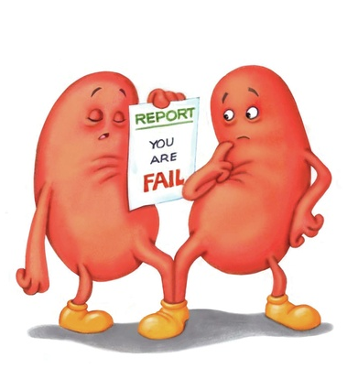
Diagnosis
Complete blood count
Biochemical profile
Urinalysis
Urine culture
Diagnostic imaging
GFR measurements
Infectious disease testing

Slide 35
Diagnosis
Complete blood count
  HCT
    Increased – dehydration
    Decreased – GI loss / hemolysis
  Platelet count – low to normal; Uremia can induce thrombocytopathy
  Leukocytosis – with infection
Biochemical profile
Urinalysis
Urine culture
Diagnostic imaging
GFR measurements
Infectious disease testing

Slide 36
Diagnosis
Complete blood count
Biochemical profile
  Azotemia
    BUN:Creatinine ratio – hi: GI bleeding, low: early AKI
  Ionized calcium – normal to low
  AG – high
Urinalysis
Urine culture
Diagnostic imaging
GFR measurements
Infectious disease testing

Slide 37
Diagnosis
Complete blood count
Biochemical profile
Urinalysis
  USG - May be isosthenuric in instinsic failure
  Nonhyperglycemic glucosuria, Proteinuria, Bilirubinuria, Hemoglobinuria
  Generally acidic urine
  Sediment abnormalities – Pyuria, Casts , Crystals
Urine culture
Diagnostic imaging
GFR measurements
Infectious disease testing

Slide 38
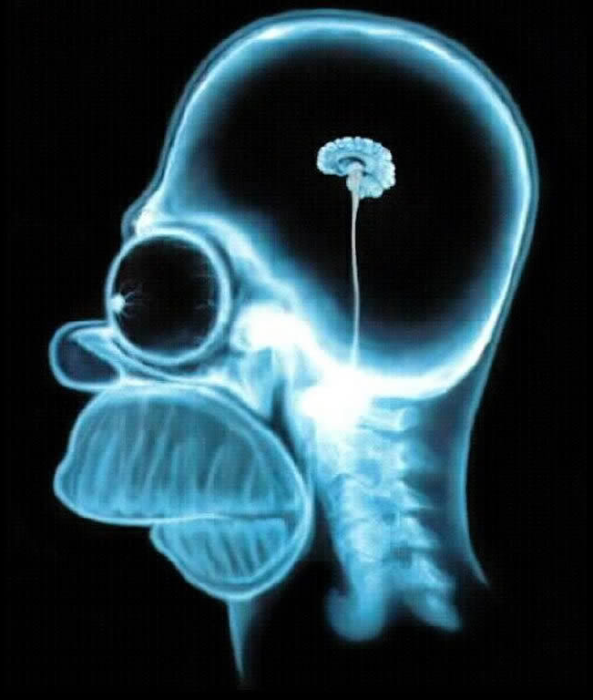
Diagnosis
Complete blood count
Biochemical profile
Urinalysis
Urine culture
Diagnostic imaging
  Radiographs – renoliths, ureteroliths, evaluating renal silhouette
  Ultrasound – normal to enlarged kidneys, perirenal fluid, pelvic dilation, changes to architecture
GFR measurements
Infectious disease testing

Slide 39
Diagnosis
Complete blood count
Biochemical profile
Urinalysis
Urine culture
Diagnostic imaging
GFR measurements
  Iohexol clearance, endogenous creatinine clearance, scintigraphy
Infectious disease testing

Slide 40
Diagnosis
Complete blood count
Biochemical profile
Urinalysis
Urine culture
Diagnostic imaging
GFR measurements
Infectious disease testing
  Leptospira titers/PCR
  RMSF, Lyme, Babesia, Leishmania, Ehrlichia – regionally useful

Slide 41
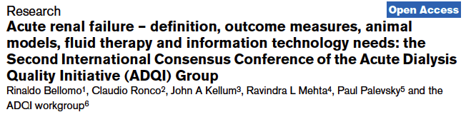
Diagnosis – Scoring systems
RIFLE criteria
Developed a consensus definition for AKI
RIFLE criteria
  Risk, Injury, Failure, Loss, End stage disease
  Serum creatinine, urine output changes, GFR
  Criteria that leads to the worst possible classification should be used

Slide 42
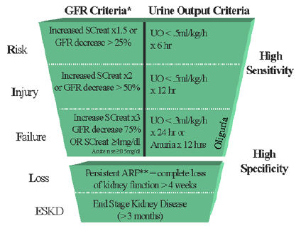
RIFLE criteria

Slide 43
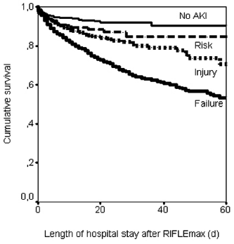
RIFLE Criteria
Risk, Injury, Failure – associated with increased hospital mortality
Risk – high risk for progression to I or F
I and F – increased risk of mortality and increased length of stay compared to R.

Slide 44
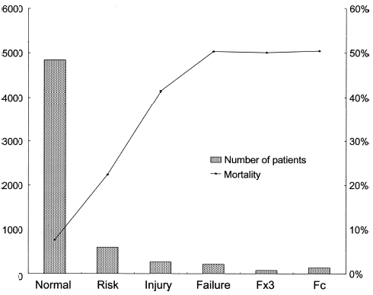
RIFLE Criteria
>20K patients
All categories were significantly at risk for hospital mortality
  Odds ratio:
    Risk – 2.5
    Injury – 5.4
    Failure – 10.1

Slide 45
RIFLE Criteria
Strengths
Limitations
Validated in determining incidence of AKI and prognostic stratification
Facilitated ID of AKI patients
Increase in mortality with increasing severity
Good predictor of mortality
Baseline creatinine needed
Creatinine is a relatively insensitive marker of renal function
Creatinine does not correlate with histopathological lesions
UO can be altered by diuretics, requires catheter
Etiology not considered

Slide 46

Scoring system – AKIN
Acute Kidney Injury Network – www.akinet.org
Modification to the RIFLE criteria
Does not include GFR criteria
Lesser increase in creatinine required to move from stage 0 to 1 compared to RIFLE.

Slide 47
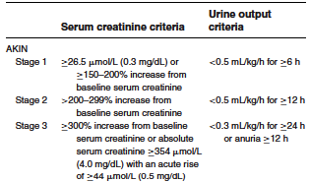
AKIN scale

Slide 48
AKIN
Strengths
Limitations
Patients are to be considered adequately hydrated before assessing AKI status
Removes GFR
Does not need baseline creatinine to score, does req at least 2 measurements within 48h
Does not allow ID of AKI when creatinine increase occurs >48h
Stage 3 – limited diagnostic acuity due to variability in RRT treatment

Slide 49
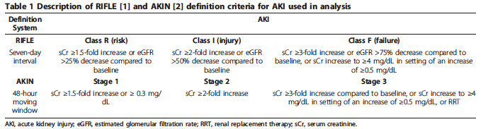
RIFLE vs AKIN
More patients diagnosed via AKIN then RIFLE
Both showed worse outcomes with increased severity of AKI
Lower predictive ability of RIFLE for mortality
AKIN may lead to overdiagnosis.
Notes:
4800 patients – retrospective study

Slide 50
Combined definition
Increase in serum creatinine ≥0.3mg/dL (≥26.5umol/L again for the damn foreigners) within 48 hours
Increase in serum creatinine to ≥1.5x baseline (≥1.5 in SI units also) within 7 days
Urine ovlume <0.5ml/kg/hr for 6 hours
Staged in severity according to AKIN criteria
Biomarkers???

Slide 51
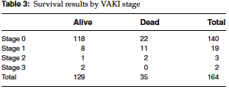
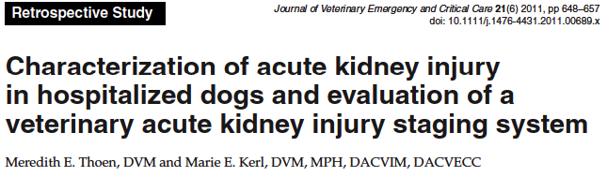
Scoring system – VAKI
Veterinary Acute Kidney Injury Score
Retrospective
  164 dogs – scoring system retrospectively applied
  Dogs classified into stages 1-3 were less likely to survive to discharge
  Only 4/19 dogs in stage 1 had creatinine levels above the reference range.

Slide 52
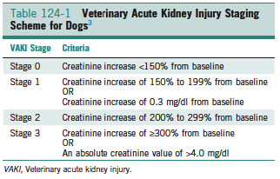
VAKI scoring system

Slide 53
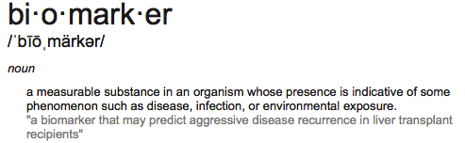
Biomarker:
Ideal characteristics:
  Noninvasive, easy to perform (bedside), or in standard lab, using easy to obtain samples (blood, urine)
  Rapidly and reliably measurable using standardized assay
  Highly sensitive to facilitate early detection and risk stratification
  Exhibit strong performance statistically
NGAL (neutrophil gelatinase-associated lipocalin
Cystatin C
KIM-1 (kidney injury molecule-1)

Slide 54
Diagnosis - NGAL
NGAL (neutrophil gelatinase-associated lipocalin)
  Plasma and urine
  Originally identified as a 25 Kda protein covalently bound to gelatinase from neutrophils
  Normally expressed in low levels in several tissues
  Rapidly increased (within hours)
  Sensitive, specific and highly predictive biomarker of AKI
  Currently seems to be the best indicator of early AKI

Slide 55
Diagnostics – Cystatin C
Cysteine protease inhibitor synthesized and released into blood at relatively constant rate by all nucleated cells
Freely filtered by glomerulus – completely reabsorbed by proximal tubule.
Urinary excretion of cystatin C has been shown to predict the requirement for RRT in patients with AKI 1 day earlier than increases in serum creatinine

Slide 56
Diagnostics – KIM-1
Kidney injury molecule-1
  Transmembrane protein that is highly overexpressed in dedifferentiated proximal tubule cells after ischemic or nephrotoxic AKI in animal models
  Proteolytic processed domain is easily detected in the urine
  Appears to be increased within hours of insult, but max at 24hr
  Seems more specific to ischemic or nephrotoxic injury, not affected by CKD or UTI.
  Perhaps used in a panel?

Slide 57
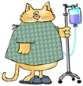
Treatment
Treatment of underlying disease
Fluid therapy
  Maintenance
  +Correct hydration deficit
  + Accounting for polyuria
  Colloids – no benefit over crystalloids
  Anuria/Oligouria
    Patients at risk for overhydration
    Insensibles only
    No fluid therapy

Slide 58
Treatments - Diuretics
Why considered?
  Increase urine output to prevent AKI
  Achieve fluid balance
  Hasten renal recovery
  Decrease progression to CKD
Notes:
Prevent AKI theory: decreasing GFR and tubular workload (ie decreased medullary sodium reabsorption) in AKI can contribute to an improved oxygen supply/demand relationship by reducing O2 consumption and increasing medullary oxygenation, thus protecting nephron from further ischemic injury

Slide 59

Treatment – Furosemide
Rationale:
  Prevention of tubular obstruction
  Reduction of medullary oxygen consumption
  Increase renal blood flow
Studies have shown conflicting results…
  Patients with normal renal function undergoing cardiac surgery:
  Increased urine flow and fractional excretion of sodium; decreases in GFR, filtration fraction, tubular sodium reabsorption and renal O2 consumption.
Notes:
Loop diuretics have been shown to protect the chronically hypoxia juxtamedullary regions during oxidative stress by decreasing GFR and tubular workload.

Slide 60
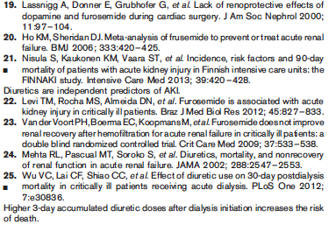
Diuretics – Furosemide
Summary of studies
  CRI associated with higher post-op creatinine, higher incidence of AKI (19)
  Ineffective…detrimental in prevention of AKI (Meta-analysis) (20)
  Increased risk of AKI (OR 1.68, CI 1.41-2) (21)
  Assoc with 3-5x inc risk for AKI. In established AKI – no reduction in RRT need, no shortened duration of AKI (23)

Slide 61


Diuretics - Furosemide

Slide 62
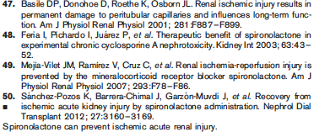
Diuretics – Spironolactone
Summary of studies
Inhibited renal vasoconstriction (48)
Prevented reduction in renal blood flow, decreased tubular apoptosis and incidence of AKI (49, 50)
Protection: decreased oxidative stress and upregulation of eNOS expression(49, 50)
Treatment before or after ischemic event prevented progression to CKD (51)

Slide 63
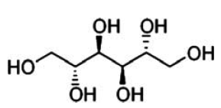

Diuretics - (Mannitol)
MOA
Osmotic diuretic
  Freely filtered thru tubules – not reabsorbed, therefore remains osmotically active.
Causes release of renal prostaglandins
Free radical scavenger
  Reduces harmful effects of free radicals during ischemia-reperfusion injury

Slide 64
Diuretics – Mannitol
Proposed benefits in AKI
Causes increase in sodium delivery to distal tubules and causes osmotic diuresis
  “flushing” – may reduce accumulation of necrotic cells and debris
  Must be administered before clogging occurs
Improves RBF
  Local protection of vasodilating prostaglandins
  Reduction in renin production
  Questionably helpful
Reduces post-ischemic endothelial cell swelling
Decreases ischemic-reperfusion injuries thru free radical scavenging

Slide 65
Diuretics – Mannitol
Side effects
Initial volume expansion
Subsequent hypovolemia, hypotension, metabolic acidosis, electrolyte imbalance
  Hypernatremia, hypokalemia
Can cause AKI
  Large doses
  Intra-renal vasoconstriction and intravascular volume depletion
Hyperosmolality →neuro complications

Slide 66
Diuretics – Mannitol
Is it helpful?
Results of clinical studies - conflicting
  Failed to show protective effect (cardiac, abdominal aortic surgery)
  Reduce incidence of AKI (renal transplant)
  Increase GFR (severe trauma/sx, post-op cardiac sx)
  Increased urine flow, increased renal blood flow, decrease in renal vascular resistance (post-op cardiac sx)
  Metaanalysis – mannitol conveys no additional benefit over adequate hydration in patients at risk for AKI. Detrimental in the mgt of contrast induced nephropathy

Slide 67
Diuretics – Mannitol
Clinical uses
Standard of care for mgt of intracranial hypertension
Little evidence to support use for other indications
  Renal protection during cardiac and vascular sx
  After renal transplantation
  Where adequate hydration appears effective

Slide 68
Diuretics – Natriuretic peptides
MOA: selective dilation of afferent arterioles and constriction of the efferent arterioles → increased GFR without affecting RBF
Induce diuresis / natriuresis by blocking angiotensin-stimulated sodium and water absorption in proximal tubules.
Effectiveness in AKI has not been proven.
Did not reduce incidence of dialysis or all cause mortality. Reduced incidence of AKI.

Slide 69
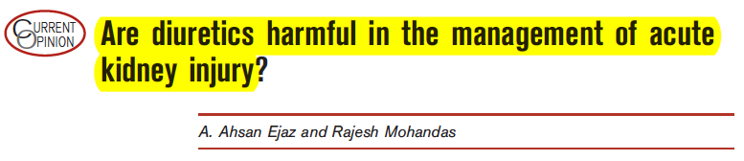
Treatment
Diuretics - Bottom line
Furosemide:
  Bottom line: Do not use to prevent or treat AKI, unless used in the management of volume overload.
Spironolactone:
  May be useful in preventing progression to CKD, may be beneficial in AKI
  No clinical studies to support its use
Mannitol:
  No proven benefit
Natriuretic peptides:
  No proven benefit in their use

Slide 70

Treatment - Dopamine
Why used?
  Increase RBF and natriuresis / diuresis.
Prospective randomized controlled trial of 328 patients
  “Low dose” 2 mcg/kg/min dopamine or equivalent
    Use of higher doses may confer β-adrenergic effect that could be achieved with other pressors
  Results:
    NSD in creatinine during treatment, creatinine increase during treatment, incidence of creatinine >300umol/L (3.9mg/dL for us dumb Americans), need for RRT, death, hospitalization length.
Notes:
Concerns of dopamine safety: dec serum prolactin →transient decrease in T cell fxn →immunosuppression?, dec growth hormone and thyrotropin. (growth hormone can contribute to neg energy balance). Contributed to mucosal hypoxia in experimental model of hemorrhagic shock. Depression of resp drive, proarrhythmic.
Inclusion criteria: CV catheter, 2 or more SIRS markers, at least one marker of renal dysfxn (low UOP, inc creatinine, rise in creatinine)
Dopamine given until: RRT initiated, patient died, serious adverse effect related to trial, SIRS and renal dysfxn improved for 24 hours, patient discharged)

Slide 71
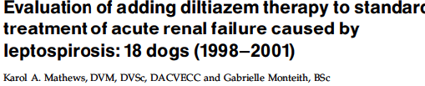
Treatment -
Proposed mechanism –
  Reversal of renal vasoconstriction by causing pre-glomerular dilation
  Natriuresis independent of GFR
  Effective inhibition of tubuloglomerular feedback induced pre-glomerular vasoconstriction
Enrolled 18 dogs suspicious to have leptospirosis. Not blinded. Not randomized.
  Diagnosis confirmed by convalescent titers in 16 dogs
Diltiazem added 12-60 hours after standard therapy initiated (n=11)
  0.3-0.5mg/kg IV slow bolus then 3-5mcg/kg/min CRI
Primary measurement was creatinine
  NSD on admission
Notes:
Std therapy – fluids +/- lasix, +/- dopamine, and ampicillin

Slide 72
Treatments - Diltiazem
Results:
  Creatinine reduced faster
    Still took 48-72 hours for drop to be statistically significant
  No clinically significant hypotension
Limitations:
  Not blinded, not randomized (clinically ill-er dogs in diltiazem)
  Small study sized – not powered
Question for discussion….clinical utility of diltiazem in AKI…

Slide 73
Treatment - RRT
No randomized, controlled, prospective studies to indicate if IHD vs CRRT is superior.
Cochrane meta-analysis of 15 trials / 1550 patients:
  CRRT did not differ significantly from IHD with respect to overall mortality, in-hospital mortality, number of patients that did not require ongoing RRT.
  CRRT patients had higher mean arterial pressures
When to initiate?

Slide 74
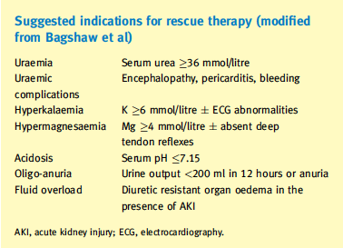
Treatments – RRT

Slide 75
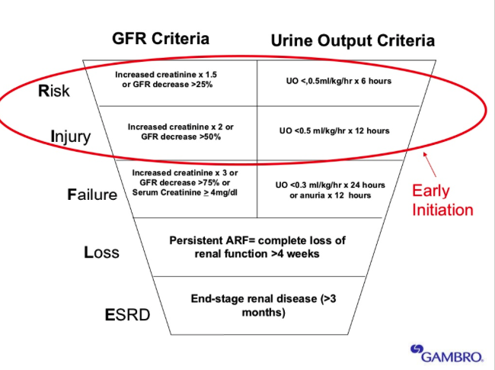
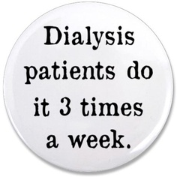
Treatments – Renal replacement therapy

Slide 76
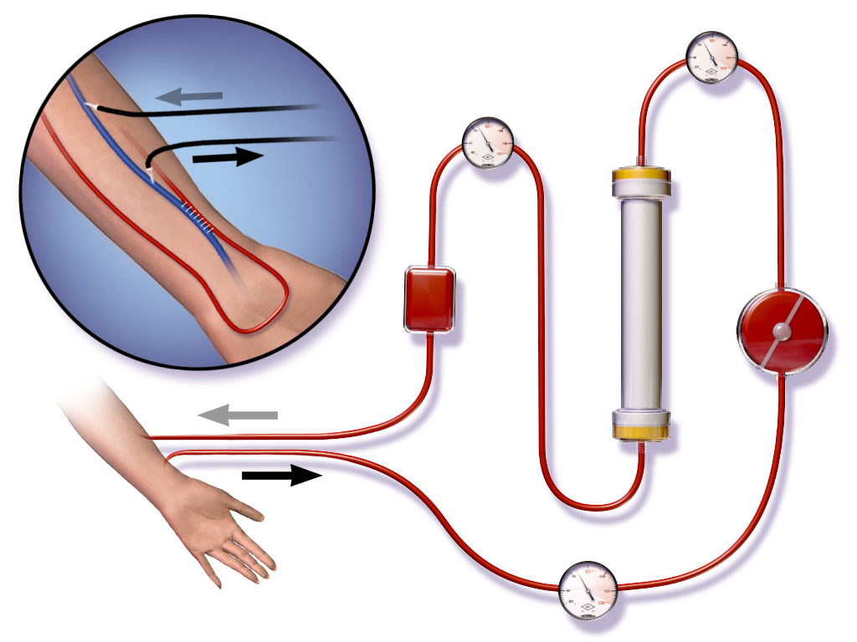
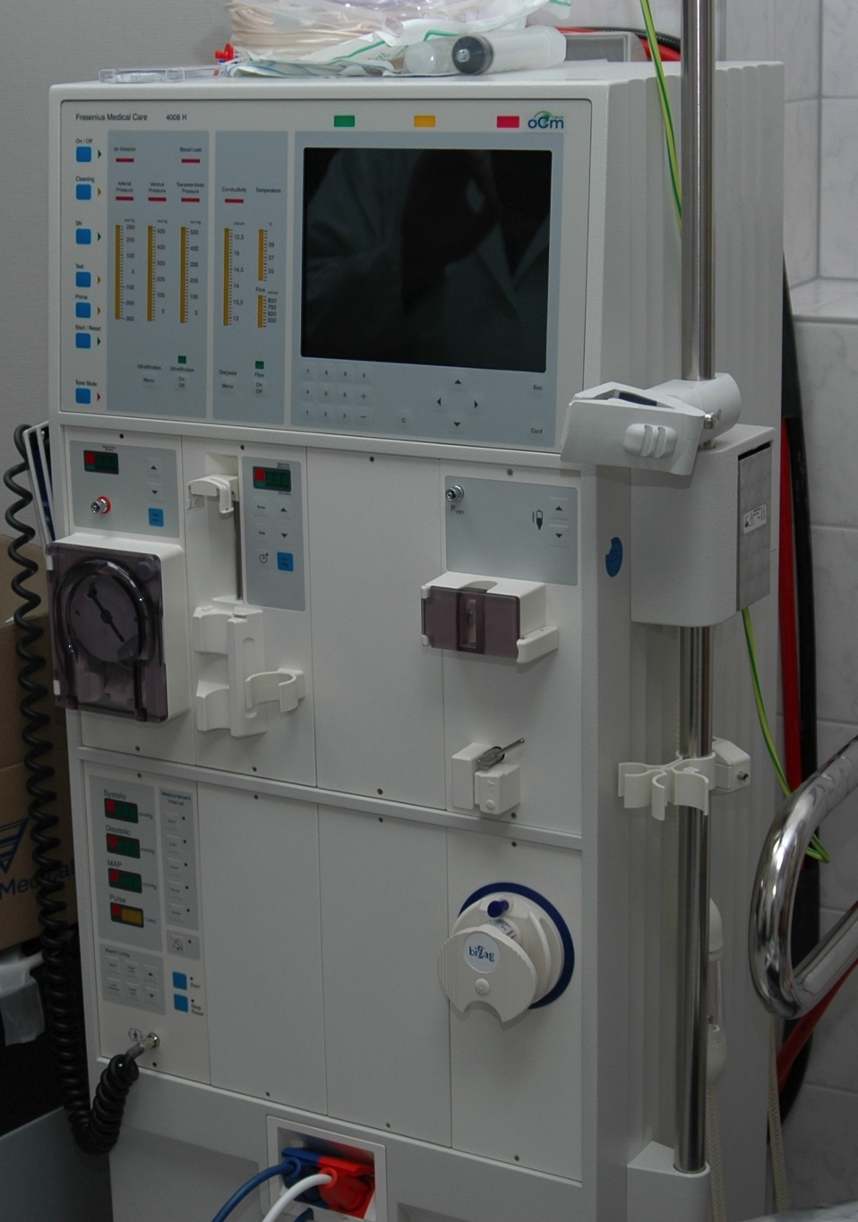
Treatments –IHD
Notes:
Blood taken from patient travels thru filter – filter determines what is filterable, clean blood returned to patient, toxins dumped.

Slide 77
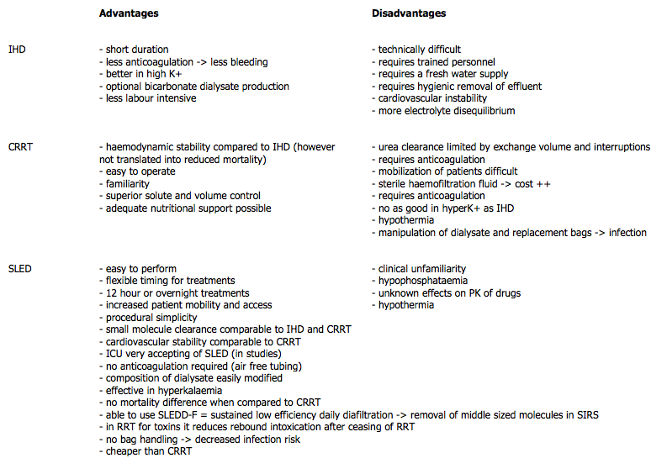
Treatments -IHD
Extracorporeal removal of waste products
Short duration treatments

Slide 78
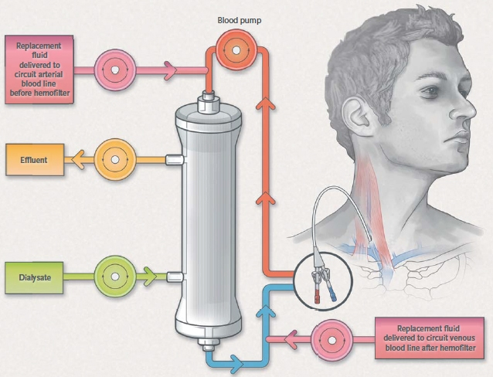
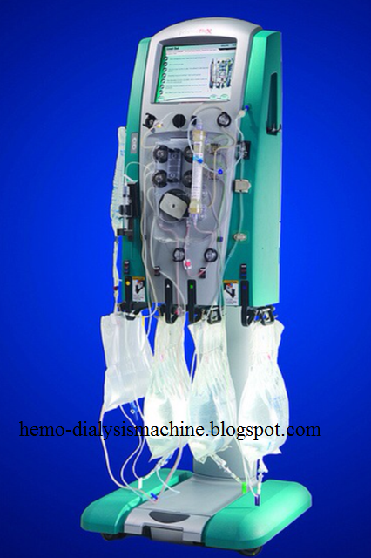
Treatments - CRRT

Slide 79
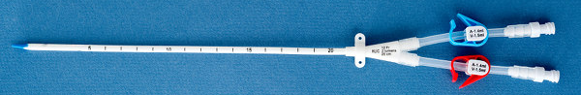
Treatments - CRRT
Gradual – more approx. normal kidney function
Superior control of uremia vs IHD
Some report superior electrolyte balance and acidosis control
Portable, cage side
Packaged dialysate solutions available
Specialized catheters

Slide 80
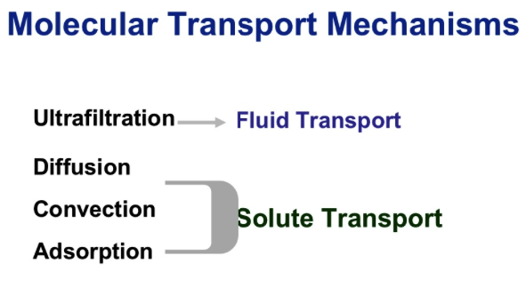
CRRT basics…
http://www.slideshare.net/HammerheadNC/1-prismaflex-crrt-intro-seg-1-2007-7394701

Slide 81
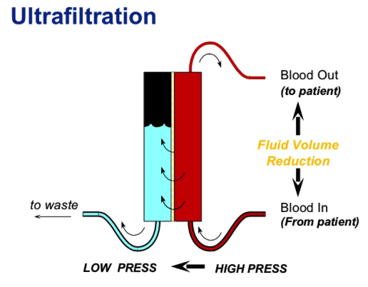
Ultrafiltration
Movement of fluid thru a semi-permeable membrane caused by a pressure gradient
Positive, negative and osmotic pressure exerted from non-permeable solutes
Reduces volume of blood returned
Potentially ideal for volume overload states incl. CHF.

Slide 82
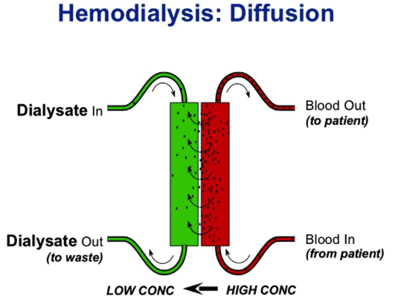
Diffusion
Movement of solutes from an area of higher concentration to an area of lower concentration
Dialysate is used to create a concentration gradient across a semi-permeable membrane

Slide 83
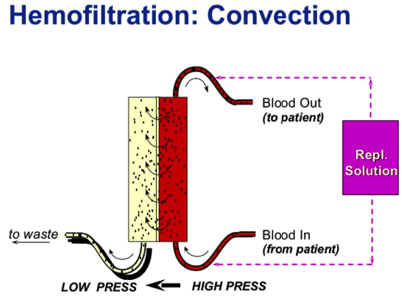
Convection
Movement of solutes with water flow
  “solvent drag”
The more fluid moved thru a semi-permeable membrane, the more solutes that are removed
Replacement fluid is used to create convection

Slide 84
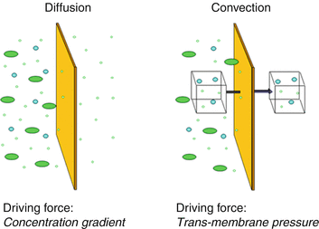
Diffusion vs Convection

Slide 85
Treatments – CRRT
Complications
Clotting of the circuit
Vascular access
Patient size – prime volume
Hypotension
Arrhythmias
Fluid balance and electrolyte disturbances
Nutrient losses
Hypothermia
Bleeding
Drug dosings – dialyzed out?

Slide 86
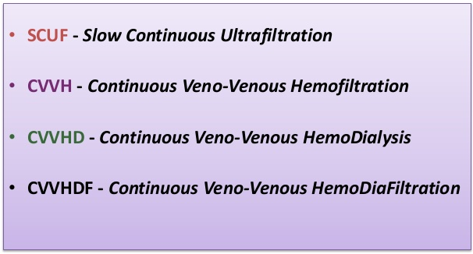
CRRT - modalities

Slide 87
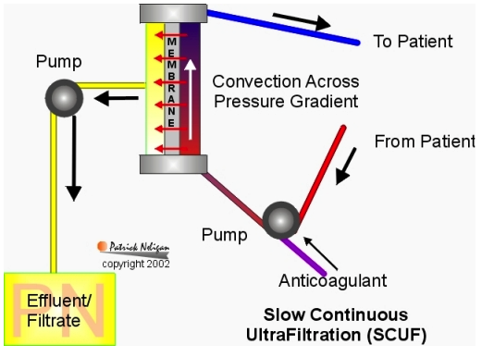
Slow Continuous UltraFiltration
SCUF
Used for volume control in fluid overloaded patients.
SCUF does not require the use of replacement fluid.
http://www.ccmtutorials.com/renal/rrt/page9.htm

Slide 88
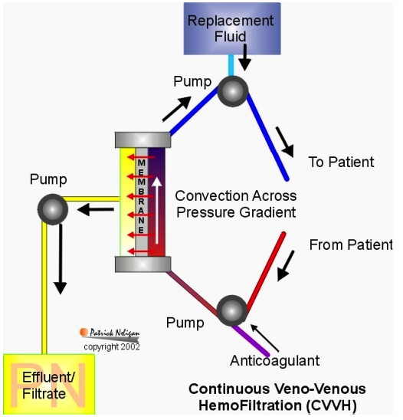
Cont. VenoVenous Hemofiltration
CVVH
Form of convective dialysis.
The ultrafiltration rate is high
Replacement electrolyte solution is required to maintain hemodynamic stability. Infused pre- or post-filter.
Clears small, medium and large sized solutes
Solute removal determined by replacement fluid rate

Slide 89
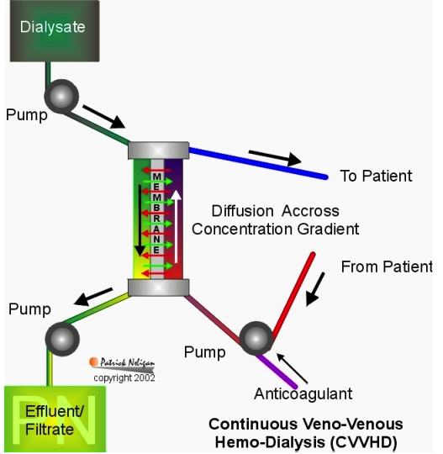
Cont. VenoVenous HemoDialysis
CVVHD
Continuous diffusive dialysis
Dialysate driven in a direction countercurrent to the blood.
Removal of small molecules
Solute removal determined by dialysate flow rate
Notes:
One of the more commonly used modes in AKI

Slide 90
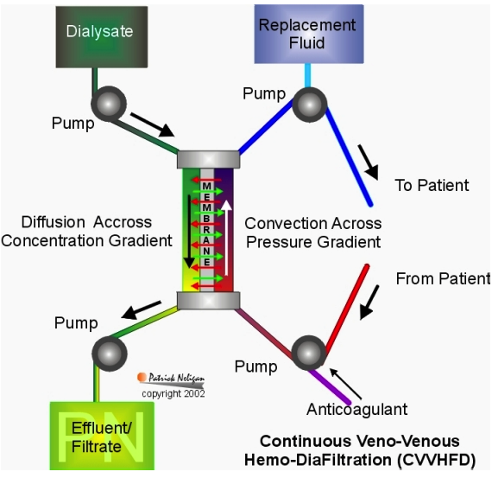
Cont. VenoVenous HemoDiaFiltration
CVVHDF
Combines convective and diffusive dialysis
Removal of small and middle molecules are cleared
Both dialysate and replacement fluids are required
Solute removal determined by replacement and dialysate flow rates
Notes:
Other most commonly used mode in AKI

Slide 91
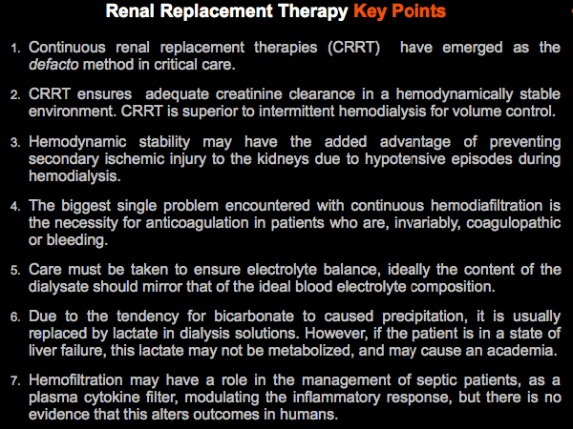
RRT Key points

Slide 92
RRT – Comparing techniques

Slide 93
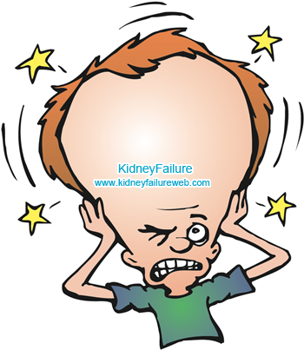
Dialysis dysequilibrium syndrome
Self-limited condition:
  Nausea, vomiting, headache, altered consciousness, and rarely seizures or coma.
  Typically occurs after a first dialysis in very uremic patients.
  Triggered by rapid movement of water into brain cells following the development of transient plasma hypo-osmolality as solutes are rapidly cleared from the bloodstream during dialysis.
  Incidence of this complication has fallen in recent years
    More gradual institution of dialysis
    Precise prescription of dialysis to include such variables as membrane size, blood flow rate, and sodium profile.

Slide 94
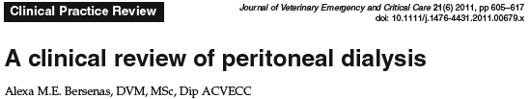
Treatment – Peritoneal dialysis
Allows removal of metabolic wastes and water by administration of large amount of dialysis solution into the peritoneal cavity.
Fluid exchange – osmosis (ultrafiltration) – osmotic gradient created by presence of osmotic agents (dextrose) in dialysate. Draws fluid into peritoneal cavity
Solute exchange – diffusion and convection – waste products in higher concentraiton in the blood diffuse across peritoneum into dialysate and are removed.
Less effective than CRRT or IHD

Slide 95
Treatment - PD
Less likely to develop dialysis dysequilibrium syndrome (vs IHD)
Will not replace full kidney functionality
Not recommended for patients with:
  Severe coagulopathy
  Vascular leak state
  Severe hypoalbuminemia
  Recent surgery
  Presence of hernia
  Peritonitis

Slide 96
Treatment - PD
Diasylate
  Commercial – Dianeal©
  Homemade – LRS+dextrose (1.5% to 4.25%)
    Higher dextrose concentrations makes soln hyperosmolar – enhances osmotic gradient favoring movement of fluid from the blood into peritoneal cavity
    Risk of dehydration, hypovolemia.
Prognosis
  27% survival to discharge
  80% Lepto (5 dogs)

Slide 97
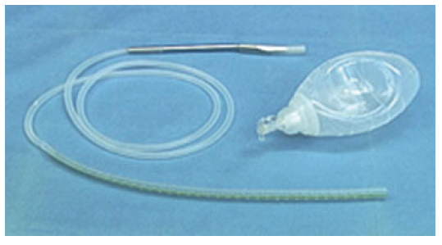

Treatment – PD
PD catheter
Reliable, rapid flow of dialysate
Silicone or polyurethane
Numerous side holes
  Omentum obstructs
  Tenckhoff
    Mini-surgical approach
    Ex lap
    Percutaneous blind
    Fluoroscopy guided

Slide 98





Slide 99
Treatment - PD
Infusion of warmed dialysis fluid into peritoneal cavity
  10-20ml/kg, initially. Increase to 30-40ml/hr if tolerating well
  Gravity flow or infusion pump over 5-10 minutes
Dwell (20min-6 hr)
  Fluid and solute are exchanged across the peritoneum
Removal of dialysis fluid
  Gravity
Wash, Rinse, Repeat. 24/7. 3-7 days. Ugh.
Continue until sufficient improvement noted on biochemical analysis, urine output, clinical improvement noted.

Slide 100



Slide 101

Treatment – PD
Complications
Catheter obstruction/migration
Dialysate leak
Inadequate dialysis
Hypoalbuminemia
Electrolyte abnormalities
Pelvic limb edema
Pleural effusion
Catheter-exit-site infections
Peritonitis

Slide 102
Treatment – PD
Complications
Catheter obstruction/migration
  Common issue reported – kinking, migration, fibrous adhesions, omental wrappings, fibrin/blood clots
  Fibrinolytic agents have been used in human medicine (tPA)
Dialysate leak
Inadequate dialysis
Hypoalbuminemia
Electrolyte abnormalities
Pelvic limb edema
Pleural effusion
Catheter-exit-site infections
Peritonitis

Slide 103
Treatment – PD
Complications
Catheter obstruction/migration
Dialysate leak
  Ensure tight seal when placing
  Try smaller volumes if leak continues
Inadequate dialysis
Hypoalbuminemia
Electrolyte abnormalities
Pelvic limb edema
Pleural effusion
Catheter-exit-site infections
Peritonitis

Slide 104
Treatment – PD
Complications
Catheter obstruction/migration
Dialysate leak
Inadequate dialysis
  Limited by surface area and permeability characteristics of peritoneal cavity
  Especially in larger patients
Hypoalbuminemia
Electrolyte abnormalities
Pelvic limb edema
Pleural effusion
Catheter-exit-site infections
Peritonitis

Slide 105
Treatment – PD
Complications
Catheter obstruction/migration
Dialysate leak
Inadequate dialysis
Hypoalbuminemia
  Loss into protein dialysate, uremic catabolism, low intake, GI losses
  Enteral feeding necessary to ensure adequate protein intake
  Anti-emetics to prevent vomiting
Electrolyte abnormalities
Pelvic limb edema
Pleural effusion
Catheter-exit-site infections
Peritonitis

Slide 106
Treatment – PD
Complications
Catheter obstruction/migration
Dialysate leak
Inadequate dialysis
Hypoalbuminemia
Electrolyte abnormalities
  Monitor, supplement as needed
Pelvic limb edema
Pleural effusion
Catheter-exit-site infections
Peritonitis

Slide 107
Treatment – PD
Complications
Catheter obstruction/migration
Dialysate leak
Inadequate dialysis
Hypoalbuminemia
Electrolyte abnormalities
Pelvic limb edema
Pleural effusion
  Pleuroperitoneal commnication - whoops
Catheter-exit-site infections
Peritonitis

Slide 108
Treatment – PD
Complications
Catheter obstruction/migration
Dialysate leak
Inadequate dialysis
Hypoalbuminemia
Electrolyte abnormalities
Pelvic limb edema
Pleural effusion
Catheter-exit-site infections
Peritonitis
  Aseptic technique when handling catheter, lines, patient
  Monitoring fluid turbidity, cytology

Slide 109



Treatments- PD Indications

Slide 110

Treatments - summary
Treat underlying cause
Antibiotics – as indicated
IV fluids – judicious use
  Crystalloids
  Colloids
Diuretics –
  Furosemide - only for fluid overload states
  Spironolactone
  Mannitol
  Natriuretic peptides
Diltiazem
Renal replacement therapy

Slide 111
Treatments - summary
Treat underlying cause
Antibiotics – as indicated
IV fluids – judicious use
  Crystalloids
  Colloids
Diuretics –
  Furosemide - only for fluid overload states
  Spironolactone ???
  Mannitol
  Natriuretic peptides
Diltiazem
Renal replacement therapy CRRT > IHD >> PD

Slide 112
Prevention
Controlled volume expansion/resuscitation
  Human: avoid HES formulations
Avoid use of diuretics to prevent or treat AKI
Maintain MAP >60-65 mmHg (potentially higher if hypertension previously diagnosed)
  Norepinephrine as first choice vasopressor
  Avoid lose dose dopamine for prevention of AKI
Promote adequate enteral nutritional intake

Slide 113

Prognosis
Dogs
  Mortality ~60%
  Approx 60% of survivors develop CKD
Cats
  Mortality 40-50%
  Approx 50% of survivors develop CKD
Leptospirosis
  82-86% survival

Slide 114
References…
1. Acierno MJ. Continuous Renal R e p l a c e m e n t Th e r a p y in Dogs and Cats Acute kidney injury Dialysis. Vet. Clin. NA Small Anim. Pract. 2011;41(1):135-146. doi:10.1016/j.cvsm.2010.09.001.
2. Belcher JM, Edelstein CL, Parikh CR. Clinical applications of biomarkers for acute kidney injury. Am. J. Kidney Dis. 2011;57(6):930-40. doi:10.1053/j.ajkd.2010.11.032.
3. Bellomo R, Kellum J a, Ronco C. Acute kidney injury. Lancet 2012;380(9843):756-66. doi:10.1016/S0140-6736(11)61454-2.
4. Bellomo R, Ronco C, Kellum J a, Mehta RL, Palevsky P. Acute renal failure - definition, outcome measures, animal models, fluid therapy and information technology needs: the Second International Consensus Conference of the Acute Dialysis Quality Initiative (ADQI) Group. Crit. Care 2004;8(4):R204-12. doi:10.1186/cc2872.
5. Bennett AJ, Reineke EL. decontamination and intravenous fluid diuresis. 2013;242(8).
6. Bersenas AME. A clinical review of peritoneal dialysis. J. Vet. Emerg. Crit. Care (San Antonio). 2011;21(6):605-17. doi:10.1111/j.1476-4431.2011.00679.x.
7. Bloom CA, Labato MA. Intermittent Hemodialysis for Small Animals. Vet. Clin. NA Small Anim. Pract. 2011;41(1):115-133. doi:10.1016/j.cvsm.2010.11.001.
8. Bragadottir G, Redfors B, Ricksten S. Mannitol increases renal blood flow and maintains filtration fraction and oxygenation in postoperative acute kidney injury : a prospective interventional study. Crit. Care 2012;16(4):R159. doi:10.1186/cc11480.
9. Bragadottir G, Redfors B, Ricksten S-E. Mannitol increases renal blood flow and maintains filtration fraction and oxygenation in postoperative acute kidney injury: a prospective interventional study. Crit. Care 2012;16(4):R159. doi:10.1186/cc11480.
10. Brown N, Segev G, Francey T, Kass P, Cowgill LD. Glomerular Filtration Rate, Urine Production, and Fractional Clearance of Electrolytes in Acute Kidney Injury in Dogs and Their Association with Survival. 2015:28-34. doi:10.1111/jvim.12518.

Slide 115
…
11. Chawla LS, Eggers PW, Star R a, Kimmel PL. Acute kidney injury and chronic kidney disease as interconnected syndromes. N. Engl. J. Med. 2014;371(1):58-66. doi:10.1056/NEJMra1214243.
12. Contrast-induced ATO, Leoncini M, Toso A, Maioli M, Tropeano F. Early High-Dose Rosuvastatin for Contrast-Induced Nephropathy Prevention in Acute Coronary Syndrome Acute Kidney Injury and Myocardial Damage in Patients With. 2014;63(1):5-9. doi:10.1016/j.jacc.2013.04.105.
13. Division N, County H. Renal ischemia / reperfusion leads to macrophage-mediated increase in pulmonary vascular permeability. 1999;55:2362-2367.
14. Dorval P. Management of acute renal failure in cats using peritoneal dialysis: a retrospective study of six cases (2003 e 2007). 2009:107-115. doi:10.1016/j.jfms.2008.06.003.
15. Ejaz a A, Mohandas R. Are diuretics harmful in the management of acute kidney injury? Curr. Opin. Nephrol. Hypertens. 2014;23(2):155-60. doi:10.1097/01.mnh.0000441150.17202.be.
16. Ejaz a A, Mohandas R. Are diuretics harmful in the management of acute kidney injury? Curr. Opin. Nephrol. Hypertens. 2014;23(2):155-60. doi:10.1097/01.mnh.0000441150.17202.be.
17. Endre ZH, Pickering JW, Walker RJ, et al. Improved performance of urinary biomarkers of acute kidney injury in the critically ill by stratification for injury duration and baseline renal function. Kidney Int. 2011;79(10):1119-30. doi:10.1038/ki.2010.555.
18. Eubig PA, Brady MS, Gwaltney-brant SM, Khan SA, Mazzaferro EM, Morrow CMK. Acute Renal Failure in Dogs After the Ingestion of Grapes or Raisins: A Retrospective Evaluation of 43 Dogs (1992–2002). 2005:663-674.
19. Fitzgerald KT. Lily Toxicity in the Cat. TCAM 1990;25(4):213-217. doi:10.1053/j.tcam.2010.09.006.
20. Grau JM, Ph D. Rhabdomyolysis and Acute Kidney Injury. 2009.

Slide 116
…
21. Haase M, Bellomo R, Devarajan P, Schlattmann P, Haase-Fielitz A. Accuracy of neutrophil gelatinase-associated lipocalin (NGAL) in diagnosis and prognosis in acute kidney injury: a systematic review and meta-analysis. Am. J. Kidney Dis. 2009;54(6):1012-24. doi:10.1053/j.ajkd.2009.07.020.
22. Hanna J, Nichol A. Acute renal failure and the critically ill. Anaesth. Intensive Care Med. 2012;13(4):166-170. doi:10.1016/j.mpaic.2012.01.009.
23. Hanna J, Nichol A. Acute renal failure and the critically ill. Anaesth. Intensive Care Med. 2012;13(4):166-170. doi:10.1016/j.mpaic.2012.01.009.
24. Ho KM, Sheridan DJ. Meta-analysis of frusemide to prevent or treat acute renal failure. BMJ 2006;333(7565):420. doi:10.1136/bmj.38902.605347.7C.
25. Hoste E a J, Clermont G, Kersten A, et al. RIFLE criteria for acute kidney injury are associated with hospital mortality in critically ill patients: a cohort analysis. Crit. Care 2006;10(3):R73. doi:10.1186/cc4915.
26. Hoste EAJ, Waele JJ De, Gevaert SA, Uchino S, Kellum JA. Sodium bicarbonate for prevention of contrast-induced acute kidney injury : a systematic review and meta-analysis. 2010;(August 2009):747-758. doi:10.1093/ndt/gfp389.
27. Joannidis M, Forni LG, Groeneveld ABJ, Straaten HMO, Schetz MRC. Prevention of acute kidney injury and protection of renal function in the intensive care unit. 2010;(November 2009):392-411. doi:10.1007/s00134-009-1678-y.
28. Kellum J a, Lameire N. Diagnosis, evaluation, and management of acute kidney injury: a KDIGO summary (Part 1). Crit. Care 2013;17(1):204. doi:10.1186/cc11454.
29. Krawczeski CD, Woo JG, Wang Y, Bennett MR, Ma Q, Devarajan P. Neutrophil gelatinase-associated lipocalin concentrations predict development of acute kidney injury in neonates and children after cardiopulmonary bypass. J. Pediatr. 2011;158(6):1009-1015.e1. doi:10.1016/j.jpeds.2010.12.057.
30. Lameire NH, Bagga A, Cruz D, et al. Acute kidney injury: an increasing global concern. Lancet 2013;382(9887):170-9. doi:10.1016/S0140-6736(13)60647-9.

Slide 117
…
31. Landoni G, Bove T, Székely A, et al. Reducing mortality in acute kidney injury patients: systematic review and international web-based survey. J. Cardiothorac. Vasc. Anesth. 2013;27(6):1384-98. doi:10.1053/j.jvca.2013.06.028.
32. Manuscript A. NIH Public Access. 2014;2(2):1303-1353. doi:10.1002/cphy.c110041.Pathophysiology.
33. Manuscript A. NIH Public Access. 2014;20(1):76-84. doi:10.1053/j.ackd.2012.09.004.Renal.
34. Mathews KA, Monteith G. Evaluation of adding diltiazem therapy to standard treatment of acute renal failure caused by leptospirosis : 18 dogs ( 1998 ^ 2001 ). 2007;17(2):149-158. doi:10.1111/j.1476-4431.2007.00232.x.
35. Mathews K a., Monteith G. Evaluation of adding diltiazem therapy to standard treatment of acute renal failure caused by leptospirosis: 18 dogs (1998?2001). J. Vet. Emerg. Crit. Care 2007;17(2):149-158. doi:10.1111/j.1476-4431.2007.00232.x.
36. Mejía-Vilet JM, Ramírez V, Cruz C, Uribe N, Gamba G, Bobadilla N a. Renal ischemia-reperfusion injury is prevented by the mineralocorticoid receptor blocker spironolactone. Am. J. Physiol. Renal Physiol. 2007;293(1):F78-86. doi:10.1152/ajprenal.00077.2007.
37. Murugan R. Kidney disorders Acute kidney injury Search date December 2009 Kidney disorders Acute kidney injury. 2011;(December 2009):1-36.
38. Nejat M, Pickering JW, Devarajan P, et al. Some biomarkers of acute kidney injury are increased in pre-renal acute injury. Kidney Int. 2012;81(12):1254-62. doi:10.1038/ki.2012.23.
39. Parikh CR, Devarajan P. New biomarkers of acute kidney injury. Crit. Care Med. 2008;36(4 Suppl):S159-65. doi:10.1097/CCM.0b013e318168c652.
40. Park M, Coca SG, Nigwekar SU, Garg AX, Garwood S, Parikh CR. Prevention and Treatment of Acute Kidney Injury in Patients Undergoing Cardiac Surgery: A Systematic Review. Am. J. Nephrol. 2010;31(5):408-418. doi:10.1159/000296277.

Slide 118
…
41. Pascual MT, Soroko S, Chertow GM. Diuretics, Mortality, and Nonrecovery of Renal Function in Acute Renal Failure. 2015;288(20):2547-2553.
42. Pickering JW, Endre ZH. Secondary prevention of acute kidney injury. Curr. Opin. Crit. Care 2009;15(6):488-97. doi:10.1097/MCC.0b013e328332f66f.
43. Redfors B, Bragadottir G, Sellgren J, Swärd K, Ricksten S-E. Acute renal failure is NOT an “acute renal success”--a clinical study on the renal oxygen supply/demand relationship in acute kidney injury. Crit. Care Med. 2010;38(8):1695-701. doi:10.1097/CCM.0b013e3181e61911.
44. Remuzzi G, Benigni A, Finkelstein FO, et al. Kidney failure: aims for the next 10 years and barriers to success. Lancet 2013;382(9889):353-62. doi:10.1016/S0140-6736(13)60438-9.
45. Ricci Z, Cruz D, Ronco C. The RIFLE criteria and mortality in acute kidney injury: A systematic review. Kidney Int. 2008;73(5):538-46. doi:10.1038/sj.ki.5002743.
46. Ross L. A c u t e Ki d n e y I n j u r y in Dogs and Cats. Vet. Clin. NA Small Anim. Pract. 2011;41(1):1-14. doi:10.1016/j.cvsm.2010.09.003.
47. Ross L a, Labato MA. Current techniques in peritoneal dialysis. J. Vet. Emerg. Crit. Care (San Antonio). 2013;23(2):230-40. doi:10.1111/vec.12035.
48. Schrier RW, Wang W. Acute Renal Failure and Sepsis. 2015:159-169.
49. Shawkat H, Chb MB, Mb MW, Frca C, Mortimer A, Ffpmrca F. Mannitol : a review of its clinical uses. 2012:4-7. doi:10.1093/bjaceaccp/mkr063.
Smith OM, Wald R, Adhikari NKJ, Pope K, Weir MA, Bagshaw SM. Standard versus accelerated initiation of renal replacement therapy in acute kidney injury ( STARRT-AKI ): study protocol for a randomized controlled trial. Trials 2013;14(1):1. doi:10.1186/1745-6215-14-320.
51. Stafford JR, Bartges JW. A clinical review of pathophysiology, diagnosis, and treatment of uroabdomen in the dog and cat. J. Vet. Emerg. Crit. Care (San Antonio). 2013;23(2):216-29. doi:10.1111/vec.12033.

Slide 119
…
52. Swärd K, Valsson F, Sellgren J, Ricksten S-E. Differential effects of human atrial natriuretic peptide and furosemide on glomerular filtration rate and renal oxygen consumption in humans. Intensive Care Med. 2005;31(1):79-85. doi:10.1007/s00134-004-2490-3.
53. Thoen ME, Kerl ME. Characterization of acute kidney injury in hospitalized dogs and evaluation of a veterinary acute kidney injury staging system. J. Vet. Emerg. Crit. Care (San Antonio). 2011;21(6):648-57. doi:10.1111/j.1476-4431.2011.00689.x.
54. Tolwani A. Continuous renal-replacement therapy for acute kidney injury. N. Engl. J. Med. 2012;367(26):2505-14. doi:10.1056/NEJMct1206045.
55. Tolwani A. Continuous renal-replacement therapy for acute kidney injury. N. Engl. J. Med. 2012;367(26):2505-14. doi:10.1056/NEJMct1206045.
56. Uchino S, Bellomo R, Goldsmith D, Bates S, Ronco C. An assessment of the RIFLE criteria for acute renal failure in hospitalized patients. Crit. Care Med. 2006;34(7):1913-7. doi:10.1097/01.CCM.0000224227.70642.4F.
57. Vanmassenhove J, Vanholder R, Nagler E, Van Biesen W. Urinary and serum biomarkers for the diagnosis of acute kidney injury: an in-depth review of the literature. Nephrol. Dial. Transplant 2013;28(2):254-73. doi:10.1093/ndt/gfs380.
58. Waits P, Dpi B, Inch DP, et al. Changing DPI in an image.
59. White LE, Hassoun HT. Inflammatory Mechanisms of Organ Crosstalk during Ischemic Acute Kidney Injury. Int. J. Nephrol. 2012;2012:505197. doi:10.4061/2012/505197.
60. Worwag S, Langston CE. Acute intrinsic renal failure in cats: 32 cases (1997–2004). 2008;232(5).
61. Yang B, Xu J, Xu F, et al. Intravascular Administration of Mannitol for Acute Kidney Injury Prevention : A Systematic Review and. 2014;9(1):1-9. doi:10.1371/journal.pone.0085029.
62. Zealand N, Care I, Anzics S, Trials C. Low-dose dopamine in patients with early renal dysfunction : a placebo-controlled randomised trial. 2000;356:2139-2143.

Slide 120



Questions???

