Slide 1
Pipeline Cooling
Alexandra Cheng
Apoorv Gupta

Slide 2
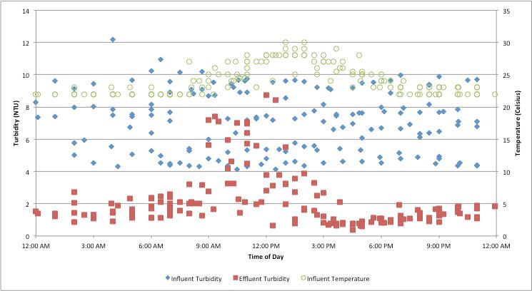
Pipeline Cooling Motivation
Low sedimentation performance in the middle of the day due to influent water temperature increase
SRSF makes up for sedimentation tank inefficiency but requires more backwash

Slide 3
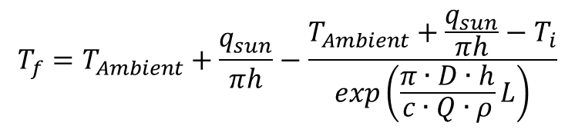

Thermal Analysis
Influence of ambient air and sun irradiance
Total temperature change: 9.84°C
Cool roof coatings adjust impact of sun (qR) but do not change effect of ambient air
$$\frac{dL}{dT}=\frac{q_{air}{⋅A}_{air}}{c⋅Q⋅ρ}+\frac{q_{sun}{⋅A}_{sun}}{c⋅Q⋅ρ}$$
$$T_{f}=T_{Ambient}+\frac{q_{sun}}{πh}−\frac{T_{Ambient}+\frac{q_{sun}}{πh}−T_{i}}{exp\left(\frac{π∙D∙h}{c∙Q∙ρ}L\right)}$$

Slide 4
Coating Options
AcryShield High Reflectance A590
  R = 0.87 (Irradiance – 130 W/m²)
  Maximum temperature increase: 3.37°C
  $21,000 for total cover
NXT Cool Zone Gloss White
  R = 0.86 (Irradiance – 140 W/m²)
  Maximum temperature increase: 3.43°C
  $22,000 for total cover
Half-coated pipeline option

Slide 5
Future Work
Further research in other coating products or built physical structures to prevent heating
Determine the relationship between temperature gradient and sedimentation tank performance
Investigate adjustments in plate settler design to reduce flow circulation due to warm influent water

Slide 6

Questions

