Slide 1
Sed Tank Controls And Floc Probe
Alexandra Green, Tiago Viegas, and Paul Vieselmeyer

Slide 2
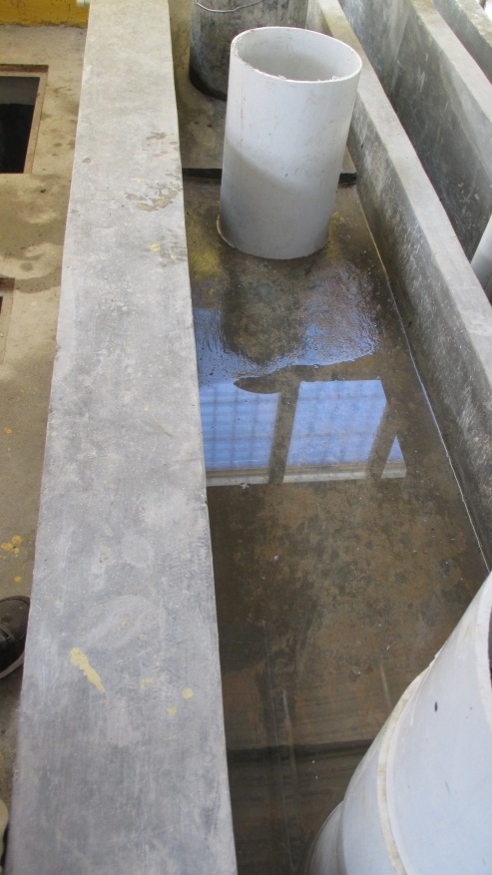
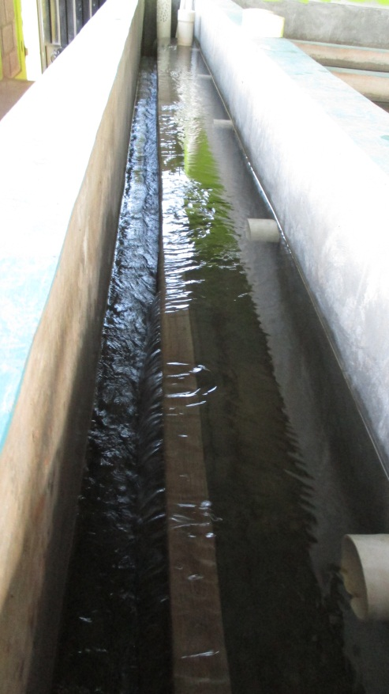
The Challenge
Inflow Channel
Effluent Launder
San Nicholas
Atima

Slide 3
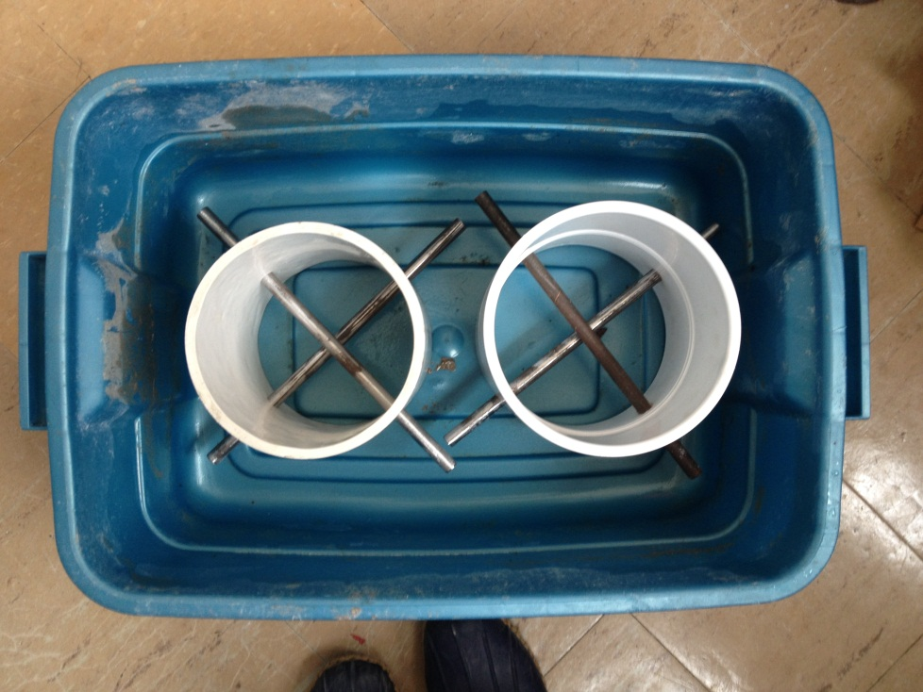
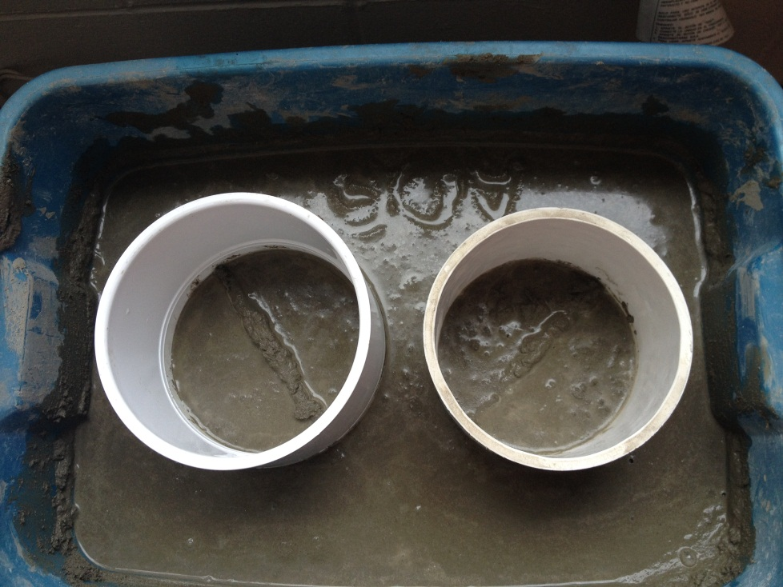
What we’ve done so far
Testing Apparatus

Slide 4
Can You Do It?

Slide 5
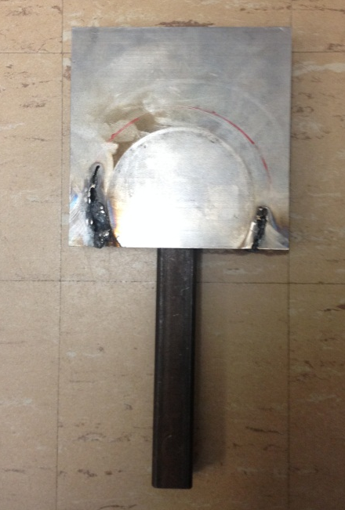
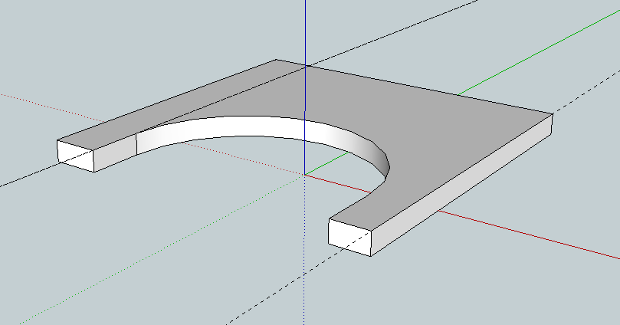
What we’ve done so far
Pipe Stub
Launder Cap
Lever
Slide Hammer
Lever Fork
Modified Cap
Cap Alternatives

Slide 6
Is it better?

Slide 7

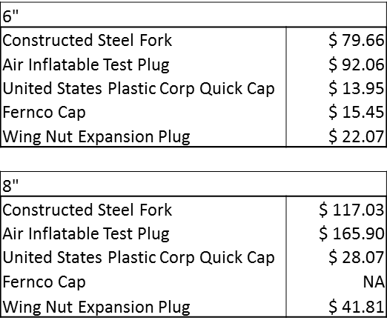
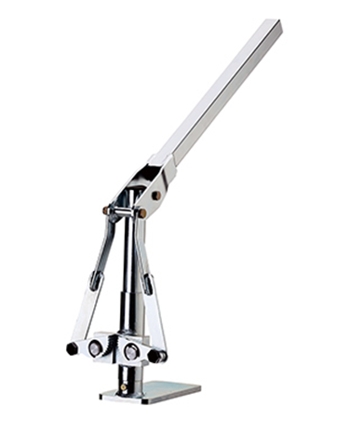
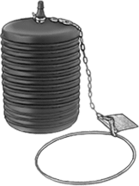
Economic Considerations

Slide 8
Future Plans
Determine the best methods
Refine designs for ease of fabrication and lowest cost
Investigate catwalks
Floc Probe

Slide 9
Questions?
Suggestions?

