Slide 1
Sed Tank Controls And Floc Probe
Alexandra Green, Tiago Viegas, and Paul Vieselmeyer

Slide 2
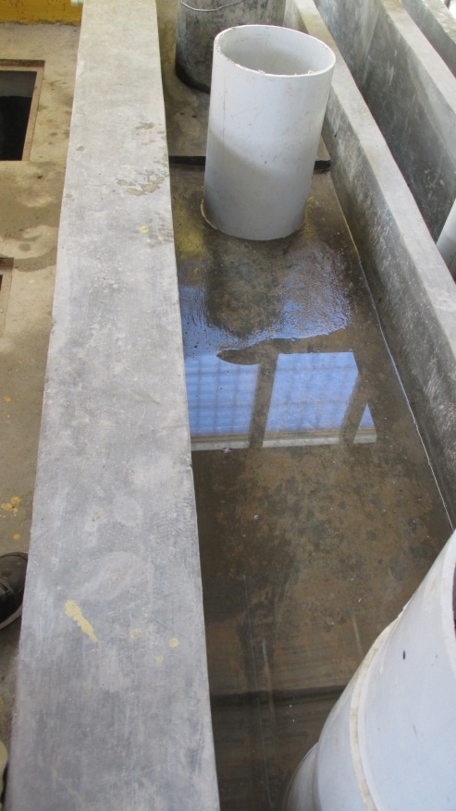
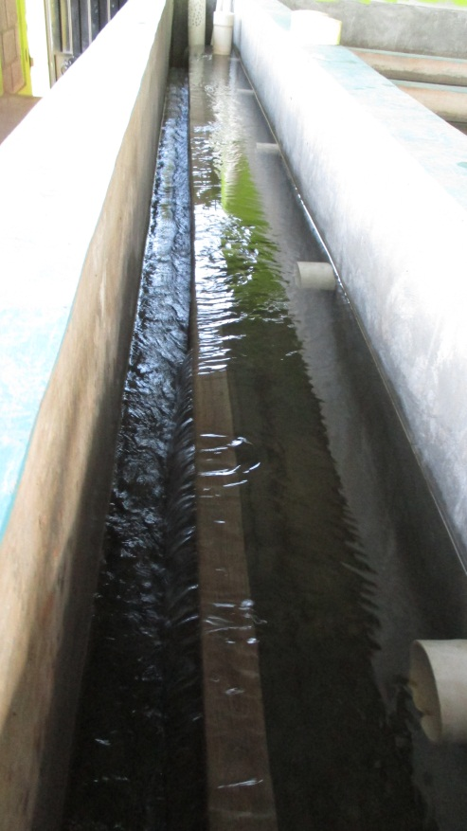
The Challenge
Inflow Channel
Effluent Launder
San Nicholas
Atima

Slide 3
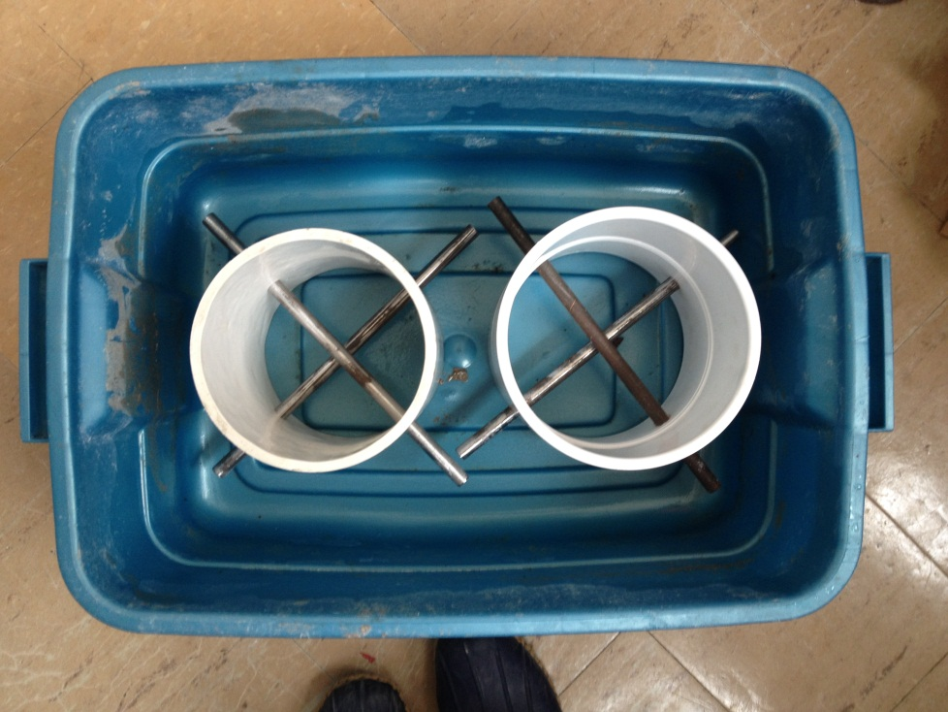
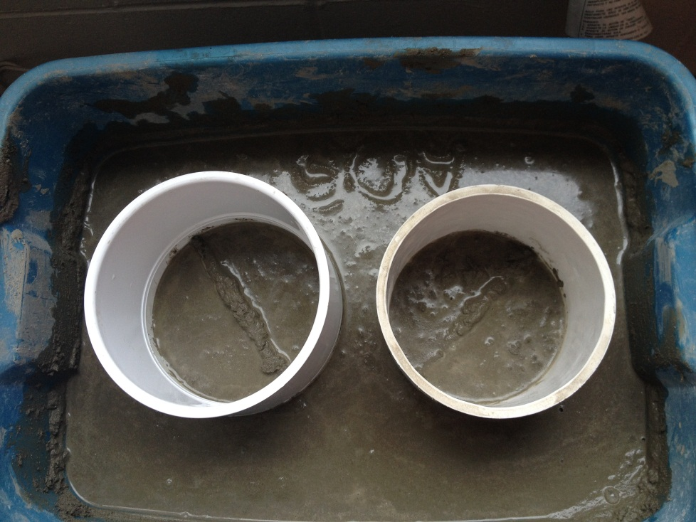
What we’ve done so far
Testing Apparatus

Slide 4
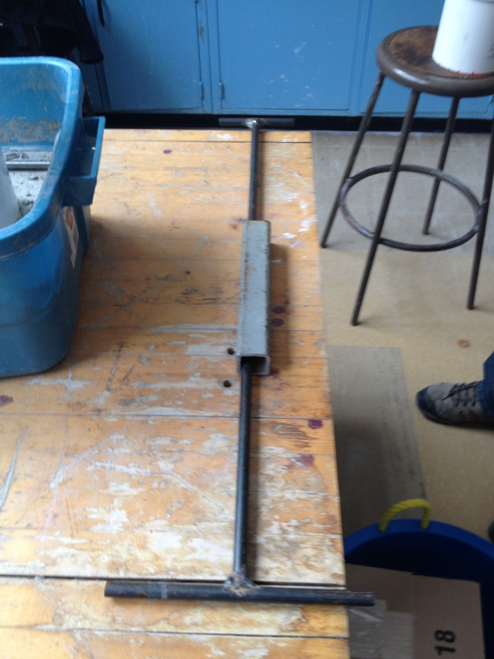
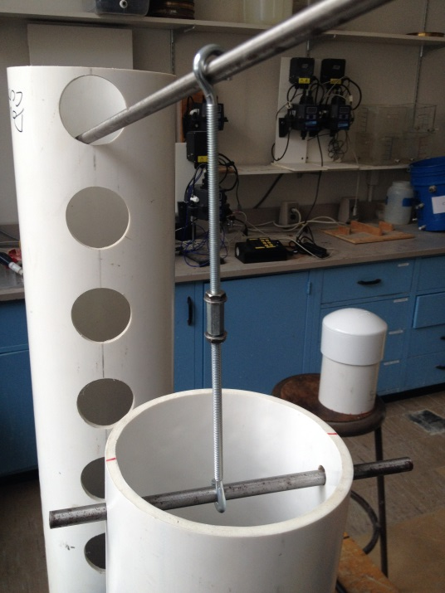
What we’ve done so far
Pipe Stub
Lever
Slide Hammer

Slide 5
Cost Analysis
Slide Hammer | Unit | Unit Cost | Cost of Use
1/2" Steel Rod | 6 ft | $ 13.89 | $ 8.49
1.5" Rectangular Steel Tube, 0.12" Thickness | 1 ft | $ 11.67 | $ 8.75
Shick Absorbing Foam Tape | 10 ft roll | $ 24.68 | $ 1.23
 |  | Total | $ 18.47
Lever | Unit | Unit Cost | Cost of Use
1/2" Steel Rod | 6 ft | $ 13.89 | $ 2.32
Open-Eye Routing Eyebolt | 10 pack | $ 8.65 | $ 1.73
Coupling Nut Grade 5 Steel | 1 | $ 0.28 | $ 0.28
Buna-N O-Rings | 1 package | $ 2.86 | $ 0.46
1" PVC | 5 ft | $ 5.27 | $ 2.11
 |  | Total | $ 6.89

Slide 6
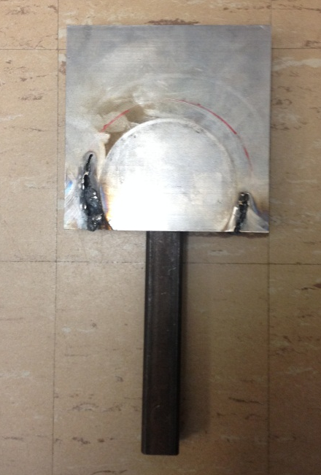
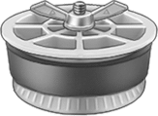
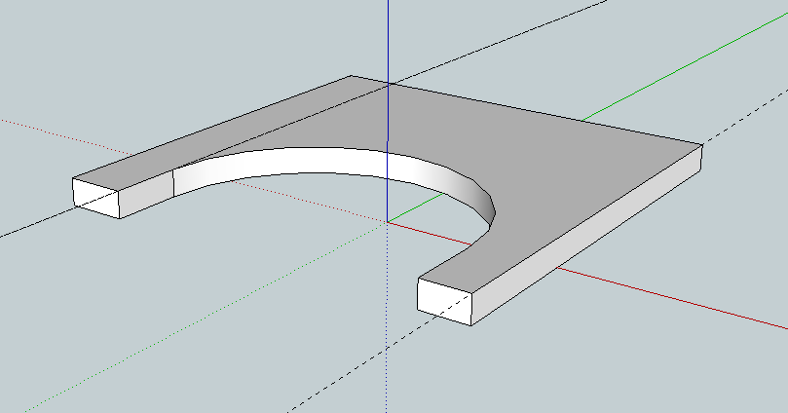
What we’ve done so far
Launder Cap
Lever Fork
Modified Cap
Cap Alternatives

Slide 7
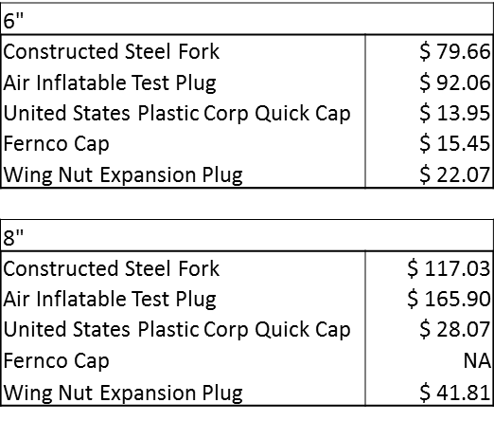

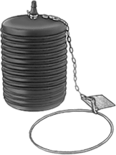
Economic Considerations

Slide 8
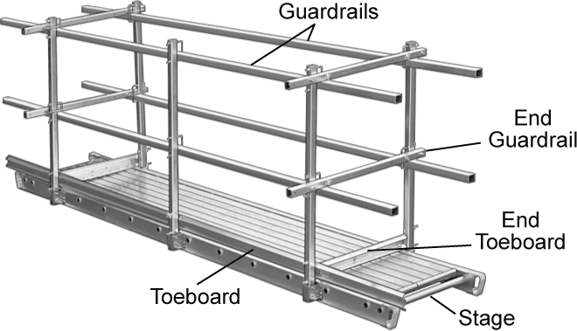
Catwalks
Cost considerations
Need multiple sedimentation bays
Impacts on weir system for sed tank entrance
Notes:
Julia’s notes, an image etc
They decided to keep all the walls and have one tank per bay

Slide 9
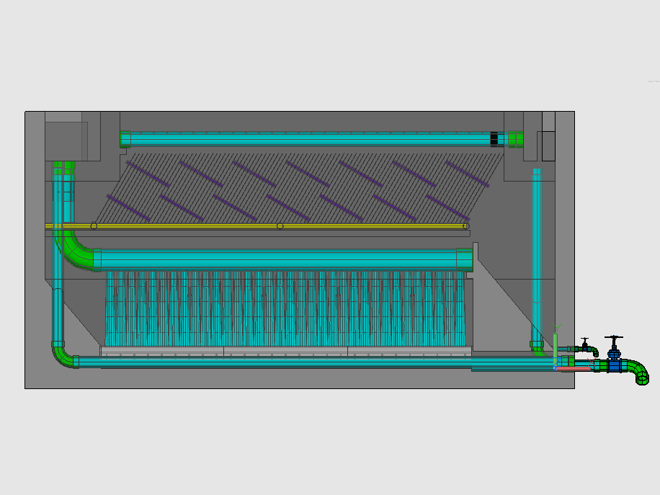
Floc Probe Challenge
Notes:
Sed tank diagrams
-what the problem
-what drew said
-what monroe thinks
-is there anything we can do?

Slide 10
Floc Probe Challenge
Drew:
  Currently, using an LED light, but not clear when the light disappears
  Sludge falling over the floc weir
  Need better viewing positioning
Monroe:
  Not able to drain floc hopper properly
  Need to be able to see a small layer of sludge water to determine

Slide 11
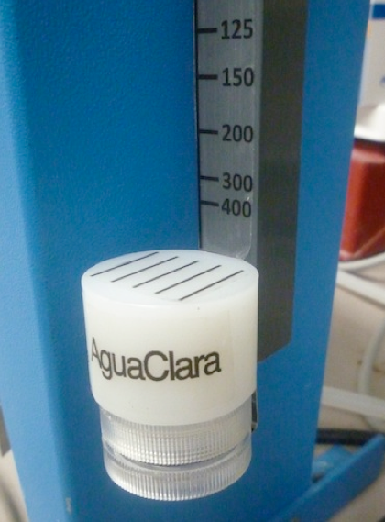
Turbidimeter Team
Developed Turbidimeters to test potential water sources for AguaClara Plants
Used an LED and HPDE block to diffuse light
Cost less than $5 and could test turbidities of above 15 NTU

Slide 12
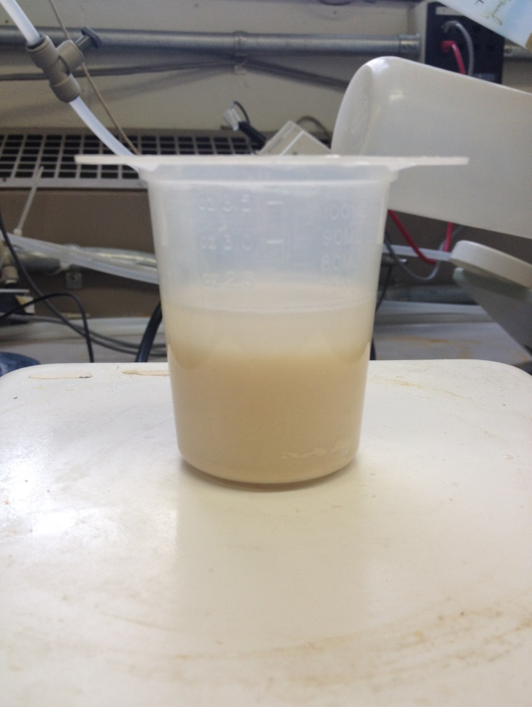
Experimental Set Up
Tried to mimic interface between floc blanket and clear water above
Ethanol layer above suspended clay solution
Vegetable oil above dark brown Pine Sol cleaner
Notes:
Couldn’t use Casey’s set up – narrow and higher NTU than San Nicolas

Slide 13
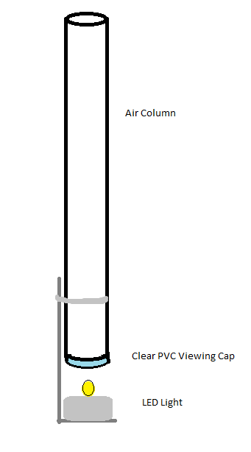
Sludge Judge
Small layer of sludge water between the light and the clear cap
Adjustable distance of LED light
Pipe length can be increased – long pipe is necessary
Notes:
Future model could have a removable Viewing cap

Slide 14

Future Plans
Figure out what’s going on in San Nicholas…
Improvement of Sludge Judge
  Removable viewing cap
  Thicker connecting bar
Notes:
NOT ENOUGH INFO
Future model could have a removable Viewing cap.
Bar thicker so that I wont bend easily

Slide 15
Questions?

