Slide 1
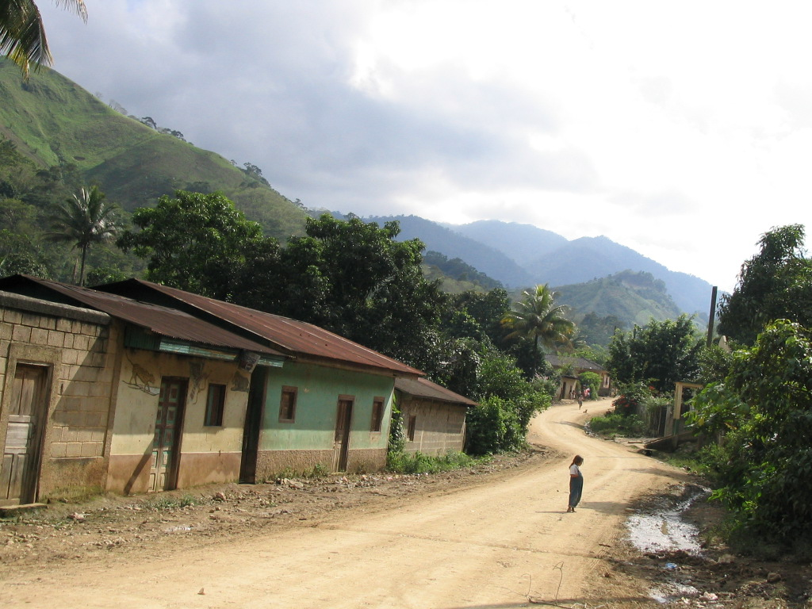
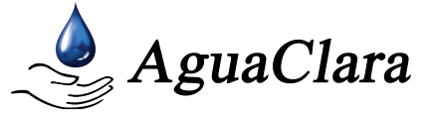

Water Treatment
Technology Selection Guide
Siwei Oon
Li Hui Goh

Slide 2
[Outline]
Background
Focus
Decision Support System (DSS)
Approach
  Develop criteria for technology assessment
  Acquiring information from users
  Information acquisition
  Scoring and Evaluation
  Moving forward

Slide 3
[Background]
Billions lack access to improved sources of water
Available guides tend to focus on contaminant removal efficiencies
Difficulty in choosing correct technologies, especially for a layperson
Develop a platform to empower decision-making

Slide 4
[Focus]
To develop a Decision Support System (DSS) targeted at small and resource poor communities
Assumptions / precepts:
  hydraulic based devices that use gravity to do work are preferred over mechanical equipment
  system selection does not take into account long term water demands, instead focuses on short term requirements to reduce financial burden on community
  indigenous resources (materials, skilled manpower) should be tapped upon to increase sustainability and expand industrial development

Slide 5
[Decision Support
System (DSS)]
Implemented in Microsoft Excel / Visual Basic for Applications (VBA)
Easily disseminated, without consistent need for internet access

Slide 6
[DSS Development Approach]
  Develop criteria for technology assessment
  Acquiring information from users
  Information Acquisition
  Scoring and Evaluation

Slide 7
[Criteria for
Technology Assessment]
Effectiveness
Appropriateness
Acceptability
Cost

Slide 8
[DSS Development Approach]
  Develop criteria for technology assessment
  Acquiring information from users
  Information Acquisition
  Scoring and Evaluation

Slide 9
[Acquiring Information from Users]
Sample questions:
  what is your source of raw water?
  which of the following pictures best illustrate the turbidity level of the raw water?
  are you aware of the drinking water standards in your country? If not, which standards (WHO / US-EPA) would you like to meet?
  are masons, carpenters and metal workers available in your community?
  how important is the taste of water?

Slide 10
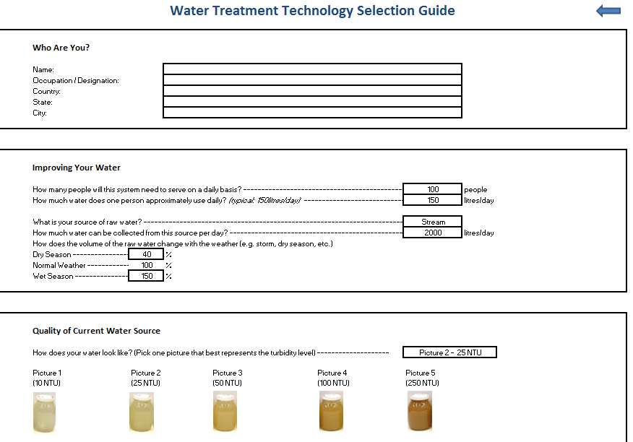
user interface

Slide 11
[DSS Development Approach]
  Develop criteria for technology assessment
  Acquiring information from users
  Information Acquisition
  Scoring and Evaluation

Slide 12
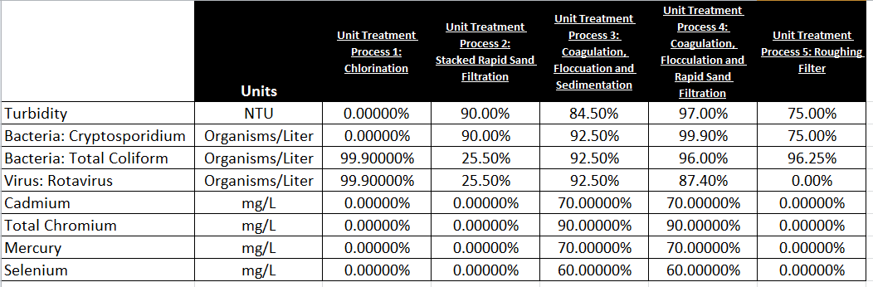
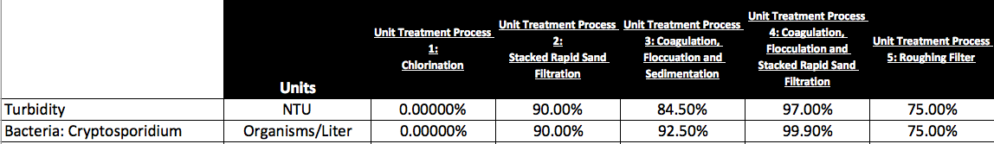
[Information Acquisition]
Performance of unit treatment processes
  roughing filter
  stacked rapid sand filtration (SRSF)
  coagulation, flocculation & sedimentation
  coagulation, flocculation & RSF
  chlorination

Slide 13
[Information Acquisition – contd.]
WHO & US-EPA drinking water standards
Parameter | WHO | US-EPA | Units
Turbidity | 5 | 0.3 | NTU
Cryptosporidum | 1.3e-5 | 0 | Organisms/litre
Total coliform | 0 | 0 | Organisms/litre
Rotavirus | 1.1e-5 | 0 | Organisms/litre
Cadmium | 0.003 | 0.005 | mg/l
Chromium | 0.05 | 0.1 | mg/l
Mercury | 0.006 | 0.002 | mg/l
Selenium | 0.04 | 0.05 | mg/l

Slide 14
[DSS Development Approach]
  Develop criteria for technology assessment
  Acquiring information from users
  Information Acquisition
  Scoring and Evaluation

Slide 15
[Scoring and Evaluation]
Multi-Criteria Scoring Model
  Weighted Score for Treatment Combination j
  =
  Recommend the Treatment Combination with the largest weighted score

Slide 16
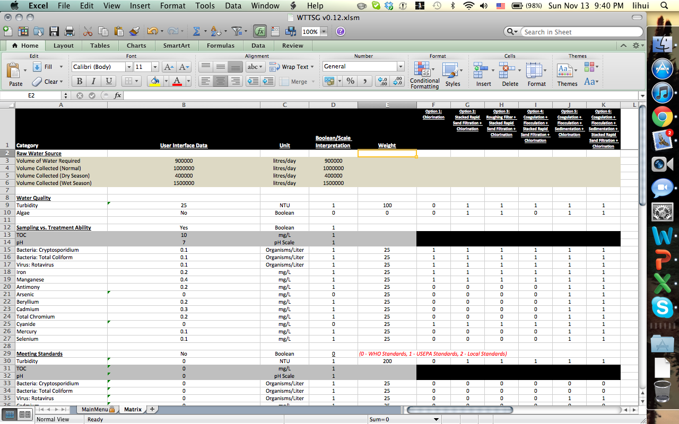
[Scoring and Evaluation – contd.]
Implementing in MS Excel

Slide 17
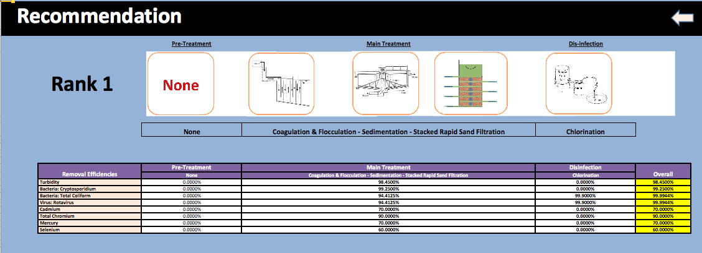
[Scoring and Evaluation – contd.]
Recommendation to the User

Slide 18
[Moving Forward]
estimating site area requirements
estimating Capital Expenditure (CAPEX) / Operational Expenditure (OPEX)
list of useful questions to guide users in liaising with technology vendors

Slide 19
[questions?]

Slide 20
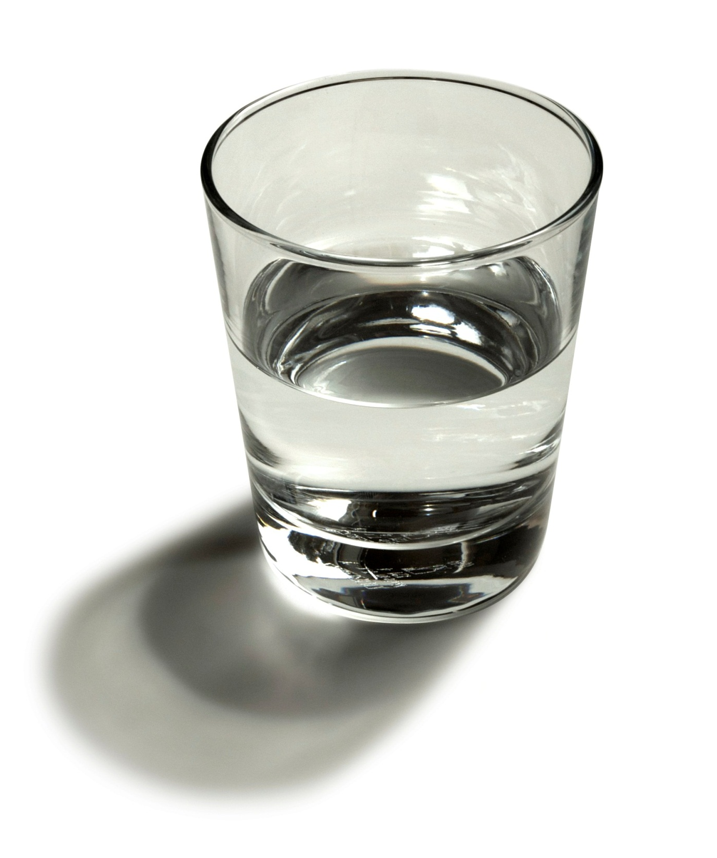
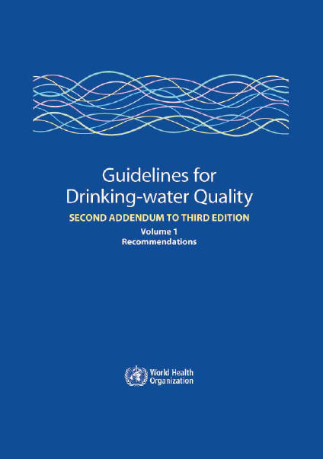
Effectiveness
Contaminant removal ability
Contaminant removal efficiency
Meeting drinking water standards/guidelines

Slide 21
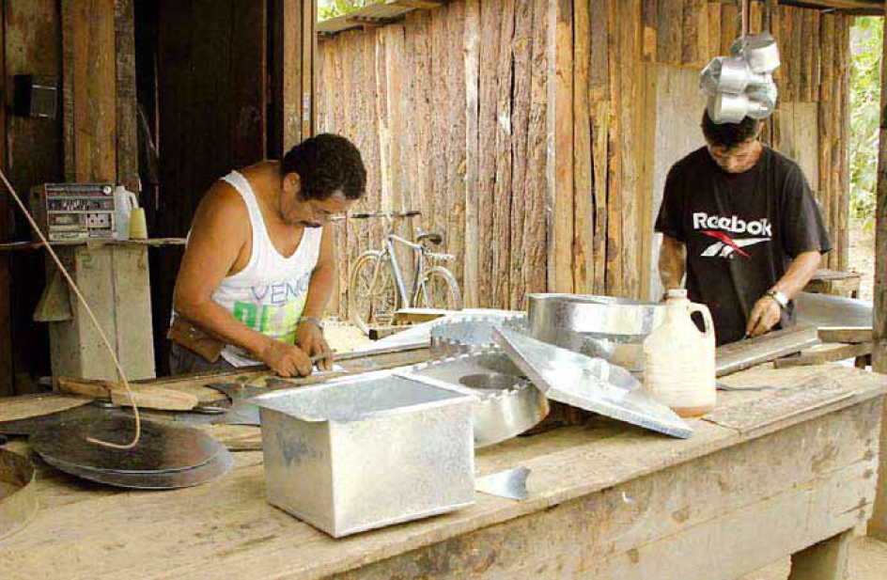
Appropriateness
Skills
Materials
Manpower
Site Requirements

Slide 22
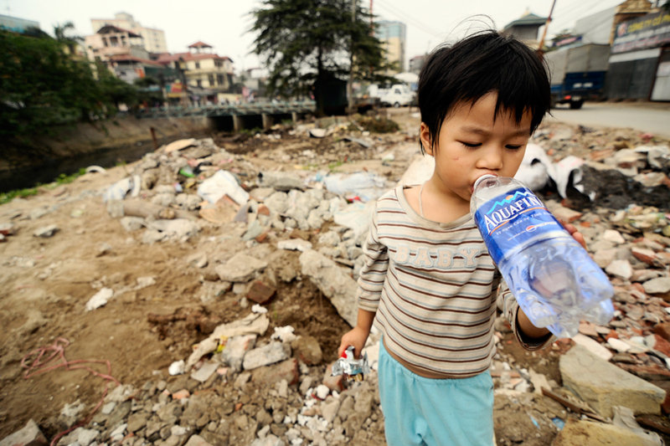
Acceptability
Taste
Smell
Appearance
Cultural Preferences

Slide 23
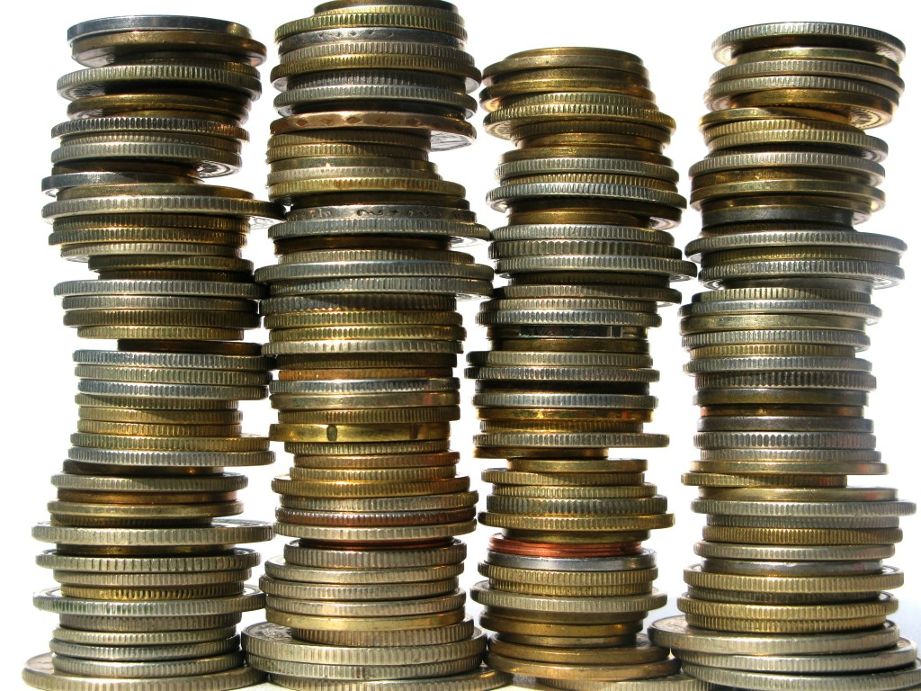
Cost
Capital Cost
Operating Cost

