Slide 1
Water Treatment Technology Selection Guide (WTTSG)
Yao Lu, Larissa Sakiyama, and Sarah Sinclair

Slide 2


Background
Water Treatment Technology Selection Guide
Plant Cost Calculator
Integrate into a single web application
Give most appropriate recommendations possible

Slide 3
Treatment Options
Multi-Stage Filtration Process (FIME)
Definition: Treats raw water without the use of pre-treatment chemicals or complex filter backwash process. Best for small systems ranging from 20 to 2,000 in population
Pros:
• Effective for a wide range of raw water quality
• Ease of operation, minimal construction
• No pre-treatment chemicals
• Lower operating/life cycle cost
• Effective for turbidity, cysts, bacteria, and color
Notes:
NO wastewater
go over the three? ish treatment types we are researching--FIME, package plants, etc, and wh someone would consider those technologies (pro/con)
Put MINIMAL information on the slide. mostly say aloud
• Ease of operation
• No pre-treatment chemicals and no large chemical storage and feed areas
• Lower operating cost, lower life cycle cost
• Meets government guideline for filtration of surface waters
• Effective treatment for turbidity, cysts, bacteria, and colour
• Simple cleaning techniques produce very little waste
• Effective for a wide range of raw water quality
• Pre-fabricated unit minimizes concrete and reduces construction time

Slide 4
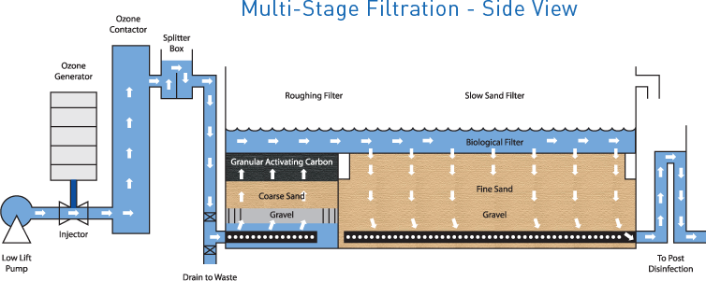
Treatment Options

Slide 5
Treatment Options
Package Plants
Definition: Pre-manufactured treatment facilities used to treat water in small communities or on individual properties.
Pros:
• Easy to install, operate
• Odor free
• Low sludge yield
Cons:
• Flexibility is limited to adapt to regulatory changes.
• More energy, more space
Notes:
Best To Use: extended aeration plants, sequencing batch reactors, oxidation ditches, contact stabilization plants, rotating biological contactors, and physical/chemical processes

Slide 6
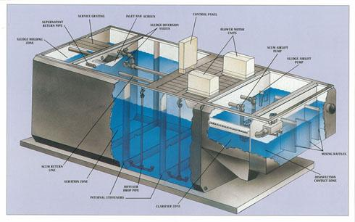
Treatment Options

Slide 7
Treatment Options
Membrane Filter Kiosks
Definition: a pressure- or vacuum-driven separation process
Best to use: reservoirs, lakes, rivers, surface water impoundments, aquifers under the influence of the surface water.

Slide 8
Plant Cost Calculator
Plant Cost Calculator
Total Cost:
Total = Wages Cost + Operating Cost + Design Cost
Design Cost: D = C * q * P(n) / 8640
C = cost per flow rate (USD/L/S); Very Rough Estimate at C = 10000 (USD/L/S)
q = per capita water demand (L/day/person)
P(n) = final population

Slide 9
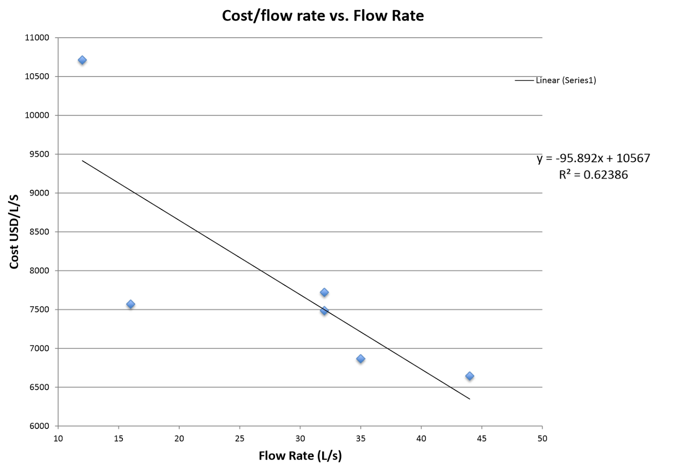
Plant Cost Calculator
Plant Cost Calculator
Improving 10000 (USD/L/S) cost per flow rate estimation:
Simple linear regression between cost per flow rate of 6 plants in Honduras and their flow rates:
C = -95.893 * f + 10567

Slide 10
Plant Cost Calculator
Curve Fitting with Linear Regression:
A scatterplot of the data below was created, and a regression was performed using the Excel Power curve of the scatterplot data
Name | Flow Rate (L/s) | Cost/Flow Rate (USD/(L/s))
Moroceli | 16 | 11777
San Nicolas | 32 | 7486
La Libertad El Faldon | 32 | 7722
La Libertad Los Laurales | 35 | 6867
Las Vegas Piedras Amarillas | 44 | 6645

Slide 11
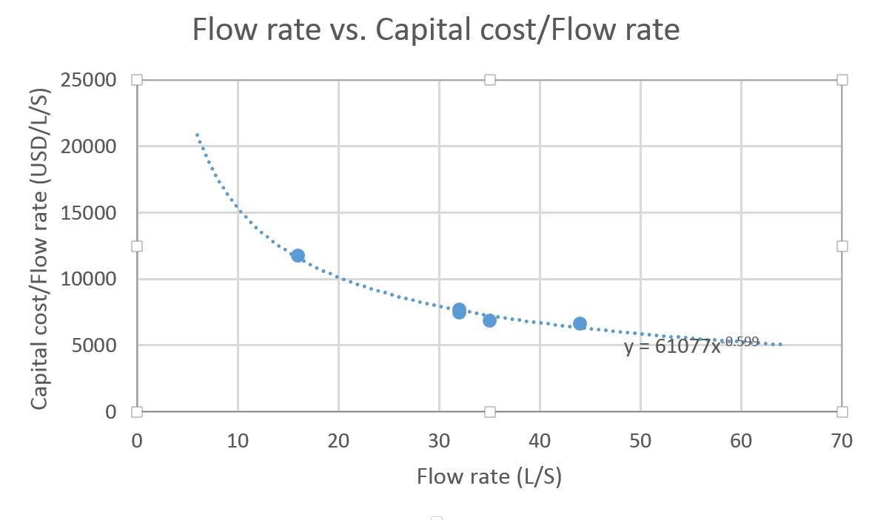
Plant Cost Calculator
Plant Cost Calculator
Curve Fitting with Linear Regression:
C = 61077*f ^{-.599}

Slide 12
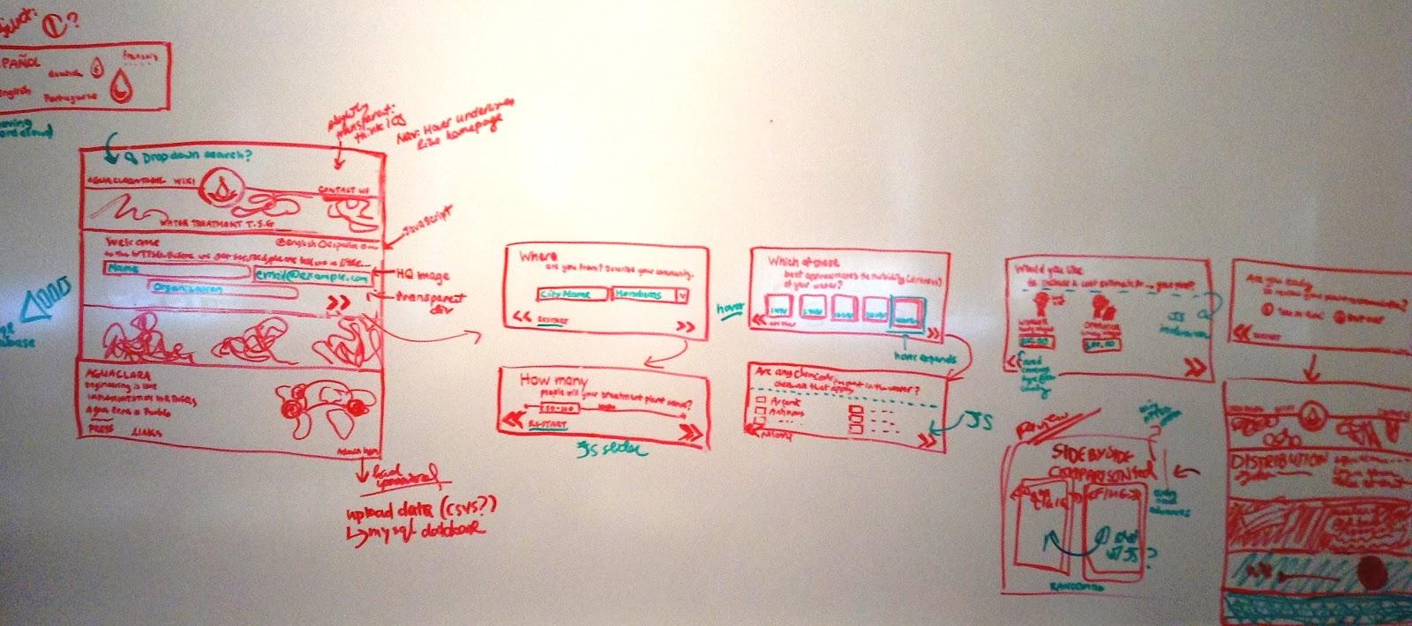
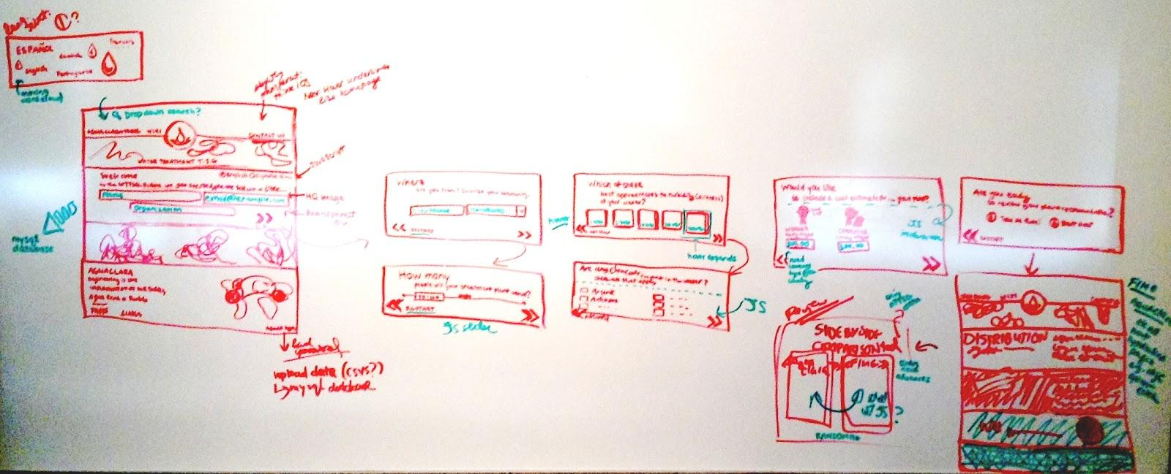
Implementation
Notes:
stop one on the journey: brainstorming the layout and design of the site

Slide 13
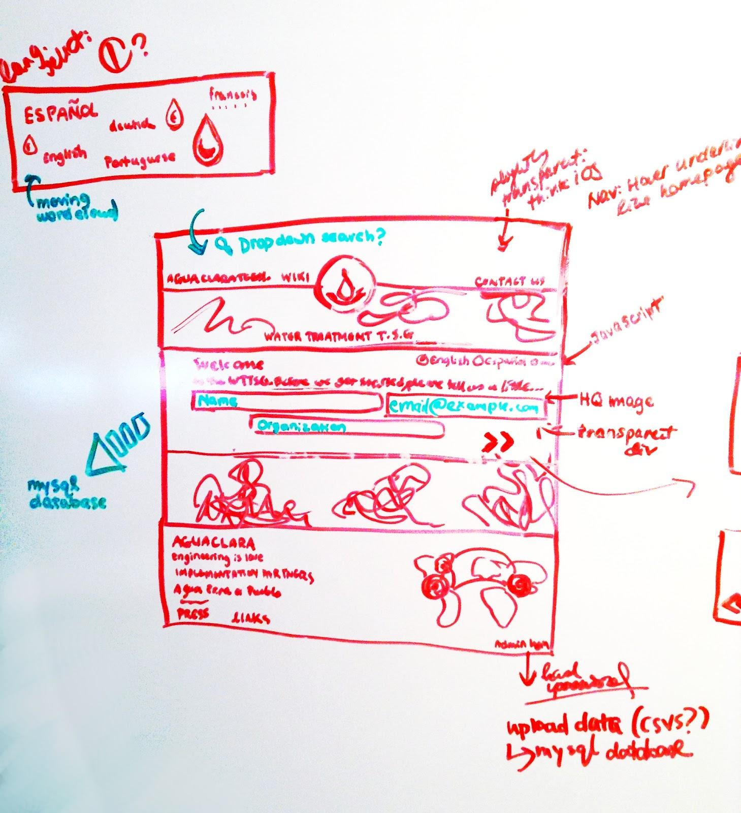

Implementation
Notes:
stop one on the journey: brainstorming the layout and design of the site

Slide 14
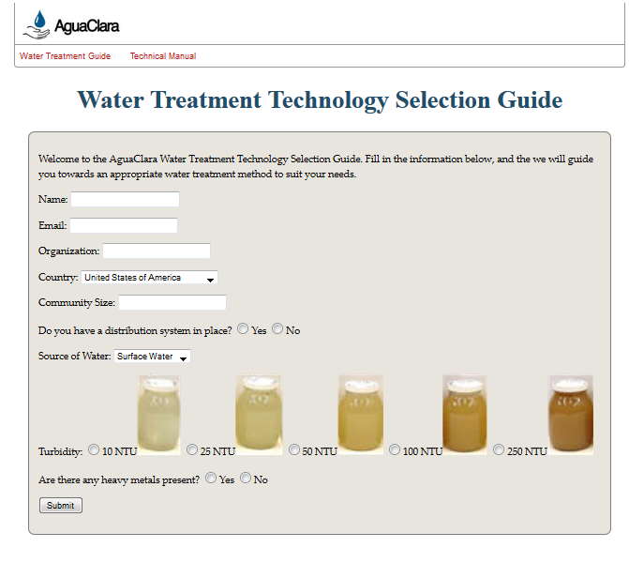

Implementation
Notes:
previous website uninspiring. now features like parallax scrolling, cool javascript to manage transition from one page to the next, etc

Slide 15

Implementation
Notes:
Dynamically resizes to best fit browser width

Slide 16
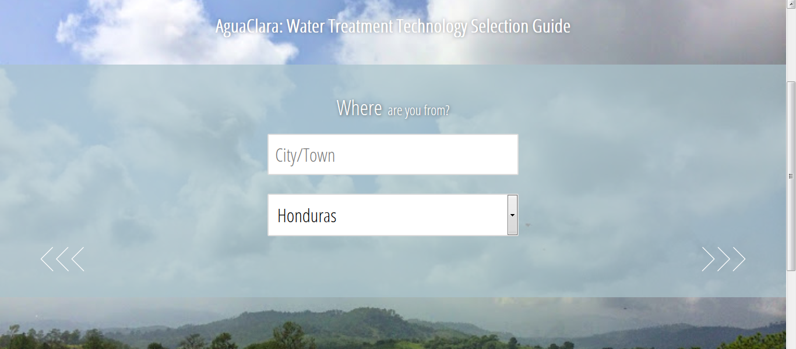


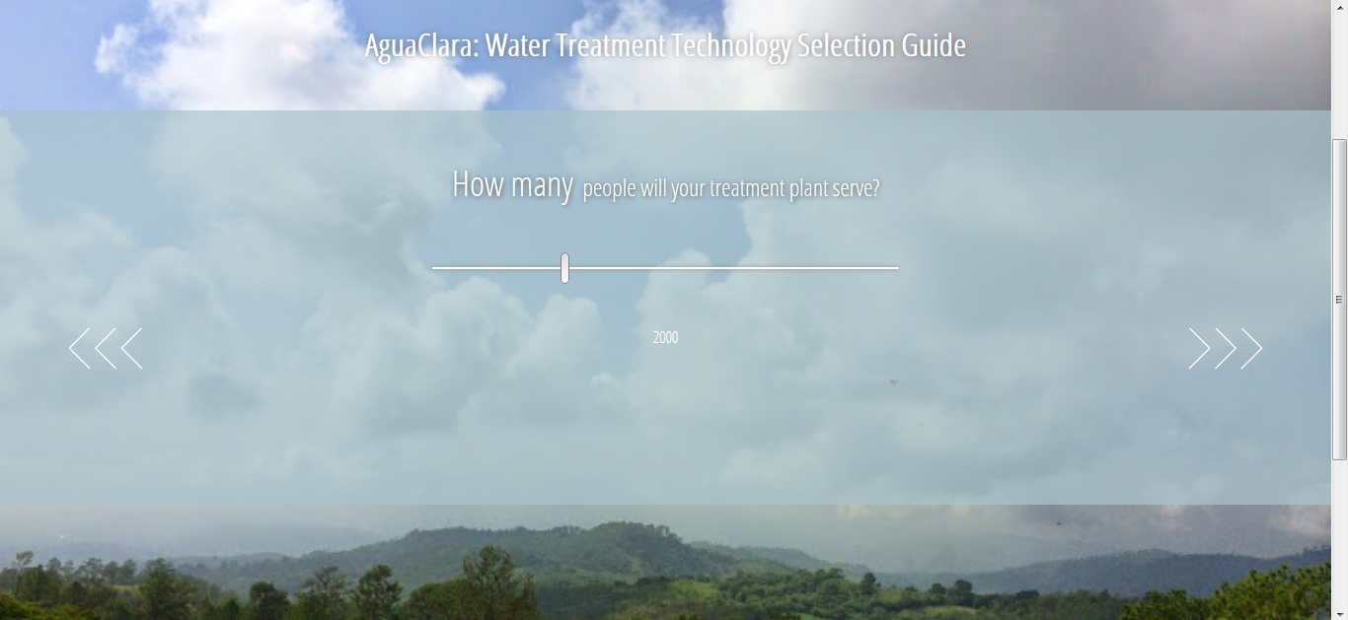
Implementation
Notes:
various inputs, login fields, favicon, and other touches being added to the implementation

Slide 17
Future Work
Continued implementation
MySQL functionality
Automatic regression
Estimate total cost with cost curves
Deploy site!

Slide 18

Any Questions?
?

