Slide 1
Water Treatment Technology Selection Guide
Sarah Sinclair and Anthony Arce

Slide 2
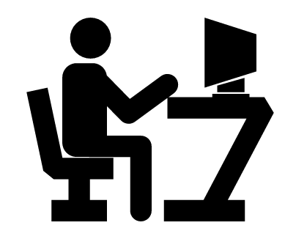
What We’re Up To
So what’s a Water Treatment Technology Selection Guide, anyway?
Who will use it?
What content does it need?

Slide 3
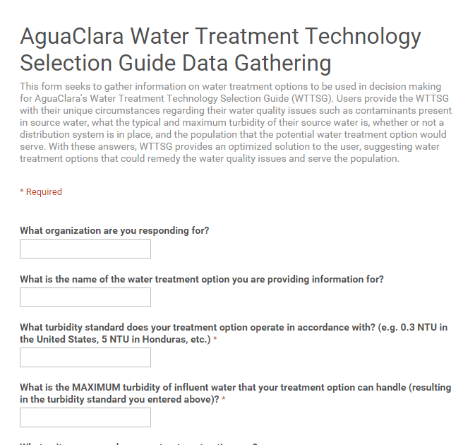
Survey
Challenge: how can we collect information about treatment options that simply doesn’t exist in the aggregate?

Slide 4
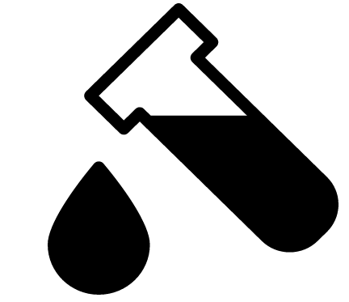
Recommendation
Based on water treatment plants’ unit processes
Needs to consider each user’s unique contaminant issues
Unit Process Organization

Slide 5
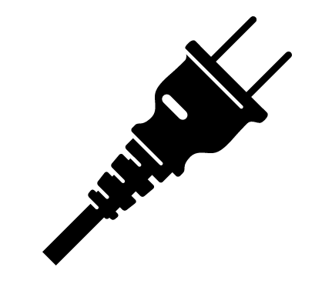
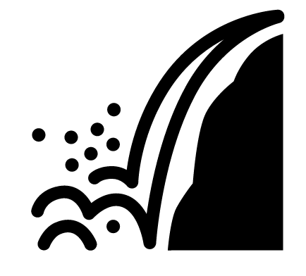
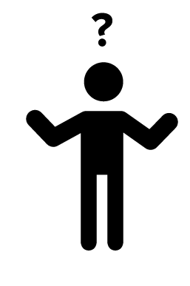
Additional Considerations
Electricity demand
Hardness in source water
Difficulty obtaining specific product information

Slide 6
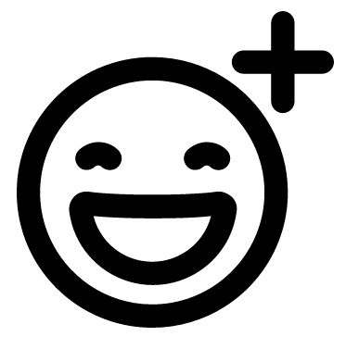
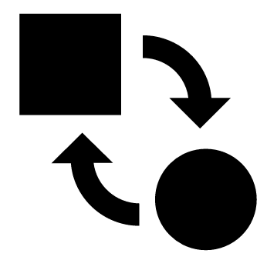
Web Development
Provide high-quality user experience
Be scalable: multiple treatment options and constraining factors
Content added, changed easily and flexibly

Slide 7
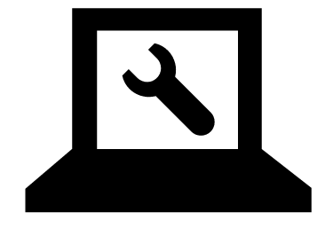
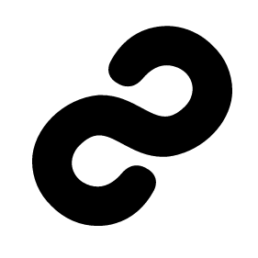
Web Development
Administrative features
Results page features, and permalinking results
aguaclaraserver.cee.cornell.edu/

Slide 8

Questions
?

