Slide 1
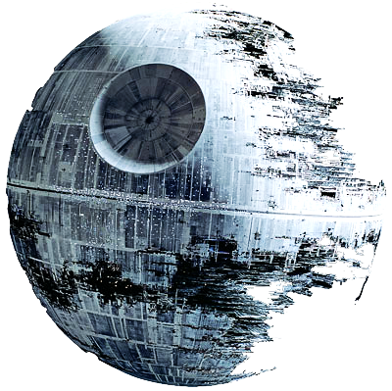
Water Treatment Technology Selection Guide
Andrew Mullen and Sarah Sinclair

Slide 2


What We’re Up To
Water Treatment Technology Selection Guide: an introduction

Slide 3

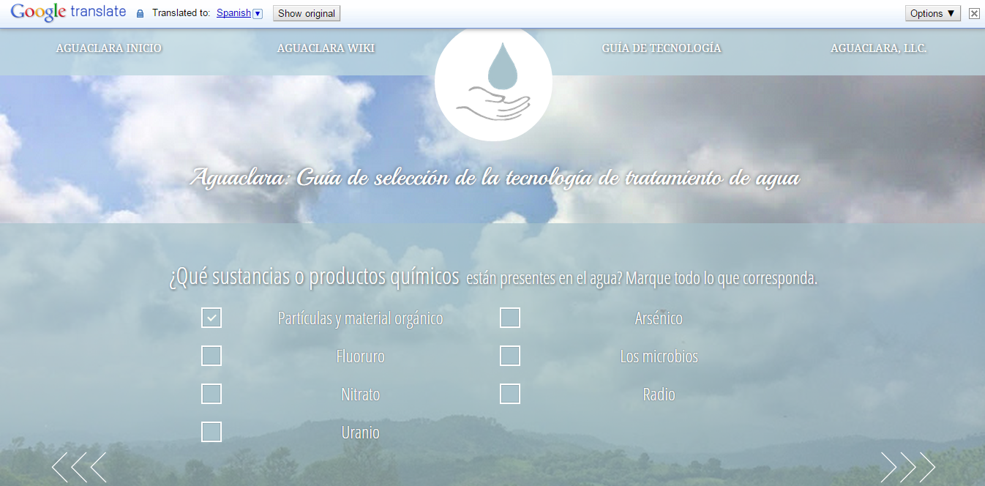
Language Translation

Slide 4
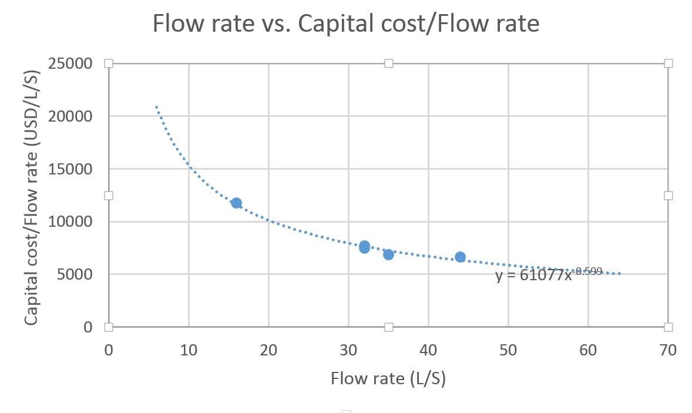

Plant Cost Calculation
Curve Fitting with Linear Regression:
C = 61077*f ^{-.599}

Slide 5
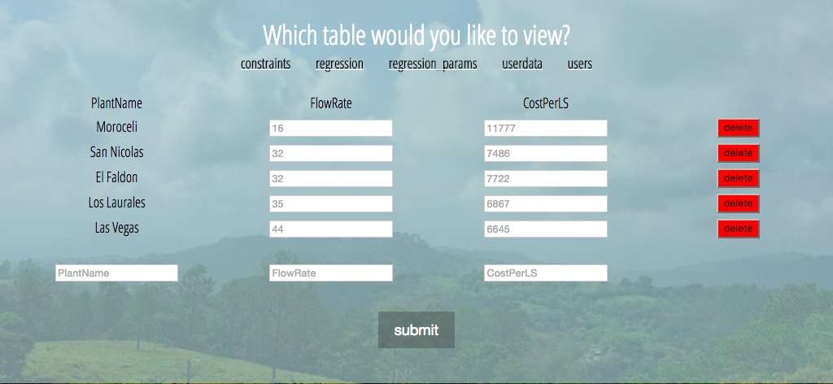
Admin Page
Easily Updatable

Slide 6
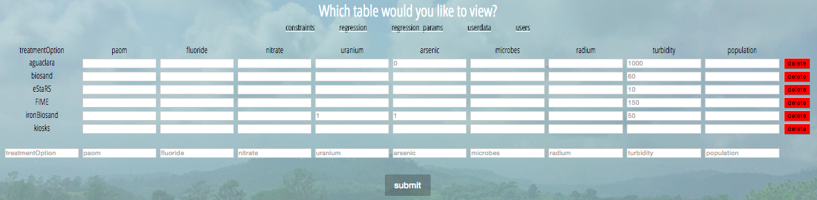
Admin Page
Logic for technology selection is easily updatable as well

Slide 7
Literature Review
AguaClara
EStaRS
FIME (Multi-stage Filtration)
Biosand Filters
Iron-Amended Biosand Filters
Filter Kiosks
Filter Straws
Packaged Plants

Slide 8
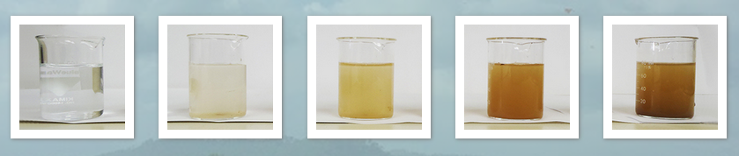
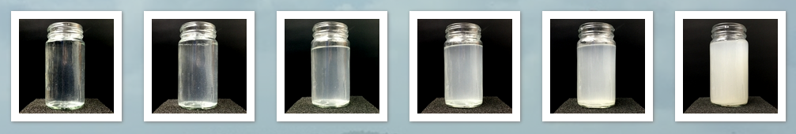
New Pages

Slide 9
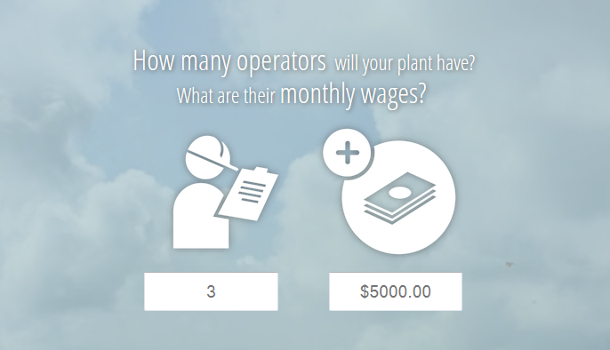
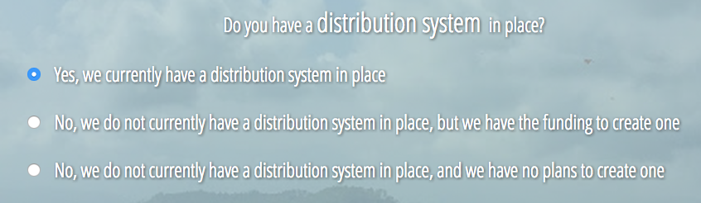
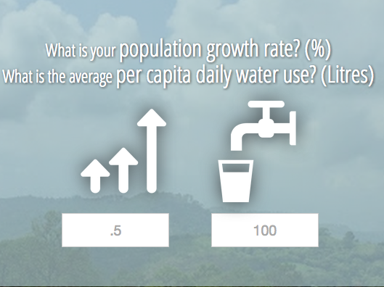
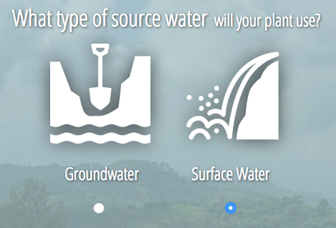
New Pages

Slide 10
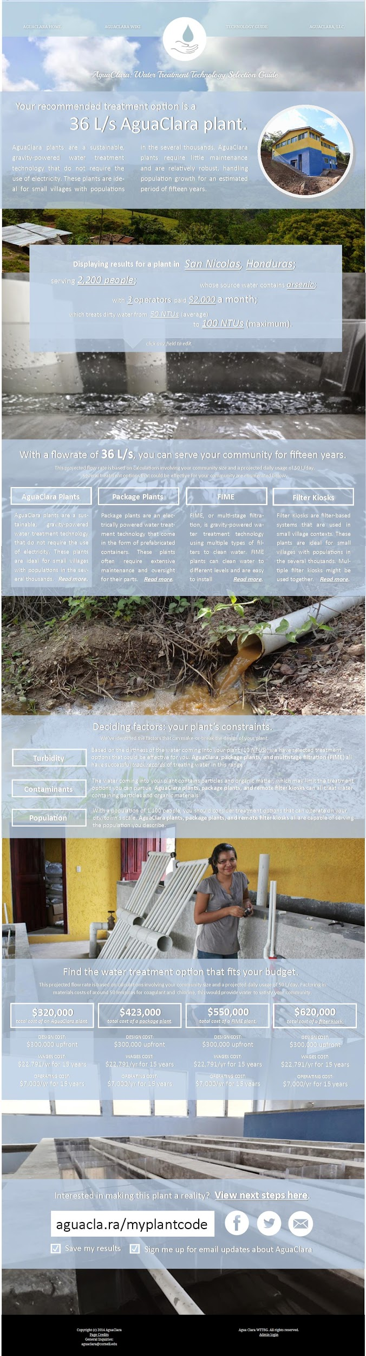
Results Page Design
http://invis.io/UH29ZLSXB

Slide 11
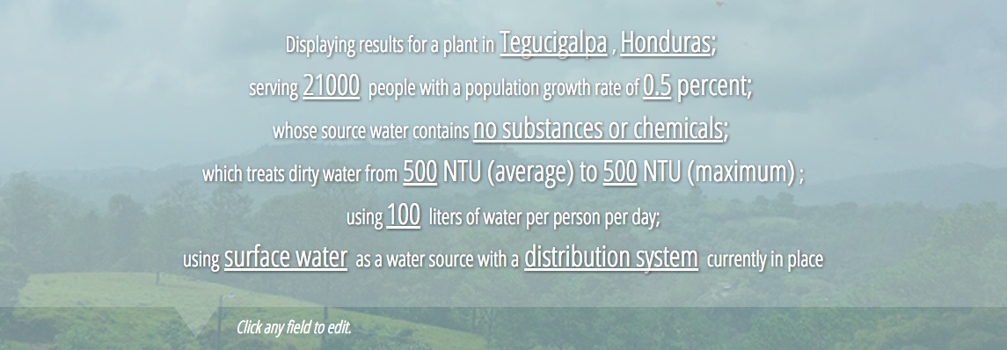
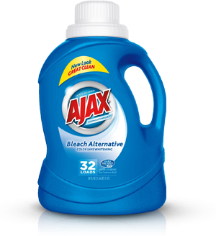
Results Page
Editable Results Page

Slide 12
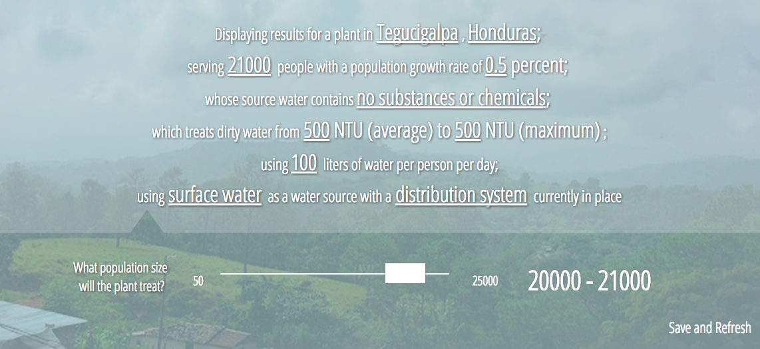
Results Page
Editable Results Page

Slide 13
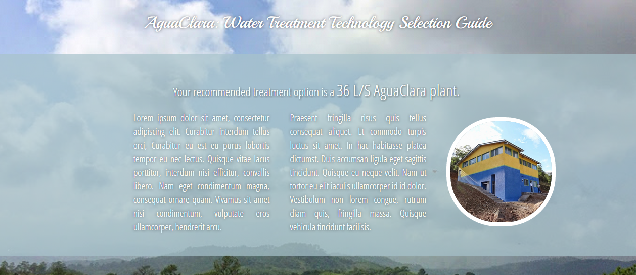
Results Page
Formatting for the information

Slide 14
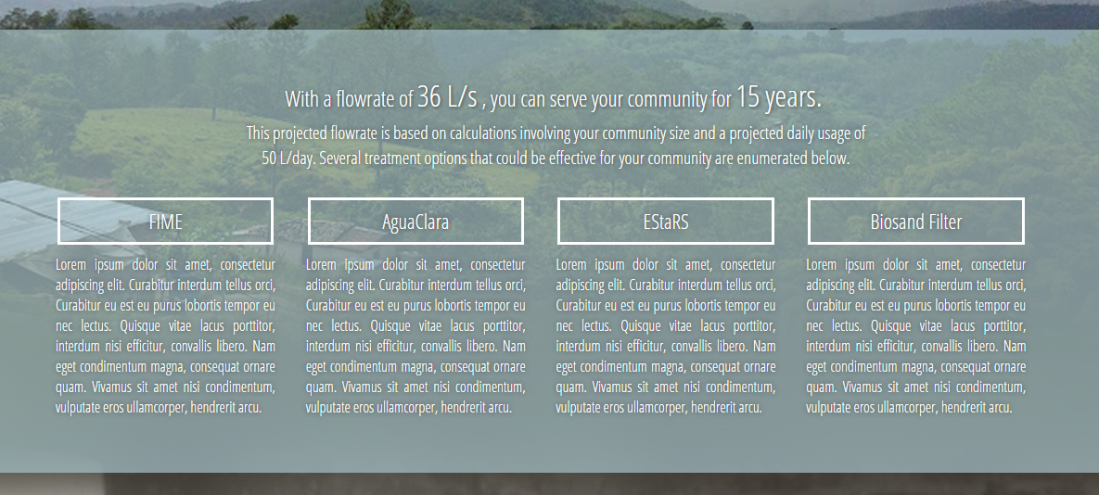
Results Page
Formatting for the information

Slide 15
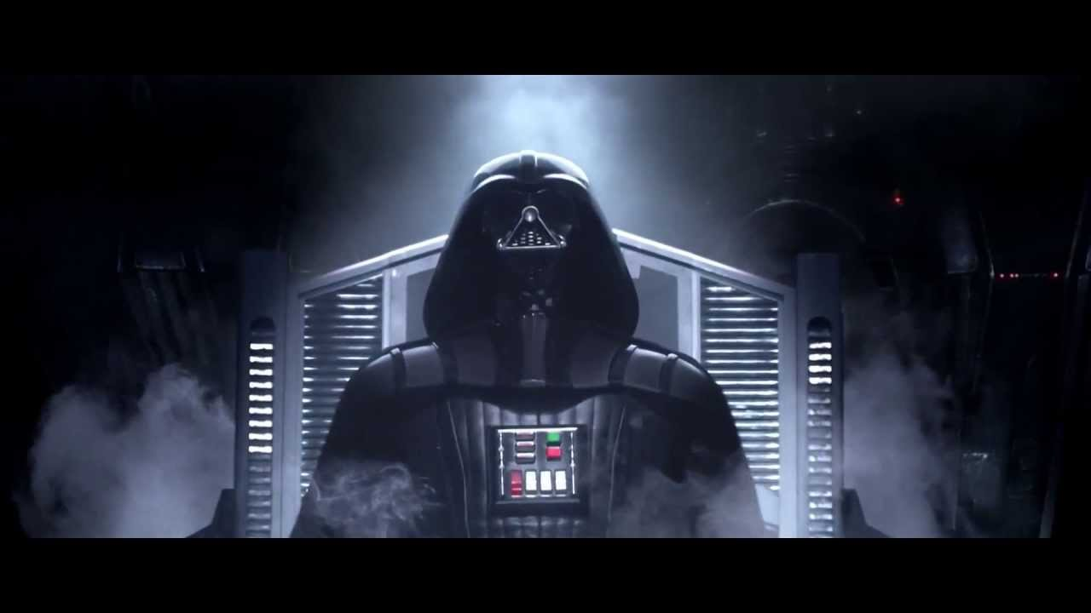
IT LIVE(S)!
Site is deployed! (kind of)
aguaclaraserver.cee.cornell.edu

Slide 16

Questions?
?

