Slide 1
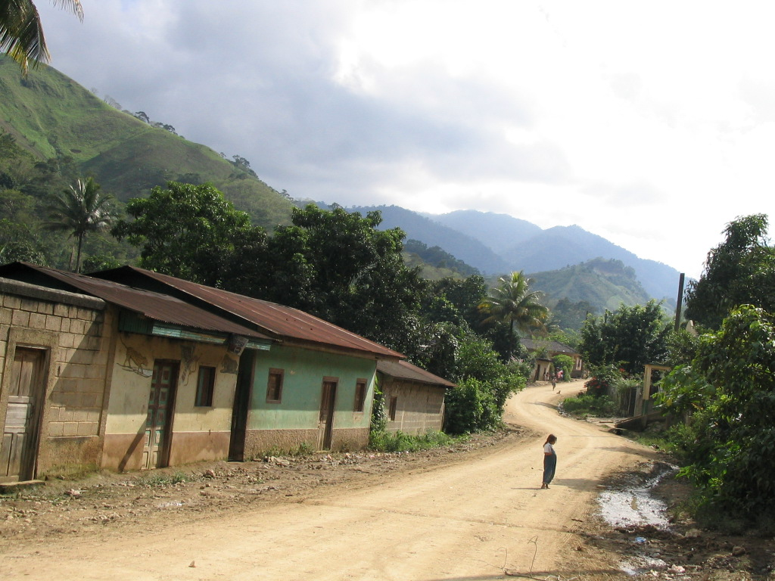
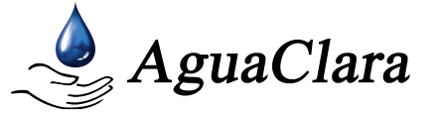

Water Treatment
Technology Selection Guide
Siwei Oon
Li Hui Goh
Notes:
Good Afternoon, everyone! I am Siwei and this is Li Hui. We are here today to share about our project - the Water Treatment Technology Selection Guide. This guide is special, because it allows our knowledge about water treatment to trickle down to the masses, to people from all walks of life.
Specifically, we hope to empower a layperson, especially one from a resource-poor community, to choose the correct water treatment technology by using our platform.

Slide 2

Outline
Background
Case Studies
Demonstration
Conclusion

Slide 3
Background
To develop a Decision Support System (DSS)
    Targeted at resource-poor communities
    Choose suitable water treatment technologies
    Focuses on immediate water demands
    Recommend hydraulic-driven water treatment technologies
    Tap upon indigenous resources for sustainability
    Implemented in Microsoft Excel using Visual Basic for Applications (VBA) language

Slide 4
Background (contd.)
Providing a SOUND recommendation:
  Sound = Sustainable?
  Sound = Directly implementable?
OR
Sound = Sustainable AND Directly Implementable

Slide 5
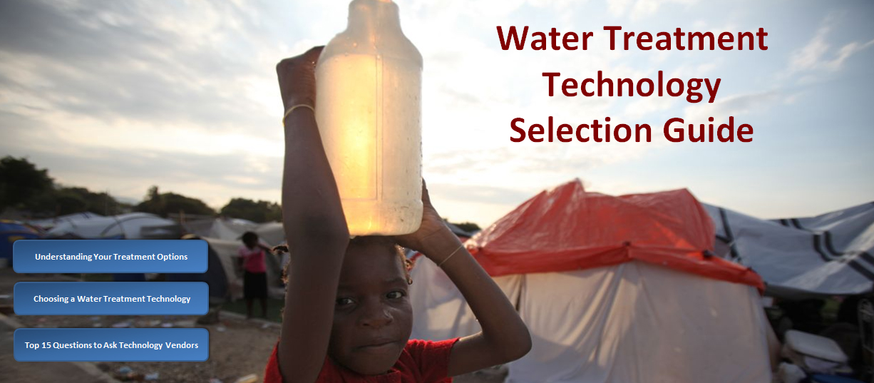
Case Studies

Slide 6
Case 1: Stream Water
User Inputs
  Water Quality & Resource Availability
Parameter | Value | Units
Turbidity | 10 | NTU
Cryptosporidium | 0.00001 | Organisms/L
Total Coliform | 0.0001 | Organisms/L
Rotavirus | 0.00013 | Organisms/L
Cadmium | 0.0001 | mg/L
Mercury | 0.009 | mg/L
Resource | Availability
Chlorine | Yes – Can be obtained within community
PACl | Yes – Can be obtained within community
Cement | Yes – Can be obtained within community
Bricks | Yes – Can be obtained >10km in country
Masons | Yes – With Basic Skills
  Desired Drinking Water Quality
WHO Drinking Water Guidelines

Slide 7
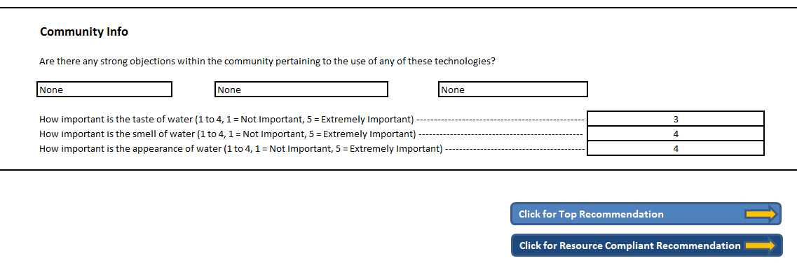
Screenshot of User Interface

Slide 8
Case 1: Stream Water
Ranked Solutions in DSS:
Top-ranked option is recommended
Rank | Treatment Combination | Score
1 | Coagulation & Flocculation – Sedimentation - Chlorination | 67.35%
2 | Coagulation & Flocculation – Sedimentation | 63.76%
3 | Coagulation & Flocculation – Sedimentation - SRSF | 62.32%
4 | Coagulation & Flocculation – Sedimentation – SRSF - Chlorination | 61.91%
5 | … | …

Slide 9
Case 1: Stream Water
Recommended:
Coagulation & Flocculation – Sedimentation – Chlorination
Parameter | Source Concentration | Final Water Quality | WHO Drinking Water Guidelines | Compliance
Turbidity | 10 NTU | 1.55 NTU | < 5 NTU | ✓
Cryptosporidium | 0.00001 Organisms/L | 0.00000075 Organisms/L | 0.000013 Organisms/L | ✓
Total Coliform | 0.0001 Organisms/L | 0.00000000075 Organisms/L | 0 Organisms/L | x
Rotavirus | 0.00013 Organisms/L | 0.00000000975 Organisms/L | 0.000011 Organisms/L | ✓
Cadmium | 0.0001 mg/L | 0.00003 mg/L | 0.003 mg/L | ✓
Mercury | 0.009 mg/L | 0.0027 mg/L | 0.006 mg/L | ✓

Slide 10
Case 2: No Access to Chlorine
User Inputs
  Water Quality & Resource Availability
Parameter | Value | Units
Turbidity | 10 | NTU
Cryptosporidium | 0.00001 | Organisms/L
Total Coliform | 0.0001 | Organisms/L
Rotavirus | 0.00013 | Organisms/L
Cadmium | 0.0001 | mg/L
Mercury | 0.009 | mg/L
Resource | Availability
Chlorine | No – Cannot be obtained easily
PACl | Yes – Can be obtained within community
Cement | Yes – Can be obtained within community
Bricks | Yes – Can be obtained >10km in country
Masons | Yes – With Basic Skills
  Desired Drinking Water Quality
WHO Drinking Water Guidelines

Slide 11
Screenshot of User Interface

Slide 12
Case 2: No Access to Chlorine
Ranked Solutions in DSS:
Resources are available for the implementation of second-ranked option
Rank | Treatment Combination | Score
1 | Coagulation & Flocculation – Sedimentation - Chlorination | 66.83%
2 | Coagulation & Flocculation – Sedimentation | 63.90%
3 | Coagulation & Flocculation – Sedimentation - SRSF | 62.46%
4 | Coagulation & Flocculation – Sedimentation –SRSF - Chlorination | 61.39%
5 | … | …

Slide 13
Case 3: Lack of Coagulants
Demo Time!

Slide 14
Conclusion
DSS help eliminates information barrier towards having safe drinking water
DSS is developed for ease-of-use by a layperson
Format of DSS can be easily disseminated

Slide 15

Questions?

