Slide 1
Water Treatment Technology Selection Guide
Neelesh & Subhani

Slide 2
Goals For The Semester
Design a selection guide to provide a clear rubric for evaluating and comparing water treatment technologies
Determine the best-suited technological platform
Based on chosen technology, create a proof of concept prototype (Surface Water)

Slide 3
Features of the Guide
Web-based
Incorporate community size
3 main distribution options
  Kiosk
  Point of Use Systems (POU)
  Centralized Treatment Plants

Slide 4
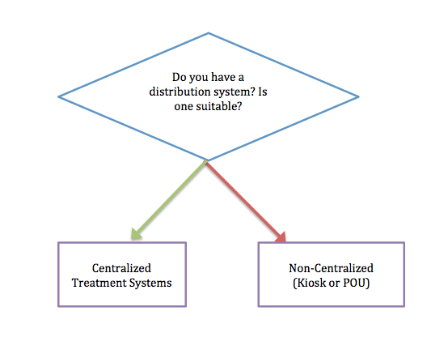
Decision Tree
Existing centralized system?
Community Size
Region
Turbidity
Heavy metal contaminants
Notes:
1. Get flow rate using community size and region (Use per capita consumption)
2. Are we getting enough data from the user?

Slide 5
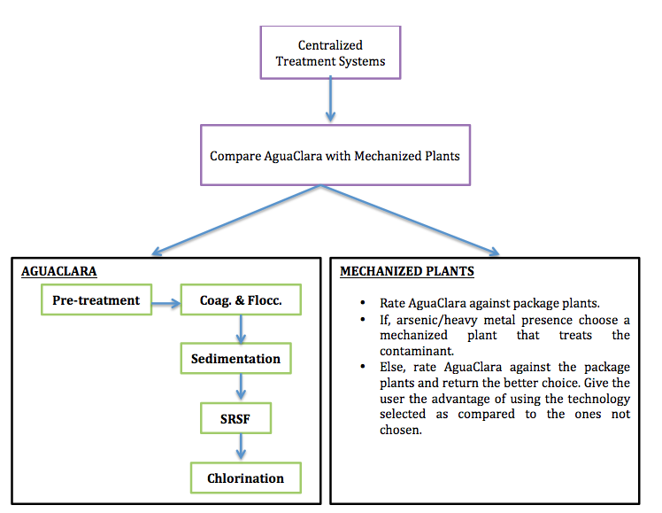
Decision Tree
Notes:
User inputs will prompt us to decide between AC and MP - depending on inputs (and in future, on other sources of water) we might not suggest all stages
Choose AC if no heavy metal/arsenic present

Slide 6
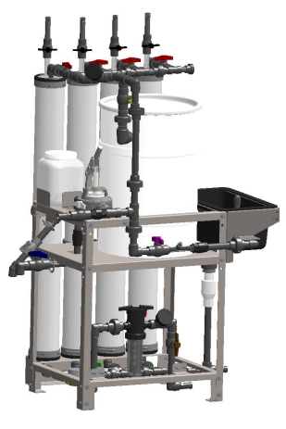
Decision Tree
Kiosk
  Larger community
  Smaller funds
POU
  Small community
Membrane Filter Kiosk
Notes:
Kiosk is more ideal - there are newer designs (such as pictured) that can:
1. serve high populations (up to 3500 gal/day
2. not use electricity
3. be easily transported/lightweight/easy to install

Slide 7

Technology Platforms
LabVIEW, LabVIEW Web UI Builder
Web Technologies
  PHP, HTML
  mySQL
Notes:
The technologies we have looked into so far are LabVIEW, LabVIEW UI Builder and some web technologies like PHP, HTML, mySQL.
Link for pictures:
1. http://www.nyu.edu/classes/mcdonough/m&eiii.htm
2.http://codewiz.biz/article/post/Crash+Course+in+MySQL+for+PHP,+Inserting,+Updating,+and+Querying+to+display+in+HTML#.UyS4l61dXk4

Slide 8
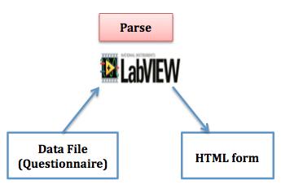
LabVIEW
HTML Generation in LabVIEW
Notes:
Now I will demonstrate the flow of the application If we the platform chosen was LabVIEW.
1. The initial questions will be stored as a data file, which will be fed into LabVIEW. LabVIEW would parse the data file, and create an HTML form which the user would fill out.

Slide 9
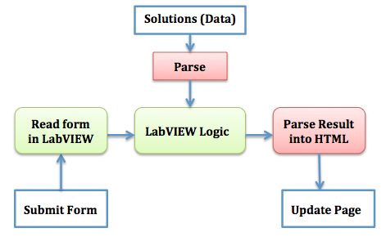
LabVIEW
LabVIEW Architecture
Notes:
In the next stage, the user fills out the form and hits the submit button.
1. LabVIEW parses the submitted form and stores the information in its data structures.
2. LabVIEW also parses the solutions data file and stores it in some data structures.
3. LabVIEW logic chooses the best result, and then parses the result again into HTML format to update the HTML format

Slide 10
LabVIEW
Advantages
  Graphical code - easy to understand
  Change data files, without changing LabVIEW code
Disadvantages
  Complexity (Parsing)
  Difficult to handle dynamic events
  Compromises styling
Notes:
Using LabVIEW, has its share of advantages and disadvantages
1. LabVIEW code is easy to understand,
2. The future users would just modify data files, and not touch the LabVIEW code
Disadvantages :
1. Parsing is complicated!

Slide 11
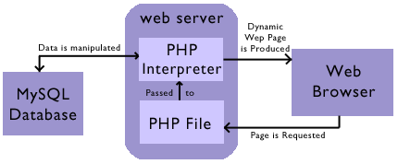
Web-Based Technologies
Architecture of a Web-Based Application
Notes:
On the other hand, if we use web-based technologies we would have,
1. The form written in HTML, and results pre-stored in a mySQL database
2. Would use PHP -
a. Acts as a bridge between the web browser and web server(server scripting language, powerful tool for making dynamic and interactive Web pages).
b. The user would send a request to the web-server which would fetch the result from the mySQL table, which would then be returned by PHP to the web browser

Slide 12
Web-Based Technologies
Advantages
  Makes the user experience very interactive, good looking and dynamic
  Industry standard for web-based applications
Disadvantages
  Updating data requires some programming knowledge
Notes:
1. Allows us to use other web technologies like Ajax - to update web pages dynamically
2. Most web based applications are made using these technologies, so it is easier to solve issues/find solutions

Slide 13

The Road Ahead
Working prototype
Long Term Goals:
Ideally integrate with
  Plant Cost Calculator
Incorporate in AguaClara design engine
Notes:
Going forward, we would ideally want to finish making a small working prototype(Surface water).

