Slide 1
Plant Cost Calculator
Andrew Bales, Chris Mills, Derrick Yee

Slide 2
Purpose
Create a calculator that provides accurate plant cost estimates
Ultimately provide user with valuable information in an effort to encourage them to construct an AguaClara plant

Slide 3

Data Review
We were provided with an abundance of plant cost information
We reviewed this data and consolidated relevant information
Used information that would provide balance between accuracy and feasibility

Slide 4

Data Analysis
Needed an accurate estimate of capital cost vs. flow rate
To do this we first corrected costs for the new stacked rapid sand filtration systems on new plants
Plotted this data and performed a regression

Slide 5
Regression
We chose to use a linear regression
An exponential or quadratic regression would have been influenced by outliers too heavily
With so few data points outlier can dramatically alter results

Slide 6
Linear Regression
Y = -95.892x + 10567

Slide 7
Equations
Final Population
Design Cost
Wage Cost
Monthly Chlorine Cost/person
Monthly Coagulant Cost/person
Monthly wage cost/ person
Pf = Pi * ((1 + n) /100)^t
D = C * q * Pf / 86400
W = h * t * E * 8765.81
Cl = dcl * ccl * q * .70 *d
Co = dco * cco * q *.70 * d
Cw = E * w * 730.48 / Pi

Slide 8

Exploring web editors
Considered visual editors such as Kompozer
Also considered PHP and HTML
Ultimately chose PHP and HTML because they allowed for more freedom and were compatible with MySQL

Slide 9

Mamp
AguaClara host currently does not support PHP
We used an application called Mamp
Gives access to local PHP server which allowed us to test our calculator

Slide 10
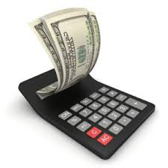
The Calculator
Requires 7 user inputs
Has default values but allows users to update them
Allows user to reset values to default without changing other inputs
Outputs initial construction costs and operating costs

Slide 11
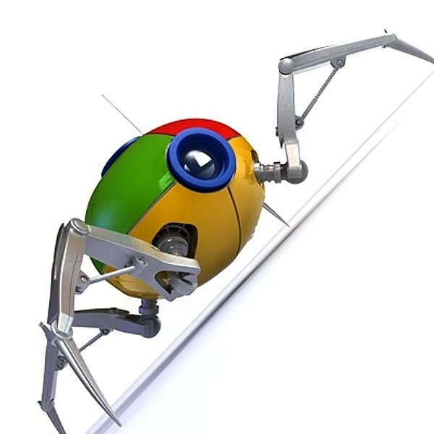
Currencies and units
Allows users to enter information in Lempiras, Indian rupees and USD
Utilizes a web crawler to access up-to-date currency exchange rates
Accepts data in metric or standard units

Slide 12

Future Work
Host cost data online to automatically compute regression
Create a more intuitive and informative front end that aligns with current AguaClara website
As more plant data comes in create a more refined cost estimate

