Slide 1
Water Treatment Technology Selection Guide (WTTSG)
Yao Lu, Larissa Sakiyama, and Sarah Sinclair

Slide 2


Background
Water Treatment Technology Selection Guide
Plant Cost Calculator
Integrate into a single web application
Give most appropriate recommendations possible

Slide 3
Technology Comparisons
FIME
Package plants
Direct Filtration
Kiosks
Filters
How to present data clearly and effectively?

Slide 4
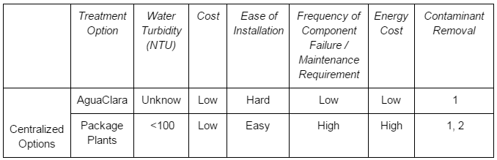
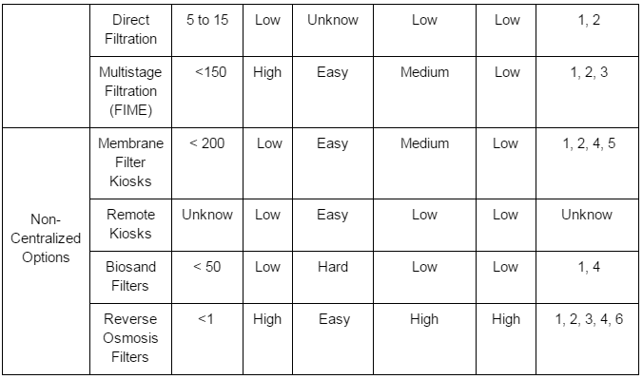
Technology Comparisons
Notes:
What does the table do:
How to use this table:

Slide 5
Options and Parameters
Relevant Changes Were Made:
Treatment option civil works eliminated (poorly ranked in almost all categories)
Direct filtration added
Category ‘quality of treated water’ was replaced by the parameter ‘water turbidity’
‘Contaminant removal’ category added

Slide 6
Plant Cost Calculator
Plant Cost Calculator
Estimating water treatment cost: User inputs
· Per capita demand
· Population growth
· Initial population
· Plant adequacy
· Dose Coagulant
· Cost Coagulant
· Dose Chlorine
· Cost Chlorine
· Monthly Wage
· No. Employees
· Purity of calcium
hypochlorite

Slide 7
Plant Cost Calculator
Plant Cost Calculator
Total monthly cost for operation and maintenance:
building energy
cost coagulant
cost chlorine
wages expense
maintenance material requirement
Total plant cost = Capital cost + monthly operating costs + monthly maintenance costs

Slide 8
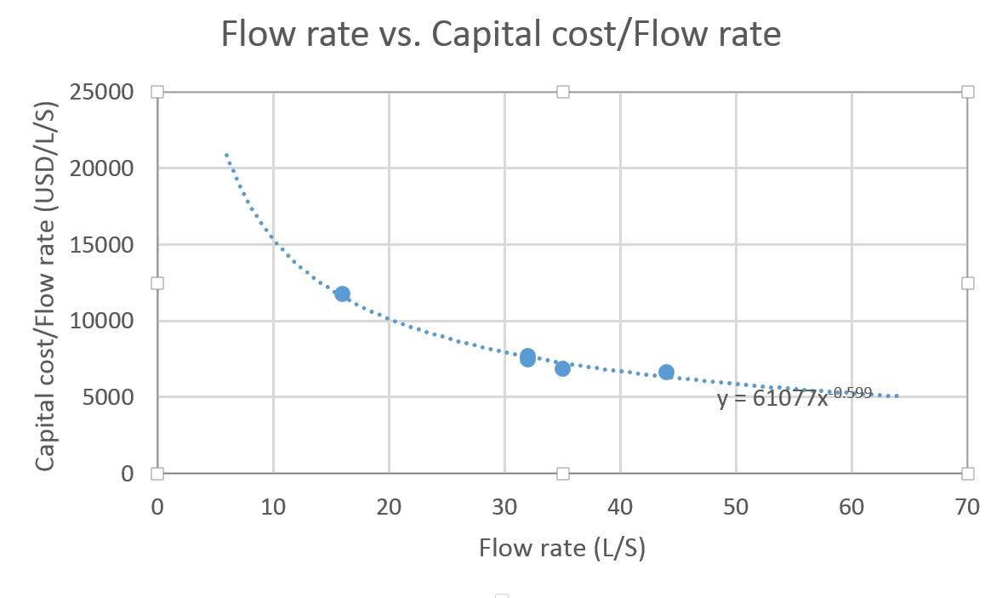
Plant Cost Calculator
Plant Cost Calculator
Curve Fitting with Linear Regression:
C = 61077*f ^{-.599}

Slide 9
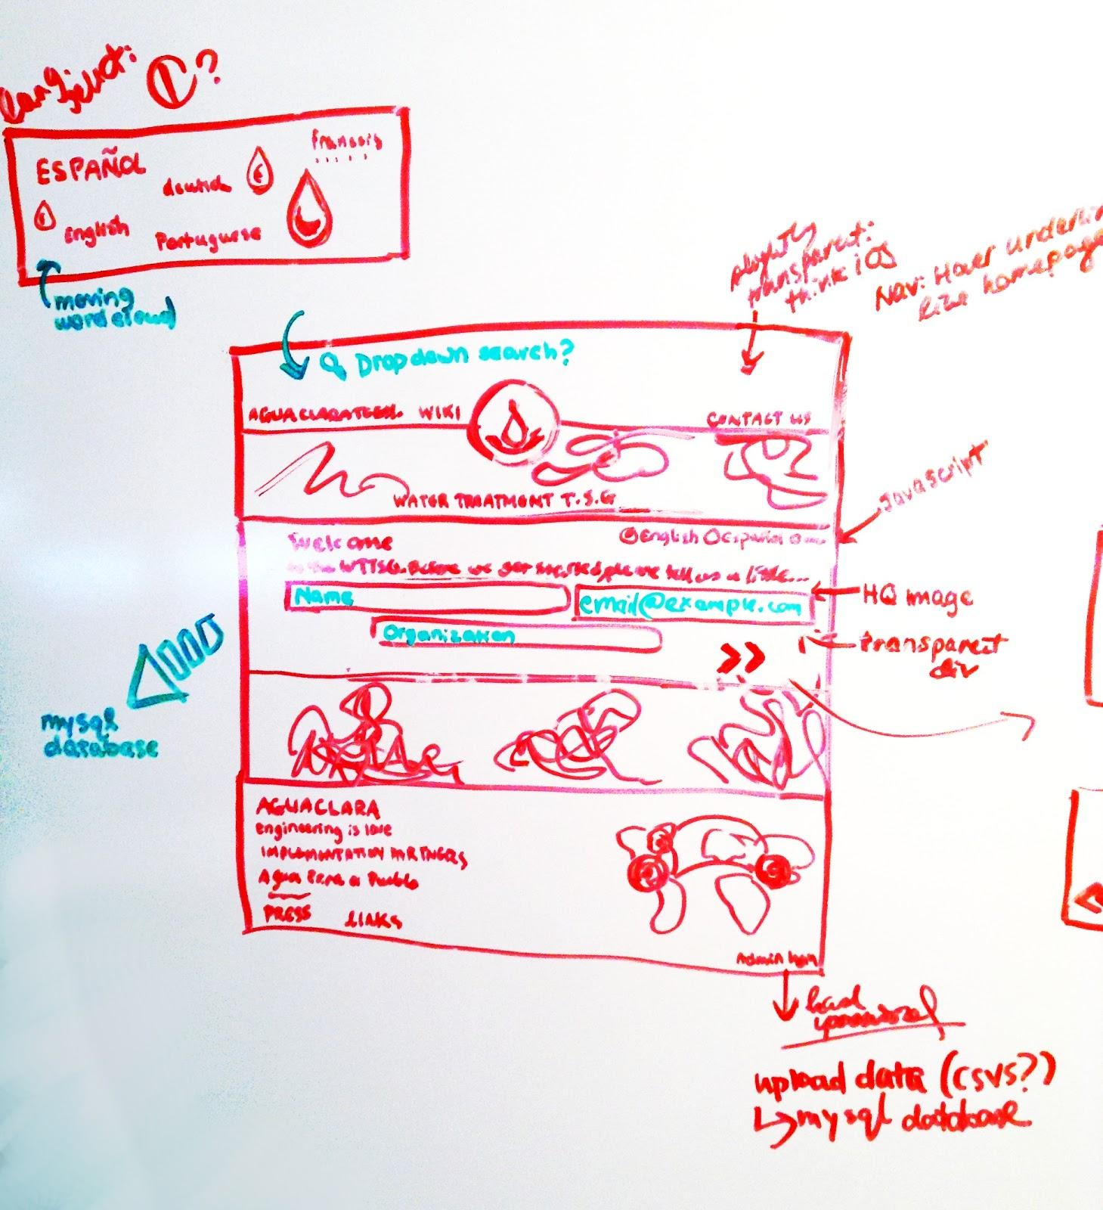

Implementation
Notes:
stop one on the journey: brainstorming the layout and design of the site

Slide 10
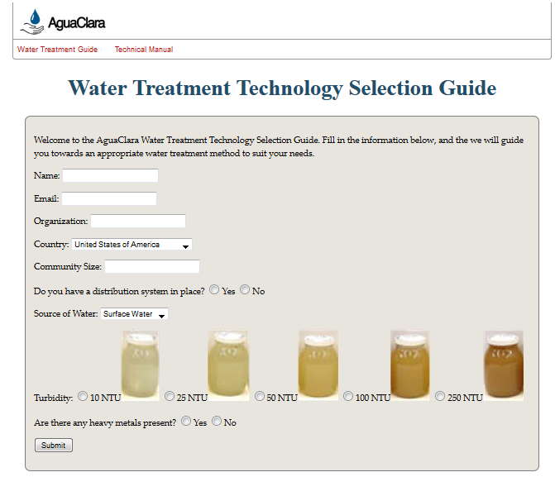
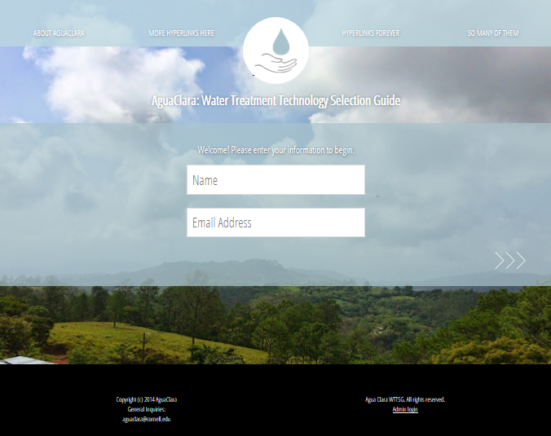
Implementation
Notes:
previous website uninspiring. now features like parallax scrolling, cool javascript to manage transition from one page to the next, etc

Slide 11
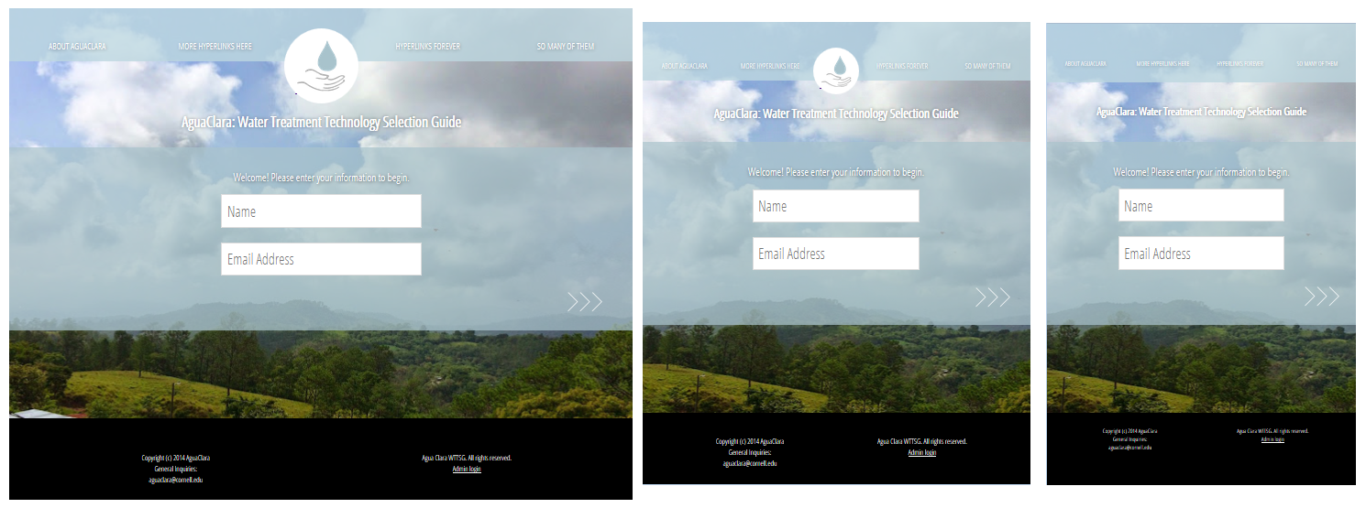
Implementation
Notes:
Dynamically resizes to best fit browser width

Slide 12
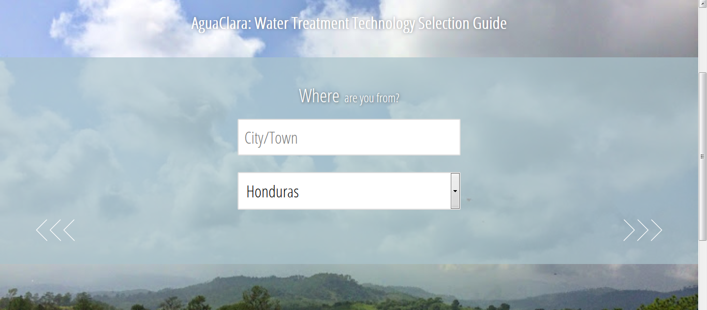

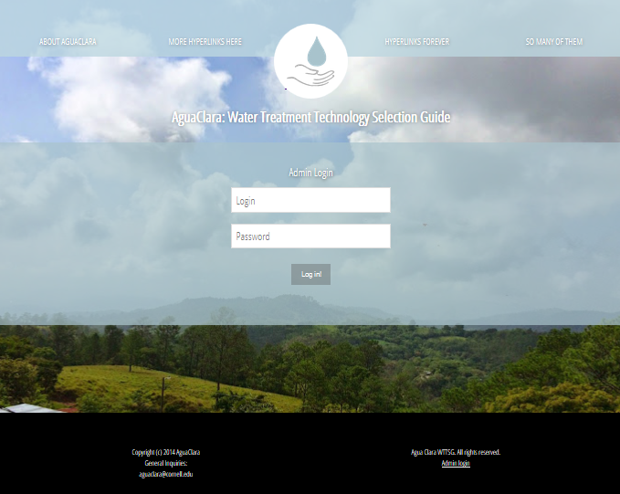
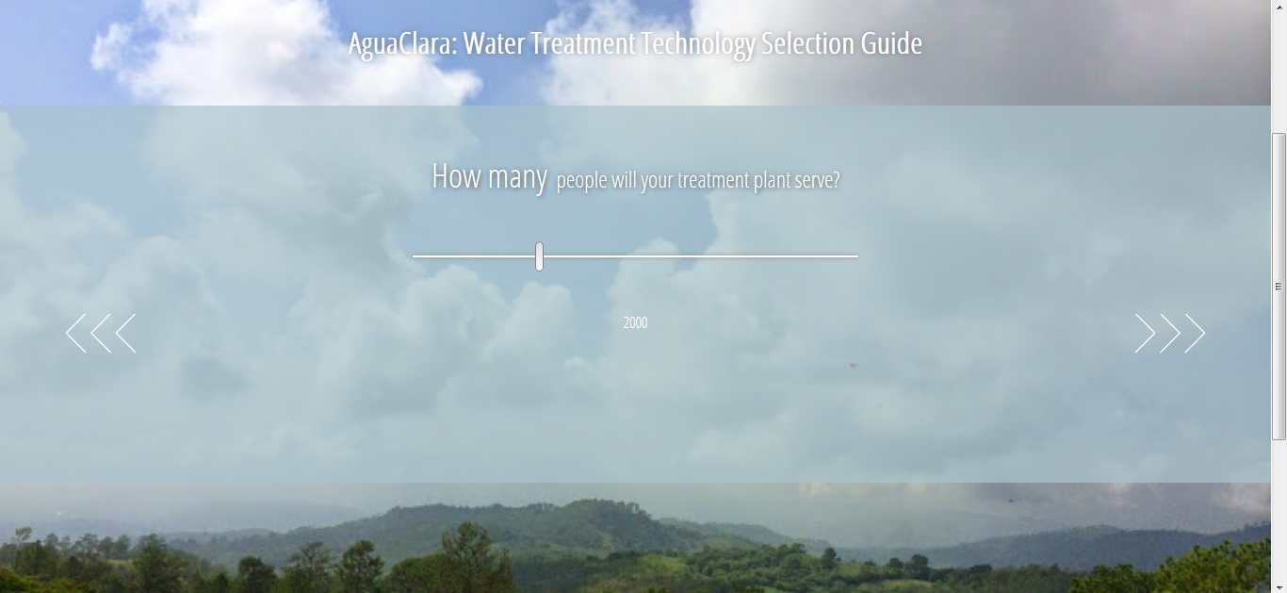
Implementation
Notes:
various inputs, login fields, favicon, and other touches being added to the implementation

Slide 13
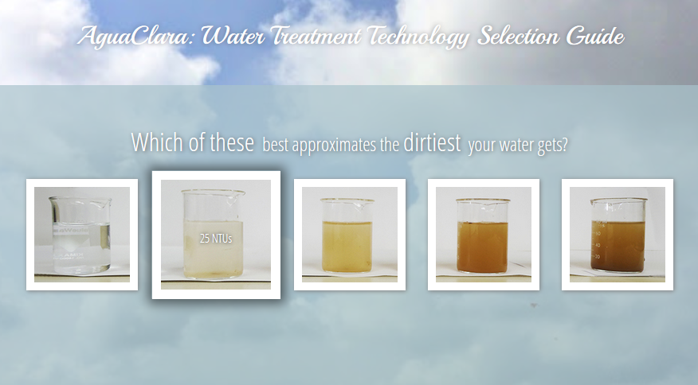
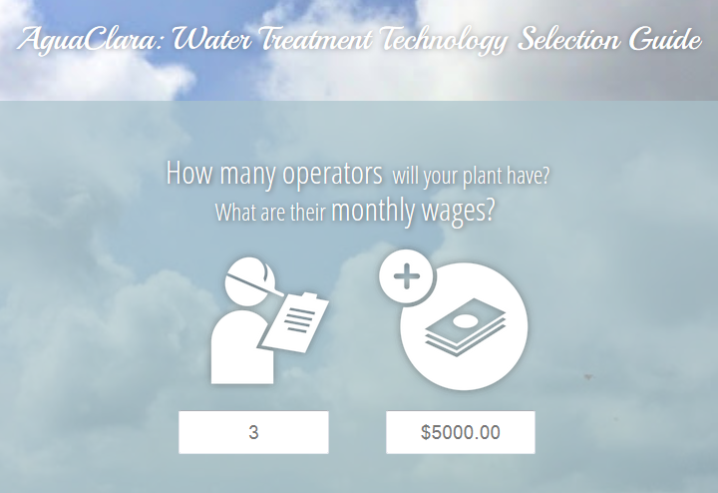
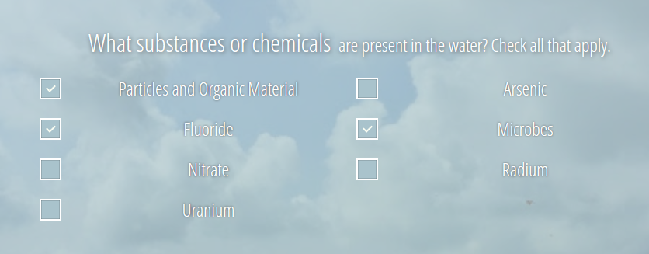
Implementation
Notes:
various inputs, login fields, favicon, and other touches being added to the implementation

Slide 14
Implementation
Data passing
Autofilled forms
Interacting with database
Notes:
various inputs, login fields, favicon, and other touches being added to the implementation

Slide 15
Future Work
Dynamic results page
MySQL functionality
Automatic regression
Language translation
Deploy site!

Slide 16

Any Questions?
?

