Slide 1
Village Supply System-Pump Design Subteam
Qingjing Gong
Anqi Wang Erika Axe
10/22/2014

Slide 2
Tasks
Research pumps/pressure requirements
Research parameters and constraints
Research pump curves, making solar panel angles manually adjustable.
Evaluate the two options
Notes:
Erika: Divide the power between the two pumps. Chlorine contact tank at the effluent from the treatment plant remains at the target level. The control system of this option is simple and easy to maintain. The photovoltaic system design can handle cloudy days of winter.
Divert all of the power to the first pump on cloudy days, and make sure that villagers can collect water from the ground level chlorine contact tank. In this option, the control system should automatically divert all of the power to the well pump when the chlorine contact tank isn’t full.

Slide 3
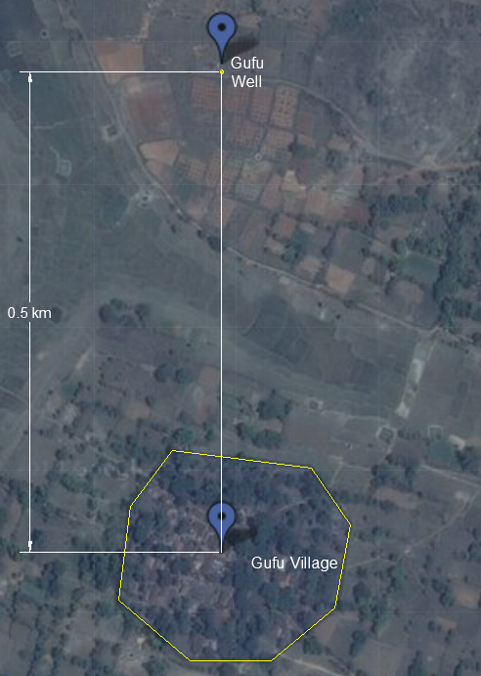
Gufu Village
Assumptions:
-per capita demand is 100 liters per day;
-village population of 500 people;
-5 people per household.
Notes:
Anqi: The elevated storage tank supplies over 50% water for daily usage. To fill the elevated storage tank, the water is pumped from a well, which is half km outside the village by using pump. Before sending the water to each household, the water will be treated through low flow stacked rapid sand filter. There are three assumptions based on 2013 design.

Slide 4
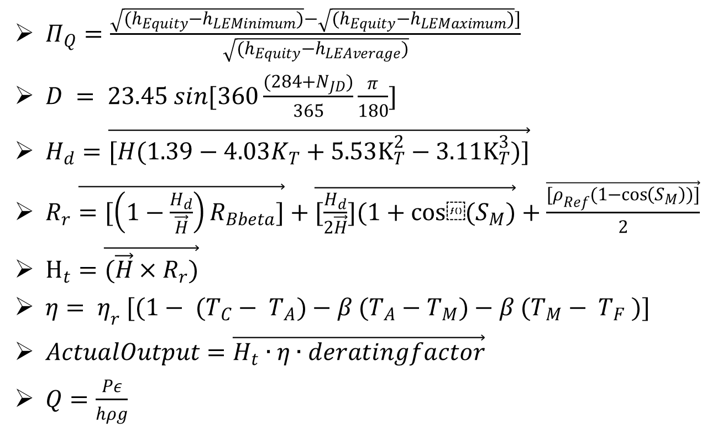
Spring 2014 Design
$Π_{Q}=\frac{\sqrt{(h_{Equity}−h_{LEMinimum})}−\sqrt{(h_{Equity}−h_{LEMaximum})}]}{\sqrt{(h_{Equity}−h_{LEAverage})}}$
$D = 23.45 sin[360\frac{(284+N_{JD})}{365}\frac{π}{180}]$
$H_{d}=\vec{[H(1.39−4.03K_{T}+5.53K_{T}^{2}−3.11K_{T}^{3})]}$
$R_{r}\vec{=[\left(1−\frac{H_{d}}{\vec{H}}\right)R_{Bbeta}]}+\vec{[\frac{H_{d}}{2\vec{H}}](1+cos⁡(S_{M})}+\frac{\vec{[ρ_{Ref}(1−\cos\left(S_{M}\right))]}}{2}$
$H_{t}=\vec{(\vec{H}×R_{r})}$
$η= η_{r} [(1− (T_{C}− T_{A})−β (T_{A}−T_{M})−β (T_{M}− T_{F} )]$
$ActualOutput=\vec{H_{t}∙η∙deratingfactor}$
$Q=\frac{Pε}{hρg}$
Notes:
Qingjing: Explain equation we will use.

Slide 5
Pump Availability in India
Power: 0.33 HP to 10 HP (or 0.25 kW to 4 kW)
Pressure capacity: 0.65 bar to 160 bar
Flow rate capacity:120 L/ min to 350 L/min
Pumps are chosen in India through a detailed process, without much experimentation
Notes:
Erika: Based on Pumpkart website. Evaluate the steps in which the pumps are selected in India: the pump power is chosen is first by determining the demand in the village. Take the number of liters per person per day and project for ten years out, it can be determined how many liters are needed in any given day. Examine the spec sheet for the Grundfos submersible solar pumps and find a chart that gives total volume of water pumped in a day based on pump strength and head. Choose the pump that matched the pumping head and required volume. Assume some number of hours the pump would run based on how sunny the location. Take the total volume divided by the assumed number of hours to get an average flow. Assume a ratio for peak flow versus average flow and use peak flow to find how many filters are required.

Slide 6
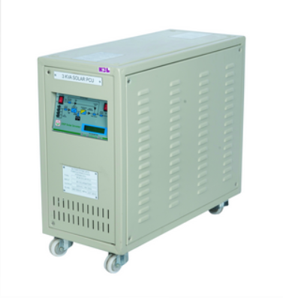
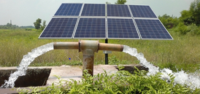
Solar Panel
Solar Panel
Charge Controller
Notes:
Qingjing: According to Maysoon, the solar pump is paired with HBL panels in Gufu village. HBL has a wide range of solar panels.
Add an introduction of charge controller.

Slide 7




Mathcad Code Review
Power (pump has 45% of the efficiency)
Costs
Notes:
Anqi: To find the power needed for the plant, the first step is to calculate the elevation changes.

Slide 8
Conclusion
What have we done?
  Background Research
What needs to do next?
  Evaluating new designs and plans
Notes:
Erika: What have we done: Laid the framework of our background research and all the factors we will need to consider as a group in order to make improvements and evaluate different designs. What to do next? Work on our different ideas for one pump versus two as well as optimization based on monsoon versus dry season as depicted by the detailed task list.

Slide 9
References
Kelterborn, D., Levine, S., Parisi, N., & Whiteheart, R. (2014, May 16). Village Source to Environment. Retrieved September 15, 2014, from https://confluence.cornell.edu/
Solar Products. (n.d.). Retrieved October 10, 2014, from http://www.hbl.in/home

