Slide 1
Village Source to Environment
Diana Kelterborn, Sarah Levine, Nick Parisi, & Rachel Whiteheart

Slide 2
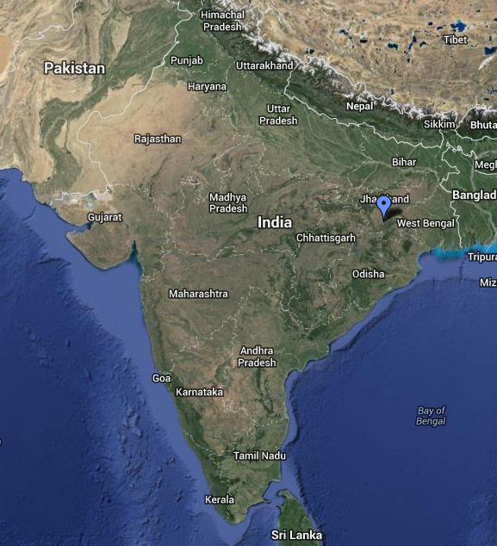
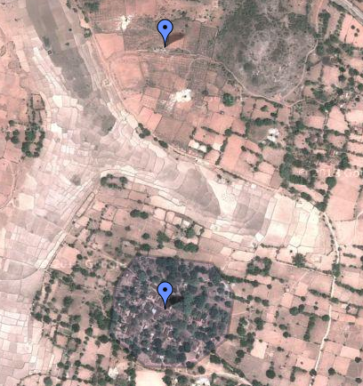
Background/Why
Notes:
Recap from last semester:
Designing a water distribution and storage system for Gufu Village in India (we estimated 250 people)
Currently in India there is an elevated storage tank that fills twice daily in the center of the village
Pipe connects well to this tank
Villagers improvise household storage for constant access to water
ASK: What are problems with this current system? Why would we want to change it?
Water is pumped from a well outside the village, through an AguaClara LFSRSF filter
This system is inefficient, inconvenient, and unsanitary

Slide 3
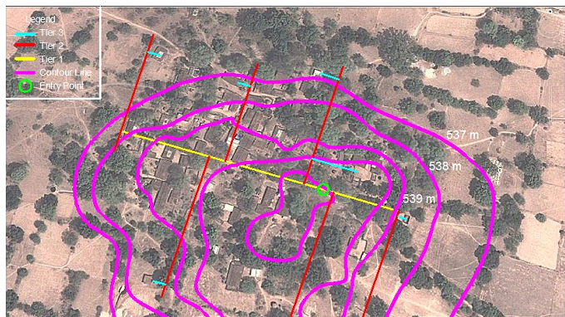
Background/Why
Notes:
Recap from last semester:
Working off The 2canzzzz’ design from 4540
3 tiers of pipe distribute water directly to each house
Green circle = entry, yellow = primary tier,….
This layout controls elevation variability and minimizes differences between length of piping leading to each house
Since the flow rate of water entering each house is determined by the head available to push water to each house, controlling this elevation variability/length (headloss) is important
See next slide

Slide 4

Background/Why
Notes:
…demonstrated by this HGL
The pump provides a certain amount of head (hp) that pushed water through the transmission line and the distribution system. When the water enters the village, it has a certain amount of head (heq) available to push water through the system.
This heq needs to be big enough to overcome elevation differences/head losses for each house so that each house receives an equitable amount of water
Ie difference in flow provided between 5 ft and 3 ft vs 105 and 103 ft -> difference is more spread out
Want no house to receive 10%+ more water than any other house
Set this pi.Q in terms of head (heq and head losses)
By setting this pi.Q < 0.1, we’re forcing flow to be equitable and then determining other parts of the system to maintain this equity

Slide 5
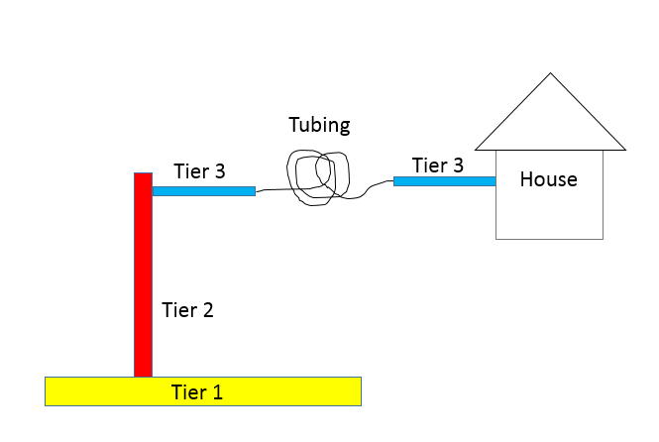
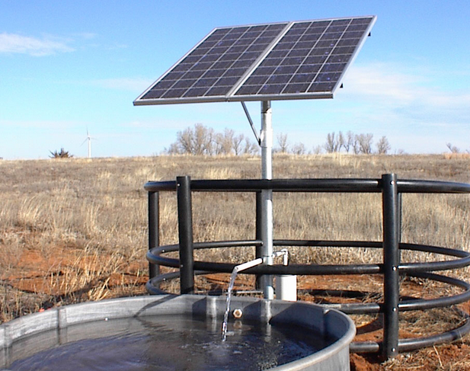
Goals
Notes:
The 2canzzzz’ design used orifices at each house to restrict flow and achieve equity
Orifice at each house could be tampered with, or clog
We want to replace orifices with tubing as head loss element
Design a storage tank/sink for each house so villagers always have access to water (and can’t be contaminated)
Size the PV system necessary to get enough water from the well to each house
Design a safety system so villagers get water even on cloudy days
Optimize the entire system for cost
FLEXIBLE/APPLICABLE CODE THAT JUST REQUIRES A FEW INPUTS AND THEN SPITS OUT SOLUTION/DESIGN

Slide 6
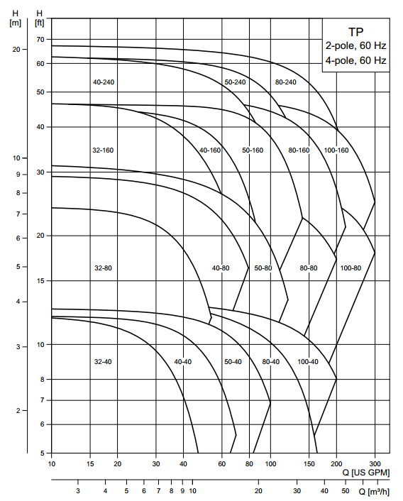
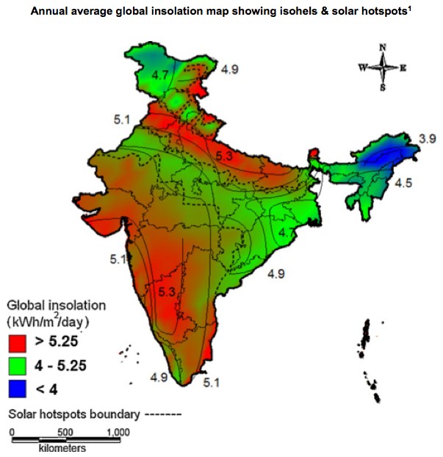


Current Work
Declination angle equation
Pump curves for Grundfos pump company
Power output equation
Notes:
Old code assumed linear (cost/watt) function for solar and then chose a pump after iterations
We want to use a more realistic cost function that iterates based on flow and head required for equity to find number of panels required and pump types for each iteration
Pump curves from different manufacturers -> programming them in to be able to pick a pump for each flow rate/head combo (explain graph axes)
Solar calculations are based on multiple factors
Explain equations shown
Explain how first equation (declination angle based on time of year) reflects variability within system
Some challenges, which will be discussed in the next slide

Slide 7
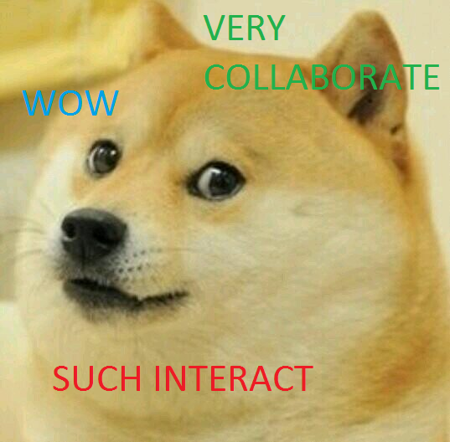
Challenges
Acquiring solar data
Elevation variations affect equity head required
Length of tubing is too long
PVC to tubing fittings
Notes:
Hard to find data for Gufu (cloudiness index, solar insolation)
Trying to model variability within the region; can’t find enough data to do this
Since head required is chosen to maintain equity, and this is impacted by elevation differences, this is difficult to maintain without changing code
What are some ways you can think of of dissipating this head and therefore requiring less tubing
Hard to find fittings that fit our system. System is limited by what we can find

Slide 8
Potential Solutions
Vary length of tubing at each house based on difference in elevation from the average elevation
Decrease diameter of tubing
Put multiple larger orifices in box at street level
Notes:
Pull out elevation differences from determining head equity and insert later into code
Tubing diameter currently limited by size of adapters/fittings we could find, but if that’s not a limiting factor…
Move orifice into box where tubing would be located, so it can’t be tampered with
Larger orifices would prevent clogging
Cheaper!

Slide 9
Next Steps
Finish integrating codes
Acquire accurate solar parameters and data and apply to code
Decrease length of tubing required
Create code to test for variability
Design for growth
Notes:
Variability code-> weather, pumping performance, solar panel performance

Slide 10
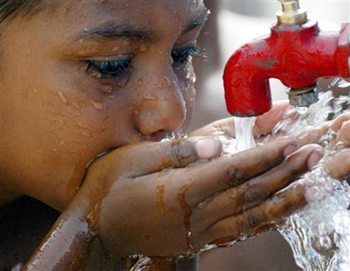
Questions?
Does anyone have questions?

