Slide 1
Village Source to Environment
Diana Kelterborn
Sarah Levine
Nicholas Parisi
Rachel Whiteheart

Slide 2
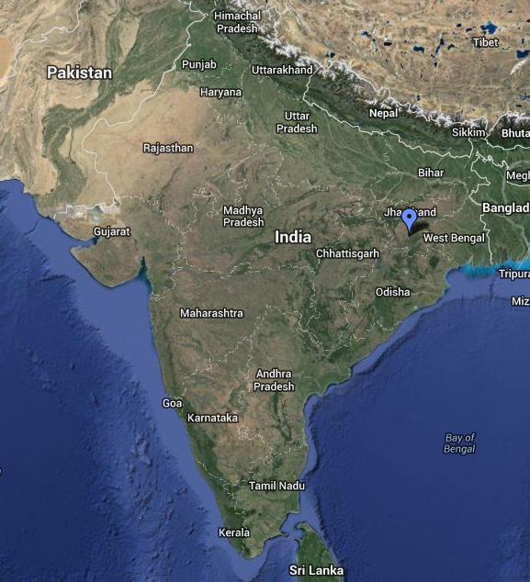
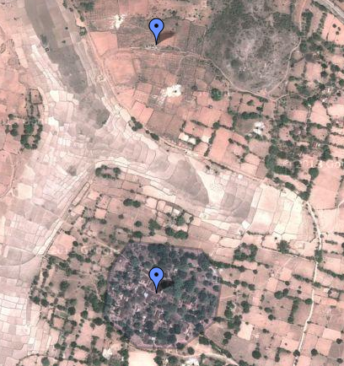
Background
Notes:
Sarah
Recap from last semester:
Designing a water distribution and storage system for Gufu Village in India (we estimated 250 people)
Currently in India there is an elevated storage tank that fills twice daily in the center of the village
Pipe connects well to this tank
Villagers improvise household storage for constant access to water
This system is inefficient, inconvenient, and unsanitary
Water is pumped from a well outside the village, through an AguaClara LFSRSF filter

Slide 3
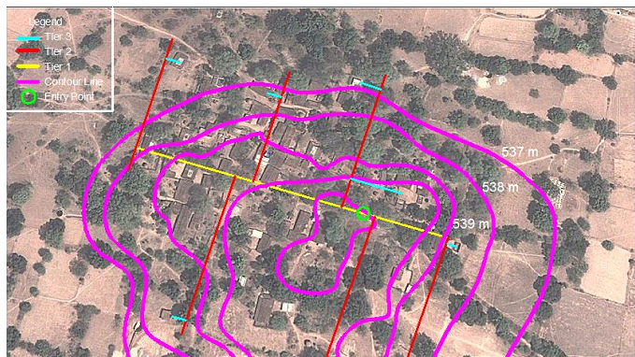
Background
Notes:
Sarah
Recap from last semester:
Working off The 2canzzzz’ design from 4540
3 tiers of pipe distribute water directly to each house
Green circle = entry point where transmission line comes in, yellow = primary tier,….
This layout controls elevation variability and minimizes differences between length of piping leading to each house
Since the flow rate of water entering each house is determined by the head available to push water to each house, controlling this elevation variability/length (headloss) is important
This idea of minimizing available head (energy) at each house is how we maintained similar flow rates for each house, as will be described in the following slides

Slide 4
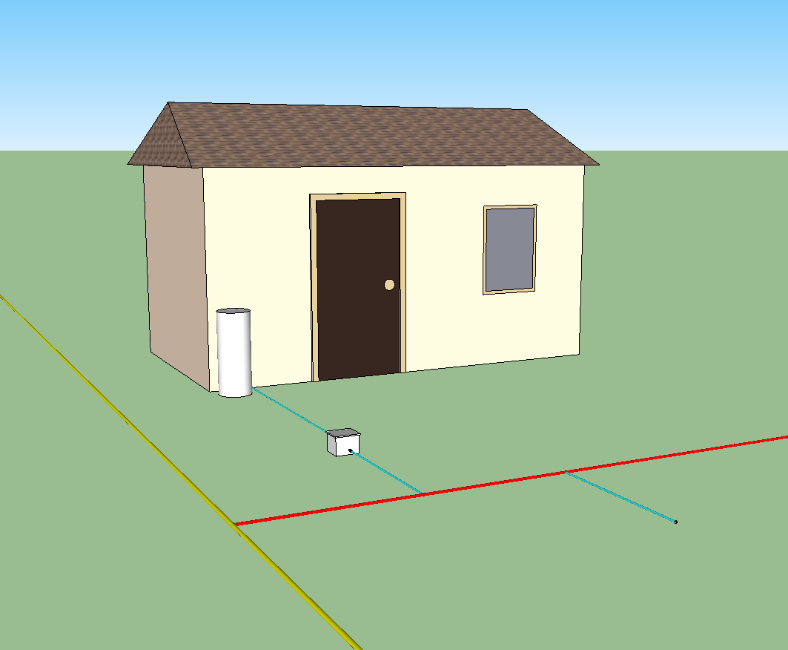
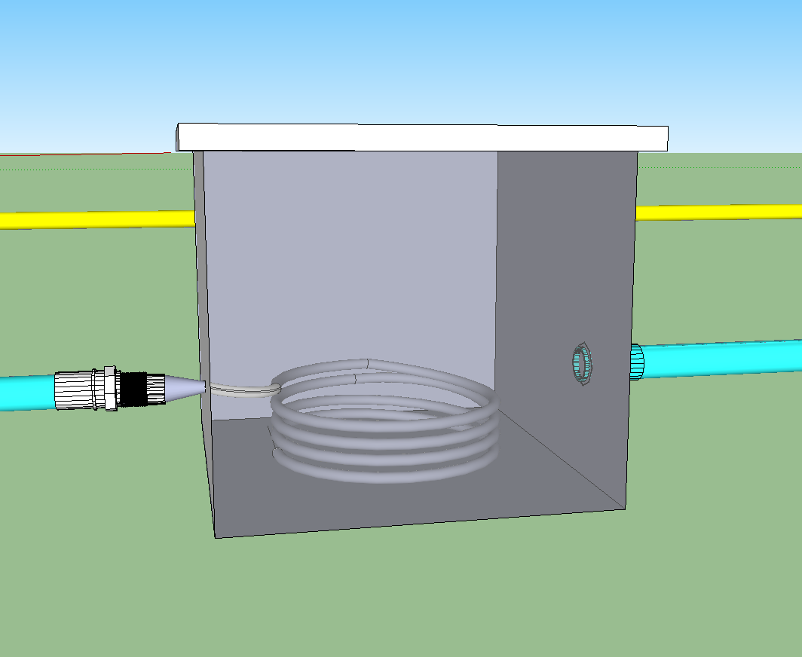
Schematic
Notes:
Sarah
Last year’s group used orifices to restrict the flow at each house and keep a high pressure throughout the system
Orifices are tiny holes and can clog easily
Could easily be widened and change flow distribution for houses
We’re using small diameter tubing stored in box at street level to restrict flow
Less prone to clogging
Stored in box so can’t be easily manipulated
Easy to put flow meters at boxes and monitor actual flow going to each house
Explain drawings

Slide 5
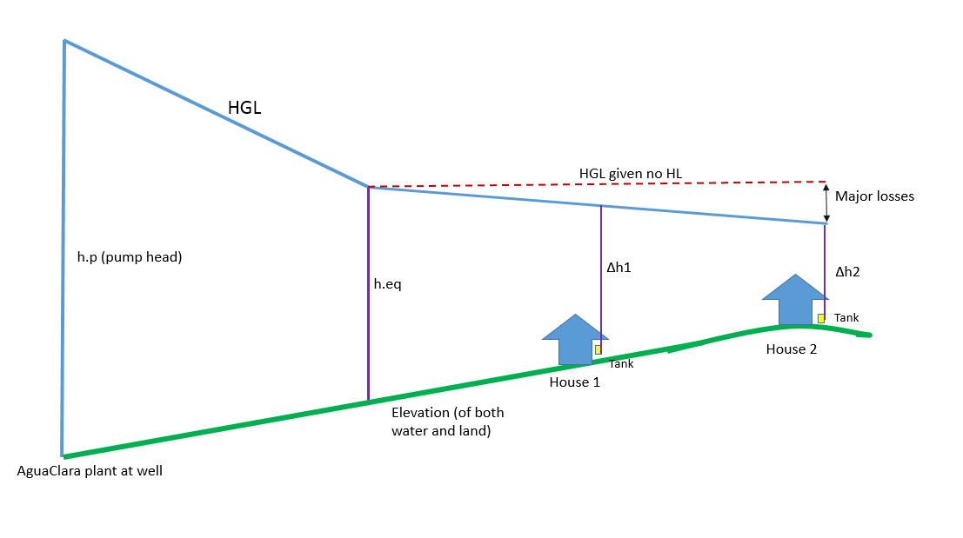

Theory
Notes:
Rachel
Explain theory
…demonstrated by this HGL
The pump provides a certain amount of head/energy (hp) that pushes water through the transmission line and the distribution system. When the water enters the village, it has a certain amount of head/energy (heq) available to push water through the system.
This heq needs to be big enough to overcome elevation differences/head losses for each house so that each house receives an equitable amount of water
Ie difference in flow provided between 5 ft and 3 ft vs 105 and 103 ft -> difference is more spread out
Want no house to receive 20%+ more water than any other house (all house flow rates are within 10% of the average)
Set this pi.Q in terms of head (heq and head losses)
By setting this pi.Q < 0.2, we’re forcing flow to be equitable and then determining other parts of the system to maintain this equity

Slide 6
Algorithm Map Part 1
Step 1:
Distribution Design
Calculate Length of Tubing Required
Calculate Cost of tubing
Inputs
Population, Population Density, Π.Q, sun hours, System Geometry, available pipes/tubing
Calculate head loss through tubing
OUTPUT 2
Village Flow Rate
Pump Head Required (h.Eq) for System Equity
OUTPUT 1
Total System Cost
Calculate Required Village Flow Rate
India Solar Data 1
Global Monthly Daily Average Solar Radiation
Choose a Pump to meet flow and head needs
Required Input Pump Power (W)
OUTPUT 3
Number of Solar Panels Required
Notes:
Rachel
Summarizes the basic steps in our algorithm:
Designing system that could be applied anywhere -> all inputs are site-specific and be easily put in by user
We assumed 48 houses in village, 5 people per house, and per capita flow of 100 L/day
Used the town geometry as shown above
Assume turbulent flow through tubing at each house (one of many iterations)
Each iteration of code took a different set of available pipes/tubing as input and found
Head loss through tubing required to even out flow rate at each house (took out elevation differences between houses because this made length of tubing required infeasible)
Length of tubing required to deliver required head loss for each house
Cost of the system (tubing, pipes, tees and adapters)
Then, using head loss through the system, determined a pump head required to provide equity
Used this, and flow rate, to find a pump to meet flow and head needs and then used this to find solar panels required to provide requisite power
Total cost of system= cost of PV + pump + PVC

Slide 7
Efficiency Curves
Notes:
Rachel
Curves for Grundfos pumps but these are not the same pump types
Applied them to Grundfos, which is in use in India now
Only curve we could find in terms of incoming watts…just an efficiency rating is not enough
Needed to determine how many panels would deliver the required amount of water

Slide 8
Final Solution
540 m Tubing
System Component | Diameter (in) | Cost (USD)
Tubing | 0.25 | 1,090
Tier 3 | 0.5 | 1,680
Tier 2 | 0.75 | 970
Tier 1 | 2.0 | 800
Transmission Pipe | 2.0 | 2,410
Notes:
Diana
Even divide: 11 m per house
Not exact do to equity constraints and elevation differences: actual range 1m – 30m

Slide 9
Final Solution
10 solar panels
1.5 horsepower pump
1.96 meters of equity head
16.2 meters of total pump head required
Cost
Solar Panels | $18,800
Pump | $1,384
Pipes | $6,953
Total | $27,140
Notes:
Diana
1.96 = amount of head we’re adding to the system to ensure equal flow
16.2 = 1.96 + head loss through the transmission line. i.e., what we need to pump
Other iterations had ridiculous cost/quantity of tubing. This is the most realistic solution
Solar panel cost = cost of equity
If we can bring cost of solar panels down, system will be must more feasible

Slide 10
Algorithm Map Part 2
Step 2:
Variability Assessment
Inputs (from previous part)
Pump Head Required
Pump Power Required
Number of solar panels
India Solar Data 2
Hourly Incoming Solar Radiation
Check with SunPump Efficiency Curves
OUTPUT 4
Output Q from Pump
Pump Efficiency
OUTPUT 5
Ratio of Required Daily Water Volume : Volume output from Pump
Notes:
Diana

Slide 11
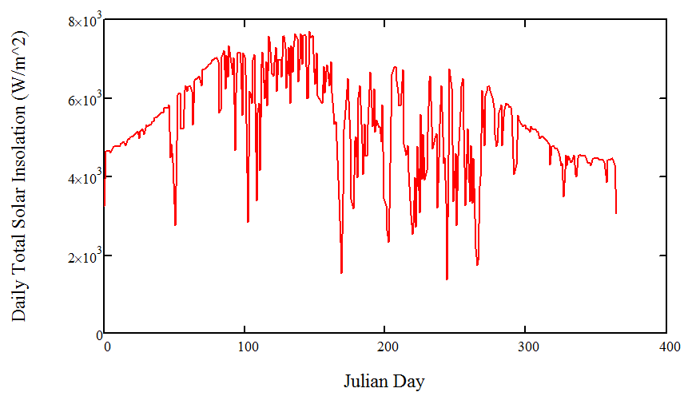
Daily Solar Insolation
Notes:
Diana

Slide 12
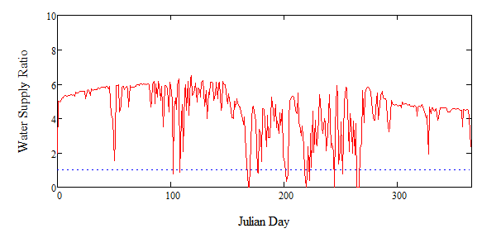
Variability Check
Consecutive Fails Count
1
1
2
2
3
3
1
1
1
Notes:
Nick
-according to a study from Colorado State University, you should design your storage tank to hold up to 3 days worth of water to account for cloudy days

Slide 13
Future Work
Use solar data from multiple years
Size household storage tanks
Design for growth and variability
Make more user-friendly
Include flow type variability
Incorporate more accurate pump efficiencies
Notes:
Nick

Slide 14

Questions?

