Slide 1
Village Supply System-Pump Design Subteam
Qingjing Gong
Anqi Wang Erika Axe
12/14/2014

Slide 2
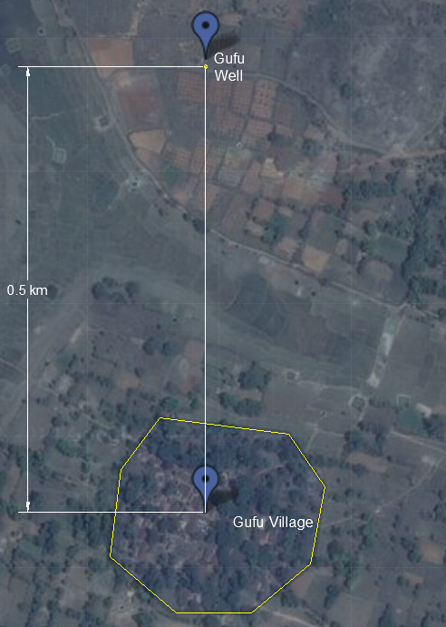
Overview of Symposium
Tasks
Basic Info for Gufu Village
Spring 2014 Design
MathCAD Code
Background Research
Evaluate the two different designs
Notes:
Erika:
Tasks: Research pumps/pressure requirements, Research parameters and constraints, Research pump curves, making solar panel angles manually adjustable, Evaluate the two options
Gufu Village: -per capita demand is 100 liters per day; -village population of 500 people; -5 people per household.
Pump Availability: Power: 0.33 HP to 10 HP (or 0.25 kW to 4 kW), Pressure capacity: 0.65 bar to 160 bar, Flow rate capacity:120 L/ min to 350 L/min, Pumps are chosen in India through a detailed process, without much experimentation

Slide 3


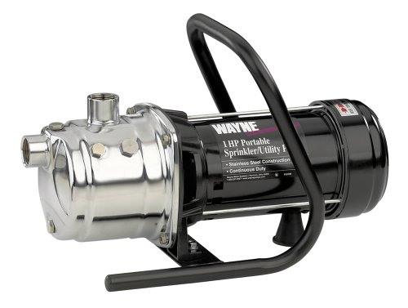
Power Requirements
Gufu village elevation: 538 m
Gufu well elevation: 527 m
Peak sunlight hours: 6 hours
Total head loss: 3.09 m
Elevation changes: 13 m
Water pump efficiency: 45%
Power needed: 0.936 Hp
2-pump system
0.5 Hp, 720 GPH pump
Notes:
Anqi: To find the power needed for the plant, the first step is to calculate the elevation changes.

Slide 4
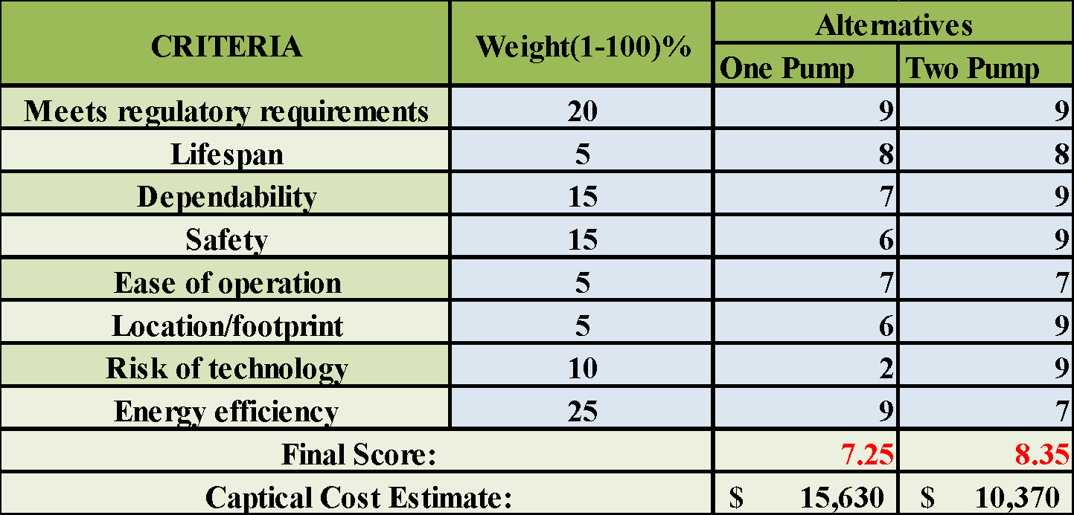
Evaluating the Two Different Pump Designs
Multi-Criteria Decision Analysis
Notes:
Qingjing

Slide 5
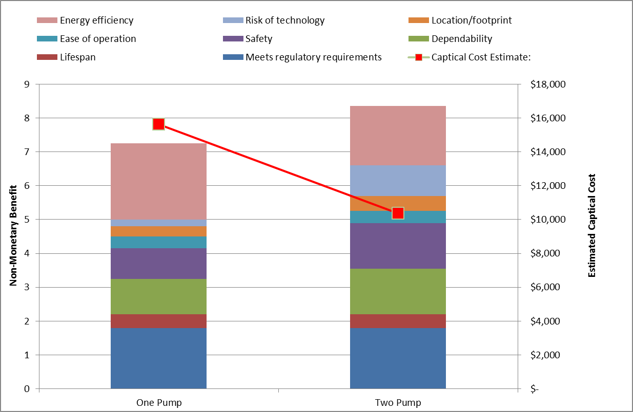
Evaluating the Two Different Pump Designs
Multi-Criteria Decision Analysis

Slide 6
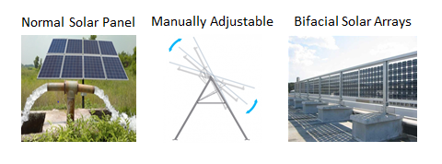
Evaluating Solar Panels
Notes:
Erika

Slide 7
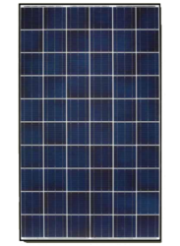
Cost Estimation
Polycrystalline PV cell
Efficiency: 14%
Relative low cost and high efficiency
Power needed: 4.98 kW 5kW
HBL 250W polycrystalline solar panel
Number of panel: 20
Cost Estimation
Pump: $79*2
Solar panel: $263*20
Inverter: $600
Total: $6,018
250 W Polycrystalline Solar Panel
Notes:
Anqi

Slide 8
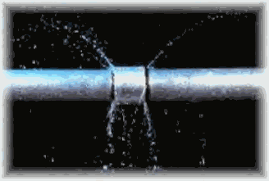
New Challenges
What needs to be done next?
  Updated weather patterns, pump curves
  Making solar arrays more efficient
  Working on corrosion and pipe leakage problems
  How to make these designs as practical as possible
  Research into singlet fission
Notes:
Erika

Slide 9


Slide 10
Village Distribution System
Maria Veronica Cordova
Tianchen Yu

Slide 11
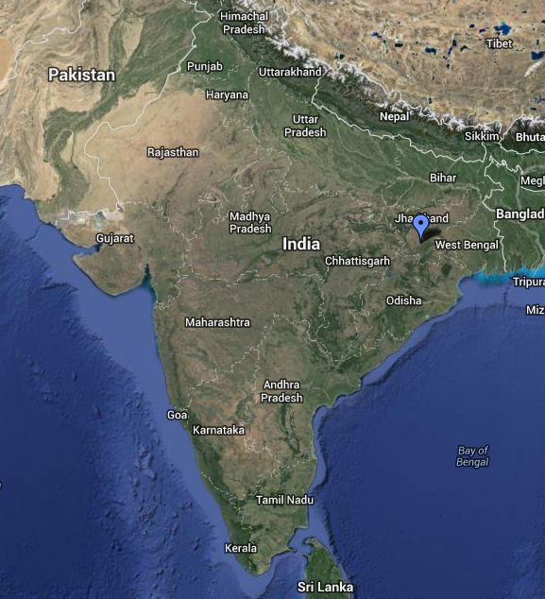
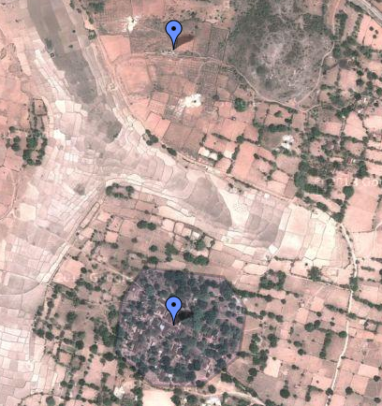
Gufu Village
Notes:
Recap from last semester:
Designing a water distribution and storage system for Gufu Village in India (we estimated 250 people)
Currently in India there is an elevated storage tank that fills twice daily in the center of the village
Pipe connects well to this tank
Villagers improvise household storage for constant access to water
ASK: What are problems with this current system? Why would we want to change it?
Water is pumped from a well outside the village, through an AguaClara LFSRSF filter
This system is inefficient, inconvenient, and unsanitary

Slide 12
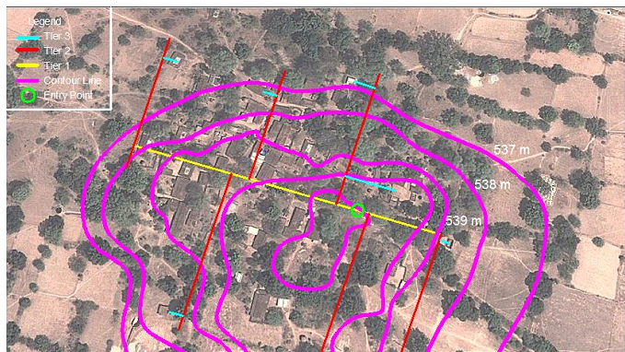
Pipe Distribution

Slide 13
Code comparison
Past Code | Our Code
Neglects height differences between houses | Considers height differences between houses
Assumes mean flow in each tier | Each tier has it's own flow and considers flow changing for each segment
Neglects minor head losses (tees and elbows) | Considers minor head losses in each segment and branch
Calculations of head loss per unit length are not clear | More accurate calculations of head loss per unit length

Slide 14
Flow
Tier | Flow (L/s)
3 | Target flow for 2 houses (1 distribution point) with 20% of safety factor
2 | Varies on each branch and segment
1 | Varies on each segments
Tier 2-Branch 4-Segment 3
Tier 1-Branch 2
Tier 1-Branch 1
Tier 3-Branch 1…48
Flow=(2*1.2*Qtarget)

Slide 15
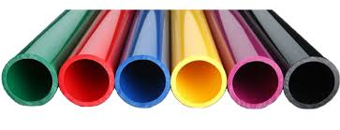
Pipe size
Branch | Tier | Diameter (inches) | Last code diameter (inches)
1…48 | 3 | 1 | 0.5
1,2,4,6 | 2 | 3 | 0.75
3,5 |  | 2
1 | 1 | 4 | 1
2 |  | 3

Slide 16
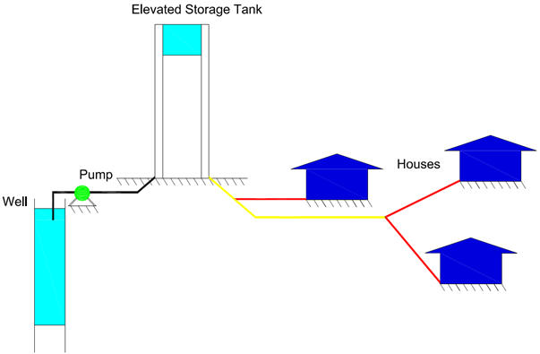
Head loss
Critical path:
  Maximum head loss throughout the entire system (minor and major losses)
  Most difference in elevation between the tank and the household
Total = 2.95 meters

Slide 17
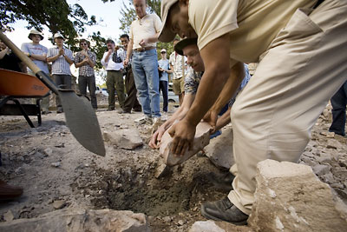
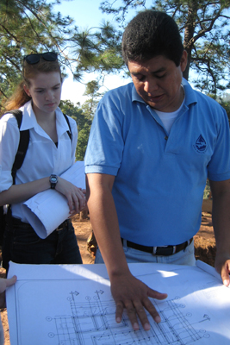

Cost
The total cost of the pipes and tees in the entire system (without the pumps) is $25,380
http://www.news.cornell.edu/stories/2008/02/students-help-lay-foundation-new-water-plant-honduras
http://www.news.cornell.edu/stories/2012/01/eighth-aguaclara-plant-under-construction

Slide 18

Future Expectation
Expectations
Re-organize the original data in another way, which will help to make a continuous code
Create a general code, which could be applied to any other village easily
Make the code more customer friendly

Slide 19
Questions?

Slide 20
Village Supply
Household Infrastructure
Mary John, Pooja Desai, Paula Gomez

Slide 21
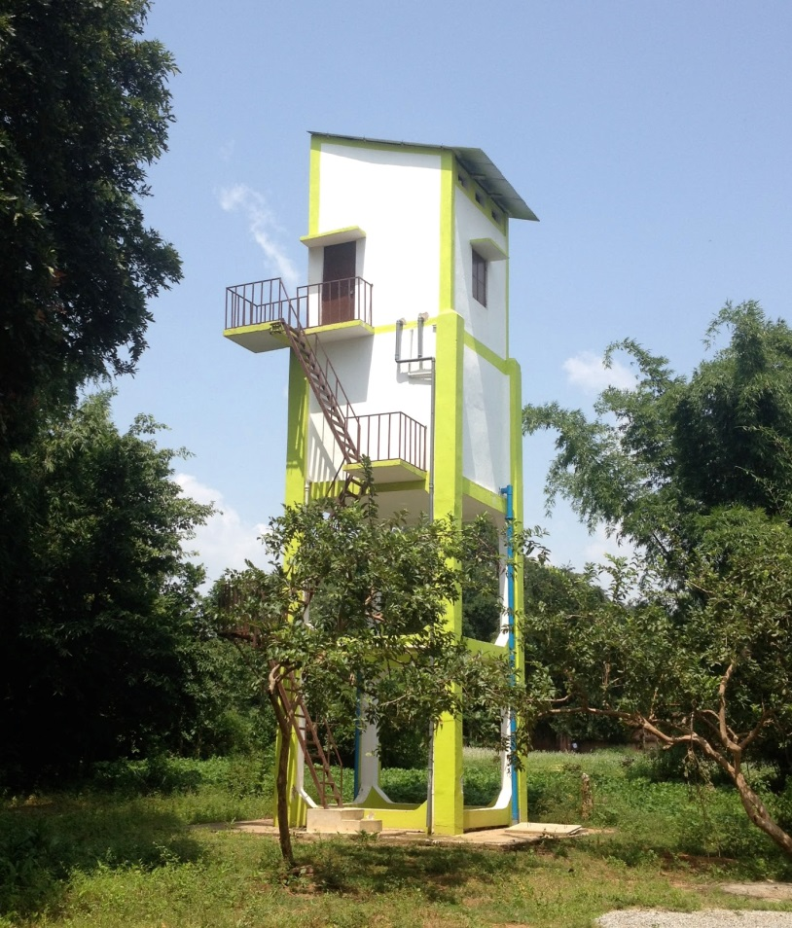
Semester Goals
Deliver equal flow to each one of the households
Design a household storage tank
Design a functional and hygienic sink.

Slide 22
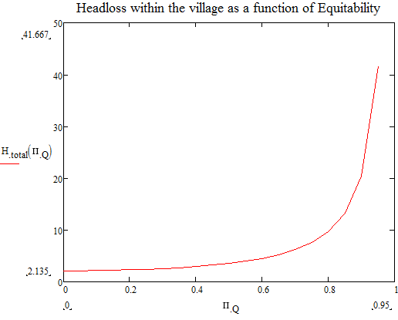
Water Equity
Desired household flow rate: Qhouse = 0.0021L/s
We use an Equity Constant of Π_{c}=0.8 to force all the flow rates to be in a range of 20% of the average.

Slide 23
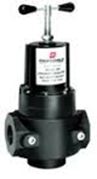
Pressure Regulator
Not feasible to create a homemade device.
Single stage regulator adjusted to 30 psi and a cost of $40. Size depends on pipes.
More useful in villages where the slope is steeper.

Slide 24
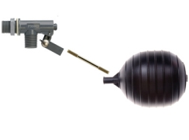
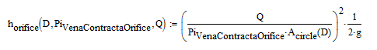
Float Valves
Flow valve regulates water in storage tank
  ¼” orifice diameter
  $22

Slide 25
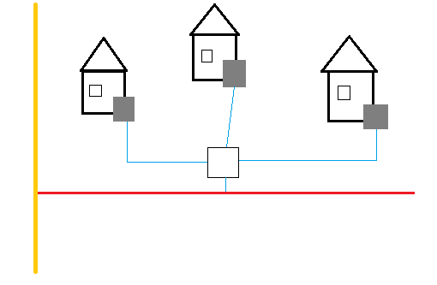
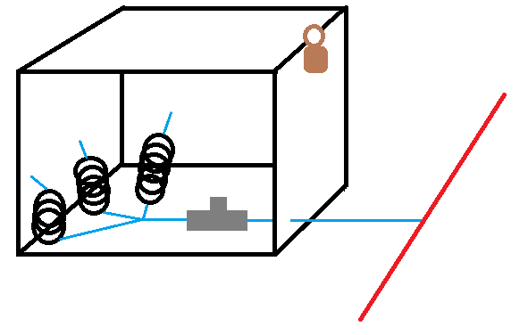
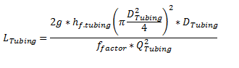
Coiled tubing
Small diameter creates large amounts of headloss
Scalable across villages

Slide 26
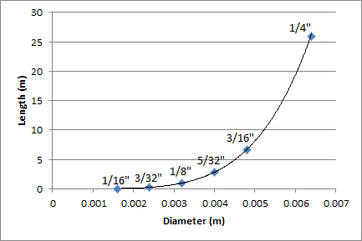
Coiled Tubing Length vs Tube Diameter

Slide 27
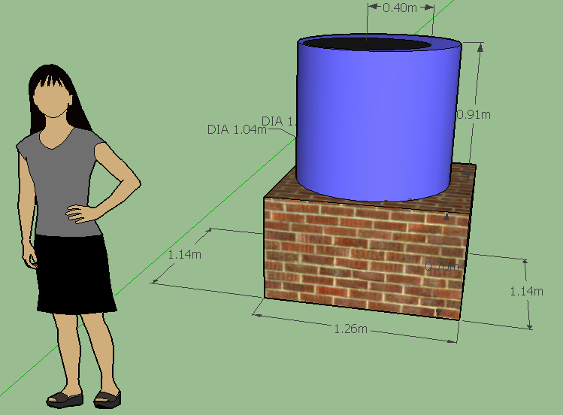
Tank Design
600L HDPE Drum
  Tank will not be made out of brick
  Families can scale up and down with the plastic tanks
  Hygienic material
Brick Stand
  Elevated 1m
  $17 to build

Slide 28
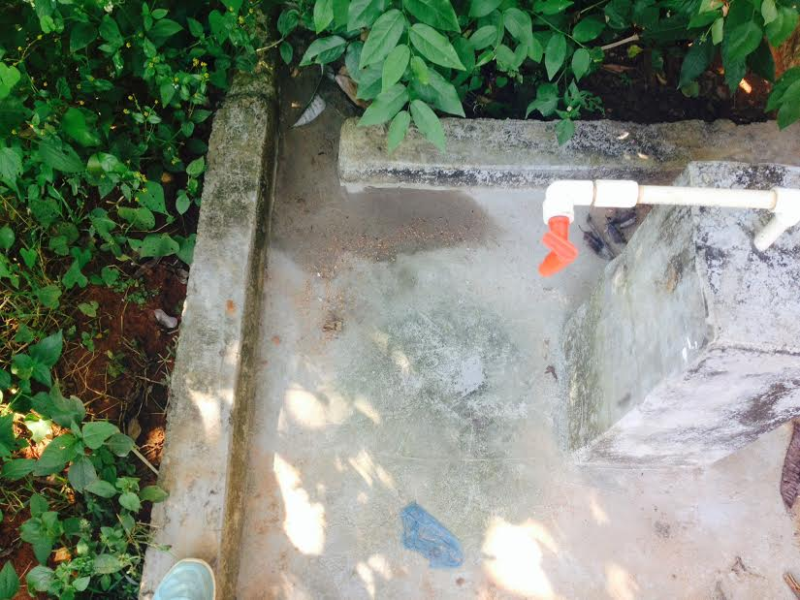
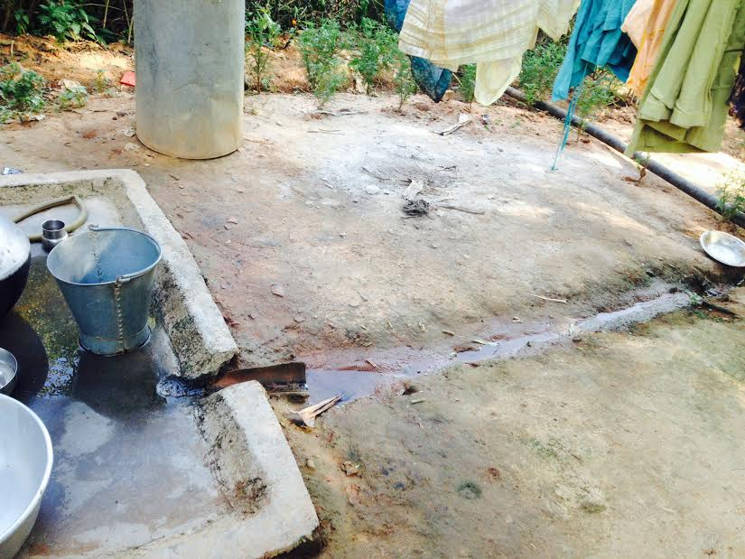
Sink Design Methods
New Design:
  Reduce contamination issue
    Buckets and concrete
  Practicality
  Versatility
  Improve conservation of grey water

Slide 29
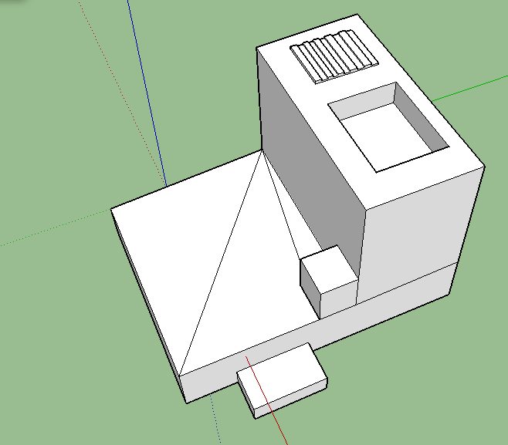
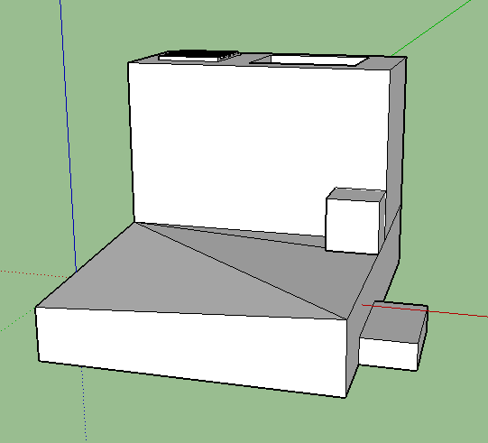
Sink Design
Dual platform and elevated sink
  Versatility in dish washing and clothes washing
  Concrete lined with steel
  Basin, washboard and platform
Raised and angled platform for agricultural grey water recycling
  Open piping on far left and bottom edges to allow for collection at bottom left corner
Determining stringent size dimensions would be impractical

Slide 30
Future Work
Integrate code with the rest of the distribution team
Is coiled tubing the best way to regulate flow?
Determine how much each villager is willing to pay for household infrastructure
  Currently Indian Government pays for water systems
Survey the Gufu villagers to more accurately determine their needs and preferences.
Consider other practical uses for grey water recycling

Slide 31


