Slide 1
Village Distribution System
Maria Veronica Cordova
Tianchen Yu

Slide 2
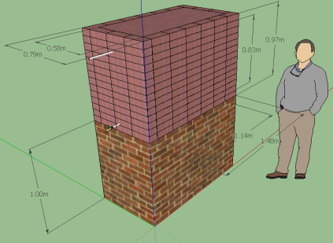
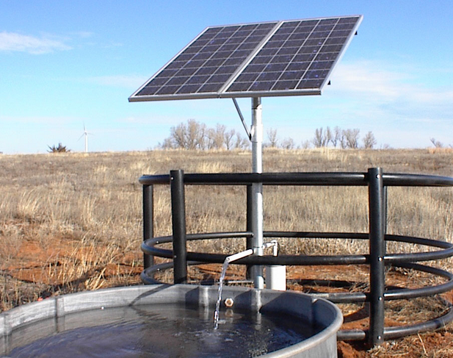
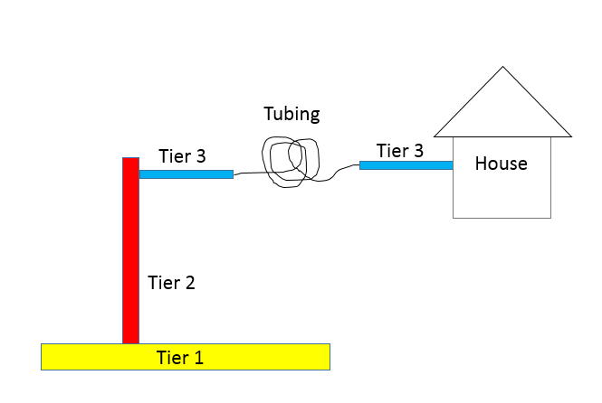
Our Team
Village Distribution System
Household
Photovoltaic
Distribution System Design

Slide 3
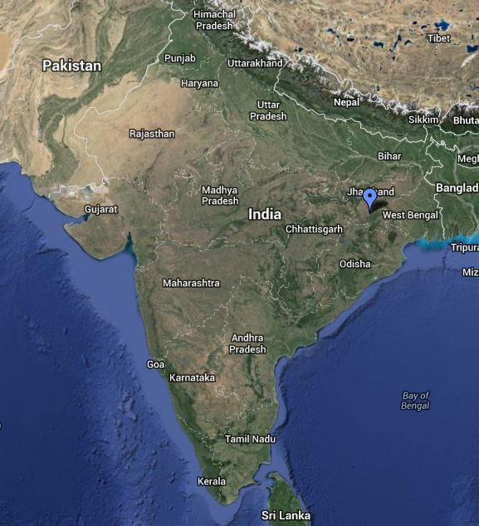
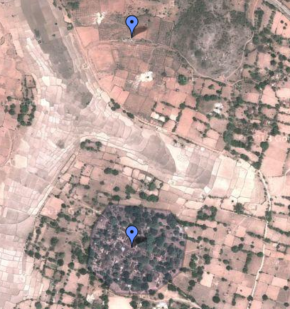
Background
Gufu Village
Notes:
Recap from last semester:
Designing a water distribution and storage system for Gufu Village in India (we estimated 250 people)
Currently in India there is an elevated storage tank that fills twice daily in the center of the village
Pipe connects well to this tank
Villagers improvise household storage for constant access to water
ASK: What are problems with this current system? Why would we want to change it?
Water is pumped from a well outside the village, through an AguaClara LFSRSF filter
This system is inefficient, inconvenient, and unsanitary

Slide 4
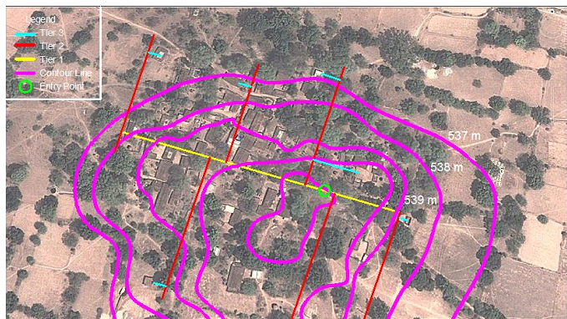
Background
Notes:
Recap from last semester:
Working off The 2canzzzz’ design from 4540
3 tiers of pipe distribute water directly to each house
Green circle = entry, yellow = primary tier,….
This layout controls elevation variability and minimizes differences between length of piping leading to each house
Since the flow rate of water entering each house is determined by the head available to push water to each house, controlling this elevation variability/length (headloss) is important
See next slide

Slide 5
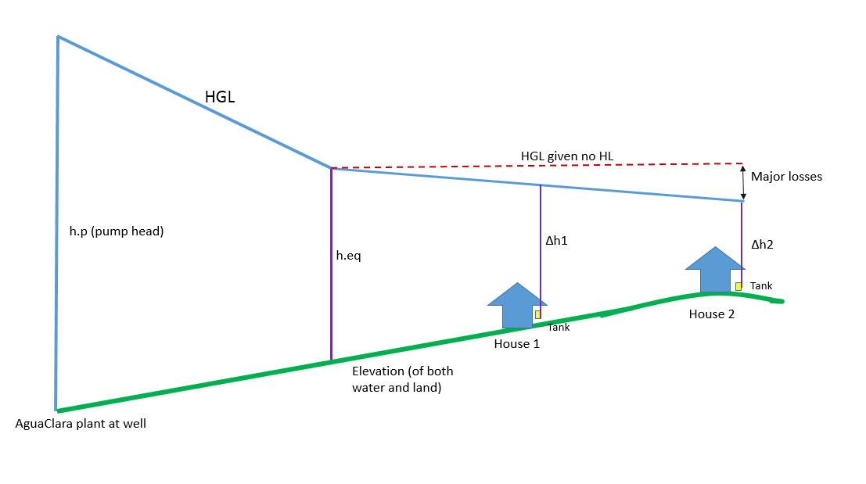
Background
Notes:
…demonstrated by this HGL
The pump provides a certain amount of head (hp) that pushed water through the transmission line and the distribution system. When the water enters the village, it has a certain amount of head (heq) available to push water through the system.
This heq needs to be big enough to overcome elevation differences/head losses for each house so that each house receives an equitable amount of water
Ie difference in flow provided between 5 ft and 3 ft vs 105 and 103 ft -> difference is more spread out
Want no house to receive 10%+ more water than any other house
Set this pi.Q in terms of head (heq and head losses)
By setting this pi.Q < 0.1, we’re forcing flow to be equitable and then determining other parts of the system to maintain this equity

Slide 6
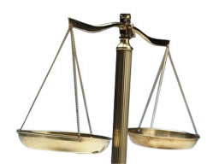

Our Goal
Innovation based on the previous work
Achieve flow equity for each house
Relative low cost
Energy Efficient

Slide 7
Single Pump VS Two Pumps
Alternative 1: A single electric pump sends water through a pressurized LFSRSF and to the town. Chlorine and coagulant are both somehow metered into the influent of the pump
Alternative 2: One electric pump lifts water from the well to an Agua Clara facility that is at ground level. A second electric pump sends water to the distribution system

Slide 8
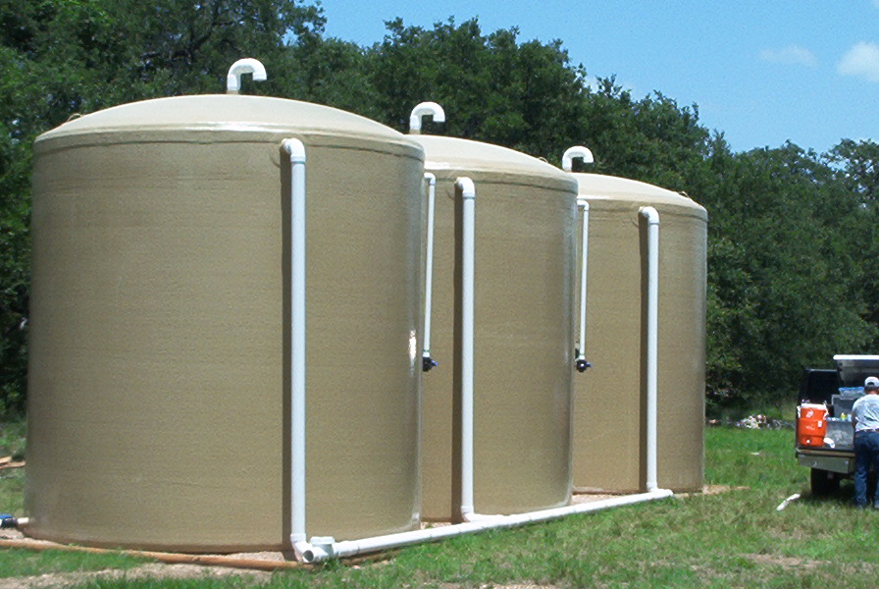
Use of the Rain Water
Rain water quality research
Consistency of the rain
Storage of rain water
Cost analysis

Slide 9
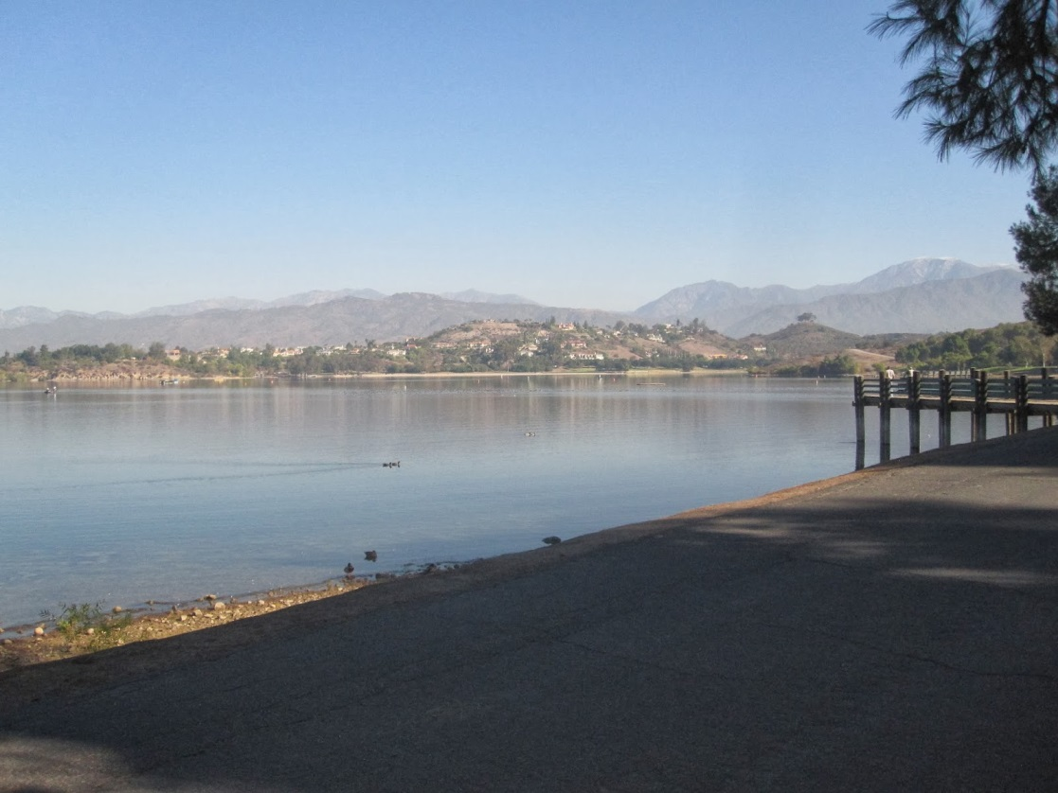
Reservoir
Enough place to build
Safety of keeping the water clean
Cost Analysis

Slide 10
Sub teams Assumptions
Household Team
  The storage tank in each house will be 1 meter above the ground.
  The coil will be kept this semester to control the amount of water coming into each house, to prevent the extra water in the houses.
  Grey water is assumed to be dumped in a village’s sewage system, for now.

Slide 11
Sub teams Assumptions
Photovoltaic and Pump Team
  The type of pump will depend on the target flow rate and the cost. The design is not relying upon specific pump.
  The system will be evaluated for two cases:
    One pump
    Two pumps
  Currently, they are still using solar radiation data and precipitation data from Gufu Village

Slide 12

Communication with our partners in India
It was not designed for equity
Reservoir requires a significance area
No rainwater quality data
The monsoons are not exactly consistent
Maysoon Sharif, E.I.T. | Managing Director, Asia, Principal | msharif@aguaclara.cc

Slide 13
Challenges
Optimize our code according to the distribution of the houses and topographic conditions
Control flow upstream first (in the mains and sub mains)
Ensure the drinking water supply required by the village at any time of the day in a safe way
Make the code more user-friendly.
Low cost design

Slide 14
Potential Solutions
The code will consider both turbulent and laminar flow in the pipes.
New inputs to define the target flow rate for any given village.
Building a reservoir seems to be too expensive and consuming idea.
Build a well to harvest rainwater.

Slide 15
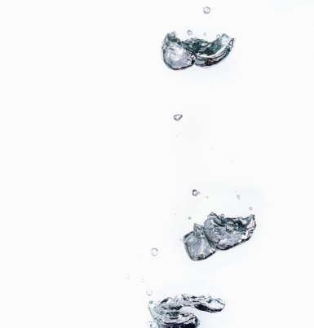

Village Distribution System
Sometimes we can take for granted that people have safe drinking water.
Not only in India, but all around the world these can be one of the most difficult goals to achieve.
Having safe drinking water is a human right that every person should have, no matter the location.

Slide 16
Questions?

