Slide 1



Cornell University
User Guide
Application Portfolio Management
Automation of the software inventory process
using Microsoft SharePoint
Oct 24th , 2013

Slide 2
Agenda
User Guide Introduction
APM Setup Instructions
APM Login Instructions
Feature Walkthrough (Screens)
Q & A

Slide 3
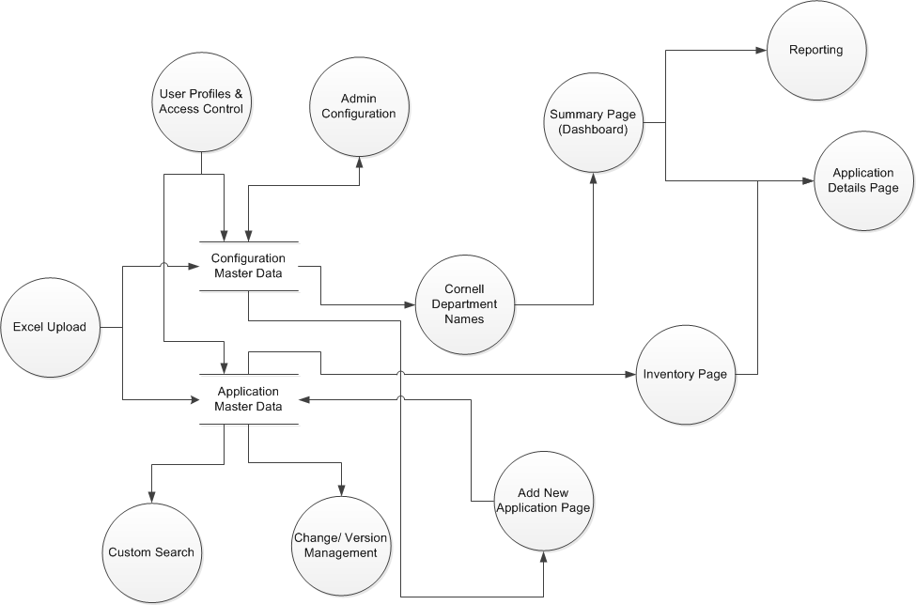
Introduction
User guide document will serve as a walkthrough for first time users in getting familiar with the Cornel APM – SharePoint Application
The document will elaborate a step by step access and explanation of the APM systems & functionalities

Slide 4
APM Setup Instructions
SCENARIO 1 – Visual Studio
SCENARIO 2 – Power Shell
User Migrate Setup
Chart Setup – Details of chart setup after migration are given in the CustomchartSetup.ppt document

Slide 5
APM Login Instructions
To access the APM sharepoint system, please type the following url in your browser - http://sf-fs-tweb-005.serverfarm.cornell.edu:8889
Preconditions
        User needs to be logged into the cornell network and the system should be able to recognize the user through his AD credentials.
        In case the user is not recognize contact
            Network administrator to add your username to the network
            Sharepoint administrator to add your username to a specific user-group in APM

Slide 6
Features/Screens common to all 3 types of users -
1. Viewers
2. Editors
3. Admins
Screens -
Landing page (list of departments & abbreviations)
All applications (grouped by unit name)
Search page
Summary page
Inventory page
Application details page (view mode)
Charts page

Slide 7
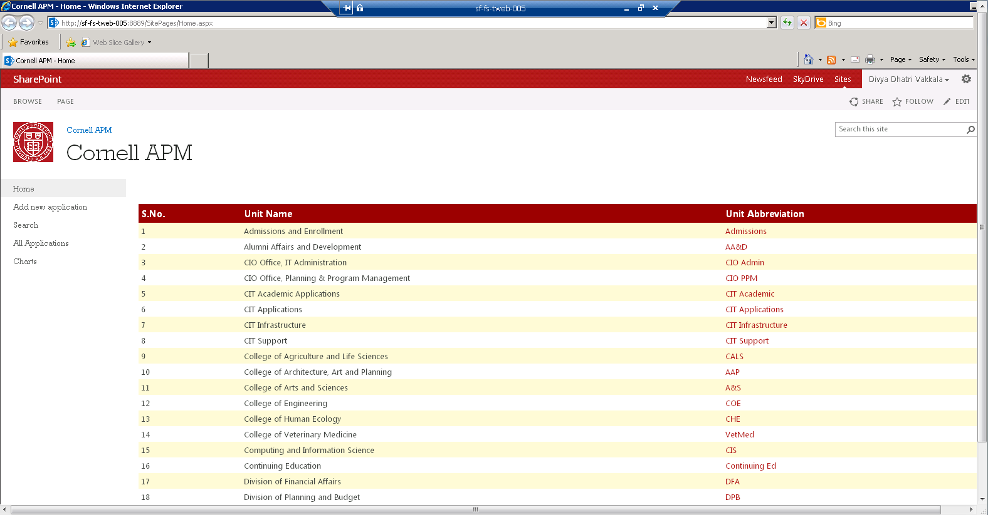
Landing page for viewer/editor
User name. Clicking on the arrow next to it shows the options available
Left navigation shows all available pages on which access has been granted. Current page is highlighted in grey
List of all available departments in Cornell for which inventory exists in APM sharepoint
Clicking on any of the unit abbreviation links will take the user to the Summary & Inventory view page

Slide 8
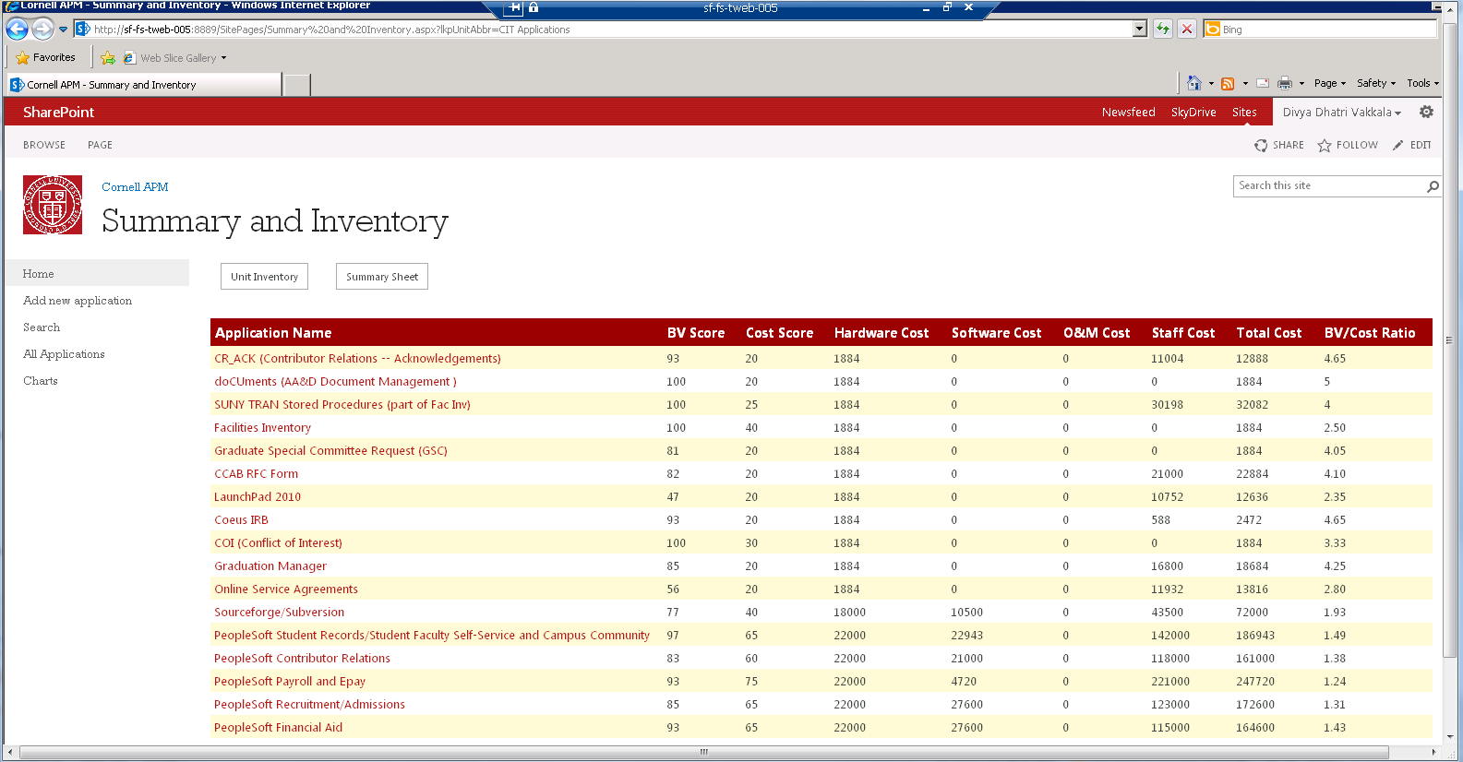
Summary Page
Clicking on either unit inventory or summary will toggle between the 2 views for the selected department
Clicking on either unit inventory or summary will toggle between the 2 views for the selected department
Clicking on any “Application Name” link – will take the user to the “Application details page” of that particular application
List of applications mapped to the specific department selected on the landing page

Slide 9
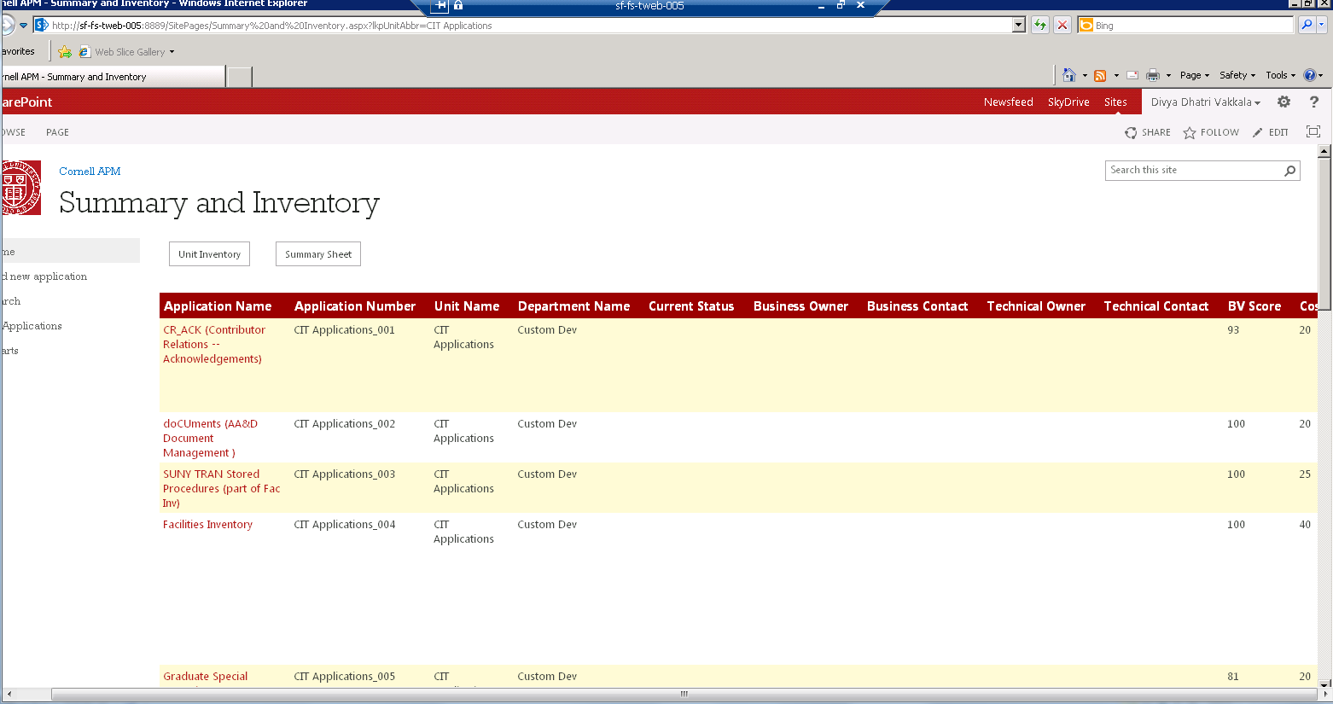
Inventory Page
Clicking on any “Application Name” link – will take the user to the “Application details page” of that particular application
List of applications mapped to the specific department selected on the landing page

Slide 10
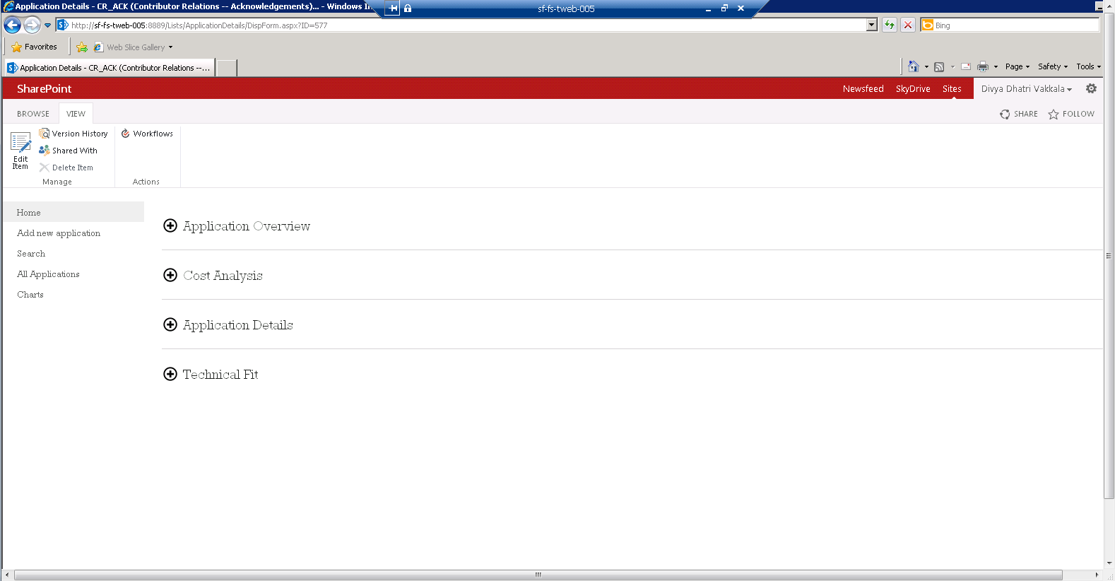
Application Details Page
Editors & Admins will be able to see the “Edit” button.
Clicking on the (+) symbol will reveal the details of the sub section

Slide 11
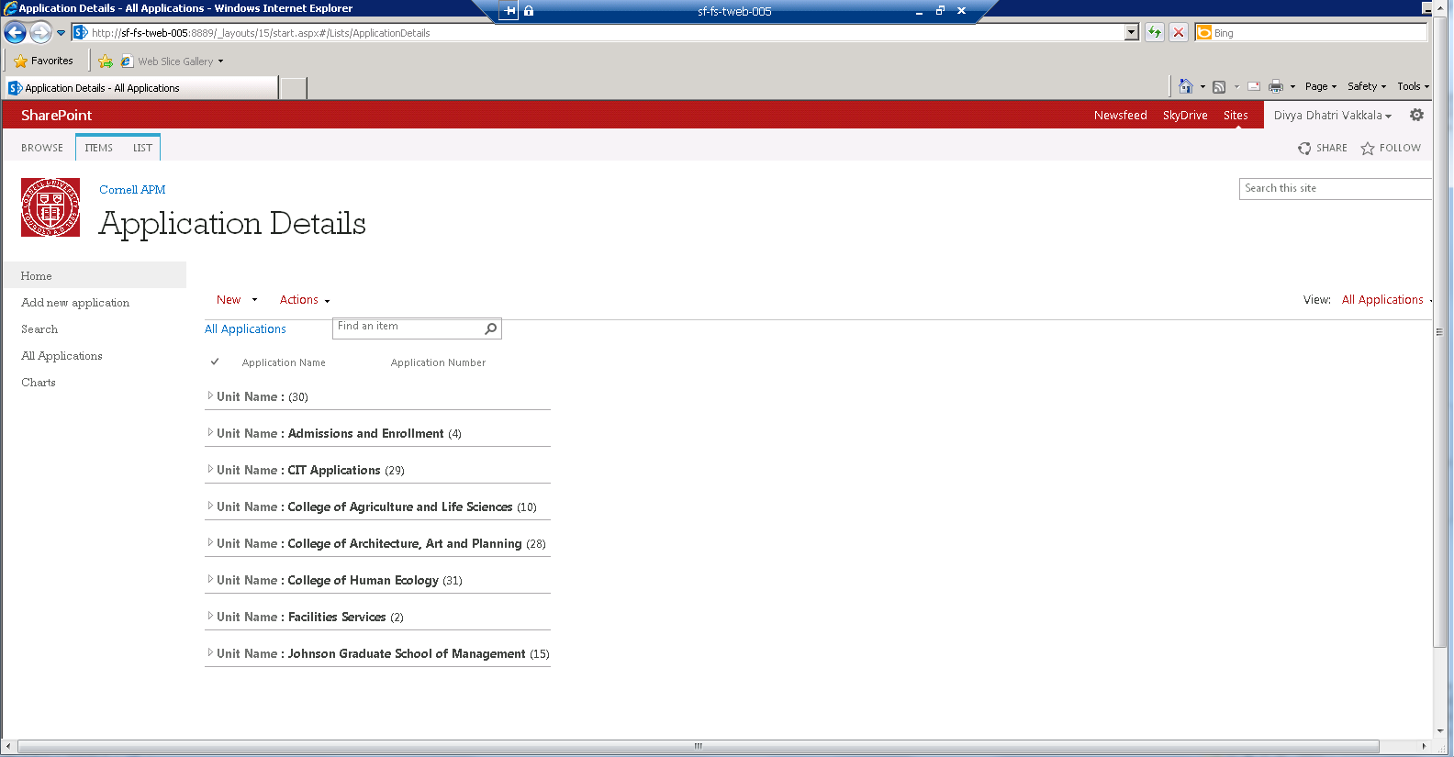
All Applications (Grouped by Unit Names)
Total applications in the sharepoint system, grouped by unit name.
Clicking on the arrow next to the unit name will show all the applications in that unit
Clicking on the “All Applications” link on the left navigation takes the user to this page

Slide 12
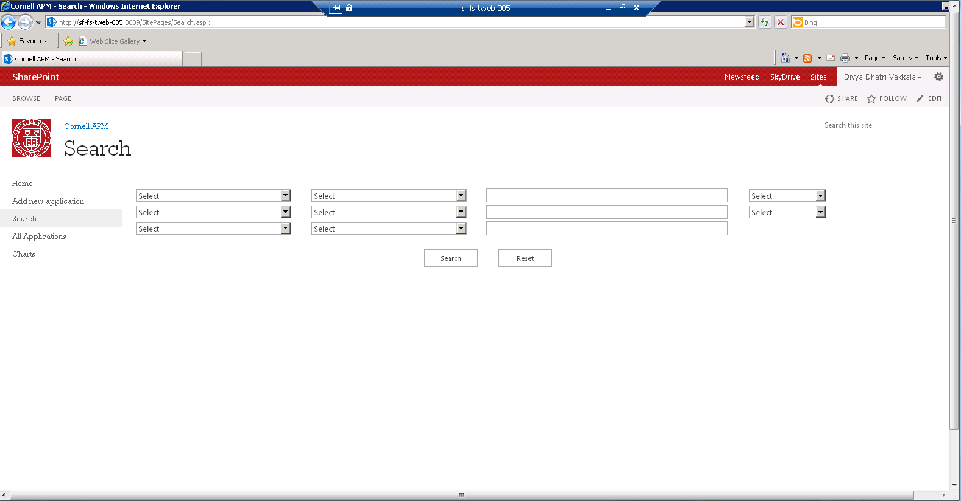
Search Page

Slide 13
Features/Screens common to –
1. Editors
2. Admins
Screens -
Edit Application Page
Add New Application Page

Slide 14
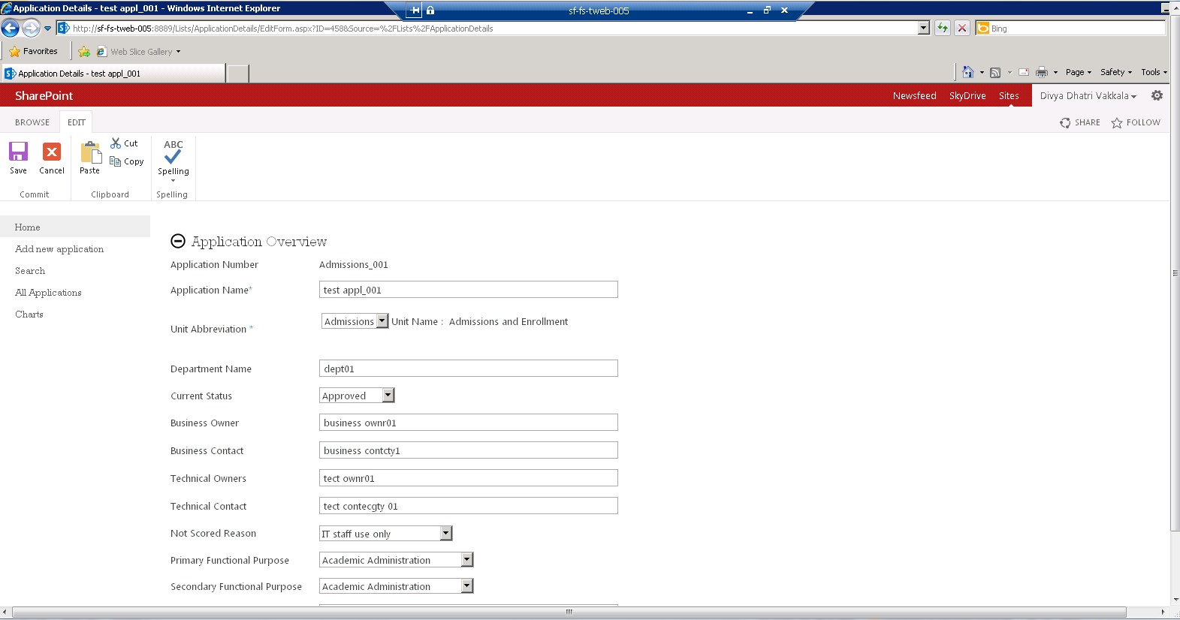
Edit Application(Available only to editor)
Clicking on Edit button in the “Application Details” page takes the user to the edit application page

Slide 15
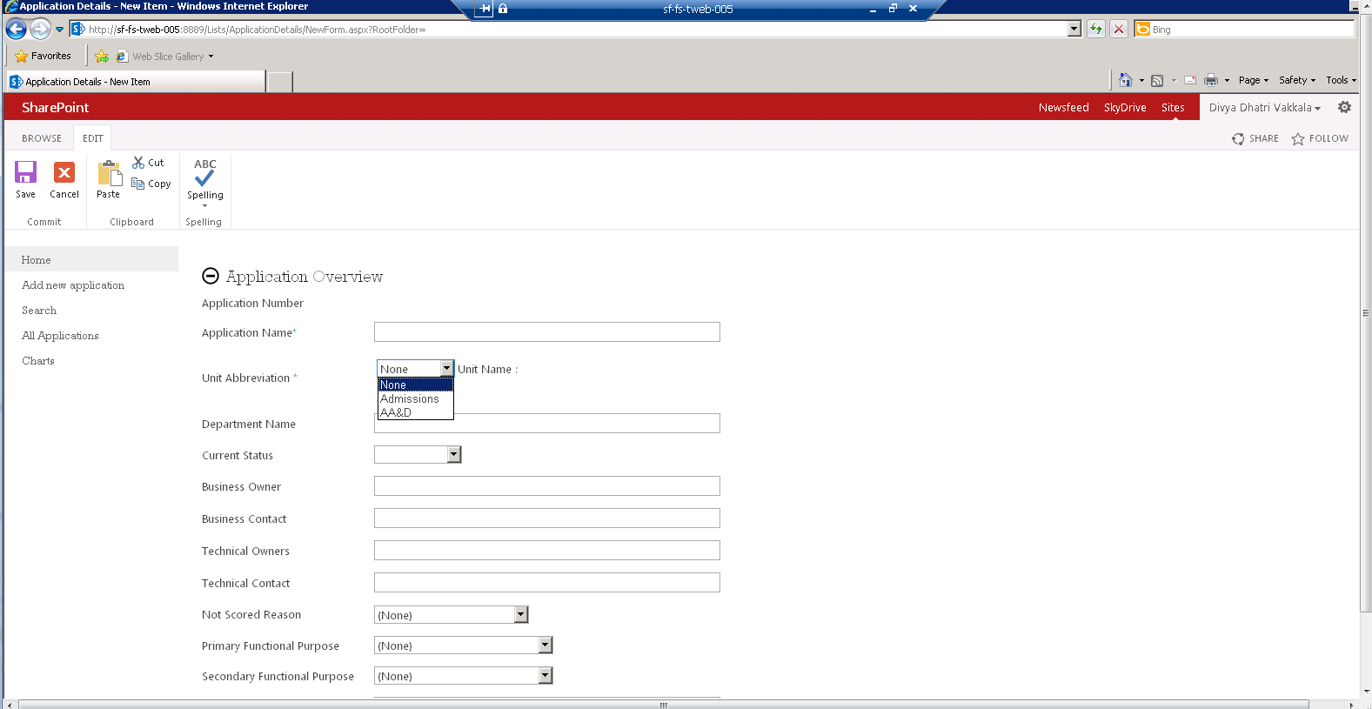
Add New Application
To access the “Add new application” page, click on the same link in the left navigation.

Slide 16
Features/Screens available to –
1. Only Admins
Screens -
View master data (all lookup tables)
Add new data to lookup tables (selection drop down)
Add new lookup data
Edit lookup data
Add viewers/ editors to a user group

Slide 17
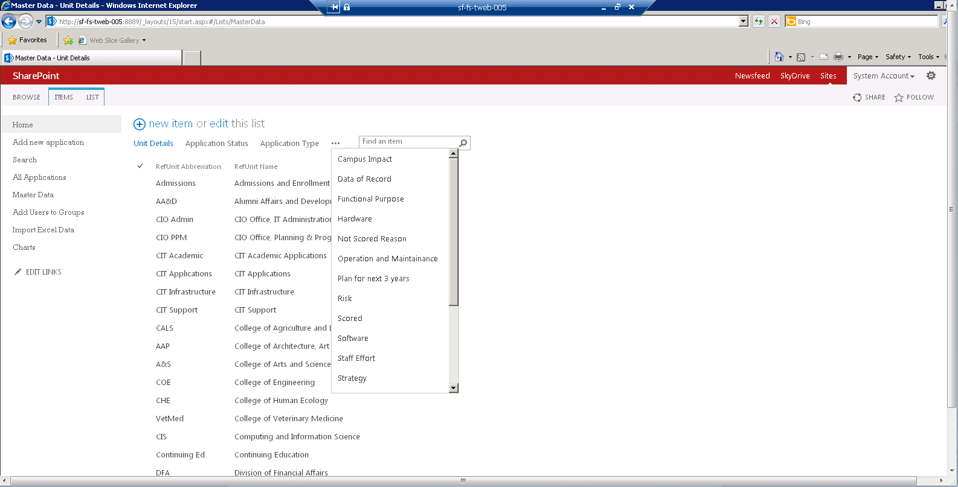
Screen to view master data for lookup
Clicking on the (…) link will show the user the whole list of lookup tables. Clicking on any one of them, will show the details of that lookup table

Slide 18
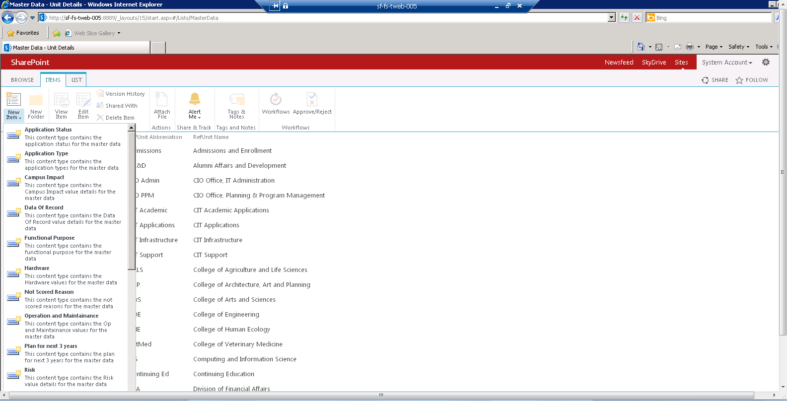
Adding new master data to lookup columns
If a new value has to be added to an existing lookup table, 2 steps need to be followed –
Click “New Item” link to select the lookup table
Enter the new value in the page that is displayed

Slide 19
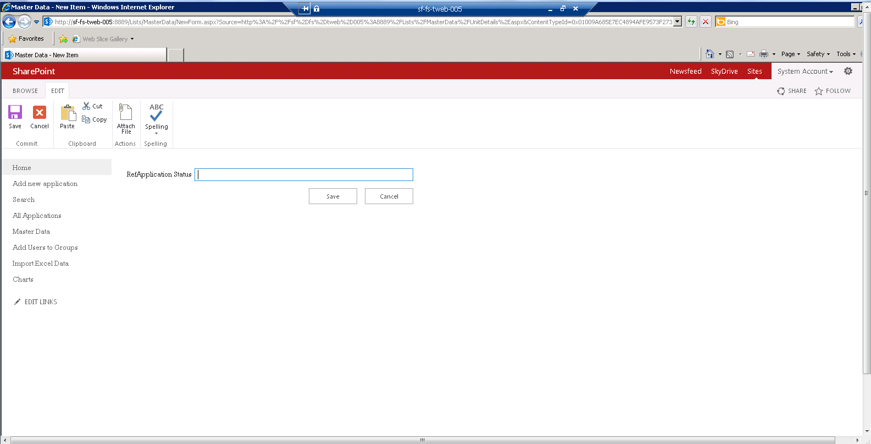
Add new lookup data
Step 2 of adding new data to lookup columns

Slide 20
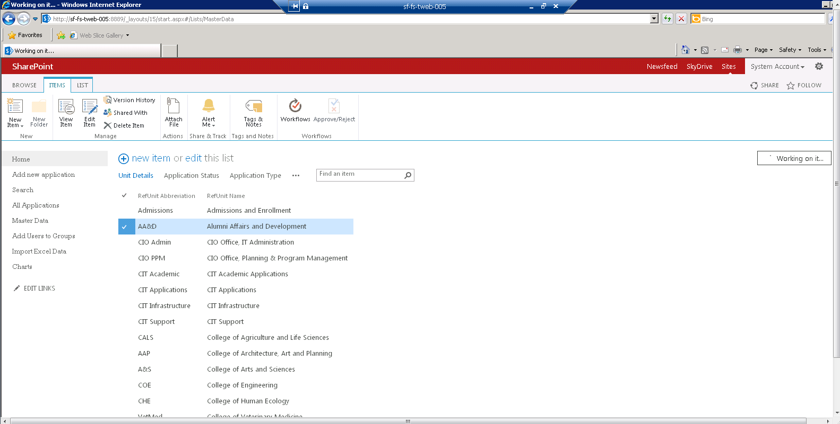
Edit Lookup Data

Slide 21
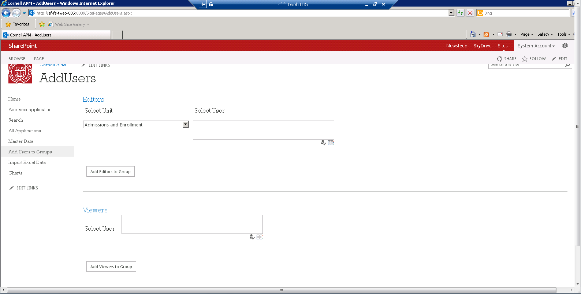
Add editors/viewers to group

Slide 22
Q & A

