Slide 1
Section Cuts
Presented by Runpeng, Songlin

Slide 2
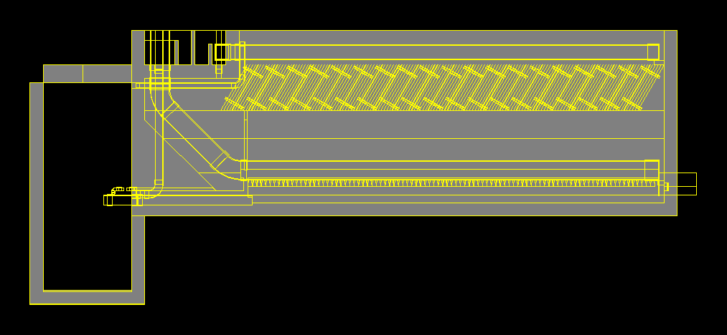
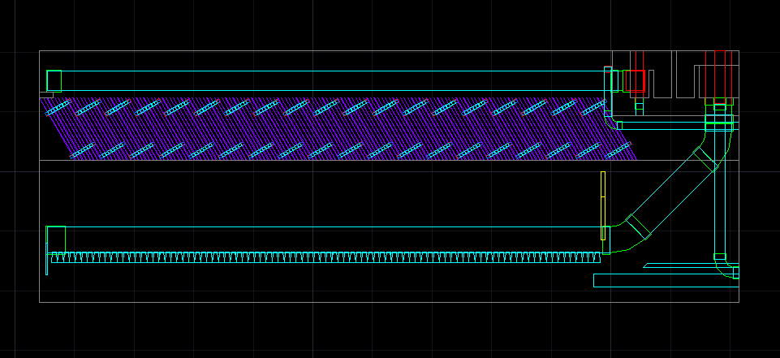
Brief Introduction
Previous Section Cut
Desire Section Cut

Slide 3
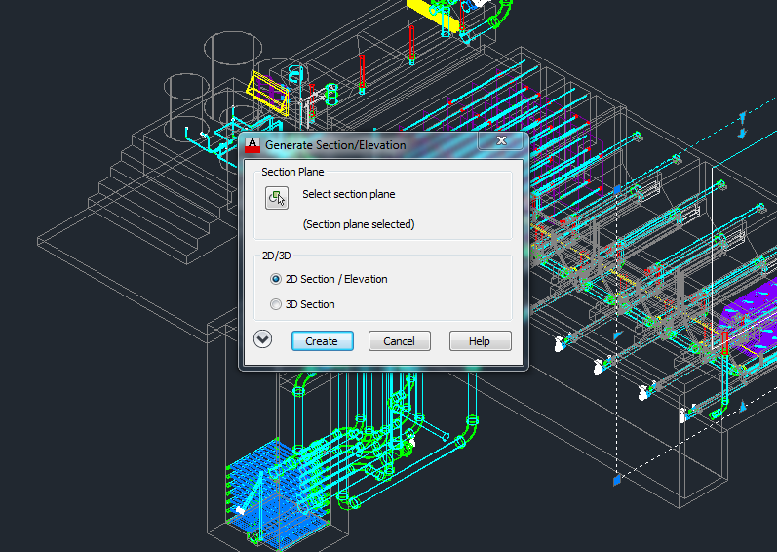
Problems Encountered
Automation

Slide 4
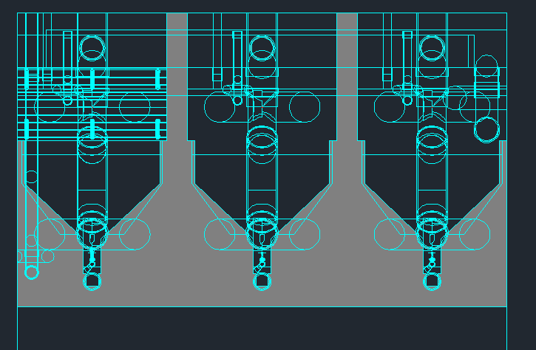
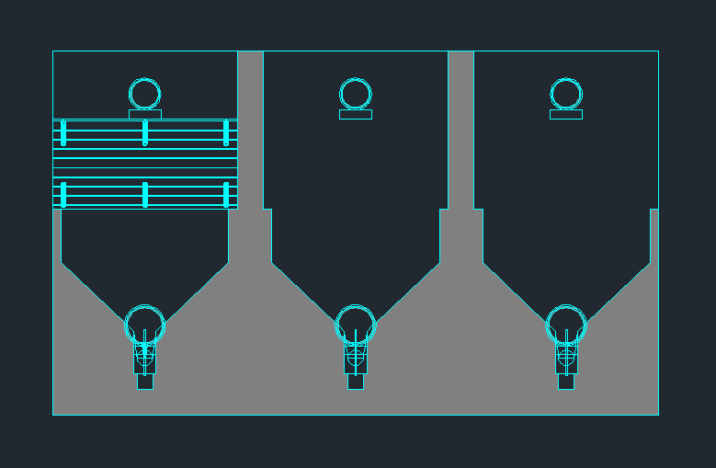
Problems Encountered
Redundant Stuff

Slide 5
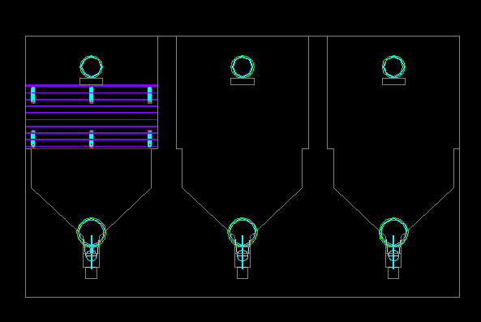
Problems Encountered
Colored by layer

Slide 6
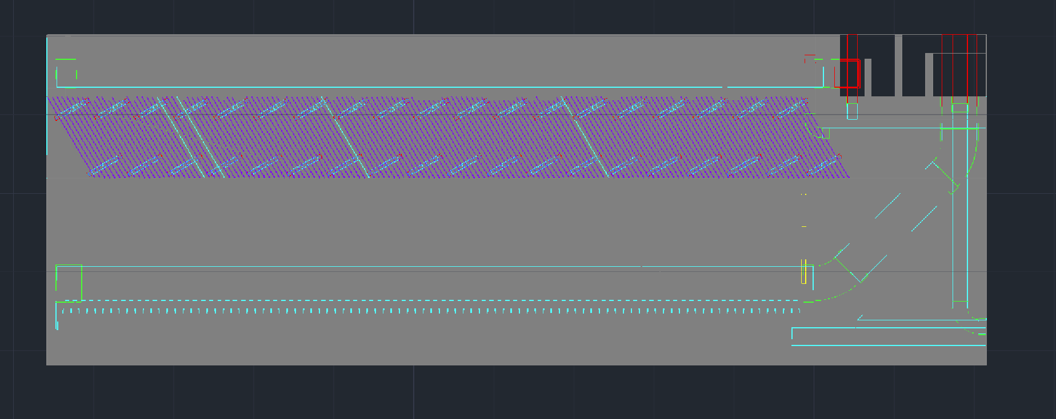
Problems Encountered
Unexpected Solid Background

Slide 7
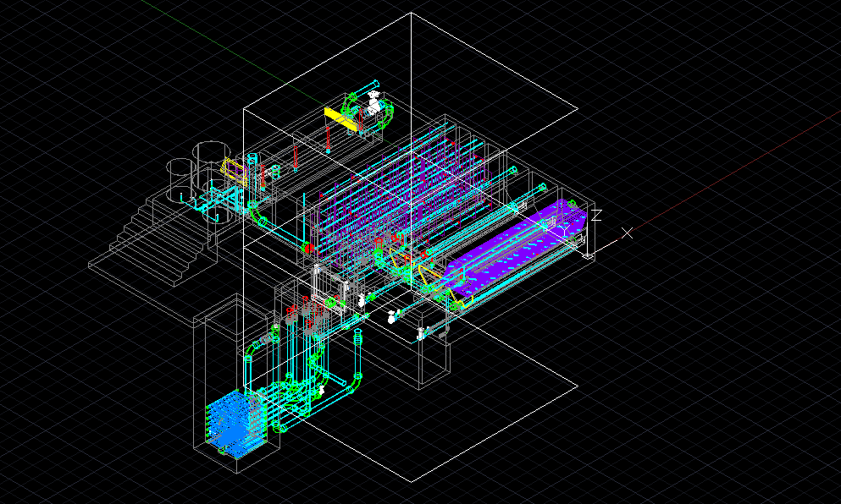
Accomplishment
Modified code

Slide 8
Accomplishment
Solved Encountered Problems

Slide 9
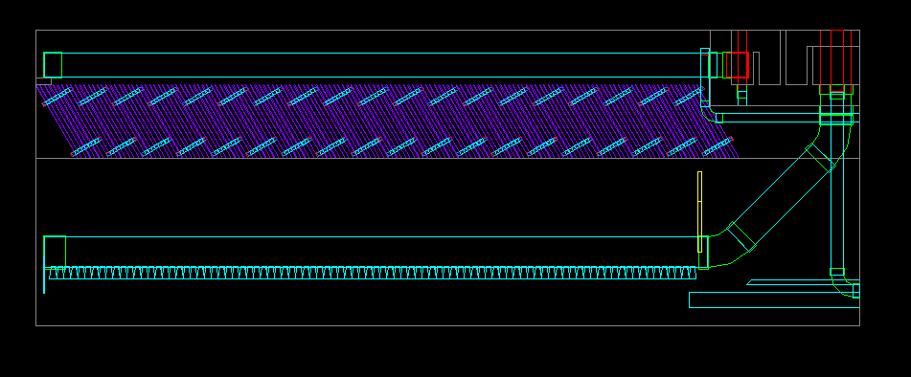
Accomplishment
Solved Encountered Problems

Slide 10
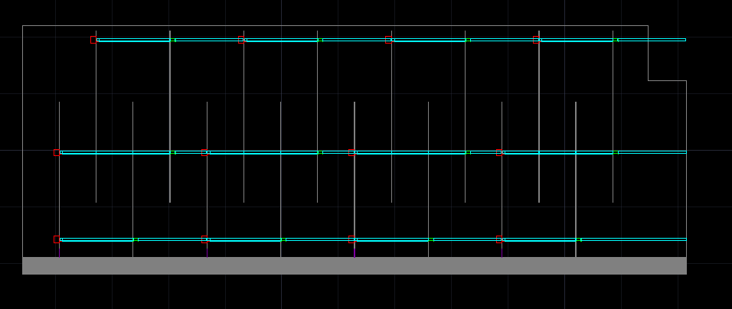
Accomplishment
Built New Section Cuts
Transverse view of flocculator

Slide 11
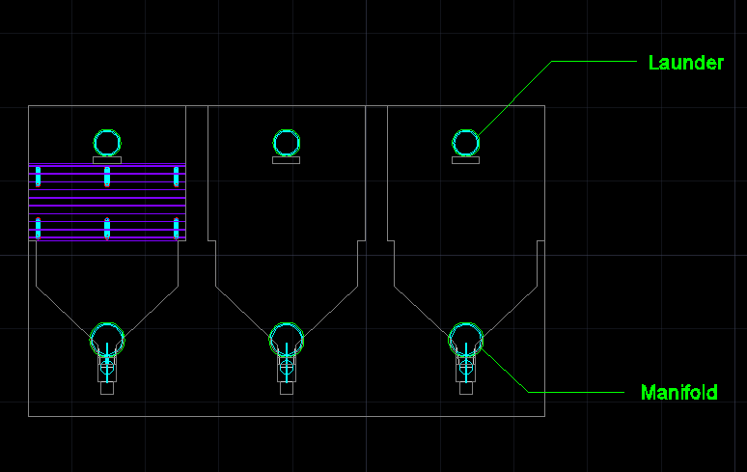
Future Work
Labeling

Slide 12
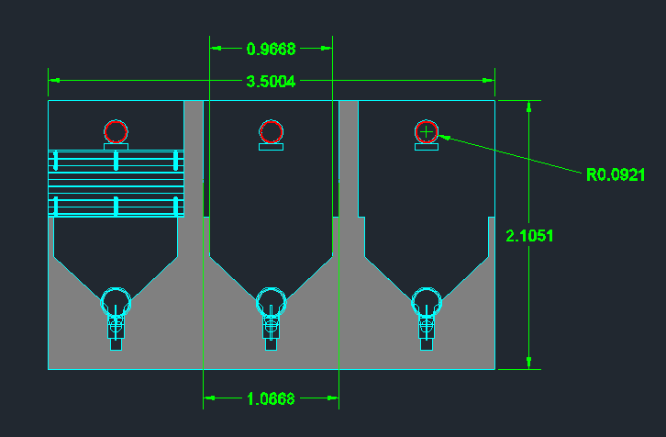
Future Work
Dimension

