Slide 1
Subject librarian services
Katherine Chiang
Networked Research Information Librarian and
Head of Instruction and Reference Services
(ksc3@cornell.edu)
November 2013

Slide 2
Subject Librarians:
Understand how information is published and exchanged in a subject area.
Maintain expertise in information organization and discovery, and general trends in scholarly information.
Aid researchers’ in their information related work in meaningful and helpful ways.

Slide 3
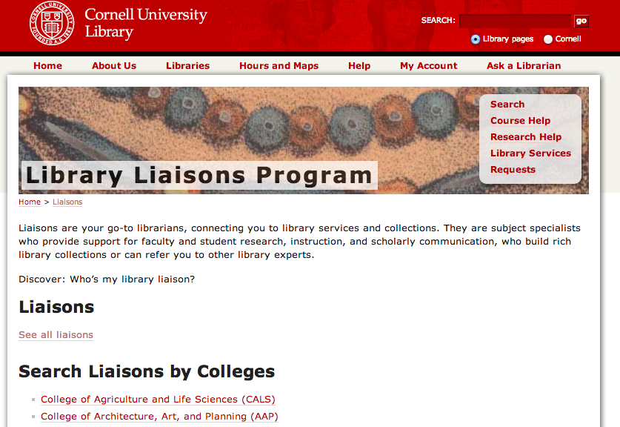
Cornell subject librarians = Liaisons program
http://www.library.cornell.edu/svcs/serve/liaisons

Slide 4
From the Cornell Library Liaison page:
The goal of the liaison program at CUL is to support the full cycle of research and scholarly exchange. Liaisons to departments and academic programs strengthen relationships with researchers and increase the in-person presence of library subject experts in academic units.
Liaisons:
know what the library does and who in the library does it.
know their audiences and the likely overlap between what those audiences need and what the library does.
make contacts with researchers that connect patrons to our services and collections, and help the patrons build a more sophisticated picture of the library.
take what they have learned about their audiences and provide the feedback loop to help the library understand what services to offer.

Slide 5
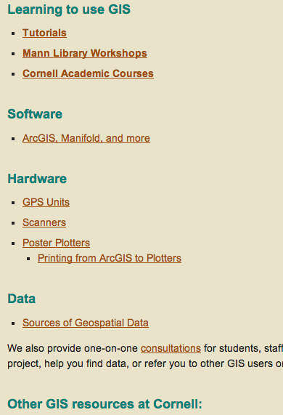
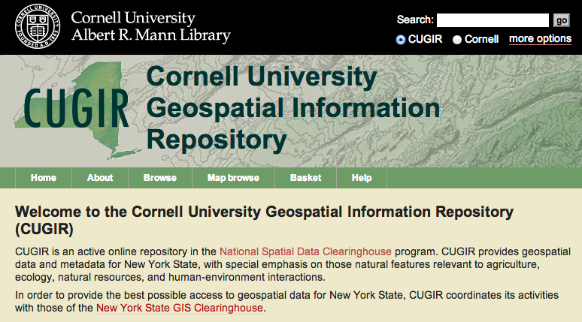
Examples of services:
Geographic information systems:
http://cugir.mannlib.cornell.edu
http://mannlib.cornell.edu/research-help/gis

Slide 6
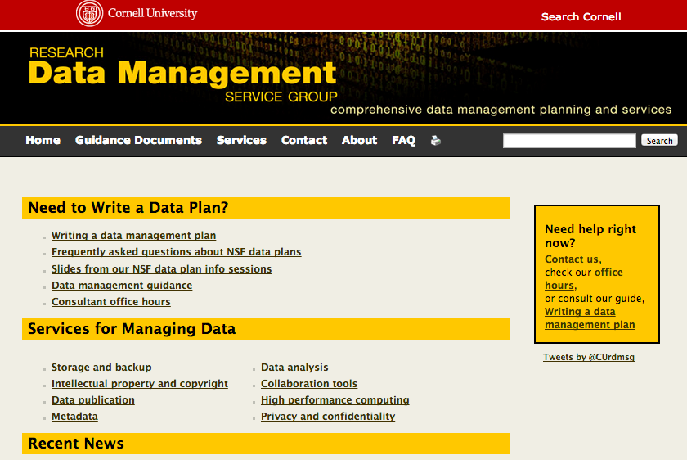
Data assistance
Research Data Management Services Group:
https://confluence.cornell.edu/display/rdmsgweb/Home

Slide 7
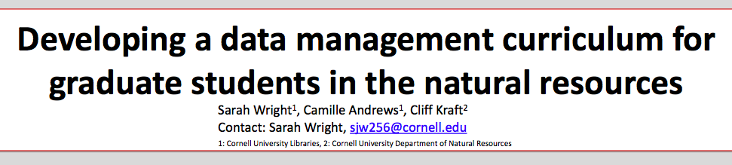
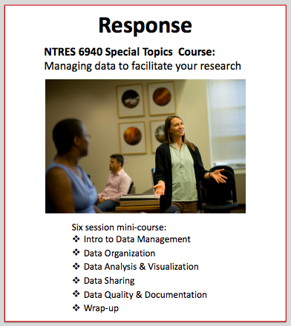
Data information literacy:
http://wiki.lib.purdue.edu/display/ste/Home
http://wiki.lib.purdue.edu/download/attachments/2097461/DIL_Symposium_Poster_Cornell_Wright_Andrews_2013.pdf?version=1&modificationDate=1379985797000

Slide 8
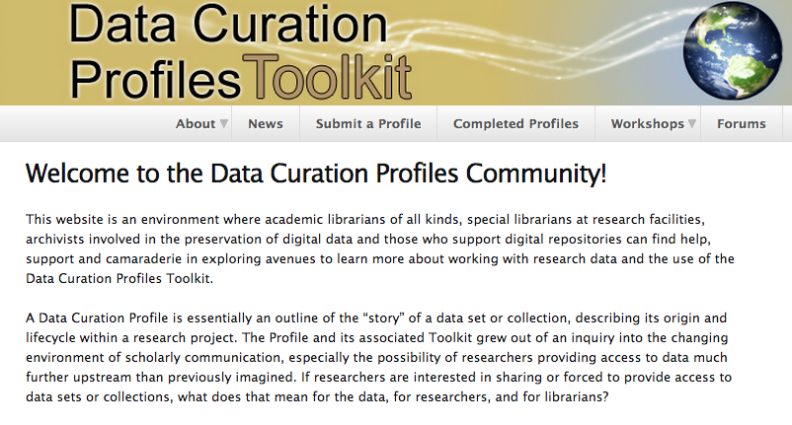
Learning more about data: http://datacurationprofiles.org/

Slide 9
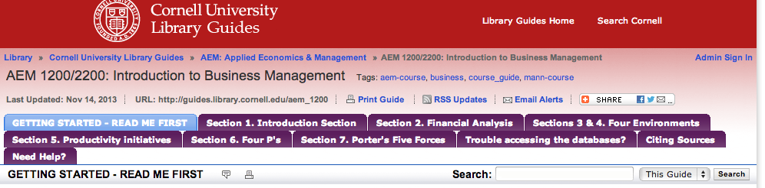

Embedded Information Literacy Instruction
Communications Lib Guide – Jim Morris-Knower:
http://guides.library.cornell.edu/content.php?pid=398126
Introduction to Management Lib Guide – Tom Ottaviano:
http://guides.library.cornell.edu/aem_1200

Slide 10
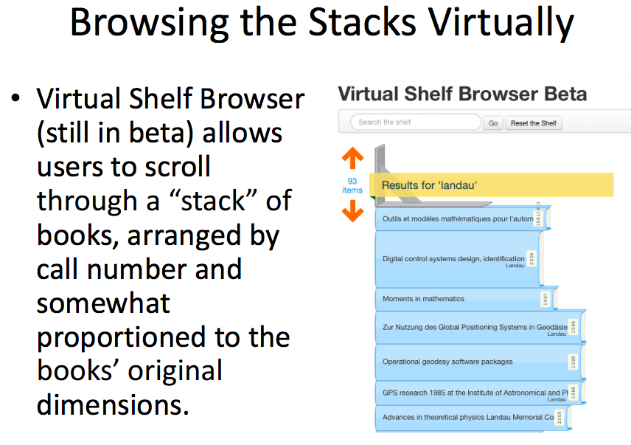
Virtual subject libraries:
http://www.sla.org/wp-content/uploads/2013/05/WhereDidtheBooksGo_Wilson.pdf

Slide 11
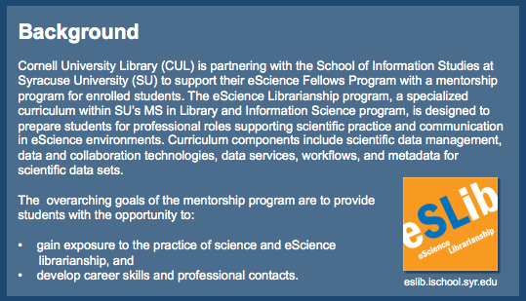
Mentoring the next generation of science librarians:
http://escholarship.umassmed.edu/cgi/viewcontent.cgi?article=1028&context=escience_symposium

Slide 12
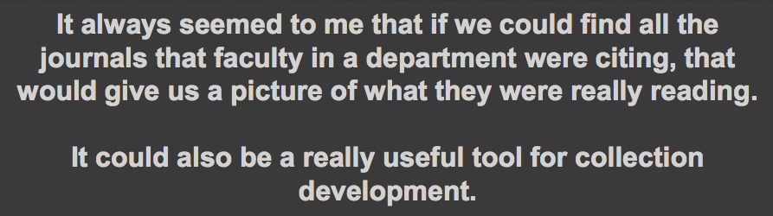
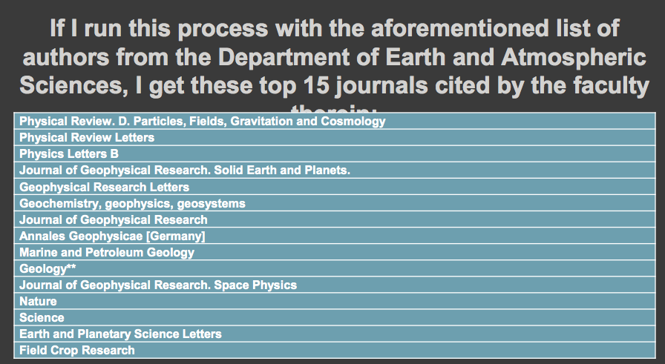
Citation habits of faculty – Jeremy Cusker:
http://uny.sla.org/wp-content/uploads/2012/05/UNYSLA_2012Spring_Cusker.pdf

Slide 13
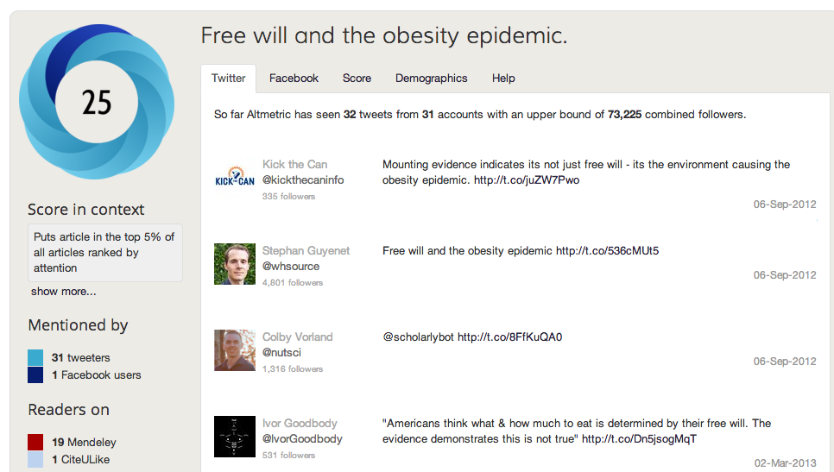
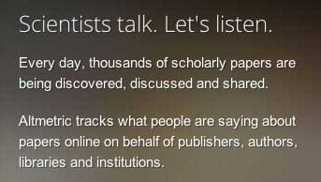
Broader information trends – Networked Information
Alternative metrics for measuring scholarly impact: Altmetric.com, plumanalytics.com

Slide 14
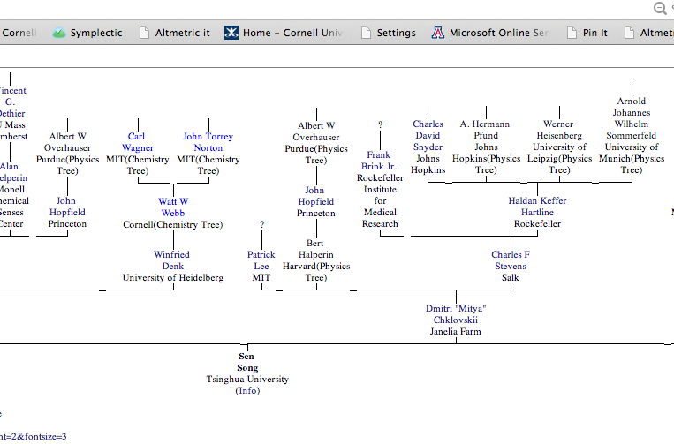
www.neurotree.org

Slide 15
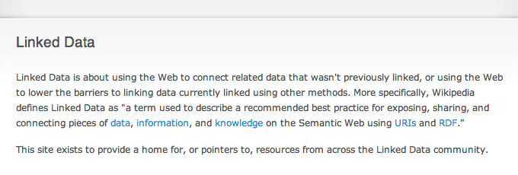
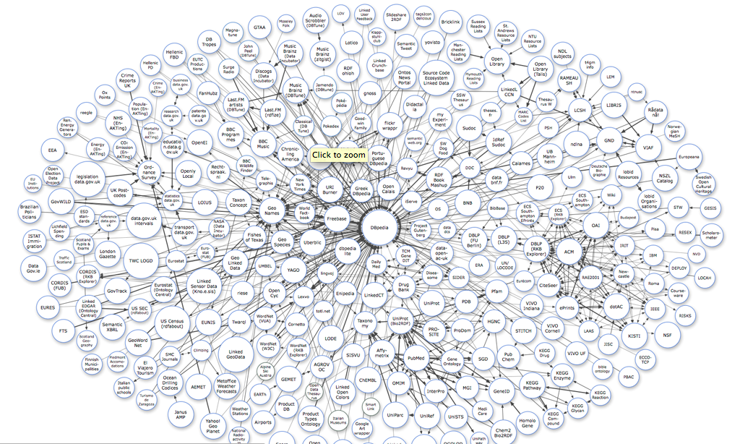
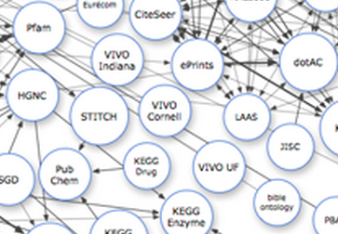

Slide 16
The Future for Subject Librarians
Librarians need to keep up with these new initiatives:
Alternative metrics (Altmetrics)
Even alternative publication models (nanopublications)
We need to develop increased skills in
Semantic web,
Ontologies and linked open data
Network science
We can exploit their potential to discover and share information.
It is an exciting time to be a librarian!
THANK YOU

