Slide 1
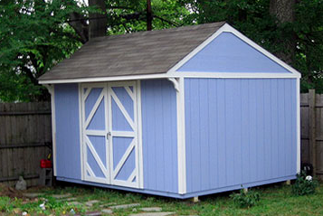
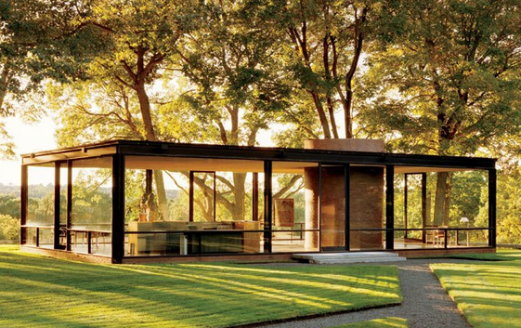
From no windows and locked doors
To big windows and open doors
The changing landscape of
research information
Presentation to Tsinghua University Library
15 November 2013
Katherine Chiang
Networked Research Information Librarian &
Head of Reference and Information Services
Mann Library, Cornell University
www.secrets-of-shed-building.com
www.architecturaldigest.com
Notes:
I am so pleased to be here this morning to give a presentation on the Changing Landscape of Research Information
Libraries and librarians value sharing, and making sharing easy.
When I started as a librarian information was hard to get to, you walked to a building to read it, and if someone else was reading it you had to wait.
Now information is beginning to resemble a giant network with the internet able to connect us to a dataset in Ithaca New York, or Paris, or Beijing with just a click.
But before I start my talk – a little background on how I came to be here, speaking to you in English.

Slide 2
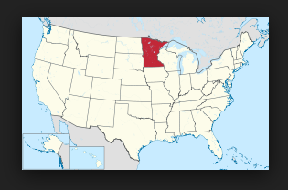
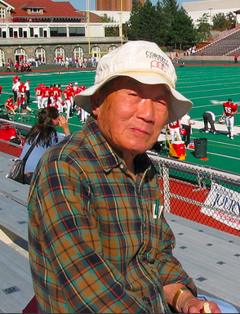
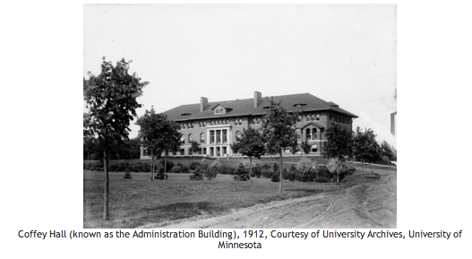
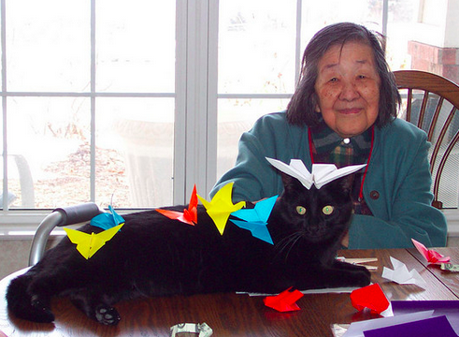
www.en.wikipedia.org
Notes:
My father was a graduate of Tsinghua University, he enrolled in 1934 and graduated from the “Associated Southwest University” when Tsinghua moved to Kunming to avoid the Japanese.
My parents left China in 1946 and settled in Minnesota where my older sister, I, and my younger brother were born.
Unfortunately none of us learned Chinese, which we all regretted later.
My father worked for the University of Minnesota as an entomology professor for 30 years. He retired in 1984.
My mother was an enthusiastic gardener and paper folder – origami.
I became a librarian in 1974 and have worked in libraries since 1968, first while I was a student at the University of Chicago, then as a librarian at the American Institute of Physics, George Washington University Library, Georgetown University Library, The Entomology, Fisheries and Wildlife Library of the University of Minnesota, and since 1984 at the Albert R. Mann Library of Cornell University. I will retire in May of 2015 and can happily say that I have enjoyed every year of my career. I have been fortunate to be a librarian in these years when What we do has not changed, but How we do it has changed significantly.

Slide 3
The researcher
Research products
Preprints
Publications
Technical papers
Conference proceedings
Datasets
Databases
Algorithms
Presentations
Exhibitions
Where research products are preserved
Personal websites
Institutional websites
Publishers sites
Libraries
Institutional repositories
Subject repositories
Government databases
Blogs
Microblogs
Notes:
What do we do?
We connect researchers and learners with the information they need to do their work.
These are just a few examples of the types of information, and where they might be found today

Slide 4
Discovery
Who wants to know about the research
Researchers
Literature searching
Collaboration and exchange
Managing their identity
Documenting their productivity for
  local administration
  Promotion
  Grant funding agencies
Institutions
Managing their research overall
Conveying the contributions of the institution to society, their research impact
Evaluating their researchers
Funding agencies
Proving value for their funding dollars
Documenting the usefulness of the research
Notes:
And here are the research community individuals and institutions are interested in information for many reasons.
Here are just a few of them.

Slide 5
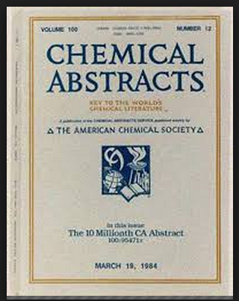
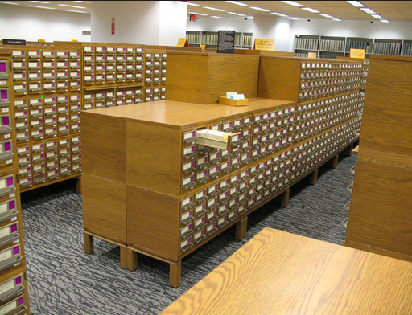
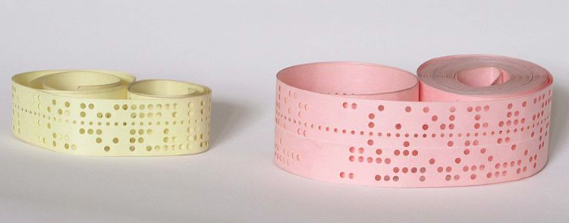
Developments in cataloging research products
Bodleian library papers slips pasted into large books
Card catalogs and print Abstracts
Dial-up online databases (BRS, Dialog)
www.commons.wikimedia.org
www.acs.org
www.en.wikipedia.org
Notes:
Those motivations and interests have not changed.
But How we do this has changed in amazing ways.
In my career as a librarian I’ve lived through this transition – I remember looking at print volume after print volume in search of a citation.
In about 1977 we would create a punch tape for a computer search of a database and then send it through a teleprinter to a company. Several weeks later we would receive a printout of the results of the search.
When I first worked in Mann Library we training researchers how to do their own searching. We needed to train them because we paid for each minute we spent on the computer, and for each citation that was printed off, so we needed to be as efficient as possible.
And now the world of databases has changed

Slide 6
Google scholar
Mendeley
Academia.edu
ResearchGate
Microsoft Academic
Activity Insight
Symplectic Elements
VIVO
Harvard Catalyst
Altmetrics
PlumAnalytics
CASRAI
EuroCRIS
Star Metrics
Research
Information
Systems
Notes:
From a world dominated by PubMed, Chemical Abstracts, the Web of Science and other commercial databases that require an institutional license and a password
To one where citations are easy to find
And where the number of open access articles is growing
And where many groups – profit and non-profit are offering services that supplement the actual citation
Where new research administration systems are appearing every year and state, national and international initiatives are trying to improve how informationa about research is gathered and shared.

Slide 7
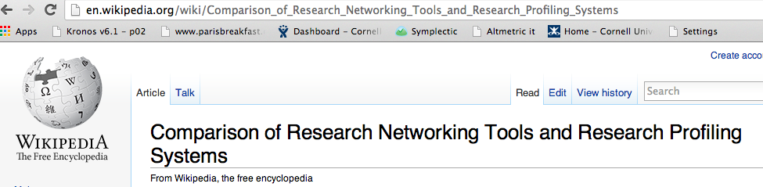
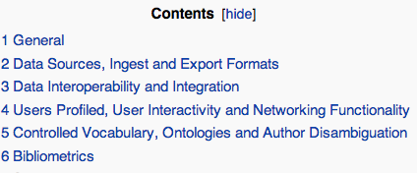
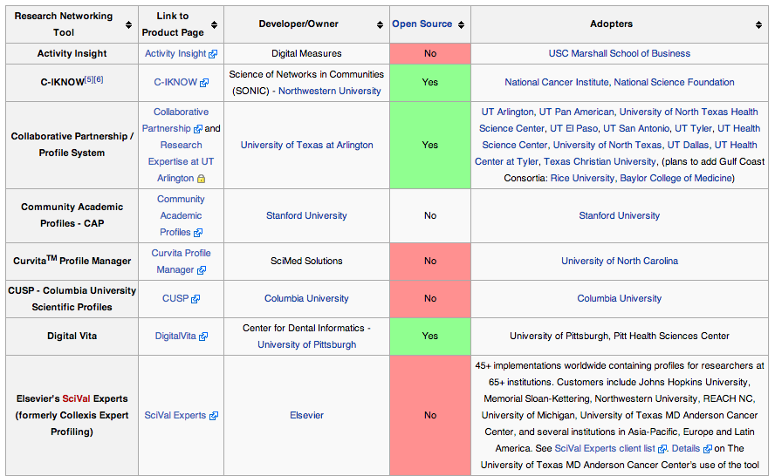
Notes:
The products appear and disappear every year. It is unreasonable to expect the researcher to figure out what to do.
Fortunately there is a growing community of librarians, information scientists, network researchers and other professionals involved in this arena.

Slide 8
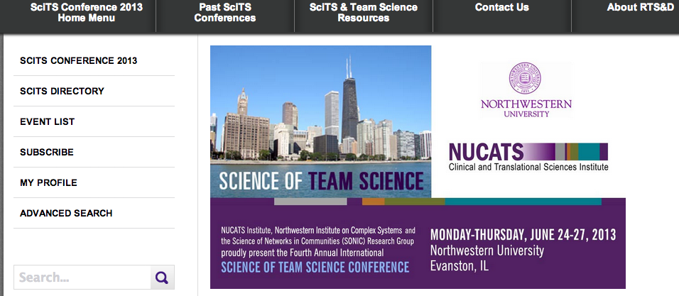
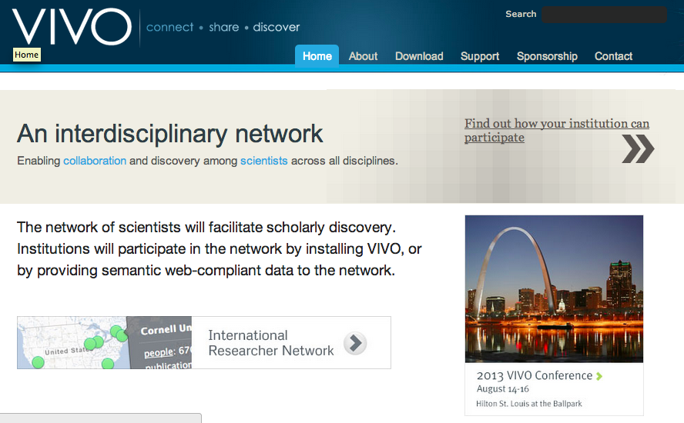
Notes:
I have been to two meetings where these sorts of services are discussed
And next year the two groups may meet together in Austin Texas in August 2014.
This year the Annual Meeting of the American Society for the Advancement of Science – they publish Science
Held a very well attended session on using microblogging and blogs and other social networking tools to promote research discovery.

Slide 9
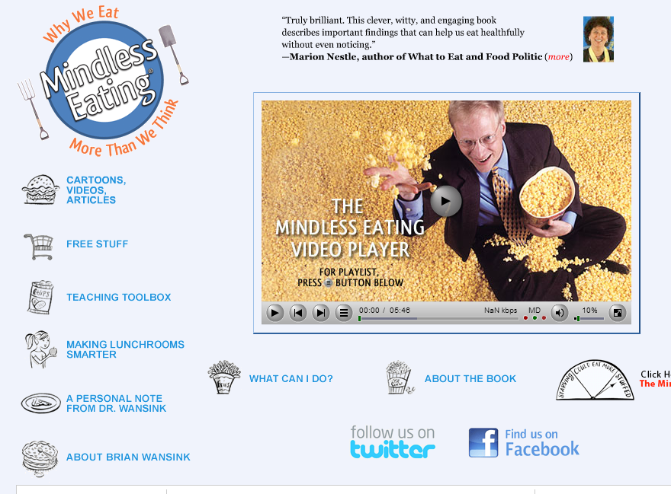
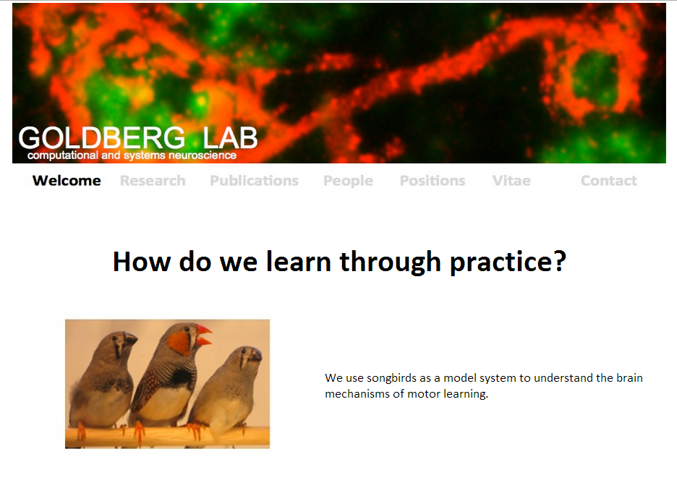
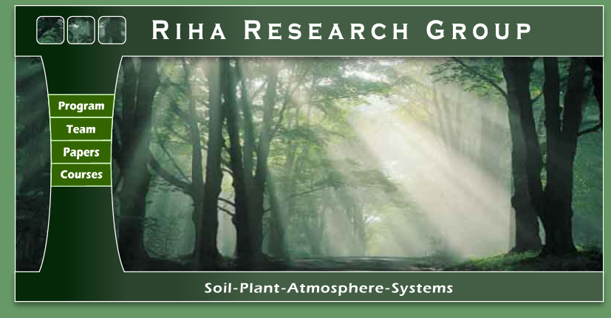
Notes:
We librarians need to understand more about how these services are being used, and can help our scholars
So in addition to attending meetings, and reading the literature, a team of librarians at Mann Library have been looking at how Cornell faculty and graduate students are using these new tools.
How they are presenting themselves on their own sites
And on cross institutional sites such as LinkedIn, Mendeley, Academia.edu and ResearchGate

Slide 10
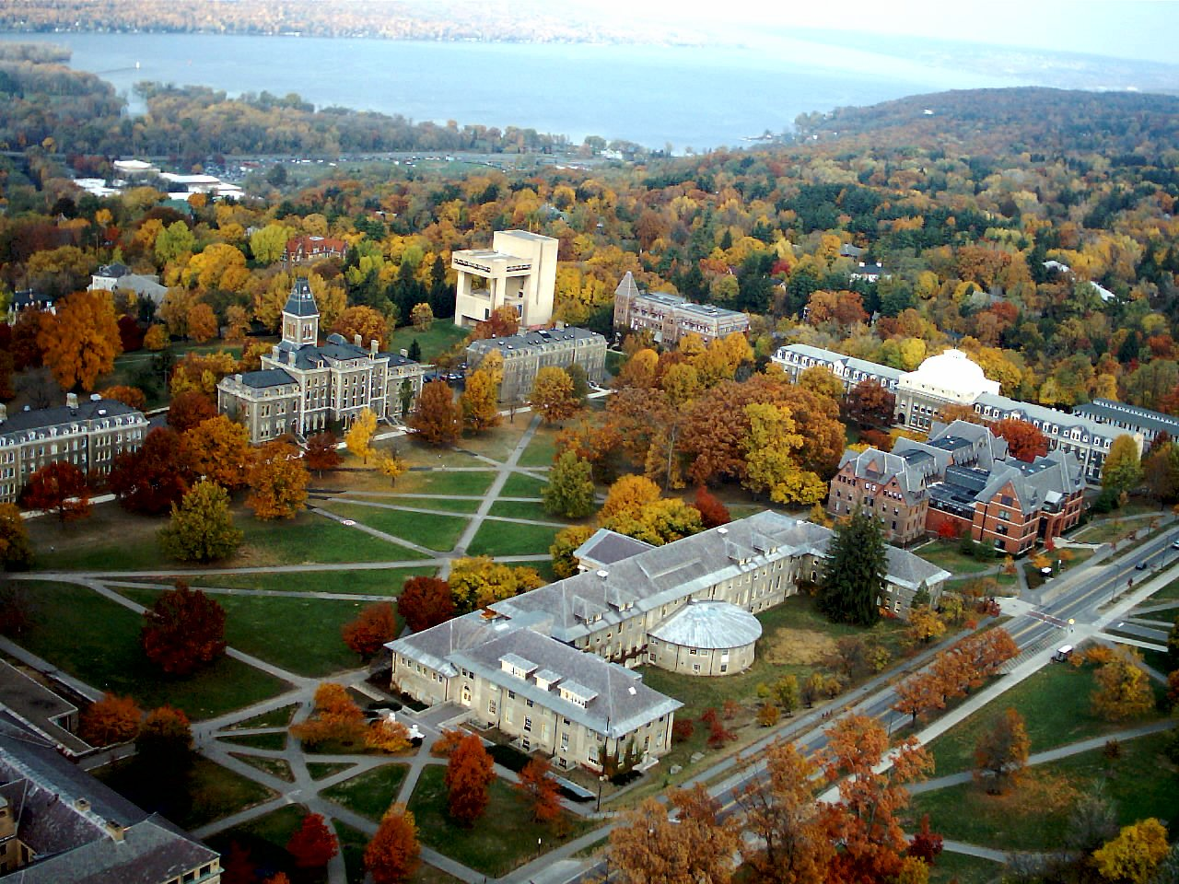

Faculty | * 1,564
Staff | ** 8,081
Undergraduate | 14,158
Graduate/professional, Ithaca | 6,964
Total undergraduate and graduate/professional, Ithaca | 21,131
Total medical graduate/professional, NYC and Qatar | 1,269
Total university | 22,400
LandmarkImages.smugmug.com
Notes:
There are about 22 thousand students, staff and faculty in Ithaca, New York City and Qatar (in the Middle East)
And another 265,680 “Living grads “
Our study was triggered from conversations with senior researchers in the life sciences – “I’m too easily found” was the common sentiment amongst those researchers. But several of the senior researchers suggested early career researchers might consider things differently and they encouraged us to talk to some of those junior researchers.

Slide 11
 | Assistant Professors | Total faculty 2012 data
Agriculture & Life Sciences | 55 | 362
Engineering | 45 | 218
Architecture, Art and Planning | 5 | 44
Notes:
Our subject group is early career faculty at Cornell, assistant professors.
This project is running in several concurrent phases. Data gathering and semi-structured interviews.
We started with the College of Agriculture and Life Sciences and identified 55 faculty and then broadened it to include two more colleges (Engineering and Architecture, Art and Planning) as we scheduled and ran interviews.
We are now expanding the study to include faculty of the College of Human Ecology, and are collecting sample data about graduate students in these same colleges.

Slide 12

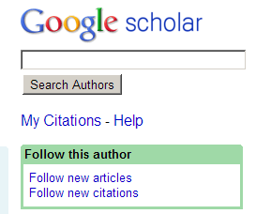


Notes:
Our team searched the researchers’ names (and name variants) in five sites.
Academia.edu
Google citations
LinkedIn
Mendeley
ResearchGate
When encountering sparse entries we erred on the side of considering they were a match if there was anything (location, subject keywords) that might indicate the entry was our researcher
Here are some of our results

Slide 13
Profile presence, and profile curation
for 105 assistant professors
Profile | % sparse | % curated | % none
Academia.edu | 6 | 6 | 88
Google citations | 0 | 30 | 70
LinkedIn | 36 | 14 | 50
Mendeley | 24 | 2 | 74
ResearchGate | 5 | 14 | 81
Notes:
Presence by sites, and if ‘active’
Looked at whether the research products (publications, conference presentations, exhibitions) were within last two years
If the job titles were current
If they were following other researchers
As you see, the majority of profiles were not maintained. Only google had up to date results – maybe that is because they send the researcher e-mails when new citations are identified, or the researchers see the “my updates” link when they search Google scholar?

Slide 14
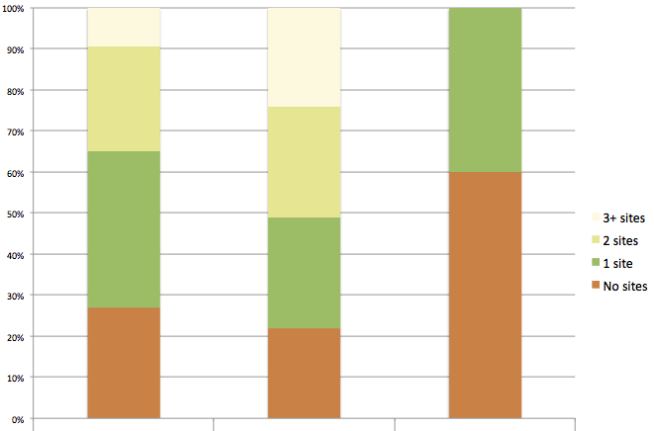
Number of sites used % | Agriculture & Life Sciences | Engineering | Architecture, Art and Planning
No sites | 27 | 22 | 6
1 site | 38 | 27 | 4
2 sites | 25.5 | 27 | 0
3+ sites | 9.5 | 24 | 0
Number of sites used
Notes:
Related to that – maybe researchers are ‘sampling’ the options
28 % of the faculty members had no presence on the 5 sites checked
16 were on three or more sites, engineers 10 out of the 45
Of those with 1 site
19 LinkedIn
10 Mendeley (but since most were sparse, it’s probably for personal citation management)
5 google citations
1 ResearchGate

Slide 15
Presence of a web page in addition to Department profile.
 | % with Lab, Group, or Personal page
Agriculture & Life Sciences | 55
Engineering | 87
Architecture, Art & Planning | 60
Notes:
We also looked at personal/lab/group pages
The Engineering College recently standardized their College and Department profiles, the AAP does something similar.
The College of Ag and Life Sciences does not, Departments handle the websites, some provide lab sites, some do not.

Slide 16
COST BENEFIT
I don’t want to spend the time to figure it out
Time is going to be the consistent answer
Efficiency is the biggest deal
MINIMAL BENEFIT
Audience for my research does not use these tools
Bothered by self promotion, while admitting it can be effective
BENEFIT
Attract grad students
Seeing who is citing or following their work
RISK
Sites die out, choosing which to invest in
Notes:
INTERVIEWS
Focus on Ag & Life Sciences – we are just starting this phase.
So far we have done 6 interviews.
Want to expand to researchers in other colleges.
Themes? – we found nothing startling
I suspect most researchers are still seeing this in a ‘search’ context, rather than a network context – one professor did note “network only works if it’s big enough”
AUDIENCE – mentioned by international development, and extension
BENEFIT
Who is following/citing –for green card application has to document impact
RISK
One researcher said Twitter and LinkedIn were going to survive, so that’s all he invests in

Slide 17
CONTROL & CUSTOMIZATION
Concept of selected publications
Choose presentation, the order, the organization
WEBSITE
Institution should support individual researchers’ websites
Notes:
Here are two more themes that emerged from the interviews: Control and using a website instead.
Not conveying much guilt – they were not saying things like “I know I should be doing this”
Seeing it as an add on to their daily work.
Some as self promotion – coming from one who had just submitted his promotion packet.

Slide 18
STILL GENERATIONAL?
Old fashioned
I’m 20th century
I’m older, maybe that’s why I’m not doing it
A student started it for our group
Notes:
Several researchers made comments that caused us to think – is this still generational?
Led me to look at Cornell from a different angle – looking at the networked sites – we looked at Academia.edu and Research gate – since we could get a list of members who identified as Cornell and their department/subject area
We chose the top two clusters, each had over 50 entries.

Slide 19
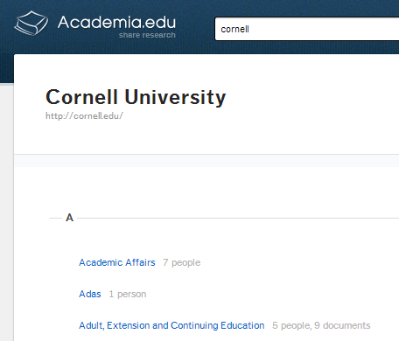
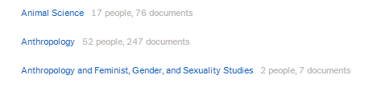
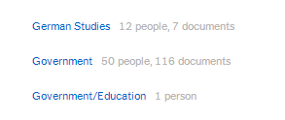
Researchers 23*
Grad students 53**
UG & misc. 7
Alumni 8
Not in CU directory 11
102
* Includes 2 duplicate entries
** includes 1 duplicate entry
Notes:
Here’s Academia.edu
Two units with 50+ Social Sciences
Looking at the two units (based on individual self identification) with 50 plus members, and searched the names against the Cornell University official directory
Researchers – faculty, emeriti, research associates, post docs
Grad students
Undergrads, staff, others
Alumni
Not in CU directory

Slide 20
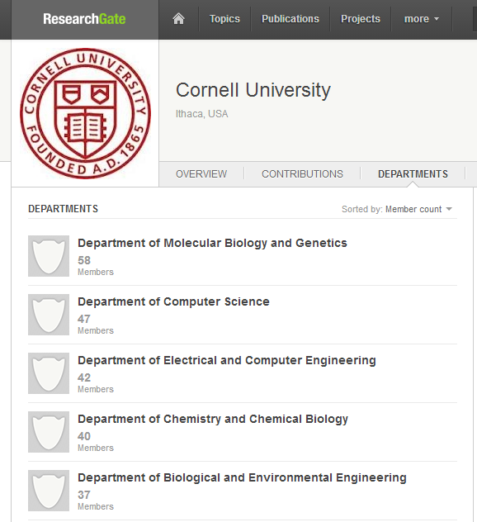
Researchers 40*
Grad students 26
UG & misc. 11
Alumni 14
Not in CU directory 14
105
*1 duplicate entry
Notes:
ResearchGate lists 1,949 as Cornell
Academia.edu tally 1,239 Cornell affiliations
Cornell 22K active, 265K living alum
Here are the two departments with the most ‘members’ Sciences
25% alumni or not in the CU directory
Another 25% Grad students
Counting Faculty through Postdocs – 37%
ResearchGate – Departments are mostly sciences, some social sciences.
Academia.edu has many more humanities and social sciences departments
MB&G in Academia.edu = 2

Slide 21
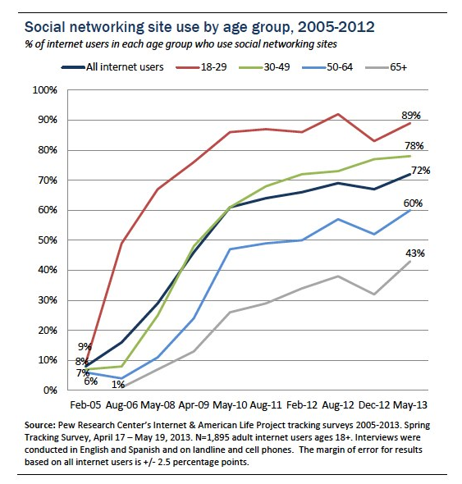
Network residents, vs visitors
http://pewinternet.org/Commentary/2012/March/Pew-Internet-Social-Networking-full-detail.aspx
Notes:
Thinking about born digital, digital native
Or residents and visitors
Researchers are starting to see the value of being within a network, where you are discovered by who or what you are connected to vs. google search by name or subject. But it is not a well recognized concept for most researchers.
Students today live with their smartphone. For me it is something I adopted, late in life.
For the network – it is a similar concept. The natives in the networked world were born into a world with Facebook and LinkedIn.
College student who used early Facebook in 2005 would have graduated by 2009 and would now be in Grad School. The red line.
Our interviewees got their PhDs between 2004 and 2007 (@7 years BS to PhD, 29 in 2004, 38 now, the green line.
But the cultural norms of academia being driven by the grey and blue lines
Will we see an uptake in networked identities as the Facebook generation reaches academia?

Slide 22
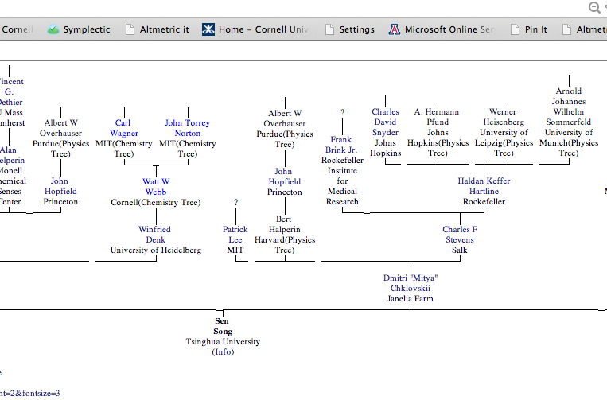
www.neurotree.org
Notes:
I believe the network is an important trend.
Senior faculty have built their network over the years attending conferences, learning from graduate students who have gone on to become professors in other institutions.
LinkedIn recognized how people use their personal networks and has become very successful because of that.
Citation network
Co-author network
Co-investigator network
Shared memberships on committees
Shared alma maters –
Academic lineage – Neurotree Here is a Tsinghua professor in the department of Biomedical Engineering who can trace his academic ‘tree’ back to a Cornell professor and to Werner Heisenberg!

Slide 23
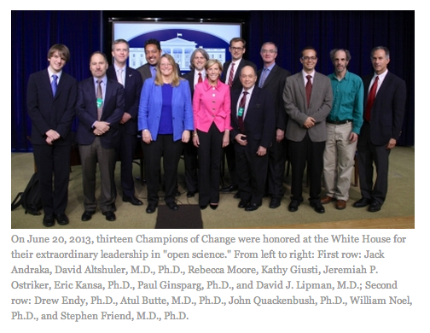
Notes:
The trends in the ‘open science’ movement will enable further changes, and an even richer network.
This summer the White House honored some of the people who are making information as open as possible – including (the only one not in a suit) Paul Ginsparg, now of Cornell, who created arXiv, now hosted by the Library.
Science content now appears in tweets or other microblogging streams, in websites, and in blogs.
Several years ago I attended an Open Science meeting in NYC – I heard a talk by a physicist who blogs about his work, even his research ideas, he is not afraid of someone stealing them – ideas are cheap in his area, figuring out how to do the experiment is the hard part.

Slide 24
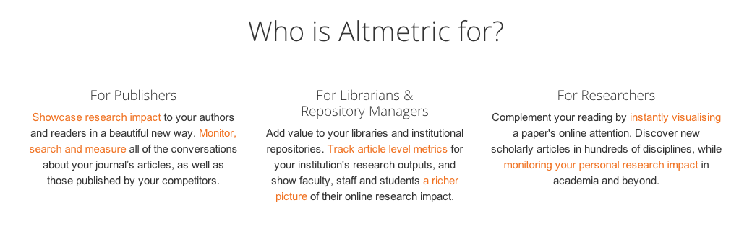
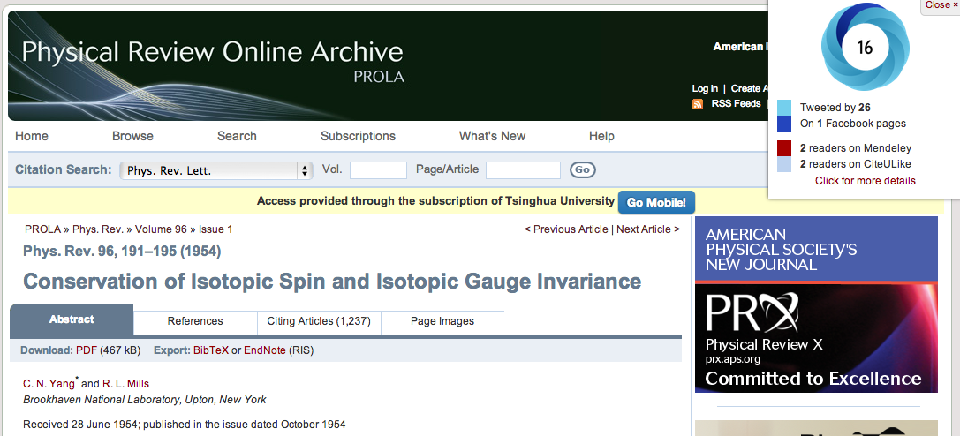
Altmetric.com PlumAnalytics.com
Notes:
Networks allow products like these to exist. They look at how research is appearing on the network as mentioned in the media or blogs and microblogs – they are going to be part of the next generation of ‘citation networks’.

Slide 25
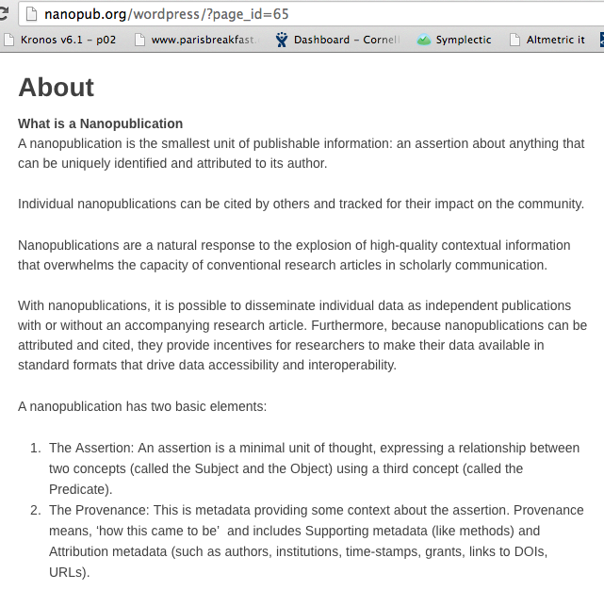
Notes:
Then there’s Nanopublication – I had to bring this up because I am fascinated by this concept and wonder if it will turn into anything significant.
If it does it could further revolutionize how we librarians work.

Slide 26
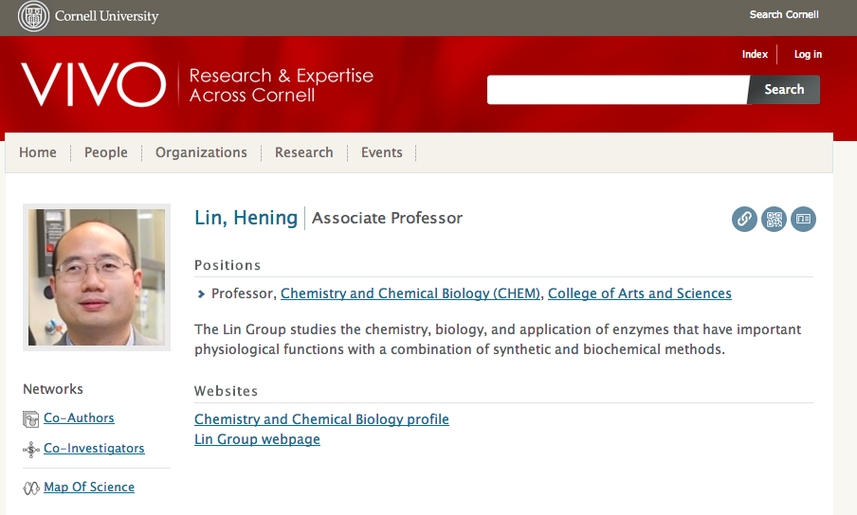
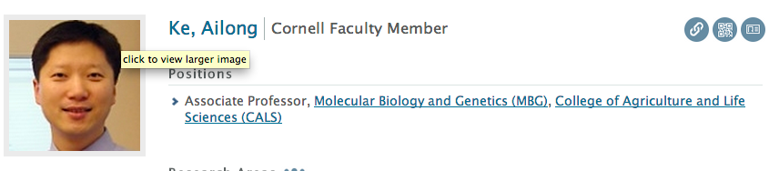

Notes:
Of course I had to show a picture from VIVO – Prof. Hening got his BS from Tsinghua in 1998
And Professor Ke will be a Santander Visiting professor here next year.
VIVO embodies the philosophies of open, linked data

Slide 27
Goal
Research to researcher connection is accurate and up to date – disambiguation
That connection can follow the researchers throughout their careers
The Researcher has some control over how he or she is presented in various places at various times – but ultimately publications are ‘public’
Data are collected once and reused, enhanced, aggregated
All systems holding research information are interoperable
Notes:
These are some of our VIVO goals

Slide 28
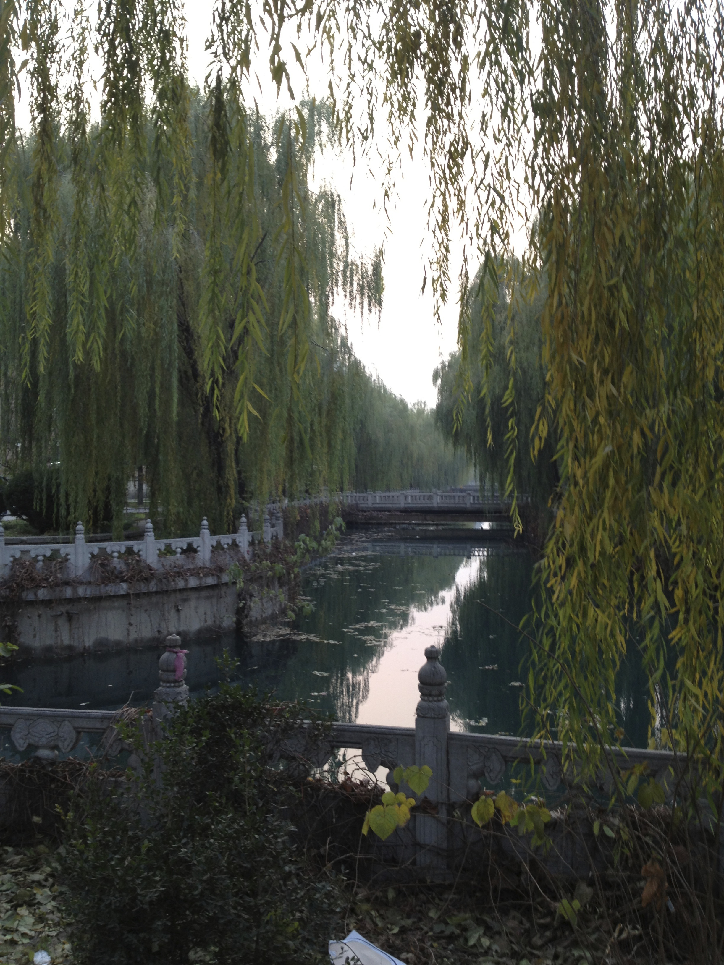
Notes:
Librarians
Need to keep up with these new initiatives – alternative metrics, alternative publication models.
Just as we have translated our cataloging expertise into metadata expertise,
We need to develop increased skills in
Semantic web,
ontologies, linked open data
Network science so we can exploit their potential to discover and share information.
Where we can help:
Author disambiguation – we can help, we understand the scope and scale of the problem. We can encourage researchers to register for an ORCID id.
If we know how authors want to control their professional presence, and how that affects their visibility and impact, we can then help researchers who want to improve their visibility.
We can continue to support open data and open access so individuals and institutions don’t waste time re-entering, or re-gathering data for their reports and department websites.
We should do everything we can to promote interoperable information.
Our role has not changed, we are still the only group in the University who has a primary responsibility for scholarly information. But how we do that is changing every day.
It is a very exciting time to be a librarian.
Thank you for giving me this opportunity to speak, and for being such generous hosts.

