Slide 1
Journal Club 11/14/13
Josh Smith

Slide 2
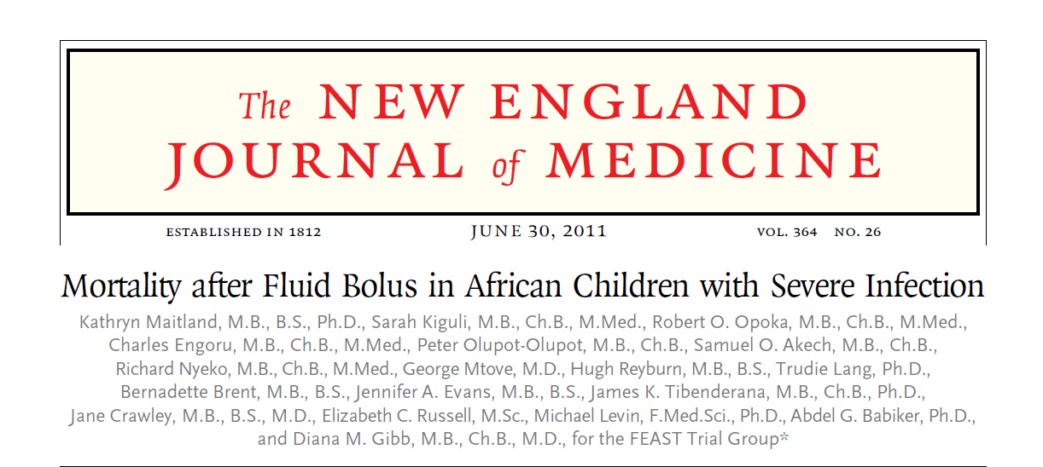

Slide 3
Background
The role of fluid resuscitation in the treatment of children with shock and life threatening infections who live in resource-limited settings is not established
Malaria and Sepsis kill more than 2 million children per year worldwide
In sub-Saharan Africa between 15-30% of children admitted to hospital because of severe infections die
Antimalarial and antimicrobial drugs are the mainstay of treatment, however most deaths occur early before definitive treatments have time to act

Slide 4
Background
Bolus therapy to correct fluid deficits is a standard supportive treatment
Routine in developed countries for the emergency management of patients with severe illness
No large trials anywhere to evaluate the safety and effectiveness of this treatment
Based on physiology and ethically not possible

Slide 5
PICO
  In African children presenting with severe febrile illness and impaired perfusion, does administration of 20 mL/kg boluses of 5% albumin or 0.9% NaCl reduce mortality at 48 hours?

Slide 6
Objective
The objective of the study was to investigate the usage of early fluid resuscitation with a 0.9% NaCl or a 5% albumin bolus compared to no bolus and maintenance fluid therapy with 0.9% NaCl in critically ill, febrile children in sub-Saharan Africa
Primary endpoint: Mortality at 48 hours

Slide 7
Design
The study was a two-stratum, multi-center, open, randomized, controlled trial conducted in six centers in Africa between January 2009 and January 2011
2 Stratum design
Ethical approval in all countries and Imperial college in London
Interim analysis every 6 months by independent data and safety monitoring agency

Slide 8
Design
Fever + impaired perfusion
Stratum A
0.9% NaCl 20mL/kg
Albumin 20mL/kg
No bolus
Severe Hypotension
Stratum B
0.9% NaCl 40mL/kg
Albumin 40mL/kg

Slide 9
Inclusion
Patients between 60 days and 12 years of age presenting with a severe febrile illness
Complicated by impaired consciousness, respiratory distress or both
AND
Impaired perfusion (1 or more)
  CRT >3 s
  Lower limb temperature gradient
  Weak radial pulse
  Severe tachycardia for age

Slide 10
Exclusion
Severe malnutrition
Gastroenteritis
Non-infectious causes of shock (trauma, surgery, or burns)
Conditions for which volume expansion would be contraindicated

Slide 11
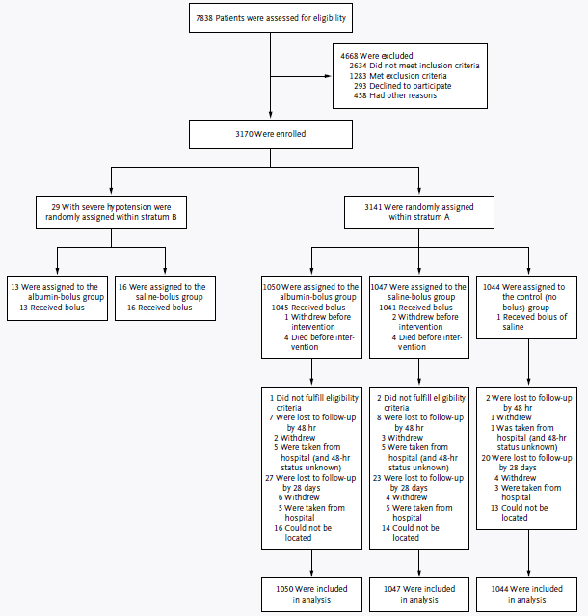

Slide 12
Randomization
Randomization was performed in permuted blocks of random sizes, and was stratified according to clinical center
Trial numbers were kept inside opaque, sealed envelopes, which were numbered consecutively and opened in numerical order by a study clinician

Slide 13
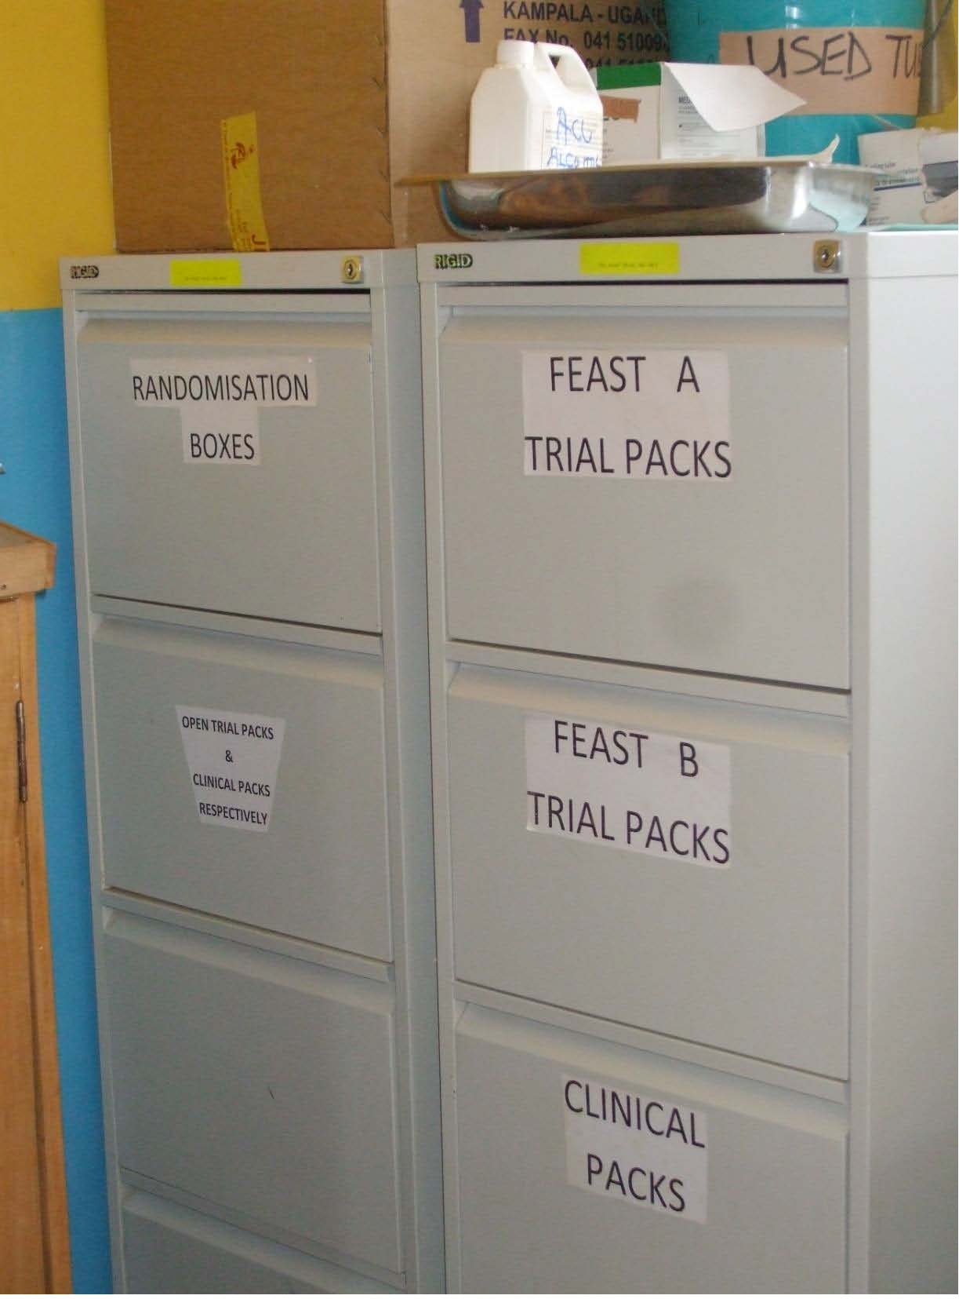

Slide 14
Randomization
Baseline characteristics of the groups were the same

Slide 15
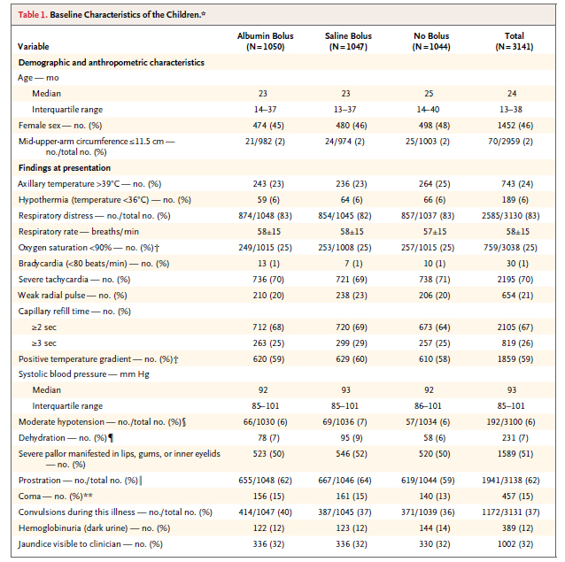

Slide 16
Outcomes evaluated
Primary
  Mortality at 48 hours
Secondary
  Mortality at four weeks
  Neurologic sequelae at 4 and 24 weeks
  Episodes of hypotensive shock within 48 hours after randomization
  Adverse events potentially related to fluid resuscitation
    Pulmonary edema
    Increased ICP

Slide 17
Additional procedures
Training in triage and resuscitation was provided to the centres
Improved monitoring abilities ie: Pulse ox oscillometric BP
Maintenance fluids provided to all 2.5-4ml/kg
Antibiotics, antimalarials, anticonvulsants, glucose supplementation when appropriate
Blood transfusion 20ml/kg whole blood over 4 hours when Hb<5g/dl

Slide 18
Stats
Initial sample size estimated 2800
Risk of death of 15% in control
Increased the sample size to 3600
  18 months in to the trial as the risk of death was lower than anticipated
Powered to 80% to detect 33% relative reduction in mortality with saline versus control
All statistical tests were 2 sided
Children lost to follow up were assumed to be alive

Slide 19
Stats
Appropriate to use Mantel Haenszel method to compute a weighted risk ratio or odds ratio

Slide 20
Results – Stratum A
3141 patients
Median age 24 months
62% neurologic compromise
83% respiratory distress
39% lactate >5
Mean Hb 7.1±3.2g/dl
Malaria 57%
HIV 4%

Slide 21
Results – Stratum A
 | Albumin | 0.9% NaCl | Control
Median volume (mL/kg) in 1st hr | 20ml/kg | 20mL/kg | 1.2mL/kg
In 2nd hour | 4.5ml/kg | 5mL/kg | 2.9mL/kg
At 8 hours | 40ml/kg | 40mL/kg | 10.1mL/kg
Mortality | 10.6% | 10.5% | 7.3%
Bolus vs control relative risk of death = 1.45 P=0.003
Albumin vs 0.9% NaCl RR of death = 1.0

Slide 22
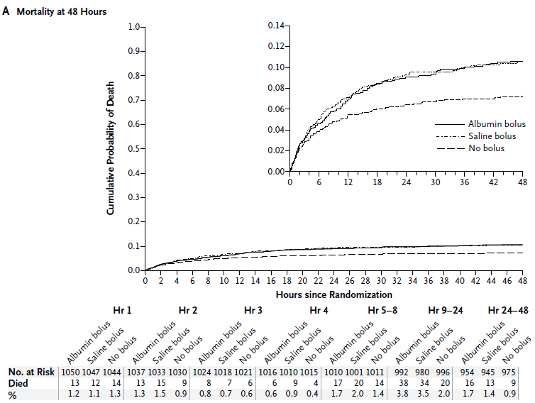
Results – Stratum A

Slide 23
Results – Stratum B
29 children
69% albumin group died
56% 0.9%NaCl group died
Relative risk of death with albumin 1.23 P=0.45

Slide 24
Follow-up
Few patients lost to follow-up, and losses similar between groups
Saline-bolus group: 8/1047 patients lost to follow-up by 48hrs
Albumin-bolus group: 7/1050 patients lost to follow-up by 48hrs
Control group: 2/1044 patients lost to follow-up by 48hrs

Slide 25
Blinding?
Open-treatment trial, in which clinicians were aware of the treatment being provided to each child
End-point review committee, whose members were unaware of the treatment assignments, reviewed all deaths, neurologic sequelae, and adverse events
Clinicians should be blinded in order to prevent differential administration of therapies that affect the outcome of interest

Slide 26
Blinding?
Overall supportive treatments were similar in each groups (transfusions, atb, etc):
A total of 1408 children received blood transfusions
  472 (45%) in the albumin-bolus group
  487 (47%) in the saline-bolus group
  449 (43%) in the control group
The receipt, and the timing of the receipt, of blood, quinine, and antibiotics were similar across groups

Slide 27
Increase the bolus amount
Amendment was proposed by the study team (who were blind to all interim results) in June, 2010, because they were concerned that the trial might fail to reach a conclusive result, since bolus volumes were much lower than standard practice in resource-rich countries
Stratum A now 40mL/kg over 1h
Stratum B now 60mL/kg over 1 h
Did not affect results

Slide 28
Stop the trial
At the 5th interim review of data on January 12, 2011, with data available from 2,995 children, the independent DSMB recommended stopping enrollment owing to safety concerns in the bolus groups and because it was very unlikely that superiority of the bolus strategy over the control strategy would be shown

Slide 29
Final result
Mortality in children receiving a fluid bolus was 3.3% GREATER than those who did not

Slide 30
Critiques
Are these patients truly shocked
  WHO – all 4 criteria

Slide 31
To ponder
If hemodynamic variables improved in bolus group why did more die?

Slide 32
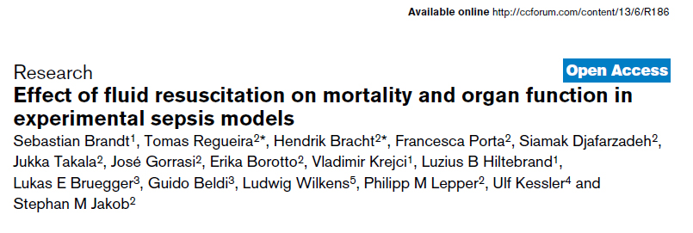
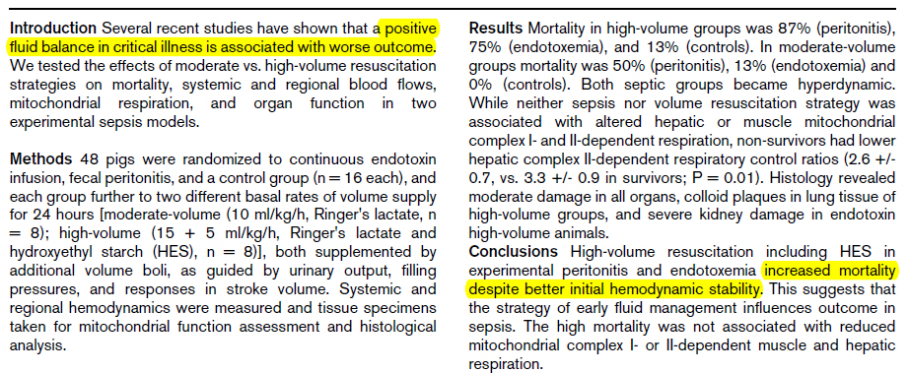

Slide 33
To ponder
If hemodynamic variables improved in bolus group why did more die?
What were these patients dying from

Slide 34
