Slide 1
Heatstroke
April Blong, DVM
November 19, 2013

Slide 2
Overview
Pretest
Normal heat sources and dissipation
Types of heatstroke and disposing factors
Pathophysiology
Treatment
Prognosis

Slide 3
Which is the most important prognostic factor for patients with heatstroke?
A) The presence of disseminated intravascular coagulation
B) Duration of time core body temperature is above the critical threshold
C) The absolute highest body temperature
D) The number of nucleated red blood cells present

Slide 4
What is the most effective cooling technique for patients with heatstroke?
A) Directing a fan to blow air over the patient
B) Wetting the patient with tepid water
C) The combination of wetting the patient and using a fan
D) Cold/ice water whole-body immersion (except the head)

Slide 5
Normal heat sources
Exogenous
  Environment
Endogenous
  Cellular respiration
  Increased with activity

Slide 6
Normal heat dissipation
Temperature set-point dictated by hypothalamus
Thermoregulation also determined by the hypothalamus
  Central temperature receptors
  Peripheral temperature receptors
  Appropriate thermoregulatory response initiated
Notes:
Cells in the preoptic anterior hypothalamic neurons sense the hypothalamic temp
Thermoreceptors in skin and spinal cord
Input from central receptors appx 9x stronger response, change in a single degree of central receptors can initiate significant responses

Slide 7
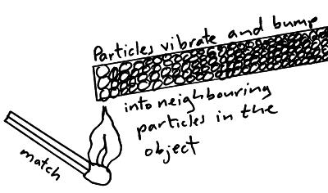
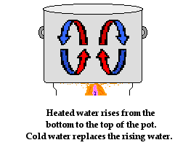
Methods of heat transfer
Conduction
  Transfer of heat in the absence of material flow
  Laying on a cold surface
  Solids > liquids > gasses
Convection
  Transfer of heat by mass motion in a liquid or gaseous medium
  Warmer medium rises brining cooler medium in contact with
  heat source
Often lumped together
http://physicsnet.co.uk/gcse-physics/thermal-energy-transfer/
http://www.physicsclassroom.com/class/thermalP/u18l1e.cfm

Slide 8
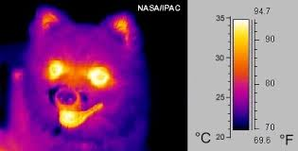
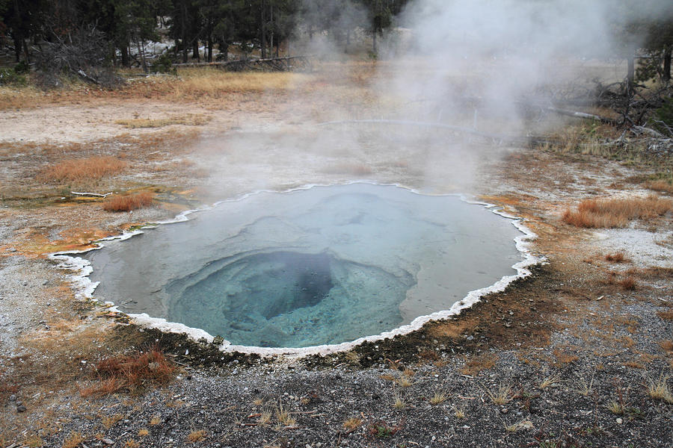
Methods of heat transfer
Radiation
  Transfer of heat by electromagnetic waves
  All things radiate electromagnetic waves
  The higher the temperature the more radiation occurs
Evaporation
  Conversion of a liquid to gas – requires energy (heat)
  Sweating/panting
m.teachastronomy.com
fineartamerica.com

Slide 9
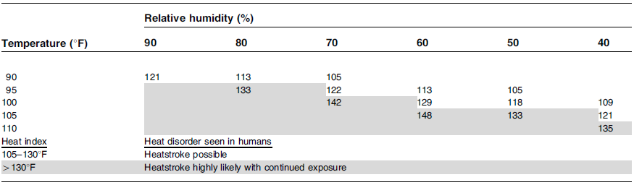
Canine ability to dissipate heat
Coat type limits radiation
Evaporative sweating on footpads
Conductive and convective heat loss via respiratory tract and whole body
Evaporative loss via panting and respiratory tract
  Most important when temp > 32°C (89.6)
  Minimal efficacy when humidity >80% at high temperatures
Johnson SI, et al. Heatstroke in small animal medicine: a clinical practice review. J Vet Emerg Crit Care 2006; 16 (2): 112-119

Slide 10
Heatstroke
Imbalance between heat production/absorption and dissipation
Humans
  Core temperature > 40°C (104) with CNS dysfunction
Dogs
  No consensus
  Core temp >41°C (105.8) w/ collapse?
Cats – very rare
Temperatures of 42-43°C (107.6-109.4) used clinically with little problem
Notes:
Little effect seen in dogs experimentally

Slide 11
Classical heatstroke
Passive thermal exposure
Inadequate thermoregulatory control mechanisms
  Humans – very young and old
    Heat waves
  Dogs with lack of resources
    Shade, water
Notes:
Children left in cars, elderly without airconditioning

Slide 12
Exertional heatstroke
Exercising beyond physical limits and inability to dissipate heat from muscle activity
Many predisposing factors
  Endogenous inherent to the individual
  Exogenous related to environment or administered drugs
In humans the prevalence is increasing
  Incidence of deaths highest from 2005-2009

Slide 13
Human predispostions:
Fever/illness
Dehydration
Sleep deprivation
Lack of acclimatization
Sedentary lifestyle
Obesity
Hypokalemia
CV dysfunction
Excessive alcohol consumption
Intense solar radiation
Mismatch between fitness and activity
Drugs
  Decreased sweat production
    Antihistamines, anticholinergics
  Alterations in skin blood flow
    Ca channel blockers, female hormones
  Reduction in contractility
    Ca channel or β blockers
  Increased heat production/altering set-point
    Amphetamines, salicylates
Notes:
Acclimatization – WHAT IS IT

Slide 14
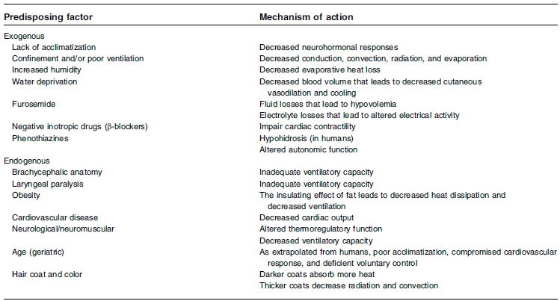
Canine predispositions
Johnson SI, et al. Heatstroke in small animal medicine: a clinical practice review. J Vet Emerg Crit Care 2006; 16 (2): 112-119

Slide 15
Pathophysiology
Hyperthermia with inflammation and MODS resulting in CV collapse
Initial response is protective
  Increase in CO with decrease in SVR
    Vasodilation of skin vessels, vasoconstriction of splanchnic vessels
  Increased panting (sweating)
  Mediated by sympathetic nervous system
Acute phase response is initiated

Slide 16
Acute phase response
Reaction involving endothelium, leukocytes, and epithelial cells
Goal: protect against injury and promote repair
Activated in response to many stressors, including heat
Primarily activated by IL-6 in heat injury
Cellular protection primarily mediated by heat shock proteins

Slide 17
Heat shock proteins (HSP)
Molecular chaperones that regulate tissue reaction to stresses
Prevent disaggregation of denatured proteins and assist in refolding
  Mark terminally damaged proteins for degradation
Attenuate loss of epithelial barrier integrity – reduce endotoxin leak
Attenuate arterial hypotension to reduce CNS ischemia and damage
Interfere with oxidative stress and block apotosis pathways
Notes:
Stresses – heat, ischemia, hypoxia, endotoxin, physical acitivy, oxidative stress, nitrosative stress

Slide 18
HSP 70 or 72
Major inducible 70 kDa HSP
Remains high after stressor = stress conditioned tissues
  Heat acclimatization results in higher basal levels
Heatstroke patients have lower levels of HSP 70
  Lack of acclimatization
  Antibodies against HSP 70
  Injection of HSP 70 ab into hypothalamus enhances onset of heatstroke

Slide 19
Thermoregulatory failure
At some point heat stress extends beyond the compensable phase
Decreased blood volume with cutaneous vasodilation = decreased CVP
  Cooling measures
  Fluid transfer from IV to interstitial space during heat stress
Splanchnic vasoconstriction leads to GIT ischemia and endotoxin leak
In decompensated phase CVP decreases precipitously
  Reduced ability to transfer heat to body surface – accelerated temperature elevation
Notes:
More than 30% of blood flow to skin est.

Slide 20
Blame the gut…typical
GIT ischemia and hyperpermeability leads to increased endotoxin leak
  Increased cellular demands with reduced blood flow leads to ROS and RNS in GIT and liver
  Oxidative stress leads to increased permeability and endotoxin leak
Normally endotoxin degraded/inactivated efficiently by liver
  Reduced hepatic portal blood flow
  Thermally altered hepatocyte function
Endotoxemia → SIRS → MODS

Slide 21
Inflammation
Endothelial activation and release of NO and endothelins
  Activation of both coagulation and fibrinolysis
  Platelet consumption
  DIC → MODS
Decreased cerebral blood flow and neuronal injury
  BBB disruption – vasogenic edema
  Increased intracranial pressure

Slide 22
Cellular dysfunction
Direct heat injury
Cells are already hypoxic and increase lactate production
  Stimulates Na/K ATPase pump
  Increased heat production and ATP depletion
  Failure of the ion transport systems
  Intracellular calcium accumulation
  Necrosis

Slide 23
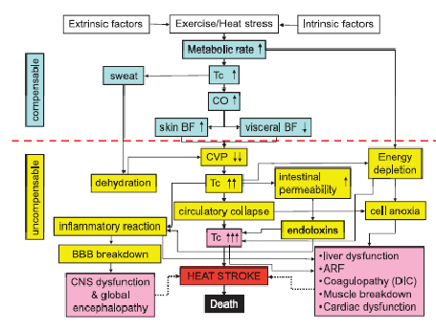
Epstein Y, Roberts WO. The pathophysiology of heat stroke: an integrative view of the final common pathway. Scand J Med Sci Sports 2011; 21: 742-48.

Slide 24
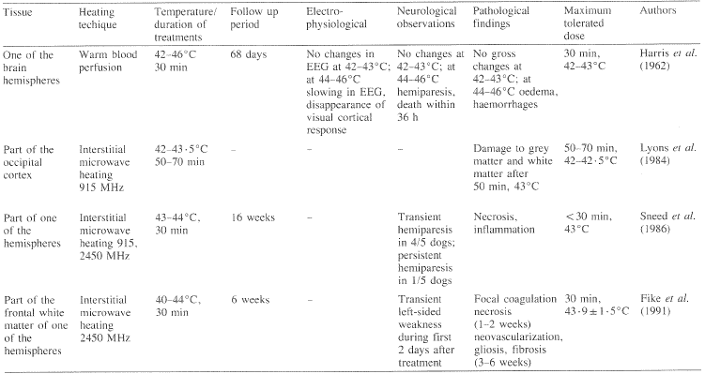
Canine brain resistance to heat injury
Dogs able to tolerate 42-43°C (107.6-109.4) for at least 30 minutes
Exposure to 44-46°C (111.2-114.8) for 30 minutes resulted in hemiparesis, anisocoria, and many did not regain consciousness
Sminia P, et al. Effect of hyperthermia on the central nervous system: a review. Int J Hyperthermia 1994; 10 (1):1-30

Slide 25
Clinical signs
Collapse during exercise
Lethargy
Excessive panting/tachypnea
Hematochezia
Elevated rectal temperature
  Owner cooling!

Slide 26
Clinical pathological abnormalities
Many have elevated hematocrit
Presence of nRBC’s with normal hematocrit– 68% - 95%
  Cytokines vs direct damage to bone marrow
Increased liver and muscle enzymes
Hypoglycemia 63%
Elevated kidney values - prerenal vs AKI
Prolonged coagulation times
Thrombocytopenia common, 62%
  Petechia /echymoses
Arrhythmia (25%) – VPCs, VT, AIVR, A Fib

Slide 27
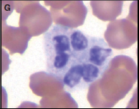
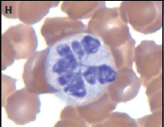
Botryoid nuclei in neutrophils
Humans – burns and hyperthermia
May aid in diagnosis if unsure if heat injury occurred
Reported in dogs with hyperthermia
Mastrorilli C, et al. Botryoid nuclei in the peripheral blood of a dog with heatstroke. Vet Clin Path 2013; 42 (2): 145-9.

Slide 28
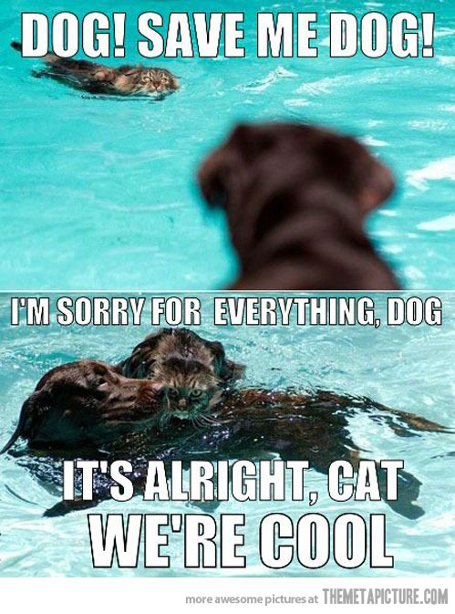
Treatment
themetapicture.com

Slide 29
What does this tell us?
“The reality of EHS medical care within the confines of organized sport and military training scenarios is that no one should die if proper, prompt and aggressive care begins within 10 minutes of collapse”
“Experiences from various military installations…and medical tents…have shown that if temperature is reduced to less than 40.0°C (104) within 30 min after collapse, the fatality rate is close to (or actually) zero.”
With appropriate field and hospital care
heat related deaths can be minimized!

Slide 30
Cooling recommendations
Worse prognosis the longer core temp is above critical threshold
  Goal: temperature <40°C within 30 minutes of collapse
Cooling rate of at least .1°C/minute when cooling starts immediate
Rate of at least .15°C/minute if cooling is delayed more than 20-30 minutes after collapse
Cooling in the “field” then transport
  Transport significantly delays cooling
  Need to stop the decompensated cycle of thermoreguatory failure

Slide 31
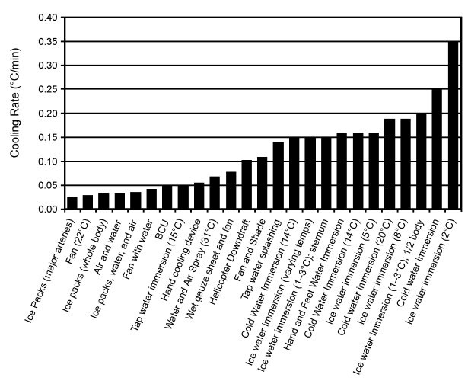
Cold/ice water immersion is the gold standard!

Slide 32
Doesn’t that decrease cooling?
Nearly all studies evaluating CWI show reliably fast cooling rates
  One study by Wyndham et al showed inferior cooling rates
  Has never been reproduced
Hyperthermic individuals are not euthermic individuals
  Peripheral vasoconstriction and shivering occur
  Maintain temperature for a short while after immersion, then temperature decreases
Hyperthermic individuals have immediate and sustained cooling

Slide 33
Immersion during heatstroke
Thermoregulatory responses are primarily governed hypothalamic temperature
  Elevated core temperature dampens or negates vasoconstriction and shivering triggered by peripheral thermosensors
  Some amount of vasoconstriction probably occurs
  They do not impair rapid cooling
Water has much greater thermal conductivity than air
  630.5 mW/m2/°Kelvin in water vs 26.2 mW/m2/°Kelvin
Immersion recruits nearly 100% of body surface area in cooling

Slide 34
Other concerns
Discomfort
Ability to access patient
Sanitation
Availability

Slide 35
Supportive care
IV fluids
Treatment for organ specific dysfunctions
+/- fresh frozen plasma
Antibiotics?
Gastroprotectants?
Continuous hemofiltration

Slide 36
Prognosis
Approximately 50% survival in published studies
Many prognostic variables
No prospective studies
Have not shown improvement with owner cooling
  Dogs with owner cooling and presented in <90 minutes had 100% survival

Slide 37
Prognostic factors
Presentation > 90 min after collapse
Obesity
Seizures
Greater increase in PT/PTT
Creatinine >1.5 at 24 hours
Blood glucose <47 mg/dL
DIC
Comatose at presentation
Lower albumin, TP, cholesterol
Higher creatinine and Tbili
18 NRBCs/100 WBC or more
  Sensitivity 91%
  Specificity 88%
  AUC .9

Slide 38
References
McDermott BP, et al. Acute whole-body cooling for exercise-induced hyperthermia: a systematic review. J of Athletic Training 2009;44 (1): 84-93
Mastrorilli C, et al. Botryoid nuclei in the peripheral blood of a dog with heatstroke. Vet Clin Path 2013; 42 (2): 145-9.
Sminia P, et al. Effect of hyperthermia on the central nervous system: a review. Int J Hyperthermia 1994; 10 (1):1-30
Casa, et al. Cold water immersion: the gold standard for exertional heatstroke treatment. Exerc sport sci rev 2007; 35 (3):141-149.
Chen G, et al. Effects of continuous haemofiltration on serum enzyme concentrations, endotoxemia, homeostasis and survival in dogs with severe heat stroke. Resuscitation 2012; 83: 657-662.
Smith JE. Cooling methods used in the treatment of exertional heat illness. Br J Sports Med 2005; 39:503-507
Casa DJ, et al. Exertional heat stroke: new concepts regarding cause and care. Current sports medicine reports 2012; 11 (3): 115-123.
Johnson SI, et al. Heatstroke in small animal medicine: a clinical practice review. J Vet Emerg Crit Care 2006; 16 (2): 112-119
Diehl, KA, et al. Alterations in hemostasis associated with hyperthermia in a canine model. Am J of Hemat 2000; 64: 262-70.

Slide 39
References
Bruchim Y, et al. Heat stroke in dogs: a retrospective study of 54 cases (1999-2004) and analysis of risk factors for death
Burke S, Hanani M. The actions of hyperthermia on the autonomic nervous system: central and peripheral mechanisms and clinical implications Autonomic Neuroscience: Basic and Clinical 2012; 168: 4-13.
Oglesbee MJ, et al. Whole body hyperthermia: effects upon canine immune and heostatic functions. Veterinary Immunology and Imunopathology 199; 69: 185-199.
Epstein Y, Roberts WO. The pathophysiology of heat stroke: an integrative view of the final common pathway. Scand J Med Sci Sports 2011; 21: 742-48.
Aroch I, et al. Peripheral nucleated red blood cells as a prognostic indicator in heatstroke in dogs. J Vet Intern Med 2009; 23: 544-51
Rosenberg H, et al. Malignant hyperthermia. Ophanet Journal of Rare Disease. 2007; 2:21

Slide 40

Questions?
www.vitamin-ha.com

