Slide 1
Envenomations
Josh Smith

Slide 2
Overview
General
Snake Envenomations
  Crotalids
  Elapids
Spider Envenomations
  Black Widow
  Brown Reculse

Slide 3
Venomous Snakes
World Health Organization
  “Snake bite is a neglected public health issue in many tropical and subtropical countries. About 5 million snake bites occur each year, resulting in up to 2.5 million envenomings (poisoning from snake bites), at least 100 000 deaths and around three times as many amputations and other permanent disabilities.”
  “Given low demand, several manufacturers have ceased production of antivenom, and the price of some antivenoms has dramatically increased in the last 20 years, making treatment unaffordable for the majority of those who need it.”

Slide 4
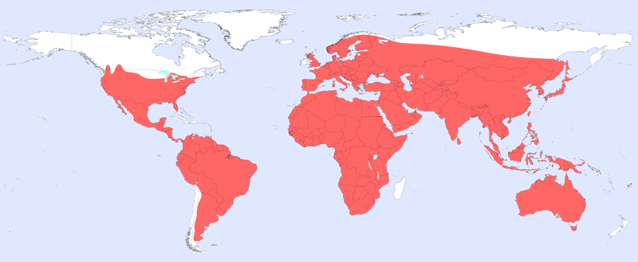
Venomous Snakes

Slide 5
Venomous Snakes
Approximately 150,000 domestic animals a year are bitten by venomous snakes in the US
Every state except Maine, Alaska, and Hawaii is home to at least one species of venomous snake
99% are from the family Crotalidae (Pit Vipers)
Pit vipers include
  Rattlesnakes
  Copperheads
  Cottonmouths
  Massasauga

Slide 6
Crotalids
Pit vipers are the largest group of venomous snakes in the United States
99% of all venomous snake bites in the US
Family Crotalidae belong to three genera:
  Rattlesnakes (Crotalus spp.)
  Massasaugas (Sistrurus spp.)
  Copperheads and cottonmouth/water moccasins (Agkistrodon spp.).

Slide 7
Crotalid identification
Venomous
Non Venomous

Slide 8
Crotalid identification
Venomous
Non Venomous
Notes:
Slit pupil vs round
Pit on face

Slide 9
Crotalid identification
Venomous
Non Venomous
Notes:
Retractable fang and blue venom gland

Slide 10
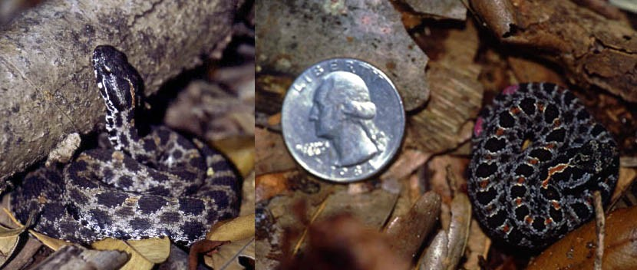
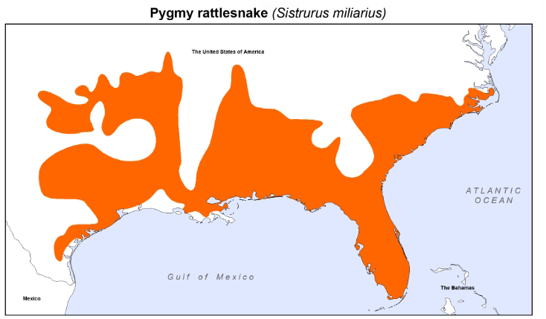
Pygmy rattlesnake (Sistrurus miliarius)

Slide 11
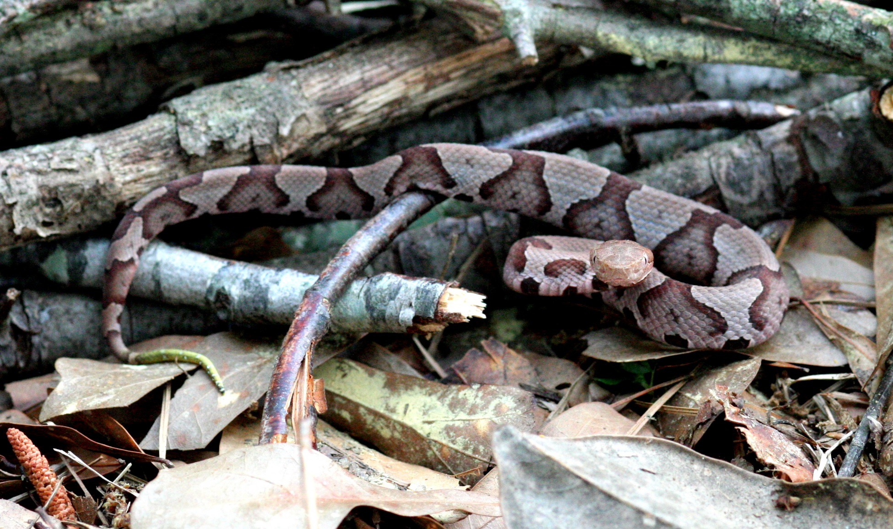
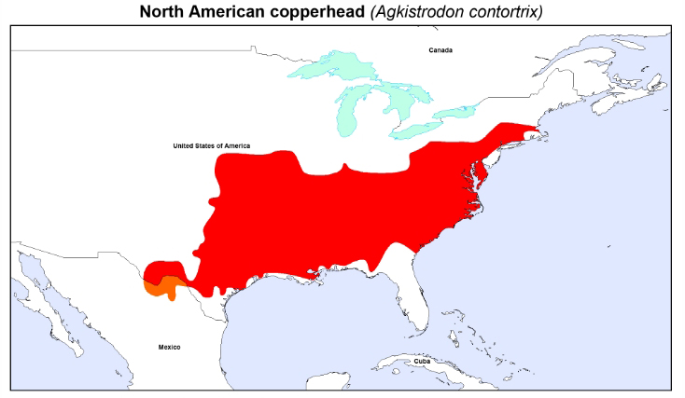
Copperhead (Agkistrodon contortrix)

Slide 12
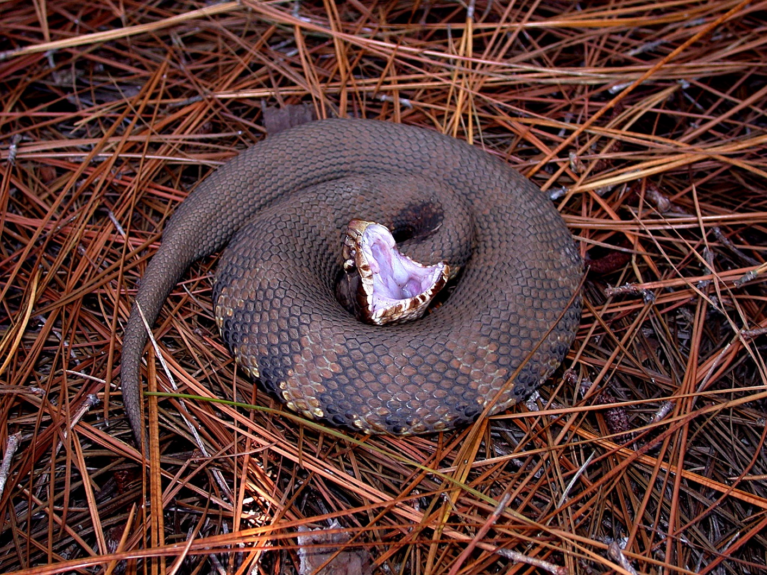
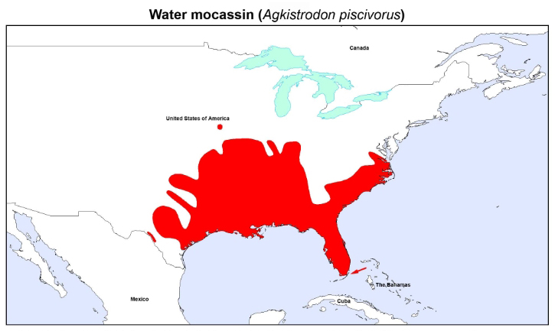
Cottonmouth aka Water Moccassin (Agkistrodon piscivorus)

Slide 13
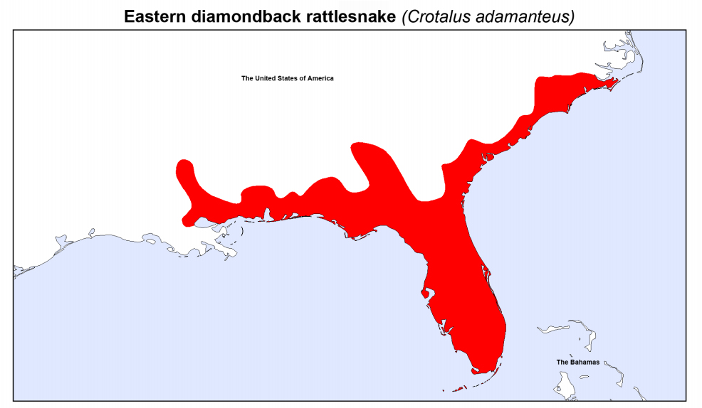
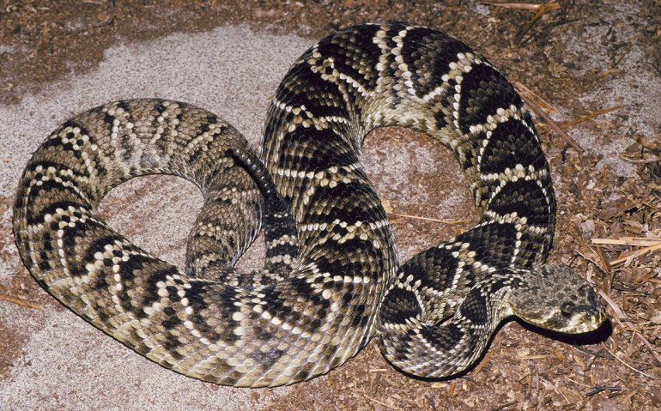
Eastern Diamondback rattlesnake (Crotalus adamanteus)

Slide 14
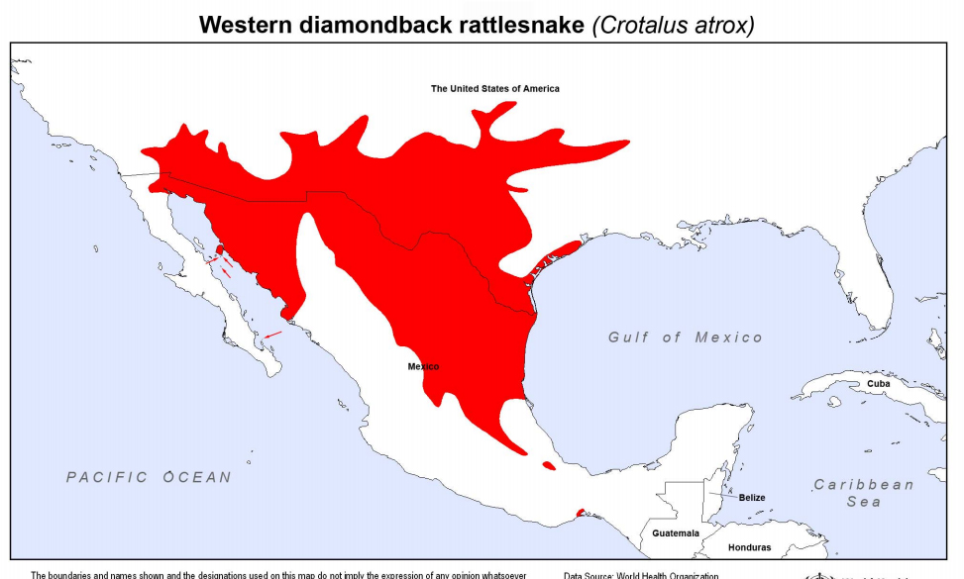
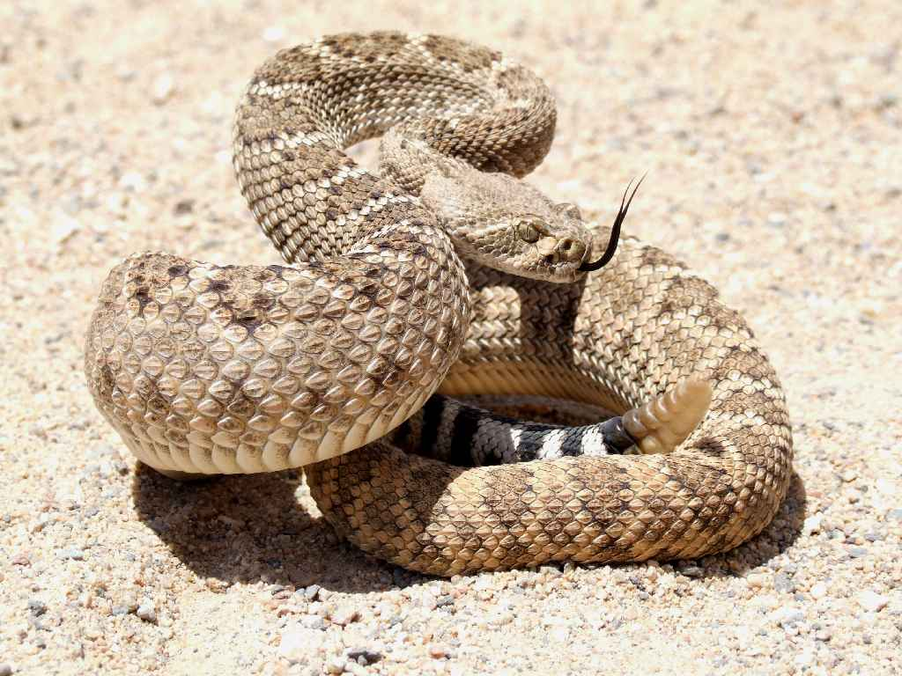
Western Diamondback rattlesnake (Crotalus atrox)

Slide 15
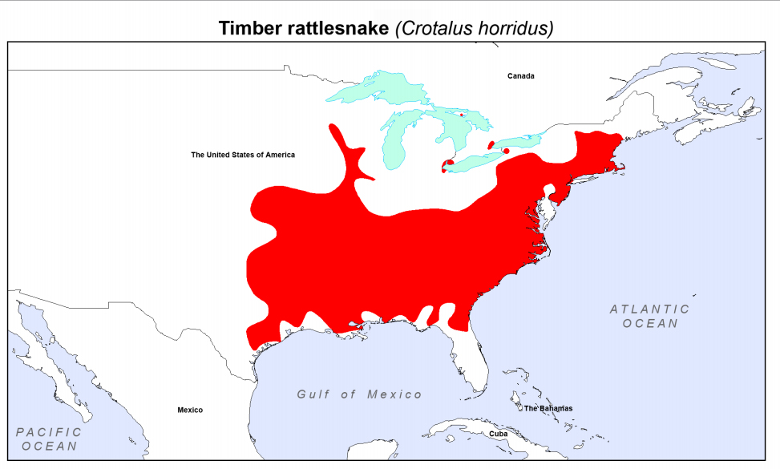
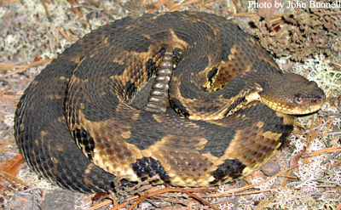
Timber rattlesnake (Crotalus horridus)

Slide 16
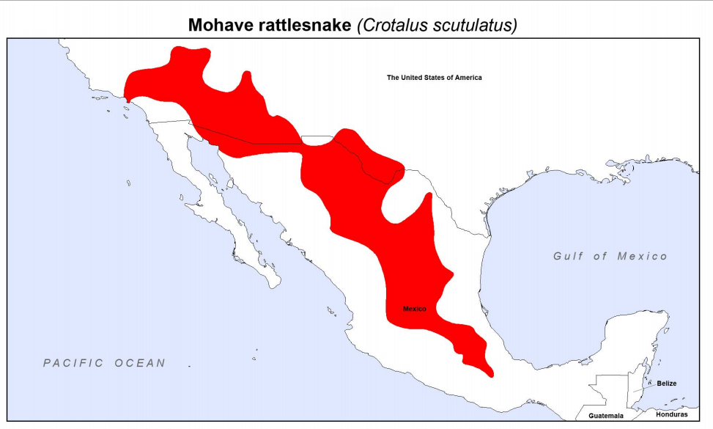
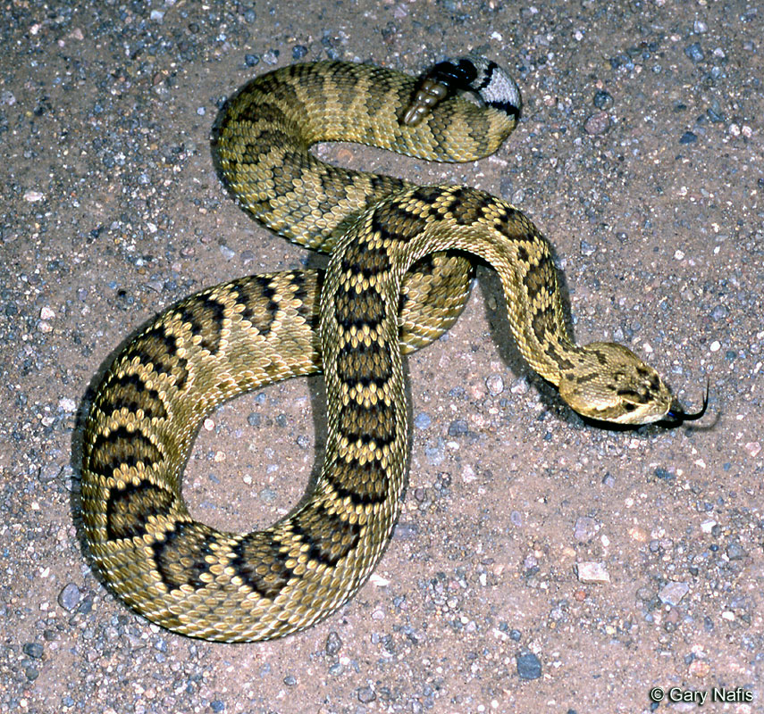
Mojave rattlesnake (Crotalus scutulatus)

Slide 17
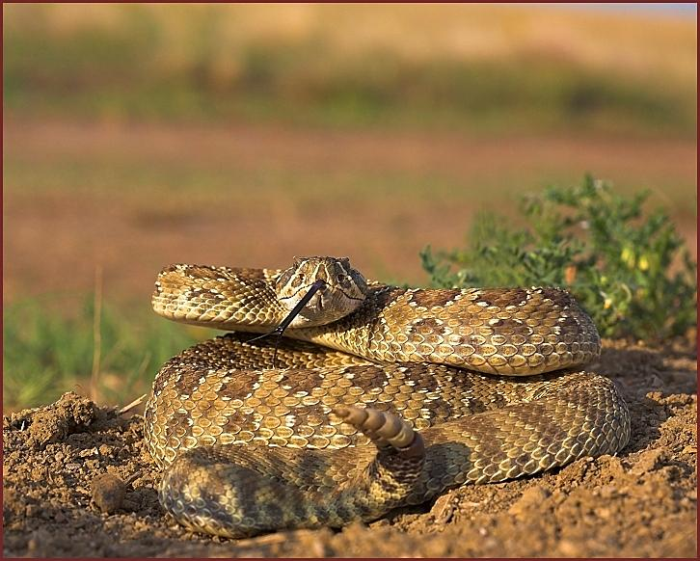
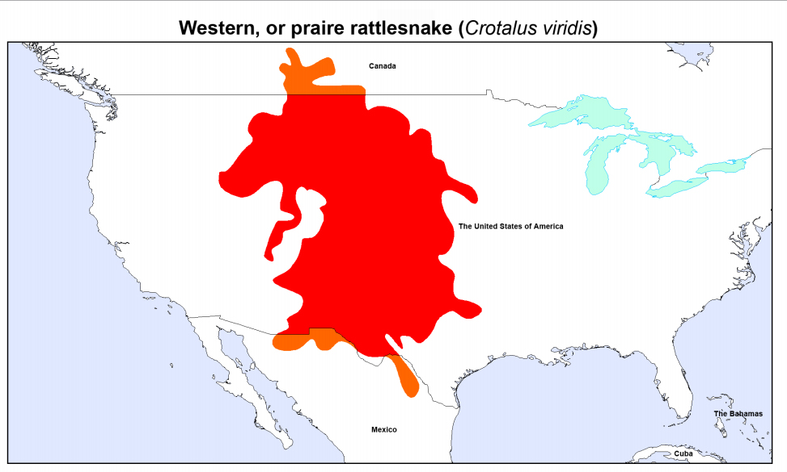
Western rattlesnake (Crotalus viridis)

Slide 18
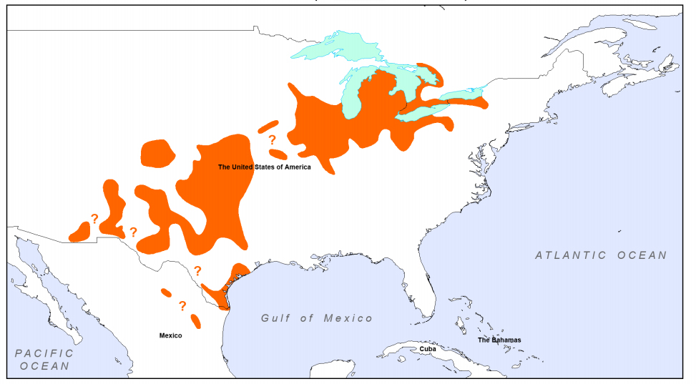
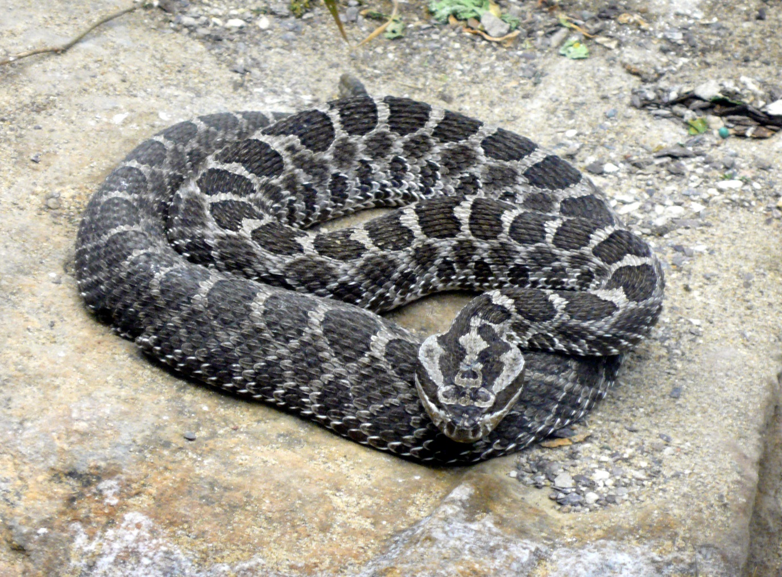
Massasauga (Sistrurus catenatus)

Slide 19
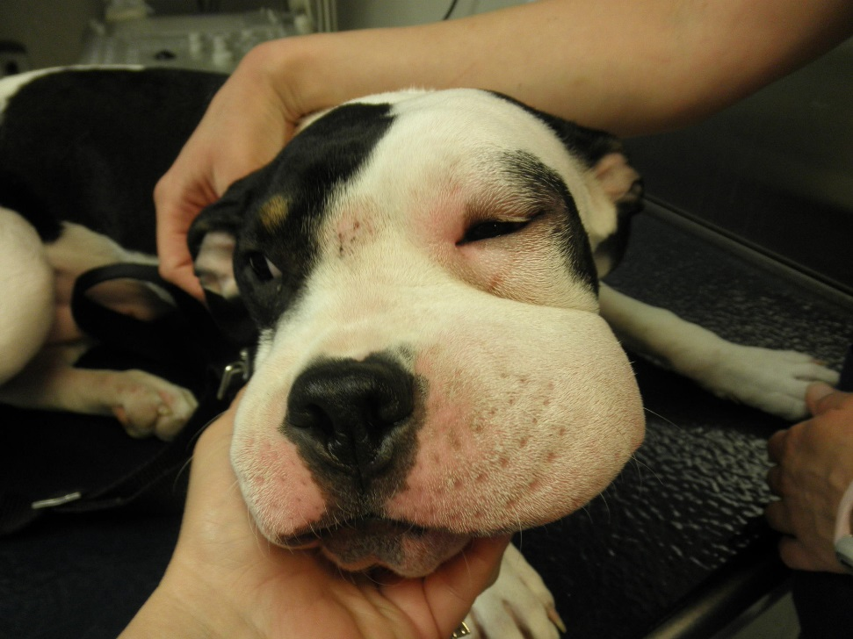
Snakebites
90% of bites from April to October
Strike at 8ft/sec
2/3 of bites from snakes < 20” in length
Onset of signs may be delayed up to 6 hours

Slide 20

Snake envenomations
Pit vipers control the amount of venom they inject during a bite
Amount depends on the snake’s perception of the situation
Defensive strikes often are not envenomating
20-25% of all bites will be dry bites

Slide 21
Snake envenomations
Agonal bites deliver the entire venom load
Bite by a juvenile is less likely to be dry
Venom is not considered more toxic during the summer months
Snakes show increased aggression and venom yield with environmental warming and longer photoperiod

Slide 22
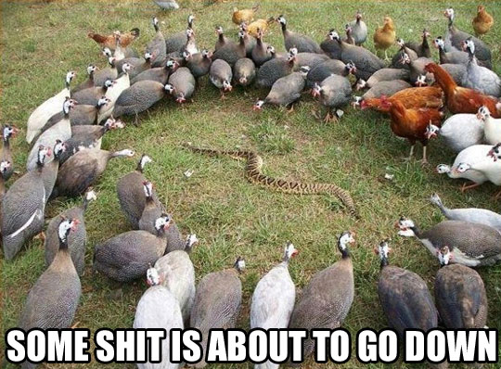
The venom
Snake venom serves to immobilize and partially digest prey
Utilizes a mixture of enzymes, high molecular weight proteins and small peptides
Enzymatic portion of the venom causes destruction of body tissues

Slide 23
The venom
Majority of pit viper venoms causes destruction of vascular walls
Non-enzymatic “killing fraction” of the venom directly affects the respiratory and cardiovascular systems, resulting in hypovolemia and hypotension
Other venom fractions, especially from rattlesnakes, may affect coagulation

Slide 24
The venom
Venom contains over 50 enzymes
Most important:
  Phospholipase A2
  Phosphatases
  Exopeptidase
  Hyaluronidase
  L-amino oxidase
ENZYME | CROTALUS | SISTRURUS | AGKISTRODON
Proteolytic enzymes | + | + | +
Arginine ester hydrolase | + |  | +
Thrombin-like enzyme | + |  | +
Collagenase | + |  | +
Hyaluronidase | + |  | +
Phospholipase A2(A) | + |  | +
Phospholipase B
Phosphomonoesterase | + |  | +
Phosphodiesterase | + | + | +
Acetylcholinesterase | - | - | -
RNase | +
DNase | +
5'-Nucleotidase | + |  | +
NAD-nucleotidase | - | - | +
L-Amino acid oxidase | + | + | +
Lactate dehydrogenase

Slide 25
The venom
Proteases break down local tissue
  RBCs exude into local tissue, consumption of platelets
Phospholipase A2
  Inhibits e- transfer
  Hydrolyzes phospholipids in nerve axons
  Breaks down acetylcholine vesicles at the myoneural junction
  Cause direct myonecrosis
Phospholipase A2 affects RBCs and induce lysis of red cell membranes
  Echinocytosis in 89% of rattlesnake cases

Slide 26
The venom
The most common coagulopathy associated with snake envenoming worldwide is venom-induced consumption coagulopathy (VICC)
Activation of the coagulation pathway by snake toxins including
  Thrombin-like enzymes
  Prothrombin activators
  Factor X activators

Slide 27
The venom
Fibrolase incompletely splits fibrin and degrades fibrinogen without activation of plasminogen
VICC like DIC
  Elevated D-dimer
  Prolonged prothrombin time
  Low fibrinogen
VICC is not like DIC
  No systemic microthrombi
  Uncommon for end organ failure

Slide 28
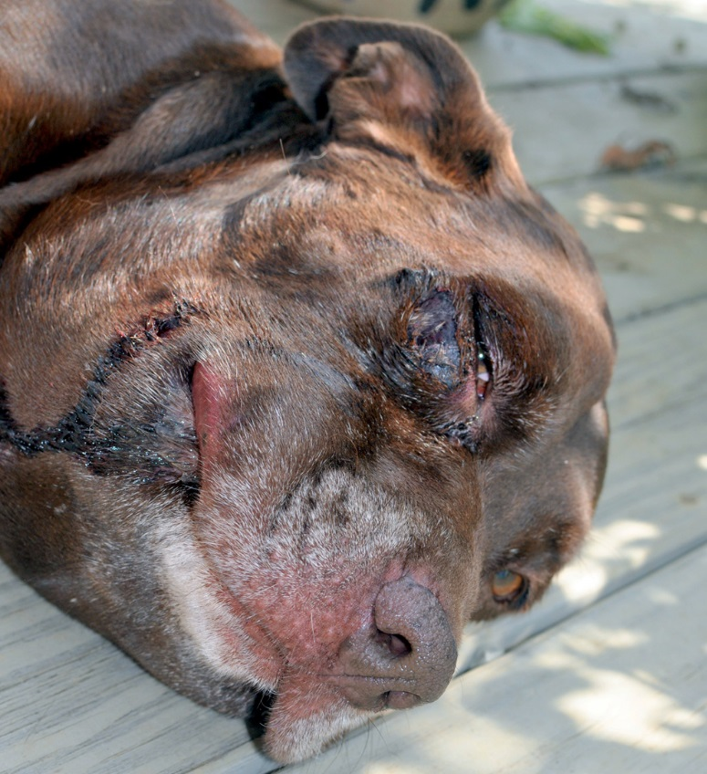
Clinical signs
Acute pain
Marked swelling and edema
Ecchymosis and bleeding at the bite site
Cardiovascular compromise
  Vasodilation
  Hypovolemia
  Tachycardia
Respiratory distress
Nausea and vomiting
Mental dullness
Muscle tremors

Slide 29

Clinical signs
On a mg/kg scale cats are more resistant to pit viper venom than dogs
Cats are presented in a more severe condition as cats often run off and hide after being bitten before they return home

Slide 30
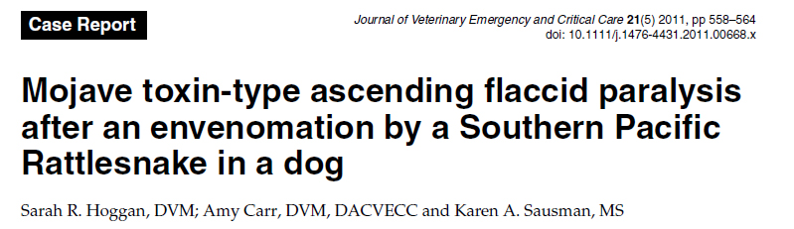
Clinical Signs
The Mojave rattlesnake possesses a neurotoxin
Can cause a flaccid paralysis
Works presynaptically by blocking the calcium channels
Prevents the release of acetylcholine
  Does not improve with calcium therapy

Slide 31
Diagnostics
CBC
Chemistry
Urinalysis
Coag Profile
Blood smear

Slide 32
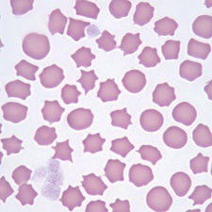
CBC + Blood Smear
Hemoconcentration or mild to severe anemia
Leukocytosis or transient leukopenia
Thrombocytopenia
Echinocytes
Spherocytes

Slide 33
Chemistry + Urine
Elevated CK
Hypokalemia
  Observed in 11% of 97 pit viper–envenomated dogs
  Secondary to epinephrine inducing serum insulin elevation
  Transient phenomenon
Elevated ALT and AST
Hemoglobinuria

Slide 34
Coagulation testing
VICC
  Low fibrinogen
  Thrombocytopenia
  Increased FDPs with normal D-Dimers
  Prolonged PT and APTT

Slide 35
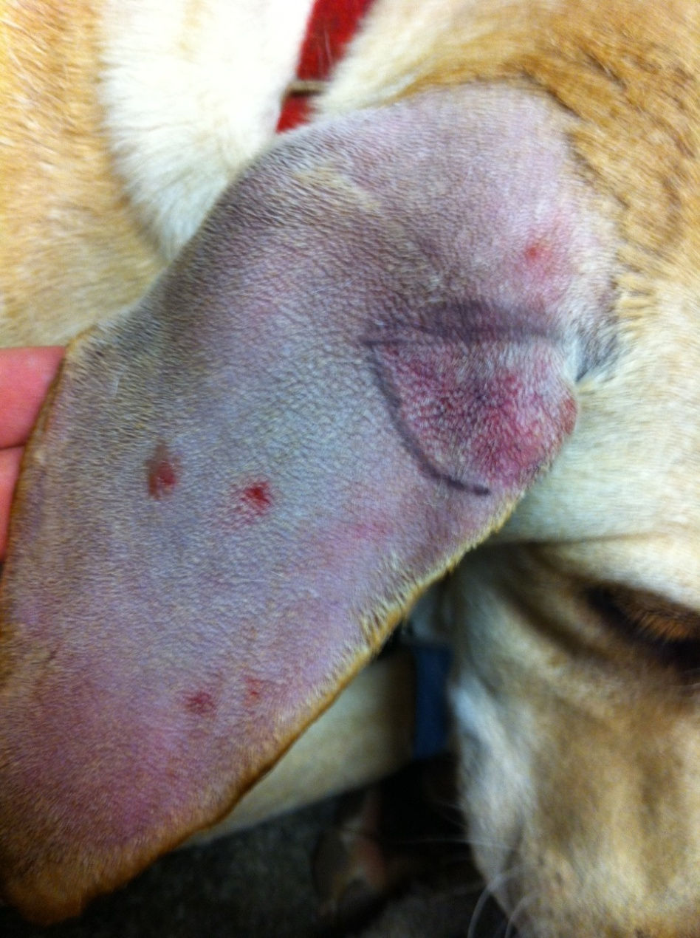
Snake envenomations

Slide 36
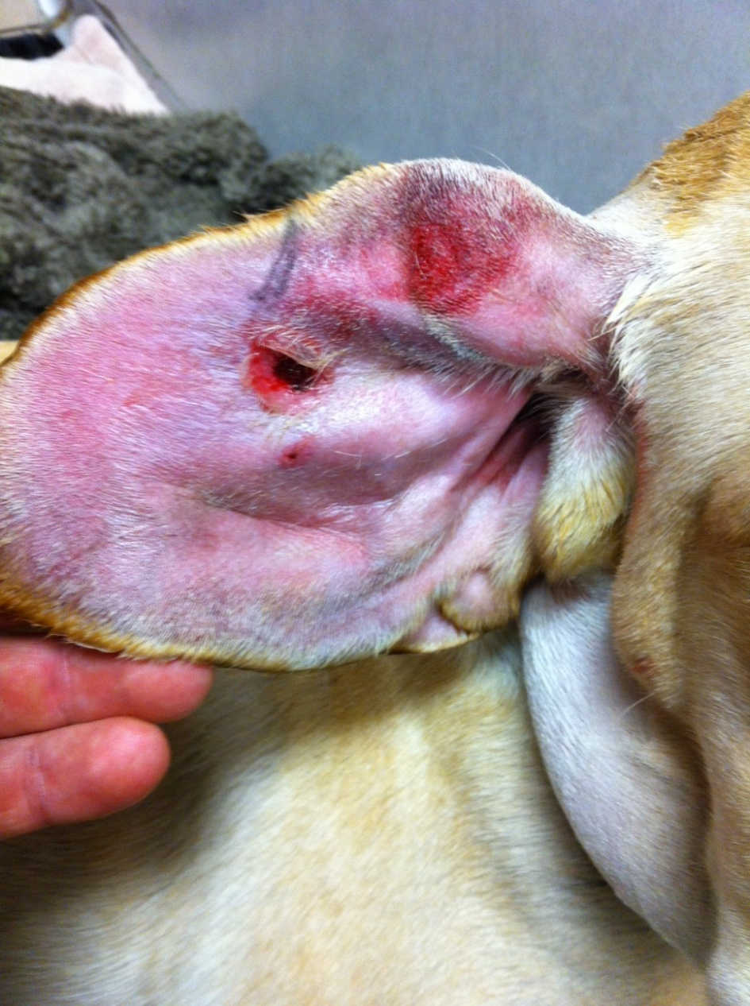
Snake envenomations

Slide 37
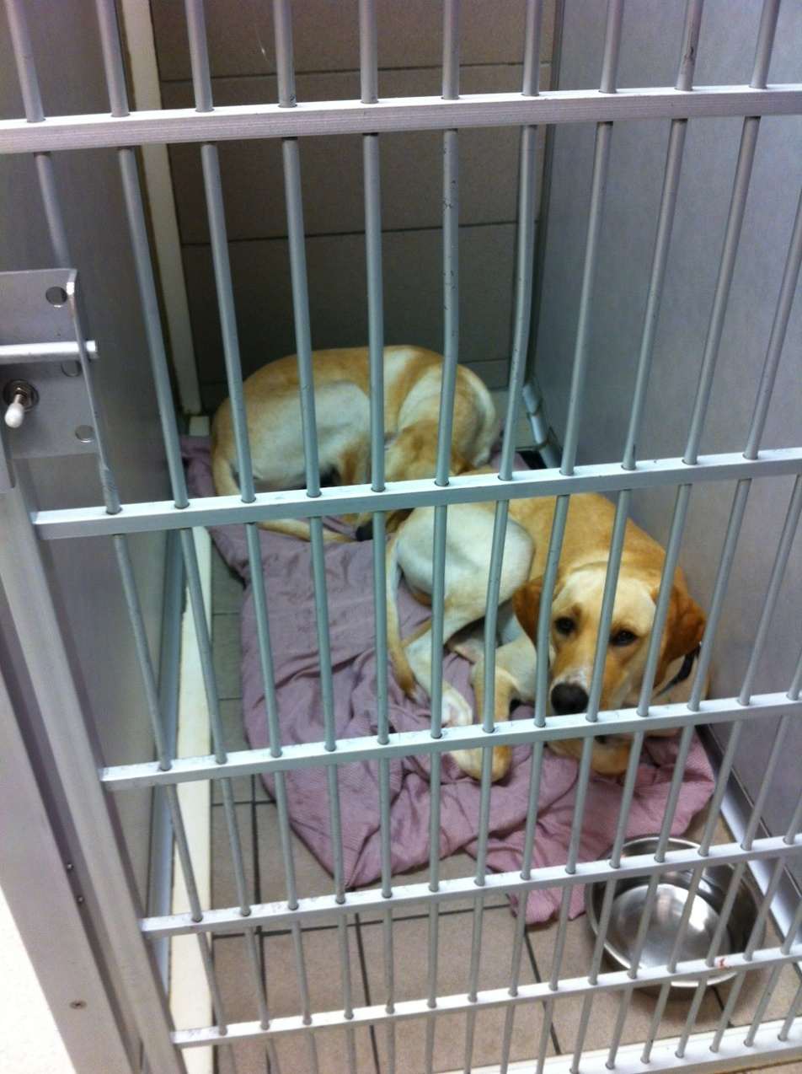
Snake envenomations

Slide 38
Treatment
Aggressive care as warranted
Pain medication!
  Pure mu opioids
IV fluids
Antibiotics
Hospitalization for at least 8-12 hours
Local wound care

Slide 39
Treatment
Only one true treatment

Slide 40


Slide 41
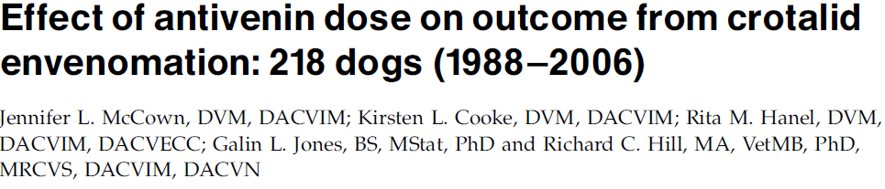
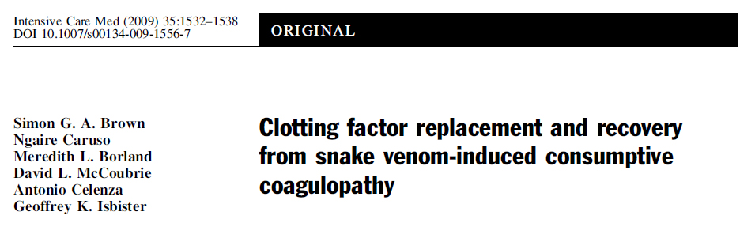
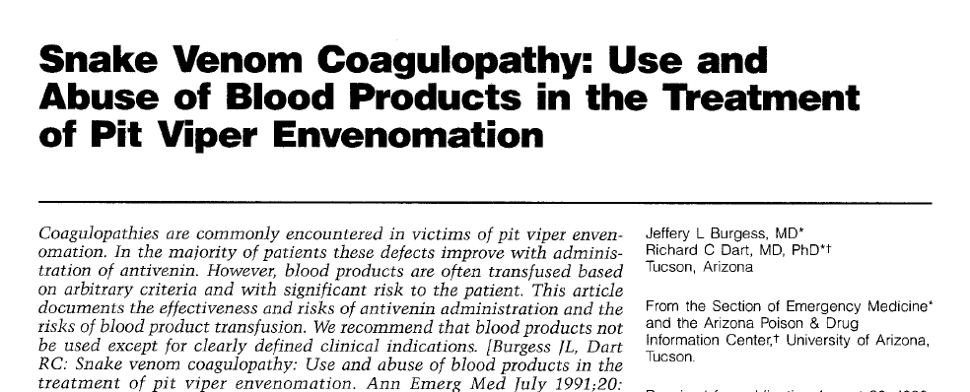
Treatment
Antihistamine therapy not useful
  Possible sedative effect
  Does not appear to prevent hypersensitivity reaction
FFP for coagulopathy
  Debatable
  May not touch coag values
  Maybe after antivenom

Slide 42
Treatment
Antibiotics
  Target G+ cocci, G- rods & clostridium
  Commensals in a snake mouth
No advantage in humans to starting antibiotics
  Does not prevent infection
One veterinary study with mild improvement with Enrofloxacin

Slide 43

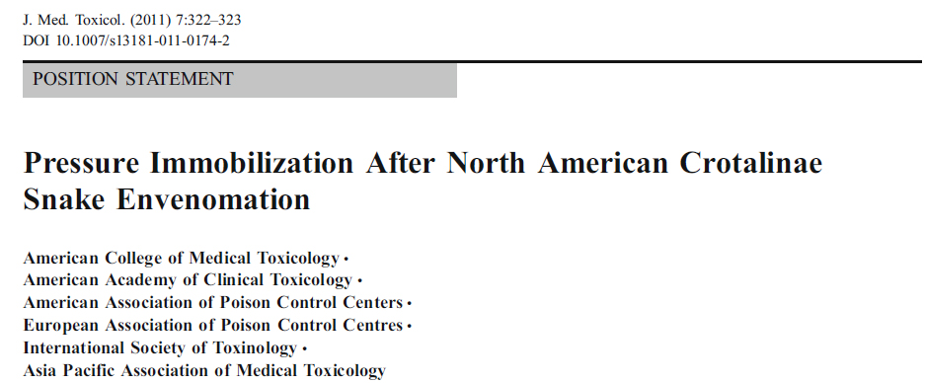
Contraindications
Tourniquet
Compression wrap
Ice therapy
Electroshock
Fasciotomy
Steroids

Slide 44

Antivenom: The Debate
Not necessary for Copperheads
Can use FFP for clotting abnormalities
Rattlesnakes are a different story...

Slide 45
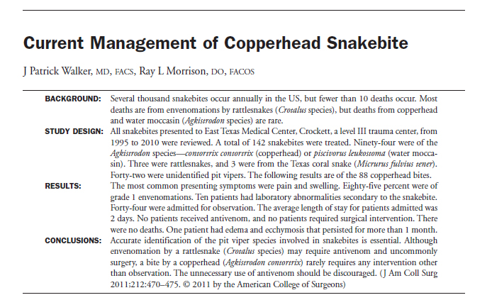
Antivenom: The Debate

Slide 46
Antivenom
Antivenin is a “true” antidote
Antivenom is most effective when administered early on
Four common indications for antivenom
Rapid progression of swelling
Significant coagulopathy, defibrination, or thrombocytopenia
Neuromuscular toxicity
Shock

Slide 47
Antivenom
Antivenoms are polyclonal antibody preparations that are produced from horses or sheep by injecting with venoms
They contain numerous antibodies of varying titre to various different toxins in the venom
Antivenom efficacy is the ability to bind and neutralise venom mediated effects
Antivenom effectiveness is the ability to reverse or prevent envenoming in human patients

Slide 48
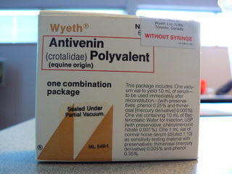
Antivenom ACP
Veterinary licensed product derived from horses
Horses are given a dose of venom
IgG and albumin are then derived
IgG is persistent and well circulated and cleared by white blood cells, however Vd is lower
Still expensive 800-1000$/vial

Slide 49
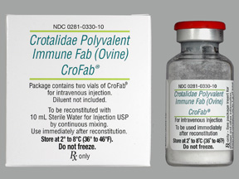
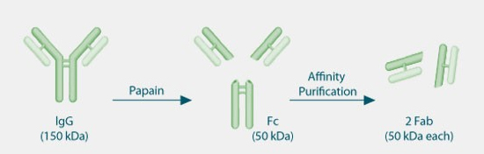
Antivenom CroFab
Uses fragments of antibodies
Fc portion cleaved leaving 2 Fab portions
Better volume of distribution, less immunogenic and clinically as effective
More expensive $1200-1400/vial

Slide 50
Antivenom
Does not stop local signs
  Tissue necrosis
Limits progression of systemic signs & reverses coagulopathy
Does not affect thrombocytopenia from Timber rattlesnake
Recommendations to give ASAP
No true dose
Should not need more than 1-2 vials

Slide 51
Antivenom inefficacy
Irreversible venom-mediated effects
Rapid venom onset
Inability of the antibodies in the antivenom to bind the toxins in the venom
Volume of distribution
Ongoing venom absorption after antivenom has been eliminated
Fab type antivenoms much more quickly cleared from body

Slide 52
Antivenom
Diluted antivenom is initially infused slowly
High fraction of equine albumin present
  Anaphylactoid/allergic reactions are a significant concern
No need to skin test as in humans
Initial vial can be administered in 1-4 hours
Up to 10% reaction
Serum sickness is a delayed consequence

Slide 53
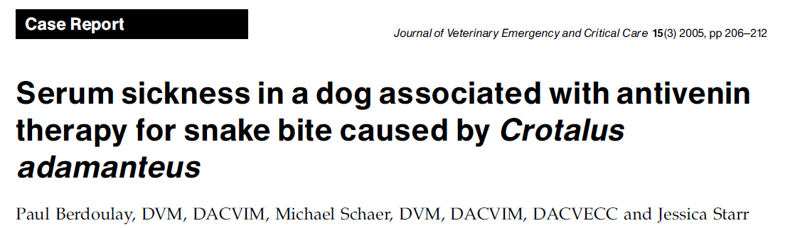
Serum sickness
Serum sickness is a delayed consequence that may occur 1-4 weeks after administration
Result of the immune complex formation
Manifests as urticaria, arthralgias, myalgias, glomerulonephritis, vasculitis and neuritis
Strong correlation between the amount of antivenom given and the incidence of serum sickness in people

Slide 54
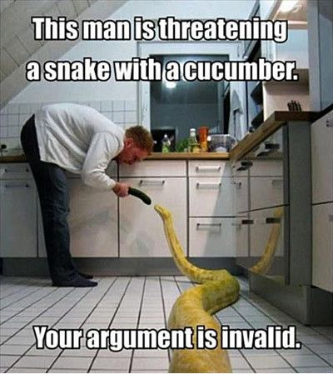
The Answer

Slide 55

Prognosis
Prognosis is excellent for Copperhead bites
Overall Crotalid envenomation 1-30% mortality

Slide 56
Coral Snake

Slide 57
Elapids (coral snakes)
Two genera are indigenous to United States
  Micruroides
  Micrurus
North American coral snakes are distinctively coloured beginning with a black snout and an alternating pattern of black, yellow (occasionally white), and red
If caution (yellow) touches danger (red), the snake is a coral snake

Slide 58
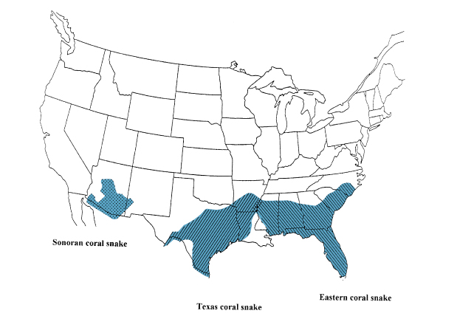
Elapids (coral snakes)

Slide 59
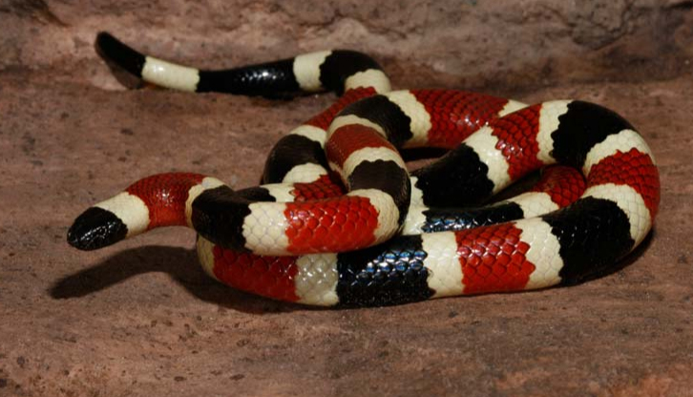
Sonoran coral snake
(Micruroides euryxanthus)

Slide 60
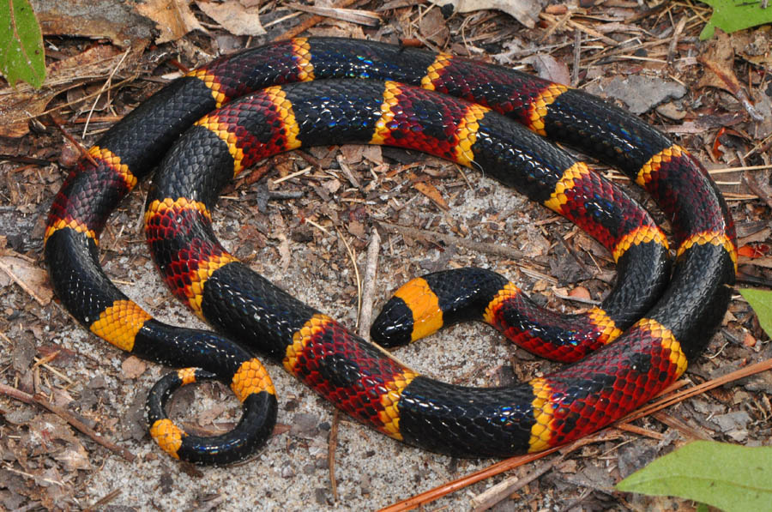
Eastern coral snake (Micrurus fulvius)

Slide 61
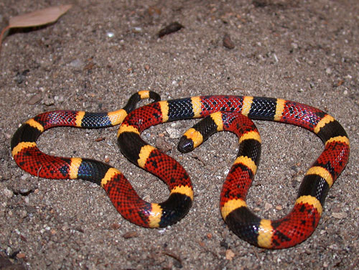
Texas coral snake (Micrurus tener)

Slide 62
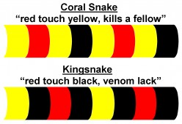
Elapids (coral snakes)
Attach on hardily and may feel like Velcro when removing the snake
Venom uptake can be delayed for many hours and can take 7 to 14 days to clear the body
May have snake still attached to dog on presentation

Slide 63

The venom
Coral snake venom is primarily neurotoxic
Act as nondepolarizing postsynaptic neuromuscular blocking agents
Venom induces central nervous system depression, muscle paralysis, and vasomotor instability
Can cause hemolysis with severe anemia and marked hemoglobinuria

Slide 64
Clinical signs
Dogs
  CNS depression
    Weakness, lethargy, coma
  Vomiting and Hypersalivation
  Hyporeflexia
  Hypotension
Cats
  Ascending flaccid paralysis
  Hypothermia
  Loss of spinal reflexes

Slide 65
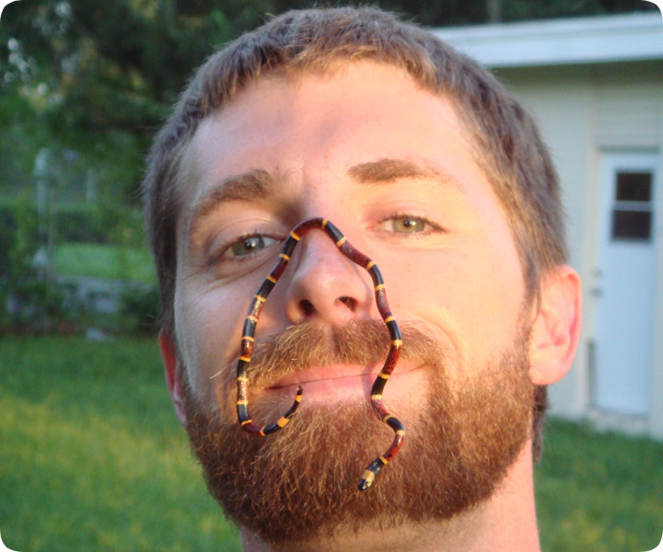
Diagnostics
CBC – moderate leukocytosis
Coag panel – hyperfibrinogenemia
Chemistry – CK elevations
Urinalysis – hemoglobinuria

Slide 66
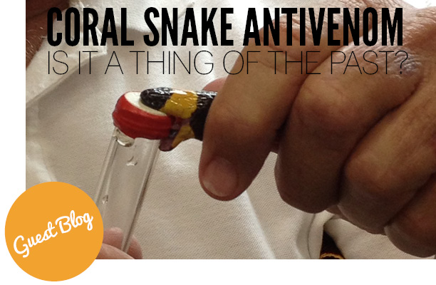
Treatment
Aggressive ICU monitoring
Access to a mechanical ventilator
Wrapping or binding the area may be of benefit
Antivenom is the true antidote
Currently, there is no approved coral snake antivenom available in the United States

Slide 67
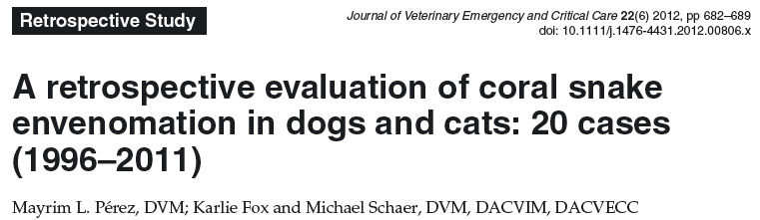
Prognosis
Good
71% survival to discharge

Slide 68
Prognosis
With no access to antivenom
Unknown?

Slide 69
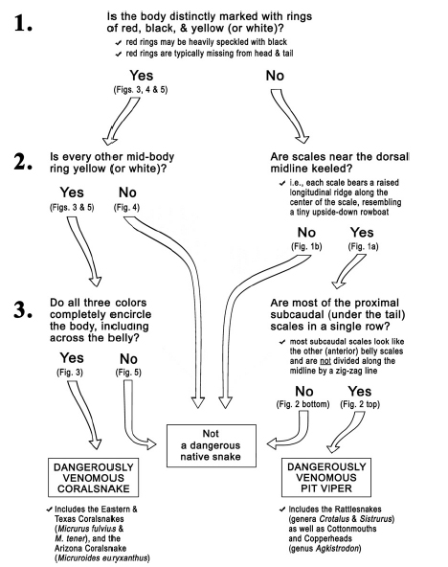
ID Venomous Snakes:
3 steps

Slide 70

Spiders

Slide 71
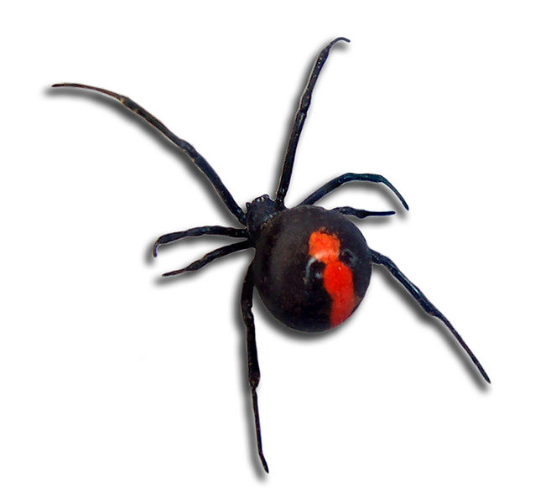
Black Widow (Latrodectus spp.)

Slide 72
Black Widow (Latrodectus spp.)
Spiders of the genus Latrodectus are typically globose black spiders
Females have an hourglass red-orange pattern on the abdomen
Found in every state in the United States except Alaska
Also into the southern Canadian provinces

Slide 73
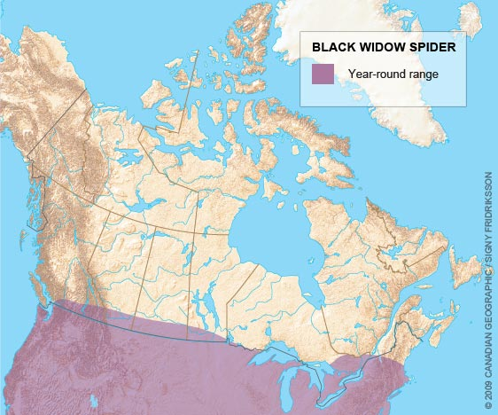
Black Widow (Latrodectus spp.)

Slide 74
Black Widow
The spiders are commonly found around houses where outside lights help to attract prey insects
Male black widow spiders are of little medical importance
  Cannot penetrate mammalian skin
Female spiders can be 20 times larger than the males
The females can be up to 2 to 2.5 cm long and are capable of life-threatening envenomations

Slide 75

Black Widow
Control amount of venom using striated muscle in venom glands
~15% of bites in humans are non-envenomating
Cats are very sensitive to the venom and death is common
In dogs the toxin can cause severe clinical signs but are more resistant than cats

Slide 76
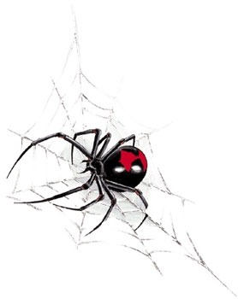
The venom
Black widow venom is produced by glandular cells in the spider's chelicerae.
Through holocrine secretion the cells disintegrate and content is released into the gland
Potent mammalian neurotoxin called alpha-latrotoxin

Slide 77
The venom
Neurotoxin that alters nerve terminals without local reaction
Results in increased neurotransmitter release and decreased uptake at the presynaptic membrane
Massive release of ACh, norepinephrine, dopamine, glutamate and enkephalins
Prevent relaxation of muscles, causing tetany

Slide 78
Clinical Signs
Occur within the first 8 hours after envenomation
Small puncture wounds may be visible with mild erythema
Initial regional numbness
Progressive hyperesthesia, muscle pain and fascicultations
Hallmark sign is abdominal rigidity without tenderness

Slide 79
Clinical Signs
Continued progression leads to development of hypertension and tachycardia
Severe signs in the final stages of envenomation may include seizures, paralysis and death
In one study, 20 of 22 feline victims died subsequent to black widow envenomation; there was an average survival time of 115 hours after the bite

Slide 80
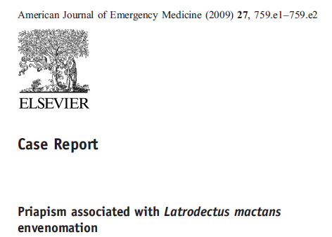
Clinical Signs
Sometimes lots of muscle rigidity……..
Not always a hard clinical finding

Slide 81
Diagnostics
CBC, Chem, UA
Elevations in CK can occur along with leukocytosis and hyperglycemia.
Urine production can be decreased
Urine may have an elevated specific gravity, possibly accompanied by albuminuria

Slide 82
Treatment
Treatment of black widow envenomation is administration of specific antivenom
Not readily available
Supportive care should be administered to relieve clinical signs
The high risk for developing hypertension should elicit extreme care when administering IV fluids

Slide 83
Treatment
Calcium gluconate has previously been recommended to treat muscle cramping and decrease the severity of pain, but this has fallen out of favor
Benzodiazepines and opioids are now preferred
The antivenom will address the hypertension and respiratory distress
The average duration of clinical signs is 3-6 days, but signs of weakness and muscle pain may persist for weeks

Slide 84

Prognosis
Poor

Slide 85
Brown Recluse
Brown recluse spiders are found mostly in the south and south central United States
Genus Loxosceles, the most famous being Loxosceles reclusa
Identified by the violin-shaped marking on the dorsal side of their thorax
Truly reclusive and shy
Bites occurring mostly when the spider gets trapped by the animal (i.e. in bedding)

Slide 86


Slide 87
Brown Recluse
Single bite can inflict a lethal envenomation
Average female Loxosceles spider carries a venom volume of approximately 0.36 µL
Prolonged periods of abnormal high or low environmental temperatures induce lower venom volumes
Bite when scared

Slide 88


Slide 89
The venom
Primary function of venom is to digest an impending meal by enzymatically destroying tissue
Sphingomyelinase D binds to cell membranes and chemotactically influencing polymorphonuclear leukocytes
Venom has a potent and long-lasting (up to several months) dermonecrotic effect

Slide 90


Slide 91
The venom
Venom induces rapid coagulation and occlusion of small capillaries at local site
Sphingomyelinase D can have a direct hemolytic effect
The venom also acts on body lipids
Frees lipid fragments into the circulation that subsequently act both as emboli and as inflammatory mediators

Slide 92
Clinical signs
The typical initial lesion is a target, or “bull’s eye,” mark characterized by an erythematous area with a dark necrotic center
Systemic involvement is rare, but can occur
Can see fever, nausea, arthralgias and hemoglobinuria
May also exhibit Coomb’s negative hemolytic anemia
Death can occur in patient exhibiting systemic signs

Slide 93


Slide 94
Diagnostics
CBC
Chem
Urinalysis
Coag profile

Slide 95
Treatment
No specific antidote
  One antivenom in Brazil, not approved in USA
Mild local envenomation usually will respond to topical cool compresses
Treatment is supportive with broad spectrum antibiotic therapy and supportive measures for wound management

Slide 96

Wet to dry

Slide 97


Slide 98
Treatment
  Shock therapy
  Topical nitroglycerine
  High doses of vitamin C
  Limehat
  Meat tenderizer
Most treatment protocols attempt to attenuate the dramatic influx of neutrophils, activation of complement, and subsequent tissue destruction
  Dapsone
  Steroids, antihistamines
  Colchicine
  Surgical excision
  Vasodilators
  Hyperbaric oxygen
None of these have been consistently effective and in some cases have been detrimental

Slide 99
Treatment
Dapsone
Inhibits influx of neutrophils
Adverse effects are severe
  Hepatotoxicity
  Anemia
  Thrombocytopenia
  Neutropenias
  Gastrointestinal signs
  Neuropathies
  Cutaneous drug
Ineffective if not given within hours
Not recommended based on lack of scientific evidence and probable harm

Slide 100
Prognosis
Dermonecrotic lesions often take weeks or months to heal, and a scar typically remains at the site
Patients exhibiting severe systemic signs generally have a guarded prognosis

Slide 101

The End

