Slide 1

DIABETES MELLITUS

Slide 2
Outline
Endocrine pancreas
Insulin
Glucagon
Physiology of insulin secretion
Insulin resistance
Diabetes
DM Dogs
DM Cats
Literature review

Slide 3
The Endocrine Pancreas

Slide 4
Endocrine pancreas
Islets of Langerhans
Constitute 1–2 % of the total pancreatic mass
4 Major cell types in islets:
β cells → insulin, amylin
α cells → glucagon
δ → somatostatin
PP cells → pancreatic polypeptide
Notes:
The endocrine function of the pancreas is provided by clusters of cells known as the islets of Langerhans. In the adult animal they constitute roughly 1–2 % of the total pancreatic mass and are scattered irregularly throughout the exocrine tissue.
There are four major types of cells in the islets:
1) b-cells (by far the most abundant) that produce insulin and amylin
2) a-cells that produce glucagon
3) δ -cells that produce somatostatin
4) PP-cells that produce pancreatic polypeptide.

Slide 5
Endocrine pancreas
Islets:
Highly vascularized
Fenestrated capillaries
Islet-acinar portal system
communication between the endocrine and exocrine
pancreatic tissue
Sympathetic and Parasympathetic innerv. → influence release of hormones
Notes:
The islets are highly vascularized and their capillaries are fenestrated, increasing their permeability. An islet-acinar portal system communicates between the endocrine and exocrine pancreatic tissue. It is assumed that blood coming from the islets flows into the acinar capillaries before leaving the pancreas and that islet hormones have a role in regulating the exocrine pancreas. The islets are innervated by sympathetic and parasympathetic fibers which influence the release of pancreatic hormones

Slide 6
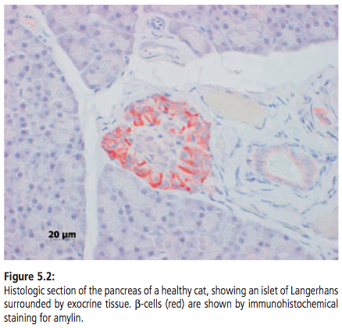
Endocrine pancreas

Slide 7
Insulin

Slide 8
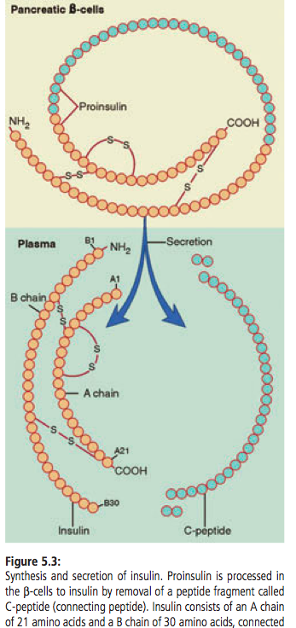
Insulin
Hormone
Decreases blood glucose levels
Synthesis:
Preproinsulin
Proinsulin
Insulin
Concentration of C-peptide in plasma is an indicator of β-cell function
Notes:
Glucose homeostasis is maintained by a complex system of regulating and modulating hormones and factors, of which insulin is the most important. Insulin is the only hormone that decreases blood glucose concentration.
The synthesis of insulin begins in the rough endoplasmic reticulum with the formation of preproinsulin, which is converted to proinsulin by removal of a small peptide fragment. Proinsulin is further processed to insulin by removal of another peptide, called C-peptide (connecting peptide)
The concentration of C-peptide in plasma is an indicator of b-cell function, but its measurement is mainly used in human medicine and for research purposes. Proinsulin is largely converted before secretion, so it does not appear in the circulation in appreciable quantities.

Slide 9
Insulin
2 polypeptide chains
A chain 21 amino acids
B chain 30 amino acids
Highly conserved structure
Canine insulin is identical to porcine insulin
Feline insulin is most similar to bovine insulin differing in only one amino acid
Feline differs from canine at 3 positions
Notes:
Insulin consists of two polypeptide chains, an A chain of 21 amino acids and a B chain of 30 amino acids, connected by two disulfide bridges
The insulin molecule has been highly conserved during evolution and the differences between species are small.
Canine insulin is identical to porcine insulin and differs in just one amino acid from human insulin.
Feline insulin is most similar to bovine insulin, also differing in only one amino acid, while differing from canine insulin at three positions

Slide 10
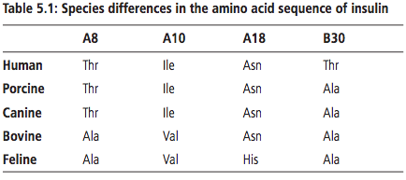
Insulin

Slide 11
Insulin
Circulating insulin is almost entirely unbound
Half-life of 5–8 min
Metabolized mainly in the liver and kidney
Notes:
Circulating insulin is almost entirely unbound, has a half-life of 5–8 min, and is metabolized mainly in the liver and kidney.

Slide 12
Regulation of insulin secretion

Slide 13
Regulation of insulin secretion
Several molecules trigger insulin release
Stimuli may be direct or indirect
Most important regulator of insulin secretion is blood glucose concentration
β-cells detect and respond to blood glucose levels
Positive feedback relationship between blood glucose concentration and the insulin secretion rate
Notes:
The body has complex mechanisms to ensure adequate basal insulin secretion between meals as well as increased insulin secretion following meals. There are various factors that stimulate insulin release, either directly or indirectly. The most important regulator of insulin secretion Is the concentration of glucose within the blood, which is detected by the pancreatic beta cells. There is a positive feedback relation between blood glucose concentration and the insulin secretion rate

Slide 14
Regulation of insulin secretion
With respect to BG levels…
Glc transported into β-cells via glucose transporter protein GLUT 2
Metabolized to produce ATP
Increase ATP:ADP ratio → closure of ATP-sensitive k+ channels in the β-cell membrane
Preventing k+ from leaving the β-cell
Notes:
Again as previously mentioned, blood glucose is the most important regulator of insulin secretion. With respect to a variable blood glucose concentration, the beta cells respond directly depending on the concentration of glucose within the blood stream as sensed by these cells. Glucose is transported into b-cells via the glucose transporter protein GLUT 2, which allows rapid equilibration between extracellular and intracellular glucose concentrations. Within the b-cells glucose is metabolized (via phosphorylation by glucokinase and production of pyruvate) to produce ATP. The increase in the ATP:ADP ratio is followed by closure of ATP-sensitive potassium channels in the b-cell membrane, preventing potassium ions from leaving the b-cell

Slide 15
Regulation of insulin secretion
Closure of k+ channels → membrane depolarization
Opening of voltage-dependent calcium channels in the membrane
Increase in cytosolic calcium triggers insulin release
Notes:
This in turn causes membrane depolarization and opening of voltage-dependent calcium channels in the beta cell membrane. The increase in cytosolic calcium then triggers insulin release

Slide 16
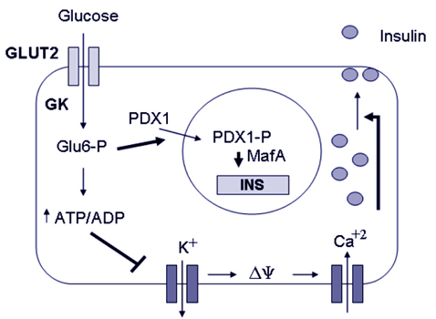

Slide 17

Regulation of insulin secretion
Insulin secretion in response to blood glucose levels varies depending upon route of glucose administration
Notes:
Insulin secretion in response to blood glucose levels varies depending upon route of glucose administration

Slide 18
Insulin secretion following IV glucose bolus
Insulin secretion is biphasic following IV bolus
Phase 1 – exocytosis of preformed insulin
Phase 2 – slow increase in insulin release directly related to glucose level
Notes:
secretion of insulin is biphasic following intravenous injection of a bolus of glucose. The first phase starts within a few minutes, lasts 5–10 min, and involves exocytosis of pre- formed insulin that is readily released from secretion granules. It is followed by a slowly increasing second phase that is directly related to the level to which glucose is elevated

Slide 19
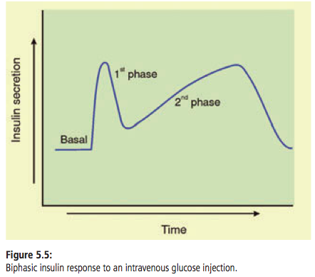

Slide 20
Oral glucose and insulin response
Oral glucose triggers more pronounced insulin secretion than glucose IV
Due to the actions of incretin hormones:
* glucagon-like peptide-1 (GLP-1)
* glucose-dependent insulinotropic
polypeptide {aka gastric
inhibitory polypeptide (GIP)}
Incretins amplify insulin secretion
Notes:
Orally administered glucose triggers more pronounced insulin secretion than does glucose given IV. This phenomenon is due to the actions of so-called incretin hormones, the most important being glucagon-like peptide-1 (GLP-1) and glucose-dependent insulinotropic polypeptide, also called gastric inhibitory polypeptide (GIP). Incretins are secreted by endocrine cells in the gastrointestinal tract in response to nutrients and are then carried in the bloodstream to the pancreatic islets, where they interact with their receptors on b-cells to amplify insulin secretion.

Slide 21
Stimuli of insulin release
Direct:
Glucose
Other sugars
Amino acids
Fatty acids
May be potentiated by incretins
Indirect:
Other pancreatic hormones
- Amylin (co-secreted
with insulin)
- Glucagon
- Somatostatin
Notes:
This slide is an overview of factors that stimulate insulin release, either directly or indirectly, again with blood glucose being the most important

Slide 22
Actions of insulin

Slide 23
Actions of Insulin
Insulin binds high affinity receptors
Receptors distributed throughout the body
Found in tissues in which insulin mediates glucose uptake
Muscle
Adipose
as well as in those in which it does not
Liver
Brain
Kidneys
Erythrocytes
Notes:
Once released, insulin binds to high affinity receptors. These receptors are widely distributed throughout the body and are found in tissues in which insulin mediates glucose uptake (such as muscle and adipose tissue) as well as in those in which it does not (such as liver, brain, kidneys, and erythrocytes)

Slide 24
Actions of Insulin
Insulin receptor – αβ subunits
Tyrosine kinase receptor
Mediates activity by transferring phosphate groups to tyrosine residues on intracellular target proteins
Insulin Receptor substrates (IRS)
Variable molecular response
Notes:
The insulin receptor itself belongs to the large group of tyrosine kinase receptors. They mediate their activity by transferring phosphate groups to tyrosine residues on intracellular target proteins . The Insulin receptor is made up of alpha and Beta units. Binding of insulin to the a-subunits triggers the tyrosine kinase activity of the b-subunits, leading to autophosphorylation which activates the catalytic activity of the receptor. The »substrate« proteins phosphorylated by the insulin receptor are called insulin-receptor substrate (IRS) molecules. They are key mediators in the insulin signaling pathway and act as docking proteins between the insulin receptor and a complex network of intracellular molecules. How the intra- cellular signals lead to the final biological effects of insulin is unclear

Slide 25
Actions of Insulin
Rapid insulin action – immediate
cellular uptake of:
glucose
amino acids
potassium
phosphate
Intermediate actions – minutes
mainly affecting protein and glucose metabolism
Delayed – hours
mainly concern lipid metabolism
Notes:
Insulin’s actions are variable depending on time since release. Insulin has 3 actions classified as rapid, intermediate and delayed. Rapid insulin actions are immediate and lead to the cellular uptake of glucose, amino acids, potassium, and phosphate. Intermediate actions occur within a few minutes, and mainly affect protein and glucose metabolism, followed several hours later by delayed actions which mainly concern lipid metabolism

Slide 26
Actions of Insulin
Glucose uptake into cells in response to insulin:
Glucose is a polar molecule
Mediated by transport proteins or Active transport
Transport across cell membranes facilitated by:
* Family of glucose transporter (GLUT) proteins in
several tissues
* Intestine and kidney by active transport with Na+
Notes:
Glucose uptake into cells in response to insulin is mediated by carrier proteins: Glucose is a polar molecule and cannot diffuse across cell membranes. Its transport is facilitated in several tissues by a family of glucose transporter (GLUT) proteins or (in the intestine and kidney) by active transport with sodium.

Slide 27
Action of Insulin
GLUT proteins:
14 types identified in humans
GLUT 4 is major insulin responsive transporter
GLUT 4 mainly in muscle + adipose tissue
Notes:
At least 14 different GLUT proteins have been identified in humans, named in order of their discovery, GLUT 1–14. Each appears to have evolved for a specific task. GLUT 4 is the major insulin-responsive transporter and is found almost exclusively in muscle and adipose tissue.

Slide 28
Action of Insulin
Insulin stimulates glucose transport in muscle + adipose tissue by translocation of GLUT 4 from the cytosol to the cell membrane
GLUT 4 molecules fuse membrane and function as pores for glucose entry
When insulin levels decrease, GLUT 4 molecules are removed from the cell membrane
Notes:
Insulin stimulates glucose transport in these two tissues by causing the translocation of GLUT 4 molecules from the cytosol to the cell membrane, with which they fuse and function as pores for glucose entry. When insulin levels decrease, the GLUT 4 molecules are removed from the cell membrane. In various other tissues such as brain, liver, kidney, and intestinal tract, glucose uptake is insulin-independent and occurs via other GLUT proteins

Slide 29
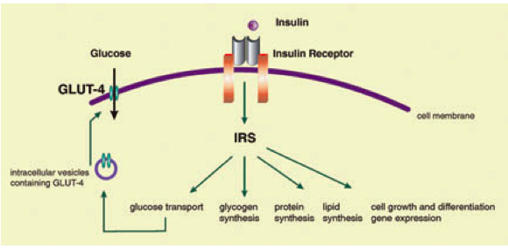
Notes:
Simplified scheme of insulin action. Glucose binding to its receptor protein initiates activation cascades that result in translocation of GLUT 4 to the cell membrane. This facilitates glucose influx and the synthesis of glycogen, protein, and lipid, as well as regulation of cell growth and expression of various genes. IRS (insulin receptor substrate) acts as a docking protein between the receptor and a complex network of intracellular signaling molecules.

Slide 30
Insulin independent glucose uptake
Insulin independent glucose uptake:
    Brain
    Liver
    Kidney
    Intestinal tract
Uptake occurs via other GLUT proteins
Notes:
In various other tissues such as brain, liver, kidney, and intestinal tract, glucose uptake is insulin-independent and occurs via other GLUT proteins

Slide 31
Functions of insulin

Slide 32
Insulin functions
Prevents catabolism of nutrient stores
Storage of glucose as glycogen
Storage of a.a as protein
Storage of f.a. as fat
Main tissue targets
Liver
Muscle
Adipose
Notes:
Insulin has various functions in the body. It is the most important anabolic hormone in the body and prevents catabolism of nutrient stores. Its main function is to ensure storage of glucose as glycogen, amino acids as protein, and fatty acids as fat. The main target tissues for insulin are liver, muscle, and adipose tissue .

Slide 33
Insulin functions - Carbohydrates
Facilitates the oxidation of glucose to pyruvate and lactate
induction of enzymes such as glucokinase, PFK,
pyruvate kinase
Promotes glycogen synthesis in liver and muscle
increasing glycogen synthetase activity
Decreases gluconeogenesis
as it promotes protein synthesis in peripheral tissues
Decreases conversion of a.a. to glucose in liver
Notes:
With respect to insulin and carbohydrates, Insulin facilitates the oxidation of glucose to pyruvate and lactate by the induction of enzymes such as glucokinase, phosphofructokinase, and pyruvate kinase. It promotes glycogen synthesis in liver and muscle by increasing glycogen synthetase activity. Gluconeogenesis is decreased by insulin because insulin promotes protein synthesis in peripheral tissues, decreasing the availability of amino acids for gluconeogenesis. Additionally, insulin decreases the activity of hepatic enzymes involved in the conversion of amino acids to glucose.

Slide 34
Insulin functions - Fats
In adipose tissue promotes synthesis of lipids and inhibits degradation
Activates pyruvate dehydrogenase and acetyl-CoA carboxylase
promote the synthesis of fatty acids from acetyl-CoA
Increases the activity of lipoprotein lipase
promotes the entry of fatty acids into adipose tissue
Inhibition of lipolysis
mediated by inhibition of hormone- sensitive lipase
Notes:
In adipose tissue insulin promotes the synthesis of lipids and inhibits their degradation. Insulin activates the enzymes pyruvate dehydrogenase and acetyl-CoA carboxylase, which promote the synthesis of fatty acids from acetyl-CoA. Insulin also increases the activity of lipoprotein lipase, an enzyme located in the endothelium of capillaries of extrahepatic tissues, which promotes the entry of fatty acids into adipose tissue. Inhibition of lipolysis is mediated by inhibition of hormone- sensitive lipase.

Slide 35
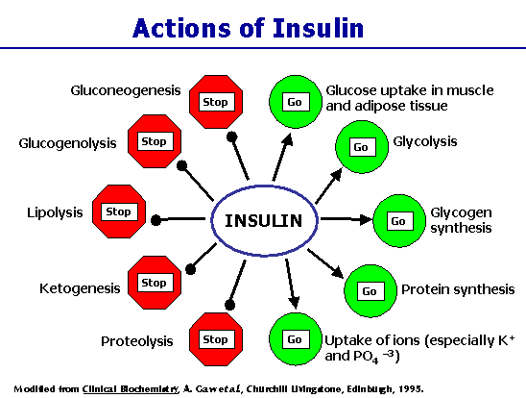
Insulin functions - Proteins
Insulin stimulates protein synthesis
Inhibits protein degradation
promotes a positive
nitrogen balance
Notes:
Insulin stimulates protein synthesis and inhibits protein degradation and thus promotes a positive nitrogen balance.

Slide 36
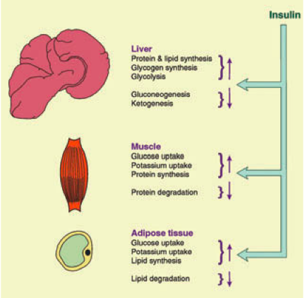

Slide 37
Glucagon
Main insulin antagonist
Acts predominantly on the liver
Increasing gluconeogenesis and glycogenolysis
Decreasing glycogen synthesis
Also a ketogenic hormone
Ability to enhance lipolysis
Insulin and glucagon act in concert following ingestion of protein
Insulin causes a decrease in BG and a.a.
Glucagon counters decrease in BG
by stimulating hepatic gluconeogenesis
Notes:
The main antagonist of insulin is glucagon. Glucagon acts predominantly on the liver, increasing gluconeogenesis and glycogenolysis and decreasing glycogen synthesis. It is also a ketogenic hormone, due to its ability to enhance lipolysis. Insulin and glucagon act in concert following ingestion of protein. Both are released when amino acids increase in the plasma. Insulin causes a decrease in blood glucose and amino acids, while glucagon counters the decrease in glucose by stimulating hepatic gluconeogenesis. This interaction allows growth and survival on diets of almost exclusively protein and fat.

Slide 38
Insulin Resistance

Slide 39
Insulin resistance
Normal amount of insulin results in subnormal response in BG levels
Decreased sensitivity, decreased responsiveness or both
  Decreased sensitivity - greater amount of insulin being required to reach the expected result
  Decreased responsiveness - inability to achieve a normal maximal response because of receptor and postreceptor abnormalities
Notes:
In insulin resistance, a normal amount of insulin causes a subnormal response in blood glucose levels. Insulin resistance progresses to overt diabetes mellitus (DM) when the existing insulin-producing beta cells cannot compensate for the insulin resistance, thus allowing hyperglycemia to occur. Insulin resistance can be further classified as decreased sensitivity to insulin, decreased responsiveness to insulin, or a combination of both. Decreased insulin sensitivity results in a greater amount of insulin being required to reach the expected result, which can still be obtained. Decreased insulin sensitivity is more likely to occur with disorders that cause alterations before interaction of insulin with the insulin receptor (ie. Insulin autoantibodies). In contrast, decreased insulin responsiveness is caused by an inability to achieve a normal maximal response because of receptor and postreceptor abnormalities.

Slide 40
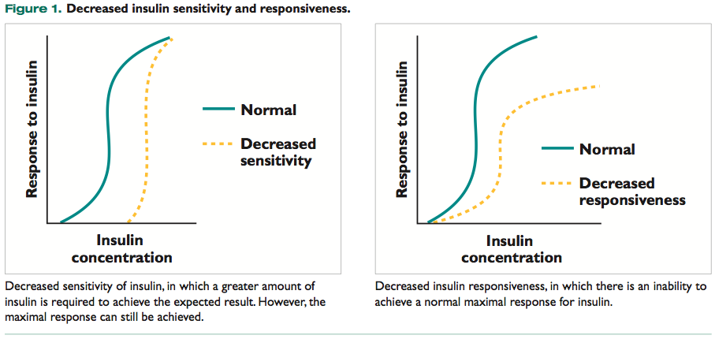

Slide 41
Insulin resistance - mechanisms
Pre-receptor
  Any cause that decreases availability of active insulin
Receptor
  Changes in insulin-receptor concentration, receptor binding affinity, and post-receptor metabolic pathways
Post-receptor
    Changes in insulin-receptor concentration, receptor binding affinity, and post-receptor metabolic pathways
Notes:
Insulin resistance can be due to prereceptor, receptor, and postreceptor factors. Prereceptor factors include any cause that decreases the availability of active insulin. Receptor and postreceptor factors are usually due to factors that change insulin action at the cellular level. Receptor and postreceptor mechanisms often include changes in insulin-receptor concentration, receptor binding affinity, and postreceptor metabolic pathways. Receptor and postreceptor changes are difficult to differentiate clinically and often coexist.

Slide 42
Insulin resistance – Pre-receptor
Anything that reduces active insulin concentration
Incomplete conversion of pro to insulin
Abnormal insulin molecule
Increased insulin degradation
Anti-insulin antibodies
~ 5% of dogs treated with recombinant human insulin have anti-insulin antibodies
Anti-insulin antibodies have been identified in 40% to 50% of dogs receiving bovine–porcine insulin and in 65% of dogs receiving bovine insulin
Notes:
Prereceptor problems can be due to any factor that reduces free, metabolically active insulin concentrations, including incomplete conversion of endogenous proinsulin to insulin, an abnormal insulin molecule, increased insulin degradation, or the presence of antiinsulin anti- bodies.
Approximately 5% of dogs treated with recombinant human insulin have antiinsulin antibodies, and circulating antiinsulin antibodies have been identified in 40% to 50% of dogs receiving bovine–porcine insulin (90% bovine) and in 65% of dogs receiving bovine insulin.

Slide 43
Insulin resistance – AutoAbs
Indirect using radioimmunoassay techniques to measure serum insulin concentrations
Circulating Abs interfere with RAS techniques used to measure serum insulin concentrations
Spuriously high concentrations of insulin are typically found in animals with antiinsulin antibodies
Notes:
The test for antiinsulin antibodies can be conducted indirectly using radioimmunoassay techniques to measure serum insulin concentrations. Circulating antibodies interfere with radioimmunoassay techniques used to measure serum insulin concentrations, similar to thyroid hormone antibodies and thyroid tests. Therefore, spuriously high concentrations of insulin are typically found in animals with antiinsulin antibodies

Slide 44
Insulin resistance – receptor and post receptor
Down regulation of insulin receptors
Abnormal post receptor insulin action
Dogs/cats
  caused by obesity or a disorder causing excessive secretion of insulin-antagonistic hormones:
    glucagon
    epinephrine
    cortisol
    growth hormone
    progesterone
    thyroid hormone
Notes:
Once the insulin receptor is bound to insulin, the receptor–insulin complex is internalized through endocytosis. Some receptors are then degraded, but most are recycled to the cell surface. Downregulation of insulin receptors occurs when the number of receptors recycled to the surface is reduced and can be due to increased insulin concentration, exercise, diet, and hormones such as glucocorticoids and growth hormone. In dogs and cats, problems in receptor and postreceptor insulin action are usually caused by obesity or a disorder causing excessive secretion of diabetogenic or insulin-antagonistic hormones (i.e., glucagon, epinephrine, cortisol, growth hormone, progesterone, or thyroid hormone)

Slide 45
Diabetes Mellitus

Slide 46
Diabetes mellitus
The Expert Committee on the Diagnosis and Classification of Diabetes Mellitus of the American Diabetes Association, defines diabetes mellitus in their latest report as:
“a group of metabolic diseases characterized by hyperglycemia resulting from defects in insulin secretion, insulin action or both”
Notes:
The Expert Committee on the Diagnosis and Classification of Diabetes Mellitus of the American Diabetes Association, working with the WHO, defines diabetes mellitus in their latest report (2008) as »a group of metabolic diseases characterized by hyperglycemia resulting from defects in insulin secretion, insulin action or both.
The same committee has abandoned the long-used terms insulin-dependent and non-insulin-dependent diabetes mellitus (IDDM, NIDDM)

Slide 47
Diabetes mellitus – 1-4
Type 1 - the cause is an absolute deficiency of insulin secretion due to T-cell mediated autoimmune destruction of the β-cells
Type 2 - It is characterized by two defects: insulin resistance and β-cell dysfunction
Notes:
There are various types of diabetes; types 1 through 4.
In type 1 diabetes, the cause is an absolute deficiency of insulin secretion due to T-cell mediated autoimmune destruction of the b-cells.
Type 2 - is characterized by two defects: insulin resistance and b-cell dysfunction. Both are usually present at the time of diagnosis, although it is un- certain which is primary.

Slide 48
Diabetes mellitus
Type 1:
Absolute insulin deficiency
Circulating autoantibodies
ICA
IA
GAD
Tyrosine phosphate autoantibodies
Genetic and environmental factors poorly defined
Notes:
In type 1 DM A marker of the disease is the presence of circulating islet-related autoantibodies such as islet-cell autoantibodies (ICA), insulin antibodies (IA), glutamic acid decarboxylase (GAD) autoantibodies, and tyrosine phosphatase IA-2 antibodies.
There is a genetic contribution and the autoimmune process is triggered by environmental factors that are still poorly defined.

Slide 49
Diabetes mellitus
Type 2
Insulin resistance and β-cell dysfunction
Main sites of insulin resistance are
  Liver
  Muscle
  Adipose tissue
Genetic basis
Promoted by obesity, inactivity, drugs, high BG
Dysfunction of β-cells is essential for the development of type 2 diabetes
Notes:
Type 2, which is largely identical to the previous NIDDM, accounts for up to 90 % of human cases. It is characterized by two defects: insulin resistance and b-cell dysfunction. Both are usually present at the time of diagnosis, although it is uncertain which is primary. The main sites of insulin resistance are liver, muscle, and adipose tissue. Insulin resistance in humans has a strong genetic basis and is promoted by obesity, physical inactivity, certain drugs, and high glucose levels.
Obesity is a subject of intense research, in particular since the discovery that adipose tissue is an active organ releasing large amounts of nonesterified fatty acids (NEFA) and adipokines. Some of the adipokines, such as adiponectin and possibly leptin, may improve insulin sensitivity, but others, such as NEFAs and proinflammtory cytokines, such as TNF-a and IL-6, induce or worsen insulin resistance
Dysfunction of b-cells is essential for the development of type 2 diabetes.

Slide 50
Diabetes mellitus
β-cell failure…
Reason for dysfunction unknown
Hyperglycemia and hyperlipidemia can be damaging
Deposition of amyloid in the islets due to polymerization of amylin
Notes:
The reasons for b-cell failure are largely unknown. Hyperglycemia and hyperlipidemia can be damaging to beta cells (this is referred to as glucose toxicity and lipotoxicity respectievly). Another suggested factor is the deposition of amyloid in the islets due to polymerization of amylin.

Slide 51
Diabetes mellitus
Third category of diabetes…
Other specified types
Diabetes that develops in association with other diseases or factors
Can develop secondary to:
  disorders of the exocrine pancreas - pancreatitis, pancreatic carcinoma
  hypersecretion of counterregulatory hormones- hypersomatotropism, hypercortisolism, hyperthyroidism
  administration of glucocorticoids or progestins
Notes:
The third category of diabetes, classified as »Other specific types«, refers to diabetes that develops in association with diseases or factors other than defined as type 1 or type 2. Diabetes can develop secondary to various disorders, including disorders of the exocrine pancreas (such as pancreatitis, pancreatic carcinoma), hypersecretion of counterregulatory hormones (hypersomatotropism, hypercortisolism, hyperthyroidism), and administration of glucocorticoids or progestins. The extent of glucose intolerance varies widely and insulin therapy may or may not be required;

Slide 52
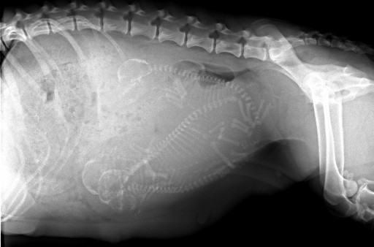
Diabetes Mellitus
Fourth category…
Gestational diabetes
Little importance in dogs and cats
Diabetes associated with diestrus in dogs can be considered its equivalent
Notes:
The fourth category in humans, gestational diabetes, is of little importance in dogs and cats, but the diabetes associated with diestrus in dogs can be considered its equivalent

Slide 53
Metabolic disturbances and DM
Hyperglycemia
Alterations to cabrobohydrate metabolism
Alterations to fat metabolism
Alterations to protein metabolism
Notes:
Hyperglycemia develops when insulin secretion is absent or is inadequate for the degree of insulin resistance. Initially, insulin resistance may be compensated by increased insulin secretion, but eventually this is no longer possible. Absolute or relative lack of insulin has profound effects on carbohydrate, fat, and protein metabolism

Slide 54
Hyperglycemia
Occurs due to:
    Reduced entry of glc into muscle and adipose tissue
    Unopposed production of glucose in the liver via gluconeogenesis and glycogenolysis
Glucagon and stress hormones contribute to increased production of glc
Intestinal absorption of glc unaffected
Entry into brain, kidney, and RBCs unaffected
Notes:
Hyperglycemia results in part from the reduced entry of glucose into muscle and adipose tissue. Intestinal absorption of glucose is unaffected, as is entry of glucose into brain, kidney, and erythrocytes. The second and potentially more important cause of hyperglycemia is the unopposed production of glucose in the liver via gluconeogenesis and glycogenolysis. Glucagon contributes to the increased production of glucose, as do other stress hormones.

Slide 55
Hyperglycemia
PU/PD – osmotic diruesis
Increased appetite
  Loss of energy via glucosuria
  Appetite stimulation via hypothalamus
Notes:
When the renal capacity for glucose reabsorption is exceeded, glucose is lost in the urine. The resulting osmotic diuresis is compensated by increased water intake and the polydipsia may become severe. The loss of energy via glucosuria is compensated by increased food intake. Appetite stimulation by the hypothalamus, due to deficient glucose utilization, and various other mechanisms play a role

Slide 56
Lipid metabolism
Acceleration of lipid catabolism
Increased availability of glycerol accelerates hepatic gluconeogenesis
Increased levels of NEFA transported to the liver
  β-oxidation to acetyl CoA, the amount of which may exceed the need for ATP production by further oxidation in the Krebs cycle
  Shift to ketone body production
Notes:
Derangement of lipid metabolism plays a major role in the development of diabetes and its complications. The intracellular deficits of glucose and the lack of insulin lead to acceleration of lipid catabolism. The increased availability of glycerol accelerates hepatic gluconeogenesis. The increased levels of NEFA are also transported to the liver. There they undergo b-oxidation to acetyl CoA, the amount of which may exceed the need for ATP production by further oxidation in the Krebs cycle. This causes a shift to ketone body production, which can result in ketoacidosis

Slide 57
Lipid metabolism
Increased hepatic f.a. concentration results in enhanced synthesis of:
  Triglycerides
  VLDL
Results in hyperlipidemia and fatty liver
Notes:
Increased hepatic concentration of fatty acids also results in enhanced hepatic synthesis of triglycerides and very-low density lipoproteins (VLDL). The consequences are hepatic steatosis and hyperlipidemia.

Slide 58
Protein metabolism
Decreased protein synthesis
Increased proteolysis
  Increased availability of a.a accelerates hepatic gluconeogenesis
Negative nitrogen balance
Loss of muscle mass
Cachexia
Notes:
Protein metabolism shifts toward decreased protein synthesis and increased proteolysis. The increased availability of amino acids further accelerates hepatic gluconeogenesis. The consequences are negative nitrogen balance, loss of muscle mass, and possibly cachexia.

Slide 59
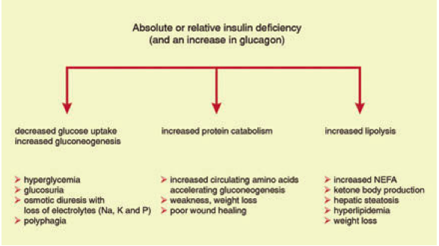

Slide 60
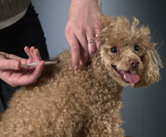
Diabetes Mellitus Caine

Slide 61
Diabetes Canine
One of the most common endocrine disorders in dogs
Similar to type 1 human diabetes
  autoimmune destruction of β-cells in genetically predisposed individuals
Antibodies against β-cells and islet components (insulin, GAD65, IA2) have been demonstrated in the serum of dogs
Notes:
Diabetes mellitus is one of the most common endocrine disorders in dogs, having a prevalence of 0.3–0.6 %. In many dogs the disease is similar to human type 1 diabetes, which is caused by autoimmune destruction of b-cells in genetically predisposed individuals. Antibodies against b-cells and several islet components (insulin, GAD65, IA2) have been demonstrated in the serum of dogs with newly diagnosed diabetes, suggesting that these antigens are involved in the autoimmune process.

Slide 62
Diabetes Canine
Breed predisposition
Genetic component
Association with certain DLAs
Caine type 1 corresponds to human subgroup type 1: latent autoimmune diabetes in adults
Those with concurrent endocrine disorders correspond to human autoimmune polyendocrine syndrome type 2
Notes:
The observation that certain breeds of dogs are predisposed to diabetes has led to genetic studies. The risk of diabetes was shown to be associated with certain dog leukocyte antigen (DLA) haplotypes. Since most dogs are middle-aged to elderly at the time of diagnosis, canine type 1 diabetes seems to correspond best to the subgroup of type 1 diabetes termed latent autoimmune diabetes in adults (LADA). Dogs with diabetes may have concurrent endocrine diseases of possible autoimmune etiology (such as hypothyroidism and Addison’s disease), a combination which may be equivalent to human autoimmune polyendocrine syndrome type 2.

Slide 63
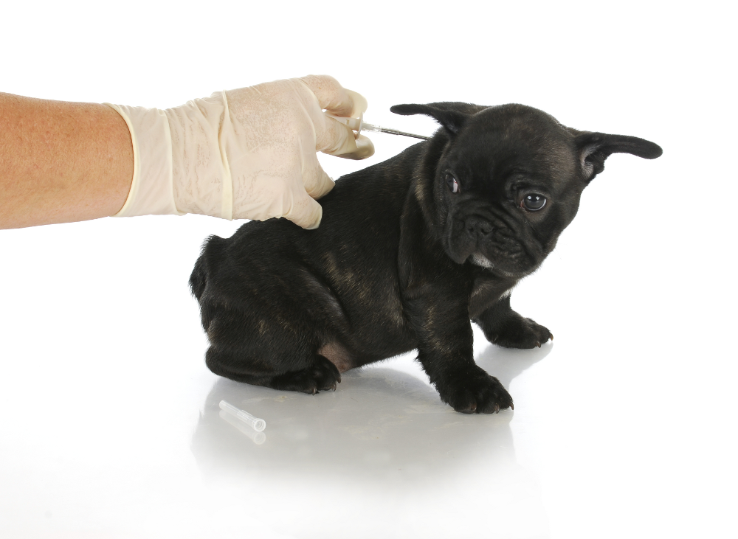
Diabetes Canine
Occurs occasionally in dogs less than 12 months of age
Most likely due to β-cell aplasia or abiotrophy
Notes:
Diabetes mellitus occurs occasionally in dogs less than twelve months of age, most likely not due to autoimmune destruction but to b-cell aplasia or abiotrophy. There has been no evidence that dogs develop an equivalent of human type 2 diabetes.

Slide 64
Signalment
Middle aged to elderly
Females ~ 55%
Breed predilections:
  Samoyed
  Terriers
  Poodles
  Beagles
  Schanuzers
Notes:
Diabetes typically occurs in middle-aged to elderly dogs, most being five or more years of age, and rarely occurs in dogs < 12 months of age. The proportion of females has decreased from more than 70 % to around 55 %, most probably because of more frequent early neutering and the consequent decrease in diestrus-associated diabetes. Samoyeds, various terrier breeds (Australian, Tibetan, cairn, West Highland white), miniature schnauzers, beagles, and poodles (miniature and toy) are at increased risk for diabetes. The boxer, German shepherd dog, and golden retriever appear to be at low risk

Slide 65
Clinical signs
Polyuria
Polydipsia
Polyphagia
Weight loss
50 % develop cataracts within the first six months and about 80 % within 16 months after diagnosis
C/S occur when renal absorptive capacity for glucose is overwhelmed (~ 10mmol/L; 180mg/dl)
Notes:
The four typical symptoms of diabetes mellitus are polyuria, polydipsia, polyphagia, and weight loss. About 50 % of diabetic dogs develop cataract within the first six months and about 80 % within 16 months after the diagnosis of diabetes. Most diabetic dogs are not presented for veterinary examination until blood glucose concentration exceeds the renal capacity for glucose reabsorption (~10 mmol/l).

Slide 66
Diagnosis
Based on:
Clinical signs
Persistent hyperglycemia
Glucosuria
Additional diagnostics
Fructosamine
Glycosylated hemoglobin (GHb)
Notes:
Diabetes is diagnosed on the basis of appropriate symptoms and signs, persistent hyperglycemia, and glucosuria. There are no diagnostic criteria for diabetes in dogs. If mild hyperglycemia (blood glucose 7–9 mmol/l) persists in an unstressed and otherwise unremarkable dog, a search for diseases causing insulin resistance, such as hypercortisolism, may be warranted. Glucosuria alone is insufficient for the diagnosis of diabetes, since it may also by caused by renal defects. Fructosamine is not required for the diagnosis per se in dogs, but it is useful in long-term management and an initial measurement provides a reference point and is therefore recommended. Diabetes is diagnosed when blood glucose concentration is above the renal threshold, causing obligatory water loss and hence the signs of polyuria and polydipsia.

Slide 67
Diagnosis
Fructosamine:
  Product of an irreversible reaction between glucose and amino groups on plasma proteins
  Reflects the mean blood glucose concentration in the preceding 1-2 weeks
  Not affected by short-term changes in BG
  May be normal in a diabetic due to: diabetes of very short duration (< 5 days) or hypoproteinemia

Slide 68
Diagnosis
Gylcosylated hemoglobin:
  Product of an irreversible, nonenzymatic, non-insulin-dependent binding of glucose to hemoglobin
  Half-life of circulating GHb is directly related to the RBC lifespan
  Used to measure long-term glucose regulation over the previous 10- to 14-week period in the dog and 6- to 9-week period in the cat
Notes:
Canine red blood cells have a longer lifespan (100 days) than cats (<68 days) . this test is not appropriate for an animal that is still undergoing regular changes in insulin dosages. A more appropriate application of this test is for follow-up analysis of an animal that has been consistently well controlled

Slide 69
Diagnosis
Diagnosis of concurrent conditions
Work up:
  CBC/Chem/U/A
  Urine culture
  Radiographs
  Ultrasound
  TLI/cPLI
Notes:
Typical findings include a stress leukogram, hyperlipidemia, slight to moderate elevation of alanine aminotransferase (ALT) and alkaline phosphatase (ALP), urine specific gravity <1.020 despite polyuria, and glucosuria, proteinuria, and bacteriuria with or without pyuria. There may be a trace of ketone bodies in the urine even in uncomplicated diabetes. Testing for hypercortisolism should be delayed until treatment of the diabetes is stabilized.

Slide 70
Treatment
Aims:
Eliminate symptoms
Prevent short term complications (DKA, hypoglycemia)
Not necessary to achieve normal BG
Most patients do well between 5-15mmol/L (90-270mg/dl)
Notes:
The aims of therapy are to eliminate the symptoms and signs of diabetes mellitus and prevent short-term complications (hypoglycemia and ketoacidosis). Most diabetic dogs and cats appear to do well when the blood glucose ranges between 15 mmol/l before insulin administration and 5 mmol/l at the time of the glucose nadir

Slide 71
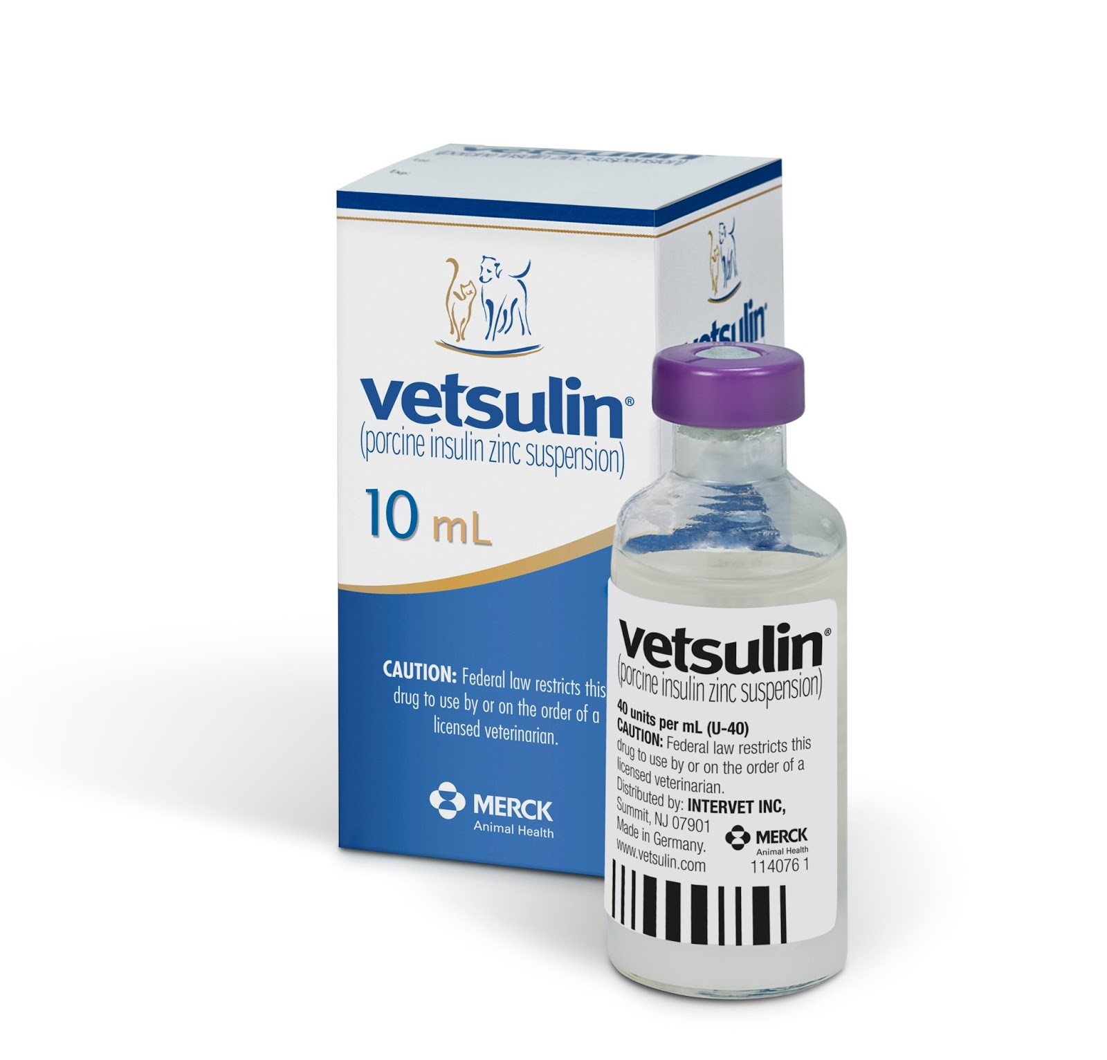
Treatment:
Insulin therapy
Dietary management
Weight reduction
Notes:
Treatment consists of insulin therapy, dietary management, body weight reduction if the dog is overweight, daily exercise, cessation of diabetogenic drugs, and control of concurrent or underlying problems. All dogs with diabetes should be treated with insulin. Oral hypoglycemic drugs are ineffective for metabolic control, even though a-glucosidase inhibitors or chromium may have slight auxiliary effects.

Slide 72
Treatment
Insulin:
  Preparations are categorized according to duration of action
  Short-, intermediate-, and long-acting
  Dogs with uncomplicated diabetes- treat with an intermediate-acting insulin, which is porcine-derived, lente-type insulin
    (Caninsulin®/Vetsulin®, Intervet)
  Or with a long acting insulin
      (Galrgine)
Notes:
Insulin preparations are categorized according to duration of action as short-, intermediate-, and long-acting (fig. 5.10). In dogs with uncomplicated diabetes, treatment is started with an intermediate-acting insulin, which is porcine-derived, lente-type insulin (Caninsulin®/Vetsulin®, Intervet) licensed for use in dogs.

Slide 73
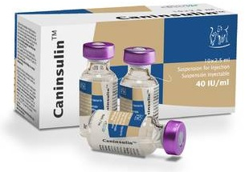
Treatment:
Lente insulin:
Mixture of 30 % short-acting amorphous and 70 % long-acting crystalline insulin
The starting dose is 0.25–0.5 U/kg, administered twice daily
Notes:
Lente insulin is a mixture of 30 % short-acting amorphous and 70 % long-act- ing crystalline insulin. The starting dose is 0.25–0.5 U/kg, administered twice daily.

Slide 74
Treatment
Insulin and diet:
Meals of constant composition and caloric content
Fed at the same times each day, just before each dose of insulin
A high- fiber diet (> 8 % fiber on a dry-matter basis) is preferred
Notes:
The diabetic patient should receive meals of constant composition and caloric content, fed at the same times each day, just before each dose of insulin. A high- fiber diet (> 8 % fiber on a dry-matter basis) is preferred

Slide 75
Treatment
Intact females should be spayed
  Prevent progesterone induced hypersecretion of mammary derived growth hormone during diestrus
If unable to spay → progesterone receptor antagonist
  Aglepristone
Notes:
All intact bitches with diabetes should be castrated, even if there has been no obvious temporal relation between diestrus and the onset of diabetes. Even though remission of the diabetes is not usually achieved by castration, it is necessary to prevent progesterone-induced hypersecretion of mammary-derived GH during subsequent diestrus and the resulting insulin resistance and disruption of treatment.

Slide 76
Treatment
Start of insulin - Inpatient vs outpatient
Inpatient:
  BG monitoring (BG q6hrs)
  Reduce dose if BG < 5mmol/L
  If BG > 15mmol/L no need to increase dose
Notes:
During this time blood glucose concentration should be measured three to four times over the day and the dose of insulin reduced if blood glucose falls below 5 mmol/l. It is not necessary to increase the dose of insulin if blood glucose remains high, because full action of insulin develops over a few days (so-called equilibration)

Slide 77
Treatment
Training owners
  Insulin storage – refrigerated upright
  Insulin handling and administration
  U-40 syringes vs U-100
  Recognition of hypoglyemia
  Return of clinical signs
  Symptoms of DKA
Notes:
The owner should also know that the insulin should be stored in the refrigerator in the up-right position and that Caninsulin is a U-40 insulin, in contrast to U-100 insulins for humans, and that only a U-40 syringe should be used.

Slide 78
Long term management
Takes ~ 2-3 months for reasonable glycemic control
Lifelong supervision and periodic adjustment of therapy is usually needed
Follow-up examinations should be made at:
  1,3, 6-8, 10-12 weeks after diagnosis
  Then once every 4 months
Notes:
It usually takes two to three months for reasonable glycemic control to be achieved, but lifelong supervision and periodic adjustment of therapy is usually needed. Follow-up examinations should be made at one, three, six to eight, and ten to twelve weeks after diagnosis, and then approximately every four months.

Slide 79
Long term management
Recheck examination includes:
  Assessment of the owner’s observations of symptoms
  Body weight
  Measurement of blood glucose
  Fructosamine concentrations
The presence or absence of PU/PD, polyphagia, lethargy, and weight loss are used to assess the quality of metabolic control

Slide 80
Fructosamine
Concentration increases when glycemic control worsens; decreases when control improves
Well-controlled diabetic dogs are slightly to moderately hyperglycemic throughout the day
    fructosamine does not usually become completely normal during therapy
The finding of a normal fructosamine (especially in the lower half of the reference range) should raise concern about the possibility of prolonged periods of hypoglycemia due to insulin overdosage
Notes:
Fructosamine concentration increases when glycemic control worsens and decreases when glycemic control improves. Since even well-controlled diabetic dogs are slightly to moderately hyperglycemic throughout the day, fructosamine does not usually become completely normal during therapy. Thus the finding of a normal fructosamine concentration (especially in the lower half of the reference range) should raise concern about the possibility of prolonged periods of hypoglycemia due to insulin overdosage. Fructosamine levels of 350–450 μmol/l indicate good metabolic control, levels of 450–550 μmol/l indicate moderate control, and those above 550 μmol/l indicate poor control (

Slide 81
Fructosamine
Fructosamine levels:
350–450 μmol/l indicate good metabolic control
450–550 μmol/l indicate moderate control
above 550 μmol/l indicate poor control

Slide 82
Fructosamine
High fructosamine levels indicate poor control
Does not help to identify the cause
Thus all possibilities must be considered:
  Insulin underdosage
  Short duration of insulin effect
  Diseases causing insulin resistance
  Somogyi effect
Notes:
High fructosamine levels indicate poor control but do not help to identify the cause and thus all possibilities must be considered: insulin underdosage, short duration of insulin effect, diseases causing insulin resistance, and the Somogyi effect

Slide 83
Blood glucose measurements
BG measurements are required to characterize the problems and evaluate the action of insulin
Single measurements are sufficient when all of the following are true:
  Symptoms of diabetes have been resolved
  BG around the time of insulin administration is found to be 10–15 mmol/l
  Fructosamine is 350– 450 μmol/l
This indicates satisfactory control and additional blood glucose measurements are unnecessary
Notes:
Glucose measurements are required to characterize the problem and evaluate the action of insulin. Single measurements are sufficient when symptoms of diabetes have been resolved and blood glucose around the time of insulin administration is found to be 10–15 mmol/l and fructosamine is 350– 450 μmol/l. This indicates satisfactory control and additional blood glucose measurements are unnecessary.

Slide 84
Blood glucose measurements
Serial BG measurements should be obtained when:
  Persistence of PU/PD
  Weight loss
  Fructosamine > 550umol/L
For determination of the BGC, BG is measured before insulin injection (fasting) and then every 2hr
Notes:
In contrast, serial blood glucose curves (BGC), for which glucose is measured every 1–2 h, should be obtained in animals with persistence of polyuria, polydipsia, and weight loss, and fructosamine levels above 550 μmol/l.

Slide 85
Blood glucose curve (BGC)
The most important variables evaluated by the BGC are:
  Insulin efficacy
  Glucose nadir
  The duration of effect
Notes:
The most important variables evaluated by the BGC are insulin efficacy, the glucose nadir, and the duration of effect

Slide 86
Blood glucose curve
Insulin efficacy
Is defined as the difference between the highest and the lowest glucose concentration
Interpreted with reference to the highest blood glucose concentration and the insulin dose
Notes:
Insulin efficacy (= difference between the highest and the lowest glucose concentration) is interpreted with reference to the highest blood glucose concentration and the insulin dose. A small difference (e.g., 3 mmol/l) is acceptable if the highest blood glucose is < 12 mmol/l but not acceptable if it is > 17 mmol/l. A difference of 6 mmol/l would indicate satisfactory insulin efficacy in an animal receiving an insulin dose of < 0.5 U/kg but insulin resistance if the dose is > 1.5 U/kg. In the latter case, technical problems and the counterregulatory phase of the Somogyi effect must also be considered.

Slide 87
Blood glucose curve
Nadir (Ideally 5–8 mmol/l; 90-144mg/dL)
A lower nadir can be caused by:
  an insulin dose that is too high
  excessive overlap of insulin actions
  lack of food intake
  strenuous exercise
A nadir > 9 mmol/l can be cause by:
  Insulin dose that is too low
  Stress
  The counterregulatory phase of the Somogyi effect
  Technical problems of the owners
  In an animal already being treated with high doses, insulin resistance is also possible
Notes:
The glucose nadir, which should be interpreted next, is ideally 5–8 mmol/l. A lower nadir can be caused by an insulin dose that is too high, excessive overlap of insulin actions, lack of food intake, and strenuous exercise. A glucose nadir > 9 mmol/l can be the result of an insulin dose that is too low, stress, the counterregulatory phase of the Somogyi effect, and technical problems of the owners . In an animal already being treated with high doses, insulin resistance is also possible. It is very important to identify the cause, for it is necessary in order to correct the treatment

Slide 88
Blood glucose curve
Duration of insulin effect:
Defined as the time from the injection through the glucose nadir until the BG returns to 12–15 mmol/l
  If duration < 8–10 h, there is usually polyuria, polydipsia, and other symptoms of diabetes
  If more > 14 h there is a risk of hypoglycemia or the Somogyi effect
If unacceptable duration, then changing to an insulin with a different action profile is indicated
Notes:
The duration of insulin effect is defined as the time from the injection through the glucose nadir until the glucose concentration returns to 12–15 mmol/l. f the duration is less than 8–10 h, there is usually polyuria, polydipsia, and other symptoms of diabetes and if more than 14 h there is a risk of hypoglycemia or the Somogyi effect. If unacceptable duration, then changing to an insulin with a different action profile is indicated

Slide 89
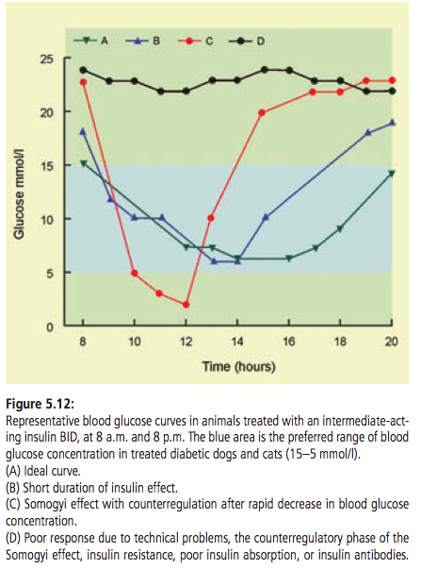
Notes:
n the Clinic of Small Animal Internal Medicine of the University of Zurich, HM is not begun before the third week of treatment. This allows the owner to become familiar with the disease and to gain experience with the injection of insulin. Once the owner is comfortable with the procedure, he or she measures the animal’s fasting blood glucose concentration twice weekly and a BGC once monthly. The former serves to detect morning hypoglycemia, in which case the owner is instructed to contact the clinic.

Slide 90
Insulin alterations
Based on BGC changing insulin dose or type may be indicated
Changes in the dose should be of the order of 10–25 %
  Except following hypoglycemia or the Somogyi effect, dose should be decreased by at least 50 %
Changes should not be made more frequently than every five to seven days
  Except in case of repeated hypoglycemia
Notes:
Depending on the results of the BGC, a change in the insulin dose and sometimes a change in the insulin preparation is required. As a rule of thumb, changes in the dose should be of the order of 10–25 %, but following hypoglycemia or the Somogyi effect, the dose should be decreased by at least 50 %. Changes should not be made more frequently than every five to seven days, except in case of repeated hypoglycemia.

Slide 91
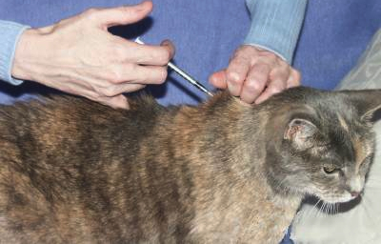
Diabetes Mellitus- Feline

Slide 92
Diabetes Feline
Prevalence ~ 1.2%
Similar to type 2 diabetes (~ 80% of cats)
  Combination of insulin resistance and β cell failure
Environmental and genetic factors play a role
Additional risk factors include:
  increasing age
  male gender
  being neutered
  physical inactivity
  glucocorticoid and progestin administration
  obesity
Notes:
Genetic factors have not yet been characterized in cats. The most convincing arguments for the existence of genetic factors have been derived from studies in Australia and the UK in Burmese cats, in which the frequency of diabetes was shown to be about four times higher than in domestic cats. Additional risk factors include increasing age, male gender, being neutered, physical inactivity, glucocorticoid and progestin administration, and obesity.

Slide 93
Diabetes Feline
As in humans, the most important risk factor in cats is obesity
It has been shown that obese cats are 3.9 times more likely to develop diabetes than those of optimal weight
Adipose tissue functions as an endorcine organ
  Adipokines influence insulin sensitivity
  Leptin, adiponectin, cytokines such as TNF-a and IL-6
Notes:
Ref: SCARLETT JM, DONOGHUE S. Associations between body condition and disease in cats. J Am Vet Med Assoc 1998;212: 1725–1731.
In humans it is now well accepted that adipose tissue is an important endocrine organ, producing various factors collectively termed adipokines that influence insulin sensitivity. Among them are leptin, adiponectin, and proinflammatory cytokines such as TNF-a and IL-6 (see also chapter 5.2.1).52 Preliminary studies in obese cats have shown that, as in humans, adiponectin levels decrease in obesity while leptin and TNF-a levels increase.
HOENIG M, McGOLDRICK JB, DEBEER M, DEMACKER PNM, FERGUSON DC. Activity and tissue-specific expression of lipases and tumor-necrosis factor a in lean and obese cats. Domest Anim Endocrinol 2006;30:333–344.

Slide 94
Diabetes Feline
When β-cells are healthy, the adaptive response to obesity and insulin resistance is an increase in insulin secretion
Normal glucose tolerance is maintained
When there is β-cell dysfunction, glucose tolerance is impaired → type 2 diabetes results
Notes:
When b-cells are healthy, the adaptive response to obesity and insulin resistance is an increase in insulin secretion, so that normal glucose tolerance is maintained. However, when there is b-cell dysfunction, glucose tolerance is impaired and eventually type 2 diabetes results. Initially, the first phase of insulin release is markedly reduced, whereas the second phase is delayed and often exaggerated. This is the threshold situation before the development of overt hyperglycemia and symptoms of diabetes, and it occurs when insulin secretion capacity is reduced by 80–90 %

Slide 95
Diabetes Feline
It is not known what is responsible for the reduction in insulin secretion and the progression to diabetes:
  Amyloid deposition?
  Glucotoxicity?
  Lipotoxicity ?
Notes:
It is not yet known what is responsible for the reduction in insulin secretion and the progression to diabetes: amyloid deposition, glucotoxicity, and/or lipotoxicity. Islet amyloid is derived from amylin (also called islet amyloid polypeptide), a hormone cosecreted with insulin from b-cells. Cats are among the few species in which the amino acid sequence of amylin predisposes it to fold into b-pleated sheets. These are deposited as amyloid in the islets, leading to loss of b-cells

Slide 96
Diabetes Feline
Amyloid deposition is found in about 90 % of cats with diabetes, but it is also a frequent finding in older healthy cats
Glucose toxicity is the concept that prolonged hyperglycemia impairs insulin secretion by the b-cells; reversible initially
Lipotoxicity is the analogous effect of excessive fatty acids on the b-cells
Notes:
Amyloid deposition is found in about 90 % of cats with diabetes, but it is also a frequent finding in older healthy cats and hence it probably should be regarded as a contributing factor and not the primary cause of b-cell failure. Glucose toxicity is the concept that prolonged hyperglycemia impairs insulin secretion by the b-cells. The phenomenon can be nicely demonstrated in healthy cats in which insulin secretion ceases after three to five days of continuous induction of high blood glucose levels. This is reversible initially, but then becomes permanent. These are very important concepts because immediate treatment of diabetes may reverse the adverse effects of glucose toxicity and increases the probability of complete remission of the diabetes. Due to glucose toxicity, circulating insulin concentration at the time of diagnosis is usually low and thus measuring insulin does not help to predict whether remission is possible.

Slide 97
Diabetes Feline
~ 20% of cats have other specific types of diabetes
The causes include:
  Pancreatitis
  Hypercortisolism
  Hypersomatotropism (acromegaly)
  Exposure to diabetogenic hormones (progestins, glucocorticoids)
Notes:
Other specific types of diabetes (formerly called secondary diabetes) in the cat account for approximately 20 % of cases. The causes include pancreatitis, hypercortisolism, hypersomatotropism (acromegaly), and exposure to diabetogenic hormones (progestins, glucocorticoids).

Slide 98
Signalment:
Occurs most often in middle-aged to elderly cats
  more than 95 % being older than five years
Strong sex predilection ~ 70 % being male
Burmese cats are at risk
~ 60 % of diabetic cats are overweight
~ 35 % are of normal weight
~ 5 % are underweight
Notes:
Diabetes occurs most often in middle-aged to elderly cats, more than 95 % being older than five years. There is a strong sex predilection, approximately 70 % being male. Burmese cats are at risk, but no other breed has been reported to be. Approximately 60 % of diabetic cats are overweight 35 % are of normal weight, and 5 % are under- weight.

Slide 99
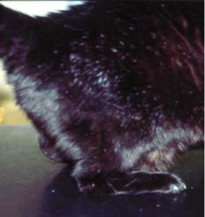
Clinical Signs
PU/PD
Polyphagia
Weight loss
~ 10% have overt signs of diabetic neuropathy
  Hind limb weakness, decreased ability to jump, and plantigrade posture
Diabetic cataracts
  Less pronounced than dogs
Notes:
Most diabetic cats have classical symptoms of diabetes: polyuria, polydipsia, polyphagia, and weight loss. Approximately 10% have overt signs of diabetic neuropathy, such as hind limb weakness, decreased ability to jump, and plantigrade posture. Physical examination often reveals hepatomegaly and neurological abnormalities consistent with peripheral neuropathy. Cats have long been assumed not to develop diabetic cataracts, but a recent study of 50 diabetic cats showed that almost all had lens opacities that were more pronounced than in nondiabetic cats.

Slide 100
Diagnosis
Work up similar to dogs
Differences:
Renal threshold is higher in cats
  Cats ~ 15 mmol/l, Dogs ~10 mmol/l glucosuria does not occur until blood glucose reaches a higher level
Cats prone to stress-induced hyperglycemia
  May be difficult to differentiate from diabetes
Notes:
The diagnosis and workup are generally similar for dogs and cats but a few differences should be noted. First, the renal threshold is higher in cats than in dogs (cats ~ 15 mmol/l, dogs ~10 mmol/l) and thus glucosuria does not occur until blood glucose reaches a higher level. Second, cats are prone to stress-induced hyperglycemia that may be difficult to differentiate from diabetes; it can be mild but concentrations >15 mmol/l are not exceptional and thus glucosuria may also be present

Slide 101
Diagnosis
Stress hyperglycemia:
This can be resolved by measuring fructosamine
  Above 400 μmol/l in diabetic cats
  Not elevated with stress hyperglycemia
Note: fructosamine may be normal if
  diabetes is very recent onset
  when there is concurrent hyperthyroidism or hypoproteinemia
Notes:
This can be resolved by measuring fructosamine, which is above 400 μmol/l in dia-betic cats and may be as high as 1500 μmol/l, but is not eleveated in cats with stress hyperglycemia.

Slide 102
Diagnosis
Measurement of plasma insulin concentration …?
Baseline or after insulin secretogogue
  Does not identify type of diabetes
  Does not predict if there is residual b-cell function for eventual remission
Usually low at the time of diagnosis, regardless if remission is possible or not
Glucose toxicity contributes to the low release of insulin due to the loss of b-cell function
Insulin therapy may reverse glucose toxicity
Notes:
Measurement of plasma insulin concentration (baseline or after injection of an insulin secretogogue) does not help to identify the type of diabetes or to predict whether there is sufficient residual b-cell function for eventual remission of the disease . The plasma insulin concentration is usually low at the time of diagnosis, regardless of whether remission is possible or not. Glucose toxicity contributes to the low release of insulin, due to the loss of b-cell function. Insulin therapy may reverse glucose toxicity, leading to partial or complete recovery of b-cell function.

Slide 103
Treatment
Aims: same as dogs
Eliminate symptoms
Prevent short term complications (DKA, hypoglycemia)
Most patients do well between 5-15mmol/L (90-270mg/dl)

Slide 104
Treatment
Insulin therapy
Weight Reduction
Dietary management
  High protein, low carbohydrate
Treatment of diabetes mellitus should be ASAP following diagnosis
  Good glycemic control reverses the effects of glucose toxicity and increases the probability of remission
Notes:
Treatment of diabetes mellitus should be started as soon as possible after the diagnosis is confirmed. Good glycemic control reverses the effects of glucose toxicity and increases the probability of remission. The mainstays of treatment are administration of insulin and management of the diet.

Slide 105
Treatment - Insulin
Intermediate-acting insulins
  Caninsulin®/Vetsulin®,Insuvet® Lente, Insuvet® PZI, PZIVet®
The initial dose of lente insulin is:
  1 U/cat twice daily for cats weighing < 4 kg
  1.5–2.0 U twice daily for those weighing > 4 kg
  If BG < 20 mmol/l at time of diagnosis, the initial dose is no more than 1 U twice daily, independent of body weight
Notes:
Intermediate-acting insulins are preferred in cats with uncomplicated diabetes
The initial dose of lente insulin is 1 U/cat twice daily for cats weighing <4 kg and 1.5–2.0 U twice daily for those weighing > 4 kg. If blood glucose is < 20 mmol/l at the time of diagnosis, the initial dose is no more than 1 U twice daily, independent of body weight

Slide 106
Treatment - Insulin
Intermediate acting insulin
BG is measured 3-4 times over the day
Dose is reduced if BG < 5 mmol/l
The BID dose is increased in increments of 0.5–1.0 U at intervals of five days
Satisfactory regulation is usually achieved in 1-3 months
Notes:
Blood glucose is measured three to four times over the day and the dose of insulin is reduced if glucose is found to be < 5 mmol/l. The twice-daily dose is increased in increments of 0.5–1.0 U at intervals of five days. Satisfactory regulation is usually achieved in one to three months.

Slide 107
Treatment - Insulin
Glargine (Lantus®, Aventis)
Long-acting insulin analog
Two basic amino acids are substituted on the C-terminal portion of the B chain
  This makes the analog soluble for injection at a slightly acidic pH but after injection small crystals precipitate at the pH of the subcutaneous tissue
Duration of action longer than lente
  < 24hrs; BID dosing
Notes:
Absorbed steadily without peaks

Slide 108
Treatment - Insulin
Detemir (Levemir; Novo Nordisk) is a long-acting human insulin analogue that was approved by the FDA for human use for the US market in 2005
Mechanism of action differs substantially from that of insulin glargine
  Molecules associate through strong hydrophobic interactions between the fatty acids
  These fatty acids also bind reversibly to albumin, which buffers the concentration of insulin detemir in the blood and tissues, adding to its protracted and more predictable effect
BID dosing
Reported improved remission rates when compared to Lente formualtions

Slide 109
Treatment – Oral hypoglycemics
Since 80 % of diabetic cats have type 2 diabetes, oral hypoglycemic drugs may in theory be used
Five classes of these drugs have been approved for treatment of type 2 diabetes in humans
Work through various mechanisms:
  stimulation of pancreatic insulin secretion, requiring some number of functioning pancreatic B cells
  Some slow intestinal glucose absorption
  Some enhance tissue sensitivity to insulin
Notes:
Since 80 % of diabetic cats have type 2 diabetes, oral hypoglycemic drugs may in theory be used
Five classes of these drugs have been approved for treatment of type 2 diabetes in humans

Slide 110
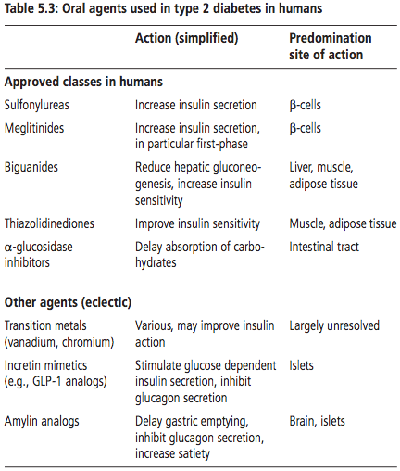
Treatment – Oral hypoglycemics

Slide 111
Treatment – Oral hypoglycemics
Sulfonureas have been investigated in cats
Stimulate insulin secretion
  Bind β-cell ATPases
  thus some residual β-cell function is required for them to work
Glipizide is the member of this class that has been used most often in cats
Notes:
Sulfonylureas stimulate insulin secretion and thus some residual b-cell function is required for them to be effective. Glipizide is the member of this class that has been used most often in cats

Slide 112
Treatment – Oral Hypoglycemics
Glipizide
Should only be used in diabetic cats that:
  In good physical condition
  Not ketotic
  Have only moderate symptoms of diabetes
Initial dose: 2.5 mg BID
  Increased to 5 mg BID after 2 weeks if no adverse effects and hyperglycemia is still present
Disadvantages of glipizide are that
  Treatment is successful in only 30 % of diabetic cats
  Drug may have negative effects on islets and accelerate β-cell loss
  May cause liver damage
Notes:
should only be used in diabetic cats that are in good physical condition, are not ketotic, and have only moderate symptoms and signs of diabetes. The initial dose is 2.5 mg twice daily, increased to 5 mg twice daily after two weeks if there are no adverse effects and hyperglycemia is still present. The disadvantages of glipizide are that treatment is successful in only 30 % of diabetic cats. Increased amyloid deposits have been observed in cats receiving glipizide in experimental trials, probably because glipizide stimulates the secretion of amylin as well as insulin. Since glipizide offers no medical advantage over insulin, it should only be used in cases in which the owner is unable to inject insulin.
The nonresponders likely had B-cell insufficiency secondary to glucose toxicity, desensitization, or exhaustion. Other possible causes for treatment failure could include inadequate dosing by owners, discontinuation of drug administration by owners because of adverse events, or malabsorptive disorders that might prevent therapeutic drug levels from being achieved. Side effects, including vomiting immediately after administration, hypoglycemia, increases in hepatic leakage enzymes, and increased bilirubin concentrations have been reported to occur in approximately 15% of treated cats.

Slide 113
Treatment – Oral hypoglycemics
Dipeptidyl-peptidase 4 (DDP-4) inhibitors are the most recently available oral hypoglycemics
Inhibition of DPP-4 leads to increased insulin secretion and decreased glucagon release
Reported low risk for causing hypoglycemia and to preserve β-cell function
Trials in healthy cats
Further research needed

Slide 114
Management
Close supervision is important during the first few months
Remission of diabetes may occur and if unnoticed and insulin administration may result in serious hypoglycemia
Remission during the first 3 months of therapy
Scheduling of follow-up exams interpretation of BG values, and aims of therapy are the same as in dogs
Notes:
Close supervision is of particular importance during the first months, because remission of diabetes may occur and if unnoticed and insulin administration is not terminated, serious hypoglycemia may occur. Most cats go into remission during the first three months of therapy (fig. 5.19), but remission can occur after one year or more. Home monitoring: recommend measuring fasting blood glucose twice weekly, to detect hypoglycemia, and a BGC for 12 h at least once a month.

Slide 115
Problems with Regulation
Consider concurrent disease
Insulin dose and formulation
Owner compliance
Insulin resistance
Insulin overdoasge
  Somogyi - glucose concentration falls very quickly, provoking the release of counterregulatory hormones and then rebounds to even higher than baseline
  BG values will be high for as long as 48 hours after a Somogyi phenomenon

Slide 116

Literature Review

Slide 117
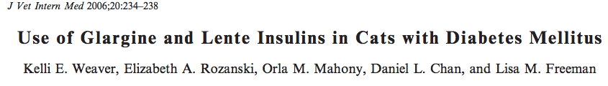
Cats were randomized to receive either 0.5 U/kg Lente insulin BID or 0.5 U/kg Glargine SID
Significant improvement in serum fructosamine and glucose concentrations in all cats but there was no significant difference between the 2 insulin groups
Notes:
The goals of this study were to compare the efficacy of once-daily administered Glargine insulin to twice-daily administered Lente insulin in cats with diabetes mellitus and to describe the use of a high-protein, low-carbohydrate diet designed for the management of diabetes mellitus in cats. All cats with naturally occurring diabetes mellitus were eligible for inclusion. Baseline testing included a physical examination, serum biochemistry, urinalysis and urine culture, serum thyroxine concentration, and serum fructosamine concentration. All cats were fed the high-protein, low-carbohydrate diet exclusively. Cats were randomized to receive either 0.5 U/kg Lente insulin q12h or 0.5 U/kg Glargine insulin q24h. The results of the study support the use of once-daily insulin Glargine or twice-daily Lente insulin in combination with a high-protein, low-carbohydrate diet for treatment of feline diabetes mellitus.

Slide 118
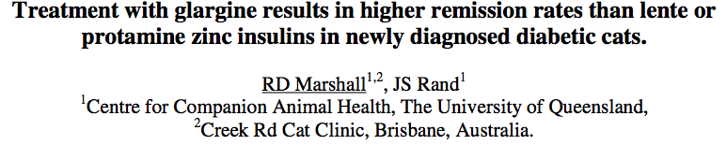
Aim to compare the effectiveness of glargine, protamine zinc insulin (PZI) and lente insulins in newly diagnosed diabetic cats
Findings:
  Mean 12hr BG at 4 weeks was significantly lower for glargine
  Fructosamine after 4 weeks was significantly lower than at diagnosis for glargine treated cats only
  Glargine use resulted in higher remission rates
Notes:
treated either with glargine, PZI or lente and fed a very low carbohydrate-high protein diet. It is postulated that improved glycaemic control with glargine resulted in better reversal of beta cell glucose toxicity and higher diabetic remission rates.

Slide 119
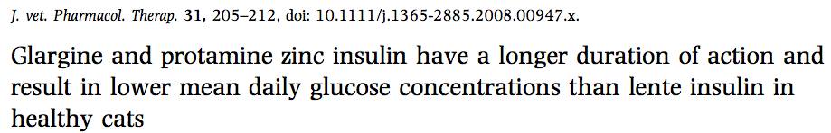
Pharmacological effects of glargine, PZI, and lente insulin were evaluated in nine healthy cats.
Time to onset of action did not differ between insulins
  Mean time to first nadir glucose was longer for glargine (14 h) relative to PZI (4 h) and lente (5 h)
The duration of action was similar for glargine and PZI and was longer than that for lente insulin
Notes:
The pharmacological effects of glargine, protamine zinc (PZI), and lente insulins were evaluated in nine healthy cats. A 3-way crossover study was performed and plasma concentrations of insulin and glucose were determined for 24 h after a single subcutaneous injection of each insulin at 3-day intervals.

Slide 120
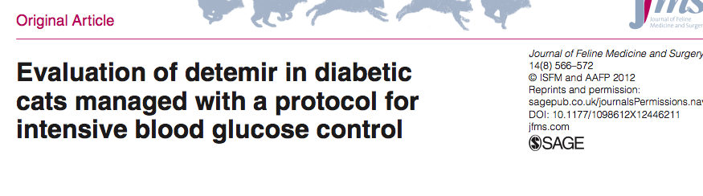
Similar remission rates, time to remission, relapse and hypoglycemia when compared with glargine
Difference: a slightly older median age of the detemir cohort at diabetes diagnosis, a higher rate of chronic kidney disease in the detemir cohort and lower maximal dose for insulin detemir

Slide 121

(J Am Vet Med Assoc 2013;243:1154–1161)
To evaluate the effects of BID glargine insulin administration in dogs with DM
Prospective
No significant difference between mean minimum and mean maximum [BG] nor were there significant differences between [BG] measured at other time points
Conclusions:
  Glargine is a peakless insulin that does not induce a distinct BG concentration nadir
  For glargine insulin, 0.3 U/ kg SC twice daily is recommended as an initial dosage
Notes:
Dogs with poorly regulated or newly diagnosed diabetes mellitus were enrolled if their owners agreed to return them to the hospital at 1- to 3-week intervals for 4 follow-up visits. During each follow-up visit, blood glucose concentrations were measured every 2 hours for at least 10 hours after feeding a diet high in insoluble fiber and after administration of glargine insulin (time 0). The initial glargine insulin dosage was 0.5 U/kg (0.23 U/lb) SC twice daily. results in a relatively flat blood glucose concentration curve

Slide 122
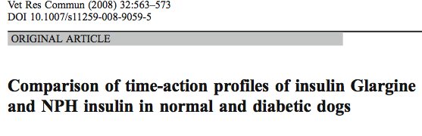
Investigated the time-action profiles of both NPH and glargine in normal dogs
Findings:
  confirming that NPH is intermediate-acting and glargine is a long-lasting preparation
  co- administration of NPH insulin and insulin glargine resulted in tight glycemic control as compared to NPH insulin alone
  co- administration result in hypoglycemia at the dosages tested
Notes:
to determine whether co-administration of NPH and glargine would be of benefit to insulin dependent diabetic dogs as it is for humans suffering from insulin dependent diabetes
Galrgine: after subcutaneous injection, the body, at physiological pH levels, slowly neutralizes the solution causing insulin microcrystals to gradually precipitate from the insulin glargine solution, which then release insulin in biologically active form. This gradual process ensures that small amounts of insulin glargine are released into the body continuously, giving an almost peakless profile, and prolonging the duration of action
Insulin glargine was designed to provide a basal or background insulin concentration, with the intention that a shorter-acting insulin (eg. NPH insulin) be administered at meal times to achieve optimal glycemic control than either insulin preparation alone
The diabetic dogs were treated with insulin combination injections of 0.05–0.1 IU/kg insulin glargine and 0.44–1.03 IU/kg human NPH insulin BID

Slide 123
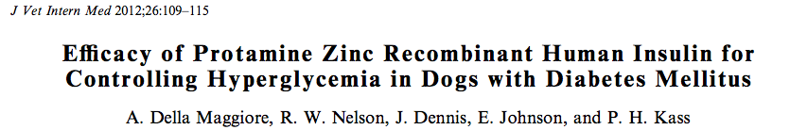
Evaluated the efficacy of recombinant human protamine zinc insulin (rhPZI) for treating diabetic dogs
Dogs were treated with rhPZI for 60 days
Glycemic control was assessed on days 7, 14, 30, and 60
Conclusions:
  rhPZI is effective in diabetic dogs and can be considered as an alternative treatment in diabetic dogs that are poorly controlled using other insulin preparations
Notes:
Glycemic control was assessed on days 7, 14, 30, and 60 by evaluation of history, physical examination, body weight, serum fructosamine concentration, and blood glucose concentrations measured before and 2, 4, 6, 8, and 10 hours after rhPZI administration

Slide 124
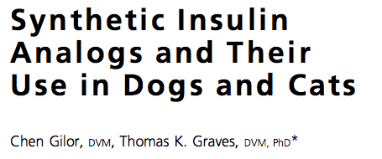
Vet Clin Small Anim 40 (2010) 297–307
Review article

Slide 125
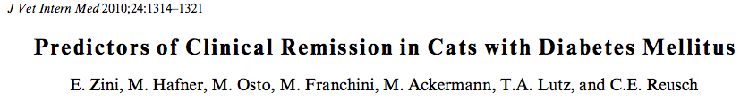
Retrospective
50% cats achieved remission, after a median time of 48 days (range: 8–216)
Remission was:
  more likely with higher age
  less likely with increased serum cholesterol
  longer with higher body weight
  shorter with higher blood glucose
Notes:
Remission was more likely with higher age (OR: 1.23, 95% CI: 1.04–1.46; P 5 .01) and less likely with increased serum cholesterol (OR: 0.36, 95% CI: 0.11–0.87; P 5 .04). Remission was longer with higher body weight (HR: 0.65, 95% CI: 0.42–0.99; P 5 .04) and shorter with higher blood glucose (HR: 1.01, 95% CI: 1.00–1.02; P 5 .02).

Slide 126
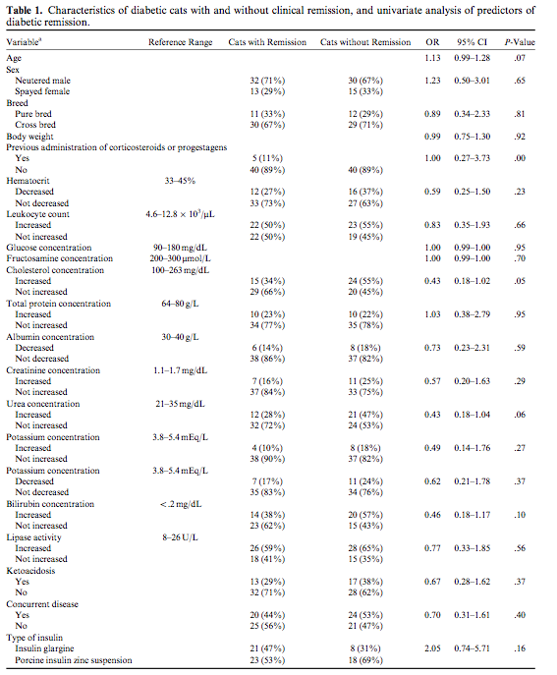

Slide 127

Vet Clin Small Anim 43 (2013) 245–249
Review article
  Glargine and detemir have been associated with the highest rates of remission
  A low-carbohydrate diet improves remission rates
  Corticosteroid administration before the diagnosis of diabetes is a positive predictor for remission
  Corticosteroid administration once remission is achieved is a risk factor for relapse
  Negative predictors for remission include a plantigrade stance and increased cholesterol
  Age is positively associated with remission

Slide 128

J Am Vet Med Assoc 2013;243:91–95
To determine overall survival time and identify prognostic factors associated with survival time in cats with newly diagnosed DM
Findings:
  Median survival time was 516 days (range, 1 to 3,468 days)
  70%, 64%, and 46% lived longer than 3, 6, and 24 months, respectively
  Survival time was significantly shorter for cats with higher creatinine concentrations, with a hazard of dying approximately 5% greater for each increase of 10 μg/dL in serum creatinine concentration
  Ketoacidosis was not significantly associated with survival time
Notes:
Retrospective

Slide 129
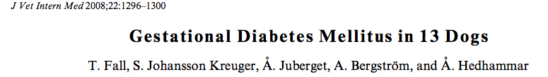
This report suggests:
  GDM affects mainly middle-aged bitches in the 2nd half of pregnancy
  With a breed predisposition toward Nordic Spitz breeds
  GDM may resolve within days to weeks after pregnancy has ended
Notes:
Restropective evaluation

Slide 130
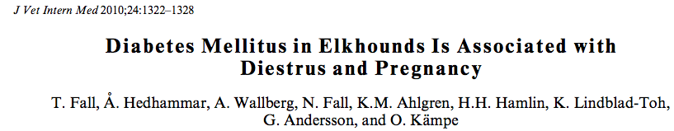
Diabetes mellitus in Elkhounds develops mainly during diestrus and pregnancy
Immediate OHE improves the prognosis for remission of diabetes
Notes:
Medical records from 63 Elkhounds with diabetes were reviewed and owners were contacted for follow-up infor-
mation. Blood samples from the day of diagnosis were available for 26 dogs. Glucose, fructosamine, C-peptide, growth hormone (GH), insulin-like growth factor-1, progesterone, and glutamate decarboxylase isoform 65-autoantibodies were anal- yzed and compared with 26 healthy dogs. Logistic models were used to evaluate the association of clinical variables with the probability of diabetes and with permanent diabetes mellitus after ovariohysterectomy (OHE).

Slide 131
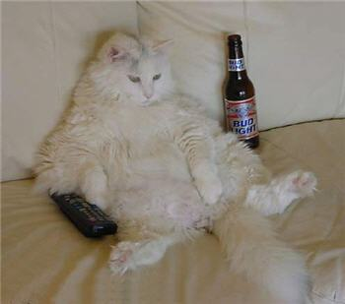
The End

Slide 132
References
Bennet, N. 2002. Monitoring Techniques for Diabetes Mellitus in the Dog and Cat. Chnical Techniques in Small Animal Practice, Vol 17, No 2 (May): pp 65-69
Callegari, C., Mercuriali,E., Hafner, M., Coppola, L.M., Guazzetti, S.,. Lutz, T.A., Reusch, C.E., Zini, E. 2013. Survival time and prognostic factors in cats with newly diagnosed diabetes mellitus: 114 cases (2000–2009) .J Am Vet Med Assoc ;243:91–95
Chen, G., Graves, T.K. 2010. Syntheic Insulin Analogues and Their Use in Dogs and Cats. Vet Clin Small Anim 40 (2010) 297–307
Hackendahl, N., Schaer, M. 2006. Insulin Resistance in Diabetic Patients: Mechanisms and Classifications. Compendium. Pp 262-270
Hess,R.S., Drobatz, K.J. 2013. Glargine insulin for treatment of naturally occurring diabetes mellitus in dogs. J Am Vet Med Assoc ;243:1154–1161)

Slide 133
References:
Hoenig M, McGoldrick JB, Debeer M, Demarcker PNM, Ferguson DC. 2006 Activity and tissue-specific expression of lipases and tumor-necrosis factor a in lean and obese cats. Domest Anim Endocrinol;30:333–344.
Marshall RD, Rand JS, Morton JM. 2009. Treatment of newly diagnosed diabetic cats with glargine insulin improved glycaemic control and results in higher probability of remission than protamine zinc and Lente insulins. J Feline Med Surg. Vol 11: 683–91.
Palm, C.A., Feldman, E.C. 2013. Oral Hypoglycemics in Cats with Diabetes Mellitus. Vet Clin Small Anim 43 (2013) 407–415
Rand, J.S. 2013. Pathogenesis of Feline Diabetes Mellitus. Vet Clin Small Anim 43. Pp 221–231

Slide 134
References:
Rijnberk, A., Kooistra, H. Clinical Endocrinology of Dogs and Cats 2nd ed. © 2010, Schlütersche Verlagsgesellschaft mbH & Co. KG, Hans-Böckler-Allee 7, 30173
Rios, L. Ward, C. 2008. Feline Diabetes Mellitus: Diagnosis, Treatment and Management. Compendium.
Rios, L. Ward, C. 2008. Feline Diabetes Mellitus: Pathophysiology and Risk Factors. Compendium.
Scarlett, JM., Donoghue, S. 1998. Associations between body condition and disease in cats. J Am Vet Med Assoc;212: 1725–1731.
Zini E, Hafner M, Osto M, et al. Predictors of clinical remission in cats with diabetes mellitus. J Vet Intern Med 2010;24:1314–21.

Slide 135
References:
Zerrenner, D., Peterson, M., Crawford, M.A.2007. The Evolution of Insulin therapy. Compendium. Pp 522-536
Zoran, D. Obesity in Dogs and Cats: A Metabolic and Endocrine Disorder. Vet Clin Small Anim 40 (2010) 221–239

