Slide 1
CT Images
March 2014
ECC Resident Board Review

Slide 2
#1

Slide 3
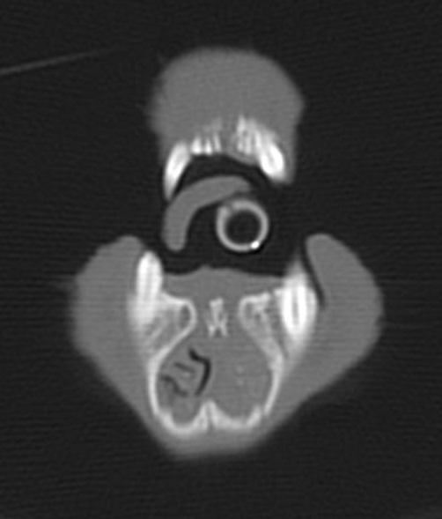
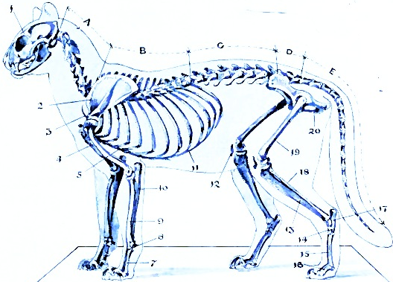
3.7 yr DSH – Trauma – CT Head
Bone
Axial

Slide 4
3.7 yr DSH – Trauma – CT Head
List the major abnormality(s) in the CT image…
What one definitive treatment could YOU perform?
Describe how you would perform this definitive treatment procedure…

Slide 5
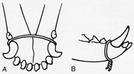
3.7 yr DSH – Unknown Trauma – CT Head
196784
Major abnormalities in the CT image
  Fx of mandibular symphysis
  More fx…
  Fluid filled nasal cavities extending into the sphenoid and frontal sinuses
What definitive treatment would you recommend?
  Wiring of the mandibular symphysis fx
Describe the procedure
  Simple symphyseal fractures of the mandible are immobilized using a single 18- or 20-gauge wire located just caudal to the canine teeth (A).
  The wire is tunneled under the mucosa of the mandible, penetrating the skin under the jaw.
  The wire is twisted to provide reduction and stability (B).

Slide 6
#2

Slide 7
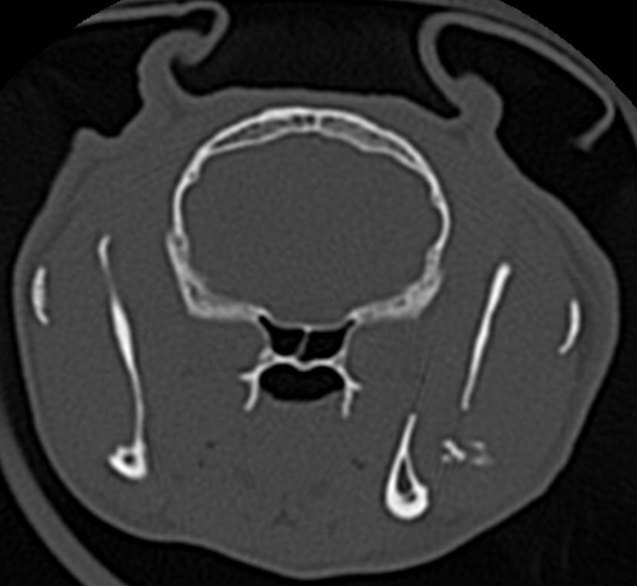
8.6 yr. DSH – Bite Trauma – CT Head
Bone
Axial

Slide 8
8.6 yr. DSH – Bite Trauma – CT Head
List the major abnormality(s) in the CT image…

Slide 9
8.6 yr, DSH – Bite Trauma – CT Head
201735
List the major abnormality(s) in the CT image…
  Left mandibular fracture

Slide 10
#3

Slide 11
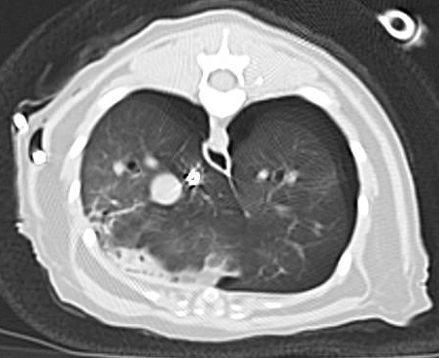
1.6 yr. DSH – HBC Trauma – CT Thorax
ST
Axial

Slide 12
1.6 yr. DSH – HBC Trauma – CT Thorax
List the major abnormality(s) in the CT image…
Based on these findings, what would you do next?

Slide 13
1.6 yr. DSH – HBC Trauma – CT Thorax
202136
List the major abnormality(s) in the CT image…
  Pneumothorax
  Partial lung collapse (R>L)
  A thoracostomy tube is present on the right - the tube enters the thoracic cavity at right-eleventh intercostal space and courses cranioventrally
Based on these findings, what would you do next?
  Aspirate the thoracostomy tube

Slide 14
#4

Slide 15
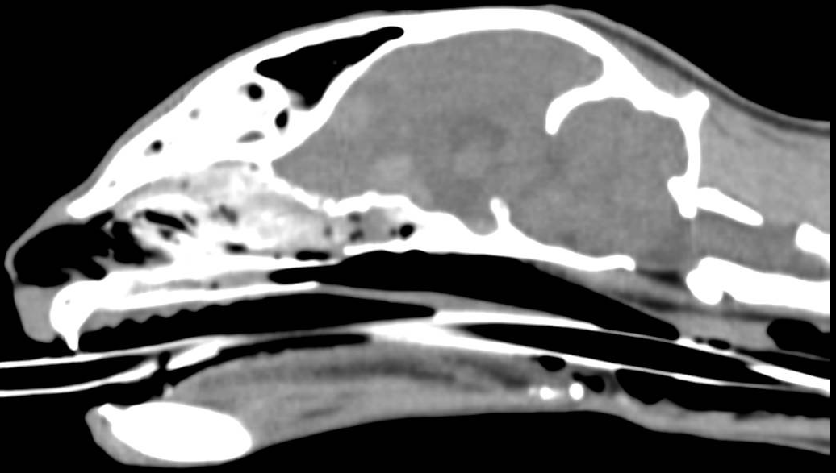
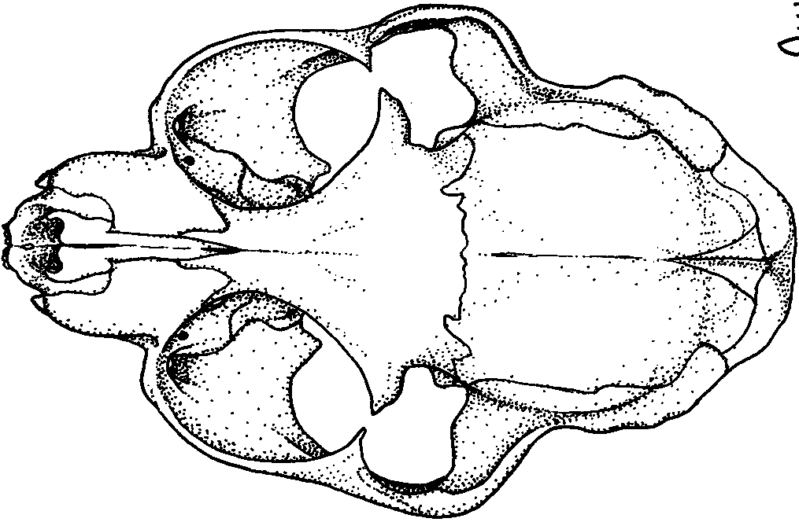
1.6 yr. DSH – HBC Trauma – CT Head
ST
Sagittal

Slide 16
1.6 yr. DSH – HBC Trauma – CT Head
What abnormality(s) in the CT image are most concerning…

Slide 17
1.6 yr. DSH – HBC Trauma – CT Head
202136
What abnormality(s) in the CT image are most concerning…
  Multiple, poorly defined areas of increased attenuation consistent with intraparenchymal hemorrhages
Summary of abnormalities
  The dorsal aspect of the sphenoid bone is fractured in multiple places, these fractures communicate with the cranial cavity
  In the brain adjacent to this fracture, there are large, poorly defined areas of increased attenuation
  Fluid within both nasal cavities and multiple sinuses

Slide 18
#5

Slide 19
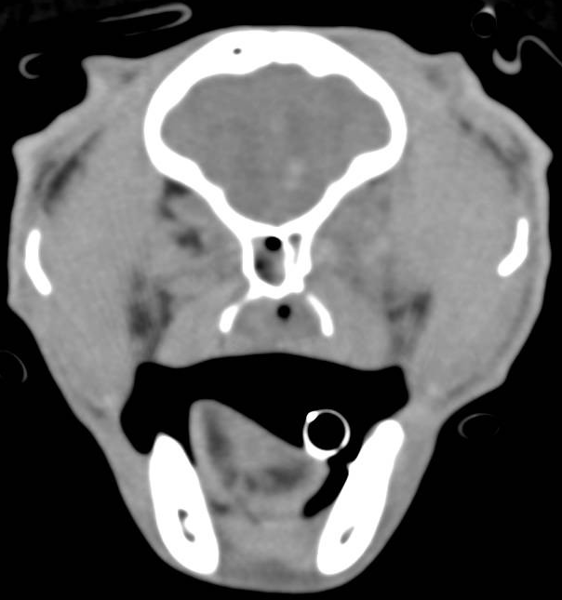
3.6 yr. DSH – HBC Trauma – CT Head
Soft Tissue
Axial

Slide 20
3.6 yr. DSH – HBC Trauma – CT Head
What abnormality(s) in the CT image are most concerning…

Slide 21
3.6 yr. DSH – HBC Trauma – CT Head
211985
What abnormality(s) in the CT image are most concerning…
  At the level of the frontal lobes (L>R), multiple coalescing regions of hyperattenuation are seen.
  These lesions are consistent with hemorrhage

Slide 22
#6

Slide 23
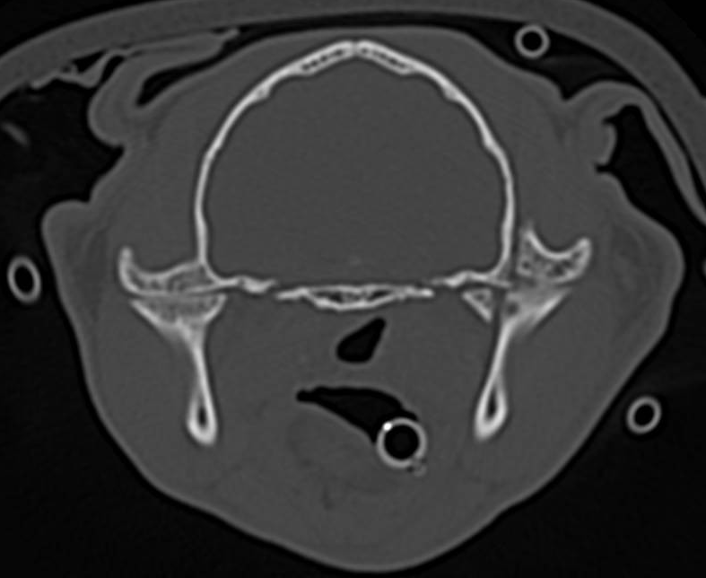
3.6 yr. DSH – HBC Trauma – CT Head
Bone
Axial

Slide 24
3.6 yr. DSH – HBC Trauma – CT Head
What abnormality(s) in the CT image are most concerning…

Slide 25
3.6 yr. DSH – HBC Trauma – CT Head
211985
What abnormality(s) in the CT image are most concerning…
  Articular fx of left mandible

Slide 26
#7

Slide 27
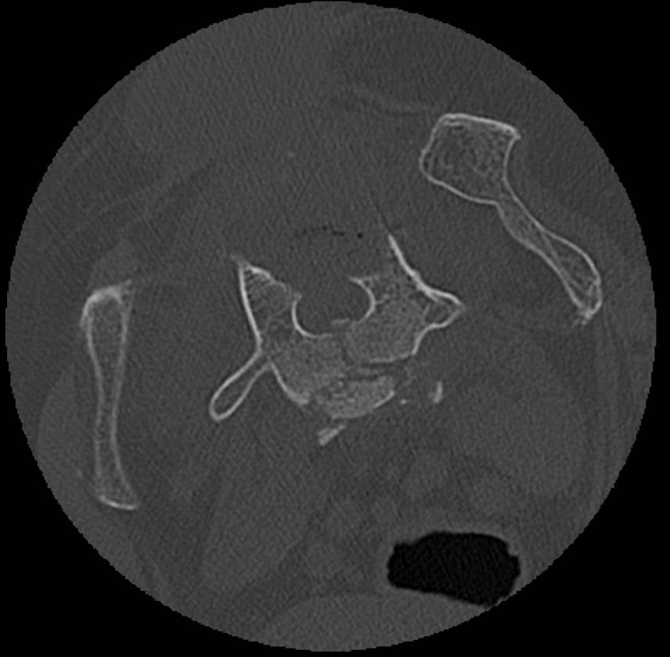
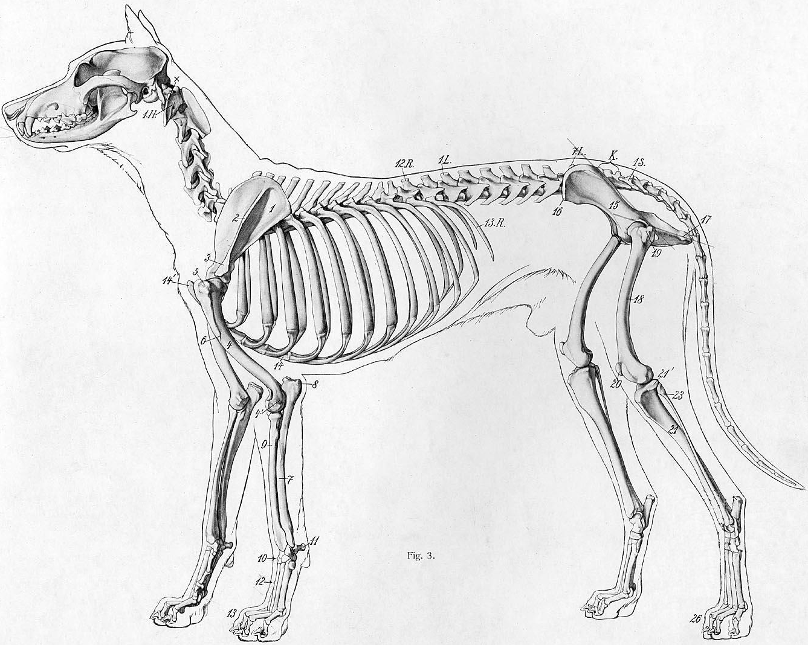
11 yr. GSD – PO Deterioration following L6-7, L7-S1 Dorsal Laminectomy – CT Spine
Bone
Axial

Slide 28
11 yr. GSD – PO Deterioration following L6-7, L7-S1 Dorsal Laminectomy – CT Spine
What abnormality(s) in the CT image are most concerning…

Slide 29
11 yr. GSD – PO Deterioration following L6-7, L7-S1 Dorsal Laminectomy – CT Spine
167261
What abnormality(s) in the CT image are most concerning…
  Comminuted fx of L7

Slide 30
11 yr. GSD – PO Deterioration following L6-7, L7-S1 Dorsal Laminectomy – CT Spine
167261
What abnormality(s) in the CT image are most concerning…
  Comminuted fx of L7
Given the appearance, what is your top differential?

Slide 31
11 yr. GSD – PO Deterioration following L6-7, L7-S1 Dorsal Laminectomy – CT Spine
167261
What abnormality(s) in the CT image are most concerning…
  Comminuted fx of L7
Given the appearance, what is your top differential?
  Trauma

Slide 32
#8

Slide 33
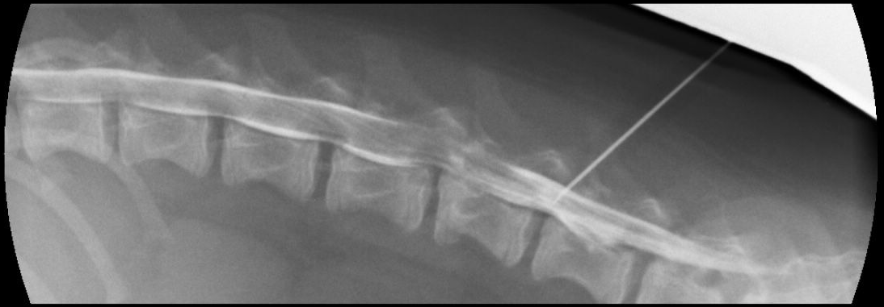
? yr. Mixed Breed – Trauma

Slide 34
? yr. Mixed Breed – Trauma
What abnormality(s) in the radiographic image are most concerning…

Slide 35
? yr. Mixed Breed – Trauma
172045
What abnormality(s) in the radiographic image are most concerning…
  At L4-5, the contrast ring is attenuated and a focal accumulation of contrast medium.
  In the cranioventral aspect of the body of L5, multiple thin fracture lines with no displacement are present.
Interpretation
  Extradural spinal cord compression secondary to traumatic intervertebral disk herniation at L4-5 or hematoma associated with the L5 fracture.
  The accumulation of contrast medium at L4-5 is attributed to traumatic dural tear or technical artifact (epidurogram).

Slide 36
#9

Slide 37
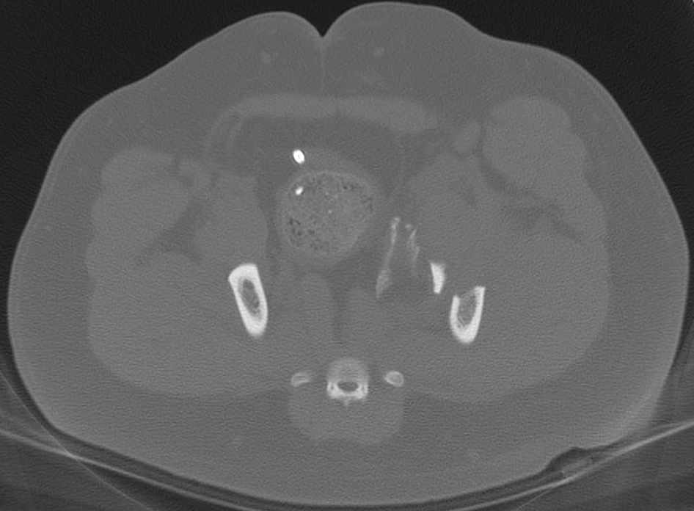
0.8 yr. Mixed – Trauma – CT Pelvis
Bone
Axial

Slide 38
0.8 yr. Mixed – Trauma – CT Pelvis
What abnormality(s) in the CT image are most concerning…

Slide 39
0.8 yr. Mixed – Trauma – CT Pelvis
188439
What abnormality(s) in the radiographic image are most concerning…
  In the left ilial body, a segmental, non-articular fracture is present extending just cranial to the left acetabulum. The segmental fracture fragment is moderately displaced medially.

Slide 40
#10

Slide 41
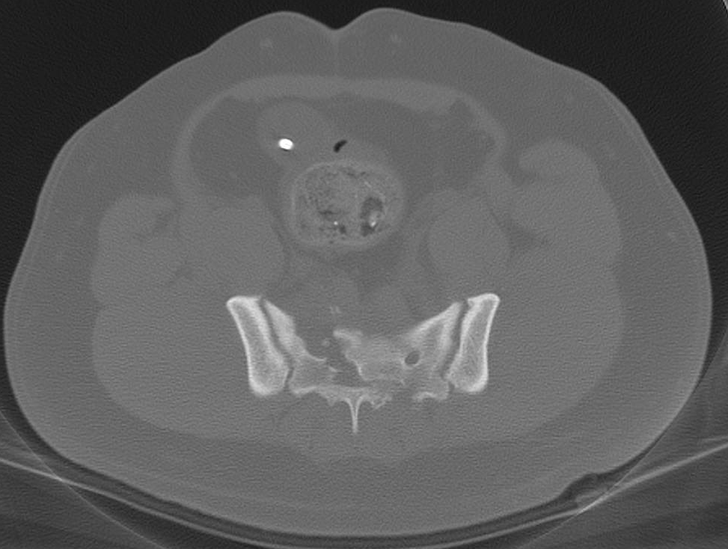
0.8 yr. Mixed – Trauma – CT Pelvis
Bone
Axial

Slide 42
0.8 yr. Mixed – Trauma – CT Pelvis
What abnormality(s) in the radiographic image are most concerning…

Slide 43
0.8 yr. Mixed – Trauma – CT Pelvis
188439
What abnormality(s) in the radiographic image are most concerning…
  Comminuted fx of the sacrum
    The fracture traverses all right sacral foramina with moderate (50%) rightward displacement of the sacral wing and lamina.
    The vertebral canal diameter is severely distorted and reduced in size.
    In and ventral to the fracture gap, several bone fragments are present.
    Ventral to the fracture site, the soft tissues are mildly swollen.

Slide 44
#11

Slide 45
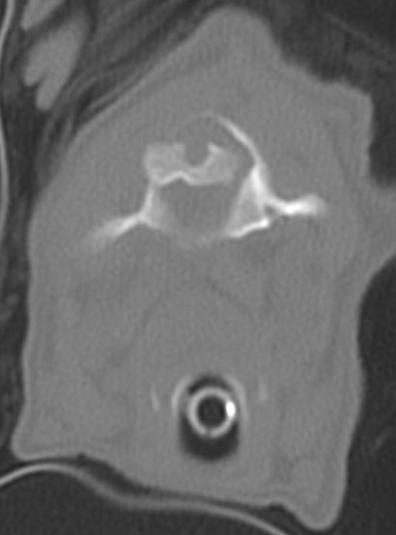
1 yr. Toy Poodle – Unk? Trauma – CT Neck
Bone
Axial

Slide 46
1 yr. Toy Poodle – Unk? Trauma – CT Neck
What abnormality(s) in the radiographic image are most concerning…

Slide 47
1 yr. Toy Poodle – Unk? Trauma – CT Neck
189835
What abnormality(s) in the radiographic image are most concerning…
  Severe atlantoaxial subluxation

Slide 48
#12

Slide 49
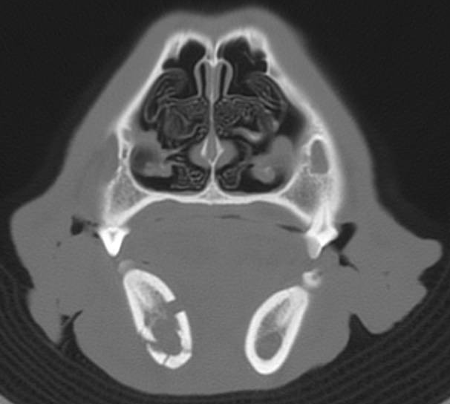
1.6 yr. Gldn Ret – Bat Trauma – CT Head
Bone
Axial

Slide 50
1.6 yr. Gldn Ret – Bat Trauma – CT Head
What abnormality(s) in the radiographic image are most concerning…

Slide 51
1.6 yr. Gldn Ret – Bat Trauma – CT Head
190826
What abnormality(s) in the radiographic image are most concerning…
  Comminuted, mildly-displaced fracture, right mandible

Slide 52
#13

Slide 53
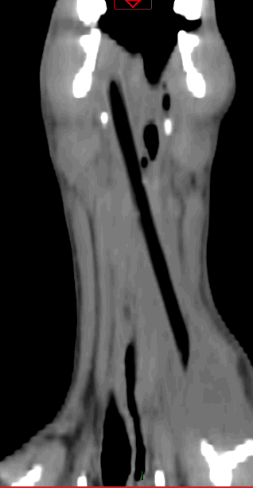
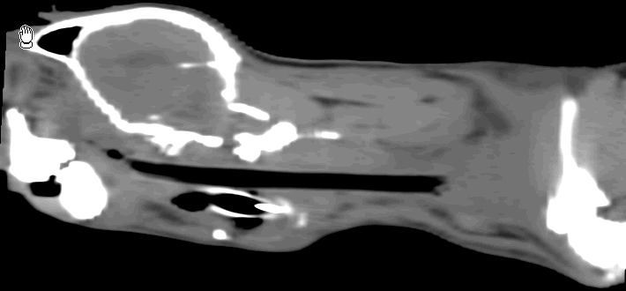
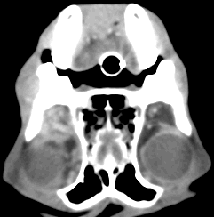
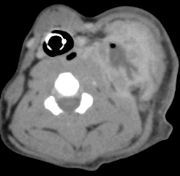
6 yr. Beagle – Poss. Trauma – CT Head

Slide 54
6 yr. Beagle – Poss. Trauma – CT Head
What abnormality(s) in the CT image are most concerning…

Slide 55
6 yr. Beagle – Poss. Trauma – CT Head
191866
What abnormality(s) in the CT image are most concerning…
  Extending from the right pharyngeal region to the level of C5 on the left, a large linear, hypodense object is present.
  The caudal end of this object is within 3 mm of the left internal carotid artery.
  At the cranial end of this object, a large soft tissue attenuating mass is seen that is peripherally contrast enhancing and displaces the soft tissues ventral to the right eye.
  At the caudal end, a larger soft tissue attenuating mass is seen that is peripherally contrast enhancing and distorts the left side of the neck.
  Surrounding the central portion of the object, the soft tissues are thick and are homogenously contrast enhancing.
  The course of the esophagus is not well delineated in the mid-neck.
Summary
  Retropharyngeal esophageal bulbar foreign body (reported stick)
  Abscess, caudal left cervical region
  Retrobulbar abscess, right eye

Slide 56
#14

Slide 57
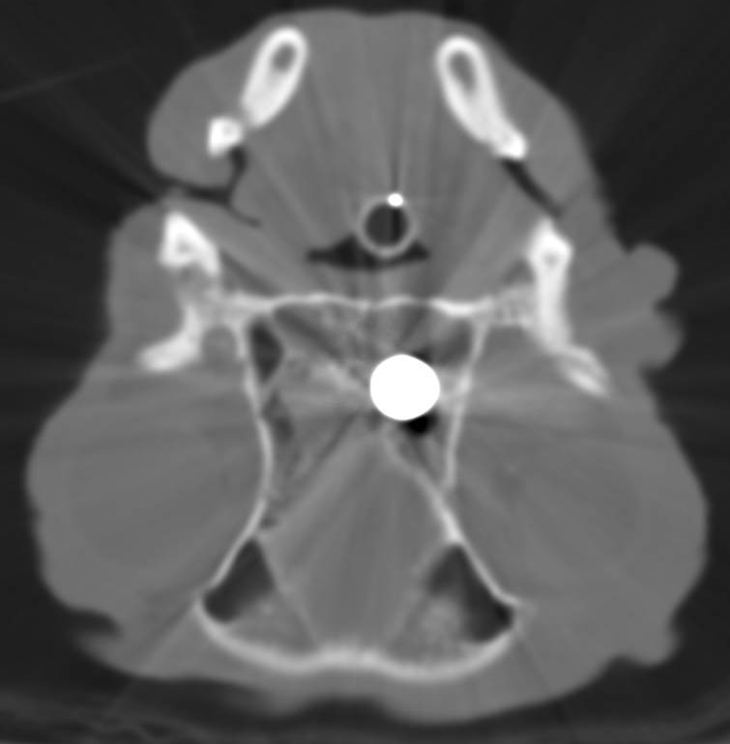
7.6 yr. Boston Terrier – Trauma – CT Head
Bone
Axial

Slide 58
7.6 yr. Boston Terrier – Trauma – CT Head
What abnormality(s) in the CT image are most concerning…

Slide 59
7.6 yr. Boston Terrier – Trauma – CT Head
194356
What abnormality(s) in the CT image are most concerning…
  In the left side of the nasal cavity, there is a large (3 cm) metal bullet
  The ventral portion of the nasal cavity and the nasopharynx contain fluid dense material

Slide 60
#15

Slide 61
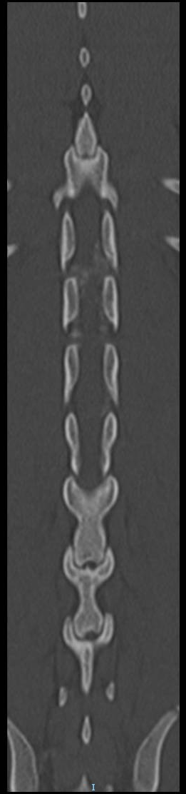
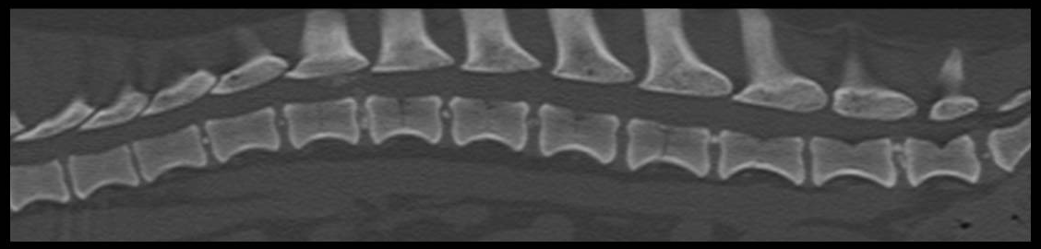
5 yr. Dachshund – Spine CT – T3-L3
Bone
Coronal / Sagittal

Slide 62
5 yr. Dachshund – Spine CT – T3-L3
199699
What abnormality(s) in the CT image are most concerning…

Slide 63
5 yr. Dachshund – Spine CT – T3-L3
What abnormality(s) in the CT image are most concerning…
  T13-L1, focal, extra-axial spinal lesion, herniated mineralized IVD, left

Slide 64
#16

Slide 65
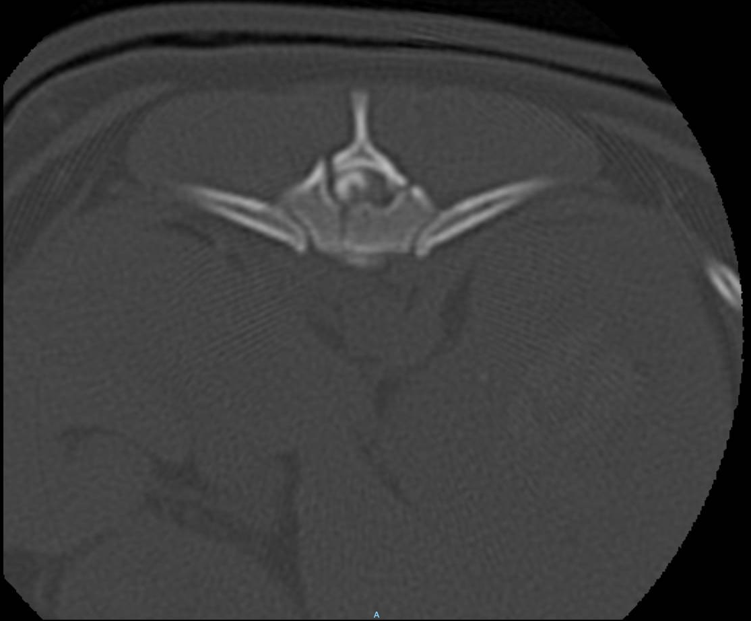
7.4 yr. Yorkie – Trauma – CT Spine

Slide 66
7.4 yr. Yorkie – Trauma – CT Spine
What abnormality(s) in the CT image are most concerning…

Slide 67
7.4 yr. Yorkie – Trauma – CT Spine
204067
What abnormality(s) in the CT image are most concerning…
  Comminuted fx of T12
  Intra-axial spinal cord enhancement
    Hemorrhage
    Myelomalacia
    Pre-existing syrinx

Slide 68
#18

Slide 69
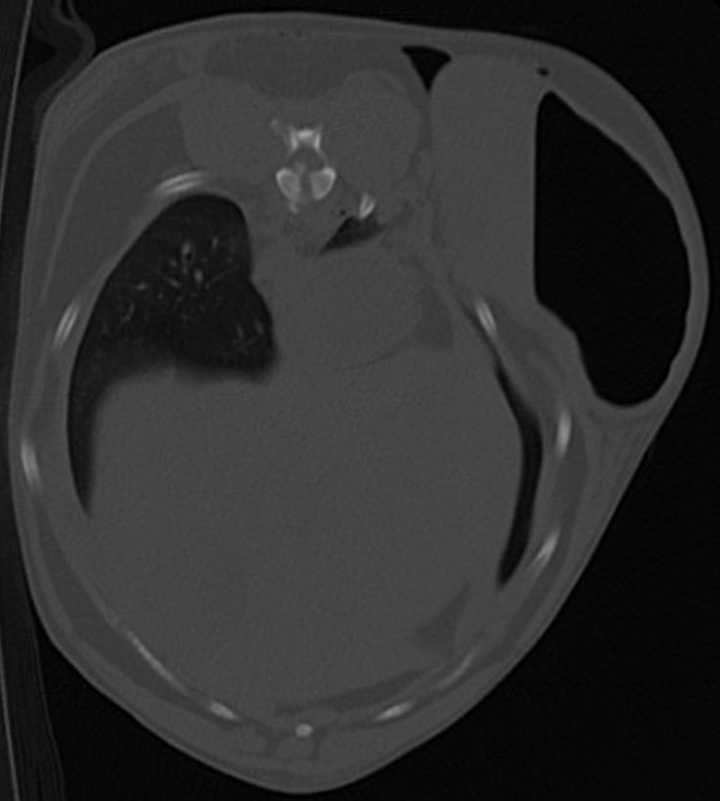
5.7 yr. Mixed Breed – Bite Trauma – CT Body

Slide 70
5.7 yr. Mixed Breed – Bite Trauma – CT Body
What abnormality(s) in the CT image are most concerning…
  T11 vertebral body fx
  Gastric herniation through left body wall with entrapment of the outflow tract
  SQ and intramuscular emphysema

