Slide 1
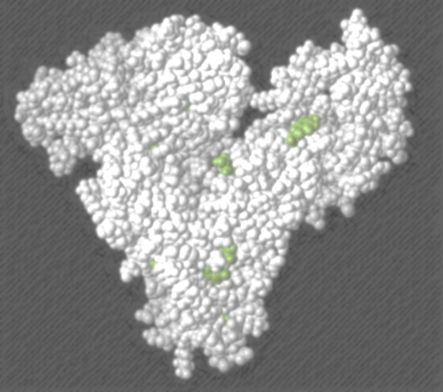
Albumin
April Blong
May 6, 2014
Cornell university

Slide 2
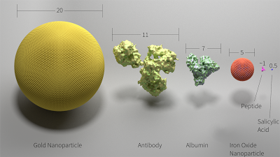
General characteristics
Most abundant extracellular protein
Single polypeptide
Strong negative charge
About 66 kDa in size
Half-life of ~20 days – humans
  Dogs 8.2 vs 1-2 weeks
http://crowsandcats.blogspot.com/2013/04/visualizing-size-in-biochemical-systems.html
Notes:
Strong negative charge of -17 to -19
Albumin is 65-69 kDa in size, 16 nm
IgG is 150kDa in size

Slide 3
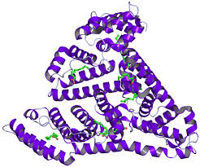
Highly soluble
Low viscosity
  Elliptoid shape
Can reversibly bind cations and anions
http://necat.chem.cornell.edu/Structures2/3UIV.html

Slide 4
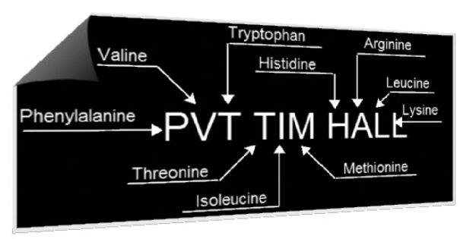
Composition
585 amino acids
Generally deficient in tryptophan
Excess aspartic and glutamic acid
35 cysteine residues
  17disulphide bonds
  One free at position 31
http://www.the-everydayathlete.com/uncategorized/protein_quality/

Slide 5
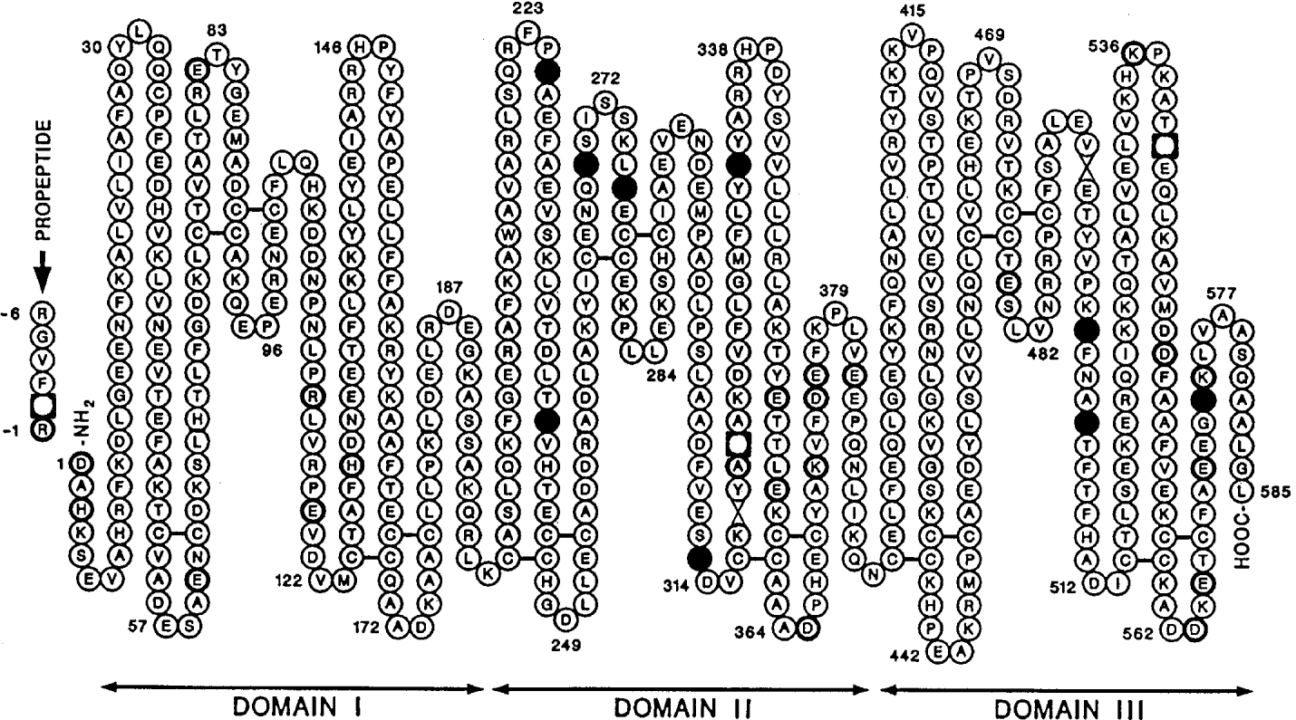
Notes:
585 amino acids

Slide 6

Production
Manufactured at 9-12 g/d
Only 20-30% of hepatocytes normally synthesize
Can increase synthesis 200-300%
After 3 yrs of age produce 130-200 mg/kg/d
No storage for release on demand

Slide 7
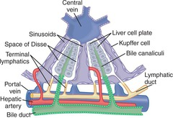
Intracellular use
  Synthesized by free polysomes in cytoplasm
Cellular export
  Synthesized by polysomes bound to endoplasmic reticulum
  Into sinusoids and vascular space
  Space of Disse and lymphatics
  Directly through the capsule into ascites

Slide 8
Elimination
Pinocytosed at rate equal to production
  Rate is related to ANP levels
  Uncertain where – adjacent to vascular endothelium of tissues
Not catabolized excessively during starvation
  Possibly because it is poor source of amino acids
  Initially derive amino acids from liver protein, then muscle

Slide 9
Control of production
*Osmoreceptors near the site of synthesis*
  COP and osmolality
  Extravascular liver space
  Increases in COP decrease synthesis immediately
    Albumin catabolism
Nutrition – nitrogen balance
  Consumes 6% of daily nitrogen intake
Disease states
Notes:
Under normal conditions this is principal regulator
Alb catabolism to prevent hyperoncotic state

Slide 10
Increased synthesis
Insulin – chiefly
Thyroxine
Cortisol
Testosterone
+/- Growth hormone
ACTH

Slide 11
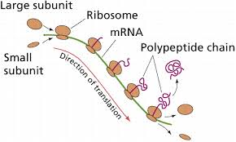
Decreased synthesis
Liver dysfunction
  Poor marker of liver function
Stress response
  Negative acute phase protein
  Later global synthesis increase
Decreased tryptophan levels inhibit polysomes on ER
Amino acid deficiency
Notes:
Many factors can alter albumin levels so poor marker of liver fx, PT is more reliable
IL6 directly decreases expression of albumin messenger mRNA
Leucine, argenine, isoleucine, and valine
Unclear if rate of synthesis can be increased by AA supplementation in absence of deficiency

Slide 12
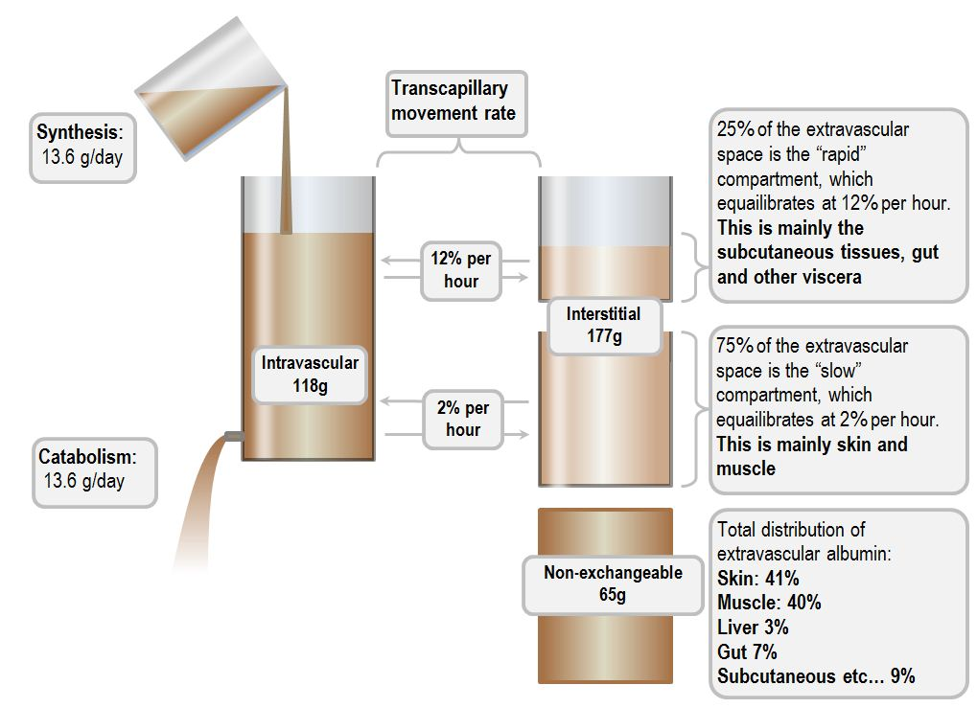
Transcapillary exchange rate
4-5% of albumin leaves intravascular space hourly
  Free albumin gradient
  Movement of solvents/solutes
  Transcapillary electrical charge
  Capillary permeability
Returns via lymphatics and thoracic duct
Albumin levels in lymph 80% of plasma

Slide 13
Albumin clearance dependent on lymphatic flow
  Interstitial fluid pressure
  Intrinsic pumping by lymphatic vessels
  Muscular contraction / external compression
Circulation half-life is 16-18 hours
Some extravascular albumin is bound to tissues and does not circulate
  Skin contains 30-40% of extravascular albumin
Notes:
Skin is only 6% of body weight.

Slide 14
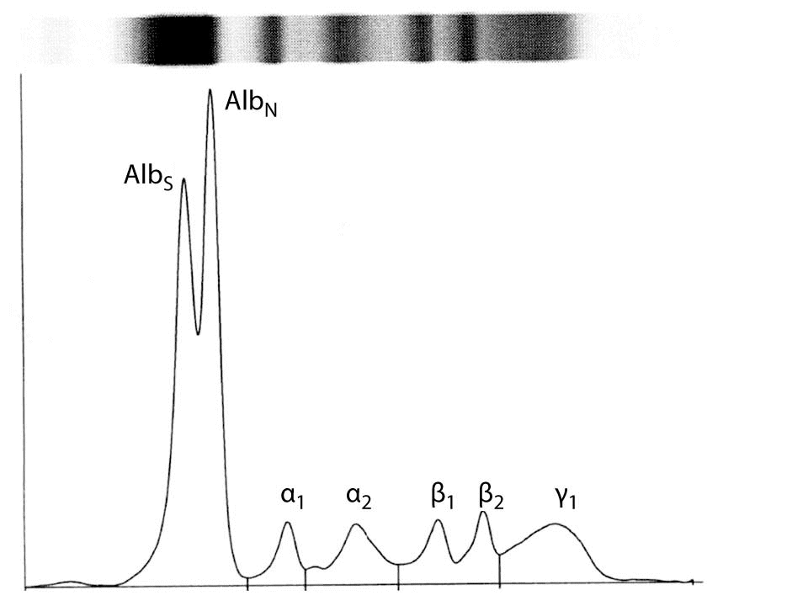
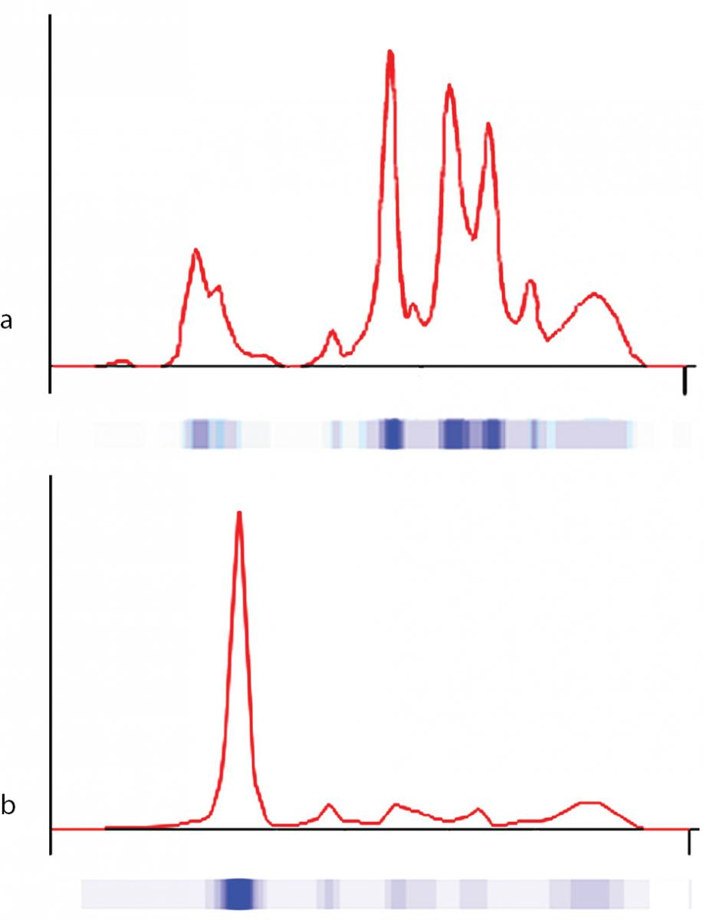
Allo-albumin
Bisalbuminemia
Analbuminemia
Evolved from ancestral gene 300-500 million years ago
Albumin located on chromosome 4
  Two autosomal co-dominant alleles
80 variants identified
  Most aclinical
Later modifications
http://www.biochemia-medica.com/content/
bisalbuminemia-male-croatian-patient-sarcoidosis
http://www.biochemia-medica.com/2014/24/151
Notes:
Later alpha-fetoprotein, Hgb, and myoglobin diverged
Bisalbuminemia – associated w/ drugs, pancreatitis, aging
Analbuminemia – common in pigs, rare in humans – about 18 families

Slide 15
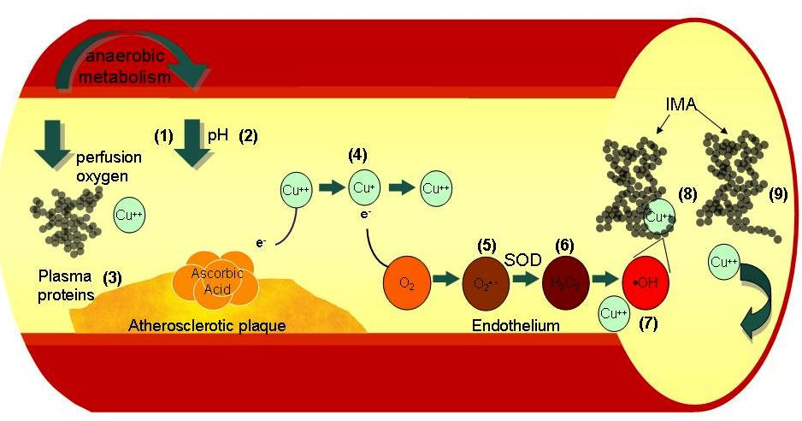
Ischemia-modified albumin
Myocardial ischemia
  Alterations in albumin occur within minutes of ischemic event
  Detectable for up to 6 hr post event
Changes in the NH2 terminus of albumin
  Endothelial/extracellular hypoxia, acidosis, free radical injury, Na and Ca pump disruptions
  Increase binding of transitional metals
  Can be assayed using cobalt binding test
Transitional metals increase ROS production
http://www.intechopen.com/books/ischemic-heart-disease/biomarkers-of-cardiac-ischemia.
Notes:
Current biomarakers such as cTnIonly increase after myocardial necrosis ensues
Trasitional metals – nickel, copper, cobalt
[1]Tissue hypoxia from anaerobic metabolism reduces ATP and causes a [2]lower localized pH inducing acidosis. [3]Cu⁺⁺ ions are released from plasma proteins such as caeruloplasmin. In the presence of ascorbic acid, [4]Cu⁺⁺ is converted to Cu⁺. Cu⁺ reacts with O₂ to form [5]O₂ •–. Superoxide dismutase dismutates the O₂ •– to [6]H₂O₂, which in presence of Cu⁺⁺ or Fe⁺, undergoes the Fenton reaction forming [7]OH •hydroxyl radicals. Free Cu⁺⁺ is scavenged by [8]HSA, where it binds tightly to the N-terminus. OH • radicals alter the amino acid N-terminus of [9]HSA rendering it incapable of binding Cu⁺⁺. These two altered forms are known as IMA.

Slide 16
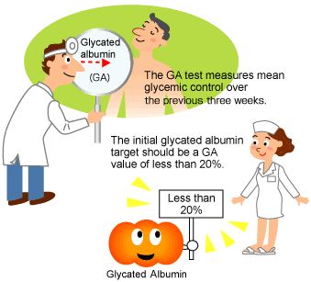
Glycated albumin
Nonenzymatic covalent attachment of glucose to lysine side-chains
  Hyperglycemia results in 2-5 times normal levels
  59 lysine residues that can form early stage glycation products
With glycated albumin free copper ions can generate free radicals
  May explain tissues damage associated with diabetes
  Glycation w/ high copper levels induces conformational changes
Notes:
Actual % of glycated alb varies by analytic method
Glycation alone has little effect on conformation, unclear how it alters function/drug binding

Slide 17
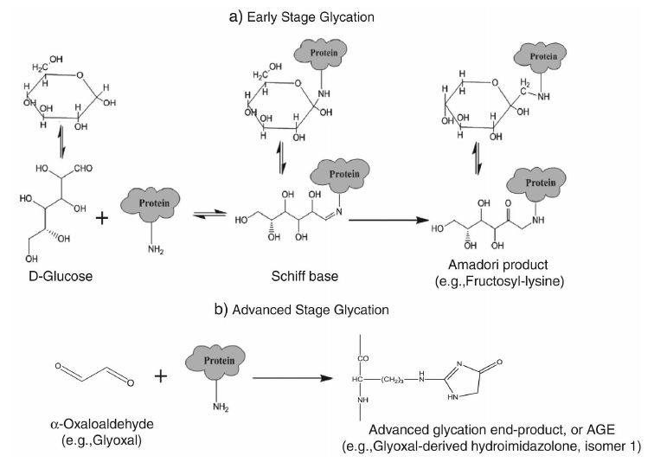
Advanced glycation end (AGE) products
  24 arginine residues that could form AGEs
AGE may bind to RAGE/TLRs to signal danger
  Gut derived lymph may trigger MODS
  Deitch, 2010
Sequelae of diabetes

Slide 18
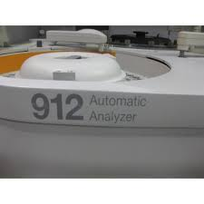
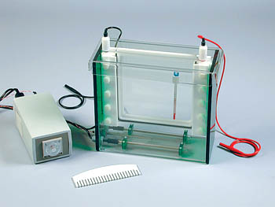
Laboratory methods
Measured using bromocresol green or purple
  Overestimates albumin
  Increased alpha or beta globulins can alter further
Electrophoresis to separate out plasma proteins
Notes:
Overestimates esp when levels are low

Slide 19
Glycated albumin
Measure glycated albumin directly
  Half-life 12-21 days
  Provides information about glucose control over past 2-3 weeks
Fructosamine
  All ketoamine linkages resulting from glycation of serum proteins
  90% glycated albumin

Slide 20
Physiologic Roles

Slide 21
Maintenance of COP
Represents 50% of plasma protein
Responsible for 70-80% of intravascular oncotic pressure
Most albumin is extravascular
Intravascular
  ~ 120 g
  4 g/dL
Extravascular
  ~ 160 g
  1.4 g/dL
COP gradient that is important
Distinguishes capillary leak vs deficiency
Notes:
Oncotic pressure = osmotic pressure exerted by colloids

Slide 22
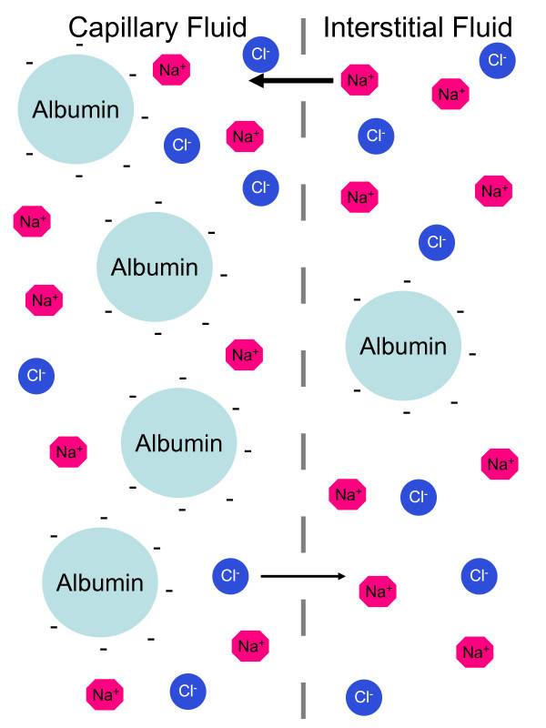
2/3 is direct osmotic effect
  Number of particles
  Small relative to other plasma proteins
1/3 is Gibbs-Donnan effect
  Large negative charge attracts positive molecules
http://www.ijponline.net/content/35/1/36/figure/F3

Slide 23
Binding and transport
Binding to albumin reduces serum concentration
  4 binding sites
  Relevance of low albumin on drug binding is unknown
Transports many substances
  Cholesterol, nitric oxide, bile pigments, fatty acids, metals
Interacts with drugs
  NSAIDs, midazolam, digoxin, thiopental, phenytoin
Notes:
2 sudlow sites are major binding areas for drugs -

Slide 24
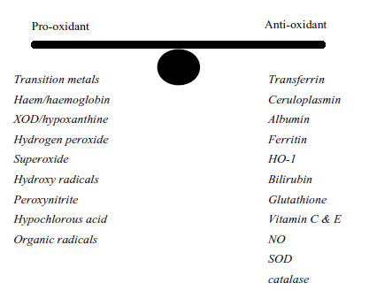
Free radical scavenging
Binds free Cu²⁺
  Limits further production of reactive species
Major extracellular source of thiols (sulphydryl groups)
  Scavenge ROS & RNS
  1 free cysteine residue
Administered albumin raises plasma thiol long after it is cleared

Slide 25
Inflammation / Permeability
HES decreases ET activation relative to albumin in vitro
Neutrophil oxidative burst increased with HES but not albumin
  Suppresses respiratory burst in response to TNF and C’5a
  Inhibits TNF induced neutrophil spreading
Directly influences permeability to large molecules and solutes
Possibly indirectly by binding arachidonic acid
Notes:
Binds to interstitial matrix and subendothelium

Slide 26
Commercial Production and
Clinical Use

Slide 27
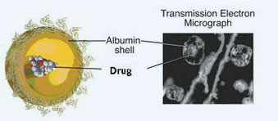
Nanoparticle albumin-bound technology
40% of drugs belong to biopharmaceutical class II or IV
  Poor aqueous solubility is a barrier in drug delivery
  Majority of effective anti-cancer agents belong to these classes
Encapsulating drug in albumin nanoparticle improves solubility
  Paclitaxel
  Can pass through leaky junctions in tumor beds more easily
  Tumor delivery via receptor mediate transcytosis
    Binding to secreted protein acidic & rich in cysteine (SPARC) on tumor
http://www.celgenecanada.net/en/research/nab-technology.aspx
Notes:
Class 2 = low solubility, high permeability,
Class 4 = low solubility, low bermeability

Slide 28
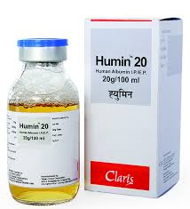
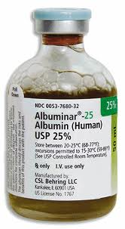
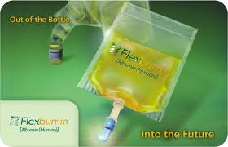

Commercial albumin
Used in greater volume than any other biopharmaceutical solution available¹
Pasteurized at 60° C for 10 hours
All products ≥ 95% pure albumin
4-5% solution considered isotonic/osmotic
20-25% solution is hypotonic but hyperoncotic
Reactions rare – 1 in 6600 (McClelland, 1990)
1. Matejtschuk, BJA, 2000
Notes:
100;s of tonnes
Isotonic – volume resuscitation
Hyperoncotic - hypoalbuminemia

Slide 29
Adverse reactions
Viral transmission is rare
Allergic reactions rare
  Febrile – endotoxin
  Hypotension – prekallikrein activator
  Hypersensitivity when haptens bind with albumin
Negative inotropy
  Calcium binding?
Plasma volume increases linearly with albumin administration
  Risk of fluid overload
Notes:
Kills HIV, Hep a, b, c… inactivates lipid enveloped and nonenveloped viruses
Allergic reactions – contaminants or polymers
Prekallikrein was more common in plasma protein fraction
Patients resuscitated with albumin need more inotropic support and diuresis than patients resuscitated with crystalloids

Slide 30
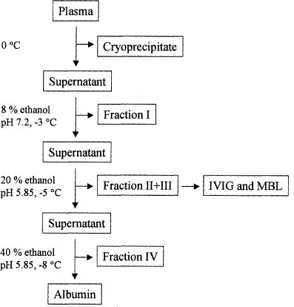
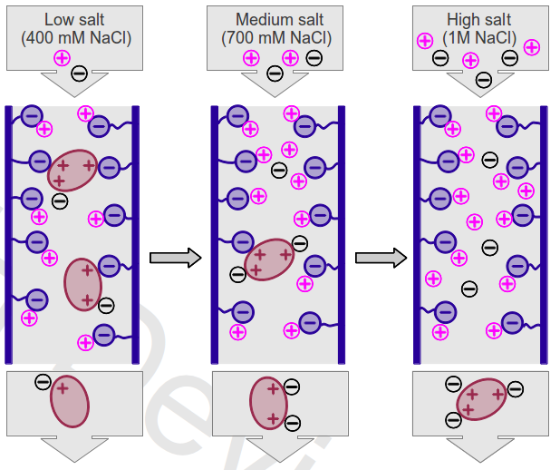
Production
Cold ethanol fractionation
  65% yield, 95% pure
Chromatographic methods
  85% yield, >98% pure
  Less damaging?
Transformed rice cell culture
α & β globulins
http://www.reachdevices.com/Protein/ProteinPurification.html0
http://www.biochemsoctrans.org/bst/031/0758/bst0310758f01.htm
Notes:
Cold ethanol fractionation – because of disulfide bonds is relatively stable and is recovered relatively undamaged

Slide 31
Clinical uses
Shock / volume resuscitation
Hypoalbuminemia
  Burns
  GI disease
  Cirrhosis
    Prevention of circulatory dysfunction after large paracentesis
  Nephrotic syndromes
Plasmapheresis
Graft vs host disease
Malnutrition / protein deficiency

Slide 32
“…its administration is often inappropriate, largely because of a common
belief in its efficacy, whereas many indications are still under debate or
have been disproved by evidence-based medicine.”¹
40-70% of albumin is used for inappropriate reasons²
No evidence that correcting hypoalbuminemia improves outcome³
Bernardi, Crit Care, 2012
Doweiko, JPEN, 1991
CCM tutorials

Slide 33
Literature reviews
Cochrane Injures Group Albumin Review – HSA in critically ill patients, 1998
  30 RCTs w/ 1419 patients
  Pooled difference in risk of death with albumin 6% (3-9 %)
  For 17 critically ill patients treated with albumin there is one additional death
Colloids vs crystalloids in critically ill, 2013
  24 trials with 9920 patients
  RR 1.01 (0.93-1.10)
Colloid solutions for fluid resuscitation, 2012
  31 trials with 1719 patients
  RR of albumin vs HES 1.06 (0.86-1.31)
HSA for resuscitation / volume expansion in critically ill, 2011
  RR for treating hypoalbuminemia 1.02 (0.92-1.13), burns 2.93 (1.28-6.72)
**Even if no decrease in risk of death, why use a more expensive product

Slide 34
Veterinary literature
Francis, JAVMA, 2007
  7 healthy dogs given albumin to assess coagulation effects
  1 dog immediate hypersensitivity, 6 delayed hypersensitivity (2 died)
  All 6 developed anti-HSA antibodies
Powell, JVECC, 2013
  2 critically ill patients received HSA, developed Type III reaction 8-16 d later
  Vasculitis – edema, hemorrhage, neutrophilic perivascular infiltrates
  IHC demonstrated HSA in ag-ab complexes
  Both survived with pred and other meds
Notes:
Pentoxyphylline and diphenhydramine

Slide 35
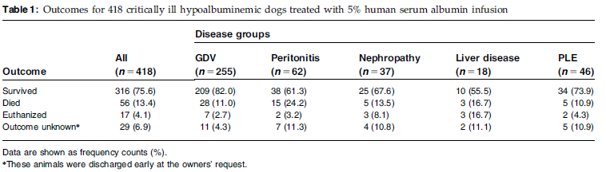
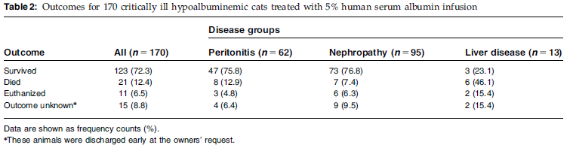
Trow, JAVMA, 2008
  73 critically ill dogs received 25% albumin
  23% had at least one possible complication during, w/i 24 hours
  4% had severe delayed complications
Vigano, JVECC, 2010
  418 dogs, 170 cats, critically ill, given for hypoalbuminemia
  Given 5% albumin at 2 ml/kg/hr for 10 hours per day until alb reached 2.0 (2-11d)
  No hypersensitivity, some minor reactions (diarrhea, hyperthermia)
  75.6% of dogs survived, 72.3% of cats survived
Notes:
Increase in vitals, edema, arrhythmia, new coagulopathy, 4 had cardiac arrest, no fulminant anaphylaxis
Minor reaction in 43% dogs, 36% cats – none that necessitated stopping transfusion, no reactions beyond day 3
NO follow up for delayed reactions
Safer than 25%???

Slide 36
Martin, JAVMA, 2008
  14 critically ill dogs, 2 healthy dogs that received albumin
  47 healthy, 21 ill dogs that did not receive albumin
  All dogs that received albumin developed IgG
  7% of dogs that did not receive albumin had IgG

Slide 37
References
CCM tutorials (http://www.ccmtutorials.com/misc/albumin/page_01.htm)
Doweiko JP, Nompleggi DJ. Use of Albumin as a volume expander. JPEN 1991; 15(4): 484-7.
Tullis JL. Albumin, 1. Background and Use. JAMA 1977; 237 (4): 355-360.
Tullis JL. Albumin, 2. Guidelines for clinical use. JAMA 1977; 237 (5): 460-3.
Evans TWl, Review article: albumin as a drug – biological effects of albumin unrelated to oncotic pressure. Aliment Pharmacol Ther 2002; 16 (S5): 6-11.
Abel FL, Wolf MB. Increased capillary permeability to ¹²⁵I-labeled albumin during experimental hemorrhagic shock. Transaction New York Academy of Sciences 1973; 35 (3): 243-52.
Christenson RH, Duh SH, Sanhai WR, et al. Characteristics of an albumin cobalt binding test for assessment of acute coronary syndrome patients: a multicenter study. Clinical chemistry 2001; 47 (3): 464-70.
Rothschild MA, Oratz M, Schreiber SS. Albumin synthesis (First of two parts). NEJM 1972; 286 (14): 748-757.
Rothschild MA, Oratz M, Schreiber SS. Albumin synthesis (Second of two parts). NEJM 1972; 286 (15): 816-21.
Coussons PJ, Jacoby J, McKay A, et al. Glucose modification of human serum albumin: a structural study. Free Radical Biology & Medicine 1997; 22 (7): 1217-27.
Anguizola J, Matsuda R, Barnaby OS, et al. Review: Glycation of human serum albumin. Clinica Chimica Acta 2013; 425: 64-76.
Bernardi M, Maggioli C, Zaccherini G. Human albumin in the management of complications of liver cirrhosis. Crit Care 2012; 16: 211.
Matejtschuk P, Dash CH, Gascoigne EW. Production of human albumin solution: a continually developing colloid. British J Anaes 2000; 85 (6): 887-95.

Slide 38
Cochrane Injuries Group Albumin Reviewers. Human albumin administration in critically ill patients: systematic review of randomized controlled trials. BMJ 1998;317:325-40.
Perel P, Roberts I, Ker K. Colloids versus crystalloids for fluid resuscitation in critically ill patients. Cochrane Database Syst Rev 2013; 28 (2)
Bunn F, Trivedi D. Colloid solutions for fluid resuscitation. Cochrane Database Syst Rev. 2012; 11 (7):
Roberts I, Blackhall K, Alderson P, et al. Human albumin solution for resuscitation and volume expansion in critically ill patients. Cochrane Database Syst Rev 2011; 9:
Fu Q, Sun J, Zhang W, et al. Nanoparticle albumin-bound (NAB) technology is a promising method for anti-cancer drug delivery
Doweiko JP, Nompleggi DJ. Reviews: Role of albumin in human physiology and pathophysiology. JPEN 1991; 15: 207-211
Deitch EA. Gut lymph and lymphatics: a source of factors leading to organ injury and dysfunction. Ann NY Acad Sci. 2010; 12007 (S1): E103-111.
Powell C, Thompson L, Murtaugh RJ. Type III hypersensitivity reaction with immune complex deposition in 2 critically ill dogs administered human serum albumin. JVECC 2013; 23 (6): 598-604.
Francis AH, Martin LG, Haldorson GJ, et al. Adverse reactions suggestive of type III hypersensitivty in six healthy dogs given human albumin. JAVMA 2007; 230(6): 873-9.
Martin LG, Luther TY, Alperin DC, et al. Serum antibodies against human albumin in critically ill and healthy dogs. JAVMA 2008; 232 (7): 1004-9.
Vigano F, Perissinotto L, Bosco VR. Administration of 5% human serum albumin in critically ill small animal patients with hypoalbuminemia: 418 dogs and 170 cats (1994-2008). JVECC 2010; 20 (2): 237-243.
Trow AV, Rozanski EA, deLaforcade AM, et al. Evaluation of use of human albumin in critically ill dogs: 73 cases (2003-2006). JAVMA 2008; 233: 607-612.

Slide 39
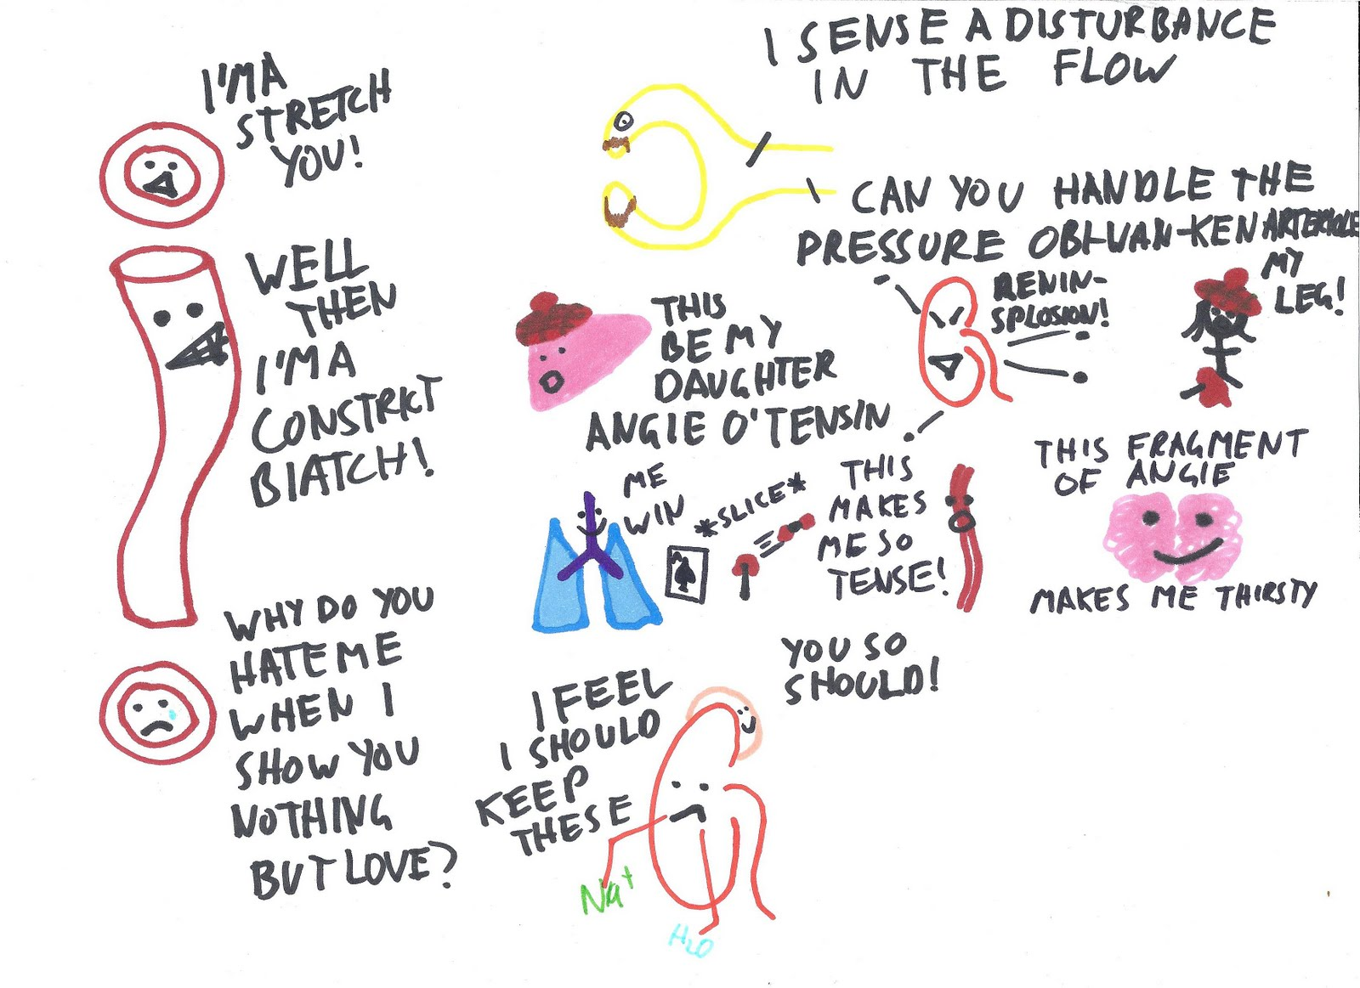

Questions

