Slide 1
Acute respiratory distress syndrome
Ventilator Management Review
Jillian DiFazio, DVM
Emergency and Critical Care Resident
Cornell University Hospital for Animals

Slide 2
Case
4 year old Labrador Retriever
Presented for a 3 day history of progressive lethargy, inappetance and vomiting
Initial diagnostics reveal necrotizing pancreatitis, SIRS, aspiration pneumonia

Slide 3
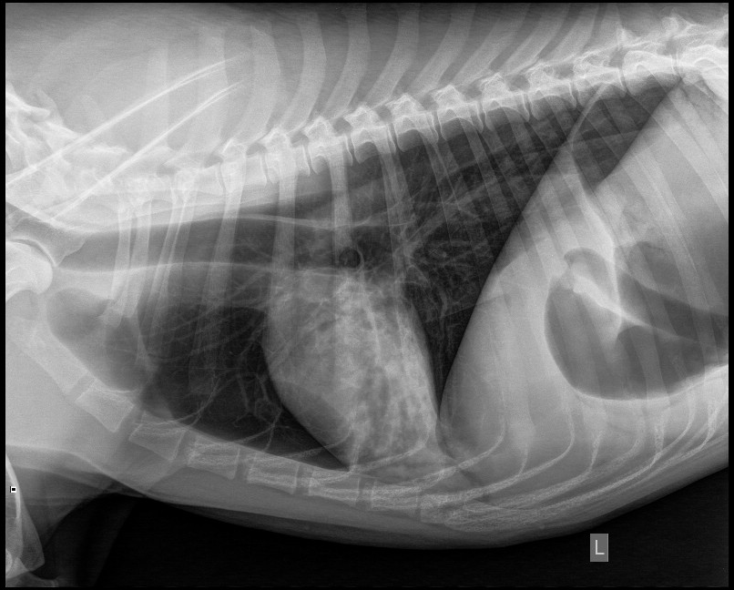
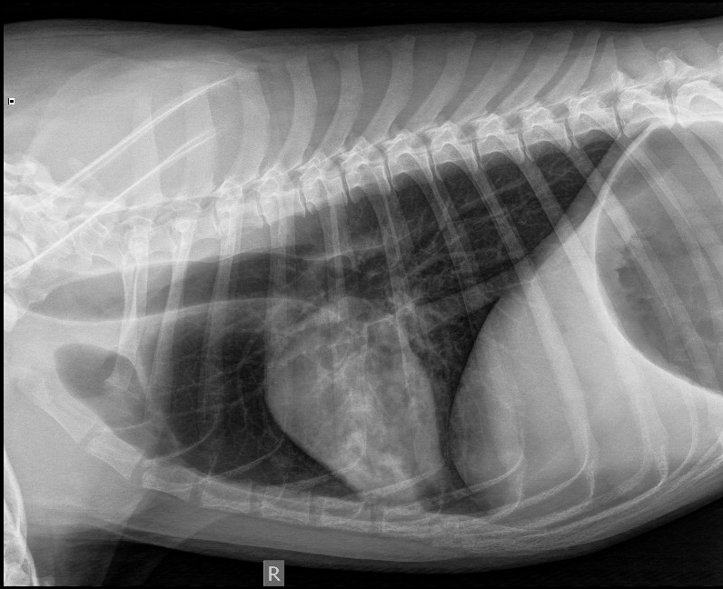
Case
Chest radiographs

Slide 4
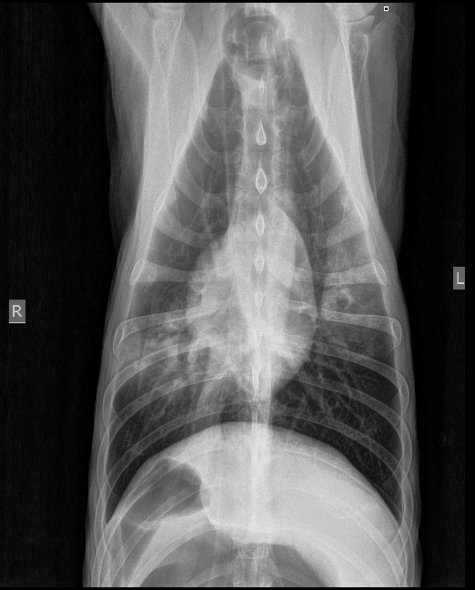
Case
Chest radiographs

Slide 5
Case
Patient did well over the initial 24 hours of hospitalization
  Treated with IVF, analgesics, broad spectrum antibiotics, gastroprotectants, antiemetics, early enteric feeding
  HR=80-120, intermittent uniform VPCs noted
  RR=30-40, eupneic
  Temperature: 100.5-102 degrees F
  BP=120-150 (systolic), 80-100 (MAP)
  Pulse ox=94-96% off of oxygen
  Comfortable
  No vomiting/regurgitation; gastric residuals ~ 40mL/hr

Slide 6
Case
One day later….

Slide 7
Case
Initial assessment in the morning revealed significant tachypnea and increased respiratory effort
Auscultation fine crackles heard bilaterally diffusely
Pulse ox=88%, FIO2=21%; 93%, FIO2=50%

Slide 8
Case
Arterial blood gas
  pH=7.351
  pCO2=60.3
  HCO3=32.6
  BE=7
  AG=8.2
  Na=140.7
  K=4.09
  iCa=1.29
  Cl=104
  Glucose=143
  Hct=40%
  FIO2=30%
  PaO2=59mmHg
  O2Sat=88.7%

Slide 9
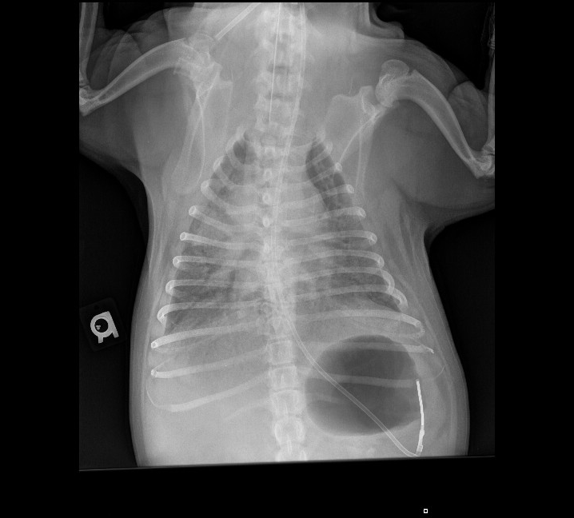
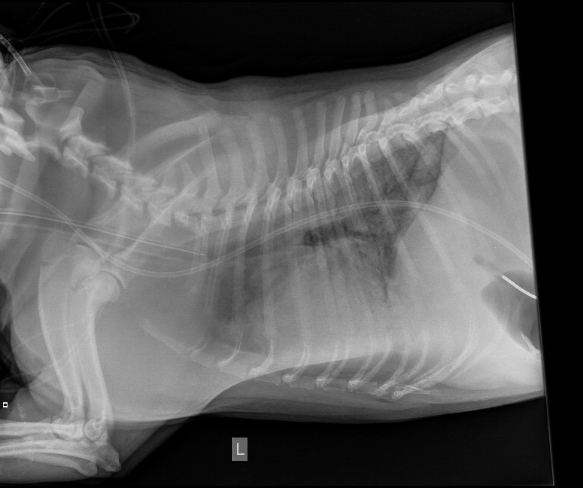
Case
Chest radiographs

Slide 10
Question
What are the criteria for ALI/ARDS?

Slide 11
Answer
Acute onset
Severe hypoxemia
  ALI- P/F<300
  ARDS- P/F<200
Bilateral pulmonary infiltrates
No clinical evidence of left atrial hypertension (PAOP<18)

Slide 12
Question
What are your criteria for initiating mechanical ventilation?

Slide 13
Answer
Fatigue
Hypoxemic respiratory failure
Ventilatory respiratory failure
Combination of any of the above
Notes:
Due to concerns over persistent refractory hypoxemia, significant hypoventilation and respiratory fatigue, you elect to begin mechanical ventilation.

Slide 14
Case
What drugs are you going to use for sedation?
Are there any specific concerns for the patient with ALI/ARDS?

Slide 15
Sedation in ALI/ARDS
Neuromuscular blockade
  Due to lung protective strategies, mechanically ventilated patients can have issues with air hunger and increased respiratory drive
  In order to minimize patient-ventilator dysynchrony, surveys reveal 25-55% ARDS patientsreceive adjuvant NMB
Azoulay 2014
Notes:
Study documented that early deep sedation was independently associated with longer time to extubation, longer lengths of hospitalization and higher 180 day mortality
Shehabi et al. replicated the ANZ SPICE study design in 11 Malaysian ICUs to assess whether early sedation depth was independently associated with delayed extubation and increased mortality. They performed a prospective multicenter study that included 259 medical/surgical patients who were sedated and ventilated for at least 24 h.
Guidelines regarding the use of NMBAs in the ICU typically caution that they should be limited to refractory hypoxemia and hypercarbia and should be short-term and guided by tran-of-four monitoring.
There is some suggestion that NMBAs negatively affect both morbidity and mortality in critically ill patients d/t risks associated with (i.e. ICU-acquired weakness)
Gainnier et al showed that a 48 hour infusion of cisatracurium in ARDS was associated with an increase in arterial partial pressure of oxygen (as compared with placebo) and this increase was sustained for 120 hrs (study only included 56 patients in 4 centers and was not powered adequately for mortality though the authors did report a non-signficiant trend toward decreased ICU stay and decreased 28 day mortality favoring cisatracurium).
In a follow-up study, Forel et al used a similar study design and found that early use of cisatracurium infusion in ARDS also decreased serum and pulmonary concentrations of pro-inflammatory markers when compared with control.

Slide 16
Sedation in ALI/ARDS
Neuromuscular blockade
  ACURASYS trial
    Neuromuscular blockers in early acute respiratory distress syndrome
      Papazian L, Forel JM, Gacouin A, et al.
      New England Journal of Medicine 2010; 363: 1107-1116
    90 day mortality reduced in cisatracurium group in those patients with a PF<120
    28 day mortality lower in cisatracurium group
    Cisatracurium group had more ventilator-free days, more days outside of ICU and more organ-failure-free days
    Pneumothorax developed more frequently in placebo group
    Comparable incidence of ICU-acquired weakness
Papazian 2010
Needham 2012
Notes:
Objective- Compare survival in adult patietns with early ARDS who were randomized to receive either a 48 hour infusion of NMBA, cisatracurium, or placebo.
Study was multicentre double-blinded randomized controlled trial involving 20 ICUs in France from March 2006-March 2008.
Patients- >18 y/o intubated and ventilated for acute hypoxemic respriatory failure. PaO2/FIO2<150 at tidal volume 6-8ml/kg ideal body weight and PEEP>/=5 cm H20 for <48hrs. Additional inclusion criterial- radiographic evidence of bilateral pulmonary infiltrates and absence of left atrial hypertension. Exclusion- patients already receiving NMBA at enrollment, those who had increased ICP, severe chronic resp disease, severe chronic liver disease, those who had received BM transplant or had chemo-induced neutropenia, those who had pneumothorax, and those who were expected to req MV for <48hrs or were enrolled in another trial within 30 days.
Intervention- 340 underwent randomization in blocks of four and received either 48 hour infusion of cisatracurium or volume equivalent placebo
178 patients received cisatracurium (1 withdrew- 177 analysis). 162 received placebo. Prior to infusion, patients sedated to Ramsay sedation score 6. Ventilated by volume assist-controlled mode according to ARDS net mechanical ventilation protocol with a goal SPO2=88-95% or PaO2=55-80mmHg, goal plateau pressure </=35cmH20. Open-label boluses of cisatracurium 20mg were allowed if plateau pressures remained >32cmH20 despite increased sedation and despite decreased PEEP and deceased tidal volumes
Measurements- primary outcome death before hospital discharge and within 90 days of study enrollment. Secondary outcomes included 28 day mortality, number of vent-free days, number of days outside of ICU, number of days without organ system failure, rate of barotrauma dn rate of ICU-acquired paresis on day 28 and at ICU discharge
Main results- Post-hock analysis found a reduction in 90 day mortality in the cisatracurium group compared with placebo. Reduction in 90 day mortality was confined to those patients with a PF ratio <120. Additionally 28 day mortality was significantly lower in cisatracurium group (P=0.05). Cisatracurium group also had significantly more vent-free days, more days outside of ICU and more organ-failure-free days. Pneumo developed more often and earlier in placebo group than cisatracurium, group. Rate of ICU-acquired weakness at day 28or at ICU discharge did not differ significantly between the two groups.
Conclusions- treatment in early severe ARDS with NMBA, cisatracurium, for 48 hours was associated with lower adjusted 90 day mortality.
Issues with study- twice as many patients in placebo group received NMBA boluses in the first 48 hours. Total dose was still significantly higher in cisatracurium-treated group.
Protocol allowed for wide variations of PEEP. Might confound data, but PEEP was not documented to differ between groups at baseline, 24 hr, 72 hr.
Comparatively high doses of NMBA were used.

Slide 17
Case
Administer fentanyl, midazolam, propofol to effect
CRIs of fentanyl, midazolam, propofol
  Titrated to effect
Early neuromuscular blockade with vecuronium

Slide 18
Case
What are your initial ventilator settings?

Slide 19
Case
Initial ventilator settings?
  FIO2?
  Volume vs. pressure-control?
  Mode of ventilation?
    Assist/control?
    SIMV?
    CPAP?
    Pressure support?
Dog weighs 32kg

Slide 20
Case
Initial ventilator settings
  If volume….
    Tidal volume?
    Trigger?
    RR?
    I:E?
    Inspiratory time?
    PEEP?
  If pressure….
    PIP?
    Trigger?
    RR?
    I:E?
    Inspiratory time?
    PEEP?

Slide 21
Modes of ventilation
Define
  Controlled ventilation
  Assist/control
  SIMV
  CPAP
  Pressure support

Slide 22
Modes of ventilation
Controlled: Respiratory rate and characteristics of breath determined by ventilator
Assist/control: Minimum respiratory rate is determined by the ventilator. If the trigger sensitivity is set appropriately, the patient can increase the RR, but all breaths delivered will be full ventilator breaths.
SIMV: Minimum respiratory rate is determined by the ventilator. Between breaths, the patient can breathe spontaneously. The ventilator tries to synchronize breaths with the patient’s inspiratory effort.
CPAP: Spontaneous mode of ventilation. The operator can only control the baseline airway pressure during both inspiration and expiration.
Pressure-support: Spontaneous mode of ventilation. The operator augments the tidal volume of spontaneous breaths.
  Used in conjunction with CPAP or to support spontaneous breaths in SIMV
Notes:
Controlled vent- no allowance for spontaneous breaths
SIMV- attempt to prevent breath stacking
Pressure support- For example, a patient has a PSV of 6 cm H₂O. This patient will begin and end inspiration, and the ventilator will maintain a pressure of 6 cm H₂O in the airway during this inspiration; this effectively provides the patient with a greater tidal volume for less patient effort. Pressure support ventilation is generally used in conjunction with CPAP or to support the spontaneous breaths in SIMV

Slide 23
Question
What are the advantages of volume-controlled ventilation?
What are the disadvantages of volume-controlled ventilation?

Slide 24
Answer
Main advantage:
  Guarantees specific volume delivery regardless of change in lung compliance and resistance/patient effort
Disadvantages:
  Can result in barotrauma
  Other disadvantages can be related to patient-ventilator asynchrony (inadequate flow/sensitivity settings)
Notes:
Minimizes volutrauma

Slide 25
Question
What will happen if while on volume-cycled ventilation, the patient’s lung compliance decreases?

Slide 26
Answer
PIP will increase

Slide 27
Question
Draw the flow, pressure and volume scalars associated with volume-controlled ventilation.

Slide 28
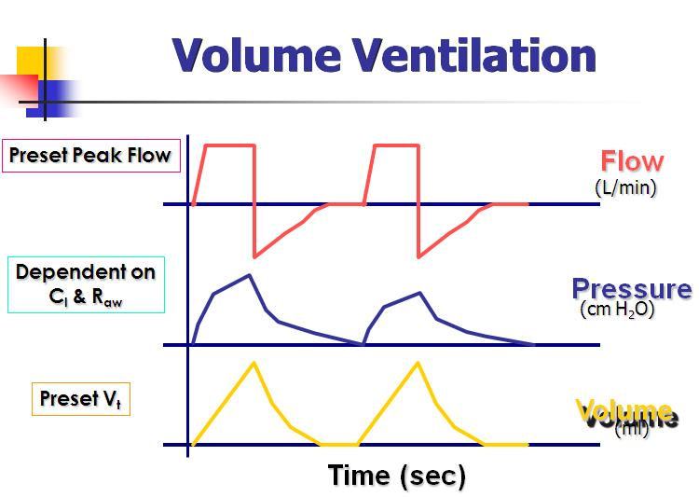
Answer
Notes:
When a ventilator maintains the volume waveform in a specific pattern the delivered breath is volume-controlled. The volume and flow waveforms remain unchanged but pressure waveform will vary with change in lung characteristics.
Flow waveform provided does not change shape during inspiration, even ith changes in lung characteristics
Flow waveform remains the same breath to breath
Volume delivery remains constant as long as breath is volume cycled

Slide 29
Question
What are the advantages of pressure-controlled ventilation?
What are the disadvantages of pressure-controlled ventilation?

Slide 30
Answer
Advantages of pressure-controlled ventilation:
  Allows clinician to set maximal pressure
    Decreased risk of barotrauma
  Improved patient comfort when spontaneously breathing (flow-pattern is decelerating as opposed to constant)
Main disadvantage:
  Volume delivery varies
    Risk for volutrauma
    Risk for hypoventilation
Notes:
Thereby reducing barotrauma

Slide 31
Question
Draw the flow, pressure, and volume scalars associated with pressure-controlled ventilation.

Slide 32
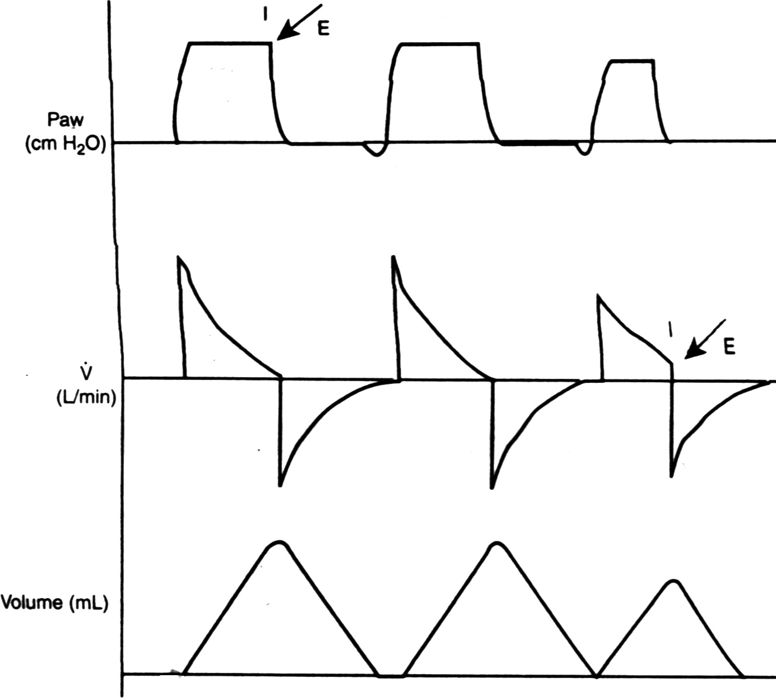
Answer
Notes:
Pressure waveform is rectangular (constant)
Pressure waveform not affected by changes in lung characteristics or patient flow demand
Rate of flow delivery varies with changes in patient’s lung characteristics, set pressure and inspiratory effort
Flow rises rapidly at the beginning of inspiration and then decreases during inspiration
Rate of volume filling is rapid at the beginning of inspiration and decreases toward the end of inspiration

Slide 33
Back to our case
Initial ventilator settings
  If volume….
    Tidal volume?
    Trigger?
    RR?
    I:E?
    Inspiratory time?
    PEEP?
  If pressure….
    PIP?
    Trigger?
    RR?
    I:E?
    Inspiratory time?
    PEEP?

Slide 34
Case
Volume control
Initial ventilator settings if volume
  FIO2=100%
  Tidal volume=6mL/kg
  RR=25 breaths per minute
  PEEP=5cm H20
  Inspiratory time=1 sec
  I:E ratio= 1:2
  Inspiratory trigger= -1cm H20

Slide 35
Case
Pressure control
  FIO2= 100%
  PIP= 20cm H20
  PEEP= 5cm H20
  Inspiratory time= 1 sec
  I:E ratio= 1:2
  Inspiratory trigger= -1cm H20

Slide 36
Lung protective ventilation strategies in ARDS
Low tidal volume
PEEP
Recruitment maneuvers
Protocols
  ARDSNet
  Open Lung Approach

Slide 37
Two protocols
ARDSNet Protocol
  Tidal volume should be equal or lower than 6mL/kg
  Airway plateau pressures lower than 30cm H20
  Fixed combinations of FIO2 and PEEP are used and adjusted periodically to achieve certain oxygenation goals
Notes:
Aimed at minimizing lung strain while maintaining a minimal acceptable oxygenation.
Recommendations of the ARDSnet protocol have also been described in combination with higher PEEP levels
Although a high PEEP strategy showed no improvement in the outcome of ALI/ARDS patients in general. It has been associated with improved lung function and better outcomes in severely hypoxemic patients when compared with a low PEEP strategy

Slide 38
Two Protocols
Open Lung Approach
  Recruitment maneuvers are used to open up the lungs
  PEEP then titrated to gas exchange/respiratory variables to keep the lungs open
Notes:
Aimed mainly at reducing dynamic strain
PEEP is titrated in a decremental PEEP trial

Slide 39
What is the evidence?
Low Tidal Volume
  Decreased mortality
  Increased number of ventilator-free days
ARDSNet 2000
Putensen C 2009
Notes:
Ventilation with lower tidal volumes as compared with traditional tidal volumes for acute lung injury and the acute respiratory distress syndrome
ARDS Network
New England Journal of Medicine 2000; 342: 1301-1308
Trial compared TV=12ml/kg, plateau pressure</=50cm H20 vs. TV=6ml/kg, plateau pressure </= 30cm H20
Mortality decreased in lower TV group (22%)
Number of ventilator-free days decreased in lower TV group

Slide 40
What is the evidence?
High PEEP
  No improvement in outcome of ALI/ARDS
    Metanalysis: Mortality similar in high- vs. low- PEEP low tidal volume strategies
    Metanalysis: Better outcome in severely hypoxemic patients
  Improved lung function
  Reduced need for rescue therapy
  Intrinsic PEEP higher in lower tidal volumes
Brower RG 2004
Briel M 2010
Putensen C 2009
De Durante G 2004
Notes:
Higher versus lower positive end-expiratory pressures in patients with the acute respiratory distress syndrome
Brower RG, Lanken PN, MacIntyre N, et al
New England Journal of Medicine 2004; 351: 327-336
In this study of 549 patients with acute lung injury and ARDS, there were no significant differences in mortality rates or the numbers of ventilator-free days, ICU-free days, or organ-failure–free days between the lower- and higher-PEEP study groups.
No improvement in outcome of ALI/ARDS
Improved lung function
Higher vs lower positive end-expiratory pressure in patients with acute lung injury and acute respiratory distress syndrome: a systematic review and meta-analysis
Briel M, Meade M, Mercat A, et al
JAMA 2010; 303: 865-873
Better outcomes in severely hypoxemic patients
Meta-analysis: Ventilation Strategies and Outcomes of the Acute Respiratory Distress Syndrome and Acute Lung Injury
Putensen C, Theuerkauf N, Zinserling J, et al
Ann Intern Med 2009; 151 (8): 566-576
Lower Vt ventilation reduced hospital mortality compared with higher Vt ventilation at similar PEEP
Higher PEEP did not reduce hospital mortality compared with lower PEEP using low Vt ventilation
Higher PEEP reduced the need for rescue therapy to prevent life-threatening hypoxemia and death in patients receiving rescue therapies
ARDSnet lower tidal volume ventilatory strategy may generate intrinsic positive end-expiratory pressure in patients with acute respiratory distress syndrome
De Durante G, del Turco M, Rustichini L, et al
Am J Respir Crit Care Med 2002; 165: 1271-1274
Intrinsic PEEP higher in lower tidal volume strategy

Slide 41
What is the evidence?
Open lung approach to PEEP
  Resulted in higher weaning rate, but did not improve survival
Amato MB 1995
Notes:
Maintain PEEP below the lower inflection point of the P x V curve, tidal volume <6ml/kg, PIP<40cm H20, permissive hypercapnia and stepwise utilization of pressure-limited modes
Beneficial effects of the “open lung approach” with low distending pressures in acute respiratory distress syndrome. A prospective randomized study on mechanical ventilation
Amato MB, Barbas CS, Medeiros DM, et al
Am J Respir Crit Care Med 1995; 152: 1835-1846
Maintain PEEP below the lower inflection point of the P x V curve, tidal volume <6ml/kg, PIP<40cm H20, permissive hypercapnia and stepwise utilization of pressure-limited modes as compared to conventional vent
Resulted in higher weaning rate, but did not improve survival
Better evolution of the PaO2/FIO2 ratio (p < 0.0001) and of compliance (p = 0.0018), requiring shorter periods under FIO2 > 50% (p = 0.001) and a lower FIO2 at the day of death (p = 0.0002). After correcting for baseline imbalances in APACHE II, they observed a higher weaning rate in NA (p = 0.014) but not a significantly improved survival (overall mortality: 5/15 in NA versus 7/13 in C, p = 0.45). They concluded that the NA ventilatory strategy can markedly improve the lung function in patients with ARDS, increasing the chances of early weaning and lung recovery during mechanical ventilation.

Slide 42
What is the evidence?
Open lung approach vs. acute respiratory distress syndrome network ventilation in experimental acute lung injury
  Spieth PM, Guldner A, Carvalho AR
  British Journal of Anaesthesia 2011; 107 (3): 388-397
  OLA was associated with improved oxygenation compared with ARDsnet after 6 hours and redistributed pulmonary perfusion
Notes:
Study in pigs
18 pigs anesthetized, mechanically ventilated and instrumented
ALI induced by surfactant washout
Animals randomly assigned to MV according to ARDSnet protocol or OLA (n=9 per group)
Gas exchange, haemodynamics, pulmonary blood flow distribution and respiratory mechanics were measured at intervals and the lungs were removed after 6 hours of MV for further analysis
PEEP and mean airway pressure were higher in OLA than in ARDSnet group (15cm H20, range 14-18cm H20 vs. 12 cm H20; 20.5 (sd 2.3) compared with 18 (1.4) cm H20, respectively, but comparable peak and transpulmonary airway pressures
OLA was associated with improved oxygenation compared with ARDSnet group after 6 hours
OLA showed more alveolar overdistension, especially in gravitationally non-dependent regions, while the ARDSnet group was associated with more intra-alveolar hemorrhage
Inflammatory mediators and markers of lung parenchymal stress did not differ signficiantly between groups
The pulmonary blood flow shifted from ventral to dorsal during OLA compared with ARDsnet protocol- may improve V/Q matching
Comparable global histological lung injury scores

Slide 43
OLA vs. ARDSnet approach
Initial ventilator settings
  OLA
    Mode- VCV
    FIO2=0.7
    RR=20-40 to achieve pH>7.3
    Tidal volume=6ml/kg
    PEEP- according to minimal Ers (PEEP trial)
    I:E=1:1
    Flow=30L/min
Notes:
PEEP set according to minimal elastance of the respiratory system
PEEP was set at 20cmH20 and a recrutiment maneuver with a continuous airway pressure of 50cm H20 for 30 sec was performed
After that PEEP was stepwise reduced to 10cm H20 in decrements of 2cmH20
The elastance of the respiratory system was measured continuously at each PEEP step and values were taken after a period of 3 minutes
After the decremental PEEP trial, a second recruitment maneuver was performed and PEEP was set according to the minimal Ers.

Slide 44
OLA vs. ARDSnet approach
Initial ventilator settings
  ARDSnet
    Mode=VCV
    FIO2=0.7
    RR=20-40 to achieve pH>7.3
    Tidal volume=6ml/kg
    PEEP=12
    I:E=1:1
    Flow=30L/min
Notes:
In ARDSnet approach, PEEP adjustment is focused on the maintenance of an acceptable oxygenation with reduced lung stretch. As in this strategy the setting of PEEP is based on the relationship between PaO2 and FIO2- can be easily accomplished.
ARDSnet protocol may be associated with increased atelectasis owing to relatively low PEEP levels and the lack of recruitment maneuvers (permissive atelectasis)
The use of a high PEEP strategy without lung recrutiment could partially overcome these limitations.

Slide 45
Variability in ARDS distribution
Potential for alveolar recruitment is variable among patients with ARDS
Regional distribution of gas and tissue in acute respiratory distress syndrome I-III.
  CT Scan ARDS Study Group
  Intensive Care Medicine 2000; 26
  Classified ARDS
    Focal (36% patients)
    Diffuse (23% patients)
    Patchy (41% patients)
  Chances of producing alveolar recruitment with PEEP can be predicted a priori
Notes:
Based on pattern of distribution of loss of aeration
Based on classification system
Accordingly, in patients with a focal distribution of loss of aeration, the use of high PEEP levels resulted in minimal alveolar recruitment in the dependent lobes but signfiicant hyperinflation in the nondependent lung lobes.

Slide 46
Why OLA may be better
Alveolar hyperinflation during ARDSnet strategy
Stress-index-guided ventilation resulted in lower static lung elastance and plasma concentrations of IL-6 and 8 and TNF-alpha
Grasso S 2007
Notes:
ARDSnet ventilatory protocol and alveolar hyperinflation- role of positive end-expiratory pressure
Grasso S, Stripoli T, De Michele M, et al
Am J Respir Crit Care Med 2007; 176: 761-767
Tested hypothesis that the table-based PEEP setting criteria of the ARDSnet low tidal volume ventilatory protocol could induce tidal alveolar hyperinflation
In 15 patients, physiologic parameters and plasma inflammatory meidators were measured during two ventilatory strategies, applied randomly: the ARDsnet and the stress index strategy. The latter used the same ARDSnet ventilatory pattern except for the PEEP level, which was adjusted based on the stress index, a monitoring tool intended to quantify tidal alveolar hyperinflation and/or recruiting/derecruiting that occurs during constant-flow ventilation, on a breath-by-breath basis.
In all patients, the stress index revealed alveolar hyperinflation during application of the ARDSnet strategy, and consequently, PEEP was signfiicantly decreased to normalize the stress index value. Static lung elastance, plasma concentrations of interleukin-6 and 8 and TNF alpha were signficantly lower during the stress index as compared with ARDSnet strategy-guided ventilation.
Stress index measured during constant-flow assist-control MV without changing baseline ventilatory pattern. A computer program aided in identifying the steady part of the inspiratory flow and the corresponding portion of the airway opening pressure curve and in fitting to the latter the power equation airway pressure=a x inspiratory time to the b + c, where coefficient b=stress index and describes the shape of the curve. For stress index values of less than 1, the curve presents a downward concavity suggesting a continuous decrease in elastance. For stress index values higher than 1, the curve presents an upward concavity suggesting a continuous increase in elastance. Finally for a stress index value equal to 1, the curve is straight, suggesting the absence of tidal variations in elastance.

Slide 47
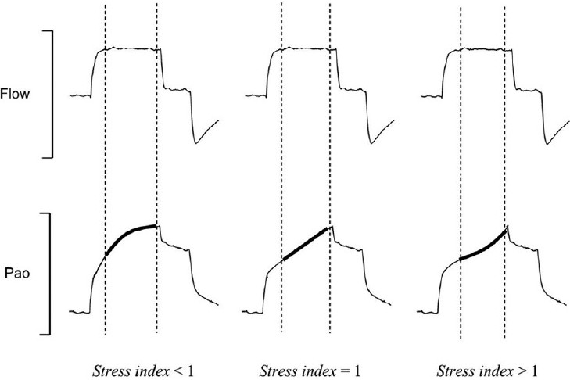
Role of PEEP- stress index

Slide 48
What are your targets for mechanical ventilation?
Oxygenation status?
Ventilation?

Slide 49
Oxygenation status
Permissive hypoxemia
  Pulse ox=88-95%
  PaO2=55-80mmHg
  The first aim in titration of ventilator settings is to lower the FIO₂ to no more than 60% while maintaining an acceptable Pao₂

Slide 50
Ventilation
Permissive hypercapnea
  When ventilation cannot be maintained at a normal level without risking damage to lung tissue, permissive hypercapnea should be considered
  pH should be maintained >7.2
Notes:
The need to maintain a normal PaCO2 has never been demonstrated, especially when pH changes are gradual and oxygenation maintained. Rapid changes in pH, on the other hand, can result in CNS dysfunction, increased cerebral perfusion and intracranial hypertension, muscle weakness, cardiovascular dysfunction and intracellular acidosis. When permissive hypercapnia is used, the patient requires sedation because it can be uncomfortable.

Slide 51
Question
Other than increasing the FIO2, how can you improve oxygenation in your patient?

Slide 52
Answer
Mean airway pressure (P_{aw})
  =1/2 [PIP x (inspiratory time/total respiratory cycle)]
  When PEEP used
    =1/2 (PIP – PEEP) x (inspiratory time/total respiratory cycle) + PEEP
  Therefore, affected by
    PIP, TV, PEEP, I:E ratio, RR, inspiratory flow pattern
Notes:
The major determinant of oxygenation in patients with ARDS is the mean airway pressure. This is the average pressure above baseline during a total respiratory cycle. The mean airway pressue affects the mean alveolar pressure and alveolar recrutiment, and therefore affects oxygenation. One can increase the mean airway pressure (average pressure above baseline during a total respiratory cycle) by the following mechanisms…

Slide 53
Question
What are the goals of PEEP?

Slide 54
Answer
Enhance tissue oxygenation
Maintain a PaO2 >/= 60mmHg and SPO2 >/= 90%, at an acceptable pH
Recruit alveoli and maintain them in an aerated state
Restore functional residual capacity
Notes:
Reduce FIO2<0.6

Slide 55
Question
What is the difference between PEEP and CPAP?

Slide 56
Answer
PEEP = End-expiratory pressure above zero cm H₂0 DURING MECHANICAL VENTILATION
CPAP = Pressure above the ambient pressure maintained DURING INSPIRATION/EXPIRATION DURING SPONTANEOUS VENTILATION

Slide 57
Question
Define the following terms
  Minimum or low PEEP
  Therapeutic PEEP
  Optimum PEEP

Slide 58
Answer
Minimum or low PEEP
  PEEP value of 3-5cmH20- used to preserve FRC
Therapeutic PEEP
  >/= 5cmH20- used to treat refractory hypoxemia
Optimum PEEP
  Level at which max benefit of PEEP occurs and minimal cardiopulmonary side effects occur
Notes:
Hypoxemia caused by increased intrapulmonary shunting and V/Q mismatching accompanied by decreased FRC and pulmonary compliance
Decrease in FRC occurs in patients intubated or in supine position

Slide 59
Optimum PEEP
Common target goals:
  PaO2=55-80, SPO2=88-95%
  Optimum oxygen transport
  Pulmonary shunt fraction <15%
  Minimal cardiovascular compromise
  Improved lung compliance and improve lung aeration
  PaO2/FIO2 ratio > 300
  Point of minimal arterial to end-tidal PCO2 gradient
  Optimal mixed venous oxygenation values
Notes:
Perform an optimum PEEP study similar to OLA ventilation
For patients req >/=10cm H20
Minimal cardiovascular compromise- adequate BP, <20% decrease in CO, stable pulmonary vasc pressure

Slide 60
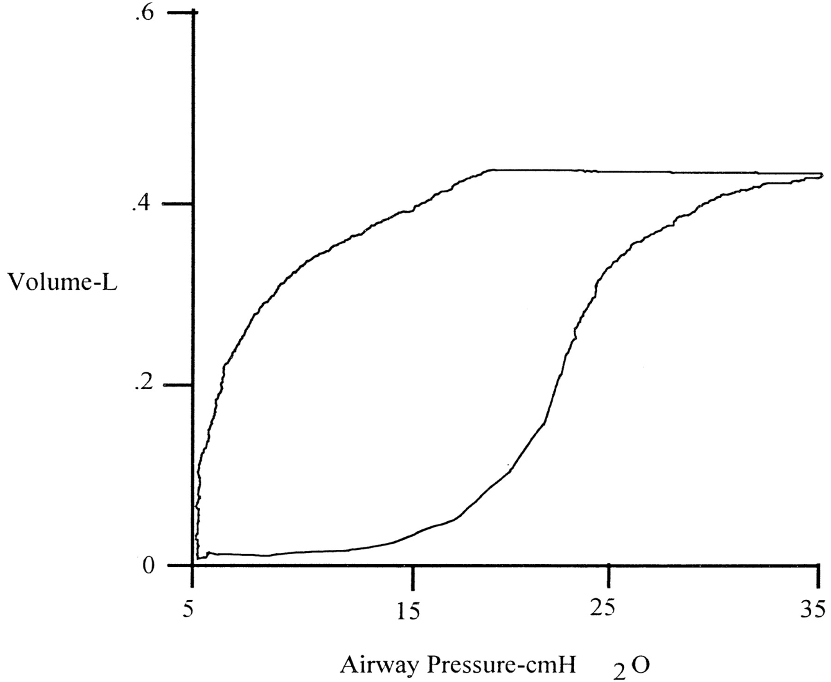
Optimum PEEP
Static Pressure Volume Loop
Notes:
Please identify the lower inflection point and the upper inflection point on the inspiratory limb. What does the slope of the line between the LIP and UIP denote?
What does the beak (upper plateau portion of the inspiratory loop) represent?
Denote the upper inflection point on the deflation portion of the curve.
What do these points represent?

Slide 61
Features of SPV loop
Lower inflection point on inspiratory limb
  Point on curve where slope of line first changes significantly
Upper inflection point on inspiratory limb
  Point on curve where slope of line changes again
  May not be identified if alveoli are still being recruited in some parts of lungs
Slope of line between LIP and UIP= compliance
Upper plateau portion of inspiratory loop represents potential recruitment and possible overdistension of lungs
  Compliance decreases at this point
Upper inflection point on deflation portion of curve=deflection or deflation point
  Set PEEP 2-3cm H20 above upper inflection point detected during deflation of lungs

Slide 62
Question
What are the cardiovascular consequences of high PEEP levels?

Slide 63
Answer
Reduces cardiac output by decreasing preload
Notes:
When a patient is placed on PPV, it causes positive intrathoracic pressure during inspiration, which opposes venous return. As a result, venous return occurs primarily during exhalation during PPV and may be reduced. With the addition of PEEP, which generates positive intrathoracic pressure during exhalation, venous return may be further compromised.

Slide 64
Question
What is the impact of PEEP on PCO2?

Slide 65
Answer
Variable effects
  If a patient has been hyperventilating b/c hypoxemia before PEEP, then relief should be accompanied by a rise in PaCO2
  May decrease if PEEP improves ventilation to previously perfused alveoli
  High levels of PEEP expand conductive airways which increases dead space and can increase PaCO2

Slide 66
Question
What is the impact of PEEP on lung compliance?

Slide 67
Answer
Increases lung compliance until reaches lung pressures with associated tidal volumes that reach total lung capacity, then decreases

Slide 68
Question
An increase in the arterial to end-tidal CO2 tension gradient to 20 is noted with increasing PEEP.
What does this mean?

Slide 69
Answer
The arterial to end-tidal CO2 tension gradient is often used as an indirect assessment of the effectiveness of ventilation
It is lowest when gas exchange units are maximally recruited without being overdistended by PEEP
An increase, signifies that too much PEEP has been added and can be expected to produce a drop in CO and an increase in V_{D}/V_{T}

Slide 70
Question
An increase in arterial-to-venous oxygen content difference is noted with an increase in PEEP.
What does this mean?

Slide 71
Answer
A reflection of oxygen utilization by the tissues
An increase in the gradient may indicate hypovolemia, decreased CO, increased oxygen consumption
Notes:
Normally 5vol%
Reflective of oxygen utilization by tissues
With increasing PEEP, as intrapleural pressures increase/gas exchange units become overdistended, venous return decreases and cardiac function is altered- cardiac output then declines and point of optimum PEEP is no longer present.

Slide 72
Question
What is the effect of PEEP on vascular pressures?

Slide 73
Answer
PEEP increases vascular pressures
***When PEEP rises, PAOP may be markedly decreased because pulmonary blood flow is reduced as a result of decreased venous return to the right side of the heart= PEEP-induced relative hypovolemia

Slide 74
Question
What are contraindications for PEEP?

Slide 75
Answer
Hypovolemia (relative)
Untreated significant pneumothorax or tension pneumothorax
Elevated ICP
Notes:
PEEP may further increase ICP by increasing CVP

Slide 76
Question
What cause of hypoxemia is typically refractory to management with increasing FIO2?
How can you improve oxygenation in these patients?

Slide 77
Answer
Shunt
PEEP/CPAP
Notes:
True shunt- perfusion in the absence of ventilation
The PaO2 does not rise with increases in FIO2 because there is no improvement in gas exchange in shunt units and hypoxemia remains severe.

Slide 78
Take home question- calculate your shunt fraction
Clinical shunt calculation example
  Pb=747mmHg
  Hb=10g
  FIO2=1.0
  PaO2=85mmHg
  PaCO2=40mmHg
  pH=7.36
  SaO2=94%
  PvO2=39mmHg
  SvO2=70%
  Respiratory exchange ratio (R)=0.8
Notes:
Answer- 34%

Slide 79
Question
Define a recruitment maneuver.

Slide 80
Recruitment maneuvers
A recruitment maneuver is a sustained increase in pressure in the lungs with the goal of opening as many collapsed lung units as possible
Occurs across entire range of lung volume from FRC to TLC
Once recruited, kept open by maintaining an adequate PEEP above UIP of deflation maneuver
Notes:
Lungs protected from overdistension by keeping PIP lower than UIP

Slide 81
Recruitment maneuvers
Regional variations exist in opening pressures of different lung units
Time is required for recruitment to occur
  Pressure sustained for >/=40 sec
Notes:
- few cm H20- 55-60cm H20
Opening pressure req for small airway collapse= 20cm H20 (loose atelectasis)

Slide 82
Recruitment maneuvers
Static pressure volume curves have been used to select optimum PEEP and Vt
Purpose of performing slow/static PV loop is to first recruit lungs and then to identify upper inflection point on the deflation curve for PEEP
Notes:
Unstable lung units must first be opened for PEEP to be effective.
Without recruitment, PEEP may hyperinflate functional airspaces, misdirect blood flow, and increase the risk of barotrauma.
In human medicine- requires a least two people at the bedside- one to perform the maneuver and monitor ventilator; other to monitor patient and provide sedation

Slide 83
Recruitment maneuvers
Hazards:
  Significant increases in thoracic pressure for an extended period can cause a significant decrease in venous return, CO, BP
  Barotrauma

Slide 84
Recruitment maneuvers
Variability among patients
  Responders- PaO2 increases, PaCO2 decreases and change in pressure required to cause an acceptable tidal volume decreases
  Non-responders- increasing levels of PEEP do not significantly increase lung aeration, hence no improvement in PaO2, PaCO2, Cs
Effects of chest wall compliance on lung recruitment

Slide 85
Types of recruitment maneuvers
Sustained inflation- provide sustained high pressure
  Ventilator set to CPAP/spontaneous mode (mandatory rate=0)
    CPAP increased to 30-40cm H20 for 40 seconds

Slide 86
Types of recruitment maneuvers
PC-CMV with a high PEEP level
  Set pressure about 20cm H20 above PEEP and mandatory rate=10-12/min
    PEEP increased so PIP at least 40 cm H20
    Sustain high pressure for 40-60 seconds and then decrease to a level appropriate to sustain inflation and prevent derecruitment

Slide 87
Types of recruitment maneuvers
PC-CMV with increased PEEP
  Increases PEEP in increments of about 5cm H20
    Each increase held for several minutes (2-5 minutes)
    PEEP is then progressively decreased until compliance decreases (derecruitment)
    Point of decreased compliance represents UIPd of lungs
    Lung reinflated to allow reopening of lung units- PEEP once again decreased until pressure 2cm H20 above UIPd obtained

Slide 88
Types of recruitment maneuvers
Sigh techniques
  3 consecutive breaths/min at Pplateau 45cm H20
  Twice Vt every 25 breaths, with optimum PEEP set
  Holding Vt constant while increasing PEEP from a low level (~10cm H20) to a high level of about 16cm H20 for two breaths every 30 seconds
  Increasing PEEP in a stepwise fashion to 30cm H20 while Vt is decreased
    Each held for 1 minute. Procedure then repeated second time
      Vt=6ml/kg, PEEP=15cm H20; Vt=4ml/kg, PEEP=20cm H20; Vt=2mL/kg, PEEP=25cm H20; Vt off and CPAP=30cm H20
  Increasing inspiratory pressure to 20-30cm h20 fro 1-3 seconds at a rate of 2-3 sighs/min
  Use of APRV or HFOV to recruit the lungs

Slide 89
What is the evidence?
Effects of recruiting maneuvers in patients with acute respiratory distress syndrome ventilated with protective ventilatory strategy
  Grasso S, Mascia L, Del Turco M
  Anesthesiology 2002; 96: 795-802
  Application of recruitment maneuvers improved oxygenation status in patients with early ARDS and who have a large potential for recruitment
Notes:
22 patients with ARDS were studied during use of ARDSnet lung protective ventilation. Recruiting maneuvers incr- application of CPAP 40cm H20 for 20 sec
Increased PF by 20+/- 3% in nonresponders (11) and by 175 +/- 23% in responders. On zero end-expiratory pressure EstL (28.4 +/- 2.2 vs. 24.2 +/-2.9 cm H20) and Est wall (10/.4 +/- 1.8 vs. 5..6 +/- 0.8) were higher in nonresponders than in responders (P<0.01). Nonresponders had been ventilated fro a .onger period of time than responders (7 +/- 1 vs. 1 +/- 0.3, P<0.01) DCO and MAP decreased more significantly in nonresponders

Slide 90
What is the evidence?
A randomised controlled trial of an open lung strategy with staircase recruitment, titrated PEEP and targeted low airway pressures in patients with acute respiratory distress syndrome.
  Hodgson CL, Tuxen DV, Davies AR, et al.
  Critical Care 2011; 15: 1-33
  IL-8 and TNF-alpha concentrations lower in recruitment group
  P/F ratios and static lung compliance higher in recruitment group
  No difference in duration of ventilation, ICU stay, hospital stay between treatment groups
Notes:
20 ARDS patients randomized to treatment or ARDSnet control ventilation strategies. The treatment group received staircase recruitment maneuver with decremental PEEP titration and targeted plateau pressure <30cm H20. Pressure-control ventilation with plateau pressures <30cm H20 while delivering tidal volumes of less than 6ml/kg ideal body weight with patients in a supine position. FIO2 was adjusted until continuously montiored oxygen saturation=90-92%. For the SRM, the high pressure was set to 15cmH20 above PEEP which was increased in a stepwise manner to 20, then 30 and then 40 cm H20 every 2 minutes, and then reduced to 25, then 22,5, then 20, then 17.5 or then an absolute minimum of 15cm H20 every 3 minutes until a decrease in SaO2>/=1% from max SaO2 was observed- defined as derecruitment point. PEEP then increased to 40cm H20 for one minute and returned to a PEEP level 2.5cm H20 above derecruitment point (defined as optimal PEEP). Following SRM, tidal volume adjusted to achieve a tidal volume </=6ml/kg and plateau pressure </=30cm. H20. Hypercapnia tolerated and acidosis only treated if pH<7.15 by increasing RR. Control group treated using ARDSnet protocol with assist, control ventilation and FIO2/PEEP titration. Tidal volumes limited to 6ml/kg, plateau pressures <30cm H20. Acidosis (pH<7.3)- managed by increasing minute ventilation. PCV was not used and recruitment maneuvers only allowed if patient met criteria for rescue therapy (FIO2>/=0.9).

Slide 91
What is the evidence?
Different patterns of lung recruitment maneuvers in primary acute respiratory distress syndrome: effects on oxygenation and central hemodynamics
  Iannuzi M, De Sio A, De Robertis E
  Minerva Anestesiologica 2010; 76 (9): 692-698
  Compared sustained inflation vs PCV recruitment maneuvers
  P/F ratio increased, right-sided pressures decreased and shunt percentage decreased significantly in PCV recruitment maneuvers
Notes:
40 patients randomly allocated to undergo different RM patterns- sustained inflation or pressure-controlled ventilation. The RM methods tested were as follows- SI was achieved by raising peak inspiratory pressure to 45cmH20 and sustaining it for 40 sec. PCV set obtain 45cmH20 peak inspiratory pressure for 2 minutes- I:E=1:2, PEE=16, RR=8/min. During study period, patinets were mechanically ventilated to achieve a volume of 6ml/kg, FIO2=0.7, PEEP=14, RR=14, Pplateau</=30 cm H20 according to ARDSnet trial
All patients sedated and paralyzed during study period
CVP increased during recruitment maneuvers.
Mean pulmonary artery pressure, pulmonary capillary wedge pressure and pulmonary vascular resistance index reduced during PCV RM compared to SI RM (P<0.05), Righ ventricular stroke work index decreased to a major extent during PCV RM (P<0.05). P/F ratio was significatnly increased after PCV RM compared to SI RM (P<0.05). PaCO2 levels similar in two groups. Compared to baseline, the Qs/Qt decreased signfiicatnly after PCV recruitment maneuver. Ventricular end-diastolic and end-systolic areas decreased during both RM protocols, but they were decreased to a greater extent after SI RM than after PCV RM (P<0.05). The eccentricity index increased from baseline after SI RM (P<0.05). PCV technique favored over SI maneuver

Slide 92
Recruitment maneuvers
Routine use in ALI/ARDS cannot be recommended or discouraged routinely at this time due to lack of effect on clinical outcome

Slide 93
Non-traditional ventilator management
Airway pressure release ventilation
High-frequency oscillatory ventilation
Notes:
maintain inherently higher mean airway pressures during tidal breathing, thereby promoting recruitment

Slide 94
Use of airway pressure release ventilation in ARDS in vet med
Case Report
Management of acute respiratory distress syndrome in a French Bulldog using airway pressure release ventilation
      Sabino CV et al
      JVECC 23 (4) 2013, pp 447–454
Notes:
APRV uses the concept of open lung ventilation combined
with spontaneous ventilation in order to improve
arterial oxygenation and minimize ventilator-induced
lung injury. APRV varies markedly from conventional
mechanical ventilation. During APRV, a high continuous
positive airway pressure (CPAP) is maintained and
the patient is allowed to breathe spontaneously.
period of high airway pressure is interrupted by a very
short period of low airway pressure. During this lowpressure
phase that facilitates expiration, PEEP is maintained
to conserve alveolar recruitment. It is the ratio
of time spent at the high airway pressure to time spent
at the low airway pressure that determines the rate of
mandatory mechanical ventilation, with further spontaneous
breaths allowed throughout the ventilator cycle
to enhance physiologic recruitment of alveoli. APRV improves
many physiologic endpoints ofmechanical ventilation
such as gas exchange, cardiac output, arterial oxygenation,
and systemic blood flow in canine experimental
models, as well as human clinical and experimental
Studies. manageARDSin an 18-month-old French
Bulldog with aspiration pneumonia.

Slide 95
Trouble-shooting in your patient
Hypoxemia (acute)
Hypercapnea (acute)
Gradual hypoxemia
Some loops…

Slide 96
Acute hypoxemia trouble-shooting
What are your considerations?
Notes:
Equipment
Pneumothorax
Loss of oxygen supply
Machine malfunction
Circuit disconnection

Slide 97
Acute hypoxemia trouble-shooting
Equipment
Pneumothorax
Loss of oxygen supply
Machine malfunction
Circuit disconnection

Slide 98
Acute hypercapnea trouble-shooting
What are your considerations?
Notes:
Pneumothorax
Endotracheal/tracheostomy tube kink/obstruction
Increased apparatus dead space
Increased pulmonary dead space
Inadequate ventilator settings
Circuit issues

Slide 99
Acute hypercapnea trouble-shooting
Pneumothorax
Endotracheal/tracheostomy tube kink/obstruction
Increased apparatus dead space
Increased pulmonary dead space
Inadequate ventilator settings
Circuit issues

Slide 100
Gradual hypoxemia trouble-shooting
What are your considerations?
Notes:
VILI, VAP

Slide 101
Gradual hypoxemia trouble-shooting
VILI
VAP

Slide 102
Patient-ventilator asynchrony trouble-shooting
What are your considerations?
Notes:
Hypoxemia
Hypercapnia
Pneumothorax
Hyperthermia
Inappropriate ventilator settings
Inadequate depth of anesthesia

Slide 103
Patient-ventilator asynchrony trouble-shooting
Hypoxemia
Hypercapnia
Pneumothorax
Hyperthermia
Inappropriate ventilator settings
Inadequate depth of anesthesia

Slide 104
Additional lung protective strategies
Prone positioning
  Prone positioning reduces mortality from acute respiratory distress syndrome: a meta-analysis
    Beitler JR, Shaefi S, Montesi SB, et al
    Intensive Care Med 2014
  Application to our patients?
Notes:
Cumulative negative fluid balance on day 4 of the study was associated with an independently lower hospital mortality and more ventilator and intensive care unit-free days.

Slide 105
Additional lung protective strategies
Fluids
  Review of a large clinical series: association of cumulative fluid balance in acute lung injury: a retrospective review of the ARDSnet tidal volume study cohort
    Rosenberg AL, Dechert RE, Park PK, et al.
    J Intensive Care Med 2009; 24 (1): 35-46.

Slide 106
Additional lung protective strategies
Bronchodilators
  Ventilator-free days were not significantly different between the albuterol and placebo groups
  Rates of death were not significantly different between the albuterol and placebo groups
  Heart rates were significantly higher in the albuterol group, but rates of new cardiac dysrhythmias were not significantly different.
  Similar findings in studies evaluating intravenous B-2 agonists
ARDSNet 2011
Notes:
Randomized, placebo-controlled clinical trial of an aerosolized B-2 agonist for the treatment of acute lung injury
ARDS Network
Am J Respir Crit Care Med 2011; 184 (5): 561-568
We conducted a multicenter, randomized, placebo-controlled clinical trial in which 282 patients with ALI receiving mechanical ventilation were randomized to receive aerosolized albuterol (5 mg) or saline placebo every 4 hours for up to 10 days. The primary outcome variable for the trial was ventilator-free days.

Slide 107
Weaning
What are your criteria?
How will you wean?
Notes:
Acceptable PaO2 on an FIO2<0.4
Hemodynamically stable

Slide 108
Weaning
Criteria for weaning from PEEP
  Acceptable PaO2 on an FIO2<0.4
  Hemodynamically stable
  Reduce PEEP by 5cm H20
  If SPO2 (or PaO2) falls by less than 20% of its original value at previous PEEP level, patient ready to tolerate lower PEEP
  If SPO2 (or PaO2) falls by greater than 20% of original value at previous PEEP level, patient is not ready to tolerate lower PEEP
  Wait between reductions in PEEP
  At PEEP</=5cm H20- can discontinue
Notes:
Patients whose PaO2 drops to 65mmHg or lower with a 5cm H20 reduction in pEEP may still need PEEP to maintain lung recruitment

Slide 109
Prognosis?
128 dogs and cats that received PPV for more than 24 hours
  36% of animals with pulmonary parenchymal disease were weaned
    50% of animals with aspiration pneumonia
    8% of animals with ARDS
Hopper 2007

Slide 110
Summary of lung protective strategies
Pplateau<30cmH20
Lowest PEEP to provide an acceptable PaO2 should be used
PIP (PEEP + inspiratory pressure to deliver inspired Vt) should not exceed the upper inflection point and total lung capacity
Vt=4-6mL/kg
PEEP should be applied early
Level of PEEP should be set 3-4cmH20 above upper inflection point of deflation limb of the P-V curve to help maintain an open lung
Notes:
Establishing the lower inflection point should be done following lung recruitment with a slow derecruitment maneuver. This may require very small, slow, stepwise decreases in pressure following a deep inflation (recruitment maneuver) (2.5cm H20 q5-10min) until the collapse point occurs. During this maneuver, Cs is probably the best single indicator of recruitment and the best indicator of closing point. A re-recruitment maneuver is required following derecruitment

Slide 111
Summary of lung protective strategies
If it becomes difficult to maintain low pressures during VCV, switch to PCV and monitor Vt delivery
If it is necessary to improve PaO2, increase the Paw by extending inspiratory time during pressure ventilation
When PaCO2 increases with increased PEEP, lung overdistension is present
Consider permissive hypercapnia

Slide 112
References
Acute Respiratory Distress Network: Ventilation with Lower Tidal Volumes as Compared with Traditional Tidal Volumes for Acute Lung Injury and the Acute Respiratory Distress Syndrome. New England Journal of Medicine 2000; 342 (18): 1301-1308.
    ARDS Network: Randomized, placebo-controlled clinical trial of an aerosolized B-2 agonist for the treatment of acute lung injury. Am J Respir Crit Care Med 2011; 184 (5): 561-568.
Azoulay E, Citerio G, Bakker J, et al: Year in review in Intensive Care Medicine 2013: II. Sedation, invasive and noninvasive ventilation, airways, ARDS, ECMO, family satisfaction, end-of-life care, organ donation, informed consent, safety, hematological issues in critically ill patients. Intensive Care Med 2014.
    Beitler JR, Shaefi S, Montesi SB, et al: Prone positioning reduces mortality from acute respiratory distress syndrome: a meta-analysis. Intensive Care Med 2014.
  Brower RG, Lanken PN, MacIntyre N, et al: Higher versus lower positive end-expiratory pressures in patients with the acute respiratory distress syndrome. New England Journal of Medicine 2004; 351: 327-336.
  Cairo JM: Pilbeam’s mechanical ventilation. 2012; Fifth edition: Elsevier, St. Louis, MO.
  Caramez MP, Miyoshi E, Harris RS, et al: Gas exchange impairment induced by open suctioning in acute respiratory distress syndrome: Impact of permissive hypercapnia. Critical Care Medicine 2008; 36 (2): 560-564
  Hodgson CL, Tuxen DV, Davies AR, et al.: A randomised controlled trial of an open lung strategy with staircase recruitment, titrated PEEP and targeted low airway pressures in patients with acute respiratory distress syndrome. Critical Care 2011; 15: 1-33
Hopper K, Haskins SC, Kass PH, et al: Indications, management and outcome of long-term positive-pressure ventilation in dogs and cats: 148 cases (1990-2001). JAVMA 2007; 230: 64-75.
  Iannuzi M, De Sio A, De Robertis E: Different patterns of lung recruitment maneuvers in primary acute respiratory distress syndrome: effects on oxygenation and central hemodynamics. Minerva Anestesiologica 2010; 76 (9): 692-698.
Needham CJ, Brindley PG: The role of neuromuscular blocking drugs in early severe acute respiratory distress syndrome. Can J Anesth 2012; 59: 105-108.
Papazian L, Forel JM, Gacouin A, et al: Neuromuscular blockers in early acute respiratory distress syndrome. New England Journal of Medicine 2010; 363: 1107-1116.
    Rosenberg AL, Dechert RE, Park PK, et al. Review of a large clinical series: association of cumulative fluid balance in acute lung injury: a retrospective review of the ARDSnet tidal volume study cohort. J Intensive Care Med 2009; 24 (1): 35-46.

