Slide 1

Sand Source and Testing Methods
Rebecca Schneider and Meghan Furton

Slide 2
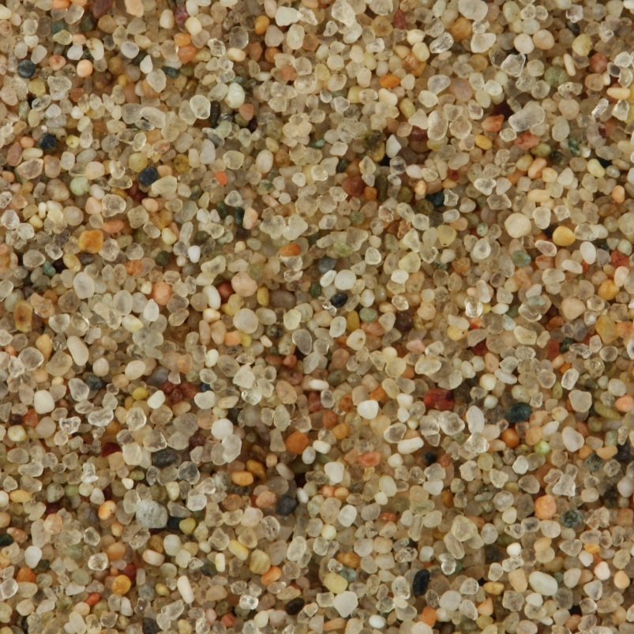
Introduction
  Need
    SRSF filter media
      Silica sand characteristics:
        Density
        Color
        Hardness
        Effective size
  Local materials
    Reduced cost
    Independent production
What material characteristic does a sample of sand have?

Slide 3
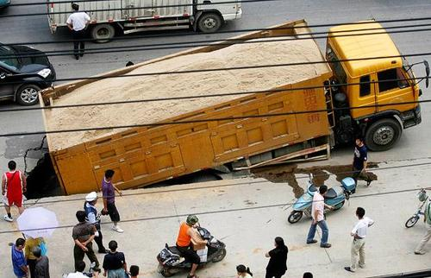

Background
  Current sand acquisition
    India:
      Taken from the Barakar river
      Sieved to correct for size
      Access to laboratories
    Honduras:
      Plans to take sand from local river beds
      Imported from the U.S.
      Testing will be done in apartments
  Importance of simplifying test methods
Notes:
http://www.youtube.com/watch?v=qWqDurunnK8

Slide 4
Goals
Short term:
  Produce viable sand from a poorly sieved sample
  Understand the relationship between different sand qualities
  Perfect a test procedure
Long term:
  Enable self-sufficient sand sourcing at water plant construction sites

Slide 5
Specifications
SRSF specifications:
No sand should be able to slide through the 0.2 mm slots in the PVC pipe
The sand should be hard and not prone to dissolution in acid
The backwash velocity required to expand the filter bed by 30% should be very close to 11 mm/s
The sand bed must not have significant stratification after backwash
AWWA standards:
85% silica
Specific gravity >2.5
Acid Solubility <5%
Visibly free of clay, dust, mica, and organic matter

Slide 6


Research
SOURCES
RESULTS
American Water Works Association (AWWA)
American Society for Testing and Materials (ASTM)
Field sites
Filter media standards
  Acid solubility test
Test procedure
  C127
  E11
Other needs
  Lab access
  Current procedure
Other Topics
Hardness Testing
Backwash Velocity

Slide 7
Testing
Acid Solubility Test
Uniformity Coefficient
Effective Size
Hardness
Samples:
Playground Sand, Aquamarium Sand, and Filter Sand
Hardness Number | Material
6 | Orthoclase
7 | Vitreous Silica
8 | Quartz

Slide 8
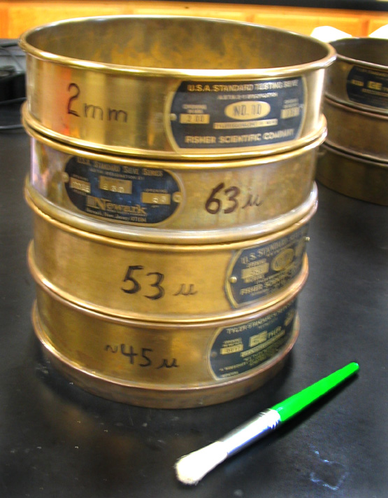
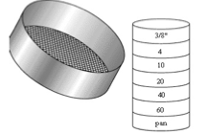
Uniformity Coefficient and Effective Size
Preliminary Results:
effective size for all
samples are less than
The required 0.2mm
Problems:
Scale doesn’t reach above 200g
Solutions:
Split up samples and measure it in pieces (not quite as exact)

Slide 9

Procedure
1) Mass the sand sample and all the sieves
2) Pour the sand into the sieve stack (starting with the lowest sieve No.)
SAND SAMPLE
About 100g
4
3) Shake the sieve stack for 5 to 10 minutes.
10
4) Mass the sand and sieves and then subtract the weight of the sieves to find the sample mass
20
Should stay in continuous motion such that not more than 1% of the sand (by wt) will not pass an individual sieve during an addition minute.
40
60
70
200
5) Graph the results
Pan

Slide 10
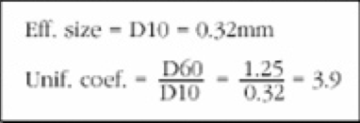
Sample Calculations
Sieve No. | Sieve Size (mm) | Sample Weight (g) Sieve before – sieve with sand sample after | % retained Sample Weight/Total Sample (~100g) | % passing last larger sieve Start at 100 and then use % passing calculation for Sieve No. one less | % passing Percent passing next largest sieve – percent retained on sieve
A | B | C | C/100g | 100 | 100 – (C/100)
D | E | F | F/100g | 100 – (C/100) | (100 – (C/100)) - F/100g
Graph the Sieve Size vs the % passing.
The effective size (D10) is the size in which only 10% of the sample is smaller
The Uniformity Coefficient (D60/D10) is the size in which 60% of the sample is smaller / the size in which 10% of the sample is smaller

Slide 11
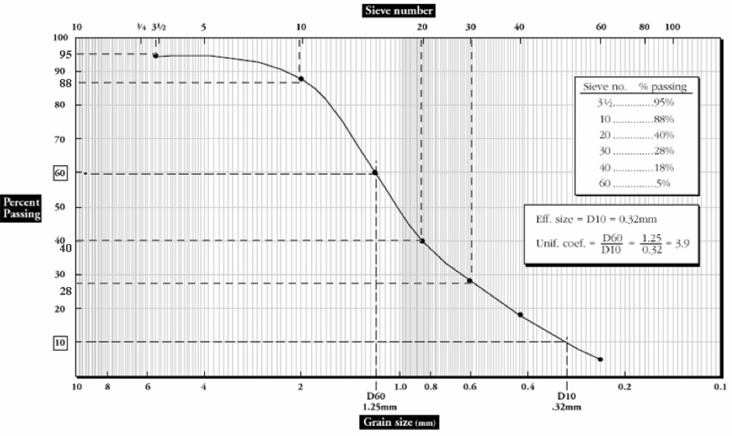
Sample Graph

Slide 12
Our Data…

Slide 13
Filter Sand
Effecitve Size = D10
Effecitve Size = | 0.463
Uniformity Coefficient = D60/D10
D10 = | 0.463
D60 = | 0.61
Uniformity Coefficient = | 0.759016393

Slide 14
Aquarium Sand
Effecitve Size = D10
Effecitve Size = | 0.39
Uniformity Coefficient = D60/D10
D10 = | 0.39
D60 = | 0.59
Uniformity Coefficient = | 0.661016949

Slide 15
Playground Sand
Effecitve Size = D10
Effecitve Size = | 0.195
Uniformity Coefficient = D60/D10
D10 = | 0.195
D60 = | 0.338
Uniformity Coefficient = | 0.576923077

Slide 16
Uniformity Coefficient
Uniformity Coefficient is not an AWWA or AguaClara restriction
However, can be used to measure
BACKWASH VELOCITY

Slide 17
Backwash Velocity
AguaClara specifications:
    The backwash velocity required to expand the filter bed by 30% should be very close to 11 mm/s
    The sand bed must not have significant stratification after backwash
Problems:
Need to adapt tests and formulas found to the specific filters being used
Preliminary Results:
Still researching best
approach. Have not
done any testing yet.
Solutions:
Still in process

Slide 18
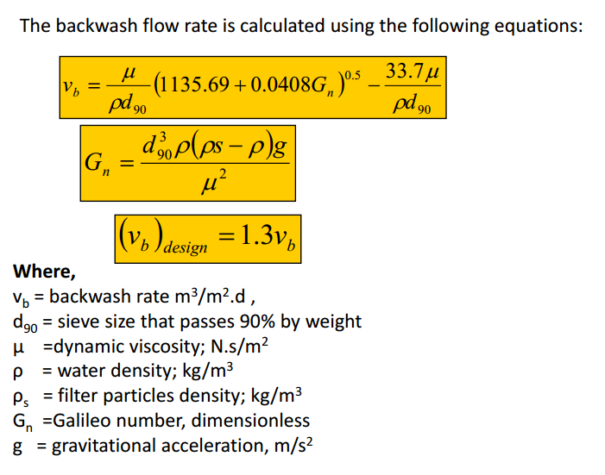
Approach 1 – Backwash Velocity
In fluid mechanics, G_{n} represents the ratio of forces in viscous fluids.
Equation: G_{n}=gL³ρ²/μ²
Given: 11mm/s
Can determine experimentally
Can look up based on temperature
Can determine experimentally
9.8m/s²

Slide 19
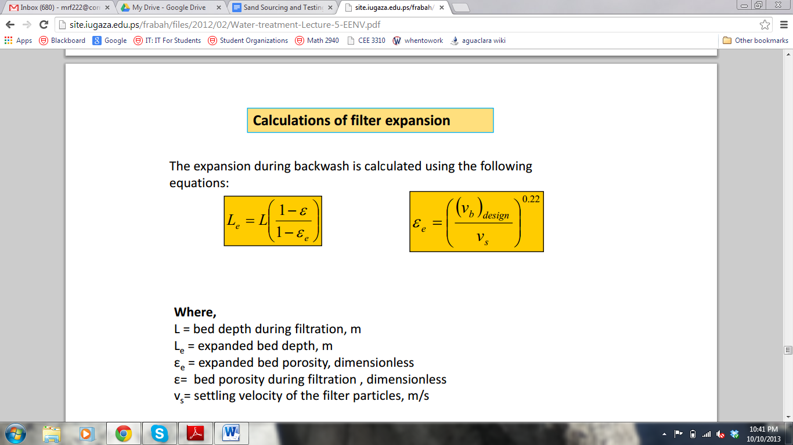
Approach 1 – Backwash Velocity
Depends on filter
Given: 1.3L
Can determine experimentally

Slide 20

Approach 2 – Backwash Velocity
V(backwash)=HLR(backwash)*A(filter)*∆t(backwash)
Substituting the two above equations:
V(backwash) = Design Flow (gal/day) * ∆t(backwash)
Design Flow can be calculated fairly easily
Typical rates
  For media-fixed systems
    HLR ~ 7.57 μm/h to 30.27 μm/h
  Need to find rates that match up with filter being used
Conversion factor
    1 gal/(ft²*day) = 30.2675 μm/h

Slide 21
Acid Solubility
Importance
  Limestone vs Silica
  Loss over time
    Lifetime of filter sand: roughly 10-20 years
Preliminary Results:
Aquarium sand: <<5% acid content
Problems:
unspecific size
Drying time
Meaning of 1:1 HCL solution
Filtration
Unspecific containers
Solutions:
Set standard sample size
Filter paper
Ordered 6N HCl Solution

Slide 22
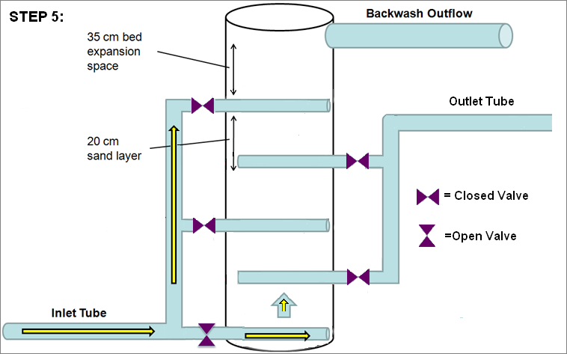
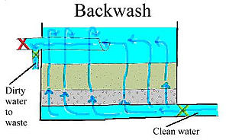
Clay and Organic Material Test
Specified in AWWA standards
Unnecessary for SRSF design
  Able to backwash instantaneously
Traditional Backwash
SRSF Backwash

Slide 23
Porosity Test
Procedure:
  Measure a known quantity of sand in a graduated cylinder
  Pour in water until the water line matches the top of the sand
  Porosity= (volume of water/total volume)*100

Slide 24
Improvements
Filter paper
Standardized sample size
Prewash
Simplify
Make easily to reproduce in a field setting

Slide 25
Challenges
New team
Lab equipment
  Availability of chemicals
  Drying time
Vague procedure
  Sample size
  How to filter sand

Slide 26
Future Work
Research:
  Hardness tests
  SRSF Backwash requirements
  Lab Work:
  Preform the hardness test
  Sort a poorly sieve sample
Communication:
  Keep in touch with field sites
  Refine lab procedure and materials list

Slide 27
Questions?

