Slide 1

Sand Source and Testing Methods
Rebecca Schneider and Meghan Furton
Notes:
Becky

Slide 2
Now What?
  Breakdown of the semester:
RESEARCH
AND
TESTING
Specifications
Test methods
Current methods in India
Backwash and Bed Expansion equations
Acquire Samples
Attempt Tests
Evaluate usefulness
  Can we change the outcome?
Design a Procedure
Notes:
Meghan
Here is the breakdown of our progress this semester:
[click]
Our tasks fell into these two categories, though we often returned to research after we did our own testing

Slide 3
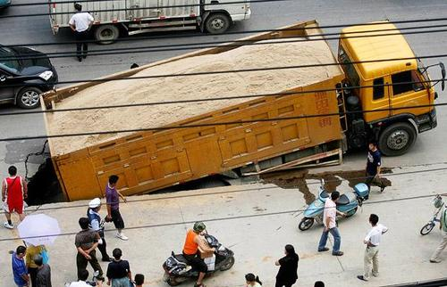

Current Sand Acquisition
    India:
      Taken from the Barakar river
      Sieved to correct for size
      Implemented in filters
    Honduras:
      Imported from the US
      HOPEFULLY: will soon be sourced from local river beds
Notes:
Becky
http://www.youtube.com/watch?v=qWqDurunnK8

Slide 4


Initial Tests
AWWA
AguaClara
Effective Size
Hardness
Specific Weight
Acid Solubility
Shape
Clay and Shale Composition
Organic Material Composition
Backwash Velocity
Bed Expansion
Stratification after backwash
Notes:
Becky
In terms of communication with field sites, we learned about the needs and limitations of the sites in Honduras and India. In India, where they are already using local sand, we learned what kinds of treatment the sand needs before entering the filters. This information is helpful in determining what characteristics are even relevant.

Slide 5
Modified List of Tests
AWWA
AguaClara
Effective Size
Acid Solubility
Backwash Velocity
Bed Expansion
  Uniformity Coefficient
  Porosity
Notes:
Becky
Able to condense list of necessary tests
Based on our specific filters and minimum requirements
Many of the tests gave us a the same overall conclusion
Others were just not a potential issue
Want to make process as easy as possible for implementation
Simplify the tests that are necessary

Slide 6
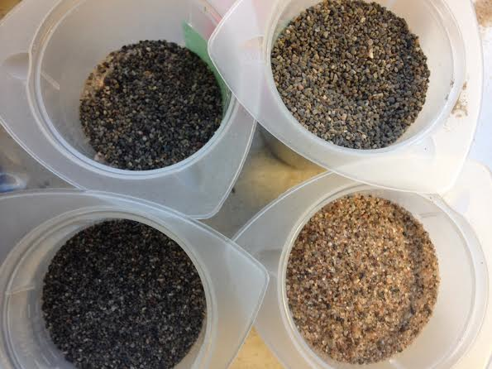
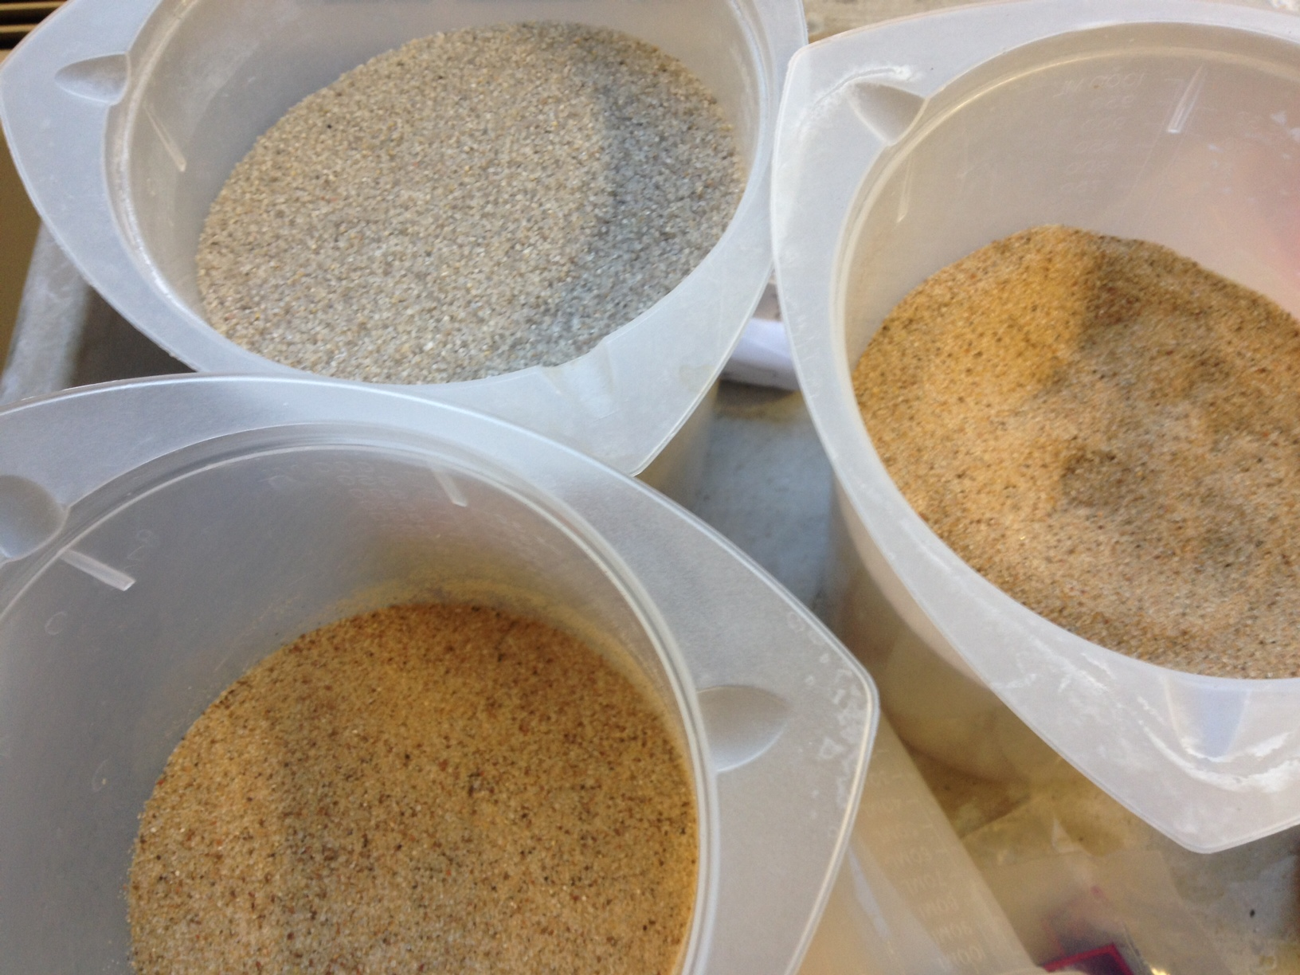
Sand Samples
Playground Sand
Aquarium Sand
Filter Sand
Unknown sand:
  size 20
  size 30
  size A
Mixed sand: Size 20 and playground sand
Notes:
Becky?

Slide 7
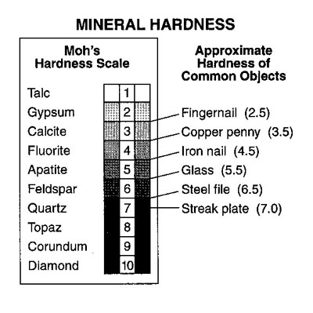
Hardness
Specification: > 2.7 on Mohs Hardness Scale
  Limestone sand → calcite (~3)
  Silica sand → quartz (~7)
  Penny can be used on site
  Not Necessary
    Silica sand will be hard enough!
    Determined more accurately in Acid solubility test
Notes:
Becky
Help determine if the sand is either silica sand or limestone sand.
Very easy to perform → not necessary if the acid solubility test has already been performed
Too imprecise to use on its own
Suggestion: do in field before transporting any sand→reduce any efforts that would potentially go towards unreliable sand

Slide 8
Silica Content and Specific Weight
Complex Procedure
  Silica Content melting the sand
  Specific Weight pycnometer
Value to Filter
  Range in filter media
  Purity of media
Notes:
Meghan
Complicated procedure for characteristics that are not easily modified and not directly tied to performance.
Pycnometer= specific gravity vessel
Like hardness, the value to the filter is in the durability of the sand– but also like hardness, a range of values are suitable in a filter.

Slide 9
Acid Solubility
Importance
  Limestone vs Silica
  Loss over time
    Lifetime of filter sand: roughly 10-20 years
Preliminary Results:
Aquarium sand: <<5% loss
PASS
Size 20 sand: 10% loss
FAIL
Problems:
unspecific size
Drying time
Meaning of 1:1 HCL solution
Filtration
Unspecific containers
Solutions:
Set standard sample size of 100g
Filter paper
Ordered 6N HCl Solution
Notes:
Meghan
This is the test we have identified as the most applicable for the durability of the sand. It is present in both the SRSF and AWWA specifications. In addition, there is a straightforward test procedure to determine it and a clear pass/ fail answer. This characteristic is more applicable than hardness or content for the lifetime of the sand.
Because there is know clear way to modify failing sand, our recommendation is to find a new source.

Slide 10
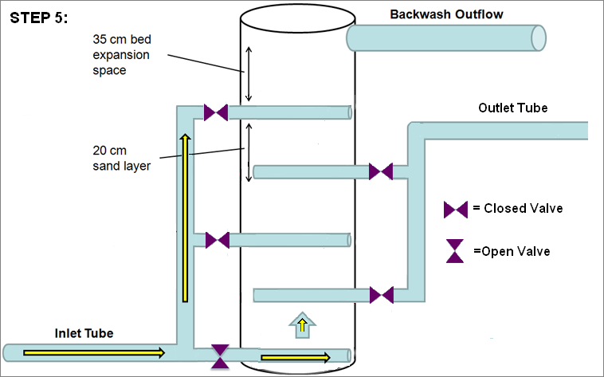
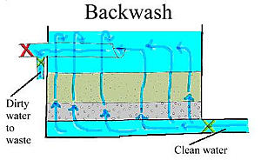
Clay and Organic Material Test
Specified in AWWA standards
Unnecessary for SRSF design
  Able to backwash instantaneously
Traditional Backwash
SRSF Backwash
Notes:
Meghan
Here is another characteristic of the sand we threw out from the original list:

Slide 11
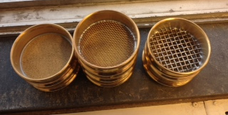
Uniformity Coefficient and Effective Size
Notes:
Becky
Effective size is very important → also very easy
As mentioned: Already being done in India (all that is needed are sieves)
Uniformity Coefficient is not as easy and not as necessary but is used for our backwash and bed expansion calculations

Slide 12
Test Summary
Approximate distribution for sand sieved in India
d₆₀ = .4 mm
d₁₀ = .275 mm
Uniformity Coefficient: 1.455
Notes:
Meghan
As you can see, the samples we tested varied slightly, but not considerably. Most were pre-sieved, as indicated by the steep slope between two data points where all of the mass falls.
[click]
The red line is an approximation of the mass distribution from India, where they are using number 30 and 60 sieves. We will use this information and assumptions for calculations later on.

Slide 13
Calculations
Relationship between Uniformity Coefficient
BACKWASH VELOCITY
and
BED EXPANSION
Notes:
Becky
We will use the uniformity in our calculations for backwash velocity and bed expansion

Slide 14
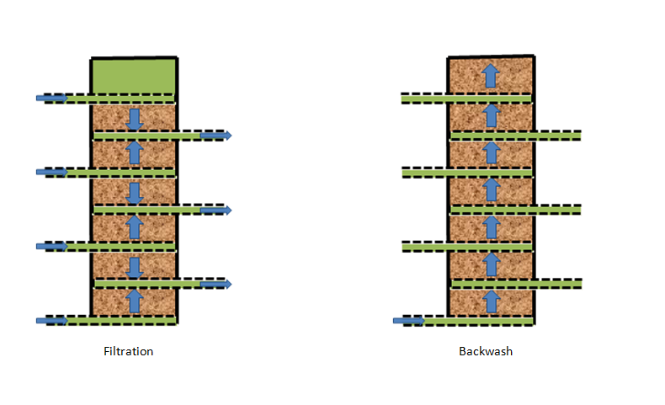
Backwash Velocity
The backwash velocity required to expand the filter bed by 30% should be very close to 11 mm/s.
Problems:
Need many experimental values
Many require the filter
Lack of equipment and time
Solution:
Many assumptions
Find relationships with easily alterable sand characteristics
Notes:
Becky
Faced problems calculating backwash velocity with minimum information given
Very vague, much of it determined by the filter (which we do not have to test)
“no significant stratification” up to us to determine how much stratification is allowed
Used many assumptions and estimates based on questionable experimental data
Not totally necessary for initial testing but if problems arise can adjust accordingly

Slide 15

Backwash Velocity Formula
Variables:
v_{mf} = minimum superficial velocity (m/s)
Υw = specific weight of water (N/m³)
SG(medium) = specific gravity of the sand
μ = viscosity of water (Ns/m²)
v_{backwash} = backwash velocity (m/s)
Constants:
v_{mf} = 11 mm/s
Υw = 998.37 (N/m³)
SG(medium) = 2.648
μ(20˚C) = 0.001005264 (Ns/m²)
Notes:
Becky
This is the formula we used to calculate backwash velocity.
vmf = the minimum superficial velocity at which fluidization occurs (m/s)
D60 (as shown in Uniformity Coefficient calculations) is the size of sand (mm) that 60% of the sand sample is finer than
Υw = specific weight of water (N/m³)
SG(medium) = specific gravity of the sand
μ = dynamic viscosity of water (Ns/m²)
v_{backwash} = backwash velocity (m/s)
The backwash velocity must be greater than the vmf, the minimum fluidization velocity
-Using the minimum fluidization velocity as 11 mm/s and solved for the maximum d60 allowed for a sand sample

Slide 16
Backwash Velocity Calculations
Solved for d60
And found that:
d₆₀ < 1.06939 mm
Notes:
Found that the d60 must be less than 1.06939
This is very high!!
Our three samples has d60s of 0.590 mm, 0.195 mm, and 0.463 mm
This should not be a problem
However, if it is it is very easy to account for

Slide 17
Vmf vs d60
Notes:
Relationship between minimum fluidization velocity and d60.
Notice any d60 below 1.1 will have a minimum fluidization velocity below 11 mm/s
Also notice how this can easily be altered by decreasing the d60 (which can be done using sieves)

Slide 18

Bed Expansion Calculations
h_{o} = depth of the expanded bed (m)
h = depth of the bed before expansion (m)
ε = porosity of the filter media,
ε_{o} = expanded porosity of the filter media
Ideally: 30% bed expansion
h_{o}/h = 1.3/1 = 1.3
Porosity can be tested for
Expanded porosity cannot be…
Notes:
Becky
h_{o} = depth of the expanded bed (m)
h = depth of the bed before expansion (m)
ε = porosity of the filter media,
ε_{o} = porosity of the filter media during expansion
Ideally we want 30% bed expansion for a backwash velocity of 11 mm/s
Thus h_{o}/h = 1.3/1 (the expanded bed will be 30% greater than the settled bed
As we will speak about soon -- Porosity is fairly easy to test for
Expanded porosity cannot be tested for independently of the filter

Slide 19

Bed Expansion
v_{settling} = settling velocity (mm/s)
v_{settling} = 8.24 mm/s
Very rough estimate
Using all equations
Solve for relationship between bed expansion and d60
Notes:
this v_{settling} value of 8.24 mm/s was calculated by the LRSF theory team
This value changes for different filters and properties of sand but we will use it as a rough estimate
Numerical data cannot be exact without the use of the filter for our testing, thus instead we implemented these formulas and performed some mathematical calculations to find the relationship between different variables. The first relationship found is between bed expansion and d60

Slide 20
Bed Expansion vs d60
Notes:
Notice that if the d60 is greater than 1.1mm, because we use a backwash velocity of 11 mm/s for our calculations, the graph jumps to infinity and is invalid for any value greater that 1.1mm

Slide 21
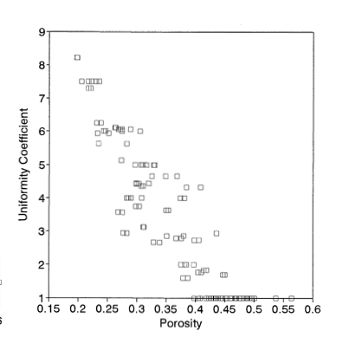
Porosity Test
Procedure:
  Measure a known quantity of sand in a graduated cylinder
  Pour in water until the water line matches the top of the sand
  Porosity= (volume of water/total volume)*100
Notes:
Meghan

Slide 22
Uniformity Coefficient vs Bed Expansion
Notes:
Rebecca
Uniformity Coefficient and Bed Expansion have a positive relationship.

Slide 23
Final Procedure
Posted on the wiki
Based on our calculations, the sand used in India meets backwash and bed expansion requirements
Initial Test:
Acid Solubility of a sample
Fail
Find a new source of sand
Pass
(Optional)
Treatment: Sieve all sand for size
India range:
No. 30 and 60 sieves
Determine Uniformity Coefficient, Porosity, and Effective size of a Sample
Re-sieve all sand to adjust uniformity coefficient
Fails to meet requirements
Determine minimum backwash velocity and predicted bed expansion
Meets Requirements
Use as filter media
Notes:
Meghan
The final procedure that we recommend comes from three main considerations:
Tests that are valuable
Tests that are possible
Tests that are being done currently (so what is ‘enough’?)
And we have determined that acid solubility is most important for durability and that uniformity coefficient and effective size– which can change the minimum backwash velocity and porosity of the sand– are also important for preparing filter media for use in the filters.

Slide 24
Future Work
  Lab Work:
    Better values for settling velocity
    Testing other types of filter media
    Bed Stratification
Communication:
  Progress in Honduras
  Details from India
  Modify procedure and materials
Notes:
Meghan

Slide 25
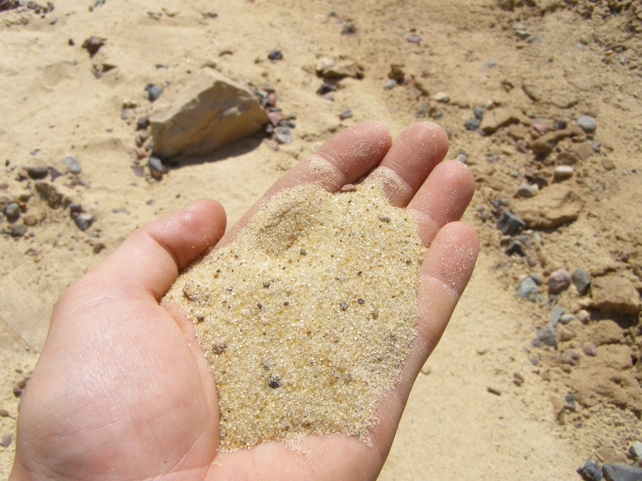
Questions?

