Slide 1
Floc Size Measurement

Slide 2
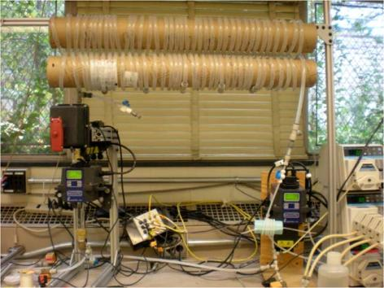
Flocculation
Process that aggregate small clay particles into bigger flocs to reduce turbidity
Flocs have a maximum
size at which they stop
absorbing particles

Slide 3
Objective
Develop a tool to quickly measure floc size and floc size distribution in a nondestructive manner in a flow through cell
Learn about the relationship between floc size and energy dissipation rate.

Slide 4
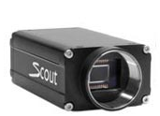
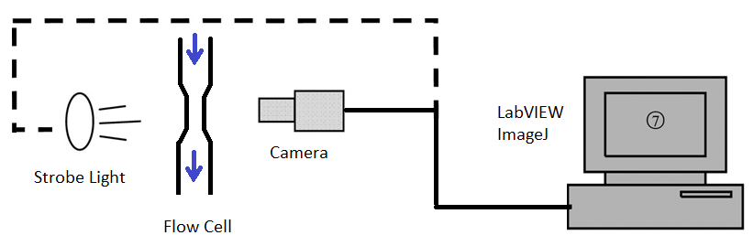
Tools
Digital Camera
LabVIEW programming
Strobe light to freeze particles
ImageJ for image analysis

Slide 5
What have been done so far
Literature review
Pixel size measurements
Searching for a new camera
Flow cell calculations

Slide 6
Flow Cell
Adapt from an existing glass materials
Maximum energy dissipation rate of 10mW/kg
1 mm biggest expected floc:
2 mm of height
2 mm of minimum width

Slide 7
Pixel Size of Camera
Current camera: Basler scA640-70fc
We need a better camera!
 | MP | Distance from Lens (cm) | mm/pix
Basler with 8mm lens | 1,1 | 20 | 14,08
Basler with 75 mm lens | 1,1 | 100 | 280,90
Web Cam | 1,8 | 13 | 28,51
iPhone | 5,7 | 10 | 5,70

Slide 8
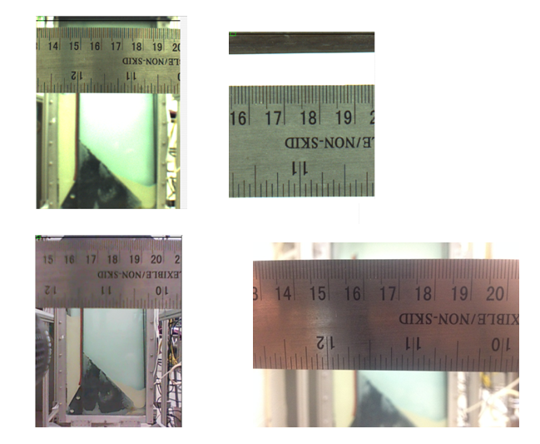
Pixel Size of Camera
Basler
8 mm and
75 mm
Webcam
Iphone

Slide 9
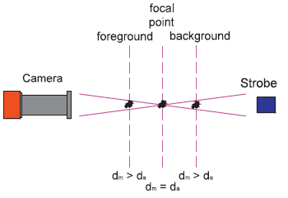
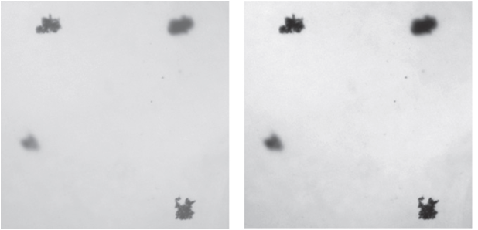
Image Quality
Estimate a focal point
Make sure to take into account only particles on focus
Figures from: Keyvani, A. Strom, K. A fully-automated image processing technique to improve measurement of suspended particles and flocs by removing out-of-focus objects . Computers & Geosciences 52 (2013) 189–198

Slide 10
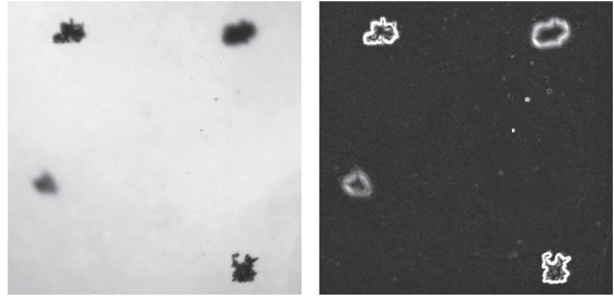
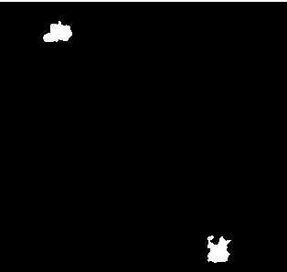
Image Processing
Noise reduction
Edge detection filter:
Find particles on focus
Identify individual particles
Make image binary
Measure sizes!

Slide 11
Next Steps
Adquire a camera and flow cell
Calibrate the camera focus and floc sizes with standard size polymer grains
Integrate camera with software
Run experiments and measure floc sizes!

Slide 12
Questions?
? ? ?

