Slide 1
Introduction to Teams

Slide 2
Teams
Team | type of activity
Laminar Tube Floc | Computer controlled experimentation
LFSRSF | Computer controlled experimentation, design, and fabrication
SRSF Theory | Computer controlled experimentation, design, and fabrication
Anaerobic Wastewater Treatment | Computer controlled experimentation, design, and fabrication
Turbulent Tube Floc | Computer controlled experimentation, design, and fabrication
Foam Filtration | Design, fabrication, and testing
Arsenic | Design, fabrication and arsenic analysis
Floc Size Capture | Design, fabrication, and LabVIEW
Sand Source and Test Methods | Testing
Stock Tank Conc Monitoring | Testing and possible fabrication
Ram Pump | Fabrication and testing
Stock Tank Centrifugal Pump | Fabrication and testing
Small Scale Plant | AutoCAD, 3-d printing and building model
Chemical Dose Controller | Fabrication and testing
Water Treatment Technology Selection Guide | Create dichotamus key and programming
Carbon Credits | literature, policy review and analysis of carbon impact of AguaClara
Design | Mathcad coding
Public Relations | PR

Slide 3
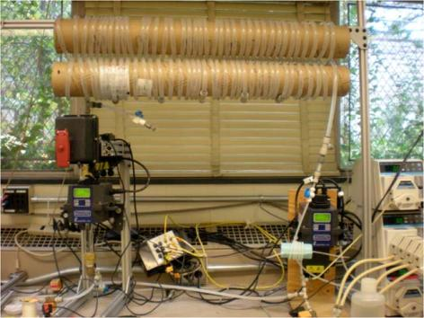
Laminar Tube Flocculator
Explore floc break up
Learn all we can with the goal of moving this technology into the field if it proves to be viable.

Slide 4
Laminar Tube Flocculator

Slide 5
Turbulent Tube Floc
Objective: understand performance tradeoffs and develop design modifications that substantially improve flocculator performance
How much collision potential is really needed in a turbulent flow reactor?
What is the best energy dissipation rate for a flocculator?
Help us optimize our full scale flocculator design

Slide 6
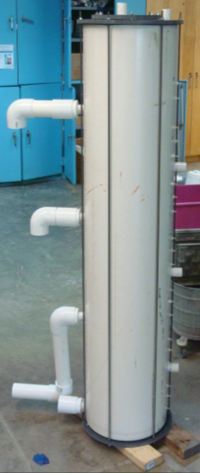
LFSRSF – Low Flow Stacked Rapid Sand Filter
EPA P3 Phase II grant
6 LFSRSF begin fabricated in India for two villages
Interest in scaling up to 50 or 100 villages
Need to improve design
  Reduce number of valves
  Simplify plumbing
  Make it easier to start backwash

Slide 7
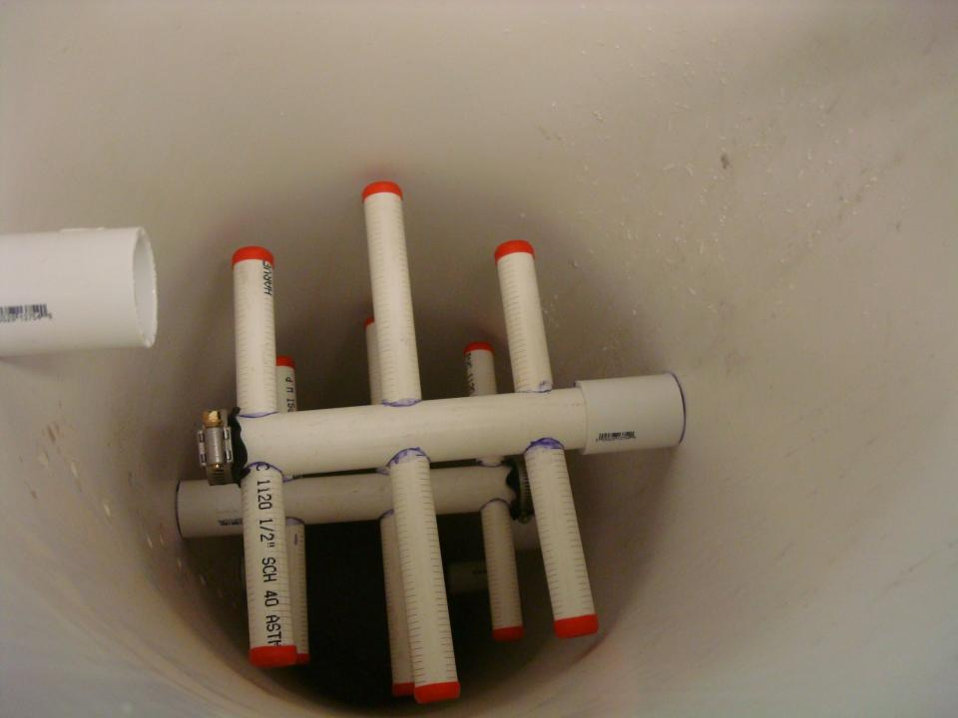
LFSRSF – Low Flow Stacked Rapid Sand Filter

Slide 8
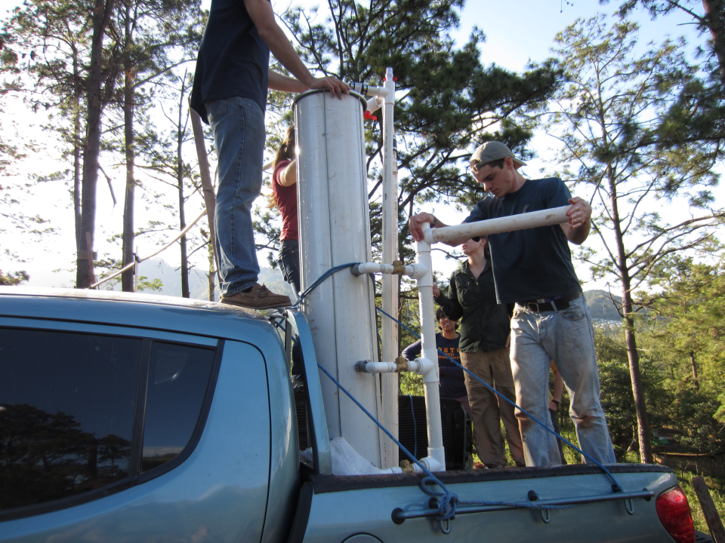
LFSRSF – Low Flow Stacked Rapid Sand Filter

Slide 9
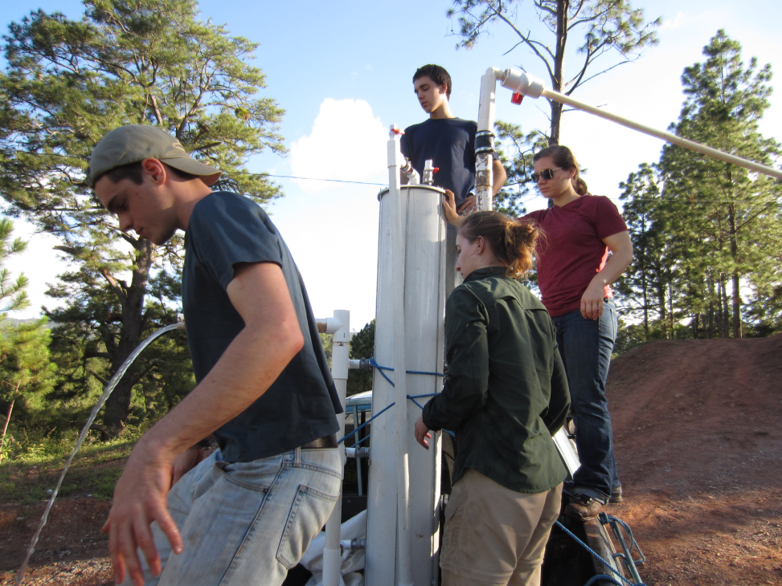
LFSRSF – Low Flow Stacked Rapid Sand Filter

Slide 10
SRSF Theory (Stacked Rapid Sand Filtration)
Develop a fundamental understanding and parameterization of SRSF performance
What controls how fast head loss develops?
What controls effluent turbidity?
Can we develop a filtration model in the same way that we have developed a flocculation model?
Big goal is to develop a performance model for an AguaClara plant so we can begin to optimize the overall design

Slide 11
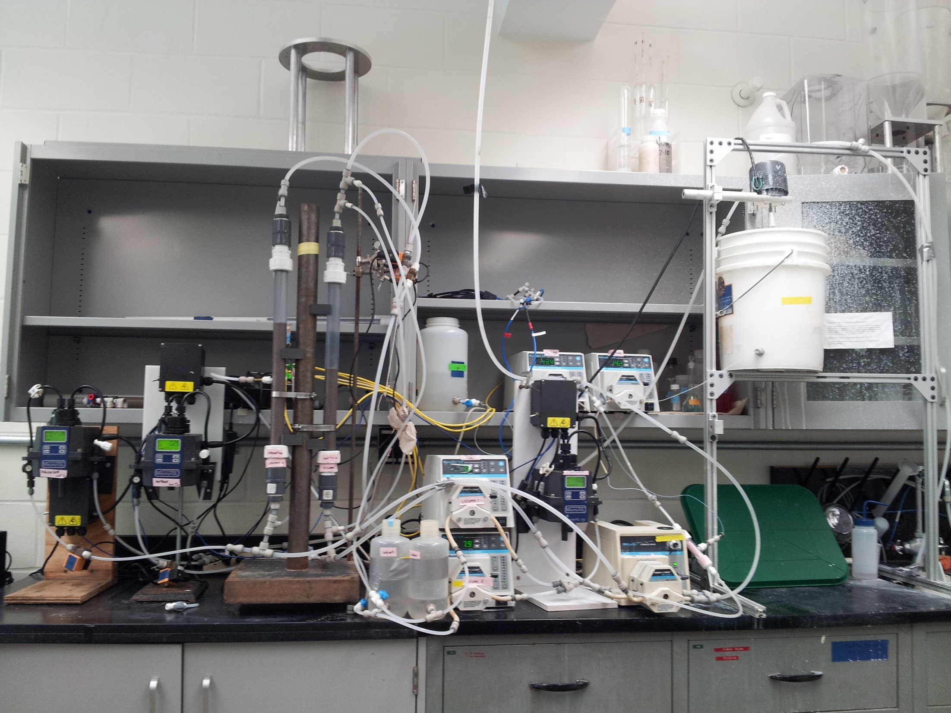
SRSF Theory
EPA Phase II Grant

Slide 12
Anaerobic Wastewater Treatment
A major new program for AguaClara
ACSF Seed Funding
Apply the key findings from the AguaClara: Drinking Water program to the AguaClara: Wastewater program
Objective: develop robust, sustainable, low energy, low cost, operator-friendly, wastewater treatment system

Slide 13
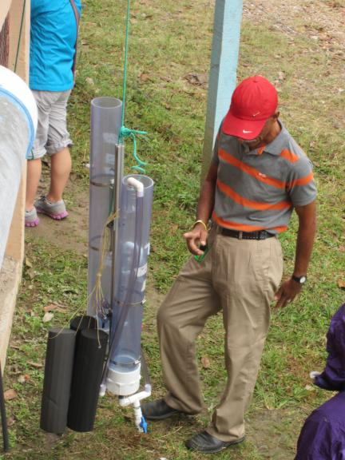
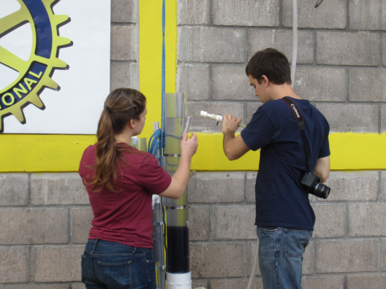
Foam Filtration
Design and build a 1 L/s plant
Dose Controller, flow meter
Work with APP to field test in January

Slide 14
Arsenic
Arsenic is a common contaminant of groundwater
We have an EPA P3 Phase I grant
Expand AguaClara into removal of arsenic from groundwater
Flocculation/Filtration is likely an effective method for removing arsenic
Design and build laboratory research apparatus
Develop measurement technique
Notes:
Learn enough so that we can do it better!

Slide 15
Floc Size Measurement: Design and Build a Tool!
Objective: create a tool to quickly measure floc size and floc size distribution in a nondestructive manner in a flow through cell
Use a digital camera, image analysis software and appropriate lighting to capture images and count and size flocs.
Will be used to learn about the relationship between floc size and energy dissipation rate (and much more!)
Will be used on the turbulent flow flocculator

Slide 16
Sand Source and Test Methods
Objective: develop standard for testing potential sand sources for the SRSF
Develop set of quick tests that can be conducted in the field to determine if a sand is suitable
Provide recommendations for sieve sizes to separate out appropriate size sand
Potential to decrease the cost of constructing the SRSF
We need these methods ASAP

Slide 17

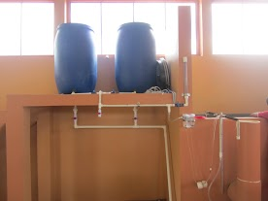
Stock Tank Concentration Monitoring
Objective: create tool to allow plant operator to measure chemical stock concentration and to confirm that the stock solution is well mixed
Demonstrate this method in Honduras in January

Slide 18
Ram Pump
There is an old technology that used hydraulic transients to lift water from a stream to a higher elevation. The device was called a “Ram Pump”and it made a rhythmic clacking noise.
High pressure pipe
Source pipe
Stream
Ram Pump

Slide 19
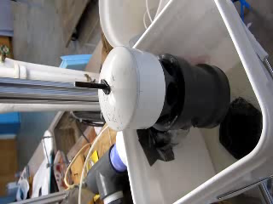
Ram pump
Create a simple, easily repaired, reliable pump that can provide water for chemical stock tanks and for the plant bathroom
The plant at San Nicolas, Honduras will be prepared for testing this in January

Slide 20
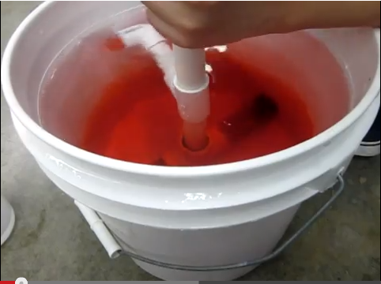
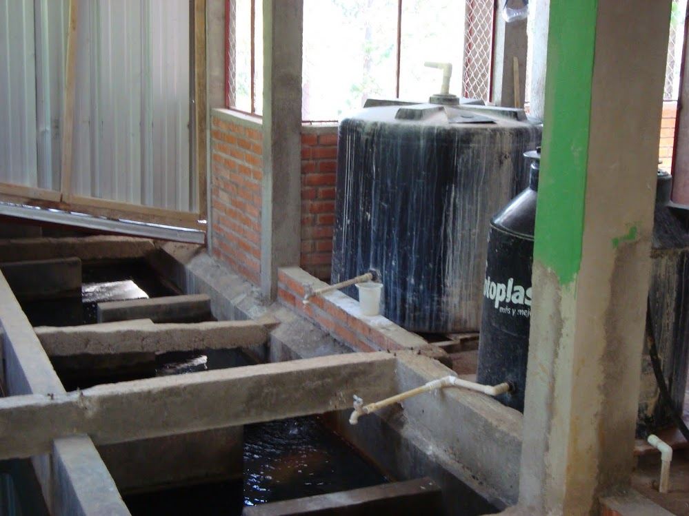
Stock Tank Centrifugal Pump
Mixing of the stock tank chemicals
Demonstrate in Honduras in January

Slide 21
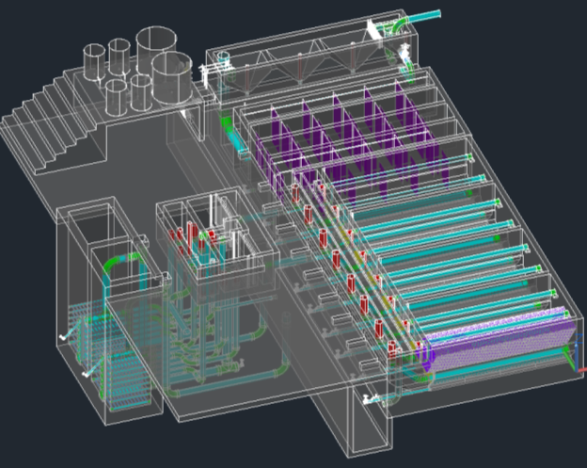
Small Scale Model Plant
Objective: produce an easily reproduced and updated scale model of AguaClara technologies
Begin with AutoCAD drawing of full scale plant which is then sent with minimal processing to a 3-D printer
Impact: use for teaching
about AguaClara
technology at Cornell, PR,
and conferences

Slide 22
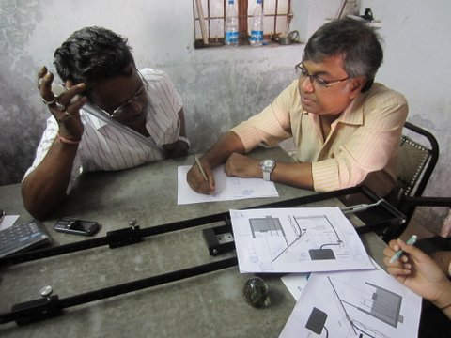
CDC (Chemical Dose Controller)
Objectives:
  Assemble and test dosers
  designed for different flow
  rates
  Develop improved
  Constant head tank mount
  Develop a set of dosers that can be shipped where needed
Impact: facilitate the implementation of dosing systems; prepare chlorinators for implementation in India

Slide 23
Water Treatment Technology Selection Guide
Objective: develop a guide to indicate the constraints that determine which technology is best suited for different levels and types of contamination
Must be designed as a front end for the AguaClara design engine

Slide 24
Carbon Credits
Objective: explore options for using the voluntary carbon markets to finance AguaClara facilities

Slide 25

Design Tool
User Inputs
Plant
Design
LabVIEW
Design Engine
AutoCAD
Mathcad
Design
MS Word
Mathcad
Drawing Code

Slide 26
Design Tasks
  Incorporating new research progress into the design
  Designing plants for a greater range of flow rates
  Making our designs more easily understood
  Communicating with the teams in Honduras and India, and with new implementation partners, to address concerns

Slide 27

The Drawing

Slide 28
Public Relations
Think Big
Publicize AguaClara – TED talk, National Press, Cornell Press,
Blog posts at least twice per month
Newsletter twice per semester
Update website with new international projects
Raise $30,000 for trip to Honduras in January

Slide 29
Expectations
All team members are expected to:
  Spend at least 10 hours per week working on their project (including time in class)
  Consistently meet with subteam
    Be respectful of teammates & show up to meetings on time
  Always attend full class meetings
  Submit reports on time
  Clean up after themselves in the lab

Slide 30
Interviews
Sign up on the sheet or online
Held in Hollister B60
  We can show you where this is after class if you ask
Will last approximately 15 minutes
Will determine admission onto the overall team as well as team placement

Slide 31
Pre-Interview Tasks
Review How Water Flows Through the Plant
  This will help you understand the challenges
Read the Team Challenges page
Fill out the team organization survey

Slide 32
Next Steps
https://confluence.cornell.edu/display/AGUACLARA/Syllabi

