Slide 1
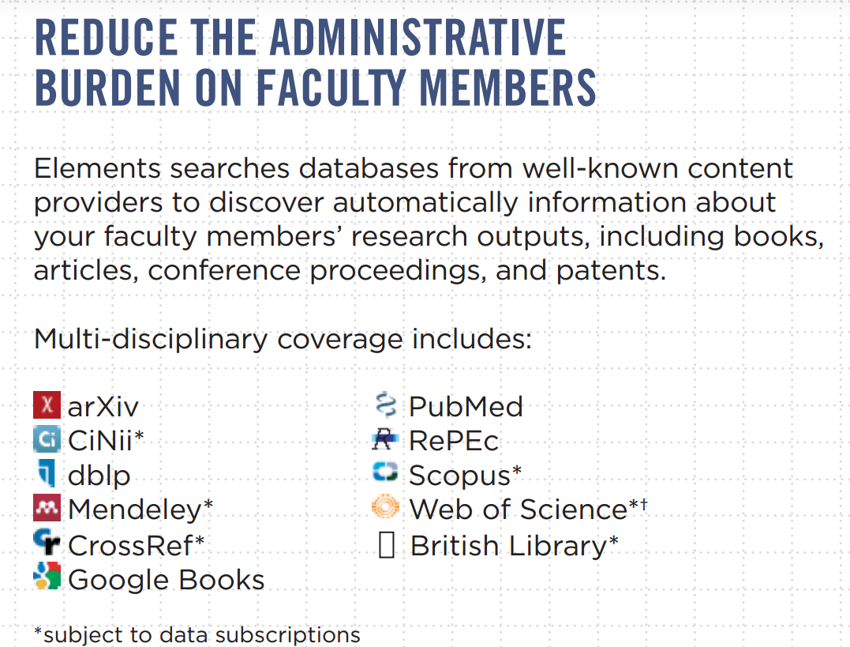
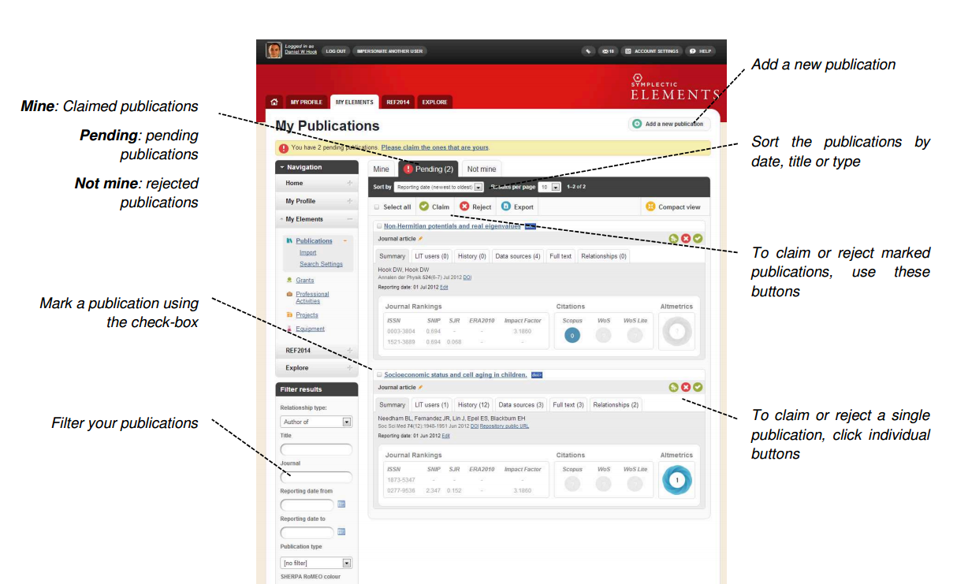
Research Information Management needs: a database of citations to Cornell faculty publications
Cornell VIVO team: Kathy Chiang, Jon Corson-Rikert, Tobi Hines, Joe McEnerney, Chris Westling, Tim Worrall
University Administrator for Activity Insight: George Spisak
The Cornell University Library is conducting a one-year pilot of Symplectic Elements to determine if a database of high-quality metadata about publications by Cornell researchers can alleviate the existing, distributed, laborious, and error-prone data collection processes.
In this pilot project we are working with the Colleges currently gathering publications via Activity Insight (AAP, CALS, Engineering, Hotel, ILR, JGSM, and Vet) and other stakeholders to evaluate the coverage and develop possible workflows to enhance the existing AI publications data collection process.
Other units on campus could also benefit from having access to the resulting data such as communications and development units and cross college research groups needing to report research productivity.
Advantages to researchers
  + no typing in your citations
  + Symplectic Elements finds your publications in major
  databases, you confirm or reject the suggestions
  + potential to feed into, and pull out of, existing
  publications lists
  + use the data to populate lab and department web
  pages
  + easier to respond to requests for your citations
  including the potential to support upcoming Federal
  open access reporting requirements
Are you interested in learning more?
Do you need publications data for your unit?
Send a message to:
VIVO-CONTACT-L
Benefits for PIs, Chairs, Deans and Communications staff
  + create aggregate publications lists for grant proposals,
  reports, accreditation, potential sponsors
  + convey the work of your department or college
  + find all Cornell research published on a topic
  + respond to Federal reporting requirements

