Slide 1
Relationship Designators
Chew Chiat Naun
Cataloging & Metadata meeting
June 11, 2013

Slide 2
PCC Relationship Designator Guidelines Task Group
Paige Andrew (Penn State)
Chew Chiat Naun (University of Minnesota)
Eileen (Heeran) Dewitya (UNC Chapel Hill)
Linda Gabel (OCLC)
Kate Harcourt (Columbia University)
Beth Iseminger (Harvard University)
Christee Pascale (NCSU)
Dave Reser (Library of Congress)
Katia Strieck (University of Pennsylvania)

Slide 3
Outline
Disclaimer
State of play and objectives
Guidelines – a few examples
“Open” vs “closed” vocabularies
Specialist communities
Source vocabularies
Codes vs terms
Definitions
WEMI issues
Relationship designators vs other devices
Other unresolved issues

Slide 4
Disclaimer
This presentation gives a high-level overview of the work of the PCC Relationship Designator Guidelines Task Group. The examples illustrate some of the issues that arose in the group’s discussions. They are not intended as a substitute for policy statements, training materials, or what your supervisor told you.

Slide 5
State of play and objectives
The situation:
  RDA Appendices I-K still work in progress
  Too early to make a call on some issues
  Limited experience with relationship designators among mainstream cataloguers
  Concern about productivity vs benefit
Our response:
  Give people guidelines to work with for now
  Identify longer-term issues

Slide 6
Guidelines – a few examples
RDA I.1/J.1/K.1
“If the relationship element is considered sufficient for the purposes of the agency creating the data, do not use a relationship designator to indicate the specific nature of the relationship”.
  RDTG 4.1.2: If you cannot ascertain a more specific relationship, assign the element term, e.g., Creator or Publisher.
“Use relationship designators at the level of specificity that is considered appropriate for the purposes of the agency creating the data”.
  RDTG 4.1.2: Within a hierarchy of relationship designators, prefer a specific term to a general one if it is easily determined.

Slide 7
“Open” vs “closed” vocabularies
RDA I.1/J.1/K.1 “If none of the terms listed in this appendix is appropriate or sufficiently specific, use another concise term to indicate the nature of the relationship”.
RDTG 5.1, 5.2: Submit proposals to PCC Standing Committee on Standards
RDA proposals vs alternative vocabularies

Slide 8
Specialist communities
Could have big role in developing vocabularies
Examples:
  RBMS
    e.g. annotator - use for the writer of manuscript annotations on a printed item
  CEAL
710 2 善成堂, ǂe 藏版.
710 2 Shan cheng tang, ǂe cang ban. [woodblock owner]

Slide 9
MARC vs RDA:
Source vocabularies
Example:
  655 #7 $a Pastoral poems $2 rbgenr
  but:
  700 1# $a Joshua, Thomas, $e scribe [from RBMS RD list]
MARBI (or Metadata Standards Committee or … ??) proposal?
Other ways to manage vocabularies
  e.g. Open Metadata Registry

Slide 10
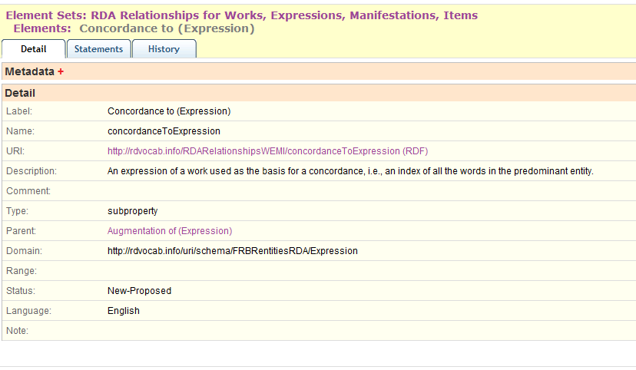
Sample OMR entry

Slide 11
MARC vs RDA: codes vs terms
A few examples:
  $4 cnd vs $e conductor
  7XX X2 vs “Contains …”
  780 vs “Preceded by”
  Authority 510 $w a vs $i Predecessor

Slide 12
MARC vs RDA: codes vs terms
Reasons to use RDA terms
  Consistent approach
  Extensibility
  FRBR-compliant
Reasons to stick with MARC
  Well-established conventions
  Problem definitions in RDA

Slide 13
Definitions
Example:
Mergee “A corporate body that merged with the other corporate body to form a third”
110 2 Body C
510 2 Body A $w a
510 2 Body B $w a
- vs -
110 2 Body C
510 2 $i Mergee: $a Body A $w r
510 2 $I Mergee: $a Body B $w r

Slide 14
MARC vs RDA:
WEMI issues
7XX X2
    Does this mean $i Contains (work) or $i Contains (expression) or … ?
830 vs J2.4 In series (work)
    130 #0 $a Pocket books historical romance
    643 ## $a New York $b Pocket books
Linking entry fields
  767 0# $a DiCamillo, Kate. $t Tiger rising $d Cambridge, Mass. : Candlewick Press, 2001 $h 116 pages $z 0763618985
  does RDA 17.4.2.3 on composite description apply here?

Slide 15
Relationship designators vs other devices
Tiiger virgub / Kate DiCamillo [Estonian translation of Tiger rising]
100 1# $a DiCamillo, Kate, $e author
240 10 $a Tiger rising. $l Estonian
- and -
500 ## $a Translation of …
- or? –
700 1# $i Translation of: $a DiCamillo, Kate. $t Tiger rising. $l English
Don Quixote : notes / by Marianne Sturman [in Cliff’s notes series]
700 1# $i Commentary on (work): $a Cervantes Saavedra, Miguel de, $d 1547-1616. $t Don Quixote
- or? -
600 10 $a Cervantes Saavedra, Miguel de, $d 1547-1616. $t Don Quixote $x Examinations $v Study guides.

Slide 16
Other unresolved issues
  Appendices I-K vs the English language
Authority vs bib records
Expressions
etc.

Slide 17
Questions?
PCC task group report at: http://www.loc.gov/aba/pcc/rda/RDA%20Task%20groups%20and%20charges/PCC-Relat-Desig-TG-report.rtf

