Slide 1

UASB
Cristina Fernandez-Baca
Xian Zhang
Walker Grimshaw
Fanny Okaikue
Sushil Shanbhag

Slide 2
Goals for the Summer
Design a UASB reactor to treat domestic wastewater for small communities
  Remove COD, turbidity, and pathogens
Anaerobic Treatment to design an energy neutral reactor
  Organic Carbon (as COD) → Biogas (CH₄ + CO₂)
Constraints:
  Low flows; influent COD: 500 mg/L
  Small footprint
  Low Energy

Slide 3
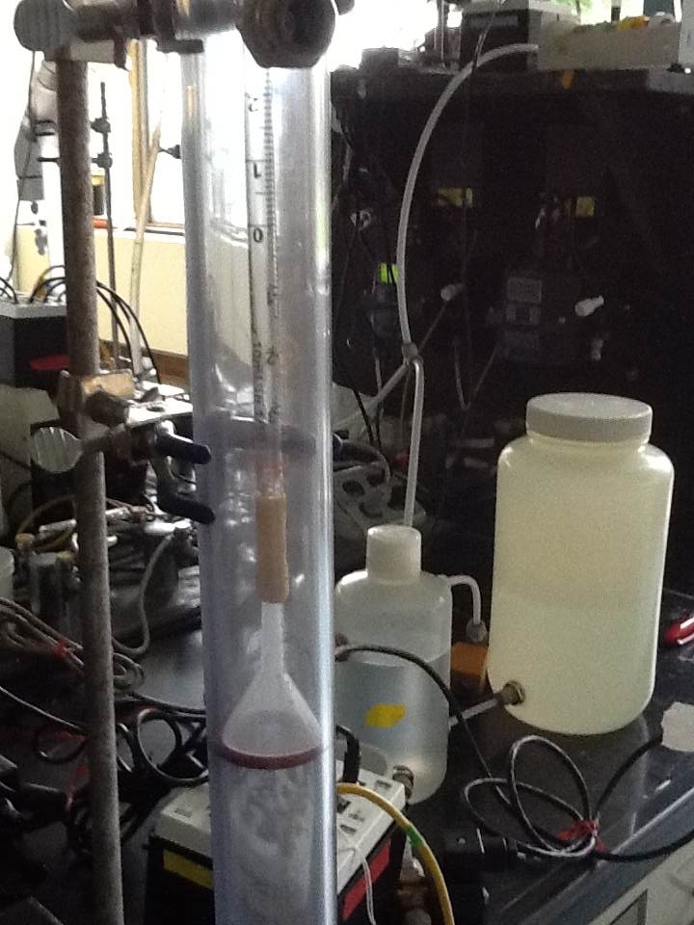
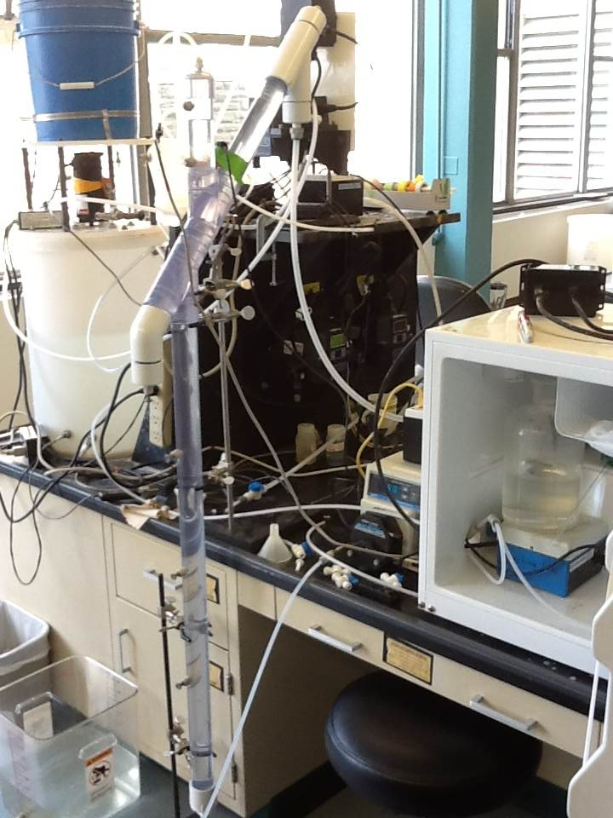
Improving Treatment Efficiency
Modify traditional GLS separator design
Reactor 1.0
Reactor 2.0

Slide 4
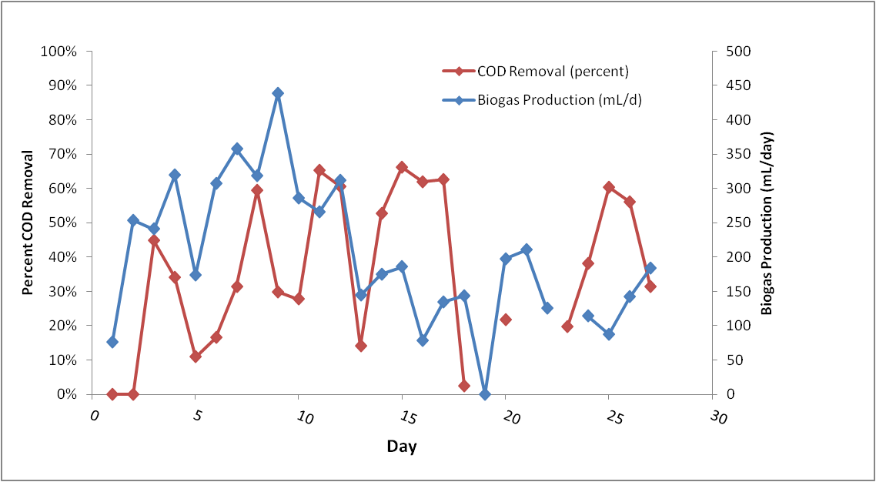
Results
Initial treatment efficiency saw steady decline in gas production & methane content; erratic COD performance
Issues: biomass washout, granule disintegration, scaling

Slide 5
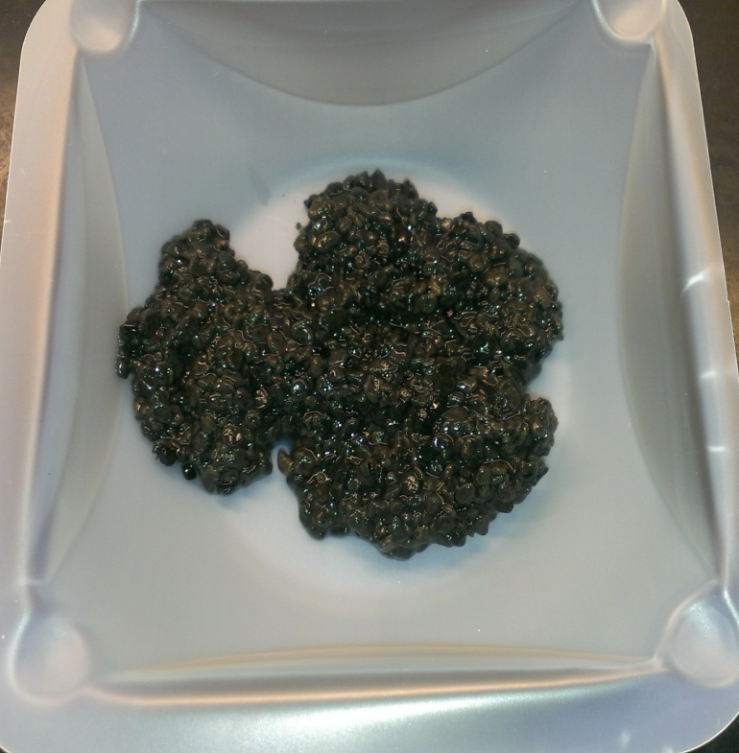
Results
Granule Characterization

Slide 6
Future Directions
Larger reactors
  Prevents clogging
  Cost & Material constraints
Experiment with different shapes (rectangular)
Support Materials
  Sand, clay, zeolite
Metabolic Pathway Characterization

