Slide 1
Anaerobic Wastewater Treatment
Ge Gao, Maithili Gokarn, Walker Grimshaw, Caitlin Rose McKinley, Liankun Zhu

Slide 2
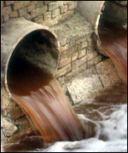
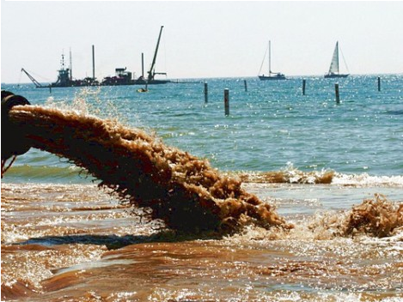
Around the world
36% of people have sewage connections
1.5 billion people have sewerage but no treatment
Environmental and Health hazard
http://news.bbc.co.uk/olmedia/1670000/images/_1672207_sewage2.jpg

Slide 3
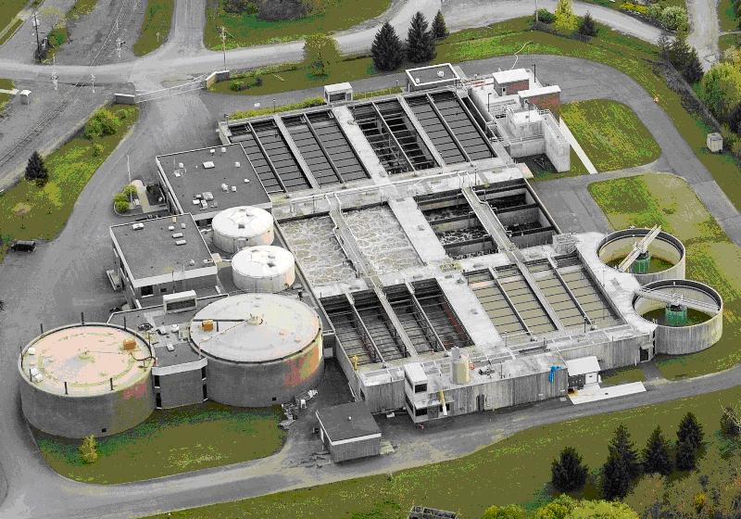
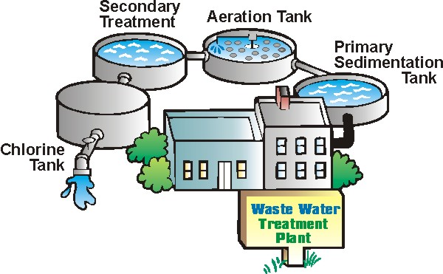
Conventional Treatment
High energy
High capitol
Require highly trained operators
Difficult to handle lower flows

Slide 4
Our Alternatives
Lower cost
Energy neutral or energy positive
Able to treat smaller scale
Low production of waste biological sludge
Low nutrient requirement

Slide 5
Summer Work
Modifications of traditional Gas-Liquid-Solid (GLS) Separator
Funnel Design → Tube Settler

Slide 6
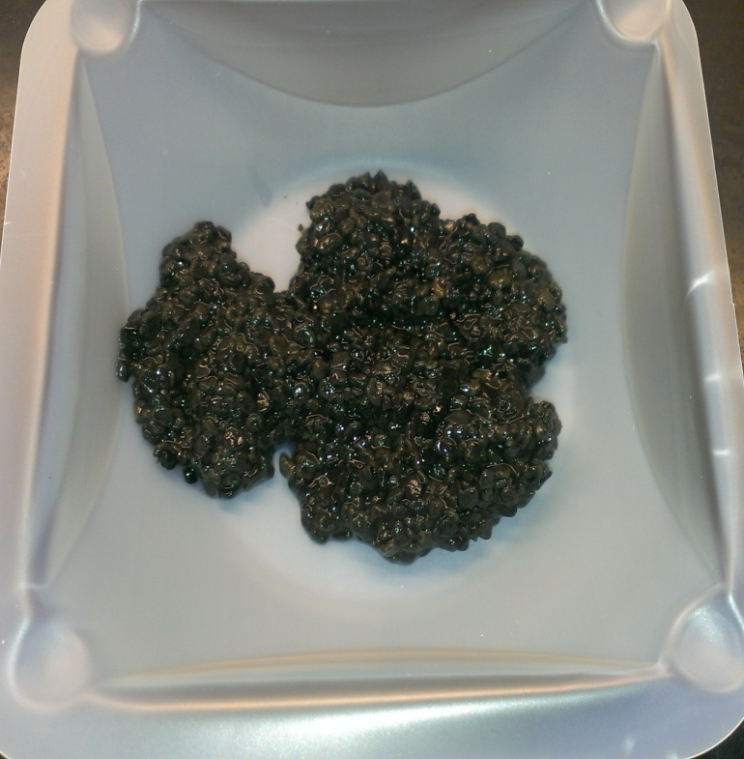
Summer Work
Granule Characterization

Slide 7
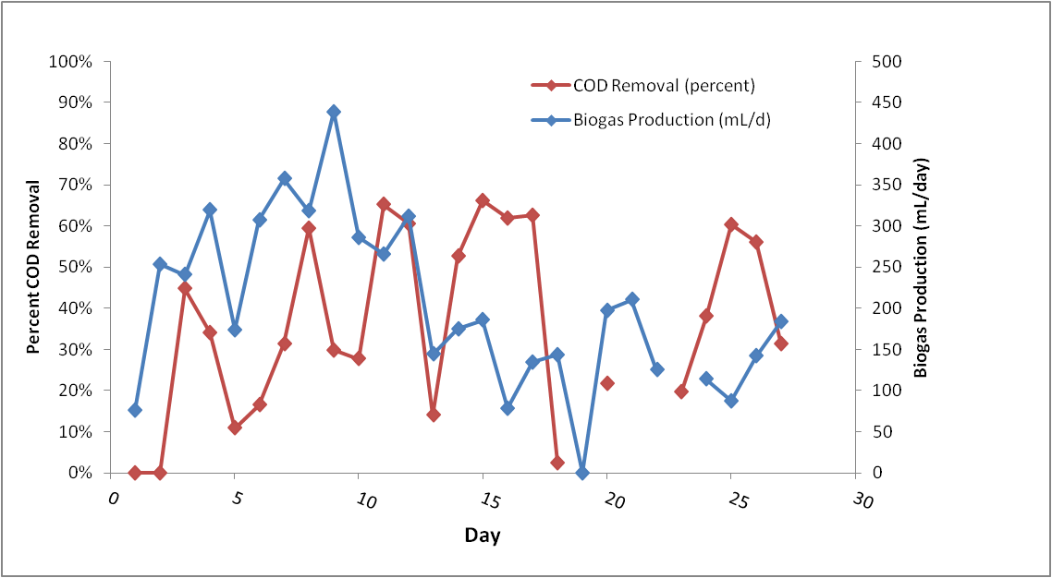
Summer Issues
Erratic COD destruction and gas production

Slide 8
Summer Issues
Granule Disintegration → Biomass washout
Biomass Plug Movement

Slide 9
Fall 2013 Goals
Construct five new reactors (six total)
  Test for leaks and defects
Triplicate operation
  UASB vs. AFBR
Prepare research questions for Honduras
Measurements
  Biogas - Gas Chromatography
  COD assay

Slide 10
Fall 2013 Goals
Develop models for:
  Effects of particle diameter and density on fluidization and settling velocities
  Biokinetics of biofilm growth on solid particles
  Effects of shear on biofilm growth

Slide 11
Reactor Operation

Slide 12
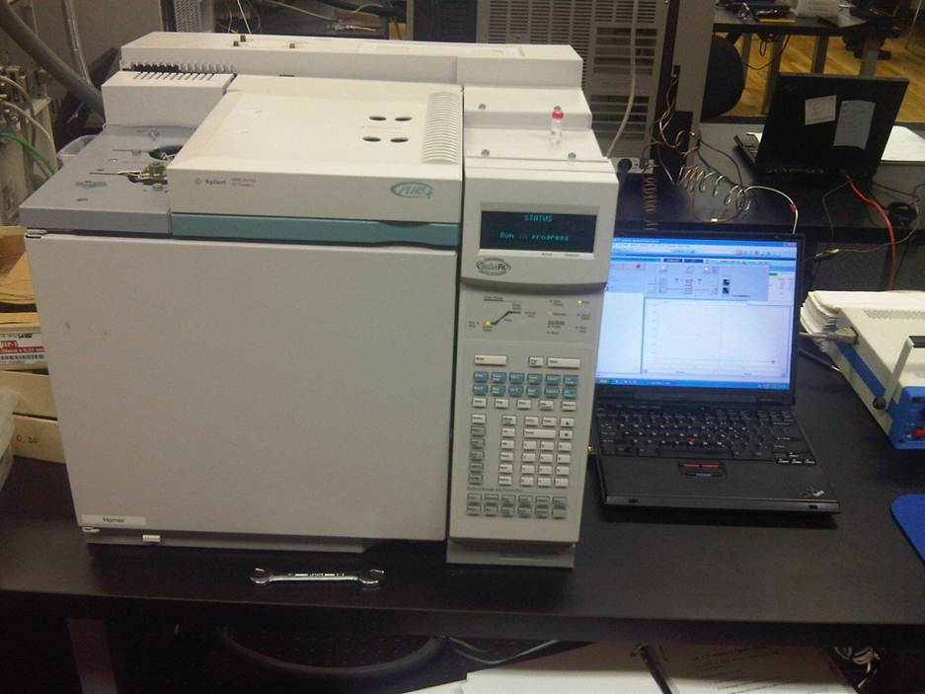
Gas Chromatography (GC)
A common type of chromatography used in analytical chemistry for separating and analyzing compounds

Slide 13
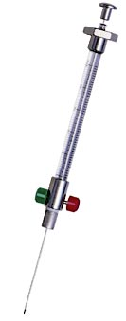
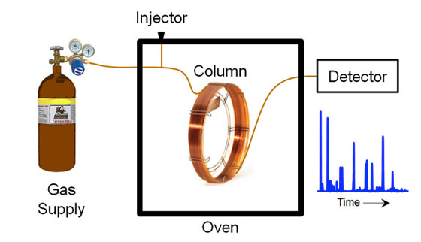
GC Sample
Syringe
GC test
Notes:
Show where on our reactors this sampling is done

Slide 14
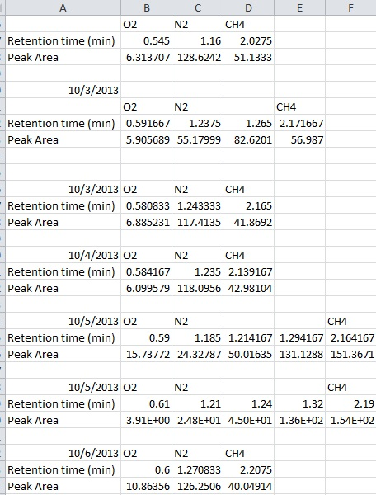
GC Results

Slide 15
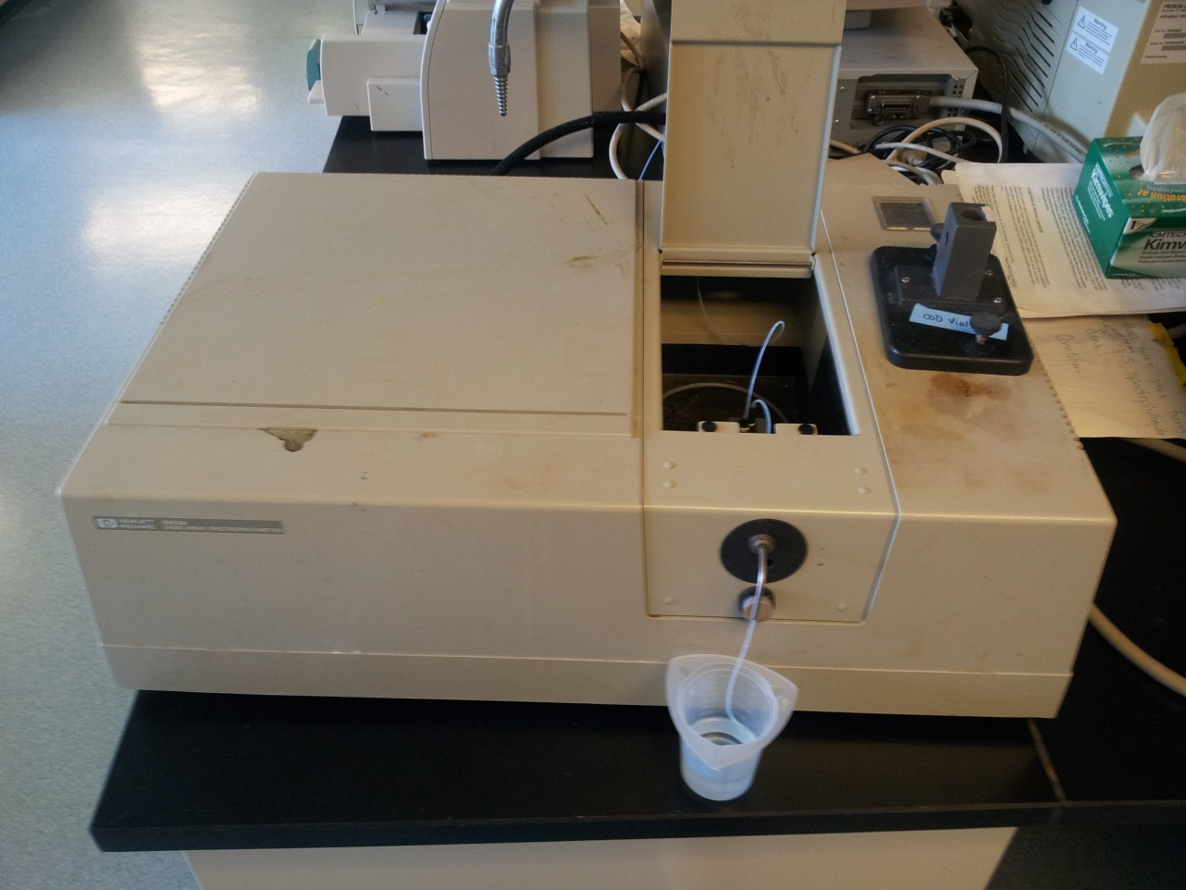
COD
Chemical Oxygen Demand

Slide 16
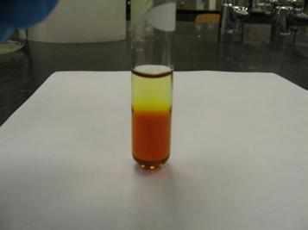
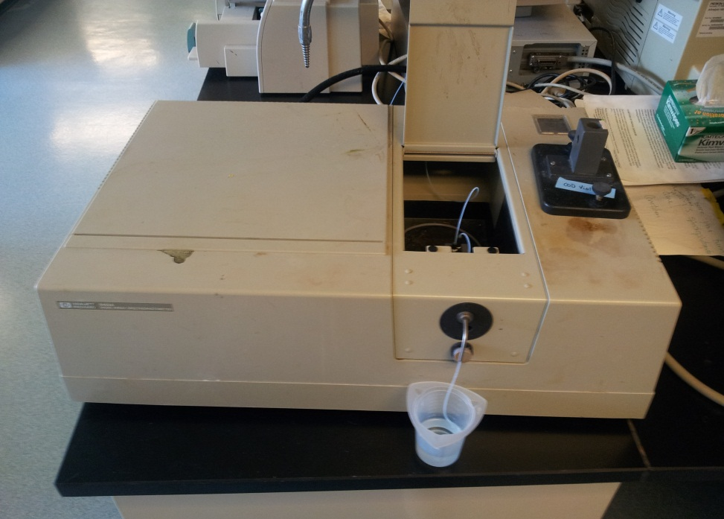
COD Test
Oxidation
Test
Notes:
What does it use to oxidize? I think this info can be found in our research report, just make sure to mention it when we present
Also mention that the test correlates absorbance at a specific wavelength to COD concentration

Slide 17
Model – Fluidized Bed Calculations
Effect of biofilm growth on fluidization and settling velocity
Vary sand diameter, density

Slide 18
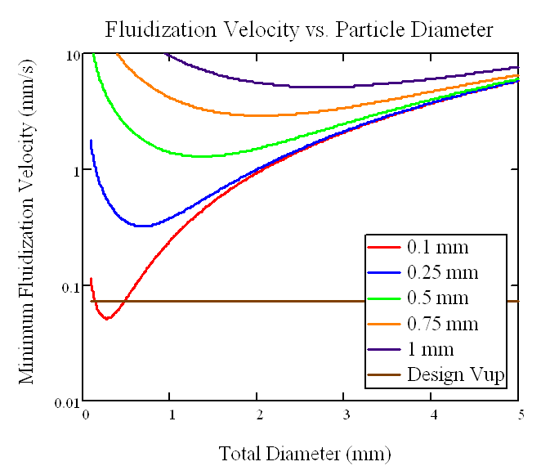
Model – Fluidized Bed Calculations
Desired:
  low minimum fluidization velocity
  High residence time
Large particles to settle to the bottom (future investigation)
Notes:
By high residence time, do you mean high solids retention time (SRT) or hydraulic residence time (HRT)?

Slide 19
Model – Fluidized Bed Calculations
Comparing Settling and Fluidization Velocities
SV is always higher than FV
  Clear solid-liquid interface as a result
Notes:
If you can, change the legend so the green line is something like “current upflow velocity” or “design upflow velocity”

Slide 20
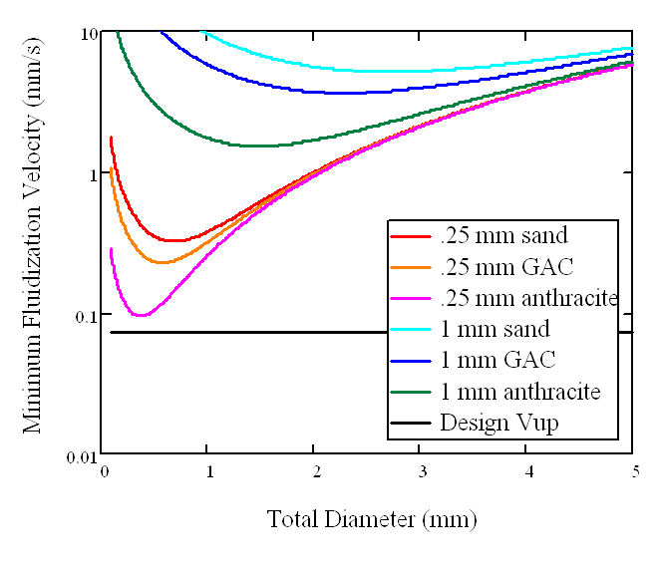
Model – Fluidized Bed Calculations
Notes:
Add some text if you want to, just a figure to show how density changes things

Slide 21
Future Work
Reactor Operation
Three reactors without media ( UASB)
Three reactors with media( AFBR).
Data Collection and Analysis
Short term
  Achieve steady state effluent COD and gas production
Long term
  optimize methane production and capture as well as COD destruction.

Slide 22
Future Work
Reactors without media
Determine best hydraulic retention time by varying the flow rate.
Reactors with media
Test the solid media's capability to fluidize
Determine the desired operating up flow velocity to match the fluidization rate .
Notes:
What do you mean by best hydraulic retention time? HRT with most COD destruction?

Slide 23
Future Work
Develop Model for the bio kinetics of bio film growth
Develop Model for the effects of shear on biofilm

